Slide 1


SNOMED CT DEUSG Subgroup
EDQM Dose Form Mapping
Linda Bird, SNOMED International
Julie James, Blue Wave Informatics
Thursday 27th January 2022

Slide 2

Welcome
Spreadsheet update
Issues discussion
Next meeting
AGENDA
http://snomed.org/deusg
Notes:
What have you been doing and what have I been doing?

Slide 3

Spreadsheet update

Slide 4
Our documentation
Mapping Guidance:
https://confluence.ihtsdotools.org/display/USRG/Mapping+Guidance+for+EDQM+to+SNOMED+CT+Pharmaceutical+Dose+Form+Mapping
“EDQM discussion items” List
https://confluence.ihtsdotools.org/display/USRG/Issues+for+discussion+with+EDQM
“SNOMED CT discussion items” List
https://confluence.ihtsdotools.org/display/USRG/Issues+for+discussion+with+SNOMED+CT
IMPLEMENTATION guidance https://confluence.ihtsdotools.org/display/USRG/Guidance+for+Implementation+of+the+EDQM+PDF+to+SNOMED+CT+PDF+mapping
A little more has gone on this new page as I sort through all our work to date

Slide 5
Mapping Spreadsheet update
A few more things moved from WIP to RC1 based on our agreements
The “x for y for z” being moved to a separate tab

Slide 6
Issues for discussion

Slide 7
Intravesical and Urethral Concepts
EDQM Code | EDQM Name | S-CT ID | S-CT FSN | Intended Site | Method
50051000 | Powder for intravesical suspension | 761907007 | Powder for conventional release intravesical suspension (dose form) | EDQM: Intravesical/Urethral | EDQM: Administration
 |  |  |  | SCT: Intravesical | SCT: Administer
50050000 | Powder for intravesical solution
50033400 | Intravesical solution/solution for injection
50050500 | Powder for intravesical solution/solution for injection
11502000 | Bladder irrigation
11502500 | Intravesical solution | 385242008 | Conventional release intravesical solution (dose form) | EDQM: Intravesical/Urethral | EDQM: Administration
 |  |  |  | SCT: Intravesical | SCT: Instill
13045000 | Intravesical suspension
Discussion
S-CT Instill: A method of administration of a dose form gradually, possibly drop by drop – not appropriate for “intravesical solution” – administer would be better ALTHOUGH the definition of Administer in SCT (A method of administration of a dose form by dispensing) is not brilliant. David: “Instill” is somewhat of an “older term” and administer is more useful

Slide 8
Intravesical and Urethral Concepts
EDQM Code | EDQM Name | S-CT ID | S-CT FSN | Intended Site | Method
11504000 | Urethral gel | 385245005 | Conventional release urethral gel (dose form) | EDQM: Intravesical/Urethral | EDQM: Administration
 |  |  |  | SCT: Urethral | SCT: Apply
13077000 | Urethral emulsion
13123000 | Urethral ointment
11505000 | Urethral stick | 385246006 | Conventional release urethral stick (dose form) | EDQM: Intravesical/Urethral | EDQM: Insertion
 |  |  |  | SCT: Urethral | SCT: Apply
Discussion
Request change for 385246006 to have method of “insert”

Slide 9
Products for unmapped intravesical/urethral dose forms
50050000 | Powder for intravesical solution – Request new PDF | FR : mitomycin MITOMYCINE MEDAC 40 mg pdre p sol intravésic NOR: Hexvix pulv og væske til intravesikaloppl 85 mg (Heksaminolevulinathydroklorid)
50033400 | Intravesical solution/solution for injection – Request new PDF when role grouping sorted | FR : epirubicin but not mention in « brand name PDF » EPIRUBICINE TEVA CLASSICS 2 mg/ml sol inj p perfintravesical BCGs IRE: just solution: IALURIL PRE-FILLED SYRINGE https://www.ialuril.uk/products/ialuril.html Also Oxybutynin intravesical solution
50050500 | Powder for intravesical solution/solution for injection – Request new PDF when role grouping sorted | UK: Mitomycin FR : mitomycin and thiotepa (THIOTEPA GENOPHARM 15 mg lyoph p us parentér)
11502000 | Bladder irrigation – will be discussed again with the other irrigation concepts | LATAM : glycin https://www.baxter.ca/sites/g/files/ebysai1431/files/2018-11/1.5pct_Glycine_Irrigation_EN.pd IRE: CRYOSERV 99% SOLUTION 10ML ULM DIMETHYL SULFOXIDE RIMSO 50 SOLUTION ULM DIMETHYL SULFOXIDE Potassium aluminum sulphate 10% concentrated sterile solution
13045000 | Intravesical suspension– Request new PDF | UK: OncoTICE (when reconsistuted); IRE: intravesical BCGs SP + BE : same as UK Oncotice FR : no more on market : IMMUCYST 81 mg pdre pour susp intravés (when reconsistuted)
13077000 | Urethral emulsion
13123000 | Urethral ointment – Request new PDF | SP : tetracaine Lubristesic 7,5 mg/g pomada uretral

Slide 10
Intravesical and Urethral – Site of administration
Intravesical – directly into the bladder via a catheter; is into a “body cavity”
Urethral – into the ureter; is into a body tube/pipe
From Chris:
The intravesical/urethral site as currently present in the ST comes from the same history as the cutaneous/transdermal – used primarily as search terms in (paper) documents rather than as attributes (descriptive or definitional) for the concept
The Standard Terms Working Party is informed of the changing nature of the use of the PDF concepts, and understands the value of mappings such as ours, and how the characteristics of PDF are now being used more widely. They are open to making change in the ST, where that is possible and sensible to do for their regulatory use cases as well as wider patient care use cases.

Slide 11
Principle?
From thinking about the OncoTICE…..
Agreement: If there is a dose form that we have products for (e.g. “Powder for intravesical suspension”) should there be a principle that a concept representing the transformed dose form (“Intravesical suspension”) is also available, so that any system wishing to make the association has the relevant concept available?

Slide 12
10521000 : Medicated nail lacquer – from September
 | SCTID | Fully Specified Name | Cardinality | Association | Attribute Match | Notes and Comments
Tara |  |  | 1…0 | No match | NA | S-CT has no concept for application to the 'nail'
Oliver |  |  | 1..0 | No match | No | SCT is missing liquid basic dose form "lacquer", other attributes match exactly
Martha |  |  | 1..0 | No match | NA | S-CT has no "nail"-concepts (?)
Catherine |  |  | 1..0 | No match | NA | STC has no basic dose form "Lacquer"
Discussion:
Why was “Nail solution” (10521500) rejected by EDQM but Nail lacquer is a standard term? In the rejection, it says “Term rejected. 'Cutaneous use' includes application to the nails.” Will need to be discussed with EDQM
Lacquer as a basic dose form: “A type of liquid pharmaceutical dose form consisting of one or more substances dissolved or suspended in a volatile solvent that evaporates to leave a hard coating.” Does this imply a transform? Or is the “drying” something that has happened after the administration so there is no requirement for a transform dose form? There are only two “lacquer” dose forms – this one and a dental one

Slide 13
“Nail lacquer products”
UK: amorolfine; tioconazole (tioconazole also has “nail solution” products)
Elsewhere?
Mapping Resolution:
This is an old concept and “cutaneous” does indeed include the nails
There should be a basic dose form of “lacquer”; it is not easy to make it a subtype of either solution or suspension, because it could be either (although it is usually a solution). We have “collodion” and “tincture” which are similar specialist and “old” concepts, so lacquer should also be present
National extensions have already authored PDFs to describe these sorts of products, so the requirement is clear
Latam has a cutaneous lacquer products to treat warts
Dental lacquers also exist

Slide 14
Plaster and Patch
From Martha:
In the Norwegian language, we have no word for patch – only plaster is used. In EDQM, both terms exist as a units of presentation (UoP), and both terms are used in several dose forms: Cutaneous patch, oromucosal patch, transdermal patch, medicated plaster, plaster for provocation test.
The medicines agency in Norway have translated the unit of presentation “patch” into: “plaster with reservoir”. We are not sure whether this is correct for all patches (e.g for cutaneous patch the EDQM definition do not mention reservoir).
In addition, plaster is not used in the international SNOMED dose forms.
What is the clinical/pharmaceutical difference between plaster and patch?

Slide 15
So far, we have Put the following on the RC1 list:
10517500 | Cutaneous patch | 764485007 | Conventional release cutaneous patch (dose form) | Exact match | SCT is more specific in Site: Cutaneous
10519000 | Transdermal patch | 385114002 | Prolonged-release transdermal patch (dose form) | Exact match | SCT is more specific in Site: Transdermal
There are no “plaster” concepts on the RC1 list

Slide 16
And we have the following on the WIP list
10506000 | Medicated plaster | No match | no plaster BDF in SNCT
10550000 | Plaster for provocation test | No match
50039000 | Oromucosal patch | No match | No oromucosal patch in SCT. EDQM def: Flexible single-dose preparation intended to be applied to the oral cavity to obtain either a systemic or a local effect by delivering the active substance(s) over a certain period of time, after which it is then removed.
10547000 | Transdermal system | 421716009 | Prolonged-release transdermal drug delivery system (dose form)
Transdermal system: Assembly of components intended for transdermal delivery driven by external forces (e.g. electric current, chemical reaction,...). Transdermal patch is excluded.

Slide 17
EDQM definitions:
Patch (BDF): A type of solid pharmaceutical dose form consisting of a flexible preparation, with an adhesive layer and a reservoir of active substance(s) that is usually behind a semipermeable membrane. Plasters are excluded.
Plaster (BDF): A type of solid pharmaceutical dose form consisting of a flexible preparation with an
adhesive layer containing active substance(s).
Patches are excluded.
Patch (UoP): A unit of presentation used to represent the quantity of product that is found in a single discrete entity where the pharmaceutical dose form is a type of patch.
For example, to describe the strength of a transdermal patch: "contains 12 mg per patch".
Plaster (UoP): A unit of presentation used to represent the quantity of product that is found in a single discrete entity where the pharmaceutical dose form is a type of plaster.
For example, to describe the strength of a medicated plaster: "contains 100 mg per plaster".

Slide 18
Transdermal patches: history, development and pharmacology: British Journal of Pharmacology (2015) 172 2179–2209
The skin is the largest organ in the human body by mass. Drugs have been applied to the skin to treat superficial disorders, for the transdermal administration of therapeutics to manage systemic ailments and as cosmetics, dating back to the oldest existing medical records of man – ointments, salves, potions, poultices…...including being “bandaged on” and later “plaster”. Glyceryl trinitrate applied topically – for systemic effect to treat for angina (first developed 1940s). But “transdermal delivery systems” only became a common practice in the latter third C20
Understanding the pharmacokinetics of topical products – lipid soluble substances penetrate more than aqueous….a systemic effect confirmed for topical application (percutaneous absorption). Site of application also affects kinetics, as does addition of adjuvants
Diffusion cells - quantity of medicament, area, vehicle and holding device (1960s)
Delivery system – a rate controlling membrane (1970s) held in place by a bandage – TRANSDERMAL PATCH – potential to maintain steady state medication levels over time
Key concepts of “patches”:
a reservoir (occluded storage) of a liquid or a gel with a rate controlling membrane which is separate from the adhesive membrane
a matrix – the medication is incorporated into a polymer
    adhesive backing onto the polymer
    adhesive included with the polymer

Slide 19
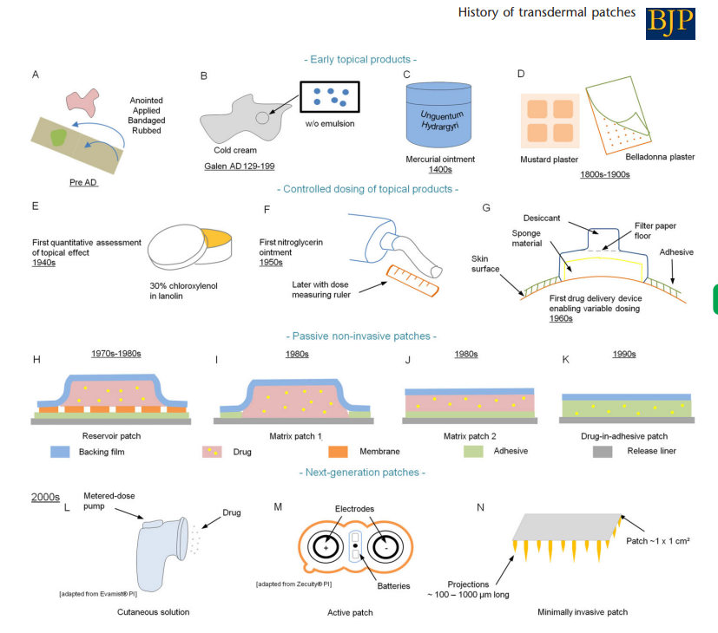

Slide 20
Adhesive properties: a critical issue in transdermal patch developments Expert Opinion on Drug Delivery Volume 9, 2012 - Issue 1
Article is about problems with adhesives, but has a summary of pharmacopoeial and other descriptions:
European Pharmacopoeia (Ph. Eur.)
‘Transdermal patches’ monograph refers to drug delivery systems intended to be applied to the unbroken skin in order to deliver the active substance(s) to the systemic circulation after passing through the skin barrier
In the other two monographs, patches are reported to maintain the active substance(s) in close contact with the skin such that these may be absorbed slowly, in order to guarantee a regional effect, or act as protective or keratolytic agents (medicated plasters)
Or to administer a drug to skin such that it may act locally (cutaneous patches)
Japanese Pharmacopoeia
Distinguishes between plasters intended to locally release the active ingredient and transdermal systems assuring a systemic effect
United States Pharmacopeia (USP)
‘Transdermal systems’ are designed to deliver the drug(s) through the skin to the systemic circulation. However, in the note it is also specified that patches intended to localize the effect of drugs are defined traditionally as ‘plasters’ or ‘tapes’

Slide 21
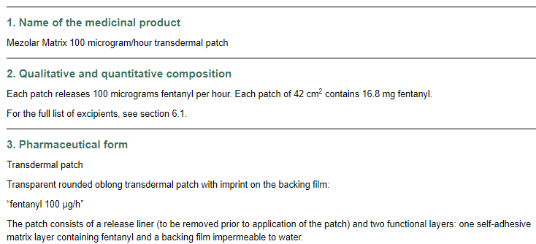
A matrix….a patch?
If a product uses a matrix, is it still a patch? (No membrane…no reservoir…only a backing strip)

Slide 22
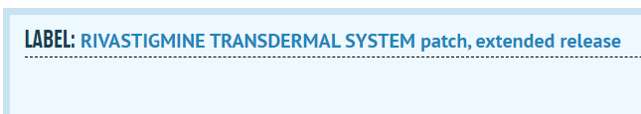

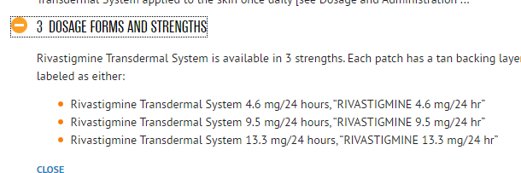
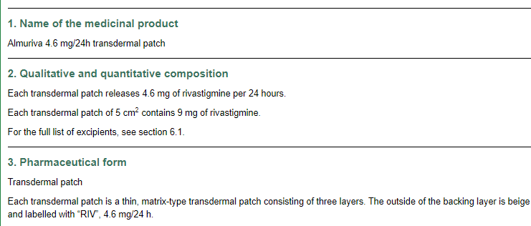


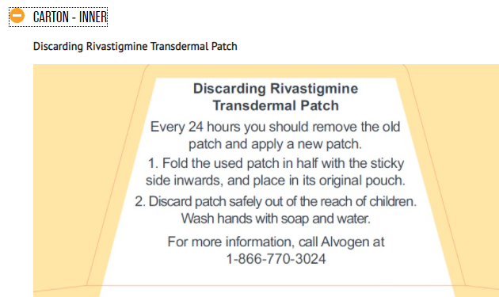

Global understanding? Is it a patch or is it a system?

Slide 23

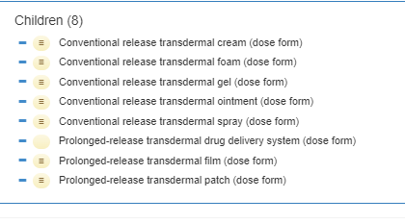
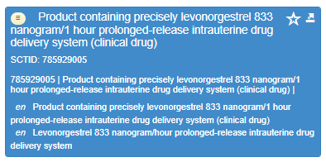
In SNOMED-CT….

Slide 24
Need to write guidance!
And what do we say if a language doesn’t distinguish? Does it matter?
The term for transdermal patch was changed in French some years ago from “dispositive” to “patch”
We need further thought and discussion on this……

Slide 25
Next actions
Working through the WIP spreadsheet
More items for discussion….
Update on the role grouping for multiple intended sites
Chris/EDQM: we have a few things that we’ve put to one side for your input (e.g. dispersion) ….what is the best way to proceed with those
Julie to send the relevant slides to Chris (e.g. on dispersion)

Slide 26

Next meeting on
Thursday 10th February 2022
at 10:00 UTC
NEXT STEPS
26

Slide 27


THANK YOU
SNOMED International: Delivering SNOMED CT

