Slide 1


SNOMED CT DEUSG Subgroup
EDQM Dose Form Mapping
Linda Bird, SNOMED International
Julie James, Blue Wave Informatics
Thursday 13th January 2022

Slide 2



Happy New Year

Slide 3

Welcome
Spreadsheet update
Issues discussion
Next meeting
AGENDA
http://snomed.org/deusg
Notes:
What have you been doing and what have I been doing?

Slide 4

Next steps for the mapping

Slide 5
Our documentation
Mapping Guidance:
https://confluence.ihtsdotools.org/display/USRG/Mapping+Guidance+for+EDQM+to+SNOMED+CT+Pharmaceutical+Dose+Form+Mapping
“EDQM discussion items” List
https://confluence.ihtsdotools.org/display/USRG/Issues+for+discussion+with+EDQM
“SNOMED CT discussion items” List
https://confluence.ihtsdotools.org/display/USRG/Issues+for+discussion+with+SNOMED+CT
New page (almost no content yet): IMPLEMENTATION guidance (as opposed to mapping guidance)
https://confluence.ihtsdotools.org/display/USRG/Guidance+for+Implementation+of+the+EDQM+PDF+to+SNOMED+CT+PDF+mapping

Slide 6
Mapping Spreadsheet update
Added (Cut/Trans) content to Map RC1 as agreed from our last meeting

Slide 7
Capsules and Role Groups update
Need to progress the role grouping for dose form attributes BEFORE we request any more new dose form concepts
Content Team will hold existing CRS requests until we have what we think is the “full set”
Currently, our testing is of the role groups is giving some “pause for thought” – more information coming as soon as possible

Slide 8
Role Groups update
            All the existing intended site grouper concepts would need to change from being ungrouped to being grouped
            All the existing PDFs would need to change from having their attributes ungrouped to having them grouped
            We need to consider the value of this work, as it will affect 500ish concepts (the clinical drug classification should stay the same, once all the groupers PDFs were updated)
            Benefits of change include being more understandable, reproducible and usable (URU) and being able to manage dose form concepts well on into the future

Slide 9
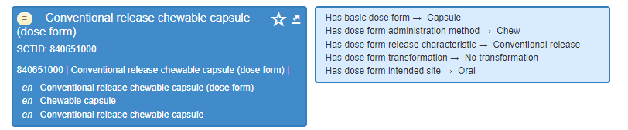
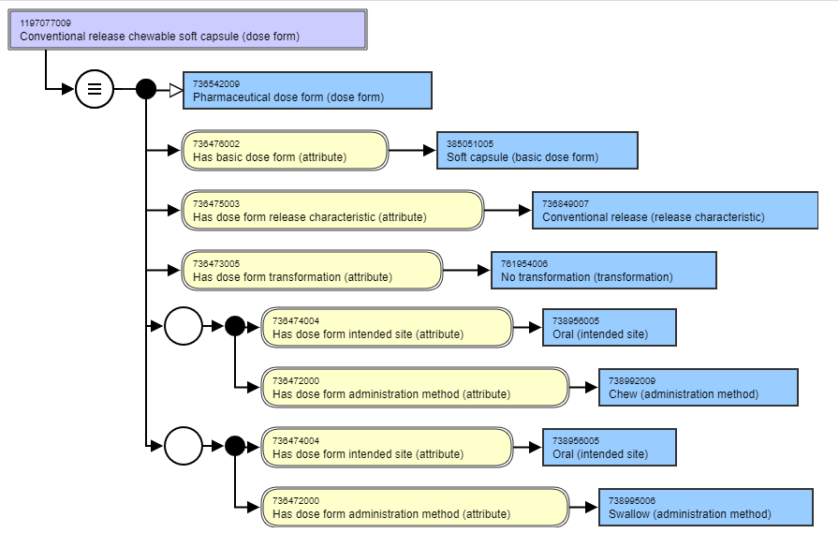
Chewable capsules
For “chewable”, there is currently only this.
EDQM has only “chewable soft capsule”
Do we:
Ask for a new concept to be authored that is explicitly “chewable soft”?
The new concept should replace the current chewable capsule as current concept is “ambiguous”. There is no requirement for a grouper concept because a chewable hard capsule is an oxymoron
What about chew and swallow as methods? - Test
Products include an ibuprofen for children and a GTN product in Germany/Mexico
Testing (with help from Alejandro) shows we can have “chew” and “swallow” as methods
Two role groups, each with the site and the method (cannot have one role group with two methods)

Slide 10
Issues for discussion

Slide 11
Prolonged release and gastro-resistant
Query from the Content Team about a request for a product to have a “prolonged release” dose form, although the supporting literature has it as a “gastro-resistant, prolonged release” dose form
What do we think?

Slide 12
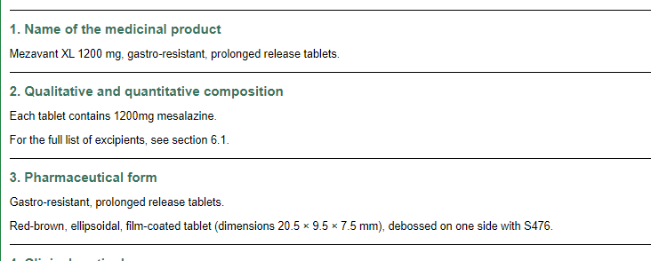
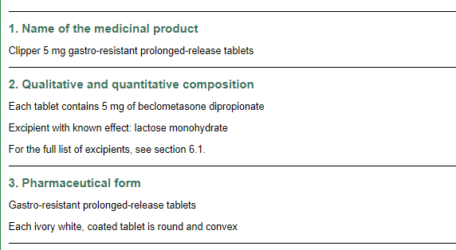
Prolonged release and gastro-resistant
Various products have been described with dose forms that are both gastro-resistant AND prolonged release; in the UK we have several, most of which are for mesalazine, but also one for beclomethasone

Slide 13
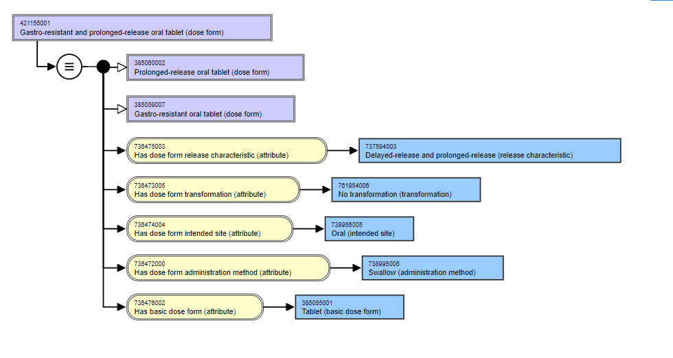
SNOMED CT does currently allow both PR and GR in a single PDF:

Slide 14
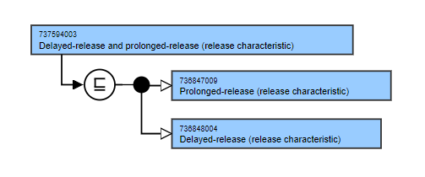
Although the Ed Guide and MRCM has 0…1 for Release Characteristic….
There are single “release characteristic concepts” that contain two characteristics within them
So, in SNOMED CT a PDF can effectively have two release characteristics
The group wondered if this felt like a bit of a “trick” to get around a 0..1 cardinality for the characteristic, but understood that it was reflecting the requirement that some products currently have

Slide 15
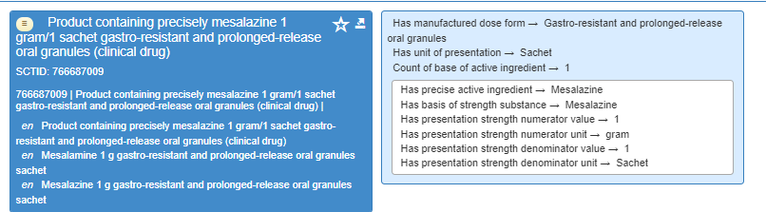
And these types of PDF can be used in CDs:

Slide 16
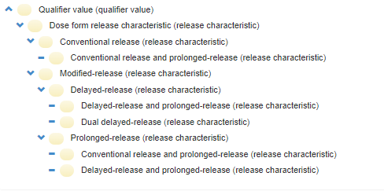
SNOMED CT builds these release characteristics into a hierarchy:

Slide 17
Which, if we take away the multiple concepts, looks like this:
Release characteristic
 | Conventional release
 | Modified release
 |  | Delayed release | Dual delayed release
 |  | Prolonged release

Slide 18
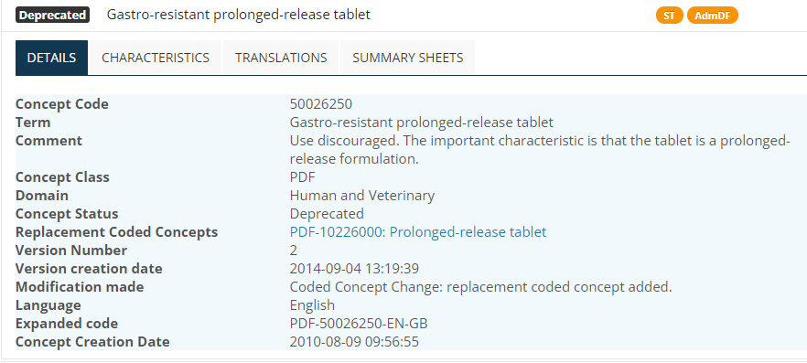
However, the EDQM principle is as follows:

Slide 19
Discussion: will products change?
Clearly, products in Europe are currently described using these deprecated multiple release characteristic dose forms. BUT – will this change?
Norway: does expect authorised dose forms for these products to change
As a result of the regular product reorganisation process (although some pharma are better than others at moving forward with new standards)
As a result of the implementation of SPOR which will “force” pharma to use correct and current concepts for dose forms
Therefore, in their mapping, Norway have mapped these “multiple release” concepts as EDQM says, to the appropriate prolonged release concept
NZ: has examples of where dose forms have evolved in the regulatory information and would prefer that concepts had only one release characteristic (prolonged)
France: is not always swift to change to new standards, and currently information on dose form is not always clinically consistent (e.g. conv release dose form stated, but reading posology clearly indicates that dose form is gastro-resistant

Slide 20
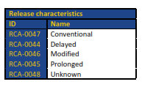
EDQM Release Characteristics
ID | Name | Definition | JMJ Comments
RCA-0047 | Conventional | Release of the substance(s) in a way that is not deliberately modified by a special formulation design and/or manufacturing method | The pharmacokinetic pattern is the standard one for the substance
RCA-0044 | Delayed | Release of the substance(s) at a later time than would be achieved with a conventional-release product, achieved by a special formulation design and/or manufacturing method; enteric-coated and other gastro-resistant products are included | “At a later (point in) time” could be equated to “beyond the stomach” – as in gastro-resistant
RCA-0046 | Modified | Release of the substance(s) in a way that differs from that which would be achieved with a conventional-release product, which is achieved by a special formulation design and/or manufacturing method, but which is not classified as delayed-release or prolonged-release; pulsatile-release products are included | Difficult to manage, as this is “defined by negation” (i.e. NOT conventional, NOT prolonged, NOT delayed) – so is any other modification
RCA-0045 | Prolonged | Release of the substance(s) over a longer duration than would be achieved with a conventional-release product, achieved by a special formulation design and/or manufacturing method | Here the focus is clearly duration of release, not when it starts
RCA-0048 | Unknown | Release of the substance(s) in a way that is unknown or not specified | Trust this is never used – surely we should always know!

Slide 21
WHO Monograph on “Tablets”
Lists different classes of tablets
Uncoated – no modification on release
Coated (includes film coating and sugar coating) – layers of mixture substances for coating
Coating may modify active substance release
Soluble – coated or film coated; dissolve in water to give clear or slightly opalescent solution
Dispersible - coated or film coated; disperse in water to give a homogenous dispersion
Effervescent – uncoated; contain acid substances and carbonates that react rapidly in the presence of water to release CO₂; dissolve or disperse in water
Chewable; uncoated; intended to be chewed before swallowing should be easily crushed and palatable
Oromucosal (including sublingual and buccal); usually uncoated
Modified-release – coated, uncoated matrix; modify rate, place or time of release of active
including
            Delayed release (gastro-resistant, enteric coated) – disintegrate in intestinal fluid
            Sustained release (extended, prolonged) – slow the rate of release

Slide 22
Thoughts?
Is the WHO set of definitions closer to SNOMED CT than the EDQM ones?
It feels like it is
Norway has authored additional concepts in their work in order to get a closer match to map to EDQM (more discussion of this to come – Julie will have some more slides)
Should there be combinations of release characteristics in a dose form?
Possibly; currently “the trick works”….but is it pharmaceutically correct and supportive of our use cases?
What about “pulsatile” release? (Intermittent, repeating, rhythmic pattern of release)
We have some examples – Ventolin Spandets (salbutamol); QUASYM LP (methylphenidate); a guiaphenesin product
Is this only appropriate for oral products? What about parenteral products?

Slide 23
Thoughts?
For the specific CRS request, this group advises to accept that the CD should use “prolonged release” only in the dose form

Slide 24
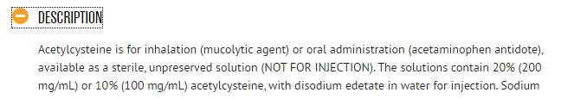
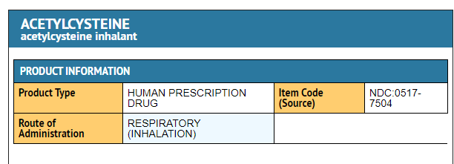
Oral and inhalation solutions
Should the dose form reference both sites of administration, or is the oral use “subsidiary” and therefore not part of the dose form?

Slide 25
What principles apply to help with the decision (1)?
We are currently proposing to add “oral and rectal” dose forms……Is this different and if so, why?
Our primary use cases are:
authoring national extensions
mapping between different MPD
decision support
international interoperability
for example: to help find “equivalent products” across MPD to support understanding of patient summaries across borders

Slide 26
What principles apply to help with the decision (2)?
Several countries (especially France) have specifically oral formulations of acetylcysteine for use as a mucolytic – therefore clearly “oral acetylcysteine” and “inhalational acetylcysteine” are valid concepts that we already have in SNOMED CT. Any clinician looking at a patient summary and wondering about “oral acetylcysteine” or “inhalational acetylcysteine” will see their global applicability
For national extensions, we aim to reflect as much as possible (given what we have just discussed about the prolonged-release, gastro-resistant) what is present in the authorisation (for us in Europe SmPC section 3). In this case, the authorised literature (from the FDA) says “inhalation solution” so the oral use is a small extra part and should not be part of the dose form. This is in contrast to the “oral and rectal” which is clearly part of the dose form, because, as the definition states, there is not a single predominant intended site

Slide 27
Next actions
Julie will prepare more items for discussion….

Slide 28

Next meeting on
Thursday 27th January 2022
at 10:00 UTC
NEXT STEPS
28

Slide 29


THANK YOU
SNOMED International: Delivering SNOMED CT

