Slide 1


SNOMED CT DEUSG Subgroup
EDQM Dose Form Mapping
Linda Bird, SNOMED International
Julie James, Blue Wave Informatics
Thursday 21st October 2021

Slide 2

Welcome
Mapping activity and policy
Next meeting
AGENDA
http://snomed.org/deusg
Notes:
What have you been doing and what have I been doing?

Slide 3

Mapping Activity and Challenges

Slide 4



WELCOME Chris from EDQM
Dr Christopher JARVIS (Chris)
Scientific Administrator – Standard Terms
IT & Publications Division / European Pharmacopoeia Department

Slide 5
Some comments from Chris
The criteria for a new dose form to be included in the EDQM PDFs includes having a (draft) SmPC showing the concept
So all new PDF concepts have “supporting evidence”
Older concepts may not have that evidence – and the products they were originally used with may not be on the market any more

Slide 6
What have I been doing?
Continuing to update our documentation
Mapping Guidance:
https://confluence.ihtsdotools.org/display/USRG/Mapping+Guidance+for+EDQM+to+SNOMED+CT+Pharmaceutical+Dose+Form+Mapping
“EDQM discussion items” List
https://confluence.ihtsdotools.org/display/USRG/Issues+for+discussion+with+EDQM
“SNOMED CT discussion items” List
https://confluence.ihtsdotools.org/display/USRG/Issues+for+discussion+with+SNOMED+CT

Slide 7
What have you been doing?
Your general thoughts, feedback and comments, please….
Anything practical, or technical….
François: The first three columns of rows 51, 59, 141, 145, 147, 149, 151, 154, 197, 206 are empty…
On investigation….these are extra rows have been added by our mappers when they want to make a 1..* mapping. The relevant EDQM concept has been added in italics – so there is no gap

Slide 8
Multiple intended site dose forms: follow up
We need to evaluate which multiple site dose forms we would like SNOMED CT to add
Then, we are advised to submit these as CRS requests (François ? ☺)
Some comments from Chris on multiple intended sites:
The EDQM Dose Form Expert Group have a principle to not allow mixing of two different intended sites of dose forms when the sites have different microbial standard requirements
              For example “oral and injectable” have different microbial standards, whereas “eye and ear and nose” have very similar microbial standards

Slide 9
Multiple intended site dose forms: follow up (2)
An additional principle emerged in our discussion:
If there is a multiple site manufactured dose form being used by products, the appropriate administrable dose form should be created in SNOMED CT even if there are no products using this directly….since some countries/implementations will be representing the administrable concept as well as the manufactured concept.
The example for this in our list is the “Powder for intravesical solution/solution for injection” with its administrable dose form of “Intravesical solution/solution for injection”
Once the requested multiple intended site dose forms that are “missing” have been added to SNOMED CT, we can make 1..1 associations for these EDQM concepts to SNOMED CT concepts, making the mapping implementation easier

Slide 10
Multiple site dose forms: follow up
EDQM Code | EDQM Name | Comments | Request addition?
50020200 | Ear/nasal drops, suspension | Any products? – Spanish product – NEO-HUBBER gotas; | Yes
50039500 | Oromucosal/laryngopharyngeal solution | Any products? – No products in UK/France
50040500 | Oromucosal/laryngopharyngeal solution/spray, solution | Any products? – No products in UK/France
50029150 | Granules for oral/rectal suspension | Any products? – Resaliki (Fr) | Yes
50037900 | Oral/rectal solution | Gastromiro https://www.medicines.org.uk/emc/product/1002/smpc | Yes
50052000 | Powder for oral/rectal suspension | Calcium Resonium 99.934% w/w Powder for Oral/Rectal Suspension https://www.medicines.org.uk/emc/product/1439 | Yes
50033400 | Intravesical solution/solution for injection | This is the AdmDF for 50050500 | Yes
50050500 | Powder for intravesical solution/solution for injection | Mitomycin 10 mg powder for solution for injection/infusion or intravesical use https://www.medicines.org.uk/emc/product/1957/smpc | Yes
50038500 | Oral solution/concentrate for nebuliser solution | Any products? PECTODIL Spanish product also LATAM Bisolvon | Yes

Slide 11
Multiple site dose forms: follow up
EDQM Code | EDQM Name | Comments
50024500 | Gargle/nasal wash | Any products?
50036500 | Nasal/oromucosal solution | ? Lidocaine Hydrochloride 5% w/v and Phenylephrine Hydrochloride 0.5% w/v Topical Solution
50036700 | Nasal/oromucosal spray, solution | Cocaine Hydrochloride Solution 10% w/v https://www.medicines.org.uk/emc/product/3692/smpc
50037400 | Nasal spray, solution/oromucosal solution
13140000 | Cutaneous/oromucosal solution | Non-sterile – quite recent
50015450 | Cutaneous solution/concentrate for oromucosal solution
A CRS has already been submitted for “Conventional release solution for intravesical or urethral irrigation”

Slide 12
Oromucosal (and Laryngopharyngeal) EDQM
No Laryngopharyngeal definition that I can find….so, as Olivier points out, the name is not fully reflected by the characteristics…
But EDQM “implies” that the laryngopharynx is not part of the “mouth”
Comments from Chris on “laryngopharyngeal:
This intended site could be added to EDQM….
If the characteristics were to be definitional, or needed for mapping (e.g. as per the FDA suggestion) then this addition would be welcome

Slide 13
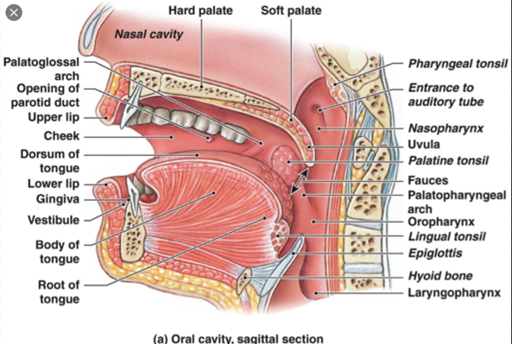
Oromucosal and Laryngopharyngeal anatomy

Slide 14

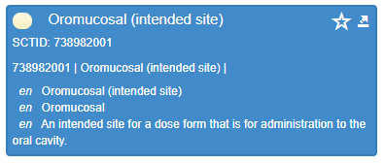
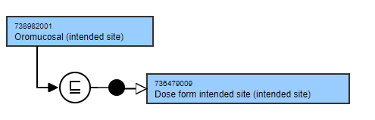
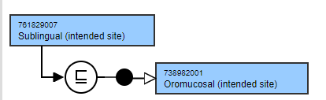

Oromucosal and Laryngopharyngeal : SNOMED CT
50039500: Oromucosal/laryngopharyngeal solution
SNOMED CT also does not have a “laryngopharyngeal” intended administration site
Notes:
Intended site concepts are primitive but have text definitions

Slide 15
The EDQM “exceptions”
For example:
EDQM: 10308300 - Oromucosal spray, suspension
SNOMED CT: 761906003 – conventional release suspension for oromucosal spray
Attributes match
BUT
EDQM: "Sublingual sprays are excluded."
whereas
SNOMED CT: sublingual intended site is a child of oromucosal intended site.
Hence what looks like an exact match is not; S-CT is “broader than” EDQM
Might it be that EDQM means “use “oromucosal spray, suspension” as a PDF when no more specific intended site is appropriate, so actually “oromucosal” does become an inclusive parent term rather than an exclusive one?

Slide 16
Comment from Chris on “Oromucosal” as an intended site
The “oromucosal” concept originated as a header term when the dose forms were published as a list
The statements like “Sublingual sprays are excluded“ are guidance for manufacturers to avoid ambiguity when they are selecting dose forms for products, not statements about the intended site concept itself
  The intent is that “if the product is a sublingual spray, give it a sublingual spray dose form, DON’T give it a “oromucosal spray” dose form (just because the sublingual site “is part of” the oromucosal“)
This makes the EDQM “oromucosal” similar to the SNOMED CT “oromucosal” – both act as grouper concepts
We can therefore make 1..1 matches between the oromucosal, sublingual and buccal concepts in EDQM and SNOMED CT without being concerned by these exclusion statements “altering” concept meaning

Slide 17
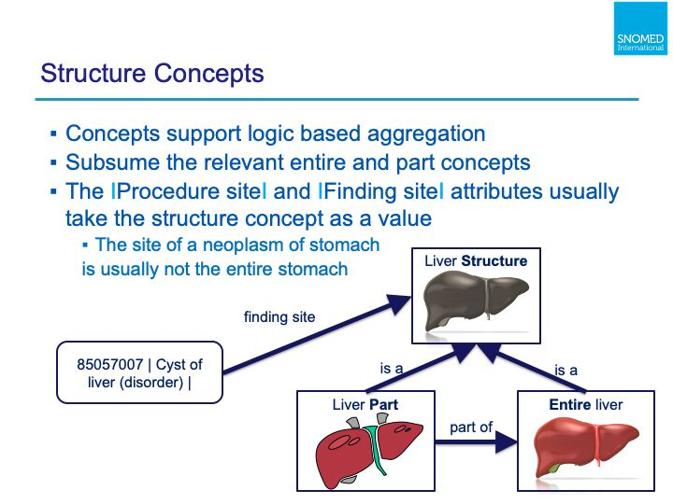
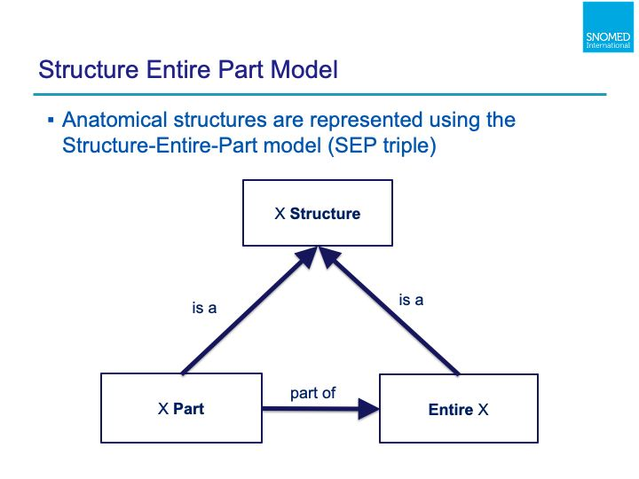
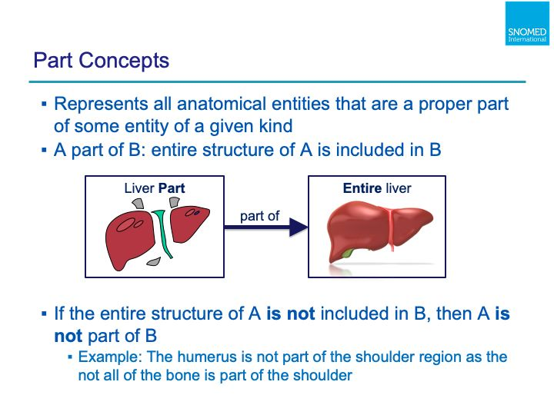
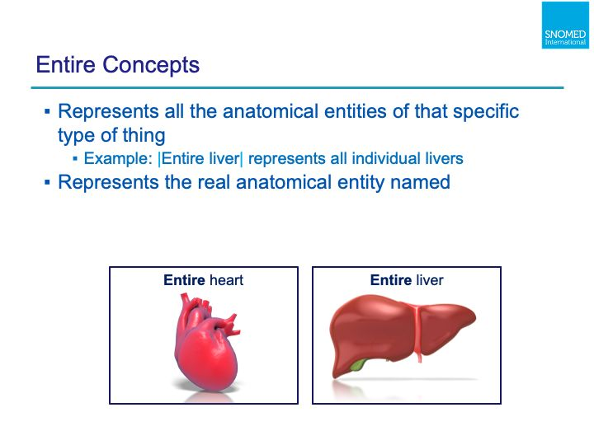
SNOMED CT Body Structure
Each ‘structure’ concept subsumes all the relevant ‘entire’ and ‘part’ concepts. This means that the ‘structure’ concepts support logic-based aggregation of references to the ‘entire’ body structure or its parts.
The |Clinical finding| and |Procedure| concepts depend on anatomy to determine their structure.
Describes normal and abnormal body structures
Will only consider “normal” anatomy for intended site….

Slide 18
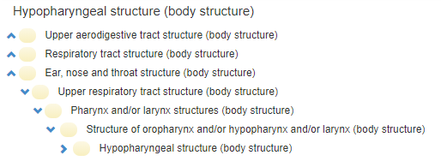
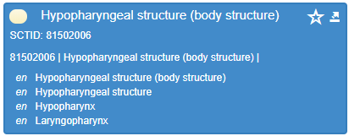
SNOMED CT Body Structure
Describes normal and abnormal body structures
Will only consider “normal” for intended site….
Implies the laryngopharynx should be considered as a separate intended site from anything oromucosal and should be added – to EDQM and to SNOMED CT and used in PDF definition

Slide 19
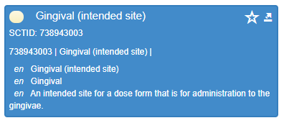
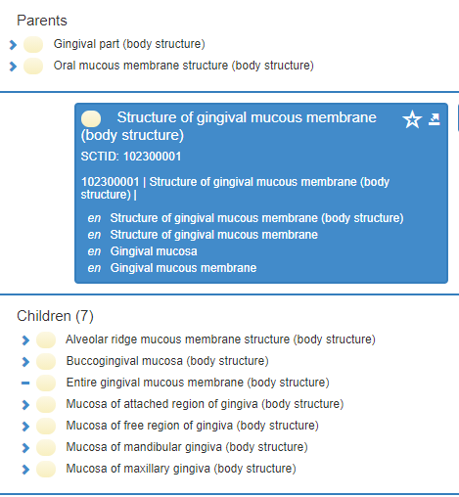
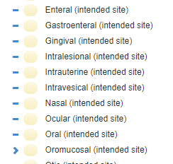
Other “oromucosal” dose forms - gingival
Should “gingival” intended site be a child of oromucosal site?

Slide 20
Request from Jane – map format requirements
Please send to Jane by email (jmi@snomed.org) your requirements for the format of this map to support its actual use/implementation

Slide 21
For next time….?
Drops/sprays
Gingival site

Slide 22
Next Steps

Slide 23


Slide 24

Next meeting on
4th November 2021
at 10:00 UTC
NEXT STEPS
24

Slide 25


THANK YOU
SNOMED International: Delivering SNOMED CT

