Slide 1

Nursing Clinical Reference Group Meeting
February 8, 2022 2000 UTC
Ian Green 17th, March 2020

Slide 2
Agenda
01
04
Welcome and Introductions
Christine Spisla/Erica Culp
5 minutes
Group Discussion: Pain Quality Value set
Christine Spisla/Erica Culp
30 minutes.
02
05
SNOMED International News/ Updates
Jane Millar/Ian Green
Call for future Nursing CRG discussion topics
Christine Spisla/Erica Culp
5 minutes
03
Terminology Consultation
Cathy Richardson

Slide 3
Nursing Clinical Reference Group
The SNOMED CT Nursing Clinical Reference Group aims to provide a global forum for the nursing community and clinicians interested in nursing. The role of all Clinical Reference Groups is to provide a forum to discuss issues, and influence the development and improvement of content in SNOMED CT.
The SNOMED CT Nursing Clinical Reference Group aims to represent the needs of nursing and clinical nursing documentation in SNOMED CT and support terminology development that will drive implementation of nursing focused SNOMED CT globally.

Slide 4
SNOMED International updates….

Slide 5
Terminology Consultation….

Slide 6
Pain Assessment value set…..
Recap of January's Nursing CRG meeting
Discussion Next Steps Feb 2022
Review terminology value set in small parts, starting with “Pain Quality”. Review 5 terms per meeting.
Review SNOMED CT requirements for inclusion criteria in the international. See https://confluence.ihtsdotools.org/display/DOCSTART/9.+Content+Development
Identify and gather group members national/organizational requirements regarding Pain assessment.

Slide 7
Pain Assessment value set: Pain Quality
Issue Possible change content request in SNOMED CT—Pain Quality
Background:
Presented here is a list of pain quality terms from an US based study https://www.ncbi.nlm.nih.gov/pmc/articles/PMC5851787/. Pain quality is defined as “those words patients use to describe their pain”. The nursing CRG is going through US pain quality terms to identifying terminology that is internationally relevant and match these terms to corresponding SCT-terms or suggest new SCT-terms/synonyms.
End goal: a list of SCT-concepts that can represent an international pain value set for “pain quality”
Review questions:
1. Which of these terms have you used in nursing practice?
2. Are any terms you have used, not on the lists?
3. Are any terms synonymous?
4. Which of these should we propose as a content change request? (new concept or new synonym)

Slide 8
Pain Assessment value set…..
Pain Quality: Value | Fully Specified Name | Preferred Term | Semantic Tag | SCTID
Aching | Aching pain | Aching pain | finding | 27635008
Burning | Burning pain | Burning pain | finding | 36349006
Constrictive | no match | x | x | x
Cramping | Cramping pain | Cramping pain | finding | 279093005
Crushing | Crushing pain | Crushing pain | finding | 279098001
Cutting | Cutting pain | Cutting pain | finding | 162503007
Deep | Deep pain | Deep pain | finding | 36630001
Dull | Dull pain | Dull pain | finding | 83644001
Gnawing | Gnawing pain | Gnawing pain | finding | 301371003
Grinding | no match | x | x | x
Heaviness | Heavy pain | Heavy pain | finding | 279095003
Itching | no match | x | x | x
Jabbing | no match | x | x | x
Nagging | no match | x | x | x
Penetrating | no match | x | x | x

Slide 9
Pain Assessment value set…..
Pain Quality: Value | Fully Specified Name | Preferred Term | Semantic Tag | SCTID
Piercing | no match | x | x | x
Pinching | no match | x | x | x
Pins and Needles | no match | x | x | x
Popping | no match | x | x | x
Pounding | no match | x | x | x
Pressure | no match | x | x | x
Prickling | Pricking pain | Pricking pain | finding | 162506004
Pulling | no match | x | x | x
Sharp | Sharp pain | Sharp pain | finding | 8708008
Shooting | Shooting pain | Shooting pain | finding | 49575005
Smarting | Smarting pain | Smarting pain | finding | 103013007
Sore | Soreness | Soreness | finding | 71393004
Squeezing | Squeezing pain | Squeezing pain | finding | 428557006
Stabbing | Stabbing pain | Stabbing pain | finding | 55145008
Stinging | no match | x | x | x
Tearing | no match | x | x | x
Tender | no match | x | x | x
Throbbing | Throbbing pain | Throbbing pain | finding | 29695002
Tightness | Tightening pain | Tightening pain | finding | 162505000
Tingling | Tingling pain | Tingling pain | finding | 786837007

Slide 10
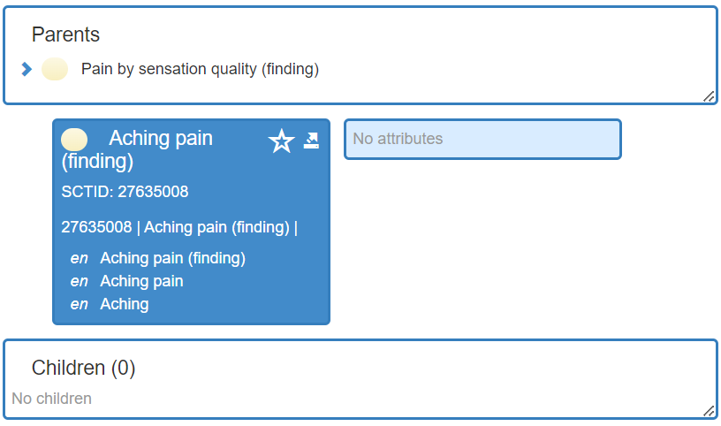
Pain Assessment value set: Pain Quality
Issue: Aching
Background: https://dictionary.cambridge.org/dictionary/english/aching: to have a continuous pain that is unpleasant but not very strong
SCTID: 27635008 |Aching pain (finding)|
1. Already deemed internationally relevant.
2. Are any terms synonymous?
3. Content change request?

Slide 11
Pain Quality: Aching
SCTID: 27635008 |Aching pain (finding)|
Synonyms:
Content change request:
Should this term be included in an International pain quality value set…..
Group Decision:

Slide 12
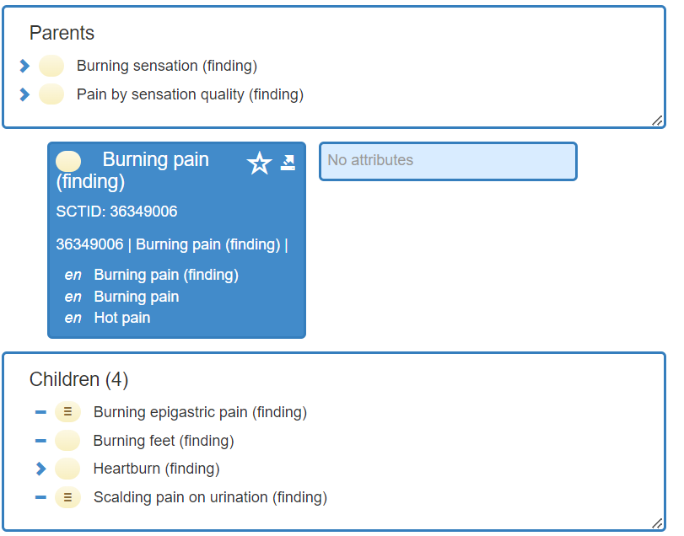
Pain Assessment value set: Pain Quality
Issue: Burning
Background: https://dictionary.cambridge.org/dictionary/english/burning: painful in a way that feels hot
SCTID: 36349006 |Burning pain (finding)|
Already deemed internationally relevant.
Are any terms synonymous?
Content change request?

Slide 13
Pain Quality: Burning
SCTID: 36349006 |Burning pain (finding)|
Synonym:
Content change request:
This term should be included in an International pain quality value set?
Group Decision:

Slide 14
Pain Assessment value set: Pain Quality
Issue: Constrictive
Background: https://dictionary.cambridge.org/dictionary/english/constrict?q=constricting: to become tighter and narrower, or to make something become tighter and narrower
SCTID: no match in (finding) hierarchy
Used case?
Are any terms synonymous? squeezing/grinding/pinching/pounding/crushing
Content change request?

Slide 15
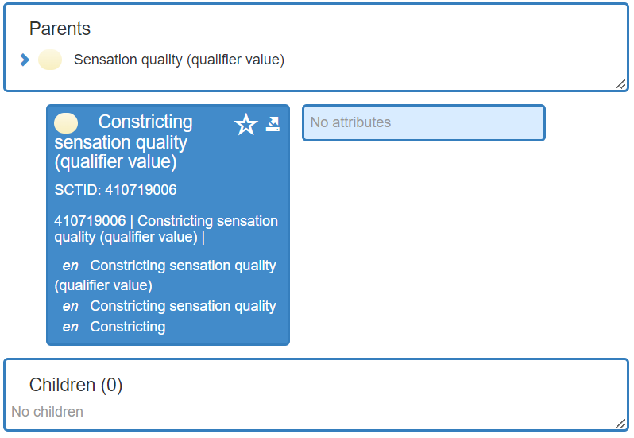
Pain Quality: Constrictive
SCTID: No match in (finding) hierarchy
Synonyms:
Content change request: “possible synonym to squeezing/crushing”
Should this term be included in an International pain quality value set?
Group Decision:

Slide 16
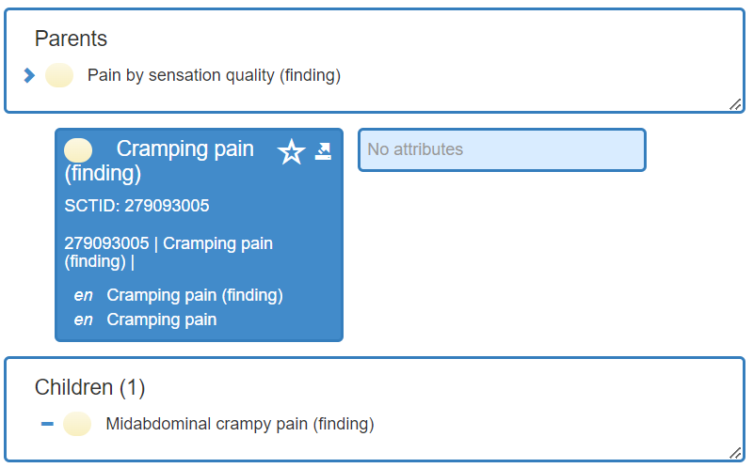
Pain Assessment value set: Pain Quality
Issue: Cramping
Background: https://dictionary.cambridge.org/dictionary/english/cramp?q=cramping: a sudden painful tightening in a muscle, often after a lot of exercise, that limits movement/pains in the lower stomach caused by a woman's period
SCTID: 279093005 |Cramping pain (finding)|
Already deemed Internationally relevant.
Are any terms synonymous?
Content change request?

Slide 17
Pain Quality: Cramping
SCTID: 279093005 |Cramping pain (finding)|
Synonym:
Content change request:
Should this term be included in an International pain quality value set?
Group Decision:

Slide 18
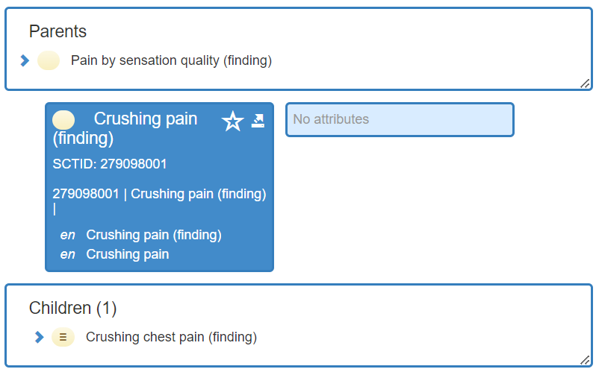
Pain Assessment value set: Pain Quality
Issue: Crushing
Background: https://www.ncbi.nlm.nih.gov/medgen/141603#:~:text=Definition,from%20NCI%5D: A sense of discomfort or distress that is squeezing or excessively compressing.
SCTID: 279098001 |Crushing pain (finding)|
Already deemed internationally relevant.
Are any terms synonymous? squeezing/compressing
Content change request?

Slide 19
Pain Quality: Crushing
SCTID: 279098001 |Crushing pain (finding)|
Synonym:
Content change request:
Should this term be included in an International pain quality value set?
Group Decision:

Slide 20
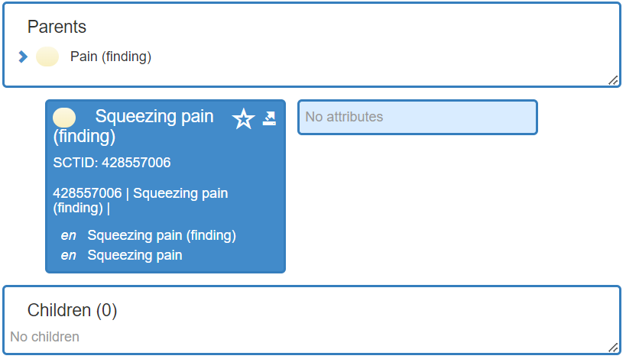
Pain Assessment value set: Pain Quality
Issue: Squeezing
Background: https://dictionary.cambridge.org/dictionary/english/squeeze?q=squeezing: to press something firmly, especially from all sides in order to change its shape, reduce its size, or remove liquid from it:
SCTID: 428557006 |Squeezing pain (finding)|
Already internationally deemed relevant.
Are any terms synonymous? constrictive/grinding/pinching/pounding/crushing
Content change request?

Slide 21
Pain Quality: Squeezing
SCTID: 428557006 |Squeezing pain (finding)|
Synonym:
Content change request:
Should this term be included in an International pain quality value set?
Group Decision:

Slide 22
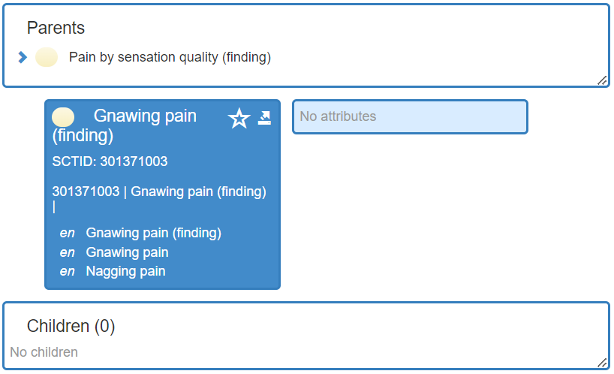
Pain Assessment value set: Pain Quality
Issue: Gnawing
Background: https://dictionary.cambridge.org/dictionary/english/gnawing: continuously uncomfortable, worrying, or painful:
SCTID: 301371003 |Gnawing pain (finding)|
1. Already deemed internationally relevant.
2. Is preferred term to nagging pain
3. Content change request?

Slide 23
Pain Assessment value set: Pain Quality
Issue: Nagging
Background: https://dictionary.cambridge.org/dictionary/english/nagging: used to describe an unpleasant feeling that continues for a long period of time: nagging doubts/pain
SCTID: 301371003 |nagging pain|
1. Already internationally relevant.
3. Is acceptable synonym to gnawing.
4. Content change request?

Slide 24
Pain Quality: Gnawing/Nagging
SCTID: 301371003 |Gnawing pain (finding)|
Synonym: Nagging
Content change request:
Should this term be included in an International pain quality value set?
Group Decision:

Slide 25
March Open Discussion…..
Continuation of pain assessment: Pain Quality review

Slide 26
Thank you for participating
We look forward to seeing you at our next Nursing CRG Meeting
March 8th 2022 2000 UTC
Christine and Erica

