Slide 1


SNOMED CT DEUSG Subgroup
EDQM Dose Form Mapping
Linda Bird, SNOMED International
Julie James, Blue Wave Informatics
Thursday 2nd Decmeber 2021

Slide 2

Welcome
Next steps for the mapping
Issues discussion
Next meeting
AGENDA
http://snomed.org/deusg
Notes:
What have you been doing and what have I been doing?

Slide 3

Next steps for the mapping

Slide 4
Since last meeting
Presentation to the DEUSG – Thank you François!
All the remaining attribute map filled in
Working on the “Narrower than”s – see below
Hard and soft capsule proposal – see below
The current process is a bit “asynchronous” as it has to wait for folk to have time to look at email – but we understand that and “so be it”

Slide 5
Start to build “Release 1”
In a new, clean spreadsheet:
Add all agreed 1..1 exact matches (all attributes match)
Add all “no matches” for which no products (currently) exist – with the note for requesting if the need arises
Add all 1..1 exact matches with non-matching attributes – as agreement reached
Add those concepts that “will map” when CRS requests have been actioned
Do we need a new “interim working” spreadsheet? Yes, that will help

Slide 6
Does R1 need to have all EDQM PDFs?
Even if we have “nothing” to say yet?
When do we send to “the reviewers”?
  Reviewers want to review when there is a high degree of confidence in the map
  We should start the review when the “Interim working” sheet is empty
When we have a candidate map (non RF2), we could open this to the wider DEUSG to look through
  Note: when we release/publish, we will have a “time stamp”
Full “official” RF2 version cannot come out until we have the DF Model changes, which will not happen till July 22 release
  Will also need to work out the RF2 map metadata prior to publication

Slide 7
Our documentation
Mapping Guidance:
https://confluence.ihtsdotools.org/display/USRG/Mapping+Guidance+for+EDQM+to+SNOMED+CT+Pharmaceutical+Dose+Form+Mapping
“EDQM discussion items” List
https://confluence.ihtsdotools.org/display/USRG/Issues+for+discussion+with+EDQM
“SNOMED CT discussion items” List
https://confluence.ihtsdotools.org/display/USRG/Issues+for+discussion+with+SNOMED+CT

Slide 8
Issues for discussion

Slide 9
The “narrower than” 1..1 matches
EDQM Mapping
November 21

Slide 10
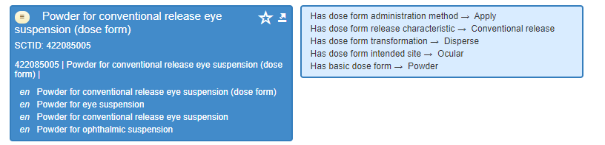
13006000: Ear drops, powder for suspension
Agreed we should make this a “no map” until products need it
13006000 | Ear drops, powder for suspension | 385136004 | Conventional release ear drops (dose form) | 1..1 | Narrower than | No
Tara’s note: EDQM is a solid powder, than undergoes transformation 'dispersion'. S-CT is a broad term for ear drops
Does anyone have any products that would use this dose form?
  If yes: we will request addition of a new PDF and then make a 1..1 mapping with “exact match” (and in the meantime alter map to “1..0 no map” with the note to update the map when the new concept is available
  If no: alter map to “1..0 no map” and make a note that if this dose form is needed, to make a CRS request and then update the map
Precedent for addition:
SNOMED CT has this, for eye drops, but not for ear drops:

Slide 11
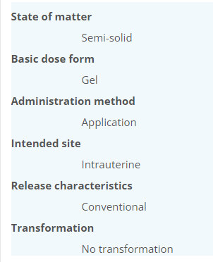
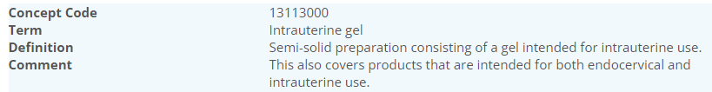
13113000: Intrauterine gel
Agreed we should make this a “no map”
13113000 | Intrauterine gel | 385251000 | Conventional release endocervical gel (dose form) | 1..1 | Narrower than | No
Mapping note: Endocervical v Intrauterine….and see EDQM comment
Does anyone have any products that would use this dose form?
For EDQM, it seems “intrauterine” is a grouper concept, with “endocervical” as a more specific child concept

Slide 12
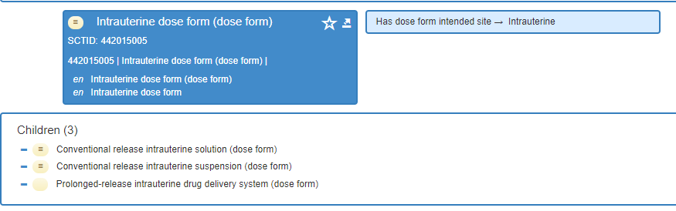
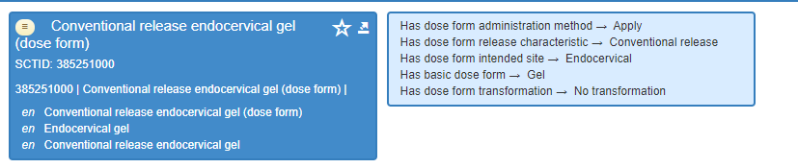
13113000: Intrauterine gel
SNOMED CT has no intrauterine gel dose form
BUT it does have the endocervical gel dose form
So, if there are products that require the intrauterine gel dose form, we should request that this is added
BUT
We need to be sure about the definition of the two intended sites….see next slide….

Slide 13
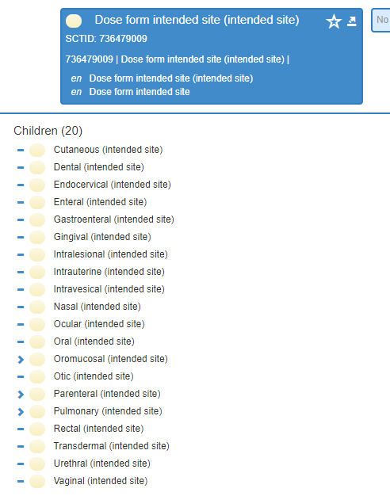
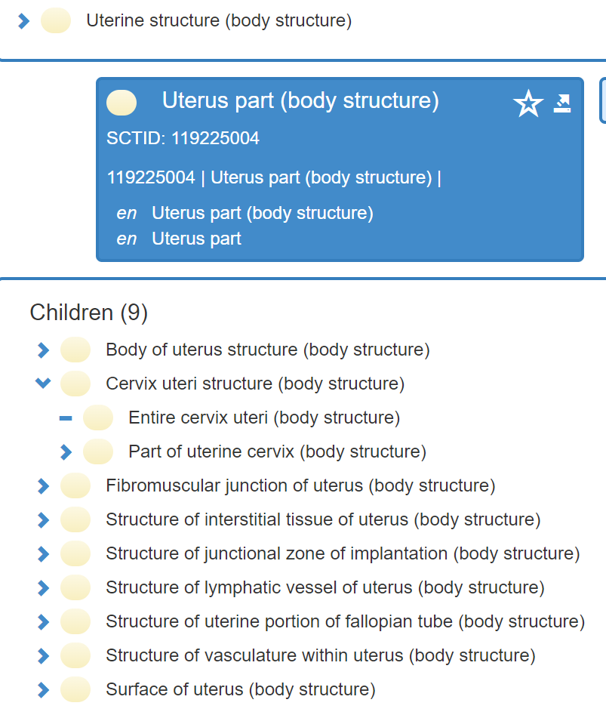
13113000: Intrauterine gel
The cervix is the lower part of the uterus situated between the external os and internal os. The mucosa lining the cervical canal is known as the endocervix
But for Intended site, intrauterine and endocervical are separate, unrelated sites of administration
Should we suggest that the “Endocervical” intended site be a child of the “Intrauterine” intended site?

Slide 14
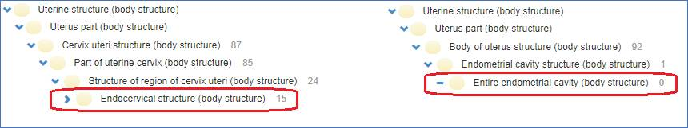
From François:
Agreed not to change the Intended Site structure for now
|endocervical structure| is not a descendant of |endometrial cavity|:

Slide 15
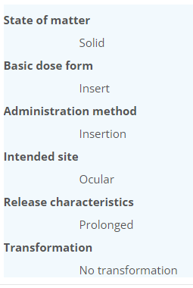
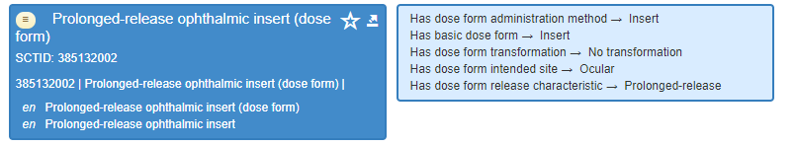
10612000: Ophthalmic insert
Agreed that even though the concept “names” do not match, this IS good enough for an “exact match”
10612000 | Ophthalmic insert | 385132002 | Prolonged release ophthalmic insert (dose form) | 1..1 | Narrower than | Yes
Elisabeth’s note: EDQM definition "Solid sterile preparation of suitable size and shape, designed to be inserted in the conjunctival sac to produce a local or ocular effect by the release of active substance(s) over a determined period of time. Ophthalmic inserts generally consist of a reservoir of active substance(s) embedded in a matrix or bounded by a rate-controlling membrane. They are presented individually in sterile containers.
Mydriasert 0.28 mg/5.4 mg ophthalmic insert (UK, FR)
Lacrisert (NOR) – hydroxypropyl-cellulose; definitely “prolonged release”
No products in SNOMED CT

Slide 16
11117000: Inhalation vapour, liquid
11117000 | Inhalation vapour, liquid | 385213000 | Conventional release vapor solution for inhalation (dose form) | 1..1 | narrower than | no
Olivier’s note: EDQM: BDF = liquide / S-CT: BDF = solution
Products using this dose form:
  UK: Liquid anaesthetics (e.g. isoflurane, desflurane): NZ: also methoxyflourane, enflurane
  FR: Aerrane, Sevoflurane, Suprane
  Please confirm / add others
To request this as a new SNOMED CT PDF, we will also have to request “Liquid” as a basic dose form
Is that acceptable? It should make the concept be “sufficiently defined”
If yes, then the new dose form could be:
Conventional release liquid for inhalation
BDF = liquid
AdmMethod = Inhale
Int Site = Pulmonary
Rel Char = Conventional
Transform = see next slide

Slide 17
11117000: Inhalation vapour, liquid
Needs further discussion about BDF with Linda
All the “solution for <inhalation> or <nebulisation>” do not have a transform in EDQM or in SNOMED CT
Is this OK?
  Or should there be a transform of “vapourisation” (which would cover both evaporation and boiling)
EDQM also has “mixing” – possibly to describe when an essential oil is “mixed” with hot water to get evaporation of the oil….but vapourisation as a transform would include that
If we go down this path (new PDF) then the action would be alter map to “1..0 no map” with the note to update the map when the new concept is available
Other Thoughts:
Currently CDs for the liquid anaesthetics have “conventional release solution for inhalation” as PDF – but they are not solutions; “water for injections” also uses “solution (see 784645002 | Product containing precisely water 1 gram/1 milliliter conventional release solution for injection (clinical drug) |)
For the liquid anaesthetics the strength is 999mg/mL – is this 100%? Surely that depends on the molecular weight of the anaesthetic?

Slide 18
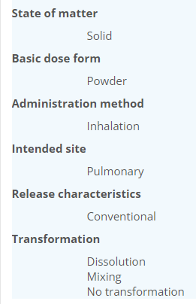
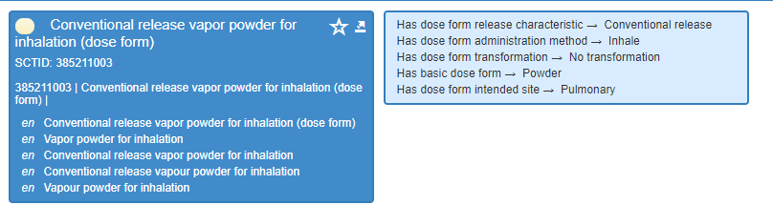

11112000: Inhalation vapour, powder
Agreed we should make this a “no map” BUT if it is needed in the future, it must have a transform
11112000 | Inhalation vapour, powder | 385211003 | Conventional release vapor powder for inhalation (dose form) | 1..1 | Don’t know | no
Catherine’s note: EDQM has additional transformation: dissolution, mixing.
Does the “unmatched” transform matter?
Does anyone have any products that would use this dose form?
There are none in S-CT that I can find using this ECL query: < 763158003 |Medicinal product|:
411116001 |Has manufactured dose form| = 385211003 | Conventional release vapor powder for inhalation (dose form) |
To me (Julie) a powder would need to transform into “a liquid” then allow a vapour to evaporate and be inhaled
NB: A vapour is a gas – with temperature and pressure constraints allowing both the liquid and gas to exist together. Powder directly to gas is sublimation

Slide 19
Responses:
The Lidocaine intrauterine gel could also be used endocervically
 | Ear drops: powder for suspension | Intrauterine gel | Endocervical intended site a child of intrauterine | Ophthalmic insert | Liquid anaesthetics | Inhalation vapour, powder
David (NZ) | No products | No products | Agree | Support “Exact match” | New dose form and new BDF | No products Transform is important
Linda (SCT) | Agree with proposal |  | Agree | Support “Exact match” | New dose form; not sure about BDF | Exact match
François (Phast) | No products | No products |  | Support “Exact match” |  | No products
Martha (NOR) | No products | No products | How would this affect MPFs? | Has additional product - Lacrisert | Created: “Conv release vapor liquid for inhalation” Also nicotine product | No products Transformation is important
Elisabeth |  | Lidocaine gel (now disc) | Agree
Tara (IRE) | No products | No products | Agree |  | Inhalation anaesthetics | No products

Slide 20
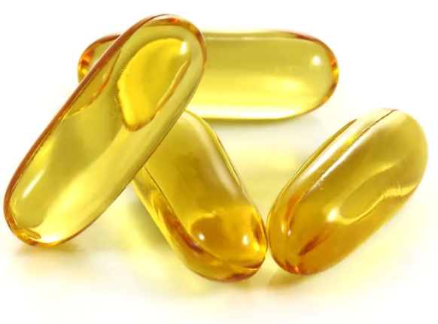
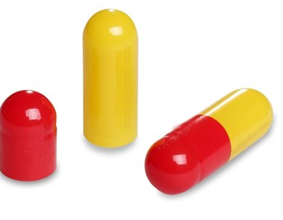
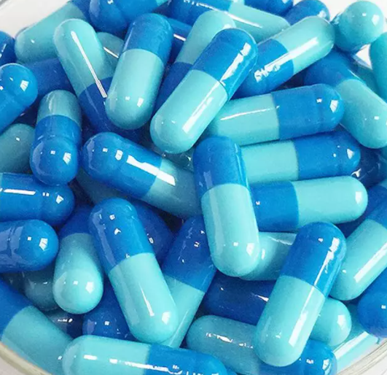
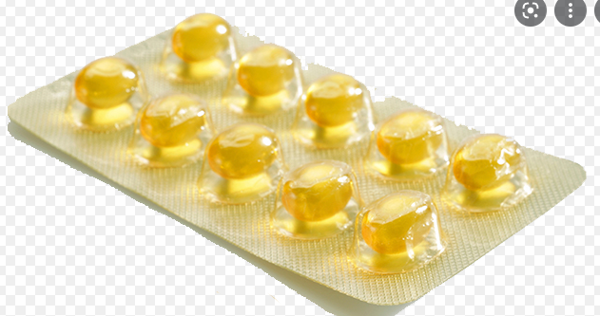
Pharmaceutical Dose Forms
Hard and Soft Capsules
November 2021

Slide 21
“Capsules” PDFs in EDQM:
10210000 | Capsule, hard | oral
10211000 | Capsule, soft | oral
10214000 | Chewable capsule, soft | oral
10212000 | Gastro-resistant capsule, hard | oral
10213000 | Gastro-resistant capsule, soft | oral
11113000 | Inhalation vapour, capsule | pulmonary
10217000 | Modified-release capsule, hard | oral
10218000 | Modified-release capsule, soft | oral
10317000 | Oromucosal capsule | oromucosal
10215000 | Prolonged-release capsule, hard | oral
10216000 | Prolonged-release capsule, soft | oral
11014000 | Rectal capsule | rectal
10910000 | Vaginal capsule, hard | vaginal
10911000 | Vaginal capsule, soft | vaginal

Slide 22
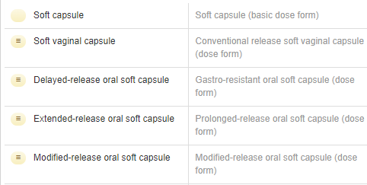

In SNOMED CT currently:
“Soft capsule” BDF
“Soft capsule” PDFs
This “imbalance” struck the group as a little unusual, since generally “hard capsules” are much more prevalent in products than “soft capsules”
“Hard capsule” BDF
“Hard capsule” PDF

Slide 23
Use cases for “hard” and “soft” capsules
For national extensions:
Acknowledgement that “prescribers do not care”
  Therefore, a representation of “capsules” is needed
BUT Pharmacists and those that administer medicines DO care
  Primarily because of divisibility and administration (open the capsule and sprinkle) for hard capsules, but not for soft capsules

Slide 24
Recommendation for “hard” and “soft” capsules
Agreed to request the additions and to leave modelling as is
For national extensions:
We do not want to “lose” the granularity of the “hard” and “soft” capsules because of its clinical use
  And we would like to be able to map 1..1 from EDQM to SNOMED CT
We recommend that there should be additional concepts in SNOMED CT for hard and soft capsules (for those PDFs that we know would be needed to describe existing products) and that the representation is “balanced” between hard and soft, especially as hard capsules are most often used
The existing “capsule” PDFs can act as a parent for the hard and soft capsule concepts and have much value in their own right
  Agreement from David (NZ) and Martha (NOR) and Linda
Keep the existing hard and soft basic dose forms with “capsule” as their parent
  Agreement from David (NZ) and Martha (NOR) and Linda
  Both IRE and NOR need to be able to use “capsule” when they have to describe imported medicines with minimal clinical information
There was general agreement/support on this – not just from European colleagues, but also from Pacific and American colleagues
BUT there is no equivalent to “capsule” in French; only a phrase that implies “choose which is appropriate” (Gélule ou capsule molle selon la forme pharmaceutique complète)
  Most products if the dose form is just « capsule » could (especially in France) be interpreted as « hard capsule »

Slide 25
Two queries: row 101 & row 196
Not addressed
EDQM Code | English Name | SCTID | Fully Specified Name | Cardinality | Association | Attribute Match | Comments
50019500 | Ear/eye/nasal drops, solution | 765164007 | Conventional release solution for ear or eye or nose drops (dose form) | 1..* | Exact match | Yes
 |  | 385154000 | Conventional release suspension for nasal drops (dose form) | 1..* | Narrower than | No | S-CT intended site Nasal, EDQM intended site Auricular and Nasal
10221000 | Film-coated tablet | 385057009 | Film-coated tablet (basic dose form) | 1..0 | No match | NA
 |  | 385060002 | Prolonged-release oral tablet (dose form) | 1..0 | No match | no | edqm: conventional release sct: extended release

Slide 26
“Hidden” 1..*s : 1
EDQM Code | English Name | SCTID | Fully Specified Name | Cardinality | Association | Attribute Match | Comments
50037900 | Oral/rectal solution | 385023001 | Conventional release oral solution (dose form) | 1..* | Narrower than | no | edqm: intended dual site in name not reflected in ISI property sct: no intended dual site (see ear or eye ointement)
10105000 | Oral solution | 385023001 | Conventional release oral solution (dose form) | 1..1 | Exact match | Yes
Will be addressed by the oral/rectal site remodel

Slide 27
“Hidden” 1..*s : 2
EDQM Code | English Name | SCTID | Fully Specified Name | Cardinality | Association | Attribute Match | Comments
50038000 | Oral/rectal suspension | 385024007 | Conventional release oral suspension (dose form) | 1..* | Narrower than | no | edqm: intended dual site in name not reflected in ISI property sct: no intended dual site (see ear or eye ointement)
10106000 | Oral suspension | 385024007 | Conventional release oral suspension (dose form) | 1..1 | Exact match | Yes
Will be addressed by the oral/rectal site remodel

Slide 28
“Hidden” 1..*s : 3
EDQM Code | English Name | SCTID | Fully Specified Name | Cardinality | Association | Attribute Match | Comments
50052000 | Powder for oral/rectal suspension | 385027000 | Powder for conventional release oral suspension (dose form) | 1..* | Narrower than | no | edqm: intended dual site in name not reflected in ISI property sct: no intended dual site (see ear or eye ointement)
10111000 | Powder for oral suspension | 385027000 | Powder for conventional release oral suspension (dose form) | 1..1 | Exact match | Yes
Will be addressed by the oral/rectal site remodel

Slide 29
“Hidden” 1..*s : 4
EDQM Code | English Name | SCTID | Fully Specified Name | Cardinality | Association | Attribute Match | Comments
50029150 | Granules for oral/rectal suspension | 385029002 | Granules for conventional release oral suspension (dose form) | 1..* | Narrower than | no | edqm: intended dual site in name not reflected in ISI property sct: no intended dual site (see ear or eye ointement)
10113000 | Granules for oral suspension | 385029002 | Granules for conventional release oral suspension (dose form) | 1..1 | Exact match | Yes
Will be addressed by the oral/rectal site remodel

Slide 30
“Hidden” 1..*s : 5
EDQM Code | English Name | SCTID | Fully Specified Name | Cardinality | Association | Attribute Match | Comments
50038000 | Oral/rectal suspension | 385188006 | Conventional release rectal suspension (dose form) | 1..* | Narrower than | no | edqm: intended dual site in name not reflected in ISI property sct: no intended dual site (see ear or eye ointement)
11006000 | Rectal suspension | 385188006 | Conventional release rectal suspension (dose form) | 1..1 | Exact match | Yes
Will be addressed by the oral/rectal site remodel

Slide 31
“Hidden” 1..*s : 6
EDQM Code | English Name | SCTID | Fully Specified Name | Cardinality | Association | Attribute Match | Comments
50052000 | Powder for oral/rectal suspension | 385191006 | Powder for conventional release rectal suspension (dose form) | 1..* | Narrower than | no | edqm: intended dual site in name not reflected in ISI property sct: no intended dual site (see ear or eye ointement)
11010000 | Powder for rectal suspension | 385191006 | Powder for conventional release rectal suspension (dose form) | 1..1 | exact match | Yes | here SNCT use Administer AM whereas for rectal solution it was apply
Will be addressed by the oral/rectal site remodel

Slide 32
“Hidden” 1..*s : 7
EDQM Code | English Name | SCTID | Fully Specified Name | Cardinality | Association | Attribute Match | Comments
10212000 | Gastro-resistant capsule, hard | 385052003 | Gastro-resistant oral capsule (dose form) | 1..1 | Broader than | Yes | S-CT has no concept for "hard capsule"
10213000 | Gastro-resistant capsule, soft | 385052003 | Gastro-resistant oral capsule (dose form) | 1..1 | Broader than | Yes | SNOMED CT does not differentiate hard and soft capsules
Will be addressed by the hard/soft capsule additional concepts

Slide 33
“Hidden” 1..*s : 8
EDQM Code | English Name | SCTID | Fully Specified Name | Cardinality | Association | Attribute Match | Comments
10910000 | Vaginal capsule, hard | 385176009 | Conventional release hard vaginal capsule (dose form) | 1..* | Exact match | Yes
 |  | 385175008 | Conventional release vaginal capsule (dose form) | 1..* | Broader than | Yes | In EDQM vaginal capsule is a patient friendly term
10911000 | Vaginal capsule, soft | 385177000 | Conventional release soft vaginal capsule (dose form) | 1..1 | Exact match | Yes
 |  | 385175008 | Conventional release vaginal capsule (dose form) | 1..* | Broader than | Yes
Will be addressed by the hard/soft capsule additional concepts

Slide 34
“Hidden” 1..*s : 9
EDQM Code | English Name | SCTID | Fully Specified Name | Cardinality | Association | Attribute Match | Comments
10210000 | Capsule, hard | 420692007 | Conventional release oral capsule (dose form) | *..* | Broader than | Yes | S-CT has no concept for "hard capsule"
10211000 | Capsule, soft | 420692007 | Conventional release oral capsule (dose form) | *..* | Broader than | Yes | S-CT has no concept for "soft capsule"
Will be addressed by the hard/soft capsule additional concepts

Slide 35
“Hidden” 1..*s : 10
EDQM Code | English Name | SCTID | Fully Specified Name | Cardinality | Association | Attribute Match | Comments
10301000 | Gargle | 385065007 | Conventional release oromucosal solution for gargle (dose form) | 1..1 | exact match | yes
50024000 | Gargle/mouthwash | 385065007 | Conventional release oromucosal solution for gargle (dose form) | *..* | Narrower than |  | EDQM has separate terms for gargle and mouthwash individually in addition
Oromucosal dose form review

Slide 36
“Hidden” 1..*s : 11
EDQM Code | English Name | SCTID | Fully Specified Name | Cardinality | Association | Attribute Match | Comments
10305000 | Oromucosal solution | 385070000 | Conventional release oromucosal solution (dose form) | 1..1 | Exact match | yes
50039500 | Oromucosal/laryngopharyngeal solution | 385070000 | Conventional release oromucosal solution (dose form) | 1..* | Narrower than | no | edqm: excluded spray solution ; AME=administration edqm: dual ISI oromucosal OR laryngopharyngeal sct: no laryngopharyngeal intended site ; AME=apply sct: oropharyngeal intended site exists
Oromucosal dose form review

Slide 37
“Hidden” 1..*s : 12
EDQM Code | English Name | SCTID | Fully Specified Name | Cardinality | Association | Attribute Match | Comments
10236100 | Orodispersible film | 447050008 | Conventional release orodispersible film (dose form) | 1..1 | Exact match | No | EDQM intended site "oral" ; "intended to be placed in the mouth where it disperses rapidly before being swallowed." This looks like an error in EDQM since the method is "orodispersion". SCT intended site = "oromucosal".
10317500 | Sublingual film | 447050008 | Conventional release orodispersible film (dose form) | 1..1 | Broader than | no | SCT has no term for sublingual film. SCT uses orodisperse, EDQM uses administration as adm method
Oromucosal dose form review

Slide 38
“Hidden” 1..*s : 13
EDQM Code | English Name | SCTID | Fully Specified Name | Cardinality | Association | Attribute Match | Comments
10309100 | Sublingual spray, emulsion | 385074009 | Conventional release sublingual spray (dose form) | 1..1 | Broader than | No | EDQM is an emulsion, S-CT doesnt define the basic dose form. S-CT intended site for sublingual spray is sublingual. EDQM intended site for sublingual spray, emulsion, is oromucosal.
10309300 | Sublingual spray, suspension | 385074009 | Conventional release sublingual spray (dose form) | 1..1 | Broader than | No | EDQM is a suspension, S-CT doesnt define the basic dose form. S-CT intended site for sublingual spray is sublingual. EDQM intended site for sublingual spray, emulsion, is oromucosal.
Oromucosal dose form review

Slide 39
“Hidden” 1..*s : 14
EDQM Code | English Name | SCTID | Fully Specified Name | Cardinality | Association | Attribute Match | Comments
10310000 | Mouthwash | 70409003 | Conventional release oromucosal solution for mouthwash (dose form) | 1..1 | Exact match | no | edqm: AME = rinsing or washing sct: AME = rinsing, which does not precise if washing is included
50024000 | Gargle/mouthwash | 70409003 | Conventional release oromucosal solution for mouthwash (dose form) | *..* | Narrower than
Oromucosal dose form review

Slide 40
“Hidden” 1..*s : 15
EDQM Code | English Name | SCTID | Fully Specified Name | Cardinality | Association | Attribute Match | Comments
10321000 | Lozenge | 764501003 | Conventional release oromucosal lozenge (dose form) | *..* |  | yes | SCT has oromucosal lozenge and buccal lozenge (focus on intended site), EDQM has lozenge and compressed lozenge (focus on how it is manufactured: compression vs moulding)
10322000 | Compressed lozenge | 764501003 | Conventional release oromucosal lozenge (dose form) | *..* |  | yes | SCT has oromucosal lozenge and buccal lozenge (focus on intended site), EDQM has lozenge and compressed lozenge (focus on how it is manufactured: compression vs moulding)
Oromucosal dose form review

Slide 41
“Hidden” 1..*s : 16
EDQM Code | English Name | SCTID | Fully Specified Name | Cardinality | Association | Attribute Match | Comments
10308200 | Oromucosal spray, solution | 761905004 | Conventional release solution for oromucosal spray (dose form) | 1..1 | exact match | yes
50040500 | Oromucosal/laryngopharyngeal solution/spray, solution | 761905004 | Conventional release solution for oromucosal spray (dose form) | 1..* | Narrower than | no | edqm: excluded spray solution ; AME=administration edqm: dual ISI oromucosal OR laryngopharyngeal sct: no laryngopharyngeal intended site ; AME=apply sct: oropharyngeal intended site exists
Oromucosal dose form review

Slide 42
“Hidden” 1..*s : 17
EDQM Code | English Name | SCTID | Fully Specified Name | Cardinality | Association | Attribute Match | Comments
11109000 | Inhalation powder | 385207009 | Conventional release powder for inhalation (dose form) | 1..1 | Exact match | Yes
11110000 | Inhalation powder, hard capsule | 385207009 | Conventional release powder for inhalation (dose form) | 1..1 | Broader than | yes | Hard capsule can be viewed as a container
11111000 | Inhalation powder, pre-dispensed | 385207009 | Conventional release powder for inhalation (dose form) | 1..1 | Broader than | Yes | S-CT concept has no sense of the "pre-dispensed"
Inhalational dose form review

Slide 43
“Hidden” 1..*s : 18
Inhalational dose form review
EDQM Code | English Name | SCTID | Fully Specified Name | Cardinality | Association | Attribute Match | Comments
11117000 | Inhalation vapour, liquid | 385213000 | Conventional release vapor solution for inhalation (dose form) | 1..1 | narrower than | no | edqm: BDF = liquide / sct: BDF = solution
11106000 | Pressurised inhalation, solution | 385213000 | Conventional release vapor solution for inhalation (dose form) | 1..1 | Exact match | Yes | EDQM has Mixing | No transformation, S-CT has No transformation ("The vapour is usually generated by adding the solution to hot water.)" SCT = "No transformation". Does not convey the "mixing". Also, SCT concept does not render "to obtain a local effect." "Broader than" or "Exact match" to be discussed. Border line.
11114000 | Inhalation vapour, solution | 385213000 | Conventional release vapor solution for inhalation (dose form) | 1..1 | Exact match | no | EDQM specifies local effect and has transformation mixing and no transformation. SCT has no transformation. Status P

Slide 44
“Hidden” 1..*s : 19
EDQM Code | English Name | SCTID | Fully Specified Name | Cardinality | Association | Attribute Match | Comments
12301000 | Medicinal gas, compressed | 385217004 | Conventional release gas for inhalation (dose form) | *..* |  | no | EDQM uses medicinal gas as basic dose form, SCT uses gas. SCT divides the gases in how it will be used (inhale, insufflate) and EDQM focuses on what the dose form is (compressed, cryogenic, liquified). EDQM do not use insufflate as a adm method
12302000 | Medicinal gas, cryogenic | 385217004 | Conventional release gas for inhalation (dose form) | *..* |  | no | See comment medicinal gas, compressed
12303000 | Medicinal gas, liquefied | 385217004 | Conventional release gas for inhalation (dose form) | *..* |  | no | See comment medicinal gas, compressed
Inhalational dose form review

Slide 45
“Hidden” 1..*s : 20
EDQM Code | English Name | SCTID | Fully Specified Name | Cardinality | Association | Attribute Match | Comments
50015500 | Cutaneous spray, emulsion | 385105007 | Conventional release cutaneous spray (dose form) | 1..1 | Broader than | No | S-CT have cutaneous spray, also cutaneous spray solution, also cutaneous spray suspension, but not an emulsion. cutaneous spray has intended site 'cutaneous'. EDQM has intended site as 'cutaneous/transdermal'.
10510000 | Cutaneous spray, suspension | 385105007 | Conventional release cutaneous spray (dose form) | 1..* | Broader than

Slide 46
“Hidden” 1..*s : 21
EDQM Code | English Name | SCTID | Fully Specified Name | Cardinality | Association | Attribute Match | Comments
13113000 | Intrauterine gel | 385251000 | Conventional release endocervical gel (dose form) | [1..1] | Narrower than | No | Endocervical v Intrauterine….and see EDQM comment
11701000 | Endocervical gel | 385251000 | Conventional release endocervical gel (dose form) | 1..1 | Exact match | Yes

Slide 47
“Hidden” 1..*s : 22
EDQM Code | English Name | SCTID | Fully Specified Name | Cardinality | Association | Attribute Match | Comments
50033400 | Intravesical solution/solution for injection | 385242008 | Conventional release intravesical solution (dose form) | 1..* | narrower than | no | edqm: AME = administration ; ISI = intravesical/uretral sct: AME = instill ; ISI = intravesical
11502500 | Intravesical solution | 385242008 | Conventional release intravesical solution (dose form) | 1..1 | Exact match | No | (Elisabeth) Admin method : SCT = instill // Intended site : Intravesical Admin method EDQM = Administration // Intended site : Intravesical/Urethral

Slide 48
“Hidden” 1..*s : 23
EDQM Code | English Name | SCTID | Fully Specified Name | Cardinality | Association | Attribute Match | Comments
50020200 | Ear/nasal drops, suspension | 420891003 | Conventional release suspension for ear drops (dose form) | 1..* | Narrower than | No | S-CT intended site Otic, EDQM intended site Auricular and Nasal
10705000 | Ear drops, suspension | 420891003 | Conventional release suspension for ear drops (dose form) | 1..1 | Exact match | Yes | (Elisabeth)

Slide 49
“Hidden” 1..*s : 24&25
EDQM Code | English Name | SCTID | Fully Specified Name | Cardinality | Association | Attribute Match | Comments
10228000 | Chewable tablet | 66076007 | Conventional release chewable tablet (dose form) | 1..1 | Exact match | yes | 10228000
50001000 | Chewable/dispersible tablet | 66076007 | Conventional release chewable tablet (dose form) | 1..* | Narrower than | no | 50001000
EDQM Code | English Name | SCTID | Fully Specified Name | Cardinality | Association | Attribute Match | Comments
10121000 | Dispersible tablet | 421366001 | Tablet for conventional release oral suspension (dose form) | 1..1 | Exact match | yes
50001000 | Chewable/dispersible tablet | 421366001 | Tablet for conventional release oral suspension (dose form) | 1..* | Narrower than | no | sct: syn=Dispersible oral tablet

Slide 50
“Hidden” 1..*s : 26
EDQM Code | English Name | SCTID | Fully Specified Name | Cardinality | Association | Attribute Match | Comments
11205000 | Powder for solution for injection | 385223009 | Powder for conventional release solution for injection (dose form) | 1..1 | Exact match | Yes
50049250 | Powder for concentrate for solution for injection/infusion | 385223009 | Powder for conventional release solution for injection (dose form) | 1..* | Broader than | No | SNCT does not have Dilution as a transformation, dilution is a second transformation after dissolution, as the obtained solution is dilute to obtain the final solution for perfusion No union of AM inject OR infuse

Slide 51
“Hidden” 1..*s : 27
EDQM Code | English Name | SCTID | Fully Specified Name | Cardinality | Association | Attribute Match | Comments
11212000 | Powder for solution for infusion | 764843001 | Powder for conventional release solution for infusion (dose form) | 1..1 | Exact match | yes | EDQM definition: "one or more powders, including freeze-dried powders"
50043000 | Powder for concentrate for solution for infusion | 764843001 | Powder for conventional release solution for infusion (dose form) | 1..1 | Broader than | No | SNCT does not have Dilution as a transformation, dilution is a second transformation after dissolution, as the obtained solution is dilute to obtain the final solution for perfusion
50049250 | Powder for concentrate for solution for injection/infusion | 764843001 | Powder for conventional release solution for infusion (dose form) | 1..* | Broader than | No | SNCT does not have Dilution as a transformation, dilution is a second transformation after dissolution, as the obtained solution is dilute to obtain the final solution for perfusion. No union of AM inject OR infuse

Slide 52
“Hidden” 1..*s : 28
EDQM Code | English Name | SCTID | Fully Specified Name | Cardinality | Association | Attribute Match | Comments
12114000 | Stomach irrigation | 785898006 | Conventional release solution for irrigation (dose form) | 1..1 | Broader than | No | S-CT irrigation of stomach is a procedure. S-CT has a solution for irrigatoin that stomach irrigation could map to. It has no intended site. EDQM intended site is the stomach
12113000 | Irrigation solution | 785898006 | Conventional release solution for irrigation (dose form) | 1..1 | Exact match | yes | sct: no intented site defined

Slide 53



Slide 54

Next meeting on
Thursday 16nd December
at 11:00 UTC
NEXT STEPS
54

Slide 55


THANK YOU
SNOMED International: Delivering SNOMED CT

