Slide 1


SNOMED CT DEUSG Subgroup
EDQM Dose Form Mapping
Linda Bird, SNOMED International
Julie James, Blue Wave Informatics
Thursday 18th November 2021

Slide 2

Welcome
Mapping activity
Where next?
Issues for discussion
Presentation to the DEUSG
Next meeting
AGENDA
http://snomed.org/deusg
Notes:
What have you been doing and what have I been doing?

Slide 3

Mapping Activity

Slide 4
Our documentation
Mapping Guidance:
https://confluence.ihtsdotools.org/display/USRG/Mapping+Guidance+for+EDQM+to+SNOMED+CT+Pharmaceutical+Dose+Form+Mapping
“EDQM discussion items” List
https://confluence.ihtsdotools.org/display/USRG/Issues+for+discussion+with+EDQM
“SNOMED CT discussion items” List
https://confluence.ihtsdotools.org/display/USRG/Issues+for+discussion+with+SNOMED+CT

Slide 5





Where are we now?
EVERYTHING has been looked at once (there are no blanks in the Cardinality or Association columns)
☺ ☺ ☺
Well done everyone, thank you!

Slide 6
What is it looking like (1)?
207 1..1 matches
Of which 113 also matched on the attributes
  Which means 72 did not
  22 do not have attribute match data – we should check these
  185 were “exact match”
  18 were “broader than” (hard and soft capsules etc.)
  4 were “narrower than” – we should look at these in detail
152 1..0 no matches (37.5%)
Lots of X for Y for Z (e.g. “Dispersion for concentrate for dispersion for infusion”)
Many have “dispersion” in them…..as we mentioned last time
Countries are having to create dose forms to make systems work

Slide 7
What is it looking like (2)?
28 1..*
Mixture of broader and narrower than
        Dual sites- we need to further develop a request for role grouping the site with the admin method (rectal – administer, oral – swallow)
      Spray/drops issue
      Chewable/dispersible
10 *..*
Mixture of broader and narrower than
        Lozenges
      Gases
      Gargle/mouthwash

Slide 8
What is it looking like (3)?
Some 1..* maps are “hidden” as different mappers have used the same SNOMED CT concept as a target
They happen when
There are multiple sites (e.g. oral/rectal)
There are multiple possibilities (hard/soft capsules)
There are granularity differences (spray/drops, emulsion/solution/suspension OR intrauterine/endocervical)

Slide 9
Where next?

Slide 10
Next steps
Fill in the rows with no attribute match information
Work up the role grouping for intended site/method of admin – François and Julie etc.
Work through the few odd things
The four “1..1” that were marked “narrower than”
The *..*
The “hidden” 1..*
Decide on our QA process
Documentation and publication
Process….suggestions…

Slide 11
Process
Identify the issue
Lay out the “two sides” of the map (EDQM and SNOMED CT)
Obtain any additional information/clarification from EDQM (Chris) if appropriate (JMJ)
Identify the products involved (if there are any)
We will each need to check
Have “the discussion” by email
We “trialled” this with the Lozenge issue on the call – and will see how it works with email next

Slide 12
Presentation to the DEUSG

Slide 13
November 25th – next Thursday
What we’ve done
Where we’re at
Where we’re going next
Some of the things we’ve resolved
Everyone happy with this approach so Julie and François to work up the slides in the next couple of days

Slide 14
Issues for discussion

Slide 15
Capsules – hard or soft?
What are our use cases?
Prescribers don’t care – just “capsules”
Pharmacists do care. Use case is divisibility and administration (open the capsule and sprinkle)
What should we recommend?
We do not want to lose this hard/soft granular information
We recommend that there should be additional concepts in SNOMED CT for hard and soft capsules
The representation in SNOMED CT should be “balanced” between hard and soft, especially as hard capsules are most often used (see next slide – where currently the representation is inconsistent)
How should we map?
If we have additional PDF concepts added, we can map 1..1
How will this relate to CDs in the international edition and in national extensions?
Just because we are addition additional PDFs, it does not mean that these PDFs will be used to model CDs in the international edition. This is a separate issue and not one to deal with now

Slide 16
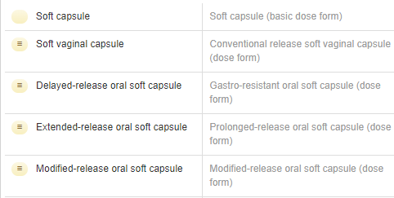

What have we got?
“Soft capsule” search result
“Hard capsule” search result
Notes:
SCT has different basic dose forms to EDQM

Slide 17
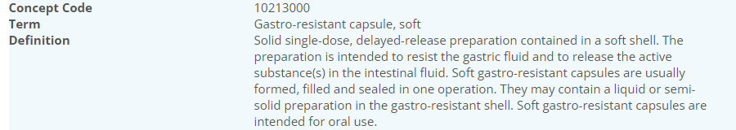
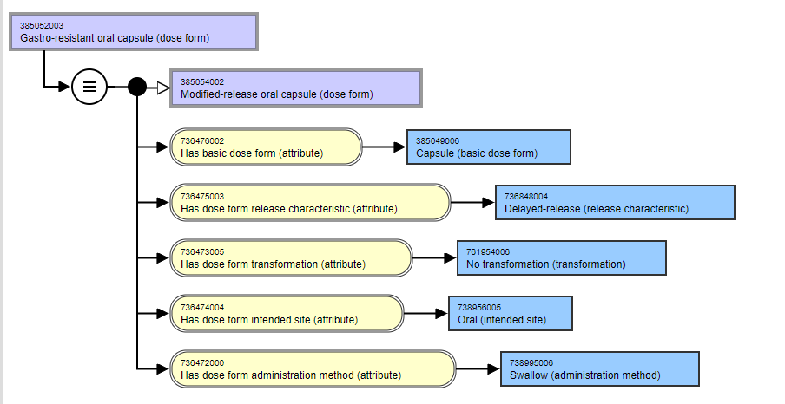
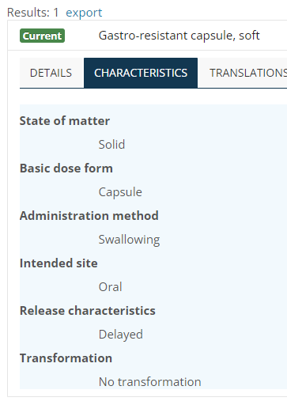
Oral capsules – hard or soft – an example

Slide 18
Lozenge – example of a *..*
10321000 | Lozenge | 764501003 | Conventional release oromucosal lozenge (dose form)
10322000 | Compressed lozenge | 764501003 | Conventional release oromucosal lozenge (dose form)
It’s a *..* because in SNOMED CT there is also “conv release buccal lozenge”

Slide 19
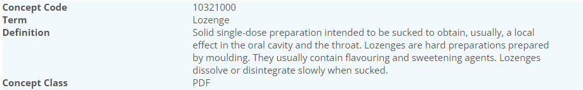
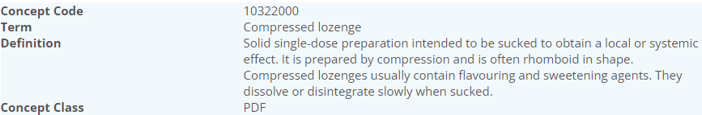
Lozenge – EDQM
In French, the translation “Compressed lozenge” is “Comprimé à sucer”
And Lozenge is “Pastille” – the difference is one of SHAPE
 | Basic DF | Admin method | Intended site | Rel Char | Transform
Lozenge | Lozenge | Sucking | Oromucosal | Conventional | No transformation
Compressed Lozenge | Lozenge | Sucking | Oromucosal | Conventional | No transformation

Slide 20
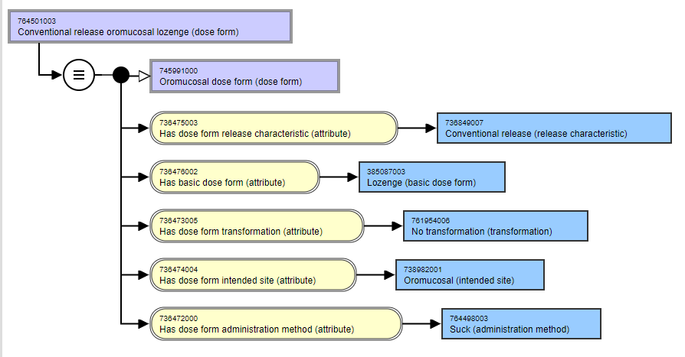
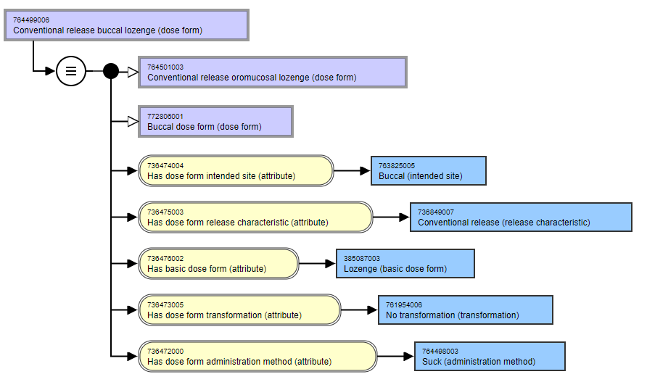
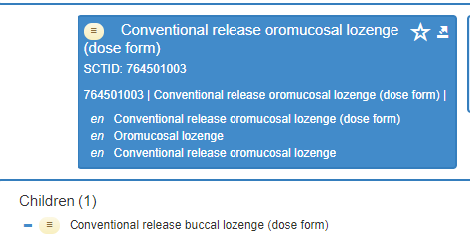
Lozenge – SNOMED CT

Slide 21
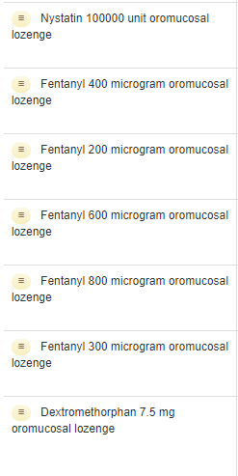
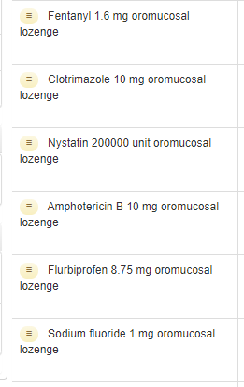
Lozenge CDs – SNOMED CT
All CDs use “oromucosal lozenge”
Anybody know any products that have “buccal lozenge”?

Slide 22



Slide 23

Next meeting on
Thursday 2nd December
at 11:00 UTC
NEXT STEPS
23

Slide 24


THANK YOU
SNOMED International: Delivering SNOMED CT

