Slide 1


SNOMED CT DEUSG Subgroup
EDQM Dose Form Mapping
Linda Bird, SNOMED International
Julie James, Blue Wave Informatics
Thursday 16th December 2021

Slide 2

Welcome
Spreadsheet update
Issues discussion
Next meeting
AGENDA
http://snomed.org/deusg
Notes:
What have you been doing and what have I been doing?

Slide 3

Next steps for the mapping

Slide 4
Spreadsheet update
New sheets/tabs in the main spreadsheet
The sheet that we have been working on is now “Map – Phase 1 Archive”
That sheet is now not being updated at all
New WIP is a copy of the Phase 1 sheet, but as rows are being sorted, they are moved from here to either:
Map RC 1 which is “Release Candidate 1” for our mapping OR
No match which is the set of EDQM concepts for which we have no map and currently no products, so we will not ask for new concepts in S-CT OR
Another sheet which is still “working” but on a specific topic….such as “Capsules”
As we sort through these topics, rows will move from a working sheet to either Map RC1 or to No match
  “Ophthalmic insert” has moved to RC1
  “Ear drops, powder for suspension” has moved to “No match”

Slide 5
Our documentation
Mapping Guidance:
https://confluence.ihtsdotools.org/display/USRG/Mapping+Guidance+for+EDQM+to+SNOMED+CT+Pharmaceutical+Dose+Form+Mapping
“EDQM discussion items” List
https://confluence.ihtsdotools.org/display/USRG/Issues+for+discussion+with+EDQM
“SNOMED CT discussion items” List
https://confluence.ihtsdotools.org/display/USRG/Issues+for+discussion+with+SNOMED+CT

Slide 6
Issues for discussion

Slide 7
Transdermal/Cutaneous
Check agreement that all straightforward
“Cutaneous” concepts can have an “exact match” can move to the RC1 list
And
“Transdermal” concepts can have an “exact match” can move to the RC1 list

Slide 8

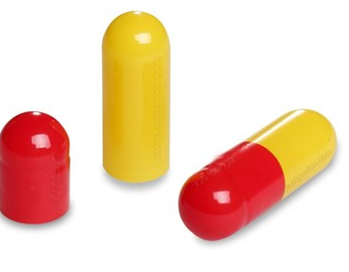
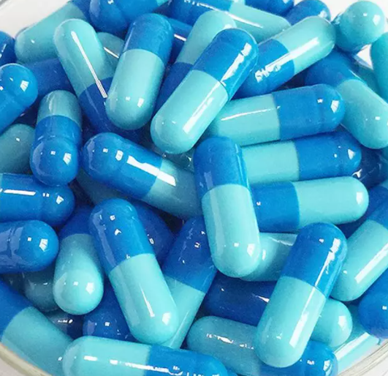
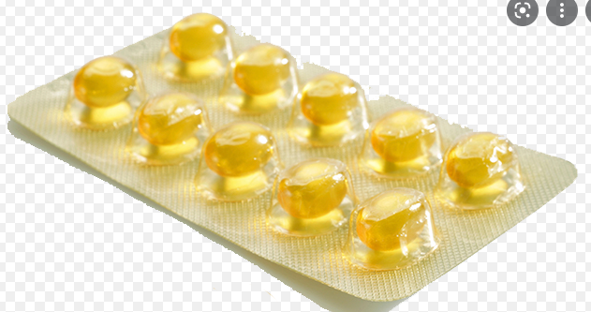
Pharmaceutical Dose Forms
Hard and Soft Capsules
December 2021 update

Slide 9
“Capsules” PDFs in EDQM:
10210000 | Capsule, hard | oral
10211000 | Capsule, soft | oral
10214000 | Chewable capsule, soft | oral
10212000 | Gastro-resistant capsule, hard | oral
10213000 | Gastro-resistant capsule, soft | oral
11113000 | Inhalation vapour, capsule | pulmonary
10217000 | Modified-release capsule, hard | oral
10218000 | Modified-release capsule, soft | oral
10317000 | Oromucosal capsule | oromucosal
10215000 | Prolonged-release capsule, hard | oral
10216000 | Prolonged-release capsule, soft | oral
11014000 | Rectal capsule | rectal
10910000 | Vaginal capsule, hard | vaginal
10911000 | Vaginal capsule, soft | vaginal

Slide 10
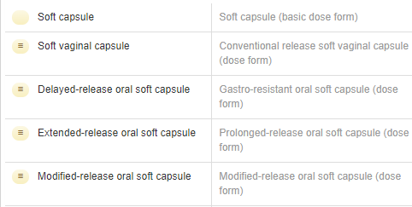

In SNOMED CT currently:
“Soft capsule” BDF
“Soft capsule” PDFs
This “imbalance” struck the group as a little unusual, since generally “hard capsules” are much more prevalent in products than “soft capsules”
“Hard capsule” BDF
“Hard capsule” PDF

Slide 11
Use cases for “hard” and “soft” capsules
For national extensions:
Acknowledgement that “prescribers do not care”
  Therefore, a representation of “capsules” is needed
BUT Pharmacists and those that administer medicines DO care
  Primarily because of divisibility and administration (open the capsule and sprinkle) for hard capsules, but not for soft capsules

Slide 12
Recommendation for “hard” and “soft” capsules
Agreed to request the additions and to leave modelling as is
For national extensions:
We do not want to “lose” the granularity of the “hard” and “soft” capsules because of its clinical use
  And we would like to be able to map 1..1 from EDQM to SNOMED CT
We recommend that there should be additional concepts in SNOMED CT for hard and soft capsules (for those PDFs that we know would be needed to describe existing products) and that the representation is “balanced” between hard and soft, especially as hard capsules are most often used
The existing “capsule” PDFs can act as a parent for the hard and soft capsule concepts and have much value in their own right
  Agreement from David (NZ) and Martha (NOR) and Linda
Keep the existing hard and soft basic dose forms with “capsule” as their parent
  Agreement from David (NZ) and Martha (NOR) and Linda
  Both IRE and NOR need to be able to use “capsule” when they have to describe imported medicines with minimal clinical information
There was general agreement/support on this – not just from European colleagues, but also from Pacific and American colleagues
BUT there is no equivalent to “capsule” in French; only a phrase that implies “choose which is appropriate” (Gélule ou capsule molle selon la forme pharmaceutique complète)
  Most products if the dose form is just « capsule » could (especially in France) be interpreted as « hard capsule »

Slide 13

Suggested Resolution 1
✓
The basic dose form stays “as is” so that the PDF capsule concepts can be fully defined

Slide 14

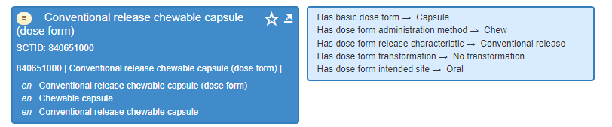
Suggested Resolution 2
We request two child concepts here:
“Conventional release oral soft capsule” and “Conventional release oral hard capsule”
Attributes for both:
Rel characteristic: conventional release
Intended site: oral
Admin method: swallow
Transform: no transform
AND
Basic dose form: soft capsule OR hard capsule as appropriate
For “chewable”, there is currently only this.
EDQM has only “chewable soft capsule”
Do we:
Ask for a new concept to be authored that is explicitly “chewable soft”?
The new concept should replace the current chewable capsule as current concept is “ambiguous”. There is no requirement for a grouper concept because a chewable hard capsule is an oxymoron
What about chew and swallow as methods? - Test
Products include an ibuprofen for children and a GTN product in Germany/Mexico

Slide 15
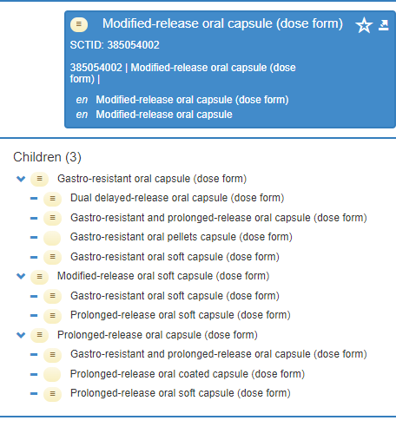
Suggested Resolution 3
We request child concepts :
“Gastro-resistant oral hard capsule”
“Prolonged-release oral hard capsule”
“Modified-release oral hard capsule”

Slide 16
Mapping guidance….
Map dose forms as explicitly as you can;
When you are authoring CDs/RCDs, be as explicit in the dose form attribute as you can
If you are unsure (e.g. the IRE ULMs), use the parent concept with the basic dose form of “capsule”

Slide 17

Word order….
Is it different in different concepts….or is it me?
These two look not to match the Ed Guide (to me at least)
Request a check on the consistency of this

Slide 18
Lozenge update:

Slide 19
Lozenge – example of a *..*
10321000 | Lozenge | 764501003 | Conventional release oromucosal lozenge (dose form)
10322000 | Compressed lozenge | 764501003 | Conventional release oromucosal lozenge (dose form)
It’s a *..* because in SNOMED CT there is also “conventional release buccal lozenge”

Slide 20
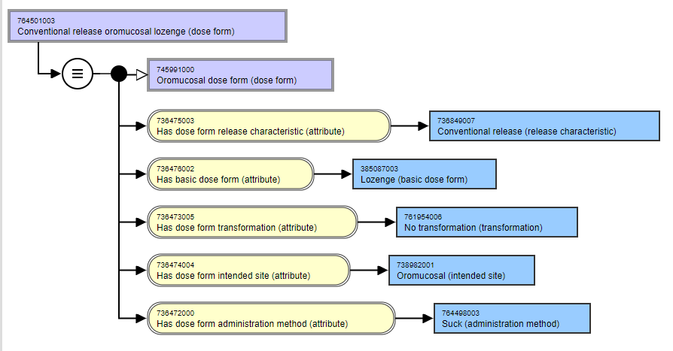
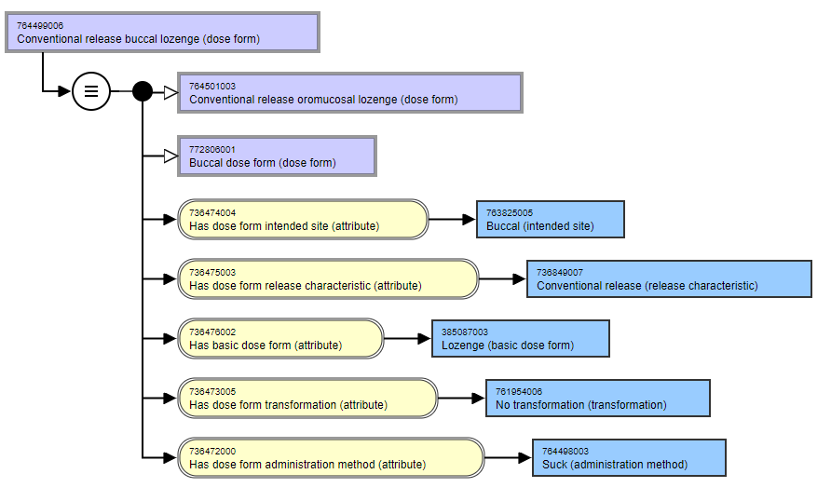
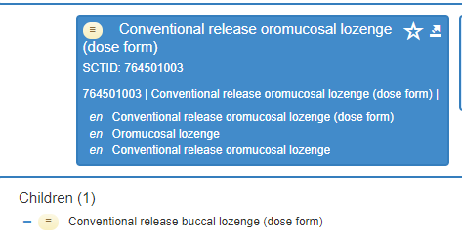
Lozenge – SNOMED CT

Slide 21
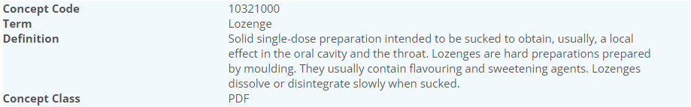
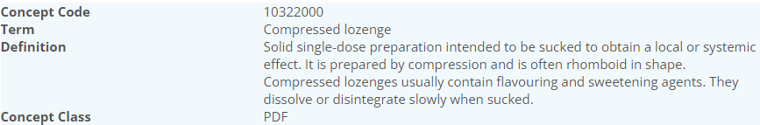
Lozenge – EDQM
In French, the translation “Compressed lozenge” is “Comprimé à sucer”
And Lozenge is “Pastille” – the difference is one of SHAPE
 | Basic DF | Admin method | Intended site | Rel Char | Transform
Lozenge | Lozenge | Sucking | Oromucosal | Conventional | No transformation
Compressed Lozenge | Lozenge | Sucking | Oromucosal | Conventional | No transformation

Slide 22
Lozenges update
From Chris at EDQM:
The concepts of ‘Lozenge’ and ‘Compressed lozenge’ are referred to in the Ph. Eur. monograph Oromucosal preparations (1807), and have slightly different tests applied to them. In particular, the compressed lozenges have to comply with some of the tests that apply to tablets (friability of uncoated tablets, resistance to crushing of tablets, dissolution of solid dosage forms), so there are some differences in that respect. In Standard Terms I would suggest that this is reflected mainly by the reference to ‘prepared by moulding’ for lozenges and ‘prepared by compression’ for compressed lozenges. In both cases they are intended to be sucked, rather than being directly swallowed as a ‘regular’ tablet would be. I agree that the reference to ‘rhomboid’ is not particularly necessary, but at least it is not a requirement (“often rhomboid in shape”) and was probably added to help users identify whether it was the appropriate term.

Slide 23
Possible resolution
Did we find any products that are “buccal lozenges”?
  I suspect not, as it’s not a standard term
Did we find any products that are “compressed lozenges”
  These used (in English) to be called “troches”
  YES – France has 30+ (cetirizine and vitamins etc.) And IRELAND - Nicotine, fentanyl (Actiq)
We map the EDQM “Lozenge” to SNOMED CT “oromucosal lozenge” with the logic that we are mapping an “oromucosal grouper DF concept” to an “oromucosal grouper DF concept”
We need a “compressed lozenge” concept in SNOMED CT
  What should we recommend for attributes if it is needed? Particularly for the basic dose form – as we would need the concept to be fully defined….
  Tablet as BDF might be possible, but this would affect the classification of the grouper, and we have chewable tablet already

Slide 24
From our last set of email slides…

Slide 25

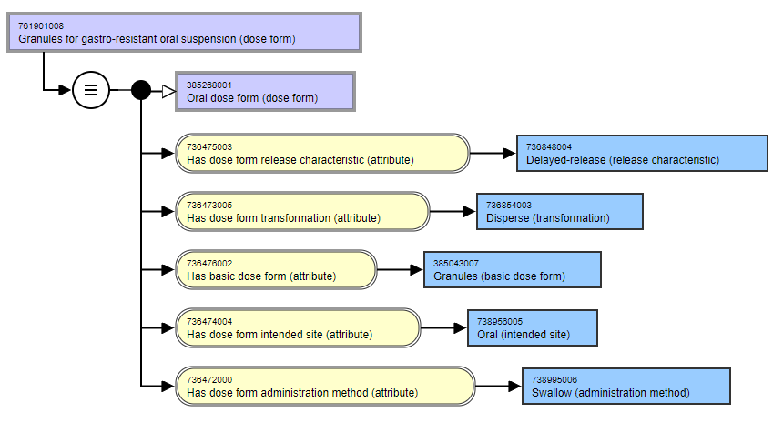
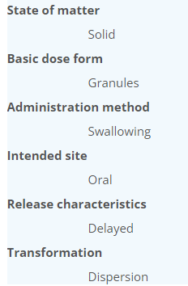
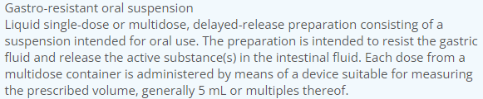
EDQM Code | English Name | SCTID | Fully Specified Name | Cardinality | Association | Attribute Match | Comments
50026000 | Gastro-resistant granules for oral suspension | 761901008 | Granules for gastro-resistant oral suspension (dose form) | 1..1 | Exact match | Yes | Wording different but it is the same meaning?
Do we think that the S-CT concept is an exact match?
If “no” – what would be better?
“Gastro-resistant granules for gastro-resistant oral suspension”?
Or same as EDQM Term? Or something else?

Slide 26
Group thoughts
Tara | I would think these are exact matches. I prefer the EDQM term. I do not like the S-CT wording. I prefer the EDQM version. Gastro-resistant granules for oral suspension The other option “Gastro-resistant granules for gastro-resistant oral suspension” seems unnecessarily long.
Olivier | “Gastro-resistant granules for gastro-resistant oral suspension” is most accurate Suggest that if we accept this (or presumably another wording) the existing S-CT concept should be inactivated, then we can get an exact match
David | EDQM term is less clumsy; exact match
Elisabeth | Gastro-resistant granules for oral suspension preferred
By saying that the granules themselves are GR, then the (resulting) suspension itself must also be
We therefore suggest a description change to match the EDQM and to be most accurate for the FSN which is the term anchor. So the existing concept will have to be inactivated as “ambiguous” and re-authored with a “replace” relationship

Slide 27

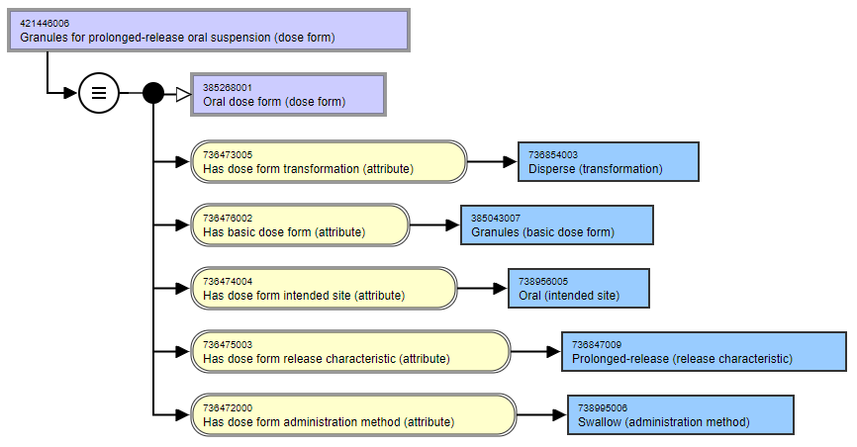
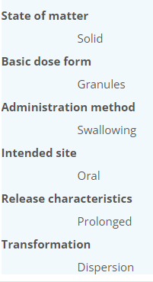
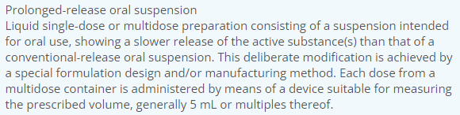
EDQM Code | English Name | SCTID | Fully Specified Name | Cardinality | Association | Attribute Match | Comments
50056000 | Prolonged-release granules for oral suspension | 421446006 | Granules for prolonged-release oral suspension (dose form) | 1..1 | Exact match | Yes | Wording different but it is the same;
Do we think that the S-CT concept is an exact match?
If “no” – what would be better?
“Prolonged-release granules for prolonged-release oral suspension”? Or same as EDQM Term? Or something else?

Slide 28
Group thoughts
Tara | Again, I agree these are exact matches, but would rather have the EDQM wording.
Olivier | Prolonged-release granules for prolonged-release oral suspension – then exact match
David | Prefer the SNOMED term; current EDQM term open to interpretation; is an exact match for mapping
Elisabeth | Prolonged-release granules for oral suspension preferred

Slide 29
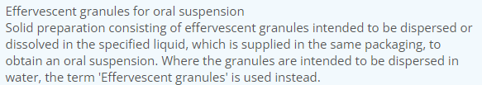
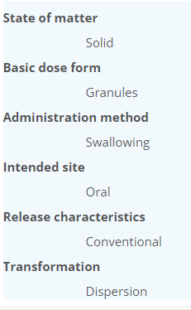
EDQM Code | English Name | SCTID | Fully Specified Name | Cardinality | Association | Attribute Match | Comments
13007000 | Effervescent granules for oral suspension |  |  | 1..0 | no match |  | BDF in SNCT "Effervescent oral granules" and "Granules for oral suspension" but no "Effervescent granules for oral suspension"
Any products?
Dukoral? https://www.medicines.org.uk/emc/product/5087/smpc
IRE and FR and NZ: only Dukoral
But Elisabeth notes that this product really uses a “combined term” with the oral suspension to dissolve the granules in
NZ also Presept (troclosene) a disinfectant so possibly not “a medicine”

Slide 30
Oromucosal dose forms
From our 21st October meeting: “This makes the EDQM “oromucosal” similar to the SNOMED CT “oromucosal” – both act as grouper concepts. We can therefore make 1..1 matches between the oromucosal, sublingual and buccal concepts in EDQM and SNOMED CT without being concerned by these exclusion statements “altering” concept meaning”
However, we have some “missing” oromucosal dose forms
EDQM Code | English Name | UK Products | IRE Products | FR Products | FR and other Products
10314005 | Oromucosal ointment |  |  |  | SANODIN (Spain) - carbenoxolone
10314010 | Oromucosal cream |  |  | 3 products | DYNEXANGIVAL 1 % (lidocaine)
10309100 | Sublingual spray, emulsion | ?a melatonin product? | ULM – a melatonin sleep spray
10309300 | Sublingual spray, suspension
10317000 | Oromucosal capsule |  |  |  | Orofar Parels (Belgium) (lidocaine)
13141000 | Oromucosal pouch | Nicovel Mint 2 mg oromucosal powder in pouch (nicotine) |  | No French translation (!)
13149000 | Oromucosal film
50039000 | Oromucosal patch |  |  | No French translation (!)
13026000 | Powder for gingival gel |  |  | No French translation (!)

Slide 31
EDQM Code | English Name | SCTID | Fully Specified Name | Cardinality | Association | Attribute Match | Comments
10315000 | Gingival gel | 385081002 | Conventional release gingival gel (dose form) | 1..1 | Exact match | No | S-CT says intended site is gingival, EDQM says intended site is oromucosal S-CT says intended site is gingival, EDQM says intended site is oromucosal
10316000 | Gingival paste | 385082009 | Conventional release gingival paste (dose form) | 1..1 | Exact match | No | S-CT says intended site is gingival, EDQM says intended site is oromucosal S-CT says intended site is gingival, EDQM says intended site is oromucosal
10309200 | Sublingual spray, solution | 763340003 | Conventional release solution for sublingual spray (dose form) | 1..1 | Exact match | no | edqm: ISI = oromucosal, broader than sublingual sct: ISI = sublingual, sibling of oromucosal in SCT hierarchy
10312000 | Gingival solution | 385077002 | Conventional release gingival solution (dose form) | 1..1 | Exact match | No | EDQM = Oromucosal S-CT = Gingival
10314011 | Buccal film | 443424002 | Conventional release buccal film (dose form) | 1..1 | Exact match | no | SCT uses buccal, EDQM uses oromucosal as intended site. SCT and EQDM both have a term that can overlap: 447050008 Conventional release orodispersible film (dose form)
10318000 | Sublingual tablet | 385084005 | Conventional release sublingual tablet (dose form) | 1..1 | Exact match | No | Sublingual/Oromucosal
Proposal: to transfer these to the “Release” spreadsheet as Exact match as the attribute match is “No” because the SNOMED CT site is more specific than the EDQM site
Group thoughts: Tara – agree; Oliver – agree; David - agree

Slide 32



Slide 33

Next meeting on
Thursday 13th January 2022
at 10:00 UTC
NEXT STEPS
33

Slide 34


THANK YOU
SNOMED International: Delivering SNOMED CT

