Slide 1

Nursing Clinical Reference Group Meeting
January 11, 2022 2000 UTC
Ian Green 17th, March 2020

Slide 2
Agenda
01
04
Welcome and Introductions
Christine Spisla/Erica Culp
5 minutes
Group Discussion: NANDA-I/Pain Value set
Christine Spisla/Erica Culp
30 minutes.
02
05
SNOMED International News/ Updates
Jane Millar/Ian Green
Call for future Nursing CRG discussion topics
Christine Spisla/Erica Culp
5 minutes
03
Terminology Consultation
Cathy Richardson

Slide 3
Nursing Clinical Reference Group
The SNOMED CT Nursing Clinical Reference Group aims to provide a global forum for the nursing community and clinicians interested in nursing. The role of all Clinical Reference Groups is to provide a forum to discuss issues, and influence the development and improvement of content in SNOMED CT.
The SNOMED CT Nursing Clinical Reference Group aims to represent the needs of nursing and clinical nursing documentation in SNOMED CT and support terminology development that will drive implementation of nursing focused SNOMED CT globally.

Slide 4
SNOMED International updates….

Slide 5
Terminology Consultation….

Slide 6
Pain Assessment value set…..
Recap of December’s Nursing CRG meeting
Discussion Topic: U.S validated and refined value set for pain assessment. https://www.ncbi.nlm.nih.gov/pmc/articles/PMC5851787/
Discussion Content:
Review of Value set: pain quality, pain type, pain onset, pain course and body site.
Discussion areas: How detailed should an international Pain assessment be? What are the inclusion criteria for international relevance? What pain assessment values are required vs recommended? How should the outcome of a pain assessment be standardized?
Discussion Purpose: Identifying terminology that is internationally relevant. Match corresponding SCT-terms and or suggest new SCT-terms for those identified terms.

Slide 7
Pain Assessment value set…..
Discussion Next Steps Feb 2022
Review terminology value set in small parts, starting with “Pain Quality”. Review 5 terms per meeting.
Review SNOMED CT requirements for inclusion criteria in the international. See https://confluence.ihtsdotools.org/display/DOCSTART/9.+Content+Development
Identify and gather group members national/organizational requirements regarding Pain assessment.

Slide 8
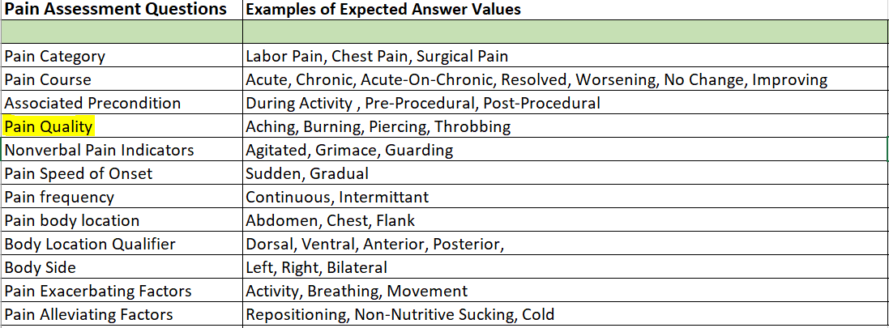
Pain Assessment value set…..

Slide 9
Call for new Nursing CRG Discussion Topics
Recap of December’s Nursing CRG meeting
Discussion Topic: Request review of new NANDA-I terms for inclusion in Snomed CT
Discussion Content:
Group member request review of new NANDA-I terms to be discussed.
Discussion Purpose: Identifying terminology that is internationally relevant. Match corresponding SCT-terms and or suggest new SCT-terms for those identified terms.

Slide 10
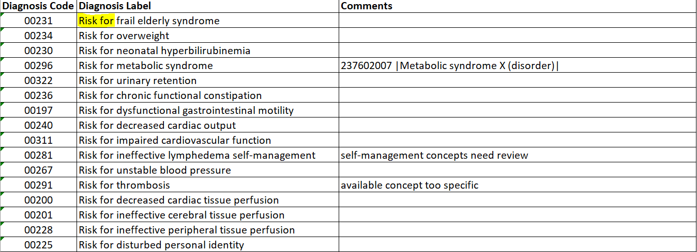
New NANDA-I terms for inclusion in Snomed CT
Discussion Next Steps Feb 2022
Review terminology in small parts, starting with “Risk for”. Review 5 terms per meeting.

Slide 11
January Open Discussion…..
New NANDA-I terms for review
Continuation of U.S value set for pain assessment

Slide 12
Thank you for participating
We look forward to seeing you at our next Nursing CRG Meeting
February 8th 2022 2000 UTC
Christine and Erica

