Slide 1
Social Determinants of Health: Observables
James R. Campbell
Carol R Geary
University of Nebraska Medical Center
Omaha, NE, USA

Slide 2
Social Determinants of Health: Observable Datasets
“Social determinants of health (SDOH) are the conditions in the environments where people are born, live, learn, work, play, worship, and age that affect a wide range of health, functioning, and quality-of-life outcomes and risks”
Healthy People 2030; USHHS-Office of Disease Prevention and Health Promotion

Slide 3
SDOH Domains (HP2030)
Economic Stability
Education Access and Quality
Healthcare Access and Quality
Community, Neighborhood and Built Environment
Social and Community Context
Datapoints regarding Personal Social Roles and Characteristics and/or Community Infrastructure and Attitudes

Slide 4
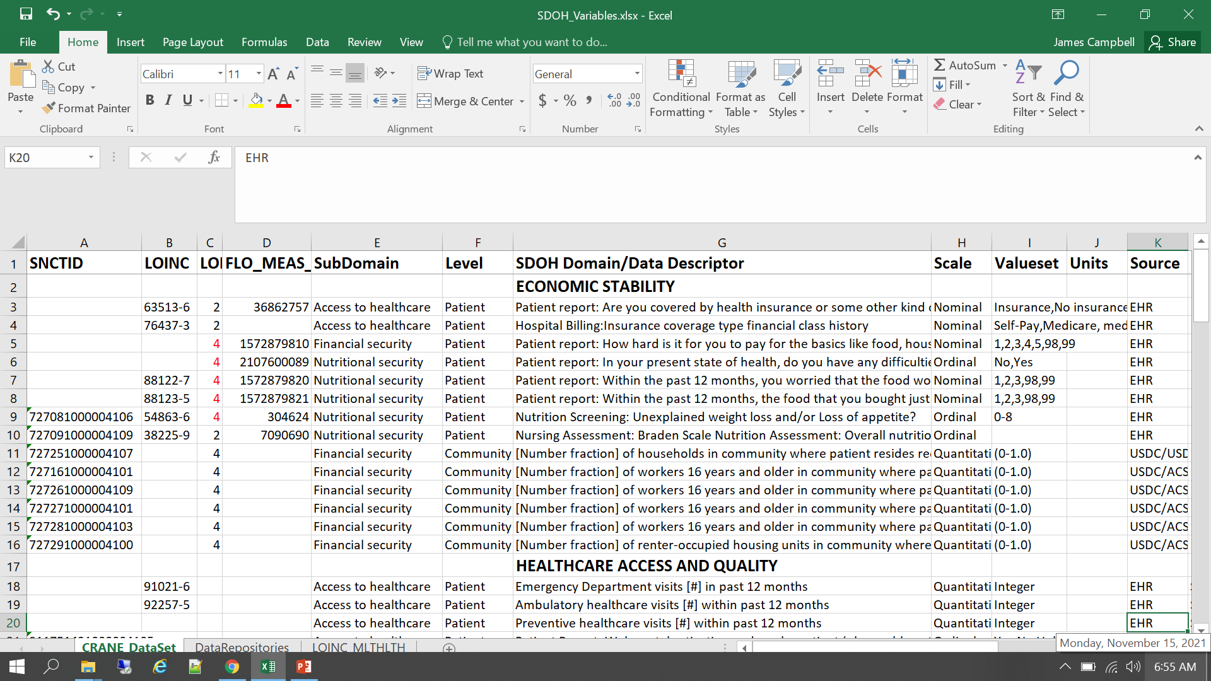
SDOH: Data Inventory

Slide 5
Patient-Level Data Points
Sources: EHR, Patient assessment scales and surveys, Patient-reported outcomes
What was my gender assigned at birth?
Nutritionist screening: Have you lost weight or lost your appetite?
Patient report: What is the highest grade of schooling [Achievement] that you have completed?

Slide 6
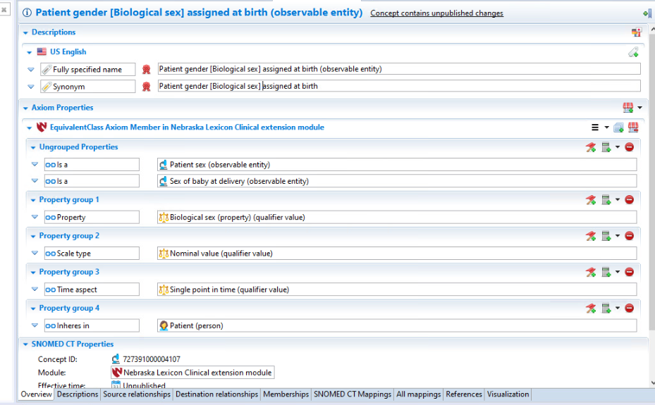
Patient gender [Biological sex] assigned at birth (observable entity)

Slide 7
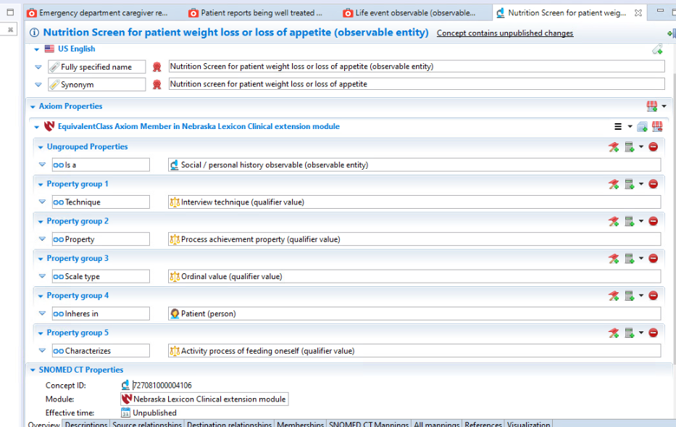
Nutrition screen for patient weight loss or loss of appetite (observable entity)

Slide 8
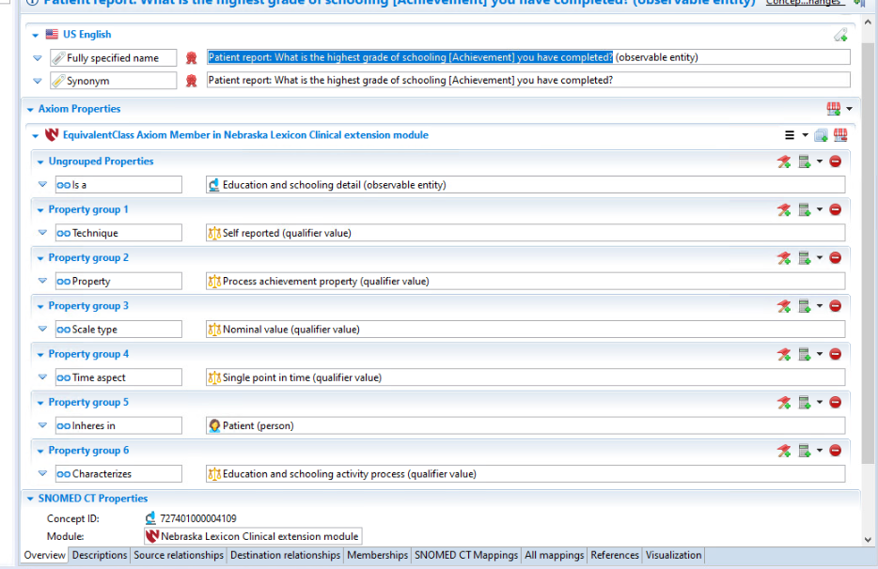
Patient report: What is the highest grade of schooling [Achievement] that you have completed (observable entity)

Slide 9
Community-Level Data Points
Sources: DOC American Community Survey, DOA RUCA class, DOA Food Access maps, DOJ Crime statistics,
What is the number of families in my community who receive food stamps/SNAP?
What is the number of adults in my community who live below the poverty level?
How easy is it to get to the doctor’s office from my home?

Slide 10
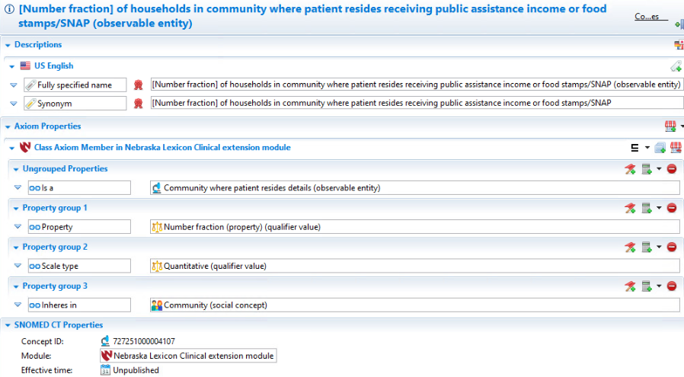
[Number fraction] of households in community where patient resides receiving public assistance income or food stamp/SNAP (observable entity)

Slide 11
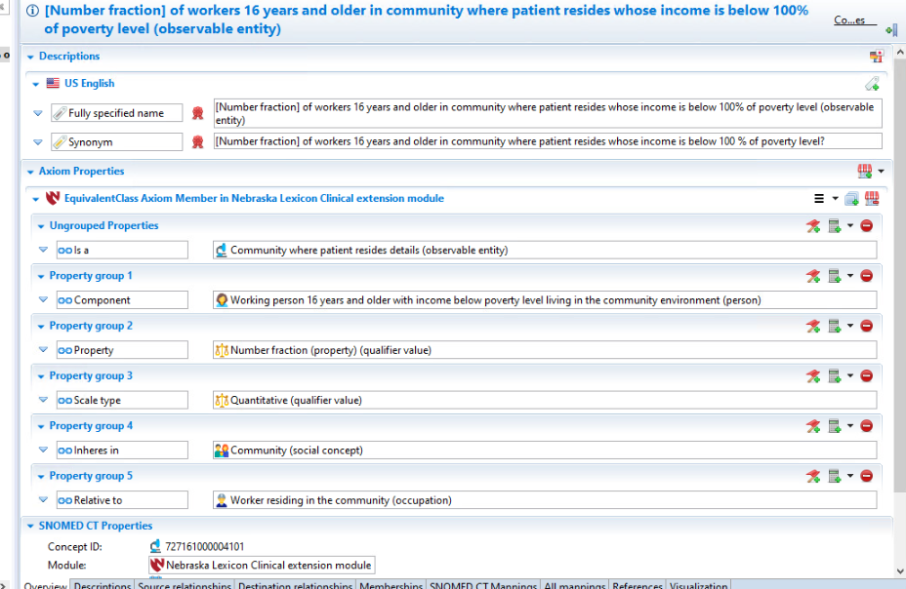
[Number fraction] of workers 16 years and older in community where the patient resides whose income is below 100% of poverty level (observable entity)

Slide 12
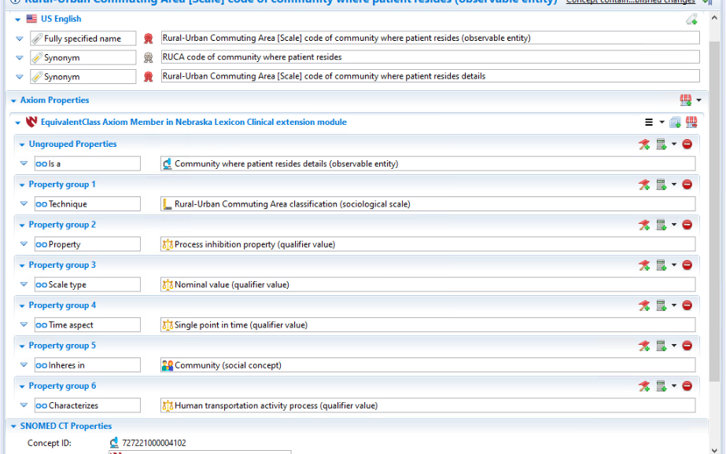
Rural-Urban Commuting Area [Scale] code of community where patient resides (observable entity)

Slide 13
Issues for Observables
Expand MRCM concept model valuesets for Component and Relative_to to include Social concepts
Expand Process and Property Qualifier hierarchies to include sociological processes

