Slide 1

Nursing Clinical Reference Group Meeting
November 9, 2021 2000 – 2100 UTC
Ian Green 17th, March 2020

Slide 2
Agenda
01
04
Welcome and Introductions
Christine Spisla/Erica Culp
5 minutes
Call for future Nursing CRG discussion topics
Christine Spisla/Erica Culp
20 minutes.
02
SNOMED International News/ Updates
Jane Millar/Ian Green
10 minutes
03
SNOMED CT Nursing Terms for Review
Christine Spisla/Erica Culp
30 minutes

Slide 3
Nursing Clinical Reference Group
The SNOMED CT Nursing Clinical Reference Group aims to provide a global forum for the nursing community and clinicians interested in nursing. The role of all Clinical Reference Groups is to provide a forum to discuss issues, and influence the development and improvement of content in SNOMED CT.
The SNOMED CT Nursing Clinical Reference Group aims to represent the needs of nursing and clinical nursing documentation in SNOMED CT and support terminology development that will drive implementation of nursing focused SNOMED CT globally.

Slide 4
SNOMED CT Nursing Activities Reviewed…….
Nursing Activities Reference Set (planned for depreciation)
884 concepts
18 concepts are not included in the 2021 ICNP simple reference set
  14 concepts previously included in 2018 ICNP refset and excluded from 2021 ICNP
  4 concepts not included in 2018 or 2021 ICNP refset and are present in the nursing subontology.

Slide 5
SNOMED CT Terms for Discussion
SCTID | Preferred Term | Acceptable Term | Sem Tag
11429006 | Consultation | N/A | procedure
225285007 | Giving oral fluid | Oral fluid therapy | procedure
370853001 | Screening for physical abuse | Screens for physical abuse | procedure
700230007 | Screening for child sexual abuse | N/A | procedure
SCTID | Preferred Term | Acceptable Term | Sem Tag
11429006 | Consultation | N/A | procedure
225285007 | Giving oral fluid | Oral fluid therapy | procedure
370853001 | Screening for physical abuse | Screens for physical abuse | procedure
700230007 | Screening for child sexual abuse | N/A | procedure

Slide 6
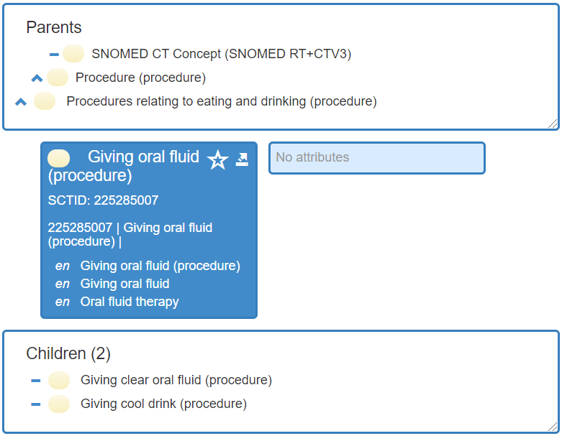
SNOMED CT Term Review

Slide 7
What do we know about Giving oral fluid (procedure)?
It’s a procedure: an activity performed in the provision of health care.
It’s effective time is 20020131
It’s primitive aka not sufficiently defined
It “is a” Procedures relating to eating and drinking (procedure)
It has no additional defining attributes
It has a synonym: Oral fluid therapy with an effective time of 20170731
It has two children: Giving clear oral fluid and Giving cool drink
It’s part of Global Patient Set, Nursing Activities Refset and CTV3 simple map
It’s most recent change was 20190731
It is a ”has focus” attribute for: Oral fluid therapy assessment, Oral fluid therapy education, and Oral fluid therapy management

Slide 8
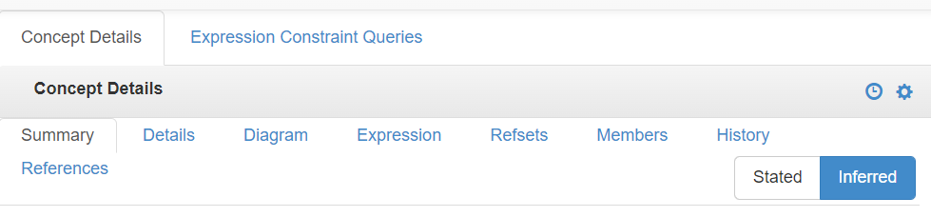
Where is this information found?
Effective time
Reference set membership
Historical changes
Referenced relationships and attributes

Slide 9
What do we need to know?
Are there any similar descriptions in SNOMED CT?
What are the relevant nursing use cases for this concept?
Is this relevant to other clinical reference groups?

Slide 10
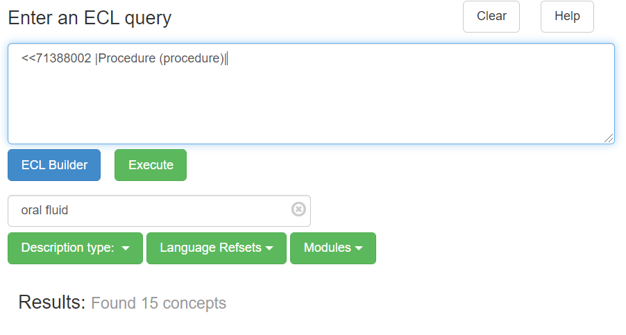
Searching for similar descriptions
Are there any similar descriptions in SNOMED CT?
  ECL search

Slide 11
Let’s discuss: Giving oral fluid…..
Discussion points provide by group members:
This could be a term easily used by nursing assistants or in elderly care homes as stated as a way to indicate someone has been given fluids by mouth.
One could interpret the synonym “oral fluid therapy” as the order and giving oral fluids as the flowing action. Also “giving clear oral fluids” was previous discussed as a possible way to denote (that a patient is only allowed clear oral fluids)
A term’s context is based on it’s placement with in the EHR. For example, if giving clear oral fluids is placed and used with in a perioperative documentation it’s context would denote a patients intake prior to surgery as being clear fluids.
Since giving oral fluids is a standard in most situations, a better capture of information would be the explicit restriction/denial of oral fluids or the absence of cloudy oral fluid intake prior to surgery.
Giving oral fluids and oral fluid therapy don’t seem to be synonyms. Oral fluid therapy has also been used as an intervention in pediatric syncope, however in some case the protocol was similar to Oral hydration therapy?

Slide 12
Other SNOMED Concepts for Review/Discussion
SCTID | Fully Specified Name | Semantic Hierarchy Tag | Useful concept? | RN CRG Comments
25953003 | Colostomy management and care | regime/therapy
133917009 | Bonding encouragement | procedure
225884000 | Talking about dying | regime/therapy
226005007 | Care of central line | procedure
275840002 | Preventing spread of infection | procedure
370814005 | Identification of presence of implantable cardiac devices | procedure
386375006 | Oral health maintenance | regime/therapy

Slide 13
Other SNOMED Concepts for Review/Discussion
SCTID | Fully Specified Name | Semantic Hierarchy Tag | Useful concept? | RN CRG Comments
396071005 | Patient education regarding Patient Bill of Rights | procedure
396079007 | Assessment of adverse drug reactions | procedure
408880004 | Nausea care assessment | procedure
430880004 | Self-confidence enhancement | procedure
439035007 | Education about sleep hygiene behavior | procedure
440169004 | Education of school staff about medical condition of subject | procedure
714410006 | Assessment of impact of illness on roles | procedure

Slide 14
Next Actions …..
  Send list of possible terms for review to ICNP editorial board. Nursing CRG would like to be helpful in reviewing these if needed in the future.
  Summarize today’s discussion about 225285007 Giving oral fluid and post as a discussion post.

Slide 15
Thank you for participating
We look forward to seeing you at our next Nursing CRG Meeting
December 14th 2021 2000 UTC
Christine and Erica

