Slide 1


SNOMED CT DEUSG Subgroup
EDQM Dose Form Mapping
Linda Bird, SNOMED International
Julie James, Blue Wave Informatics
Thursday 7th October 2021

Slide 2

Welcome
Mapping activity and policy
Next meeting
AGENDA
http://snomed.org/deusg
Notes:
What have you been doing and what have I been doing?

Slide 3

Mapping Activity
and Policy

Slide 4
What have I been doing?
Gathering all our mapping guidance together in one place:
https://confluence.ihtsdotools.org/display/USRG/Mapping+Guidance+for+EDQM+to+SNOMED+CT+Pharmaceutical+Dose+Form+Mapping
Listing our “EDQM discussion items”
https://confluence.ihtsdotools.org/display/USRG/Issues+for+discussion+with+EDQM
Listing our “SNOMED CT discussion items”
https://confluence.ihtsdotools.org/display/USRG/Issues+for+discussion+with+SNOMED+CT
And collating information and preparing for today :)

Slide 5
What have you been doing?
Your general thoughts, feedback and comments, please….
Anything practical, or technical….
Then, specific issues in the mapping itself

Slide 6
13076000: Prolonged-release solution for injection
Row 9 - Tara
S-CT has a prolonged release oil for injection and a prolonged release suspension for injection but not a prolonged release solution for injection.
I found a centralised product Buvidal, which is a prolonged release solution for injection, formulated as weekly or monthly depots.
“When injected into the subcutaneous (SC) or intramuscular (IM) tissue, the Fluid Crystal formulation absorbs interstitial aqueous body fluid and transforms from liquid to highly viscous (>>106 mPas) liquid crystal (LC) (or gel-like) phases in situ, which effectively encapsulate the active substance. This results in a slow and consistent release of buprenorphine, which can be controlled for a
week or a month depending on the composition.”
I am not sure about this...the product is not prolonged release until after it is injected? “

Slide 7
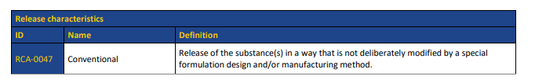
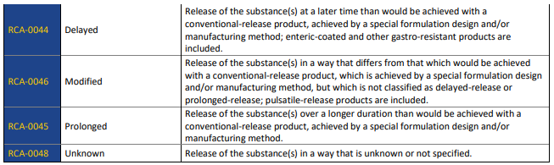
What does “prolonged release” mean?
https://www.edqm.eu/sites/default/files/standard_terms_internal_vocabularies_for_pharmaceutical_dose_forms.pdf

Slide 8
11211500: Powder for dispersion for infusion
Row 14 - Tara
EDQM definition is Solid sterile preparation consisting of one or more powders, including freeze-dried powders, intended to be dispersed in the specified liquid to obtain a dispersion for infusion.
S-CT does not have any dose forms that include the word 'dispersion'.
Example of product - Ambisome liposomal - do we need this concept? Could it be called a suspension..?? Difference between a solution and a dispersion and a suspension - discuss?

Slide 9
What is a dispersion? (in chemistry)
A system in which distributed particles of one material are dispersed in a continuous phase of another material. The two phases may be in the same or different states of matter.
Solution - a homogeneous mixture where the dispersed particles will not settle if the solution is left undisturbed for a prolonged period of time (complete miscibility). Dispersed particle size is of molecular dimensions and the particles do not scatter light and are not separable by filtration (but can be by distillation)
Colloid (colloidal suspension) - heterogeneous mixture where the dispersed particles (which may be liquid or solid) have at least in one direction a dimension roughly between 1 nm and 1 µm. Colloid particles do scatter light
Non-colloidal suspension - heterogeneous dispersion of larger particles in a medium. Unlike solutions and colloids, if left undisturbed for a prolonged period of time, the suspended particles will settle out of the mixture

Slide 10
More dispersions (in chemistry)
Aerosol - a liquid dispersed in a gas
Emulsion - a liquid dispersed in a liquid (more specifically a dispersion of two immiscible liquids) usually stabilised by an emulsifier. It will “scatter light” - often on the bluish spectrum
Gel - a liquid dispersed in a solid
In chemistry, an emulsion is a type of (usually colloidal) suspension

Slide 11
What is a dispersion? (in pharmaceutics)
EDQM Basic dose form DISPERSION: A type of liquid pharmaceutical dose form consisting of one or more substances, excluding solid particles and large liquid droplets, that are dispersed in an appropriate liquid vehicle. Liposomes, microbubbles, cells and colloidal dispersions (droplets with a nominal diameter less than approximately 1 micrometre in size) are included; for solid particle dispersions, see 'Suspension; for non-miscible, large-droplet liquid dispersions, see 'Emulsion’.
EDQM Transformation DISPERSION: Transformation of a solid or gas into a dispersion or suspension by mixing it with a specified liquid.

Slide 12
What about the other concepts?
EDQM Basic dose form EMULSION: A type of liquid pharmaceutical dose form consisting of a stable dispersion of non-miscible liquids; it consists either of oil droplets in an aqueous continuous phase (oil-in-water emulsion) or aqueous droplets in an oily continuous phase (water-in-oil
emulsion); for colloidal dispersions (droplets with a nominal diameter less than
approximately 1 micrometre in size), see 'Dispersion'.
EDQM Transformation SOLUTION: A type of liquid pharmaceutical dose form consisting of one or more substances dissolved in, or miscible with, an appropriate solvent, forming a single-phase liquid
EDQM Transformation SUSPENSION: A type of liquid pharmaceutical dose form consisting of one or more substances dispersed in a liquid vehicle; the dispersed substance(s) are solid particles that are
practically insoluble in the vehicle.

Slide 13
Dispersion: Thoughts and Comments
The concepts in chemistry are a bit different from the concepts in pharmaceutics
Solution, suspension and emulsion are well understood; how does dispersion fit?
What value does it bring?
“Liposomes, microbubbles, cells and colloidal dispersions are included”
Liposomes are mixture substances (ISO 11238) so we have some “overlap” here
Microbubbles….used in some imaging techniques and products
Cells….not usually medicinal products
Colloidal dispersions….?
Notes:
Colloidal dispersions are non-settling suspensions, based on particle size - why not call them what they are, rather than the parent term

Slide 14
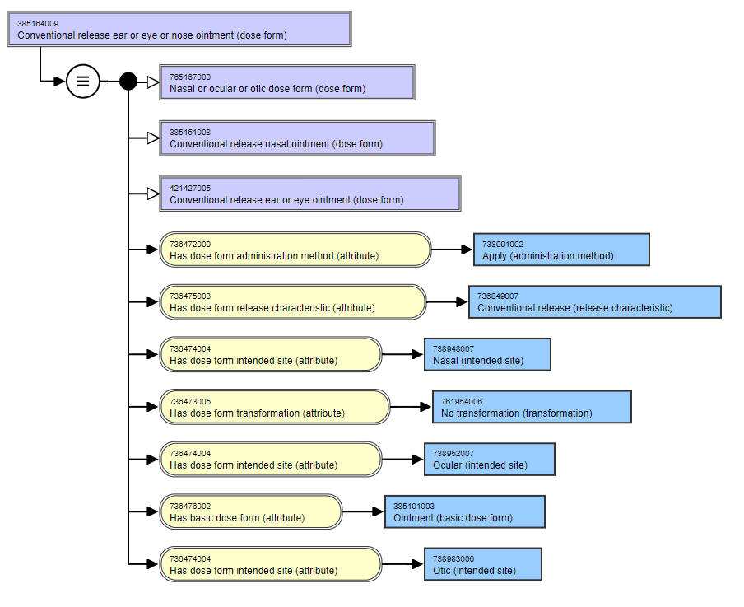
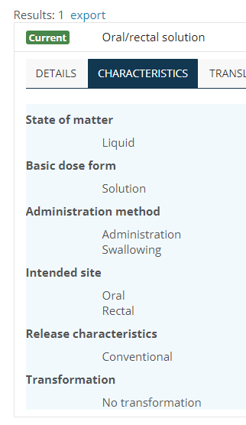
50037900: Oral/rectal solution
Row 144 - Olivier
EDQM: intended dual site in name reflected in ISI property
S-CT: no intended dual site (but see ear or eye ointment)

Slide 15
Multiple site dose forms: Thoughts and Comments
What is the purpose of “intended site”?
In EDQM?
In SNOMED CT?
What do we feel is the value of “intended site” for our users?
What is our recommendation….
….especially bearing in mind our use cases and the expressed requirement for “consistency of approach” from the DEUSG
Notes:
The difference between “intended site” and “route of administration”

Slide 16
50039500: Oromucosal/laryngopharyngeal solution
Row 140 - Olivier
EDQM: excluded spray solution ; AME = administration
EDQM: dual ISI oromucosal OR laryngopharyngeal
SCT: no laryngopharyngeal intended site ; AME = apply
SCT: oropharyngeal intended site exists
Two issues (at least):
“solution” and “spray, solution”
Oromucosal and Laryngopharyngeal - to be looked at separately next time :)

Slide 17
“solution” and “spray, solution”
Similar challenge to “solution” and “drops, solution”
Both “drops” and “spray” can be basic dose forms (!) if the solution/emulsion/suspension is not specified

Slide 18
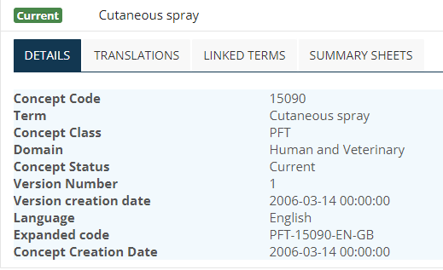
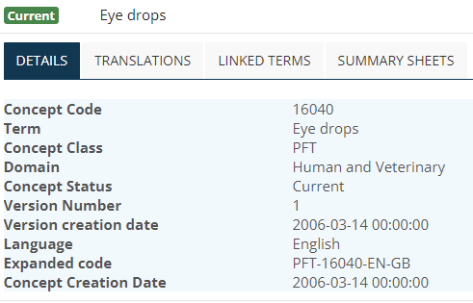
“spray” and “drops” in PFTs in EDQM
“Spray” and “drops” can be combined with an intended site to give a PFT:, but since no basic dose form (or any other characteristics) are given for PFT, these are not grouper concepts as such (or are they)?

Slide 19
“Spray (unspecified)” and “drops (unspecified)” used in PDFs in EDQM
“Spray (unspecified)” appears not to be used in human PDFs
“Drops (unspecified)” is used twice:
EDQM Code | English Name | Definition | Administration Method
10307000 | Oromucosal drops | Liquid, usually multidose preparation consisting of a solution, suspension or emulsion intended for oromucosal use. Oromucosal drops are administered by instillation into the oral cavity or onto a specific part of the oral cavity. | Instillation
10609000 | Eye drops, prolonged-release | Liquid sterile single-dose or multidose preparation intended for ocular use. The active substance is released over an extended period of time. | Instillation

Slide 20
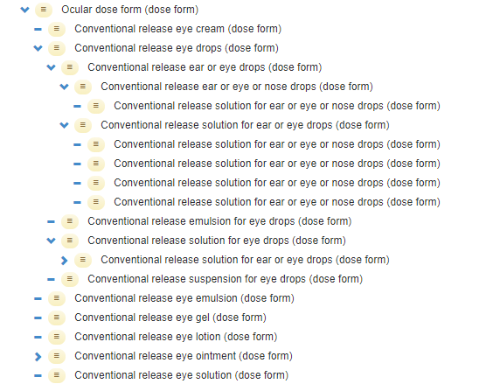
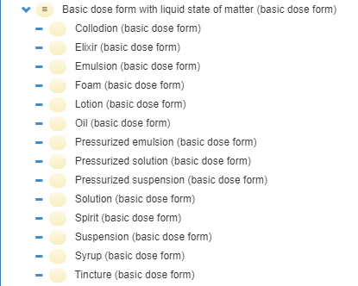
SNOMED CT (using ocular, as it is easier to see - no pun intended)
“Spray (unspecified)” appears not to be used in human PDFs
“Drops (unspecified)” is used twice:

Slide 21
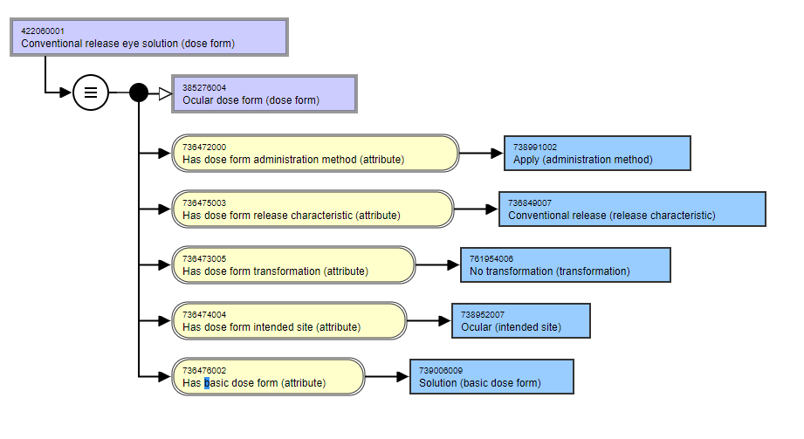
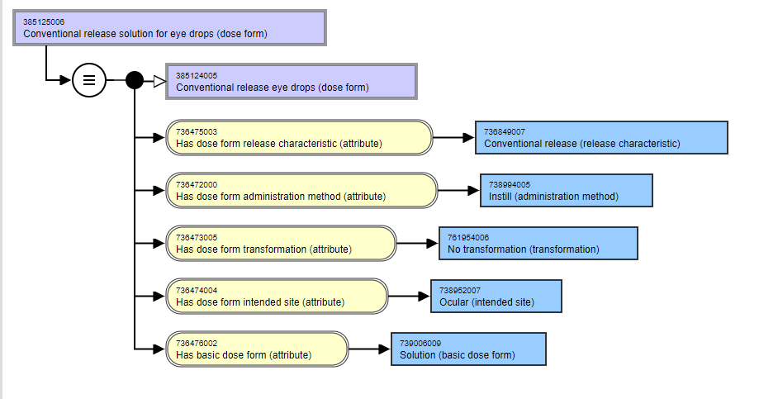
Conventional release solution for eye drops (dose form) and Conventional release eye solution (dose form)
Notes:
There appears to be no relationship between these….should there be? Should one be a child of the other? That depends on how the hierarchy is built….
The difference is between “apply” and “instill”
A spray will have “spray” as the admin method

Slide 22
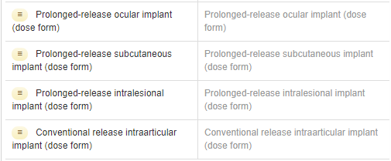
13027000: Powder for implantation matrix
Row 216 - Martha
EDQM definition is Solid sterile preparation consisting of one or more powders, including freeze-dried powders, intended to be used in the preparation of an implantation matrix, e.g. by dissolving in the specified liquid to prepare the solution used to impregnate the matrix.
S-CT focuses on where the implant "goes" (intralesional, subcutan). EDQM focuses on what the implant is (implant, matrix, tablet, chain, paste etc)

Slide 23
Implants as dose forms
Not easy dose forms to deal with….because….
What are the relevant / important things for describing implant dose forms …. Especially for patient care use cases…..

Slide 24
Any more to discuss…?

Slide 25
Next Steps

Slide 26


Slide 27

Next meeting on
Thursday 21st October
at 10:00 UTC
NEXT STEPS
‹#›

Slide 28


THANK YOU
SNOMED International: Delivering SNOMED CT

