Slide 1


SNOMED CT DEUSG Subgroup
EDQM Dose Form Mapping
Linda Bird, SNOMED International
Julie James, Blue Wave Informatics
Thursday September 2021

Slide 2

Welcome
Looking at our exemplars
Next meeting
AGENDA
http://snomed.org/deusg
Notes:
Presentation – “This is what we’re doing, and these are the challenges and questions we have.

Slide 3

Looking at our exemplars

Slide 4
Julie’s exemplars
EDQM Code | English Name | SCTID | Fully Specified Name | Cardinality | Association | Attribute Match | Notes and Comments
10101000 | Oral drops, solution | 385019009 | Conventional release solution for oral drops (dose form) | 1..1 | Exact match | No | EDQM has "Instillation | Swallowing" ; S-CT has only "Instill"
10212000 | Gastro-resistant capsule, hard | 385052003 | Gastro-resistant oral capsule (dose form) | 1..1 | Broader than | Yes | S-CT has no concept for "hard capsule"
10216000 | Prolonged-release capsule, soft | 765062008 | Prolonged-release oral soft capsule (dose form) | 1..1 | Exact match | No | EDQM has "capsule"; S-CT has "soft capsule"
10319000 | Muco-adhesive buccal tablet | 385086007 | Prolonged-release muco-adhesive buccal tablet (dose form) | 1..1 | Exact match | No | EDQM "oromucosal"; S-CT has "buccal"
10514500 | Powder for cutaneous solution | 421343002 | Powder for conventional release cutaneous solution (dose form) | 1..1 | Exact match | No | EDQM "cutaneous/transdermal"; S-CT has "cutaneous"
10713000 | Ear wash, emulsion |  |  | 1..0 | No match | NA | S-CT has very few concepts that have "wash" or similar
11111000 | Inhalation powder, pre-dispensed | 385207009 | Conventional release powder for inhalation (dose form) | 1..1 | Broader than | Yes | S-CT concept has no sense of the "pre-dispensed"
13017000 | Laryngopharyngeal spray, solution |  |  | 1..0 | No match | NA | No "laryngopharyngeal" concepts that I can find FMA: However, EDQM intended site is "oromucosal", strangely
13113000 | Intrauterine gel | 385251000 | Conventional release endocervical gel (dose form) | [1..1] | Narrower than | No | Endocervical v Intrauterine….and see EDQM comment
10808000 | Nasal spray, solution | 385157007 | Conventional release nasal spray (dose form) | 1..* | Broader than | No | Two possible concepts to map to - one broader than, with only 3 attributes
 |  | 385158002 | Conventional release solution for nasal spray (dose form) | 1..* | Exact match | Yes
10901000 | Vaginal cream | 385165005 | Conventional release vaginal cream (dose form) | 1..1 | Exact match | Yes
Notes:
Any comments here? Any thoughts about “oromucosal”? “Relating to the mouth as the intended site of administration, where the pharmaceutical product is administered with the intention of acting on the mucosa of the mouth, whether for local or systemic use.”
Does the “attribute non match” matter?

Slide 5
10908000 : Tablet for vaginal solution
 | SCTID | Fully Specified Name | Cardinality | Association | Attribute Match | Notes and Comments
Tara | 385173001 | Tablet for conventional release vaginal solution (dose form) | 1..1 | Exact match | Yes
Oliver | 385173001 | Tablet for conventional release vaginal solution (dose form) | 1..1 | Exact match | Yes
Martha | 385173001 | Tablet for conventional release vaginal solution (dose form) | 1..1 | Exact match | Yes
Catherine | 385173001 | Tablet for conventional release vaginal solution (dose form) | 1..1 | Exact match | yes
Discussion:
Notes:
Everybody seems happy!

Slide 6
11002000 : Rectal gel
 | SCTID | Fully Specified Name | Cardinality | Association | Attribute Match | Notes and Comments
Tara | 385183002 | Conventional release rectal gel (dose form) | 1…1 | Exact match | Yes
Oliver | 385183002 | Conventional release rectal gel (dose form) | 1..1 | Exact match | Yes | EDQM: "intended for rectal use to obtain a local effect." SCT concept does not render "to obtain a local effect."
Martha | 385183002 | Conventional release rectal gel (dose form) | 1..1 | Exact match | Yes
Catherine | 385183002 | Conventional release rectal gel (dose form) | 1..1 | Exact match | yes
Discussion:
Notes:
What do we think about “local effect”? How far does PDF go into effect? Suggest, not at all: “physical manifestation of a Medicinal Product that contains the active ingredient(s) and/or inactive ingredient(s) that are intended to be delivered to the patient” – only about containing, not about what happens beyond the containing

Slide 7
11101000 : Nebuliser solution
 | SCTID | Fully Specified Name | Cardinality | Association | Attribute Match | Notes and Comments
Tara | 385198000 | Conventional release solution for nebulizer (dose form) | 1…1 | Exact match | Yes
Oliver | 385198000 | Conventional release solution for nebulizer (dose form) | 1..1 | Exact match | Yes | EDQM: " converted into an aerosol by a continuously operating nebuliser or a metered-dose nebuliser." --> potential for addition to SCT Physical object hierarchy (currently only 334947002 |Nebulizer (physical object)|)
Martha | 385198000 | Conventional release solution for nebulizer (dose form) | 1..1 | Exact match | Yes
Catherine | 385198000 | Conventional release solution for nebulizer (dose form) | 1..1 | Exact match | yes
Discussion:
Notes:
This concept is primitive – what do we think about this?

Slide 8
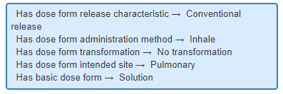
11114000: Inhalation vapour, solution
 | SCTID | Fully Specified Name | Cardinality | Association | Attribute Match | Notes and Comments
Tara | 385213000 | Conventional release vapor solution for inhalation (dose form) | 1…1 | Exact match | Yes | EDQM has Mixing | No transformation, S-CT has No transformation
Oliver | 385213000 | Conventional release vapor solution for inhalation (dose form) | 1..1 | Broader than | No | EDQM transformation is "Mixing, No transformation". ("The vapour is usually generated by adding the solution to hot water.)" SCT = "No transformation". Does not convey the "mixing". Also, SCT concept does not render "to obtain a local effect." "Broader than" or "Exact match" to be discussed. Border line.
Martha | 385213000 | Conventional release vapor solution for inhalation (dose form) | 1..1 | Exact match | No | EDQM has Mixing | No transformation, S-CT has No transformation
Catherine | 385213000 | Conventional release vapor solution for inhalation (dose form) | 1..1 | Exact match | No | EDQM has Mixing and No transformation, S-CT has no transformation
Discussion:
Notes:
How do we feel about the S-CT “no transformation”? What if we look at the attributes? Can you inhale a solution? Is a transformation going to be necessary? What would the ADF be?

Slide 9
10521000 : Medicated nail lacquer
 | SCTID | Fully Specified Name | Cardinality | Association | Attribute Match | Notes and Comments
Tara |  |  | 1…0 | No match | NA | S-CT has no concept for application to the 'nail'
Oliver |  |  | 1..0 | No match | No | SCT is missing liquid basic dose form "lacquer", other attributes match exactly
Martha |  |  | 1..0 | No match | NA | S-CT has no "nail"-concepts (?)
Catherine |  |  | 1..0 | No match | NA | STC has no basic dose form "Lacquer"
Discussion:
Notes:
Why was “Nail solution” (10521500) rejected by EDQM but Nail lacquer is a standard term? In the rejection, it says “Term rejected. 'Cutaneous use' includes application to the nails.”
What might be our suggestion for mapping? What might we say to EDQM?
Do we think “lacquer” is a good basic DF? “A type of liquid pharmaceutical dose form consisting of one or more substances dissolved or suspended in a volatile solvent that evaporates to leave a hard coating. “

Slide 10
Tara’s Concepts
EDQM Code | English Name | SCTID | Fully Specified Name | Cardinality | Association | Attribute Match | Notes and Comments
13047000 | Solution for suspension for injection |  |  | 1…0 | No match | NA | Liquid sterile preparation consisting of a solution intended for use in the preparation of a suspension for injection. S-CT has solution for injection and has also suspension for injection, but not a solution for suspension for injection.
13127000 | Sublingual lyophilisate |  |  | 1…0 | No match | NA | S-CT has Conventional release oral lyophilisate (dose form) SCTID: 385062005 which is swallowed, not sublingual. S-CT also has Conventional release sublingual tablet (dose form) SCTID: 385084005, which is a tablet…
10119000 | Granules for syrup | 385034003 | Granules for conventional release oral syrup (dose form) | 1…1 | Exact match | Yes
10206000 | Gastro-resistant granules | 385045000 | Gastro-resistant oral granules (dose form) | 1…1 | Exact match | Yes
10220000 | Coated tablet |  |  | 1…0 | No match | NA | EDQM define it as having a thicker coat than film-coated tablet, conventional release.
Discussion:
Notes:
Solution for suspension for injection…..is part of a two part kit? Should this be added to S-CT? Will we have products to support it? Do we not add until we do?

Slide 11
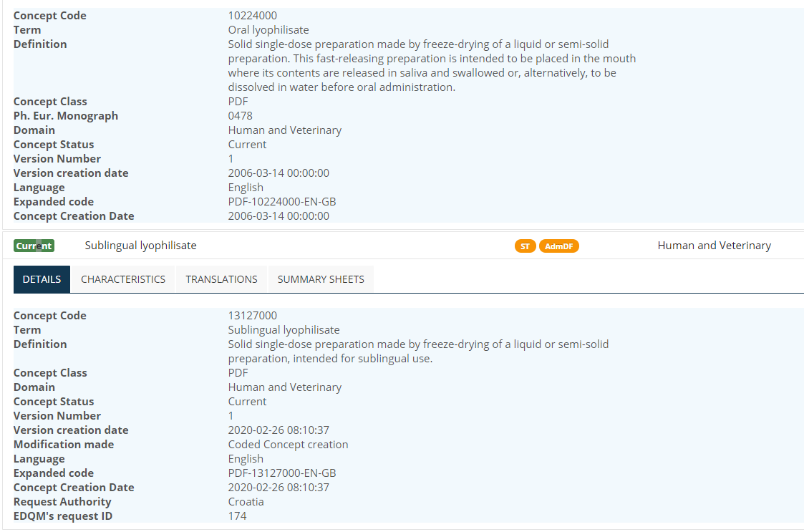

Slide 12
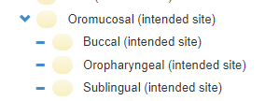
Olivier and François’ Concepts
EDQM Code | English Name | SCTID | Fully Specified Name | Cardinality | Association | Attribute Match | Notes and Comments
10236100 | Orodispersible film | 447050008 | Conventional release orodispersible film (dose form) | 1..1 | Exact match | No | EDQM intended site "oral" ; "intended to be placed in the mouth where it disperses rapidly before being swallowed." This looks like an error in EDQM since the method is "orodispersion". SCT intended site = "oromucosal".
10308300 | Oromucosal spray, suspension | 761906003 | Conventional release suspension for oromucosal spray (dose form) | 1..1 | Broader than | Yes | EDQM: "Sublingual sprays are excluded." SCT: sublingual is included in oromucosal intended site.
11203000 | Emulsion for injection | 385221006 | Conventional release emulsion for injection (dose form) | 1..1 | Exact match | Yes
11210000 | Solution for infusion | 385229008 | Conventional release solution for infusion (dose form) | 1..1 | Exact match | Yes
11502000 | Bladder irrigation |  |  | 1..0 | No match | No | Missing concept in SCT. Should be added on the model of 785899003 |Conventional release ocular solution for irrigation (dose form)|, with two intended sites: intravesical and urethral (as in EDQM)
Discussion:
Notes:
What should we be saying about this “exclusion” stuff? Do we accept that it is Guidance for MAH rather than for us? Oromucosal does seem to be challenging. There is no SL intended site in EDQM whereas S-CT has SL as child of oromucosal
What do we think about irrigation? We would need a new method….
Ah – an irrigation…..

Slide 13
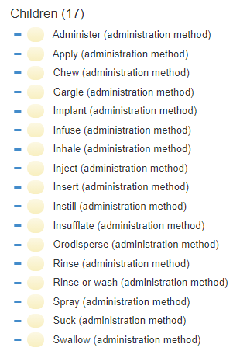
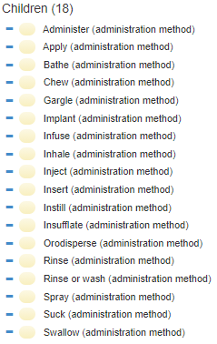
Daily Build:
2021-07-31 Version

Slide 14
Martha’s Concepts
EDQM Code | English Name | SCTID | Fully Specified Name | Cardinality | Association | Attribute Match | Notes and Comments
13047000 | Solution for suspension for injection | 385220007 | Conventional release suspension for injection (dose form) |  | Broader than | No | No exact match. The closest I found was the adm ph dose form (after transformation)
13128000 | Prolonged-release wound solution |  |  | 1..0 | No match |  | The closest is perhaps the "transdermal drug delivery system (dose form)" in S-CT?
50019500 | Ear/eye/nasal drops, solution | 385163003 | Conventional release ear or eye or nose drops (dose form) | 1..* | Broader than | No
 |  | 765164007 | Conventional release solution for ear or eye or nose drops (dose form) | 1..* | Exact match | Yes
50024000 | Gargle/mouthwash | 385065007 | Conventional release oromucosal solution for gargle (dose form) | *..* | Narrower than |  | EDQM has separate terms for gargle and mouthwash individually in addition
 |  | 70409003 | Conventional release oromucosal solution for mouthwash (dose form) | *..* | Narrower than
11108000 | Pressurised inhalation, emulsion | 385206000 | Conventional release pressurized emulsion for inhalation (dose form) | 1..1 | Exact match | No | S-CT uses pressurized emulsion, EDQM uses emulsion as basic dose form. S-CT has inconstant ordering of pressurized vs conventional release in FSN for the pressurized dose forms
Discussion:
Notes:
Solution for suspension for…
Wound solution: “Liquid sterile preparation consisting of a solution intended to be administered onto a wound, including surgical wounds; the active substance(s) are released over an extended period of time”

Slide 15
Catherine’s Concepts
EDQM Code | English Name | SCTID | Fully Specified Name | Cardinality | Association | Attribute Match | Notes and Comments
10907000 | Vaginal emulsion | 385172006 | Conventional release vaginal emulsion (dose form) | 1..1 | Exact match | yes
10709000 | Ear spray, solution | 385141007 | Conventional release solution for ear spray (dose form) | 1..1 | Exact match | yes
10105000 | Oral solution | 385023001 | Conventional release oral solution (dose form) | 1..1 | Exact match | yes
10120000 | Soluble tablet | 421701006 | Tablet for conventional release oral solution (dose form) | 1..1 | Exact match | yes
10304000 | Gargle, tablet for solution |  |  | 1..0 | No match | NA | STC has no basic dose form Tablet with Gargle administration, solution for gargle exists 385065007
Discussion:
Notes:
Tablet for solution for…..

Slide 16
Next Steps

Slide 17
Working for real…..
Building the list of issues
  For EDQM
    Nail lacquer seems inconsistent
    Orodispersible film – attributes?
  For S-CT
    Irrigation concepts
    Inhalation devices
    X for Y for Z
Continuing to write up guidance (Julie – at least initially – is a living document!)
  Systemic/local effect not part of PDF
Continue doing the mapping (you guys)

Slide 18
Working for real…..
How long did it take you to do 10 maps?
  Did that feel feasible…..?
  How much could you do “per fortnight” do you think?
What about checking?
  François has been on to this already!
What do you suggest we should do about the 90 or so concepts that had a total match on the S/S we’ve been given?

Slide 19

Next meeting on
Thursday 7TH October
at 10:00 UTC
NEXT STEPS
19

Slide 20


THANK YOU
SNOMED International: Delivering SNOMED CT

