Slide 1

September 2021 Nursing Clinical Reference Group Meeting

Slide 2
Agenda
01
04
Welcome and Introductions
Erica Culp/Christine Spisla
Cross Collaboration
Erica/Christine
02
05
ICNP alignment work updates
Jane Millar/Ian Green
Terminology Submissions
Erica/Christine
.
03
October Business Meetings
Jane/Ian
Erica/Christine

Slide 3

ICNP Alignment Work Update……….
Release Date
ICNP Editorial Guidelines Group
  Equivalency Tables
Presentations
  October business meetings

Slide 4

October Business Meetings………..
General Information
Registration
Nursing CRG topics
  ICNP release
  Sweden’s ICNP project
  Terminology submission
  Tuesday, October 19th @ 20:00 UTC

Slide 5

Cross Collaboration
Anesthesia Clinical Reference Group
  https://confluence.ihtsdotools.org/display/ACRGT
  Sept 28th 19:00-20:30 UTC
Nutrition Care Process Terminology Clinical Project Group
  https://confluence.ihtsdotools.org/display/NCPTCPG
  Sept 20th kl. 19.00 UTC

Slide 6

Submission Information
Request Information
Primary Information
Secondary Information

Slide 7
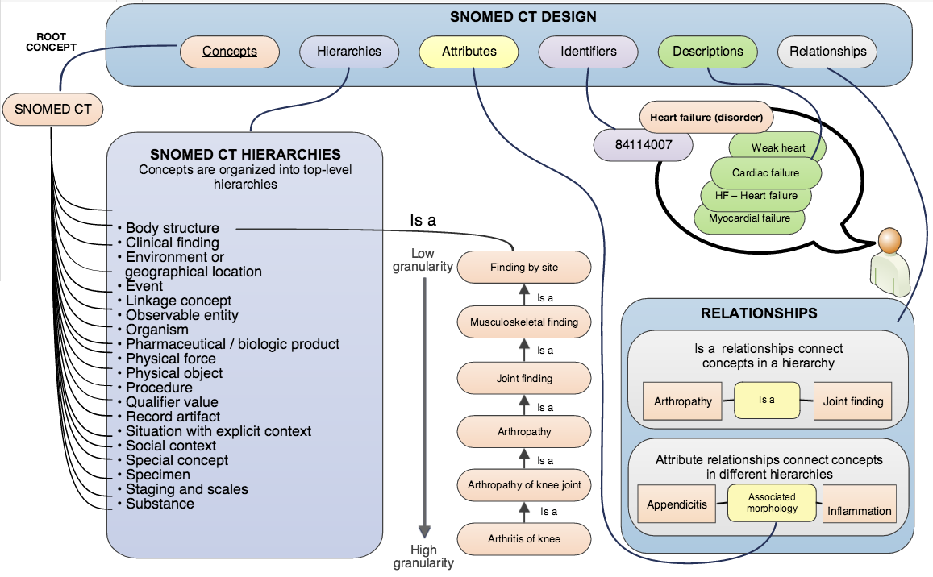
Request Information
New concept
New synonym
New relationships
Modifications
Changes
Inactivation

Slide 8

Primary Information
Topic
Summary
Use case
References

Slide 9
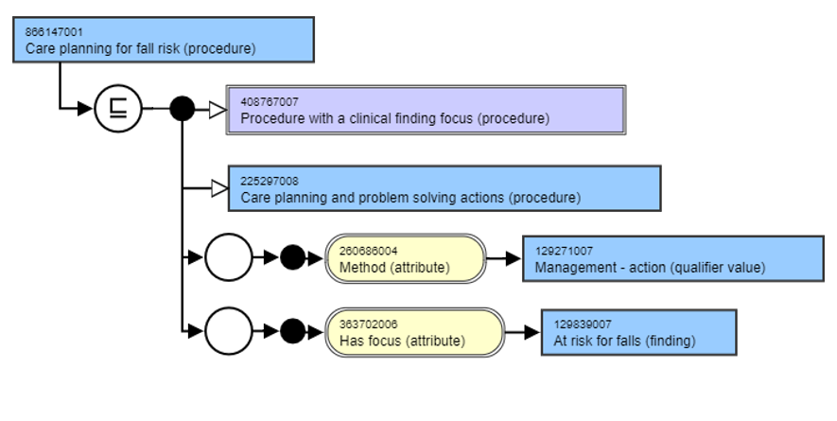
Secondary Information
Hierarchies
Attributes
Collaborations partners

Slide 10

Submission Format
Template
  Word
  PowerPoint

Slide 11
Submission
Template

Slide 12
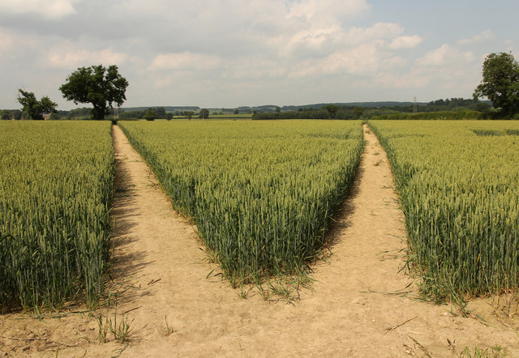
Submission Pathways
Group members
  Nursing CRG Confluence
  Directly to Co-Chairs
Group Chairs
  Content Request Service

Slide 13
Thank you for participating
We look forward to seeing you at the next meeting
October 19th 20:00-21:00 UTC
Christine and Erica

