Slide 1


SNOMED CT Drug Extension
User Support Group
Linda Bird and Monica Harry, SNOMED International
Julie James, Blue Wave Informatics
Thursday 19th August 2021

Slide 2

Welcome
EDQM map
  Background
  Fundamentals
  Use cases
  Process
Next meeting
AGENDA
http://snomed.org/deusg
Notes:
Presentation – “This is what we’re doing, and these are the challenges and questions we have.

Slide 3

EDQM Map
Background

Slide 4
EDQM Map Background
DEUSG members told SNOMED International that one of your common challenges is finding an equivalent mapping between dose forms used locally (e.g. EDQM) and SNOMED CT’s pharmaceutical dose forms
  This issue was your third highest priority
SNOMED International issued a survey to DEUSG members to better understand your requirements for mapping dose forms (8 responses)
SNOMED International and EDQM have agreed to move forward with a joint mapping from EDQM to SNOMED CT dose forms

Slide 5
Dose Form Survey Results
Which of these use cases for mapping from EDQM to SNOMED CT dose forms are important to you?
SNOMED CT Drug Extension - To represent real/branded medication products in a SNOMED CT drug extension, based on the registered product information (where EDQM used for regulatory dose forms)
Interoperability - To map drugs from a national or local medication product dictionary to international SNOMED CT clinical drugs for interoperability purposes, such as the sharing of medication lists for cross-border patient-care, pharmacovigilance and clinical research
IDMP - to map from an IDMP-compliant regulatory database of medicinal products to SNOMED CT drug concepts
Other (Unicom project)

Slide 6
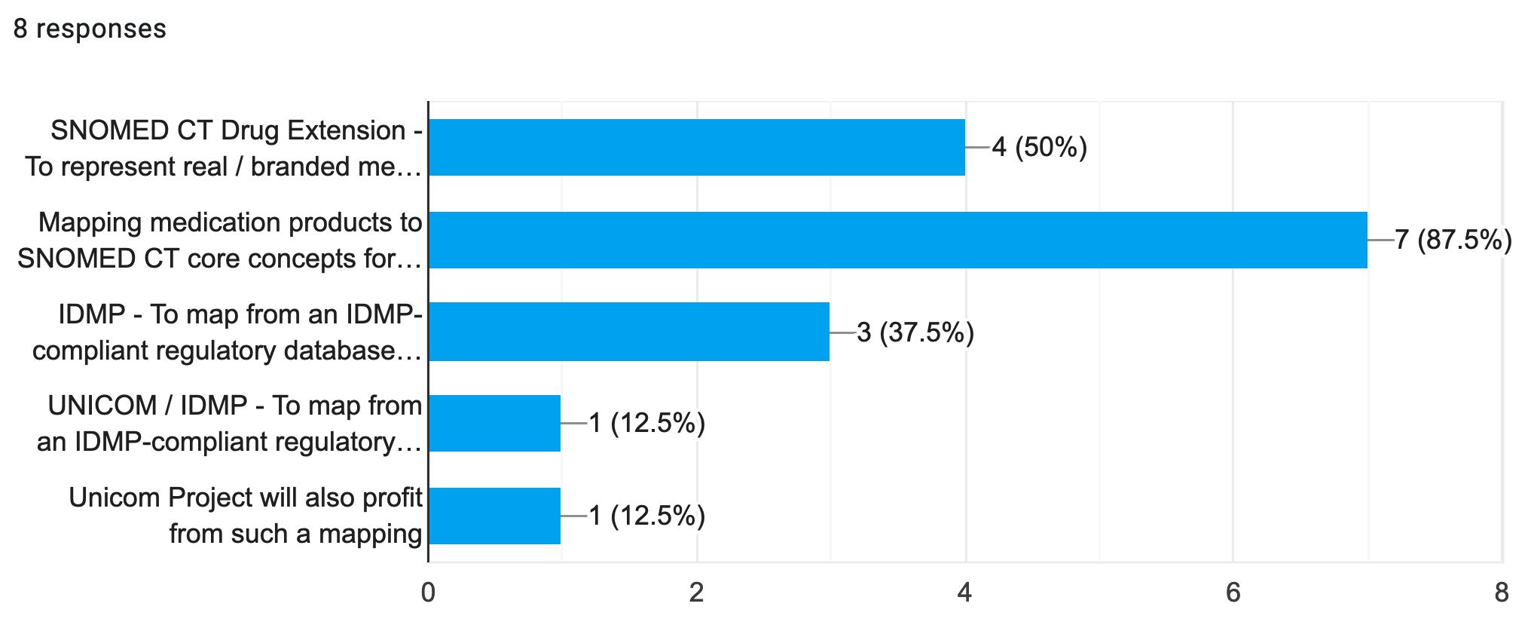
Dose Form Survey Results
Which of these use cases for mapping from EDQM to SNOMED CT dose forms are important to you?

Slide 7
Dose Form Survey Results
Which of these use cases for mapping from SNOMED CT to EDQM dose forms are important to you?
Interoperability - To map SNOMED CT clinical drug concepts (shared between systems for interoperability) to national/local medication products to allow them to be included in a local health record.
Other - (Clinical decision support)

Slide 8
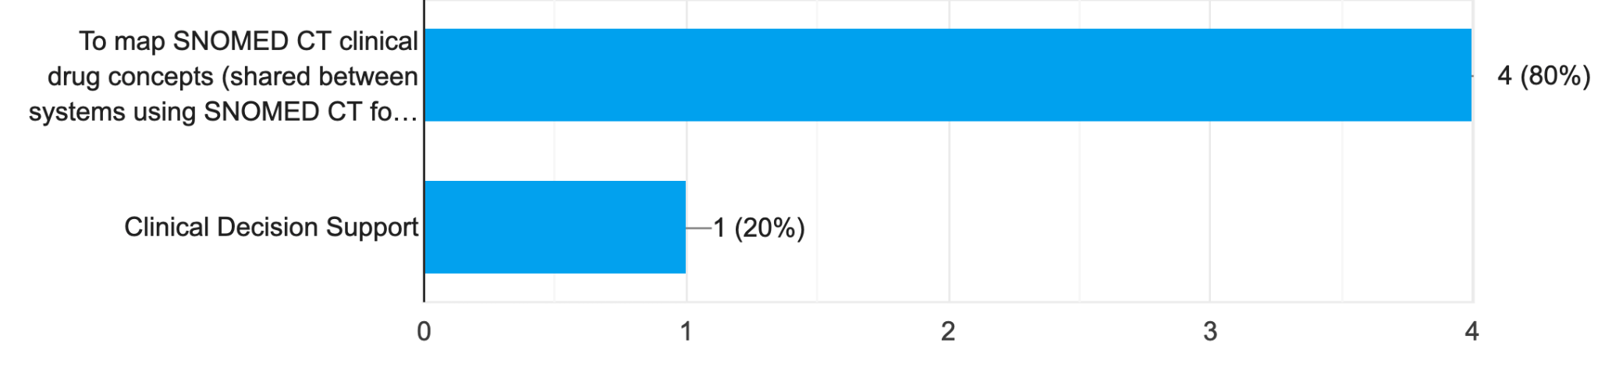
Dose Form Survey Results
Which of these use cases for mapping from SNOMED CT to EDQM dose forms are important to you?

Slide 9
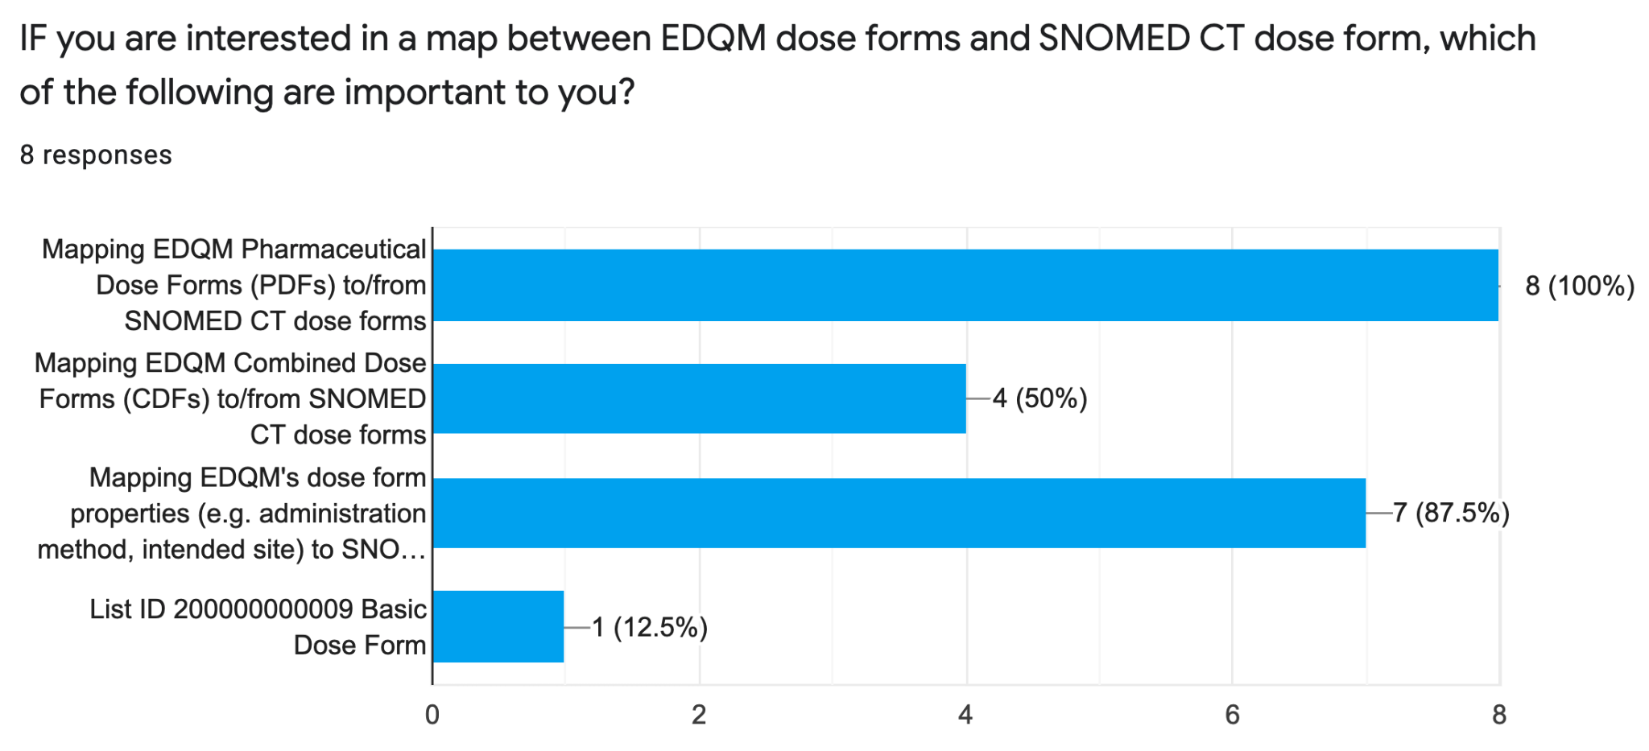
Dose Form Survey Results

Slide 10
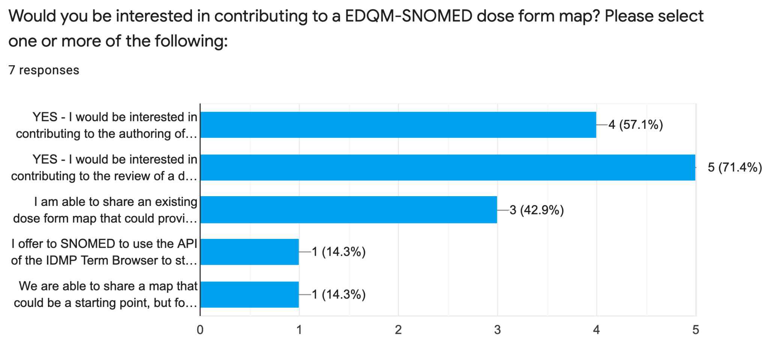
Dose Form Survey Results

Slide 11
EDQM to SNOMED CT
Mapping Fundamentals

Slide 12


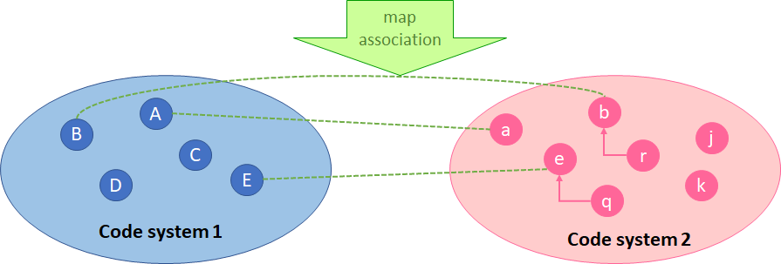
What exactly is “a map” in terminology?
An association between a “concept” in one code system and a “concept” in another code system
  Code system - a terminology, classification, taxonomy, vocabulary….
  “Concept” - code, term, object

Slide 13
Mapping always supports a use case
The use(s) for the map must be documented, either
formally (as use cases) or
informally (as storyboards) or
both - with examples
This is important because it will guide decisions on
what to map and what not to map
the direction of the map
For two different use cases, there may be two different overall maps

Slide 14
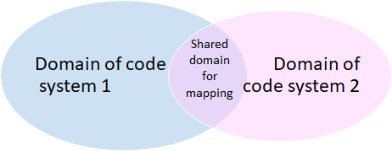
Scope - what to map?
•Is the scope of the two code systems the same?
•Or is it just a portion of one or both code systems that is being mapped…
•Does the scope cover only active concepts or are inactive concepts included?
Which version of the two code systems are being used for the initial version of the map
•For modelled terminologies, does the mapping cover attributes of concepts (which themselves are concepts) or only the concepts “in the domain”?
•The scope will help determine whether the map is expected to cover all the concepts in one or both code systems, or whether some concepts can be correctly left unmapped and without other guidance

Slide 15
How to understand the concepts to map
•Understanding the characteristics of the two code systems
•Will it be
•Text match (only)
•Using synonyms in source and/or target code system
•Using rules and/or a model
•Text definition associated with concepts
•Relationship definition
•Including hierarchy implications
•Use of qualifiers

Slide 16
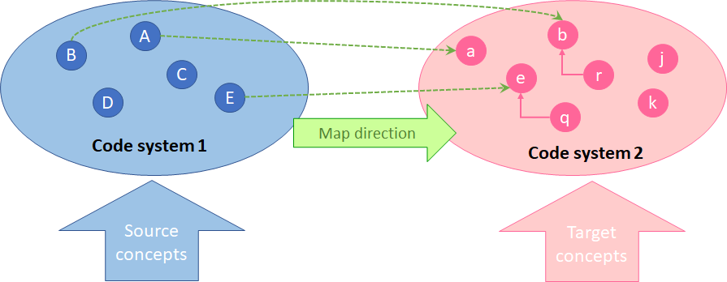
Direction – source and target
•The use case(s) will determine which code system provides the source concepts (to be mapped from) and which code system provides the target concepts (to be mapped to)

Slide 17
Multiplicity/Cardinality
•An association may be
•1..1 - a single concept in the source code system is associated to a single concept in the target code system
•1..* - a single concept in the source code system is associated to more than one concept in the target code system
•1..0 - a single concept in the source code system cannot be associated to more any concept in the target code system

Slide 18
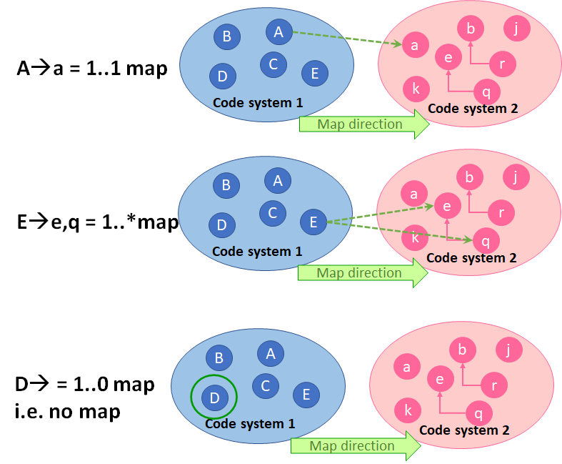

Slide 19
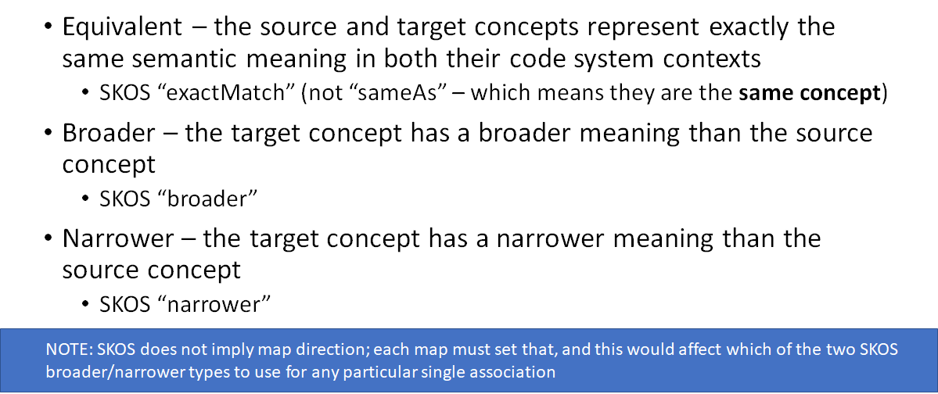
Association type (correlation)

Slide 20
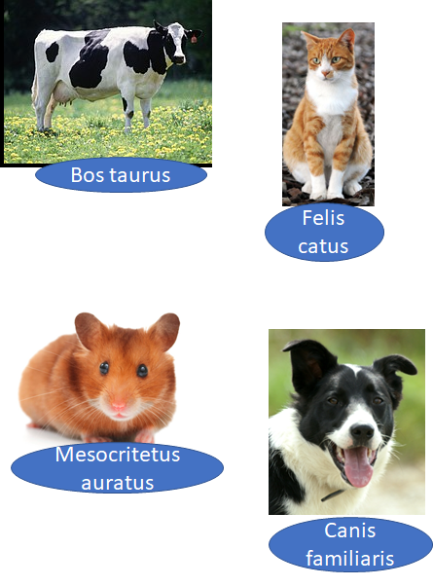
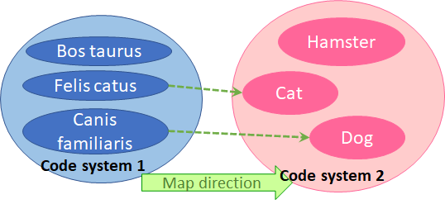
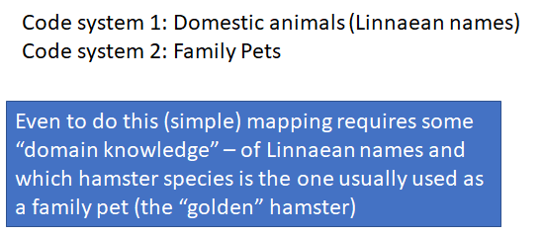
Exact match

Slide 21
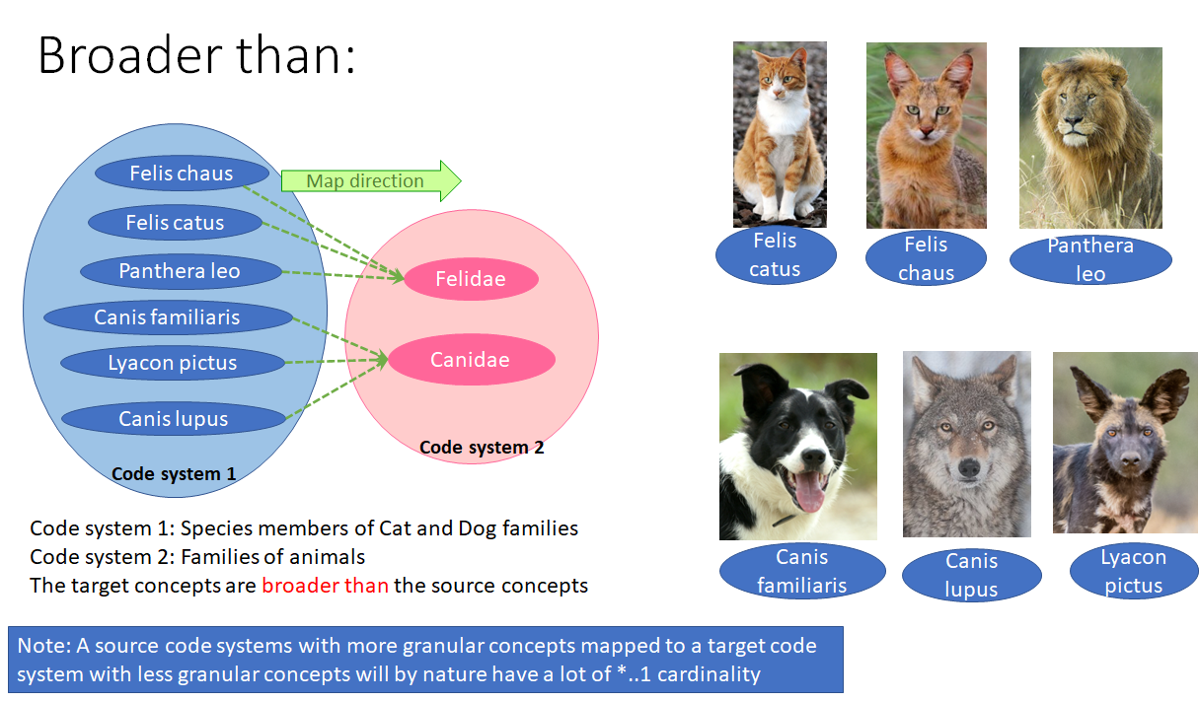

Slide 22
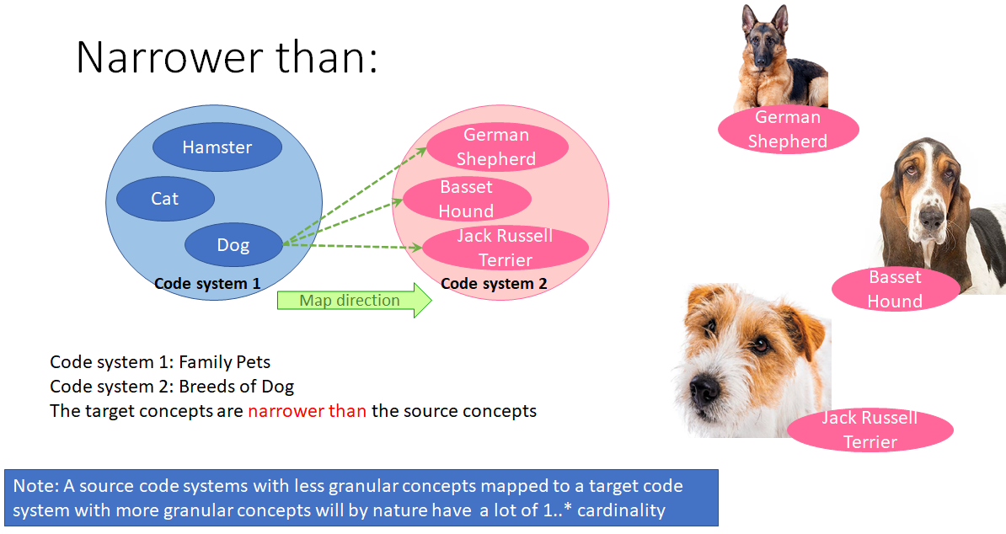

Slide 23
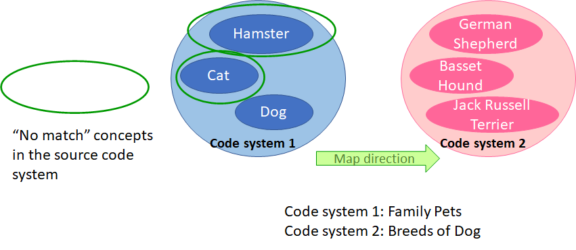

Slide 24
Bi-directionality
•Occasionally, a mapping use case requires bi-directional mapping
•This is easiest if mapping is 1:1 based on “equivalence” but since that is rarely achieved throughout a map, especially initially, a bi-directional map is usually considered as two separate mapping artefacts
•Map in one direction first, particularly noting all maps that are 1:1 and which are
• Equivalent
• Broader than
• Narrower than
•The 1:1 equivalent associations can be considered truly bi-directional
•All the “broader than” and “narrower than” associations have to be re-assessed in the alternate direction for suitability for the map use case in that direction
•All 1..* and *..1 and non-mapped concepts on each side require separate re-assessment

Slide 25
EDQM Map
Use Case

Slide 26
What is/are our “storyboards”?
UNICOM: mapping med product data from country to country and dose forms are challenging; EDQM dose forms are used in IDMP for European countries “Sharing med product data across countries” [UT]
Order medicine using “abstract” concepts from SNOMED CT; system should then be able to find the authorised product(s) to dispense. Dose form is one of the key attributes for this. So need to associate the S-CT concepts to the authorised products [MH]
Maintain MPD of authorised products and source is SmPC where EDQM is dose form (section 3); want to index this to SNOMED CT medicine concepts and dose form is a key attribute for this [FM][UT]
Maintain national extension of SNOMED CT and have to use the dose forms that are stated for authorised products

Slide 27
Other use case considerations

Slide 28
How does our storyboard set our scope?
EDQM has terms that are not valid anymore but which are still used in SmPC - therefore the scope may need to include inactive concepts
“Patient Friendly Terms” - capsule v “capsule, soft” and “capsule, hard”
Excluding the veterinary terms
How to deal with concentrate dose forms
WHAT ABOUT THE CHARACTERISTICS including Basic Dose Form
What about the Combined Dose Forms?

Slide 29
How does our storyboard set map direction?
FROM EDQM to SNOMED CT at least in the first instance

Slide 30
How does our storyboard set map cardinality?
“We have a dream”…..of “1...1”
How does that dream affect all our users, not just our European users?

Slide 31
Bi-directionality
Are there any use cases that would require bi-directional mapping in our domain?

Slide 32
EDQM Map
Process

Slide 33
Mapping Process Principles
Discuss and agree use cases
Discuss and agree how use cases define map
  Scope – whether active/inactive included, whether attributes are mapped
  Direction
  Cardinality
  Type assignment (and if anything other than exact match is appropriate)
Discuss and agree map process
  Rules for concept assessment (text, relationships, definitional attributes etc.)
  Additional resources available - use of existing maps
Discuss and agree QA process (review etc.)
Discuss and agree maintenance process
Discuss and agree publication process
  Format, timing

Slide 34
Mapping Process Practicalities
•Discuss and agree working process
•Where documentation is
•Who does what, when
•How to deal with “in flight questions”
How to deal with known issues
• Training and exemplars

Slide 35
Next steps
Doodle poll to get small group together
https://doodle.com/poll/m2qwhhr2s6umsrv8?utm_source=poll&utm_medium=link

Slide 36

Next meeting
Thursday 2nd September 2021
at 13:00 UTC
Topic:
A range of dose form topics
NEXT STEPS
‹#›

Slide 37


THANK YOU
SNOMED International: Delivering SNOMED CT

