Slide 1


SNOMED CT DEUSG Subgroup
EDQM Dose Form Mapping
Linda Bird, SNOMED International
Julie James, Blue Wave Informatics
Thursday September 2021

Slide 2

Welcome
Purpose of subgroup
Map use cases
Map fundamentals
Map process
Next meeting
AGENDA
http://snomed.org/deusg
Notes:
Presentation – “This is what we’re doing, and these are the challenges and questions we have.

Slide 3

Purpose of
Dose Form Map Subgroup

Slide 4
EDQM Map Background
DEUSG members told SNOMED International that one of your common challenges is finding an equivalent mapping between dose forms used locally (e.g. EDQM) and SNOMED CT’s pharmaceutical dose forms
  This issue was your third highest priority
SNOMED International issued a survey to DEUSG members to better understand your requirements for mapping dose forms (8 responses)
SNOMED International and EDQM have agreed to move forward with a joint mapping from EDQM to SNOMED CT dose forms
The DEUSG has formed the ‘Dose Form Map’ subgroup

Slide 5
Purpose of Subgroup
To agree upon the use cases and fundamentals of the map
  To document the mapping policy
To contribute to the authoring and/or review of the map
To deliver the first version of the map to the DEUSG

Slide 6
EDQM Dose Form Map
Use Cases

Slide 7
Use Cases for EDQM-to-SNOMED DF Map (1)
Authoring a SNOMED CT Drug Extension
The national extension wants to represent authorised (real/branded) medicinal products in a SNOMED CT drug extension as RCDs, based on the authorised product information (section 3 of SmPC)
The authorised product information uses EDQM dose forms
SO
A map from EDQM dose forms to SNOMED CT dose forms significantly helps the authoring of the RCDs, because “pharmaceutical dose form” is a definitional attribute of an RCD

Slide 8
Use Cases for EDQM-to-SNOMED DF Map (2)
National use of international concepts in patient care
An organisation wants to map concepts from a national or local medication product dictionary (MPD) to international SNOMED CT clinical drugs for the patient medication process - prescribing/dispensing/administration/recording
“Prescription” uses abstract concepts (from the international edition) but these must be matched to a local authorised product for dispensing/administration
Many or all of the concepts in the MPD use EDQM dose forms as their dose form
SO
A map from EDQM dose forms to SNOMED CT dose forms significantly helps the mapping because “pharmaceutical dose form” is a definitional attribute of a SNOMED CT clinical drug and is usually a stated attribute of the concept in the MPD. By mapping at attribute level, much of the concept level mapping can be “automated” (at least initially)

Slide 9
Use Cases for EDQM-to-SNOMED DF Map (3)
International interoperability of medication information
An organisation wants to map concepts from a national or local medication product dictionary (MPD) to international SNOMED CT clinical drugs for interoperability purposes, such as the sharing of medication lists for cross-border patient-care, pharmacovigilance and clinical research
Many or all of the concepts in the MPD use EDQM dose forms as their dose form
SO
A map from EDQM dose forms to SNOMED CT dose forms significantly helps the mapping because “pharmaceutical dose form” is a definitional attribute of a SNOMED CT clinical drug and is usually a stated attribute of the concept in the MPD. By mapping at attribute level, much of the concept level mapping can be “automated” (at least initially)

Slide 10
Use Cases for EDQM-to-SNOMED DF Map (4)
IDMP / UNICOM
An organisation wants to map data from an IDMP-compliant regulatory database of medicinal products to SNOMED CT concepts
An IDMP-compliant regulatory database should EDQM dose forms as their dose form
SO
A map from EDQM dose forms to SNOMED CT dose forms significantly helps the mapping because “pharmaceutical dose form” is a core part of SNOMED CT medicinal product information
Note: in many ways, this UC is another view on all three of the previous use cases, but we document it separately because of the importance of UNICOM, especially to our European members

Slide 11
Use Cases for EDQM-to-SNOMED DF Map (5)
Decision support
An organisation wants to manage medication decision support data using “international” medication concepts, so uses SNOMED CT and its structures, either directly or indirectly
  It then needs to map from local MPD to SNOMED CT for implementation (if the local MPD is not already mapped to SNOMED CT)
  It may also want to “stream in” IDMP data for processing in its decision support system (as in UC4)
Note: in many ways, this UC is another view on all of the previous use cases, since it involves mapping from local/national MPD to SNOMED CT, using authorised product data etc.

Slide 12
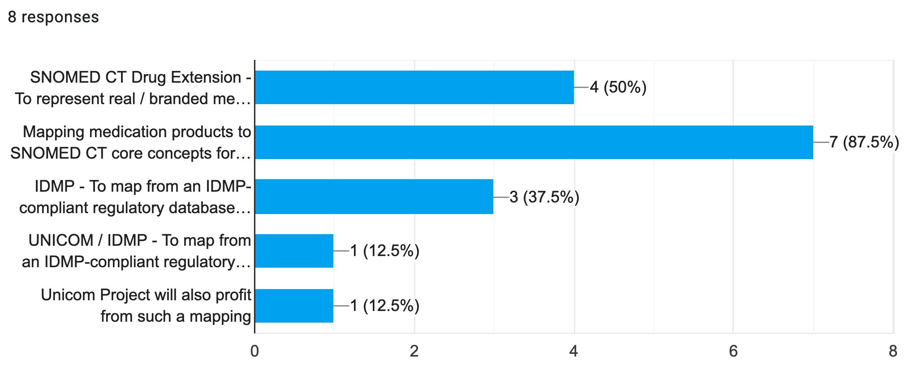
Dose Form Survey Results
Which of these use cases for mapping from EDQM to SNOMED CT dose forms are important to you?

Slide 13
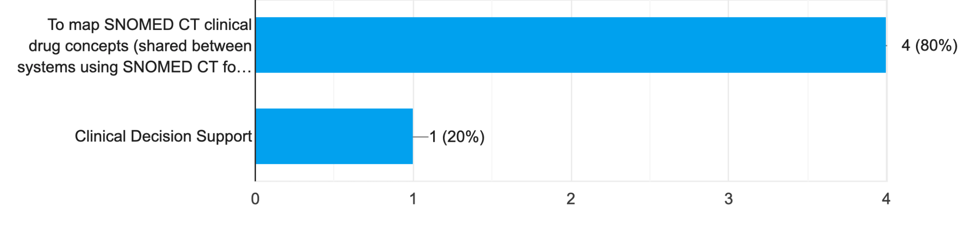
Dose Form Survey Results
Which of these use cases for mapping from SNOMED CT to EDQM dose forms are important to you?

Slide 14
EDQM to SNOMED CT
Mapping Fundamentals

Slide 15
Map Fundamentals (1)
Direction
  EDQM to SNOMED CT (for now)
Scope
  Map source: EDQM Pharmaceutical Dose Forms
    May consider CDFs and CTs later
    Active PDFs at 2021-09-07 that are not ‘Veterinary only’
    Note: Inactive PDFs (used on SmPCs) need a historical association to an active PDF
    What about Patient Friendly Terms?
  Map target: SNOMED CT 20210731 international edition
    Active concepts that are < 736542009 | Pharmaceutical dose form (dose form) |
  ? Do we map EDQM-SNOMED dose form properties (would be ‘information only’)?
    What would be the benefit and how would we leverage that?

Slide 16
Map Fundamentals (2)
Cardinality
  The ‘dream’ is a “1..1” map
  We must work through and document all exceptions to this so as to give implementation guidance
Association/Correlation
  ‘Equivalent’ is the ideal
  ‘Broader target’ may be used….which will probably give a 1..* cardinality
  ‘Narrower target’ is unlikely….except possibly for “bath additive” :)
We are fortunate that we will have the opportunity to discuss all non 1..1 maps and all broader than/narrower than maps with both EDQM and SNOMED CT

Slide 17

Understanding Concepts in each Code System
We are mapping the meaning of the concepts - which may go (some way) beyond the text of the name

Slide 18
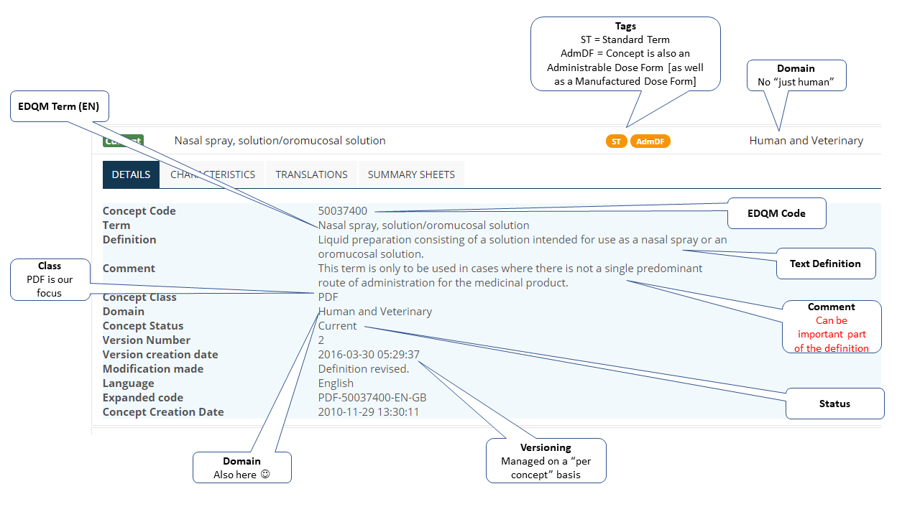
Understanding Concepts: EDQM PDFs

Slide 19
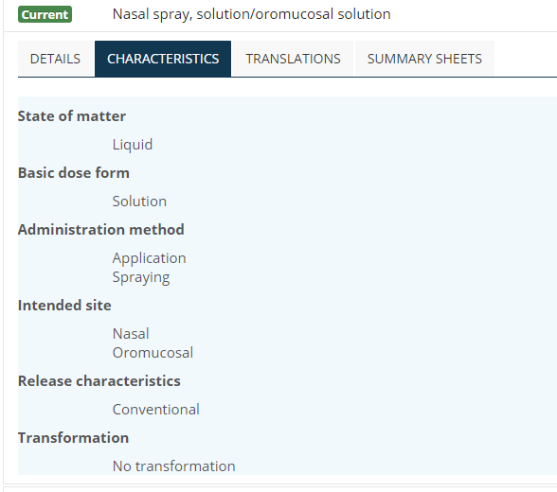
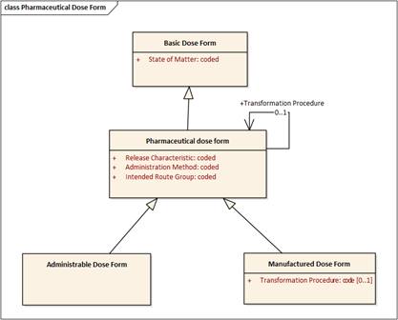
PDF Attributes
Although one can draw out a logical model of the way the attributes “work” for a PDF, the attributes are NOT definitional in the way that they would be if they were used as this model has them

Slide 20
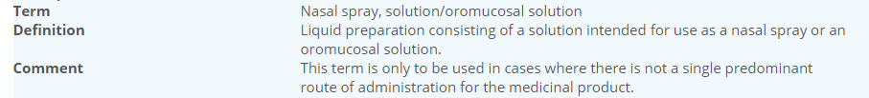

EDQM: The Comment section
The comment section is primarily aimed as “implementation guidance” for marketing authorisation applicants when they are selecting a PDF to use for their product
However, it often gives information that “clarifies” the definition, so is something to consider when making a mapping
Sometimes, it says what the concept is NOT as well as what it is - which can be challenging for mapping. If you come across any like this and have questions, please ask!

Slide 21
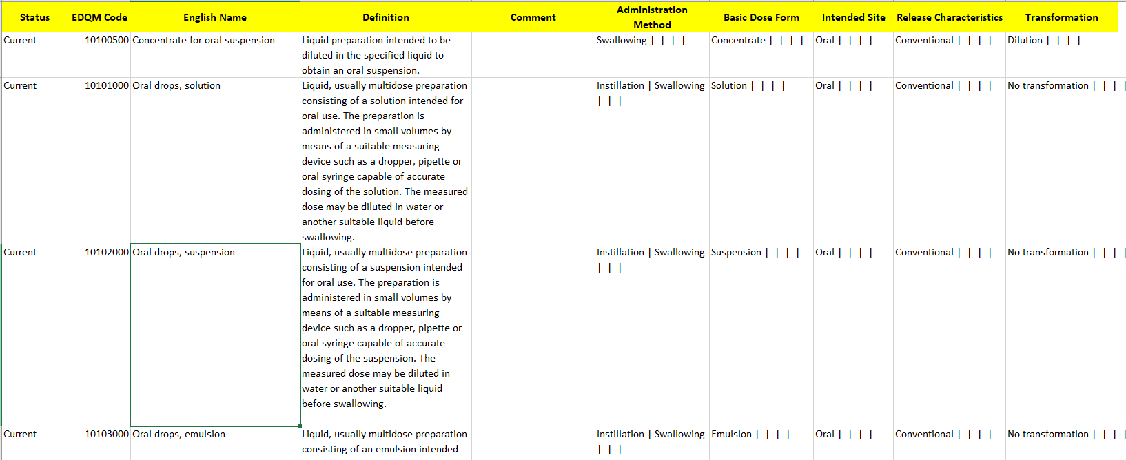
EDQM PDF in a spreadsheet
We have had to take a “snapshot” of the PDF concepts to map FROM - because there is no single “version” of the code system. We took this snapshot using the EDQM API and have converted it into this spreadsheet that (hopefully) we can all use :)

Slide 22
Understanding Concepts: SNOMED CT
Fully specified name (FSN) ‘unambiguously’ represents the meaning of the concept
Defined concepts: The set of defining relationships fully represents the logical meaning
Primitive concepts: The set of relationships represents part of the logical meaning (the rest of the meaning is captured in the FSN)
There are some text definitions, especially for primitive concepts used as attributes in the concept model
The (poly)hierarchy should reflect the relationships, which themselves represent the concept and therefore should be correct for the concept

Slide 23
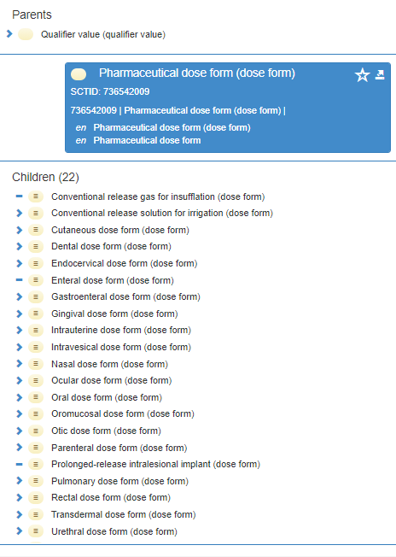
Understanding Concepts: SNOMED CT PDFs
PDFs are “qualifier values” because they are used as attributes in the medicinal product concept model
BUT they are still full concepts in their own right
The parent (grouping) concept 736542009 | Pharmaceutical dose form (dose form) | has no attributes (and is therefore marked as “primitive” but the child concepts - the PDF concepts themselves, have a concept model….

Slide 24
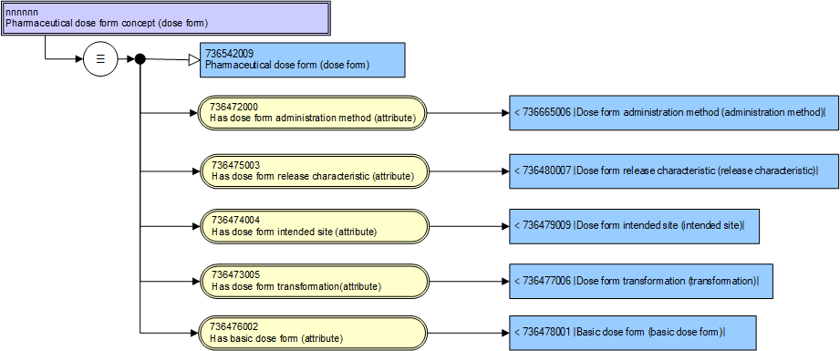
PDF Concept model (stated view)

Slide 25
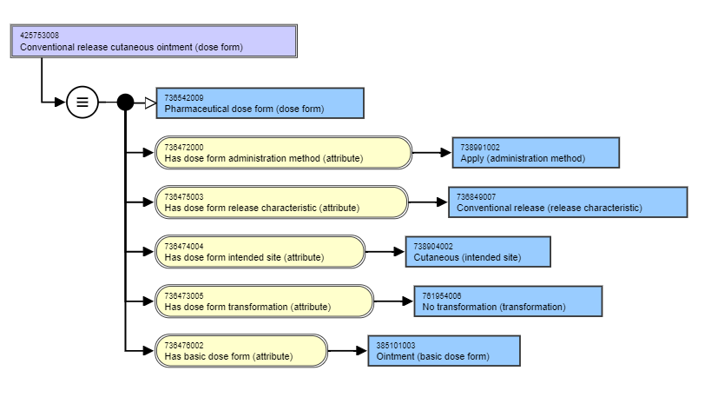
PDF Concept: stated view

Slide 26
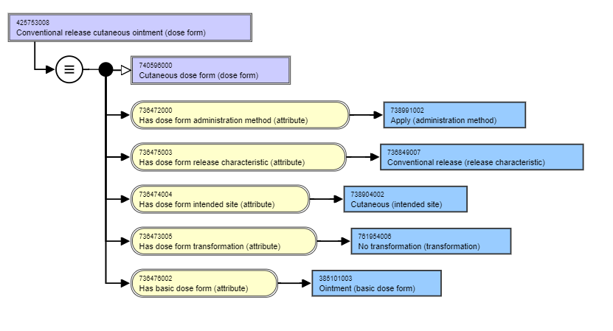
PDF Concept: inferred view

Slide 27
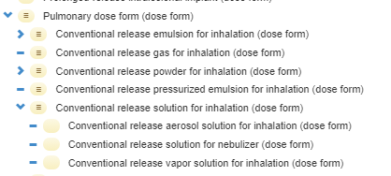
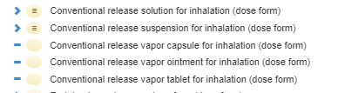
Not all PDFs are “fully defined”
Two concepts cannot share the same logical definition and be fully (logically) defined
So we have some primitive PDFs - as we have the concept model at the moment - that have to be child concepts of fully defined concepts because they have extra meaning in their FSN
And/or they may be primitive siblings
We should note where our mapping goes to a primitive PDF concept

Slide 28
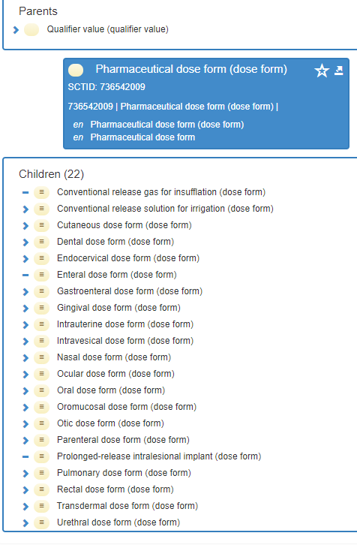
SNOMED CT 2021-07-31
https://browser.ihtsdotools.org/?perspective=full&conceptId1=736542009&edition=MAIN/2021-07-31&release=&languages=en
This is the version of SNOMED CT that we will map TO
https://confluence.ihtsdotools.org/display/DOCEG/SNOMED+CT+Editorial+Guide+-+Pharmaceutical+Dose+Form
This is the link to the Editorial Guidance for the PDFs in SNOMED CT and should be read before launching into any mapping or reviewing (if you haven’t already done so)

Slide 29
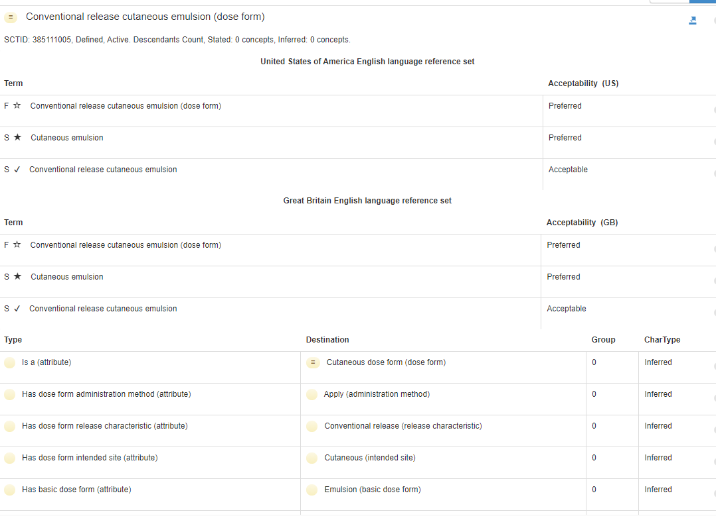
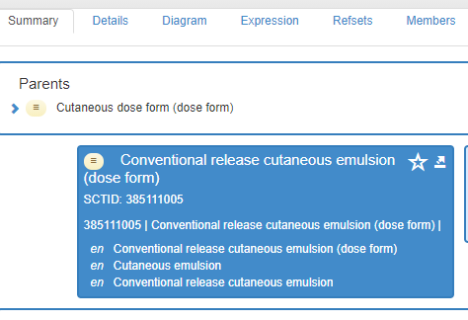
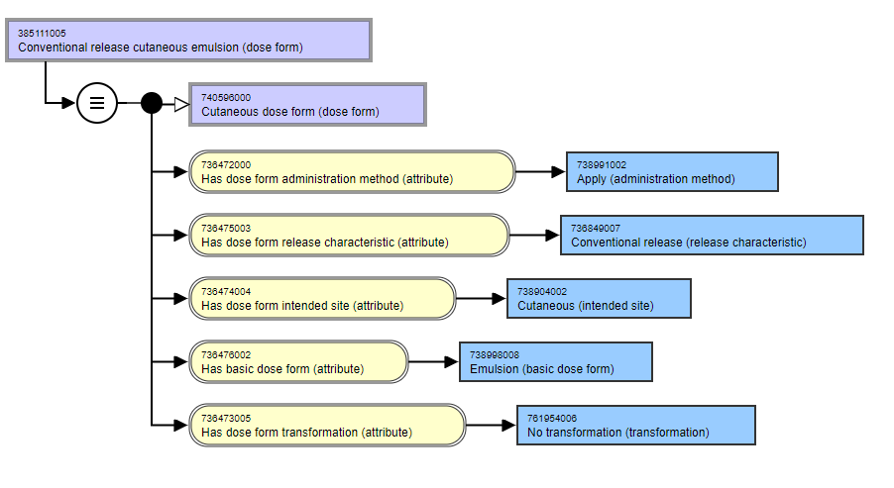
Browser details
All the information about the concept in text, including synonyms and their type
All the information about the concept in diagram form - stated or inferred view (this is the inferred - what you see after the Classifer has placed the concept in the hierarchy using the logical definition)

Slide 30
To record the map
We could “copy and paste” from the browser….into the mapping spreadsheet
We could (I think ?) get a copy of the PDFs in a spreadsheet, as we have for the EDQM PDFs
What would work best for the majority?

Slide 31
EDQM Map
Process

Slide 32
Mapping Process
Discuss and agree on
  Use cases and fundamentals
  Mapping process (training and exemplars)
  Review process
  Maintenance process
  Publication process
✔

Slide 33
Mapping Process - Who….
Map Authors
  Tara Kelly (IPU, Ireland)
  Olivier Boux (Phast, France)
  Martha Hynne (NRC, Norway)
  Ursula Tschorn (IDMP1, Germany)
Map Reviewers
  Francois Macary (Phast, France)
  Elizabeth Serrot (Vidal, France)
  Emma Melhuish (NHS, UK)
  David Mitchell (NZULM, NZ)
  EDQM
Observers
  Olivier Bodenreider (NLM, US)
  Michalis Antoniou (Cyprus)
  Catherine Duclos (INSERM, France)
  Sorya Pordeli (AMT, AUS)
SNOMED CT Implementation Team
  Linda Bird
  Alejandro Lopez Osornio
  Julie James
“Watching” from the Content Team
  Toni Morrison
  Monica Harry
Is this correct?

Slide 34
How to do the work…(1)
431 “current” EDQM PDFs
  52 are “known challenges” - for example….
    “Concentrate” and “Solvent” dose forms
    “Live animal” (?)....Tea….
  That leaves 379 to work on initially
Put into groups to encourage consistency….
  By (groups of) basic dose form….
We also have an amalgamated mapping from Phast/IPU/JMJ/[Norway] which has 90 concepts where all [3] maps agree exactly
  We could/should use this for checking - or should we take them out of the 379….which I have not done yet

Slide 35
How to do the work…(2)
Work in a (Google) spreadsheet
  How many each to do
  Timing
  How to check cardinality
    Mapper may think the map is 1..1 but someone else has also mapped to that S-CT concept, so actually it’s 1..*
  How to make standardised “comments”
    “Mapped to S-CT primitive”
    “Concept matches but x attribute does not”
  When should we start the review process?
    Should there be any “blinding”?
  When should we meet again…..

Slide 36
Mapping Process Practicalities
Communication
  Slack for chat group and direct messaging (e.g. ‘in flight questions’)
  Email group for deeper topics (e.g. ‘well known issues’ and deliverables)
Documentation
  DEUSG pages - http://snomed.org/deusg
  Training and exemplars

Slide 37
To be discussed/agreed (Linda)
Publication
  What format is required for publication?
  Where should the map be published?
Maintenance
  What tools should be used to maintain the map?
  How often should the map be updated?
  Who should do the updates?

Slide 38
Mapping Process Summary
Discuss and agree on
  Use cases and fundamentals
  Mapping process (training and exemplars)
  Review process “Mentioned” - needs more work
  Maintenance process Still to be discussed
  Publication process Still to be discussed
✔
50% organised (!) - to finalise ASAP

Slide 39

Next meeting on
Thursday 23rd September
at 10:00 UTC
NEXT STEPS
39

Slide 40


THANK YOU
SNOMED International: Delivering SNOMED CT

