Slide 1
E2O Phase 1
Semantic Interoperation of Laboratory Results
James R. Campbell
Sarah Harry
Daniel Karlsson

Slide 2
Step 1 Plan
Scope: <<Evaluation procedure + Method=Measurement action + Lab context OR <<Lab procedure (~12290 concepts)
Proceed with assembling priority set for study and migration from systems in use: UK NHS
?Identify ambiguous or duplicate concepts for retirement (for discussion)
Redefine supertype 🡺ISA Observable entity
Retire invalid attribute-values from the Procedure concept model and convert definition to Observable concept model (Some procedure attributes provide similar semantics with different value sets; eg Method 🡺Technique)
?Structured FSN: [Component] [Property] [Inheres In] [Direct_Site_Substance][Precondition]
Equivalent to an existing Observable entity? Then retire observable as duplicate and retain SCTID of Evaluation procedure for the concept due to the presumption of standing bodies of work
Later: Revise Clinical findings concept model to exclude Evaluation Procedures from Includes attribute Value

Slide 3
NHS Evaluation Procedure Usage (READ code maps)
EvaluationProcedureID | EvaluationProcedureTERM | 2011-2019 Usage
113075003 | Creatinine measurement, serum | 278893220
104934005 | Sodium measurement, serum | 263533050
271236005 | Serum potassium measurement | 263083990
271026005 | Haemoglobin level estimation | 250937900
442673006 | Measurement of total haemoglobin concentration using dipstick | 250937900
391558003 | Total white blood count | 249562990
767002 | White blood cell count | 249562990

Slide 4
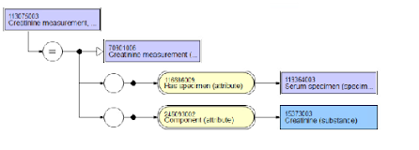
113075003|Creatinine measurement, serum (procedure)|

Slide 5
Lab Templates:
Assumptions & Pragmatics
The most specific Substance will be chosen based upon FSN and/or COMPONENT value to specify the Observables COMPONENT
If specimen is specified in SCT definition, INHERES_IN will be populated with that substance; otherwise the FSN will be reviewed for the appropriate substance grouper
If “measurement” is specified in FSN, then PROPERTY will be populated with the most general MEASUREMENT_PROPERTY that is consistent with laboratory test deployment eg: 118594004|Quantity concentration(qualifier)|
DIRECT_SITE will not be routinely employed unless a particular specimen preparation is specified in the FSN:

Slide 6
Migration Model Requirements
INHERES_IN = what we are testing
COMPONENT = what we are testing for
PROPERTY = the aspect of the tested
RELATIVE_TO = if a COMPONENT ratio requires a denominator
TECHNIQUE = if a specified method
PRECONDITION = how the patient was prepared for testing
DIRECT_SITE = only if a specific specimen preparation

Slide 7
Phase 1 Procedures Prep for Classification Testing
Use UK Procedures codes in use for Phase 1 migration assessment (1730 concepts)
Identify Orderables and Process-model Observables by examining FSN and HAS_SPECIMEN and remove those from UK Procedure codes use case (1436 concepts)
Review Specimens and FSN and develop candidates for INHERES_IN
Review Components and FSN and develop candidates for COMPONENT
Assemble candidates for additional defining attributes: PROPERTY, TECHNIQUE, RELATIVE_TO, PRECONDITION, DIRECT_SITE

Slide 8
HAS_SPECIMEN Values in Procedure concept defs
SCTID | FSN | #
NULL | null | 689
122592007 | Acellular blood (serum or plasma specimen | 50
119350003 | Calculus specimen | 6
276833005 | 24 hour urine sample | 29
119364003 | Serum specimen | 313
122575003 | Urine specimen | 110
258442002 | Fluid sample | 16
119361006 | Plasma specimen | 118

Slide 9
Phase 1 Sample Preparation for Classification Testing
1730 Procedure concepts verified in use for lab results coding in UK
211 Orderables: “73718004|Urine protein electrophoresis (procedure)” removed from sample
8 Process Observables model: “395135003|Activated partial thromboplastin time 50:50 mix” (urinary excretion rates, PT, PTT and clotting tests) removed from sample
1511 UK procedure concepts in use for lab results coding for phase 1

Slide 10
INHERES_IN assumptions for discussion…
“Fluid sample” ➔ 3346305|Liquid (substance) (16 concepts)
“Plasma” ➔ 50863008|Plasma (substance) (149)
“Serum” ➔ 67922002|Serum (substance) (391)
“Urine” ➔ 78014005|Urine (substance) (138)
“Unspecified” ➔ 256906008|Blood material (substance) (584)
“Acellular blood” ➔ 762634006|Acellular blood (substance) (46)
“Fecal” ➔ 39477002|Feces (substance) (13)
“CSF” ➔ 65216001|Cerebrospinal fluid (substance) (8)

Slide 11
Issues with assigning INHERES_IN
Half of Evaluation Procedures had no defining features for HAS_SPECIMEN
Unspecified types of blood tests: “271062006|Fasting blood glucose (procedure)” appeared to be blood tests of some type
DECISION: OK TO USE BLOOD MATERIAL AS INHERES_IN FOR NOW BUT REEVALUATE AFTER CLASSIFICATION EXPERIMENT
Blood cell studies: “Erythrocyte protoporphyrins”, “Leukocyte alkaline phosphatase”
DECISION: MODEL AS INHERES_IN = CELL STRUCTURE

Slide 12
Issues with assigning COMPONENT
Blood counts; discrepancy with modelling of tech preview: “74765001|Lymphocyte count (procedure)” do we use the cell structure or the “population of cells in fluid”
DECISION: IDENTIFY THIS AND SIMILAR TESTS UNSPECIFIED AS TO AMBIGUOUS AND REMOVE FROM PHASE 1 SCOPE

Slide 13
Issues with defining ‘total’ as denominator
271215008| Plasma free/total protein S ratio measurement (procedure)
DECISION: PROCEED WITH MODELING COMPONENT=FREE PROTEIN S, RELATIVE_TO = PROTEIN S;
CONTACT TONI MORRISON WITH CONCERNS THAT FREE PROTEIN S IS NOT A SUBTYPE OF PROTEIN S

Slide 14
Issues with assigning DIRECT_SITE
401102003|Blood spot thyroid stimulating hormone level (procedure): INHERES_IN = “Blood material”?, DIRECT_SITE = “Blood spot specimen”?
DECISION: OK FOR NOW…

Slide 15
Issues with assigning PROPERTY
415732003|Total treponema antibody measurement (procedure): PROPERTY = 118556004|Quantity concentration?
DECISION: USE QUANTITY CONCENTRATION
408239004Treponema pallidum gelatin agglutination test (procedure): PROPERTY = 705057003|Presence + TECHNIQUE = Gelatin agglutination technique

Slide 16
Meeting 14 discussion
20210721
Previous issues:
  Procedures “COMPONENT” a candidate for Observables COMPONENT
  Sparing use of DIRECT_SITE
  “Measurements”: PROPERTY = Quantity concentration

Slide 17
Followup from Farzaneh
https://confluence.ihtsdotools.org/display/OBSERVABLE/Free%2C+bound%2C+and+Total+substances
The current plan is to represent the base substance, the bound and the free substance as three siblings with a "substance X and derivatives" common supertype
This would support the Observables use cases of allowing querying for substances without regard for "bound-ness", and to distinguish between bound, free, and total.
Three patterns for Observables would be:
  Free X Observable === Observable & component = Free X
  Bound X Observable === Observable & component = Bound X (or X bound to Y)
  Total X Observable === Observable & component X (base substance concept)
FOLLOWUP WITH FARZANEH AND GROUP

Slide 18
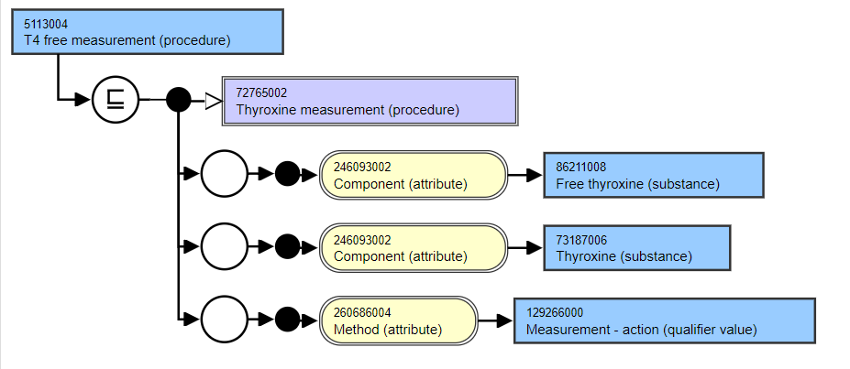
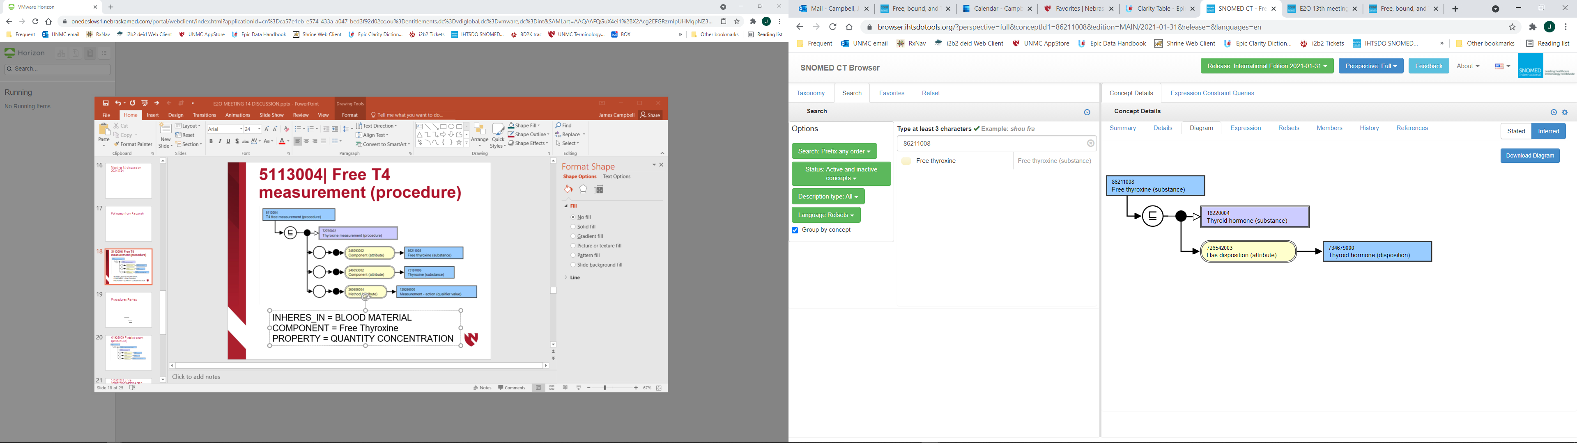
5113004| Free T4 measurement (procedure)
INHERES_IN = BLOOD MATERIAL
COMPONENT = Free Thyroxine
PROPERTY = QUANTITY CONCENTRATION

Slide 19
5113004| Free T4 measurement (procedure)
DELIVERABLE: APPROACH FARZANEH WITH
CONCERNS OF TEAM THAT ‘BOUND SUBSTANCE’
MAY NOT HAVE USE CASE; QUESTION
DEPLOYMENT PLAN FOR SNOMED CT
INHERES_IN = BLOOD MATERIAL
COMPONENT = Free Thyroxine
PROPERTY = QUANTITY CONCENTRATION

Slide 20
Procedures Review
1% Process observables: “Prothrombin time”
6% Orderables: “HIV type 1 and 2 antibodies and antigen”
1% Ambiguous: “Rheumatoid arthritis latex test”
Not “Measurement” but rather:
  “Protein C Assay” ?LEAVE OUT PROPERTY?
  “Liver antibody level” USE QUANTITY CONCENTRATION
  “Malaria antigen test” LEAVE OUT PROPERTY
  Cell counts…

Slide 21
Procedures Review
1% Process observables: “Prothrombin time”
6% Orderables: “HIV type 1 and 2 antibodies and antigen”
1% Ambiguous: “Rheumatoid arthritis latex test”
Not “Measurement” but rather:
  “Protein C Assay” ?LEAVE OUT PROPERTY?
  “Liver antibody level” USE QUANTITY CONCENTRATION
  “Malaria antigen test” LEAVE OUT PROPERTY
  Cell counts…
DELIVERABLE: EXPLORE ‘ASSAY’ USE CASE
NEXT CALL WITH MORE EXAMPLES TO FLESH
OUT CONTEXT

Slide 22
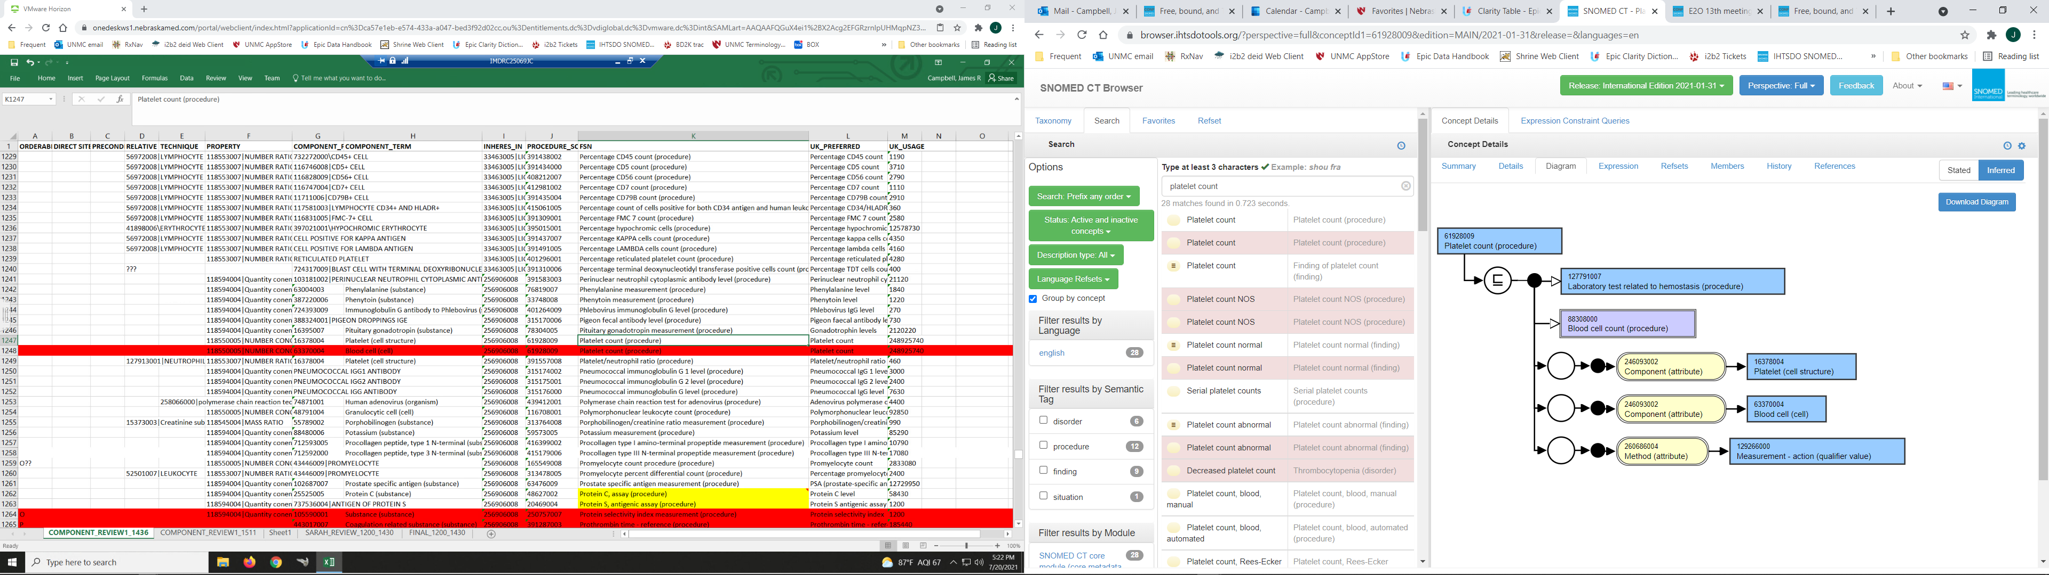
61928009|Platelet count (procedure)
INHERES_IN = FLUID SUBSTANCE
COMPONENT = Platelet (cell)
PROPERTY = NUMBER CONCENTRATION

Slide 23
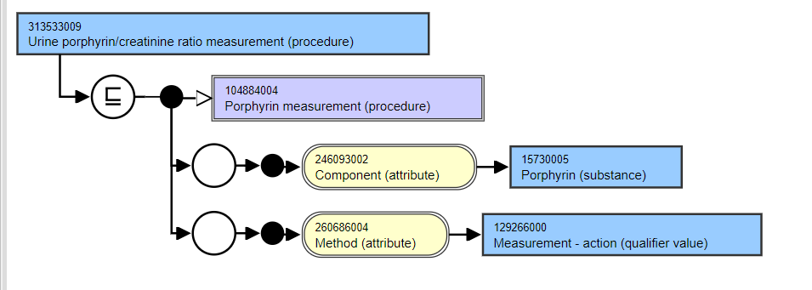
313533009|Urine porphyrin/creatinine ratio (procedure)
INHERES_IN = URINE
COMPONENT = Porphyrin
RELATIVE_TO = Creatinine
PROPERTY = Ratio

Slide 24
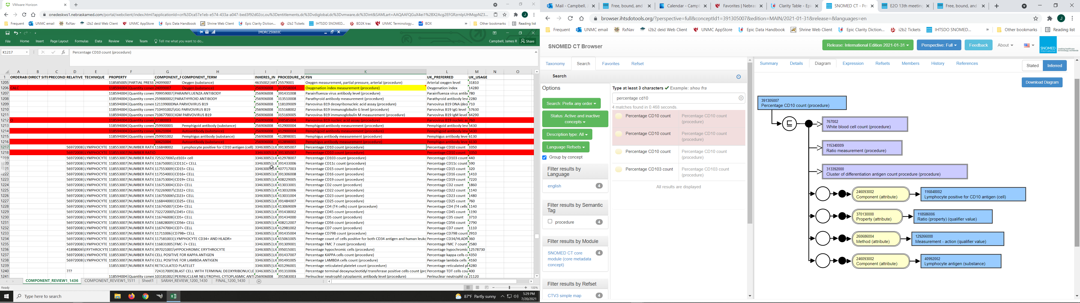
391305007|Percentage CD10 count (procedure)
INHERES_IN = FLUID
COMPONENT = Cell positive for CD10 antigen
RELATIVE_TO = Lymphocyte
PROPERTY = Fraction

Slide 25
391305007|Percentage CD10 count (procedure)
DELIVERABLE: DANIEL TO APPROACH MODELLING
TEAM WITH REQUIREMENT THAT FRACTION
PROPERTY MUST BE SUBTYPE OF RATIO IN
QUALIFIERS\PROPERTY
JIM TO CHECK DEFAULT CELL TYPE FOR
DENOMINATOR
INHERES_IN = FLUID
COMPONENT = Cell positive for CD10 antigen
RELATIVE_TO = Lymphocyte
PROPERTY = Fraction

Slide 26
END DISCUSSION 20210721
Karim: At the last E2O I attended I had a some reservation about the general “measurement” concepts as observable entity codes because in theory any value type could go against the code – quantitative or qualitative. I think Daniel said that even the qualitative result of positive/negative is still ordinal (might have misheard). I am wondering whether the problem runs deeper if the proposal is to model these high level “measurement” concept with a property of 118556004|Quantity concentration

Slide 27
Followup Issues
1511➔1304 concepts excluding orderables, process observables and ambiguous procedure concepts
“Fluid lactate dehydrogenase measurement (procedure)”; Property = “Catalytic concentration” will be revised to QUANTITY CONCENTRATION except those specifying ‘activity’ in the FSN

Slide 28
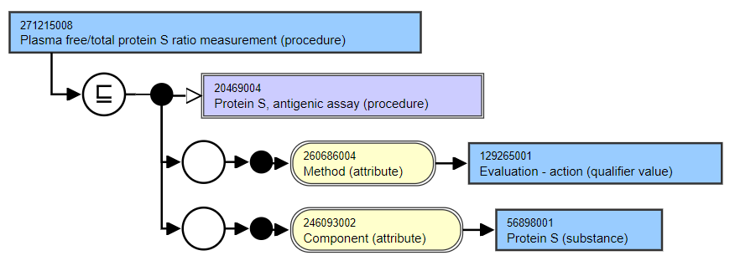
271215008|Plasma free/total protein S ratio measurement (procedure)
INHERES_IN = PLASMA
COMPONENT = FREE PROTEIN S
PROPERTY = QUANTITY FRACTION?
RELATIVE_TO = PROTEIN S
DK has submitted to SNOMED: Fraction will be a subtype of ratio

Slide 29
E2O 15: Properties Review
Not “Measurement” but rather:
  “Clostridium difficile toxin detection” Agreed out of scope
  “Clotting factor XX assay” use Agreed use QUANTITY_CONCENTRATION
  “Anti-nuclear factor titer” (vs Antinuclear antibody measurement) Agreed out of scope
  “ “Red cell (Erythrocyte) B2 level” Agreed out of scope; will advance issue to Observables call for discussion

Slide 30
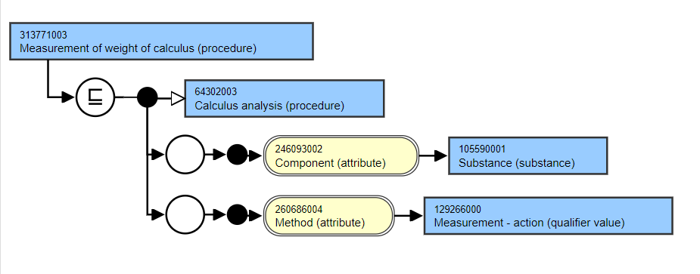
313771003|Measurement of weight of calculus (procedure)
Agreed PROPERTY = ‘Mass’

Slide 31
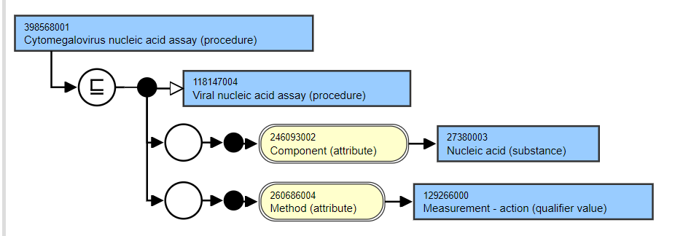
398568001|Cytomegalovirus nucleic acid assay (procedure)
Since nucleic acids may include RNA and DNA and
their subtypes specific to a species, do we extend
modeling of ‘Nucleic acids’ or use that specific to
the viral type?
29604-6|Cytomegalovirus DNA [#/volume] in Blood by
NAA with probe detection
RNA for Dengue and RNA viruses?
JCASE: these procedures are candidates for
inactivation and replacement; Out of scope for
this conversion

Slide 32
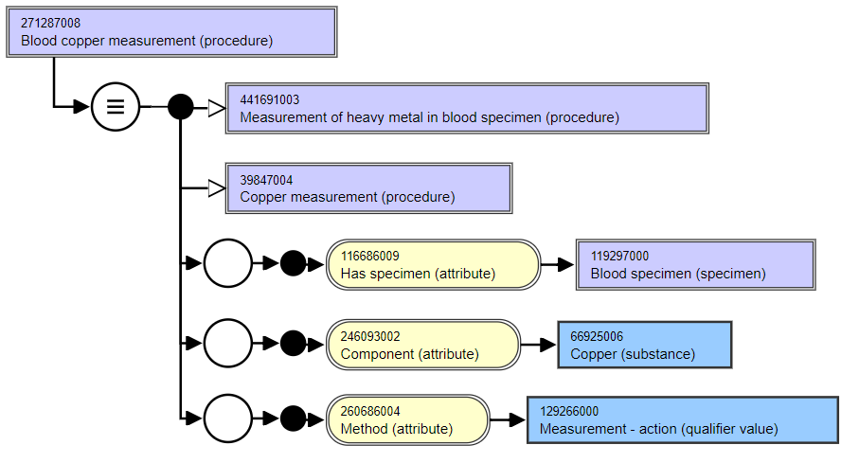
271284001|Blood copper measurement (procedure)
No electrolyte form in SNOMED CT nor
for many other soluble minerals
No action; continue with modelling as available

Slide 33
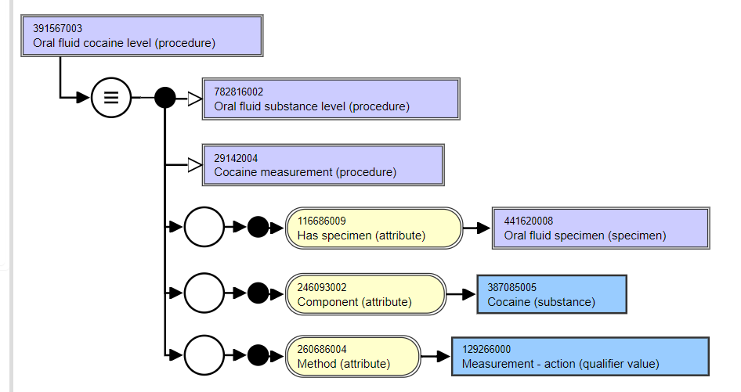
391567003|Oral fluid cocaine level (procedure)
INHERES_IN = LIQUID SUBSTANCE
COMPONENT = COCAINE
INHERENT_LOCATION = ORAL CAVITY
PROPERTY = QUANTITY CONCENTRATION

Slide 34
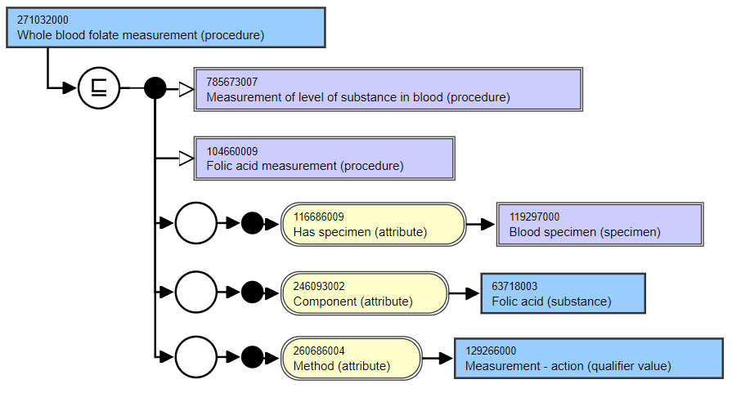
271032000|Whole blood folate measurement (procedure)
INHERES_IN = BLOOD MATERIAL
COMPONENT = FOLIC ACID
DIRECT_SITE = BLOOD SPECIMEN
PROPERTY = QUANTITY CONCENTRATION

Slide 35
END DISCUSSION
20210804

Slide 36
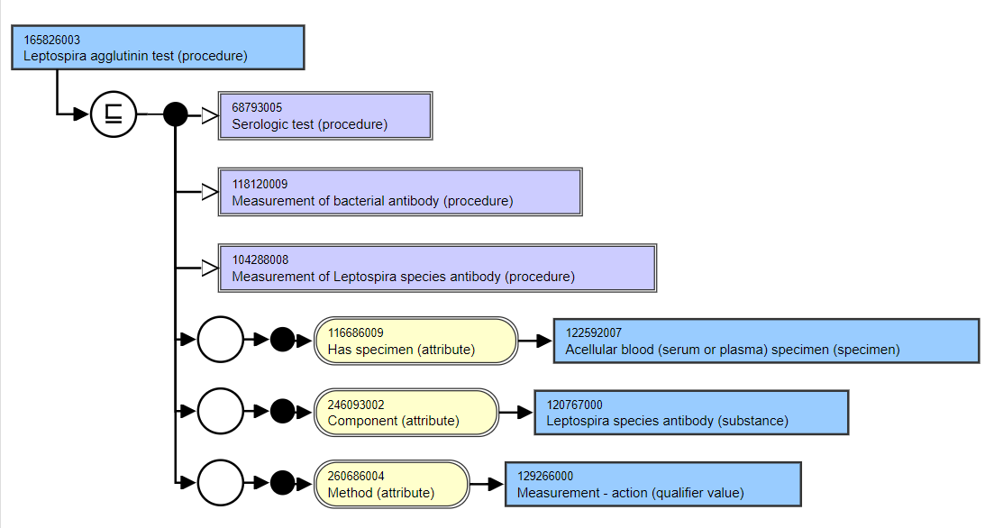
165826003|Leptospira agglutinin test (procedure)
INHERES_IN = BLOOD MATERIAL?
COMPONENT = LEPTOSPIRA ANTIBODY
SCALE_TYPE = ORDINAL
PROPERTY = PRESENCE?
TECHNIQUE = LATEX AGGLUTINATION TECHNIQUE

Slide 37
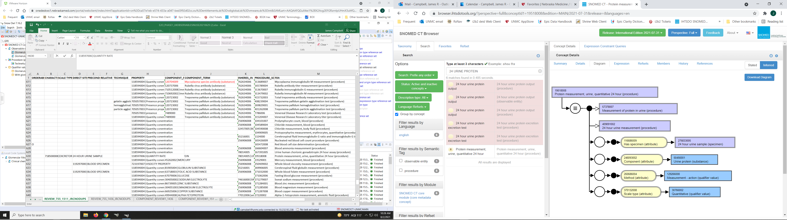
Protein measurement, urine, quantitative 24 hour(procedure)
INHERES_IN = URINE
COMPONENT = PROTEIN
DIRECT_SITE = 24 HOUR URINE SPECIMEN
PROPERTY = QUANTITY RATE
CHARACTERIZES = EXCRETORY PROCESS

Slide 38
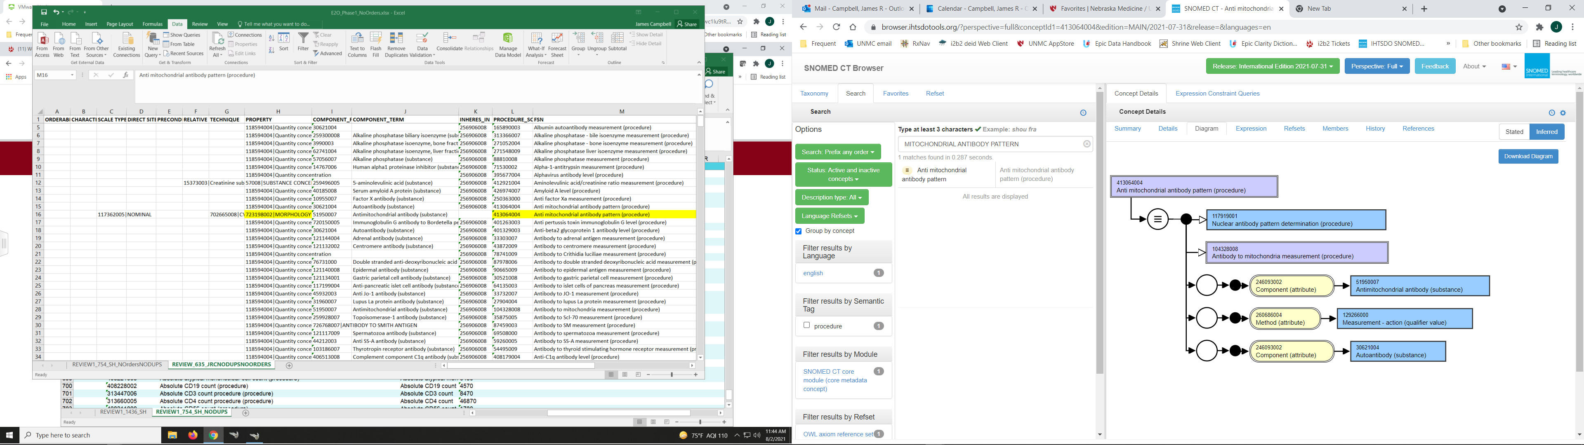
Anti-mitochondrial antibody pattern (procedure)
INHERES_IN = CELL STRUCTURE
COMPONENT = ANTI-MITOCHONDRIAL ANTIBODY
SCALE_TYPE = NOMINAL
PROPERTY = MORPHOLOGY
TECHNIQUE = CYTOLOGY STAINING

Slide 39
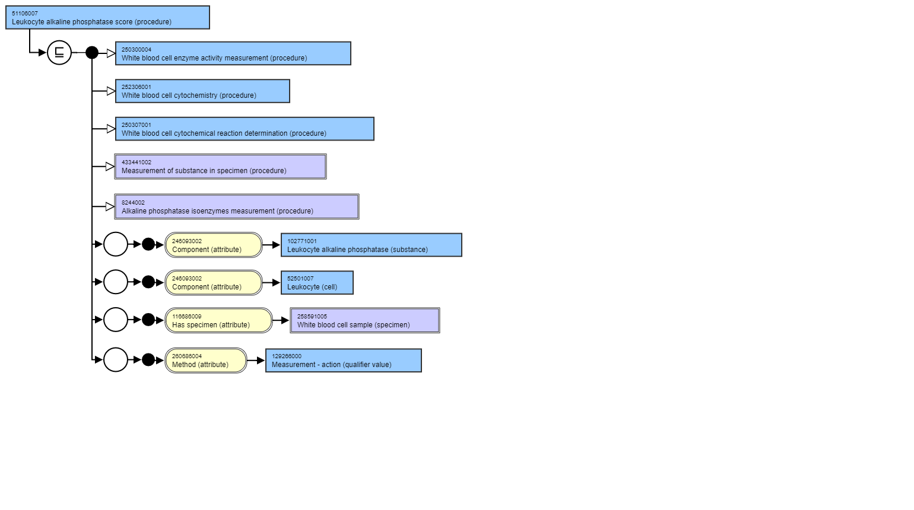
Leukocyte alkaline phosphatase score (procedure)
INHERES_IN = LEUKOCYTE (CELL)
COMPONENT = LEUKOCYTE ALKALINE PHOSPHATASE
SCALE_TYPE = ORDINAL
PROPERTY = MORPHOLOGY
TECHNIQUE = LAP SUPRAVITAL STAINING, MICROSCOPY

