Slide 1
Medical Informatics Initiative Germany
Interoperability: Core Data Set
Terminology Services
Sylvia Thun | Martin Boeker | Josef Ingenerf

Slide 2








Challenges towards Secondary Use of Clinical Data
How can we
achieve harmonized
data structures?
How can we define
consistent (broad) consent
and governance policies?
How can we objectively
measure and optimize
data quality?
How can we
securely implement
data sharing?
Routine
Clinical Data
Governance of
data access
Structured
Clinical Datasets
Patient
Consent
Secondary Use
of Clinical Data

Slide 3
Collaborative solutions through MII Working Groups
Interoperability WG
Modular
MII Core
Dataset
Consent
implementation
Quality &
Provenance
Annotations
Federated
Analysis
Platforms
Consent WG
Data Sharing WG
Harmonized
Data Sharing
Processes
Modular
Consent
Template
Harmonized
Policies &
Contracts
Harmonized Data
Consent & Governance
Quality
Secure Implementation

Slide 4







Harmonized Consent & Governance
Modular
Broad Consent
Template
Harmonized
Data Use Policy
In final negotiation
with all participaing
university hospitals
Approved by
German ethics committes
and data protection
officers
Harmonized
Data Use
Contract
Legal
Guidance
for Use
Structured
Consent
Representation
Data Sharing
Process Models
Patient
Information
Materials
Patient
Empowerment

Slide 5




Terminologies and Standards
SNOMED CT: Clinical Findings, Observable Entities
LOINC: Lab, Vital
ICD-10-GM: Diseases, Symptoms
ATC: Ingredients
UCUM: Units
      Patient (z.B. DEMOGRAPHICS)
      Consent (z.B. CONSENT)
      Observation (z.B. LAB, VITAL)
      Condition (z.B. ANAMNESIS / RISK FACTORS / COMPLICATIONS)
      Procedure (z.B. PROCEDURE)
      Encounter (z.B. CRITERIAS)
      Medication/MedicationStatement (z.B. MEDICATION)
Source: HL7

Slide 6
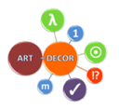




MII Modular Core Dataset
Diagnoses
Lab findings
Basic modules
Procedures
Medication
Data structures
based on
HL7 FHIR
Standard
Demographics
Person
Case data
Collaborative
tools for
requirements
specification
and data
modelling
Oncology
Pathology findings
Billing codes
Semantic
annotation
based on
international
terminologies
Extension modules
Biomaterial
Imaging findings
Cost data
Open governance
processes
and balloting
Genetic tests
PDMS/Biosignals
Structure data
…
…
…
…
…
…

Slide 7
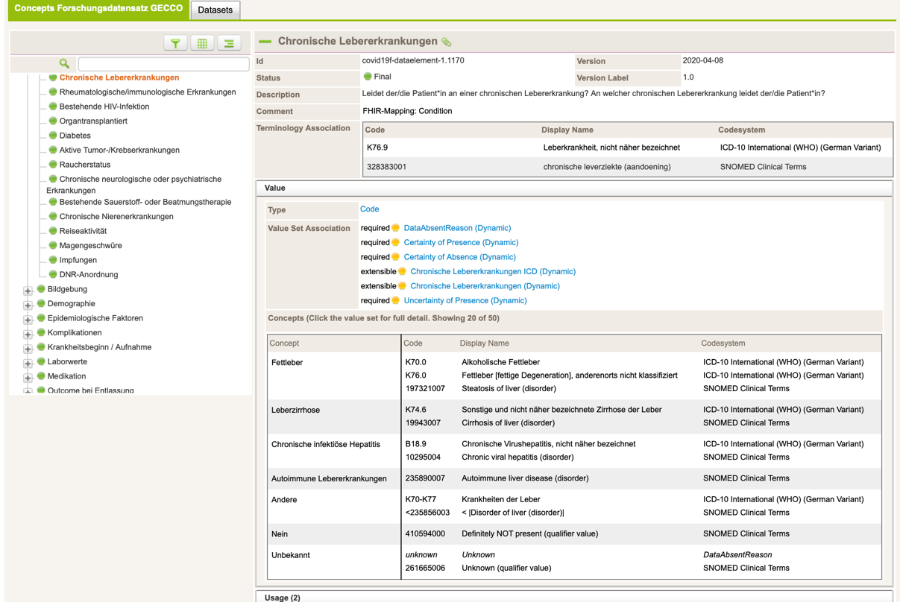
Modelling in ART DECOR

Slide 8
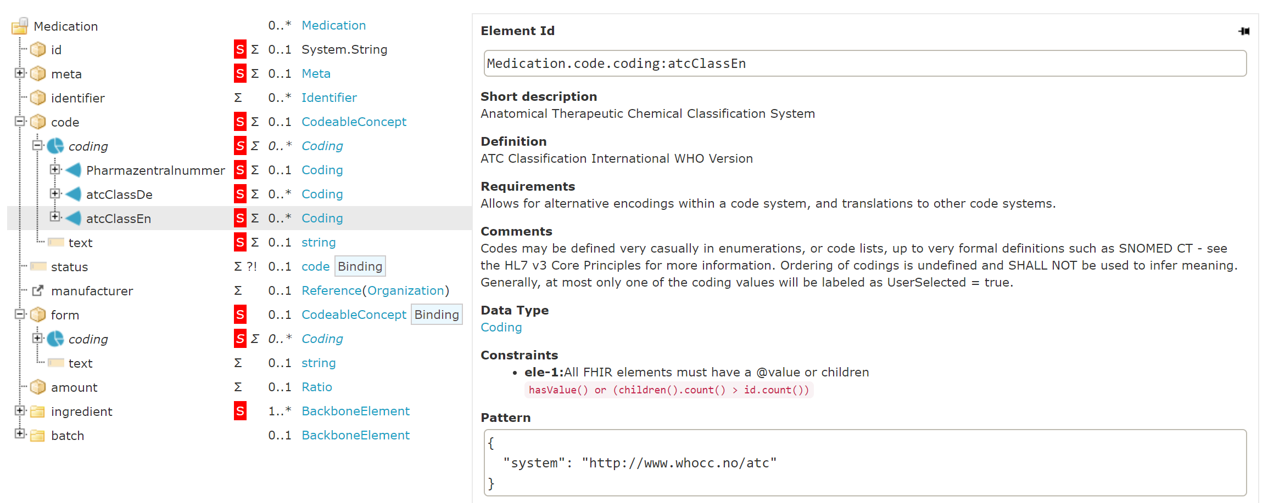
Collaborative Creation of Core Dataset Modules

Slide 9






CDS-based Harmonization & Utilization of Data
Semantic
annotation
Uniform
data structure
Utilization across
multiple locations
Data Access
Extraction &
integration
LIS
PDMS
HL7 FHIR
Terminologies
Diagnoses
Demographics
Data structure
Procedures
Case data
Lab results

Slide 10
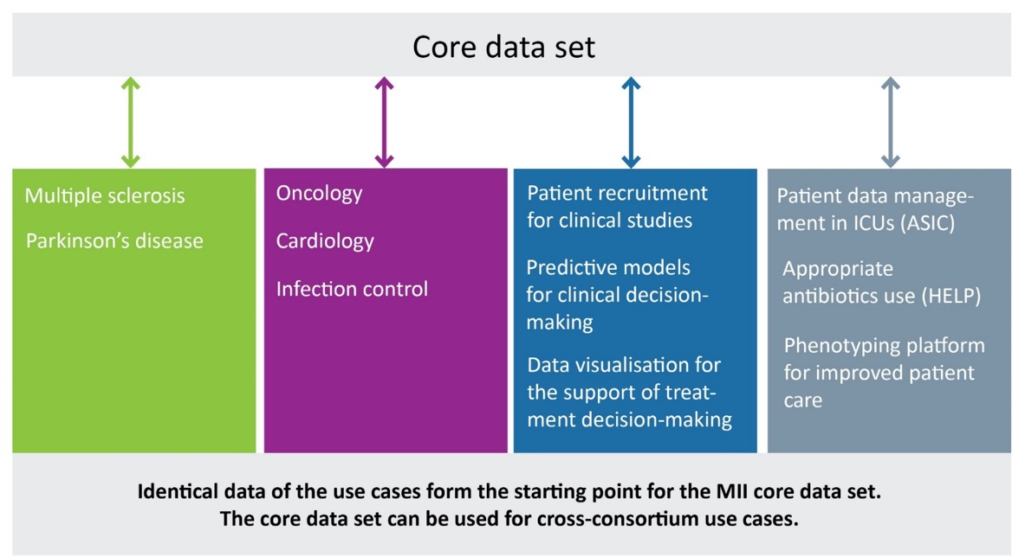
Bundling of CDS Modules for the MII Use Cases

Slide 11

German Corona Consensus Dataset
Notes:
GECCO was developed within the German COVID-19 Research Network of University Medicine
Compact set of standardized data elements to be collected in COVID-19 studies

Slide 12
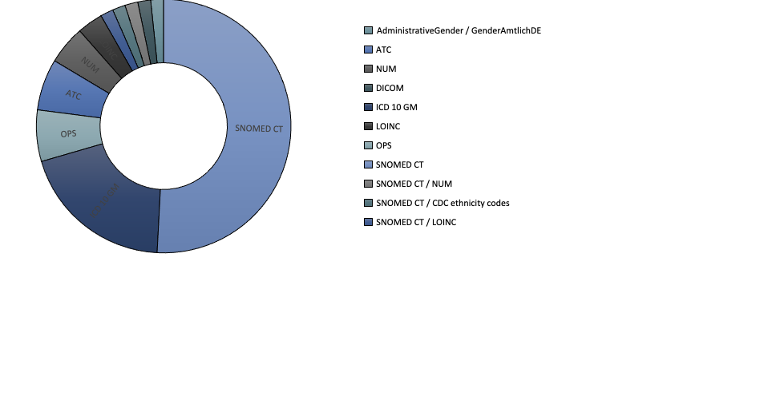
USE CASE: CORONA
German Corona Consensus Dataset GECCO
n=61
Notes:
31 of the 61 ValueSets of the GECCO dataset use SNOMED
SNOMED CT / NUM codes: SNOMED codes were used with extension codes developed in Germany.
We apply for these codes at SNOMED or wait until they show up in the international release

Slide 13
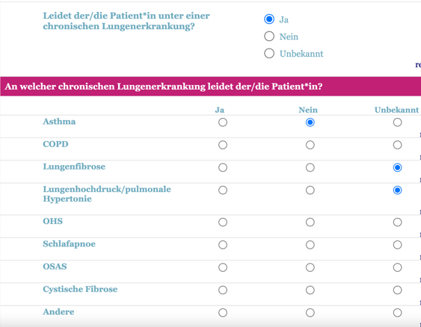
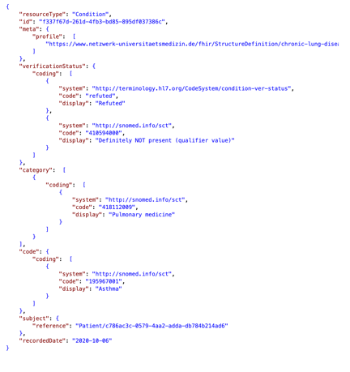


SNOMED CT in GECCO
eCRF
Condition Resource
Notes:
In REDCap export nach FHIR über ETL Strecke#
In Secutrial direkter Export über Programmierte Schnittstelle durch interActive Systems

Slide 14
SNOMED CT in GECCO
Amount Concepts
IsA | 27
Explicit | 199
DescendentOf | 2
praecoordinated | 223
postcoordinated | 5

Slide 15
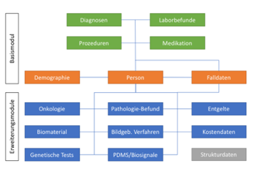
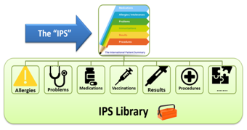




International Patient Summary in Science
Sources: HL7, MII; gematik, KBV

Slide 16
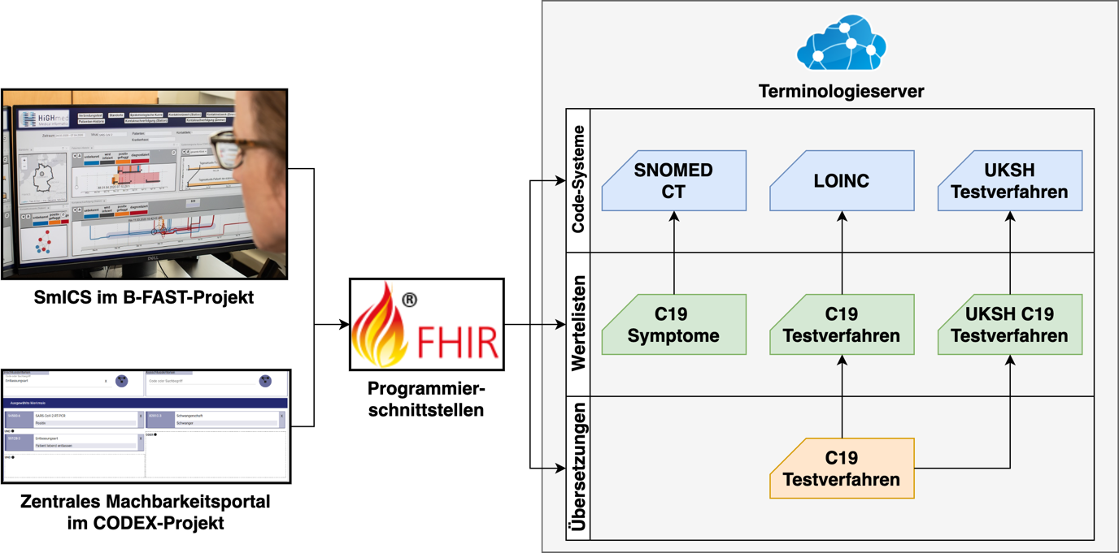
Working with SNOMED CT at UKSH, Campus Lübeck
1. MIRACUM Use Case
„Molecular Tumor
Board“
4. Providing CodeSystems, ValueSets and
ConceptMaps for validating and querying
2. HiGHmed Use Case
„Infectiology“
SmICS (Smart Infection
Control System)
terminology
operations
3. Feasibility Explorer

Slide 17
1. MIRACUM – Use Case „Molecular Tumor Board“
UKSH, Campus Lübeck (HiGHmed) works on that cross-consortia use case.
cBioPortal for Cancer Genomics (LINK) as the central platform
makes use of OncoTree (LINK) for visualizing the data and for
accessing knowledge bases like „OncoKB“
Routine coding of oncological data is based on ICD-O (location, histology).
=> Mapping ICD-O-codes to OncoTree using SNOMED CT for mediation.
Postcoordination
?
⊑
ICD-O-
location
SCT-
topo
ICD-O
Pärchen
SCT-
disease*
SCT-
disease
OncoTree-
Code
ICD-O-
histology
SCT-
morpho
Ontoserver
Subsumption?
* 93880001 |Primary malignant neoplasm of lung (disorder)| = 64572001 |Disease (disorder)|:
{ 363698007 |Finding site (attribute)| = 39607008 |Lung structure (body structure)|,
116676008 |Associated morphology (attribute)| = 86049000 |Malignant neoplasm, primary (morphologic abnormality)| }
Reimer N, Unberath P, Busch H, Ingenerf J (2021). FhirSpark - Implementing a Mediation Layer to Bring FHIR to the cBioPortal for Cancer Genomics. Stud Health Technol Inform 281303–307. doi: 10.3233/SHTI210169
The mapping issue will be published soon.

Slide 18
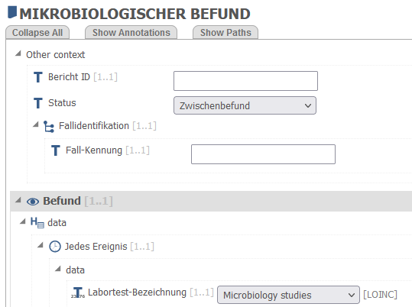
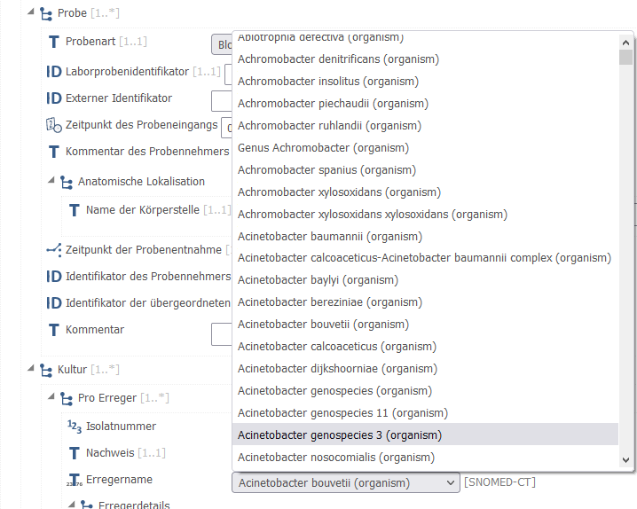
2. HiGHmed - Use Case „Infection Control“
see Talk from Semler, Ganslandt, Sax on SNOMED CT - Expo, October 2020
Microbiology Report, modelled with Clinical Knowledge Manager (CKM, openEHR), see https://ckm.highmed.org/ckm/templates/1246.169.69
Wulff A, Baier C, Ballout S, Tute E, Sommer KK, Kaase M, Sargeant A, Drenkhahn C, Schlüter D, Marschollek M, Scheithauer S (2021). Transformation of microbiology data into a standardised data representation using OpenEHR. Sci Rep 11(1):10556.
Drenkhahn C, Duhm-Harbeck P, Ingenerf J (2019). Aggregation and Visualization of Laboratory Data by Using Ontological Tools Based on LOINC and SNOMED CT. Stud Health Technol Inform 264108–112. doi: 10.3233/SHTI190193

Slide 19
3. Feasibility Explorer
A query component supports federative queries directed to data integration centers, inclusive checking eligibility criteria of clinical trials.
For filling the pick-up lists for queryable criteria the Ontoserver is used.
According to the Core Data set hierarchical Value Sets are queried dynamically (amongst others) by SNOMED´s ECL-Expressions.
„Still work in progress“
Banach A, Ulrich H, Kroll B, Kiel A, Ingenerf J, Kock-Schoppenhauer A-K (2021). APERITIF - Automatic Patient Recruiting
for Clinical Trials Based on HL7 FHIR. Stud Health Technol Inform 28158–62. doi: 10.3233/SHTI210120

Slide 20
4. Ontoserver – Providing terminological services
Tool-support with respect
to Ontoserver, e.g. Snapper,
Shrimp, Postman, ...
other Terminology-
Servers supporting
the protocol
Session 3
Session 1
FHIR Terminolo-
gical operations
Questions?
Access control: Authentification, Authorization
Session 4
Session 6
Session 5
Session 2
FHIR API
Admin API
Syndication API
Relevant FHIR Resources and Operations
FHIR Library
Ontoserver
CodeSystem | ValueSet | ConceptMap
$lookup | $expand | $translate
$validate-code | $validate-code | $closure
$subsumes
$find-matches (Trial use)
Session 1
Indexes
Database
Metke-Jimenez A, Steel J, Hansen D, Lawley M (2018).
Ontoserver: a syndicated terminology server.
Journal of biomedical semantics 9(1):24.

Slide 21
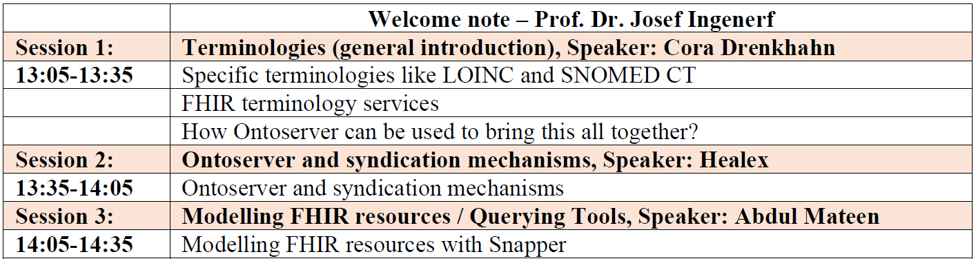
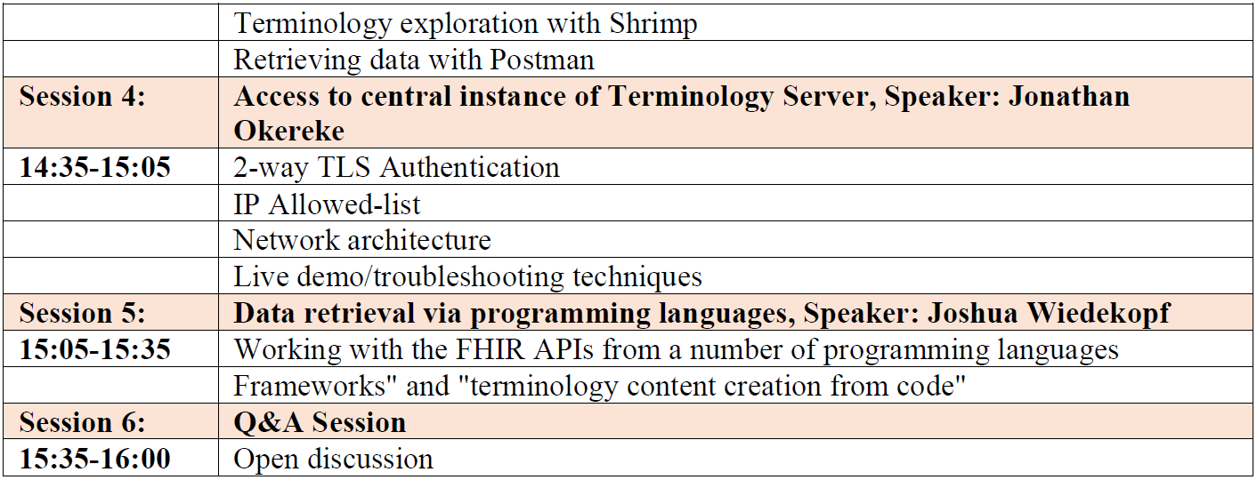
Workshop „Terminology Server“
(Universities in Cologne and Lübeck)
05. July 2021

Slide 22
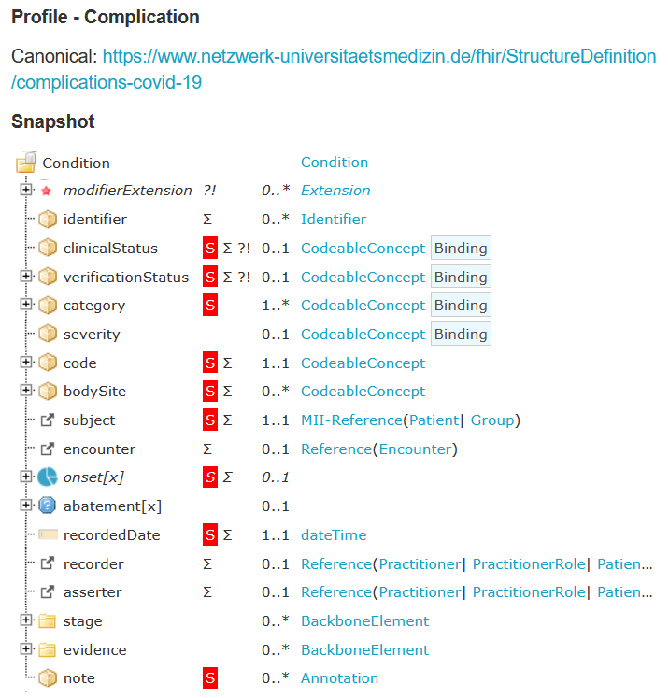
Core data sets (MII) and GECCO data sets (NUM)
Implementation Guide on Simplifier:
A variety of FHIR profiles references
numerous ValueSets with coded concepts for:
standardized data entry
validation of used codes, incl. versions
Data queries, e.g. federated Feasibility-
Explorer in MII and NUM
basis for data analysis on integrated data
Need for terminological services!
Need for a FHIR-based terminology server!

Slide 23
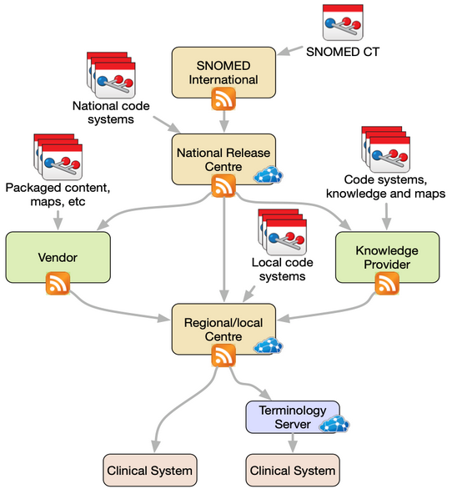
Ontoserver: Syndication
One of Ontoserver’s key features is support for content syndication.
based on the Atom Publishing Protocol and Atom Syndication Format specifi-cations of atom feeds.
Ontoserver instances can be configured to point to any number of upstream syndication feeds.
Using the Syndication API, Ontoserver can then find and download supported FHIR Resource types as well as SNOMED CT and LOINC code systems.
https://ontoserver.csiro.au/docs/6/syndication.html

Slide 24
Cascading Terminology Servers
Terminology Server
(Germany)
z.B. official Classifications (ICD-10, OPS)
und Terminologies (LOINC, Alpha-ID, ...)
Terminology Server
(Governmental Activities)
z.B. MIOs, ISiK, ...
Terminology Server
(Research context)
z.B. KDS, GECCO, ...
Medical Informatics Initiative (MII) and
Network of University Medicine (NUM)
cooperate in infrastructure issues.
Terminology Server
(DiFUTURE)
z.B. Use Case – relevant Terminologies, ...
Terminology Server
(HiGHmed)
z.B. Use Case – relevant Terminologies, ...
Terminology Server
(MIRACUM)
z.B. Use Case – relevant Terminologies, ...
Terminology Server
(SMITH)
z.B. Use Case – relevant Terminologies, ...
Further
Usages
Terminology
Server
(Site 1)
e.g. + local
Terminologies, ...
Terminology
Server
(Site n)
e.g. + local
Terminologies, ...
Terminology
Server
(Site 1)
e.g. + local
Terminologies, ...
Terminology
Server
(Site n)
e.g. + local
Terminologies, ...
Terminology
Server
(Site 1)
e.g. + local
Terminologies, ...
Terminology
Server
(Site n)
e.g. + local
Terminologies, ...
Terminology
Server
(Site 1)
e.g. + local
Terminologies, ...
Terminology
Server
(Site n)
e.g. + local
Terminologies, ...
...
...
...
...

Slide 25

Thank you
Prof. Dr. med. Martin Boeker Technical University of Munich
Prof. Dr. med. Sylvia Thun Charité Universitätsmedizin Berlin
Prof. Dr. Josef Ingenerf University of Lübeck
https://www.medizininformatik-initiative.de/en/start

