Slide 1
Machine Learning and SNOMED CT: Building a better Glasgow Coma Scale
James Campbell MD
University of Nebraska Medical Center

Slide 2
Machine Learning and Data Quality
Analyzes data sets looking for relationships between data elements that may represent new knowledge
Unsupervised ML on unstructured data such as free text reports requires much larger training sets and extensive curation/interpretation of results
Well structured (codified) data sets with good metadata (domain ontologies defining dataset semantics) are better suited to unsupervised ML; that is also true for analytics and decision support applications

Slide 3
Glasgow Coma Scale in SNOMED CT Currently
14 Clinical finding primitives; “Glasgow coma scale; 10” IS_A “Glasgow coma scale finding”;(EHR Problem list or Encounter diagnosis)
6 Observable primitives; “Glasgow coma score” IS_A “Component of Glasgow coma scale ”;(Clinical observation results)
1 Assessment scale; “Glasgow coma scale”
Since the findings and observables are all primitive, SNOMED CT concept model contributes only the codification and the IS_A relationship from the definition to metadata which might support machine learning

Slide 4
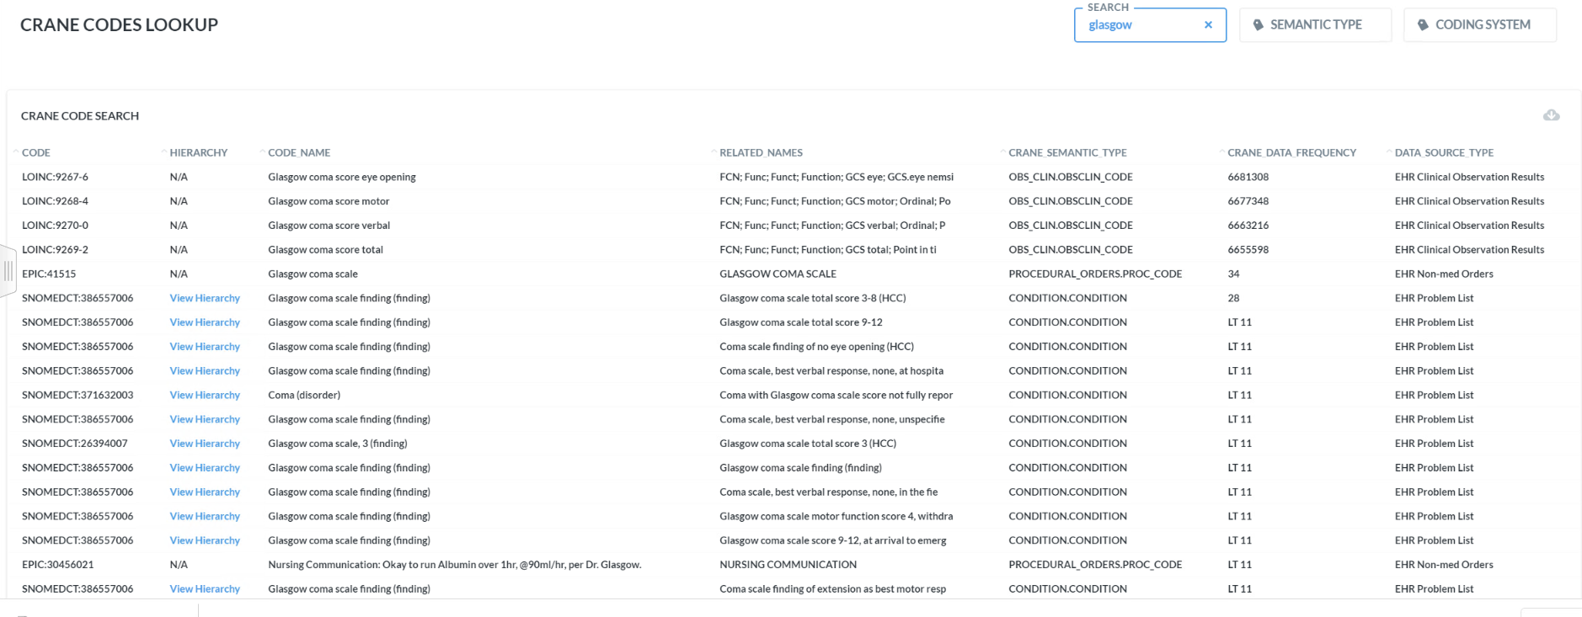
Nebraska Data Frequency:
Glasgow Coma Scale

Slide 5
Glasgow Coma Scale
Glasgow Coma Scale
The Scale was described in 1974 by Graham Teasdale and Bryan Jennett as a way to communicate about the level of consciousness of patients with an acute brain injury.
Assessment of coma and impaired consciousness. A practical scale. Lancet 1974; 2:81-4.
Teasdale G, Maas A, Lecky F et al. The Glasgow Coma Scale at 40 Years: standing the test of time. Lancet Neurology 2014 ;13(8) : 844-854

Slide 6

Glasgow Coma Scale
Opening and control of eye movements in response
to verbal request
Response to questioning “Where are you now? What
is your name? What is today’s date?”
Response to request to move arms and legs; followed
by escalating painful stimulus if no purposeful
response.

Slide 7
Glasgow Coma Scale: Fully defining the observables at Nebraska Medicine
Since the GCS quantifies the results of a series of observations on the patient responsiveness and neurologic control, it is best defined with the Observable PROCESS template
INHERES_IN = Organ system function observed
CHARACTERIZES = Physiologic process being assessed
PROPERTY = What feature of the process is being assessed?
TECHNIQUE = 386554004|Glasgow coma scale (assessment scale)|

Slide 8
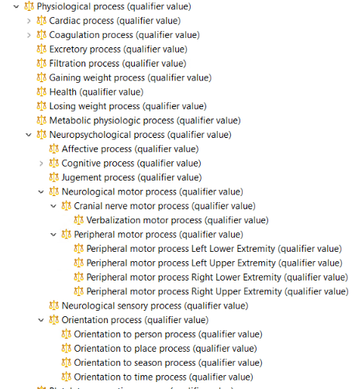
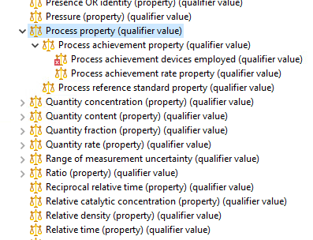
GCS new attribute definitions
Process (qualifier) Property (qualifier)

Slide 9
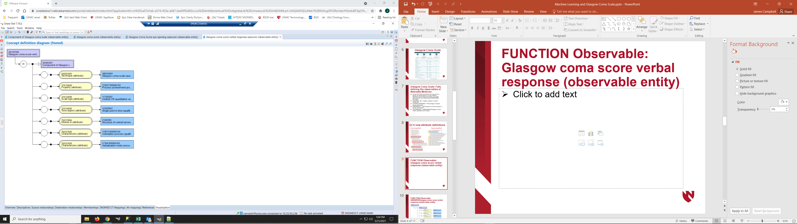
PROCESS Observable:
Glasgow coma score verbal subscore (observable entity)
Observation result:
Assessing the patient Central Nervous System
Characterizing orientation and verbalization
How well orientation/verbalization are working
Employing techniques of Glasgow Coma Scale
Recorded as semiquantitative ordinal scale

Slide 10
PROCESS Observable:
Glasgow coma score verbal subscore (observable entity)
Result refset:
None - unresponsive
Sounds – utterances not intelligible
Words – utters intelligibly
Confused – confused verbal response
Oriented – responds and oriented

Slide 11
PROCESS Observable:
Glasgow coma score verbal subscore (observable entity)
Think of this as the ontologic definition (metadata)
In the EHR for what this piece of data is about!
Machine learning, here we come!

Slide 12
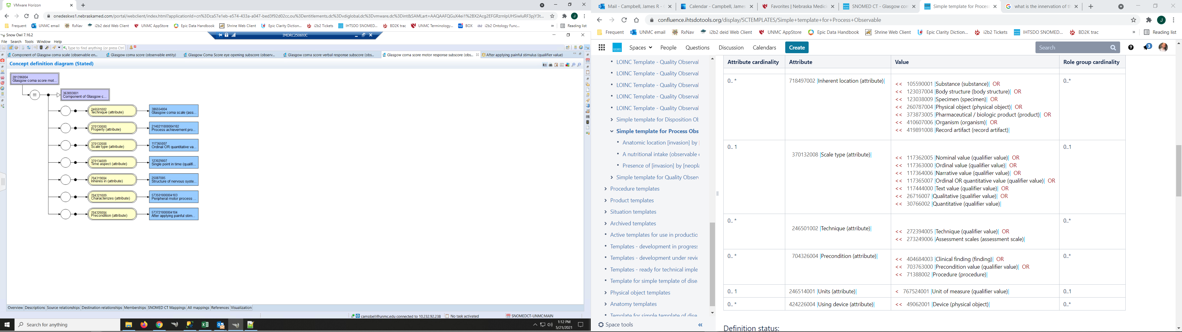
PROCESS Observable:
24824002|Glasgow coma score motor response subscore (observable entity)

Slide 13
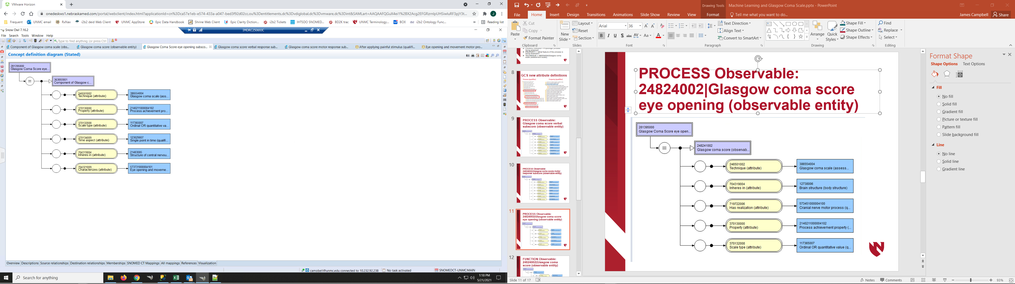
PROCESS Observable:
24824002|Glasgow coma score eye opening subscore (observable entity)

Slide 14
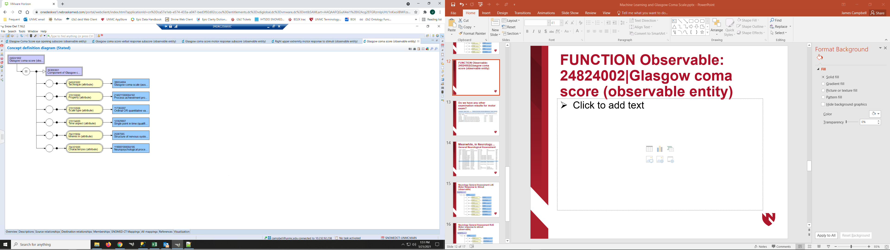
PROCESS Observable:
24824002|Glasgow coma score (observable entity)

Slide 15
GCS Clinical findings Results in the EHR
Some of these data are only stored in notes in some EHR systems. (Machine learning further complicated there…)
At Nebraska Medicine and in many US EHRs, these types of findings data are recorded as text/numbers in flowsheets or similar data entry forms integrated into the workflow management of the clinician and stored accordingly as Observable-Result pairs
The findings of a particular event are retrieved and organized in the encounter summary for clinical review
Pre-coordinated (primitive) Clinical findings are only recorded in the event that a clinician wants to place the finding on the Problem list or in an Encounter diagnosis

Slide 16
Nebraska Data Frequency:
Glasgow Coma Scale

Slide 17
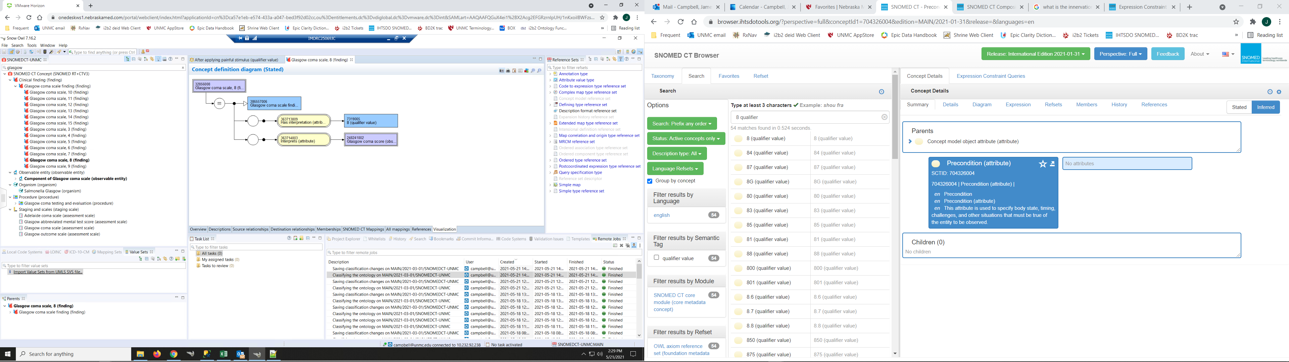
Observable entities can be employed in the concept model to fully define the associated Clinical findings:
32856008|Glasgow coma scale, 8 (finding)|
Precoordinating the results data into the Clinical finding
obfuscates the meaning of the result finding since the definition
of WHAT is being measured and HOW it is recorded is
buried in the Observable entity one layer deeper in the
Metadata. The Clinical findings concept model has no other features
of use to support full semantic interoperability or for defining the
precise ontologic definition of what the data means.

Slide 18
For building a machine learning dataset;Do we have any other examination results for items such as motor exam after stimulus?
<<363787002|Observable entity (observable entity)|:
{704321009|Characterizes (attribute)| = <<563201000004106|Neurological motor process (qualifier)| },
{704326004|Precondition (attribute)| = 573721000004104|After applying painful stimulus (qualifier value)|}
SNCTID | FSN
281396004 | Glasgow coma score motor response subscore
573671000004109 | Right upper extremity motor response to stimuli
573681000004107 | Left upper extremity motor response to stimuli

Slide 19
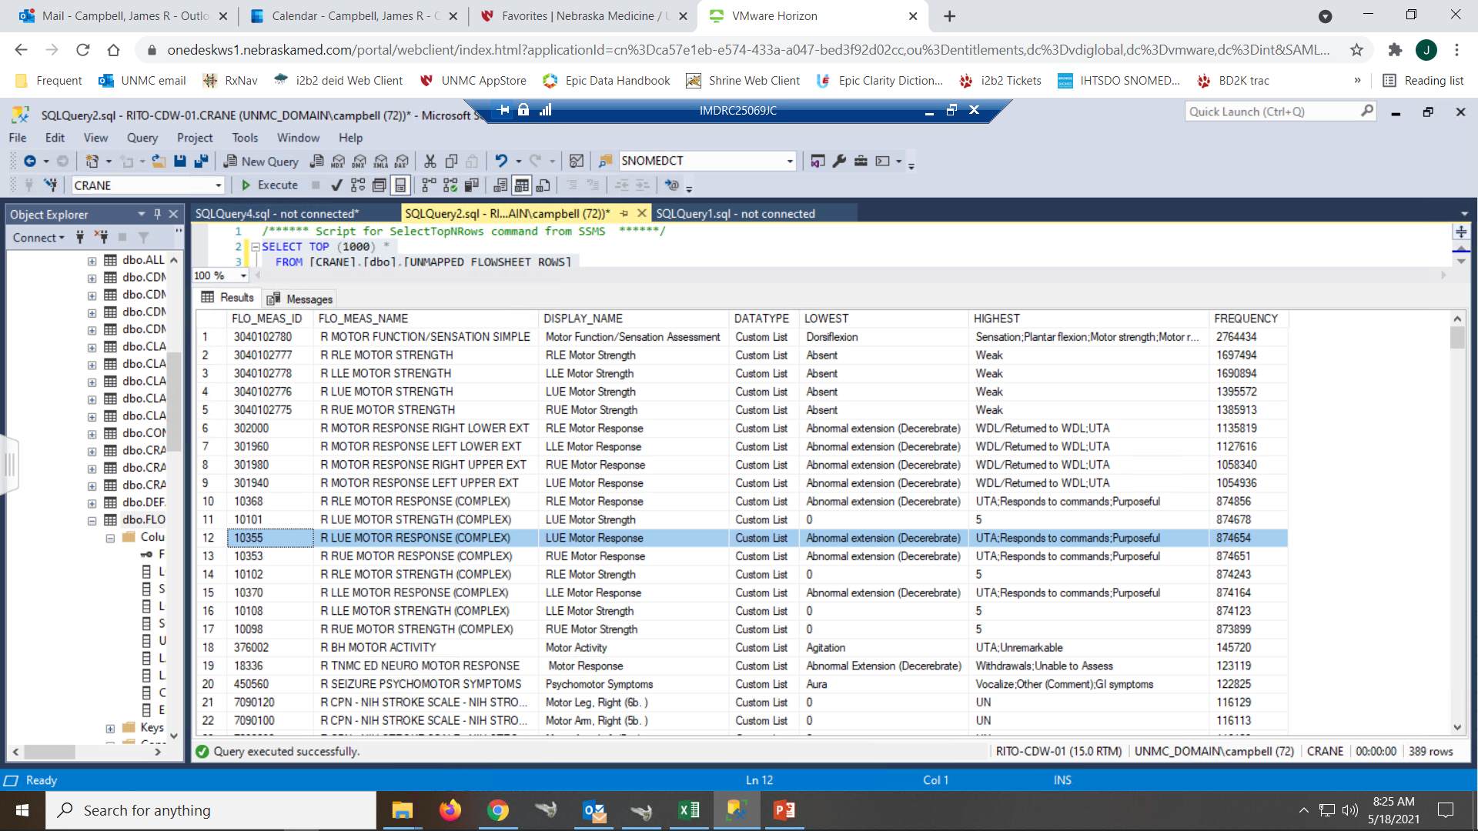
Meanwhile, in Neurology…
General Neurological Assessment

Slide 20
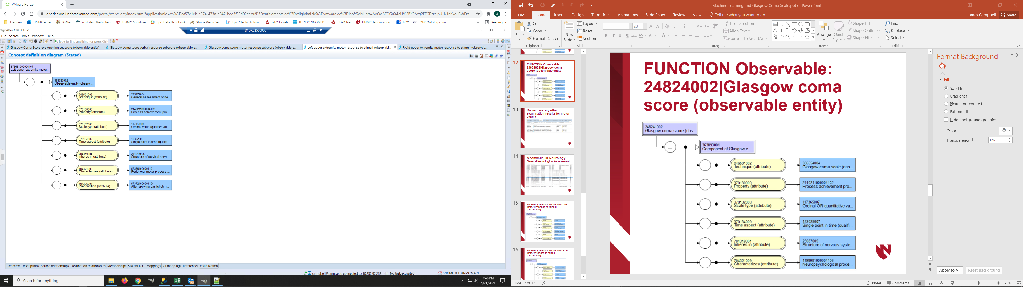
Neurology General Assessment: LUE Motor Response to Stimuli (observable)

Slide 21
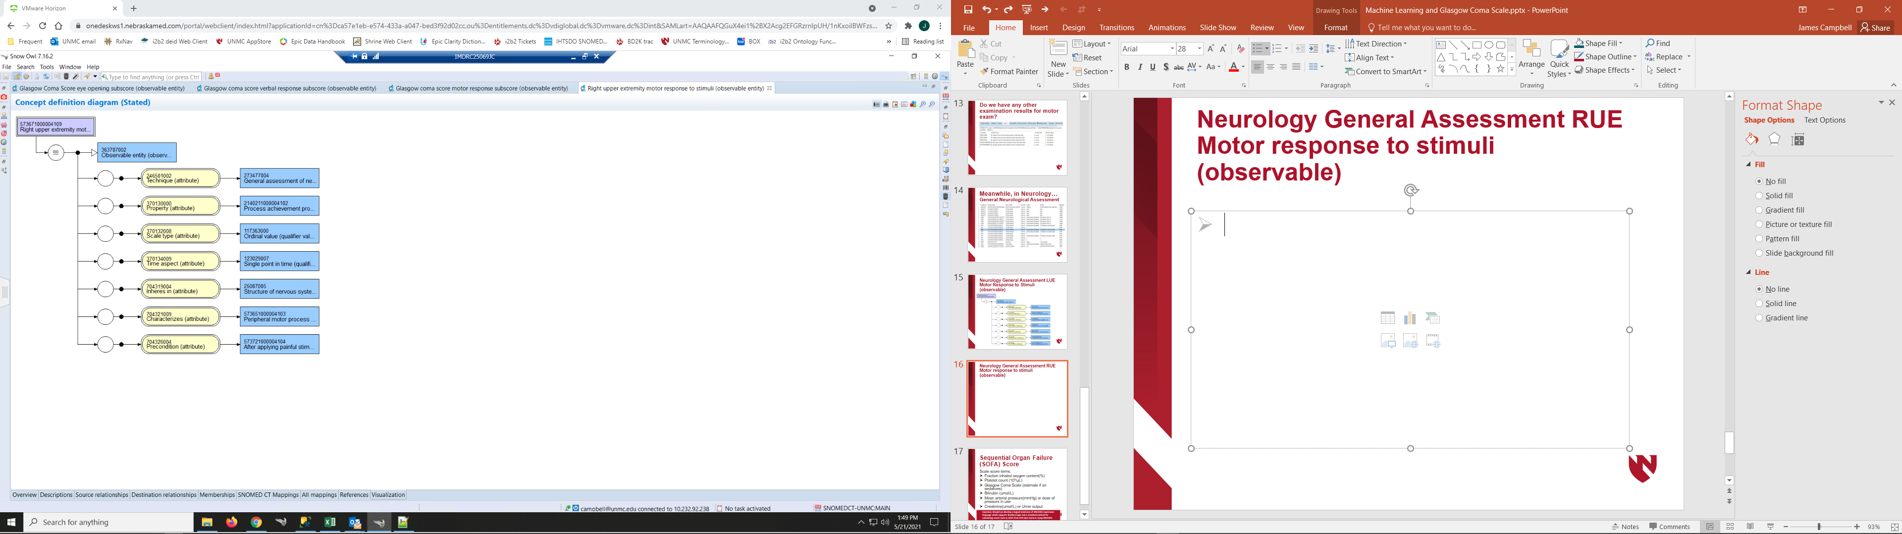
Neurology General Assessment: RUE Motor response to stimuli (observable)

Slide 22
ML: Motor examination aka Glasgow Coma Scale
In order to best support machine learning and analytics, SNOMED CT needs to fully define primitives (CF, Obs, Procs, Meds)
In this thought experiment, the Observables concept model allows us to build robust metadata defining the results of the neurologic examination and assessment scales in support of ML
These data may be recorded as fully defined Clinical findings or as Observation results but the analytics procedures are simpler and scalable if we use the latter
In US EHRs, tons of clinical results data are being recorded as we speak but the metadata is literally primitive and the implementations are not interoperable

