Slide 1
Allergy/Intolerance to food substances

Slide 2



Allergy/Intolerance to food substances
On a call with OHDSI (OBSERVATIONAL HEALTH DATA SCIENCES AND INFORMATICS) recently we discussed the "need" to record allergy and intolerances to foods. Examples given were things like "Allergy to mayonnaise", "Allergy to pizza", etc. To date we have tried to stay with specific substances vs. combined food products. Has the allergy CRG discussed these types of terms and what was the outcome? My impression is that we need to stay away from these types of general terms as they are not very clinically useful.
Jim, this scenario has not been discussed but is perhaps similar to the discussion we have had regarding allergy to animals. For that case it was recognized that an allergy to an animal such as cat is really an allergy to a cat protein and thus animal x protein concepts were created and animal x allergy concepts were (to be) created as allergy to animal x protein (finding) with a PT of Allergy to animal x. For complex foods, containing many different food components this would be more difficult. Someone may indeed present with a history of a reaction after eating a food combination such as pizza but this would likely manifest as reactions to many foods that contain the same ingredients. It would behoove the physician seeing the patient to refer to an allergist for testing. For the pizza example this would include milk/cheese, tomato, wheat, etc. Reactions may also be pseudoallergies or intolerances to food additives. I would agree to stay away from this level of complexity.

Slide 3
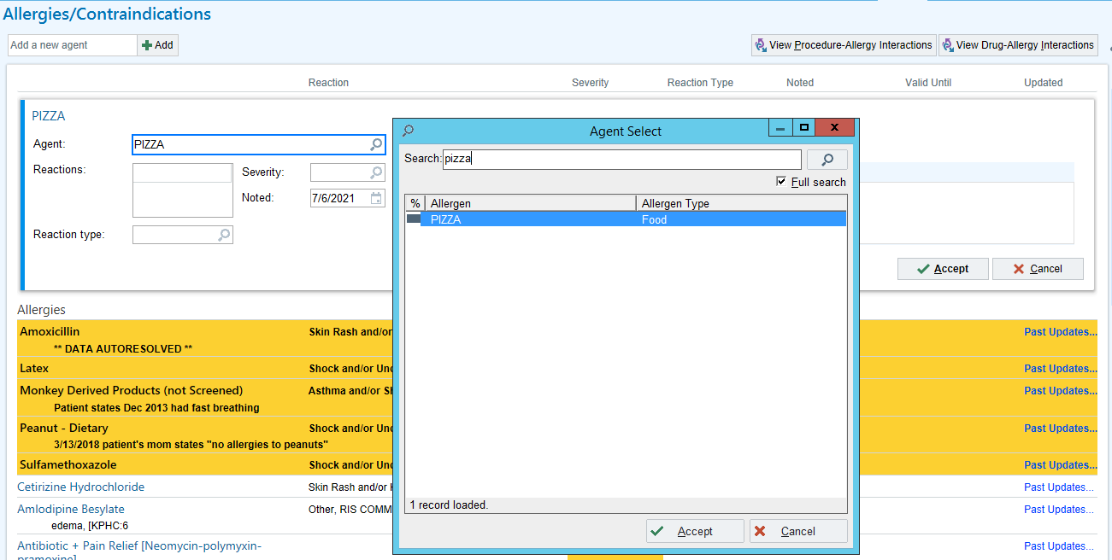
Allergy module in EPIC with FDB content

Slide 4
Example of some complex food allergens found in FDB
BUTTER
CHEESE
FORTIFIED WINE
GIN
GOATS MILK SOFT CHEESE
ICE CREAM
LAMB BURGER
LIQUEUR
PARMESAN CHEESE
PIZZA
ROOTBEER
SCAMPI
SOURED CREAM
WINE

Slide 5
Allergy/Intolerance to food substances
As discussed with OHDSI, it is a question of coverage. If these are actually important clinically, then we need some editorial guidance as to what level we would go with combined foods so we don't have to have everything anyone could eat (i.e intolerance to cheetos).

Slide 6
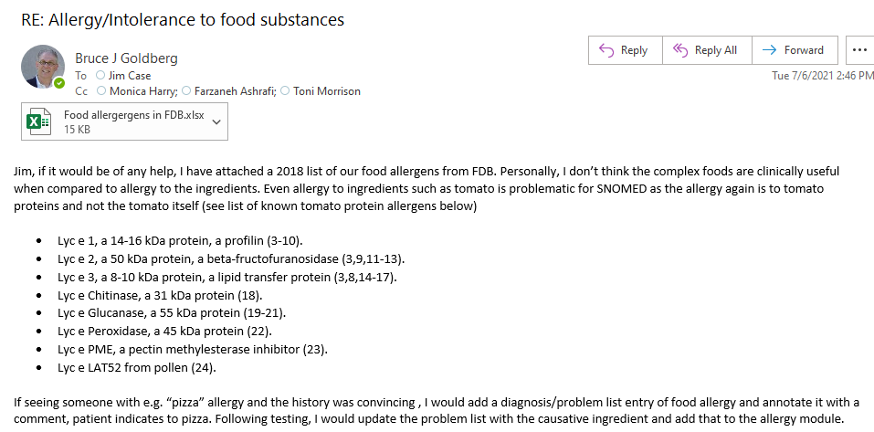

Allergy/Intolerance to food substances
I agree that the combined food products are not useful for Allergy concepts. Would like to hear from Farzaneh and Toni as to what issues currently exist in SNOMED related to these types of foods. As I mentioned at the beginning, this inquiry as based on comments from OHDSI related to real world data they are getting.

