Slide 1

Investigating a mapping between the Human Phenotype Ontology (HPO) and SNOMED CT.
Graham Ponting
Independent Clinical Terminologist
April 2021

Slide 2
Version control
14 May 2021
  HPO until end 2020
  SNOMED International Release, 2020
02 June 2021
  Updated with April 2021 HPO content
  Validated against SNOMED International Release, 31st Jan 2021

Slide 3
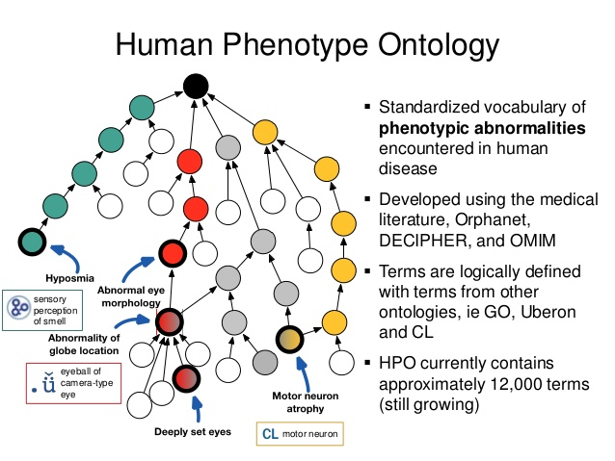
Introduction
SNOMED CT is owned and managed by SNOMED International and is the leading Healthcare Terminology worldwide. It is the mandated Clinical Terminology for the NHS in the UK for the recording of patient information at the point of care.
  The hierarchies under consideration here, disorders are categorised largely by causation and based on clinical teaching.
  SNOMED findings are based on the observation and interpretation of investigations, history and examination.
The Human Phenotype Ontology (HPO) is widely used within the genomics community for the description and identification of genomic disease/data, since 2007. It’s use is based on the definition of a phenotype itself, that is:-
  “The observations relate to the physical, morphologic, or biochemical level, of an individual,
  as determined by the genotype and environment”.
  An organism’s observable physical and biochemical characteristics directly influenced by the
  genotype (genetic factor) and/or environment. In humans, this is often the observed signs and
  symptoms of a condition.
  Details Details Human Phenotype Ontology (jax.org)
  View HPO - Human Phenotype Ontology - Summary | NCBO BioPortal (bioontology.org)
Notes:
As we know SNOMED is owned and managed by SNOMED international and is a world leading healthcare terminology.
In the UK it is the mandated terminology for the recording of information at the point of care.
For the purposes of this study we are dealing mostly with findings/diseases hierarchy, which contains>120,000 terms.
Disease teaching is generally based on a classical causation based definition, but there are differences with HPO.
The Human Phenotype Ontology has been used within the Genomics community for describing phenotypic features since 2007.
Just so we are talking as one useful definition of a phenotype is.
“The observations relate to the physical, morphologic, or biochemical level, of an individual, as determined by the genotype and environment”.
So there are differences in the way these two ontologies model disease.

Slide 4
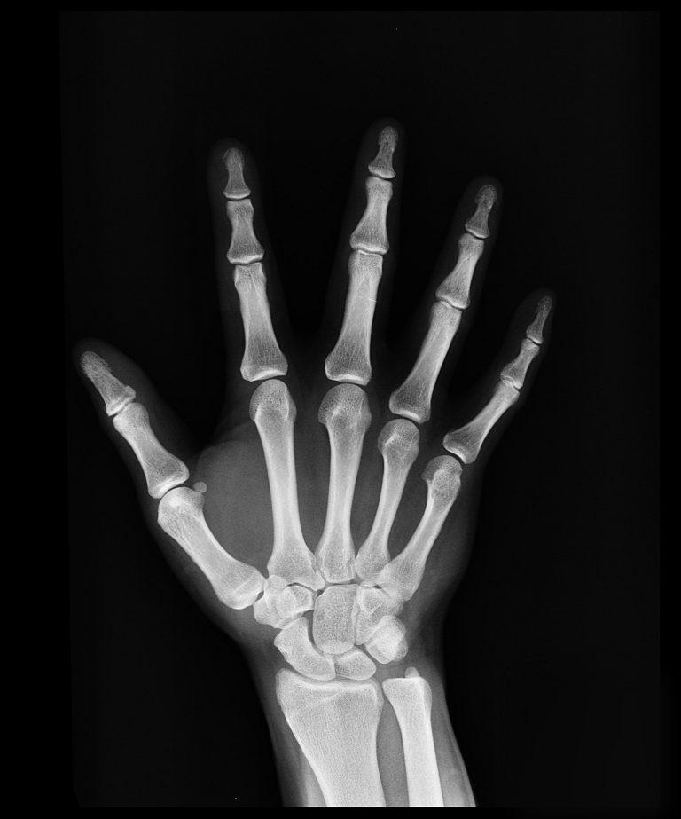


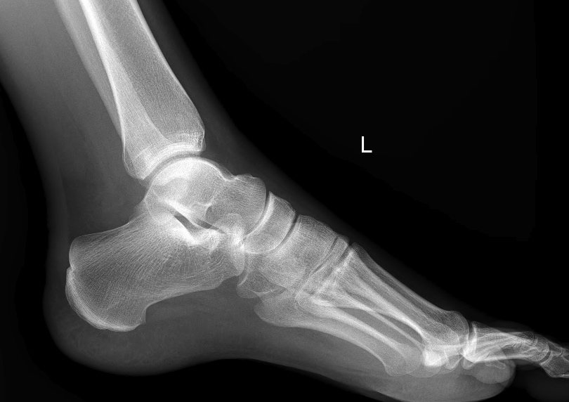
HPO - the content, by system
Abnormality | Per cent
Musculo skeletal | 19.31
Limbs | 13.17
Metabolism/homeostasis | 7.48
Nervous system | 7.22
Head and neck | 6.22
Cardiovascular system | 5.96
Genitourinary system | 5.69
The eye | 5.19
Immune system | 4.68
Integument (skin) | 4.38
Blood and blood forming tissues | 3.01
Digestive system | 2.98
Neoplasm | 2.91
Respiratory system | 2.73
Endocrine system | 1.91
The ear | 1.36
Cellular phenotype | 1.33
Prenatal development or birth | 0.77
Growth abnormality | 0.47
Abnormality of the breast | 0.16
Voice | 0.13
Constitutional symptom | 0.05
Thoracic cavity | 0.02
Lab tests, scans etc across all groups.
>600 terms relate to the finger
10% of terms relate to the bones of hand and foot
n = 15,296
Notes:
A list of the HPO top level groupings is given here of which there are 25
Approximately 50% are made up from skeletal system and limbs, of which for example more than 600 terms relate to the fingers.
This is significant because it means that HPO can pinpoint a congenital deformity to the precise phalangeal bone.
SNOMED could meet this requirement with post coordination using the body site hierarchy.
Across all of the groupings are laboratory studies and x-rays, with the results as findings, which constitute 2000 total.

Slide 5
Objectives -mapping groups
One to one map
The meaning is reflected in the mapped term or synonym, includes logical definition.
One to many map
Direct match
More than one term is required to complete the meaning.
Mapping groups
Map with expression
A SNOMED CT Compositional Grammar Expression reflecting the meaning of the HPO term
Map to local parent
Map to a local parent within the Clinical findings hierarchy.
Confirmation/clarification
Needs further information or analysis to confirm.
Out of scope
Either a navigational concept or one which is outside the current scope of SNOMED.
Describe the main principles /issues/ assumptions
Notes:
The objectives of this study then, are to map the two terminologies, identifying direct mappings as One to one or one to many.
If there is not a clear and direct map there are four options;
Build an expression – using compositional grammar which defines the meaning in SNOMED terms
Identify a mapping to a local parent, to identify where in SNOMED the term might fit.
Define any confirmations or clarifications required.
Define those that are out of scope, that is the scope was we currently know it.
Document any issues/assumptions during the process, so that we have a better understanding of similarities and differences.

Slide 6
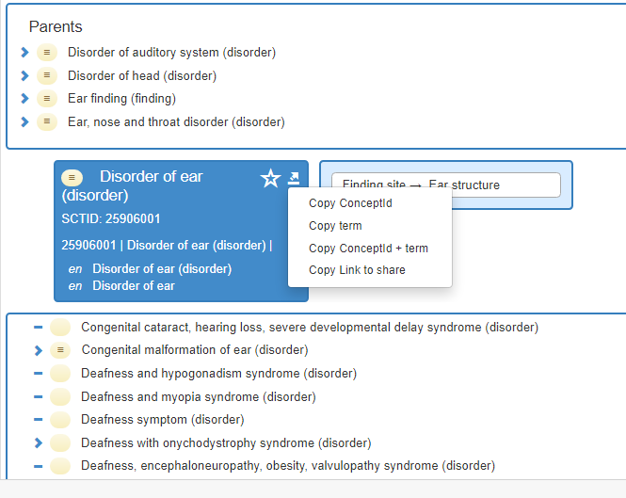
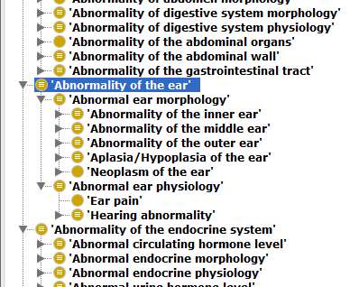
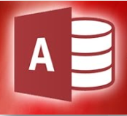
Cross mapping -the detail
HPO – OWL file release imported into the Protégé tool, to display the hierarchies and metadata
SNOMED Browser, International Release
https://browser.ihtsdotools.org/
Direct map
25906001 |Disorder of ear (disorder)|
Notes:
How did I do it - manually
On the left we have a screen shot of the Protégé tool and on the right the SNOMED international browser.
Protégé display is on the left, displaying the hierarchy and it’s easy to import the data directly from the HPO site
The parent code then maps directly to the “disorder of the ear” concept in SNOMED.
Using the example of abnormalities of the ear, we can see that the two children are the morphology and physiology which we will discuss on the next slide.
On the right side we can see that each term has synonyms, parents and children, to help decide an context to the mapping, so for each mapping the hierarchical context and logical definition are considered
The conceptid and term are then pasted into an access database.

Slide 7
Principles (1)
Map to disorders or findings where possible, occasionally morphological abnormality
Pragmatic manual solution for each HPO concept, based on definitions, synonyms and subtypes.
Mapping must be as accurate, express the complete meaning, even if involves an expression.
Abnormality of Xxxx (n=792),
  Usually directly map to disorder of Xxxx
Abnormal Xxxx (n=1990)
  Map to disorder/finding

Slide 8
Principles (2) - Morphology and Physiology codes
Morphology and physiology codes in HPO are do not directly translate to SNOMED.
Pragmatic manual solution for each based on definitions, synonyms and subtypes;
  For each morphology code (n=444),
    Congenital malformation of Xxx
    Disorder of Xxx
    Add 116676008 |Associated morphology (attribute)|=49755003 |Morphologically abnormal structure (morphologic abnormality)|
    Out of scope
  For each physiology code (n=64), consider
    Disorder of Xxx
    Functional/dysfunction equivalent
    Out of scope
For each mapping,
  One to one match
  One to many match
  Map to parent
  Expression
  Requires clarification/confirmation
  Out of scope

Slide 9
SNOMED Compositional Grammar
The SNOMED CT Composition Grammar is a lightweight syntax for the representation of a SNOMED Expression which has proven to be both human readable and machine parsable.
It is used with validation based on the Concept Model (Ref 1) and the APG parser. (Ref 2)
An example expression is below, in this case a clinical finding, attribute and a qualifier.
<<404684003 |Clinical finding (finding)|
<<410662002 |Concept model attribute (attribute)|
Range of qualifiers, based on Concept Model.
Clinical finding
Attribute
Qualifier
HP: 00031343. Jejunal arteriovenous malformation
=
234141001 |Congenital arteriovenous malformation (disorder)|: 363698007 |Finding site (attribute)|=21306003 |Jejunal structure (body structure)|
Notes:
SNOMED CG is a lightweight syntax, which is highly flexible, and can be read by both human and machine
It’s structure is based on the published concept model.
It’s grammar can be checked with the online parser.
The expression can be thought of as a refinement of the focus concept
There is a three component expression as shown with a finding, attribute and qualifier
Here is a simple example of an HPO concept.
The description is based upon the three components of findings/attribute/qualifier, and aggregations of these can be composed based on the model

Slide 10
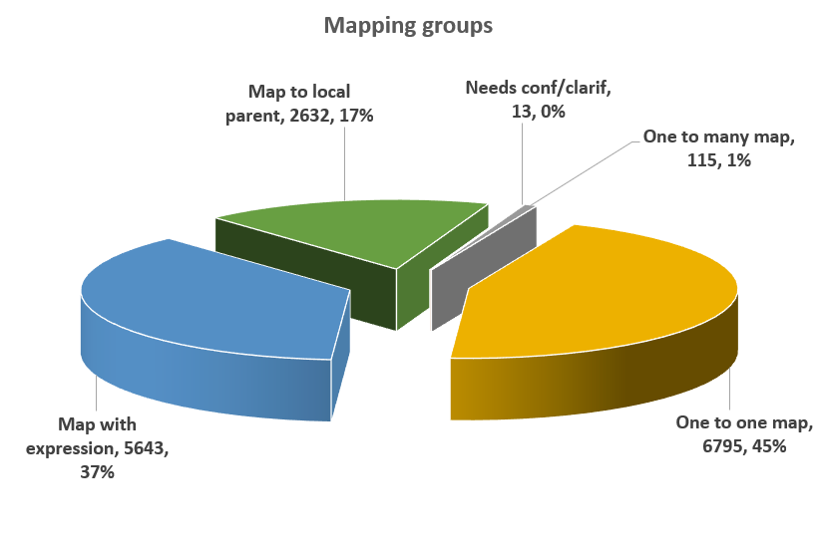
The results – mapping categories
46 % Direct mapping
Grouping | Number (%)
One to one map | 6795 (45%)
One to many map | 115 (1%)
Map with expression | 5643 (37%)
Map to local parent | 2632(17%)
Clarification/confirmation | 13 (0.1%)
Total | 15198
2020July
Out of scope 462(3%)
Total HPO 15660 concepts, until April 2021
Notes:
The total number of concepts in HPO in scope was 14038 (beginning of 2020), and it can be seen that direct mappings made up 47%, and of the remainder 34% were mapped to an expression, and 19% to a local parent.
So it can be seen that nearly half of HPO had a direct mapping to SNOMED.
What is also noticeable is that >95% of the codes were potentially mappable, confirming the extensive overlap between the two ontologies.
A small number of HPO terms were defined as “out of scope”, either because they were purely navigational, or were not part of the current SNOMED scope.
These figures may change sightly as the QA progresses

Slide 11

Problems during mapping
Use of Morphology/Physiology groupings – no direct SNOMED mapping.
  Note if these terms are excluded completely it makes little difference to the final result.
Context not always clear – congenital versus acquired.
Differences in modelling between to the two ontologies
Inconsistencies – and inaccuracies in both terminologies
Missing definitions, abbreviations explanation, supporting information (SNOMED use of eponyms)
Apparent differences in the meaning of terms between HPO/SNOMED
  Example encephalopathy
Notes:
Inevitably when mapping two ontologies, with a different internal structure, that have evolved separately, there are going to be difficulties.
The use of morphology and physiology concepts by HPO have no direct mapping to SNOMED, so as presented previously has to be handled on an individual basis.
Context is a significant problem; it is often not clear if a concept is intended to relate to congenital or acquired background, so the only option is to review the parents/children and any other metadata and reach a conclusion.
Differences in modelling and structuring between the two, which gives rise to inconsistencies and inaccuracies
Missing supporting data such as definitions, is important in particular if a disorder is eponymous terms in SNOMED for example, mean that even when clinicians search normally, there are terms that may not be selected, because they are not understood.
There are examples of the same word as different meanings, such as encephalopathy.
There are examples where more knowledge is required from both parties.

Slide 12
Summary of results
46% of HPO concepts mapped directly to SNOMED terms of which most were within the finding/disorder hierarchy.
A further 37% were able to be mapped to an expression and 17% to a local parent.
Most (>98%) HPO terms mapped to the scope Findings/Diagnosis hierarchies, with small numbers to the morphologic abnormality (1.3%) and situation (0.1%).
Analysis of those mapped to a local parent showed that the content gap was largely related to congenital anomalies of the hands, feet and ears, as well as the terms covering epilepsy/seizure, “substance levels” in the blood
Small numbers (3%) were designated as “out of scope” as they were either navigational terms, or were not mappable to any hierarchies.
Notes:
To summarise the results,
47% of the HPO concepts mapped directly to SNOMED, the majority to findings/disorders.
For a further 34% were mapped to an expression based on the approach described, and 19% mapped to a local parent.
>98%, most of the hpo terms, mapped to findings/disorders.
The content gap was largely related to congenital anomalies of the hands, feet, ears and the substance levels in the blood.
Small numbers – 3% were defined as “out of scope”
This give us a fairly good idea on the missing content and informs the approach to new content generation.

Slide 13
Current Objectives – May 2021
1) Agree the HPO terms which have a direct map to SNOMED CT, which number 6707 here, as well as the principles explained in the supporting deck.
2) Consider specific areas, such as Seizure, which are not well covered, to improve the mapping and make suggestions for any SNOMED content changes.
3) Review the Compositional Grammar expressions against the concept model and specification.
4) New SNOMED content generation to improve mapping

Slide 14
Difficult clinical areas in SNOMED
Hands and feet - anomalies
  Thousands of missing concepts but for requirement could be met by post-coordination
Epilepsy/seizure (350 codes), see slide 14
  Large number of maps to expressions/parent, ? SNOMED needs updating
Neurology - EEG findings,
  Difference between UK and US classifications
Lymphocyte functional studies- ?review for content suggestions
Substances for modelling results/findings
Vitamin metabolism – inconsistent modelling approach by HPO, needs clarification and discussion
Substance levels – incomplete modelling by SNOMED in findings.
  For example, 131114008 |Decreased vitamin D (finding)|, which specimen is referred to ?, there are any others.

Slide 15
Seizure, Epilepsy, EEG findings
Seizure (n=355)
  One to one match 70 (27.5%)
  Map with expression 126 (49.4%)
  Map to Parent 59 (23%)
  This SNOMED section needs comparison with,
    Definition & Classification // International League Against Epilepsy (ilae.org)
EEG findings (n=91)
  One to one match 17 (19%)
  Map with expression 1 (1%)
  Map to Parent 73 (80%)

