Slide 1


Phenotype content - draft content for review
21st, April 2021
Ian Green
Customer Relations Lead (Europe) and Clinical Engagement Business Manager

Slide 2

Where to find the content
SNOMED Community Browser
Modelling approaches
Next steps
Phenotype content
(draft)
2

Slide 3
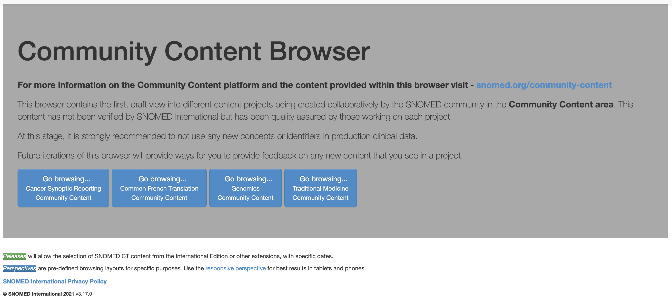
Where to find the content ?
https://community-browser.ihtsdotools.org/

Slide 4
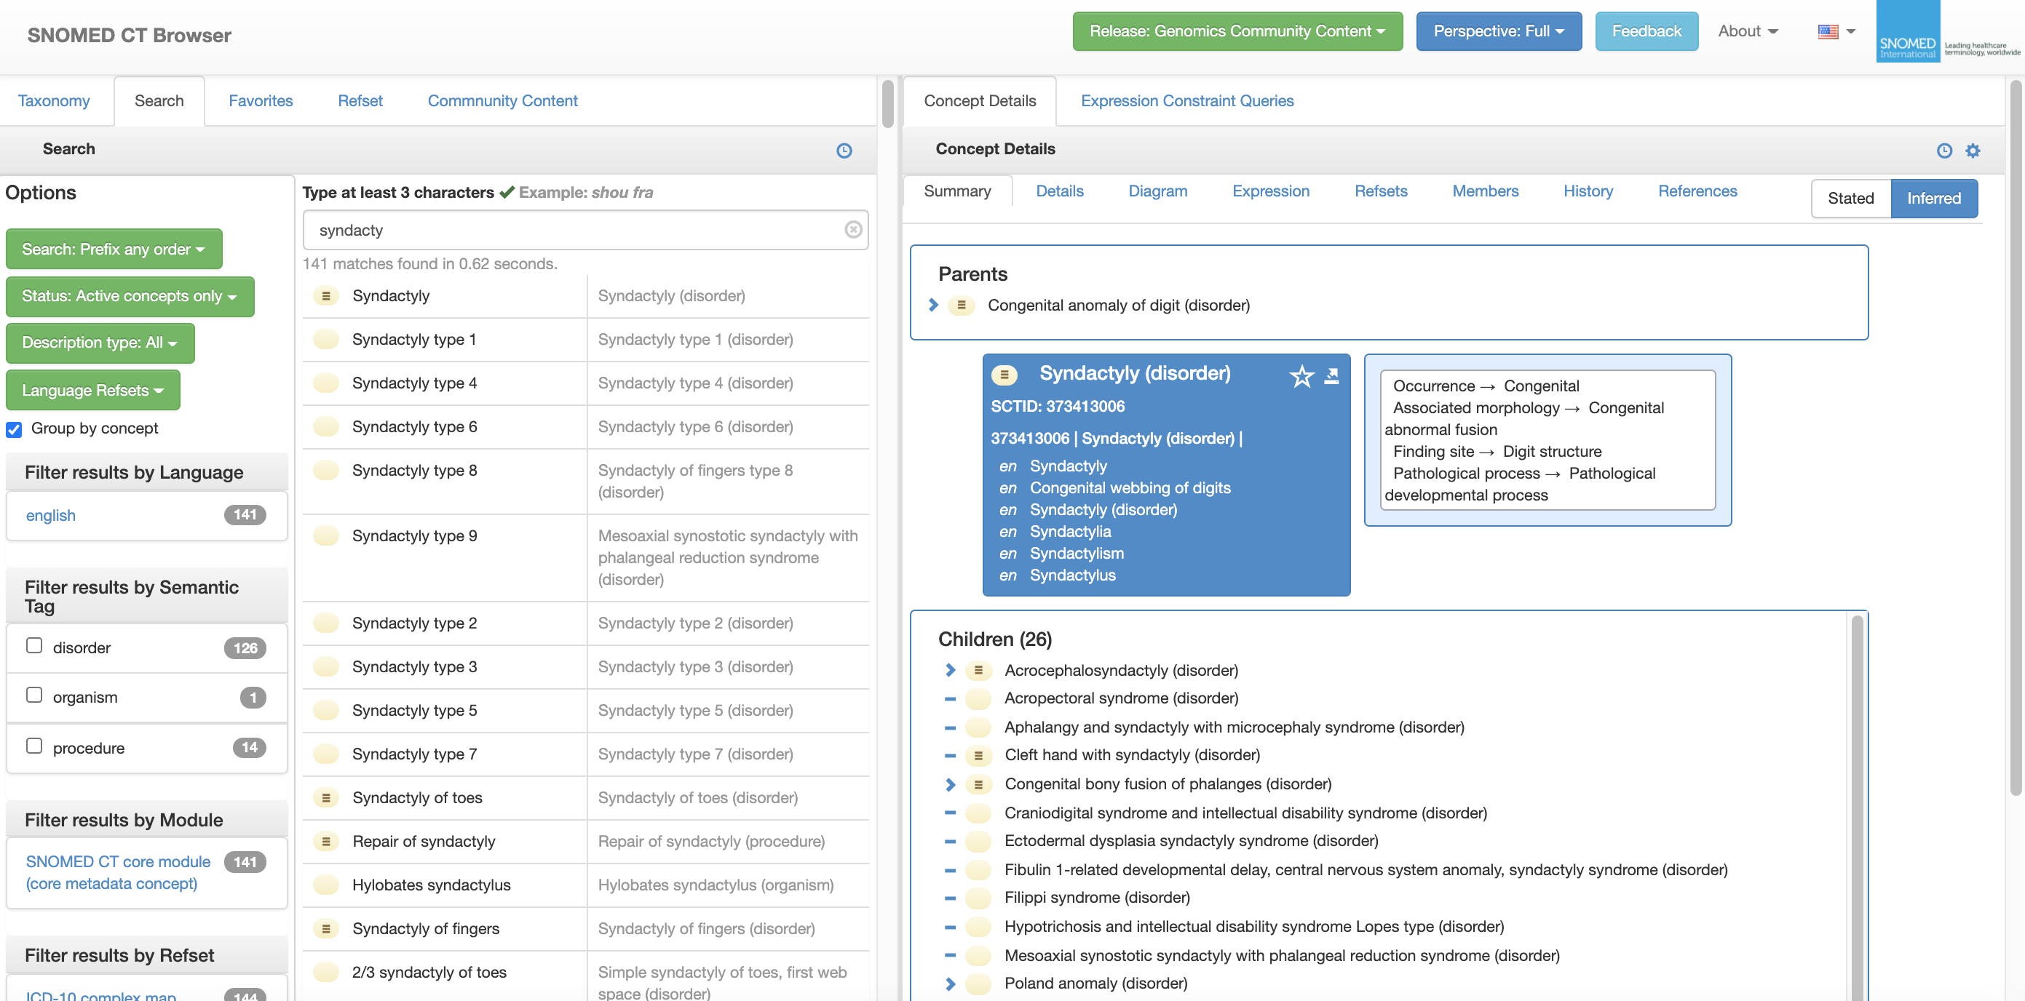
Example - Syndacty

Slide 5
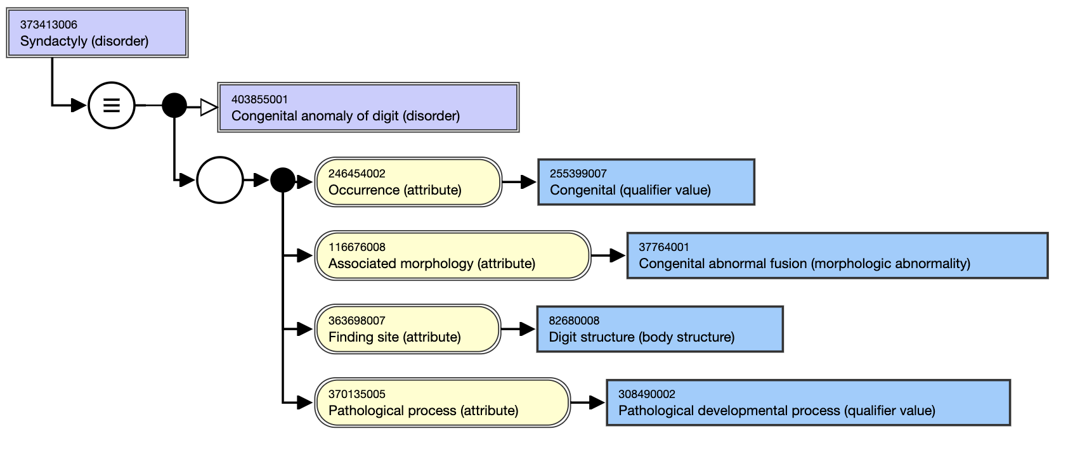
Example - modelling

Slide 6
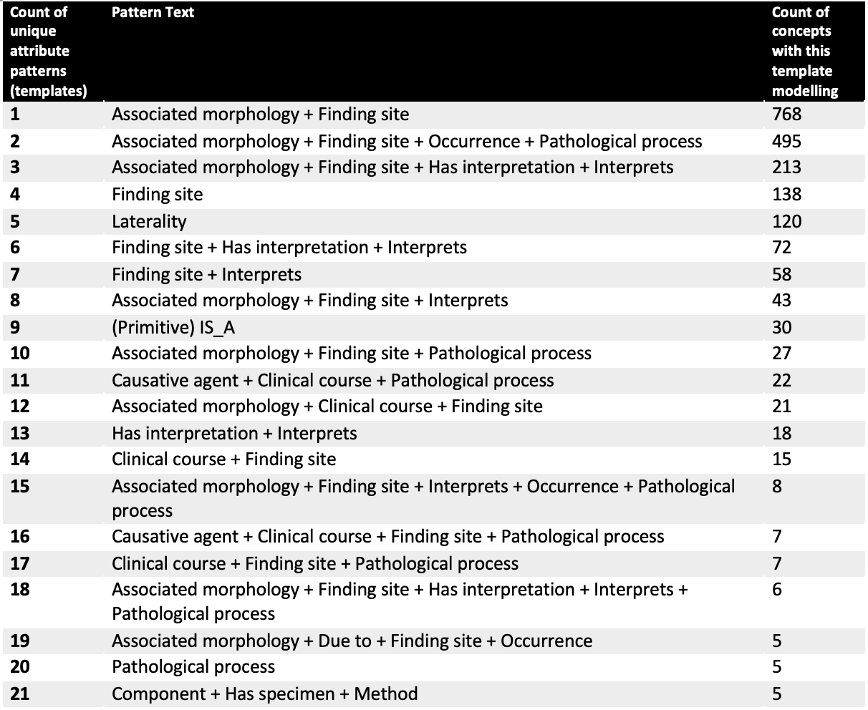
Modelling approaches
Use of authoring templates (55 in total)
Starting point was over optimistic that the data could be easily templated
Initial target was 4,000, but the reality was the modelling challenges
Approach supports large scale authoring
Ensures authoring consistency and supports content quality
New qualifier values were also added to support fully defined modelling of new content
2,141 new concepts, across a variety of hierarchies

Slide 7
Community review of the content
Update to authored concepts
Plan for future authoring and implementation support
Future authoring of clinical phenotype findings in SNOMED CT
Phenotype content
Next steps
7

Slide 8


THANK YOU
SNOMED International: Delivering SNOMED CT

