Slide 1


Genomics and Precision Medicine CRG - scope
21st, April 2021
Ian Green
Customer Relations lead (Europe) & Clinical Engagement Business Manager

Slide 2
Current scope
The scope of the CRG initially is intentionally broad, to reflect the broad range of subspecialties included within Genomics and Precision Medicine. Over time, as the groups understanding of how SNOMED CT can support these areas, the group may choose to create subgroups focused on specific areas of interest. The group will focus on the usability of SNOMED CT for the representation of clinical data to support both clinical care and research in the application of genomics.

Slide 3
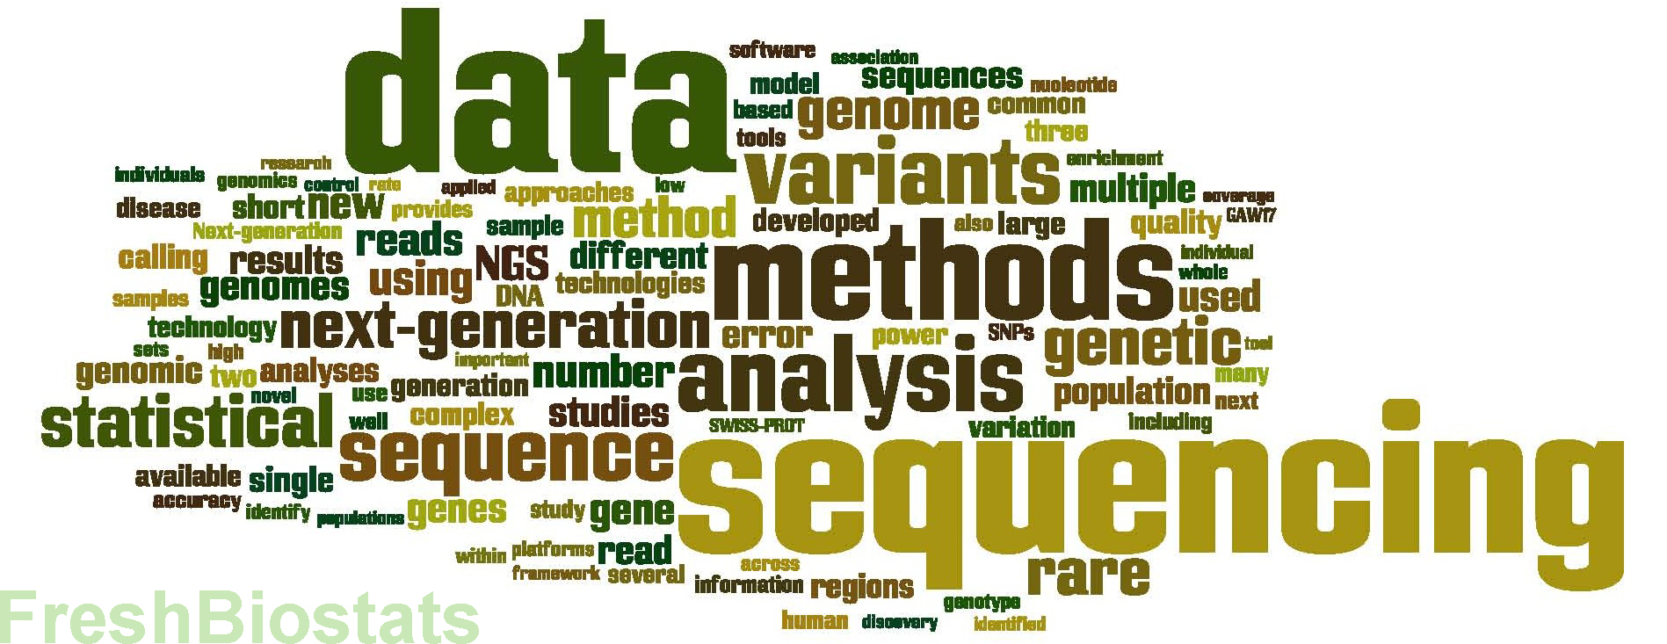
Where to focus efforts ?
GENOMICS
EHR
PRECISION MEDICINE
RESEARCH
. . . . OMICS

Slide 4

Precision medicine focus
Genomics
  EHR data recording
  New/revised modelled content
Use case requirements
  Refset support
  Use of expressions
Implementation guidance
Research support
Scope
Options
4

