Slide 1
Clinical Indexes and Scale Scores

Slide 2
EAG Test Case:
Anesthesia Observables Scales
Jim,
I've picked out a few examples of very widely used scales in Anesthesia and Critical care.
As there are so many assessment scales names included in SNOMED, we should take a value approach to this and only concentrate on ones that have a demonstrable wide use across multiple member countries. I would imagine that there are a number of obsolete examples in the current SNOMED CT content.
ASA (American Society of Anesthesiologists) Physical Status Classification
Mallampati scale (Airway assessment, prediction of difficult airway management)
Cormack Lehane scale (Airway assessment at direct laryngoscopy)
SOFA (Sequential Organ Failure Assessment) scale - (prediction of Intensive Care mortality)
Canadian Study of Health and Aging (Rockwood) clinical frailty scale - (widely used in COVID-19 as a determinant of suitability for intensive care admission)
APACHE (Acute Physiology and Chronic Health Evaluation) - (severity of illness in first 24 hours of Intensive Care admission). There are a number of versions, most widely used being APACHE II. Apache IV is not included in SNOMED CT
p-POSSUM. Portsmouth modification of the Physiological and Operative Severity Score for the enUmeration of Mortality - widely used as a risk predictor for surgical interventions.
The other clinical leads of the Anesthesia CRG may have some other suggestions of scales worth looking at.
Best wishes
Dr Andrew C Norton

Slide 3
Agenda: Observables definitions for Scale scores and associated Clinical findings
Quality Observables
Charlson Comorbidity Index
American Society of Anesthesiologists Physical Classification
Mallampati Airway Assessment Scale
Function Observables
Glasgow Coma Scale
Calculations of Assessment Scale scores
SOFA scale

Slide 4
Deployed and In-use at Nebraska Medicine
Folstein mini-mental status (cognitive screening)
Patient Health Questionnaire – 9 (depression screening)
HEART score (acute coronary syndrome)
Glasgow coma scale (sensorium)
SCHMID fall risk scale
ALS Functional Rating Scale
Critical Care Pain Observation Tool
Braden Scale (pressure ulcer risk)
Charlson Co-morbidity Index (inpatient outcomes)

Slide 5
Morbidity Index Use Cases:
Assessing Disease Burden for Prognosis
Observables Quality Model
Charlson Comorbidity Index (UNMC)
ASA Physical Assessment Classification

Slide 6
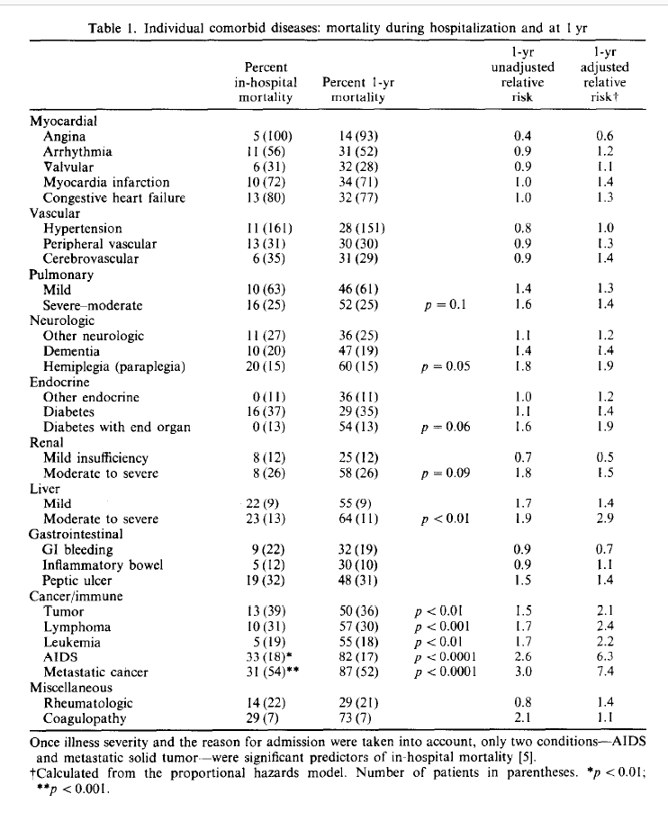
Charlson Comorbidity Index
Retrieves and enumerates EHR diagnoses in 14 clinical categories. Assigns scale scores to the importance of each relative to 10 year mortality risk in patients admitted to medicine wards of NYU hospital. Hence the observable is a weighted count of diagnostic conditions borne by the patient found from EHR review
Charlson ME, Pompei P, Ales KL, MacKenzie CR: A new method of classifying prognostic co-morbidity in longitudinal studies: Development and validation. J Chron Dis; 1987, 40(5), 373-383.

Slide 7
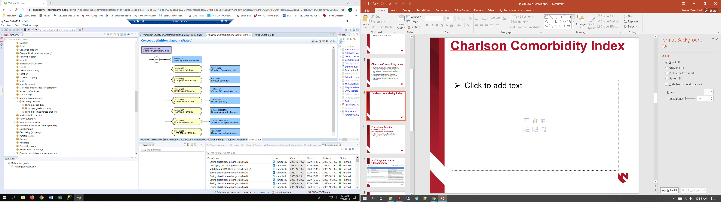
Charlson Comorbidity Index
  Proposal: For comparable scales which assess disease burden from EHR, modify the concept model for Observables to allow Clinical Findings to the valueset for Component.
  Question for discussion: Should we consider ‘Has Focus’ attribute or simply consider it implicit in the design of the scale since many scales are named by their goal rather than the actual item they assess or measure?

Slide 8
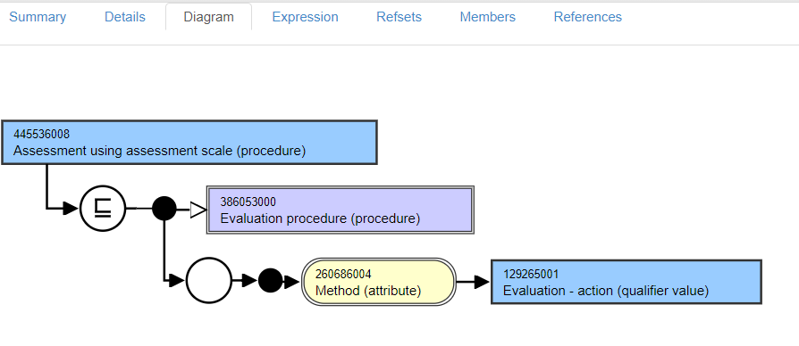
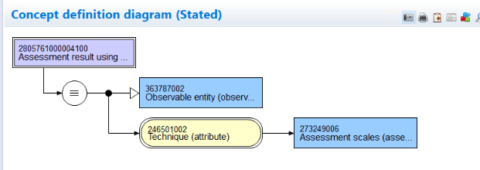
445536008|Assessment using assessment scale (procedure)|
Subtype of 386053000|Evaluation procedure (procedure)|
Falls within scope of the E2O project…

Slide 9
445536008|Assessment using assessment scale (procedure)|
  As pointed out in Andrew’s position paper, current editorial guidance is to use this concepts as the primitive parent in modeling new assessment scale observations.
  Since this concept is a subtype of Evaluation procedure (procedure) and falls within the scope of the E2O project:
  Proposal: Migrate this concept and subtypes to Observable entities as fully defined groupers. The classifier would identify all observables with TECHNIQUE << ASSESSMENT_SCALE as logical subtypes.
Subtype of 386053000|Evaluation procedure (procedure)|
Falls within scope of the E2O project…

Slide 10
ASA Physical Status Classification (ASA Class)
American Society of Anesthesiologists Physical Status Classification assesses disease burden borne by the patient as a prognostic indicator of postoperative outcomes
Wolters U, Wolf T, Stützer H, Schröder T. ASA classification and perioperative variables as predictors of postoperative outcome. Br J Anaesth. 1996 Aug;77(2):217-22. DOI: 10.1093/bja/77.2.217 PMID: 8881629.
Hackett NJ, De Olivera GS, Jain UK et al. ASA class is an reliable independent predictor of medical complications and mortality following surgery. International Journal of Surgery 2015; 18: 184-90

Slide 11

ASA Physical Status Classification
https://www.asahq.org/standards-and-guidelines/asa-physical-status-classification-system

Slide 12
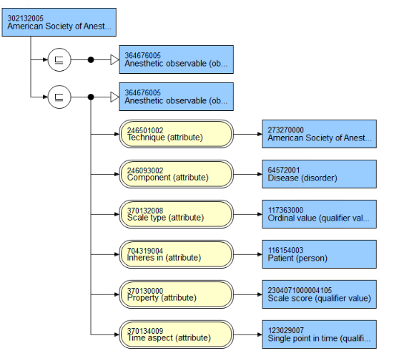
ASA Score
302132005
American Society of Anesthesiologists Physical Status Class
  Proposal: Retire 364676005|Anesthetic observable| unless we can agree on full definition as grouper implying attribute such as ‘Has focus’
273270000
American Society of Anesthesiologists
physical status classification (assessment scale)

Slide 13
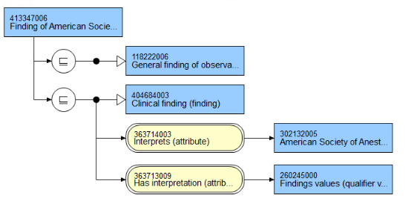
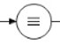
413347006|Finding of American Society of Anesthesiologists physical status classification (finding)
302132005|American Society of Anesthesiologists physical status class
Findings values /
Ordinal scale values (qualifier)
  Proposal: Although Regenstrief proposes ‘Ordinal or quantitative’ scales for scale score observables definitions, suggest that we use Quantitative\(INTEGER) when they are meant to summed or used in calculation and Ordinal scale otherwise. Has interpretation(attribute) should be expanded in editorial advice to support concrete domains and Ordinal valuesets for Assessment Scales in SNOMED CT should be added <<Findings values (qualifier)

Slide 14
Anatomical Assessment Classification:
Quality Observable model
Mallampati Airway Assessment Scale
Mallampati SR et al . A clinical sign to predict difficult intubation: a prospective study Canadian Anaesthetists Society Journal 1985; 32(4): 429-434.
Iohom G, Ronayne M, Cunningham AJ. Prediction of difficult tracheal intubation
European Journal of Anaesthesiology 2003; 20(1) :31-36. - A useful study on sensitivity and specificity of the Mallampati scale as a predictor of difficult intubation and when combined with an anatomical distance measure such as thyromental distance - which is a common practice in preoperative airway assessment

Slide 15
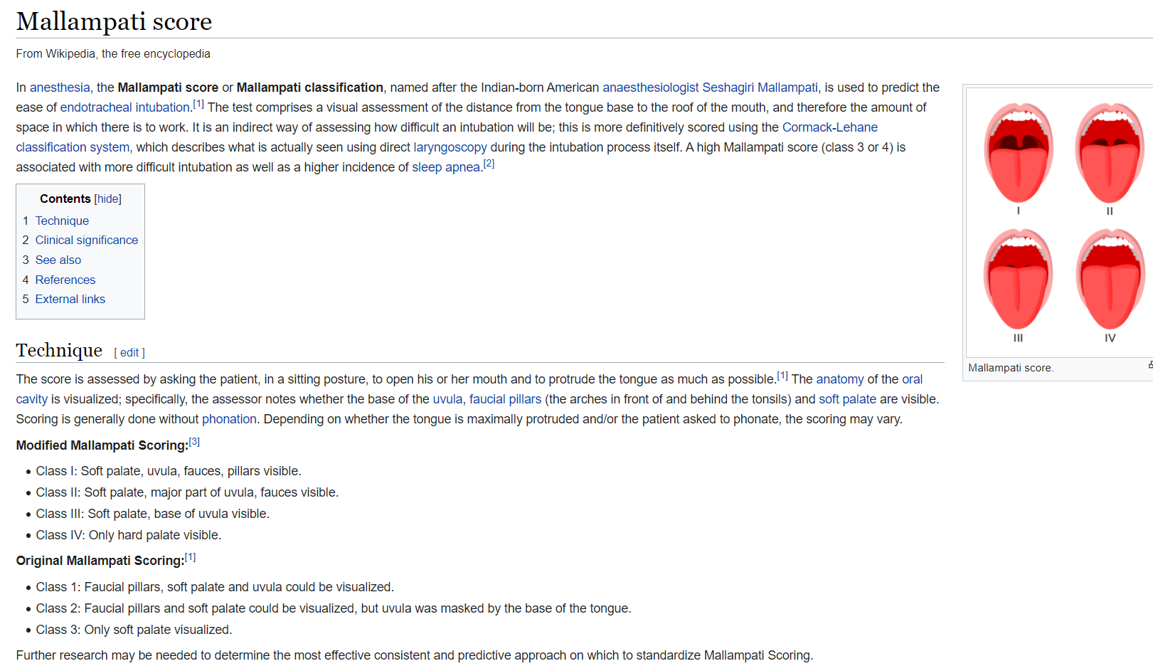
Mallampati Airway Assessment Scale

Slide 16
277388005|Mallampati Grade (observable entity)
INHERES_IN = Entire oropharyngeal cavity (body structure)
PROPERTY = Length property (Entitic length?)
TECHNIQUE = Mallampati score (assessment scale)
TECHNIQUE = Inspection technique (visual assessment)
SCALE_TYPE = Ordinal or quantitative

Slide 17
424397003|Mallampati class IV (finding)
Fully defined
IS_A = Finding of assessment scale
INTERPRETS = 277388005|Mallampati grade
HAS_INTERPRETATION = Findings values \ Ordinal findings values \ Grade 4

Slide 18
Physiologic Function Classification
Functional Observables Model
Glasgow Coma Scale
The Scale was described in 1974 by Graham Teasdale and Bryan Jennett as a way to communicate about the level of consciousness of patients with an acute brain injury.
Assessment of coma and impaired consciousness. A practical scale. Lancet 1974; 2:81-4.
Teasdale G, Maas A, Lecky F et al. The Glasgow Coma Scale at 40 Years: standing the test of time. Lancet Neurology 2014 ;13(8) : 844-854

Slide 19

Glasgow Coma Scale

Slide 20
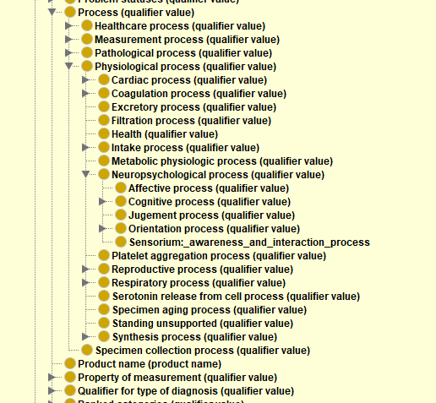
FUNCTION Observable:
24824002|Glasgow coma score (observable entity)
INHERES_IN = Structure of cerebrum (body structure)
CHARACTERIZES = Neuropsychological process \ Sensorium: awareness and interaction (process)
TECHNIQUE = 386554004|Glasgow coma scale (assessment scale)
SCALE_TYPE = Ordinal or quantitative

Slide 21
112110007|Glasgow coma scale, 4 (finding)
Fully defined
IS_A = Finding of assessment scale
INTERPRETS = 24824002|Glasgow coma score
HAS_INTERPRETATION = 4

Slide 22
Sequential Organ Failure (SOFA) Score
Scale employing multiple physiologic measurements to assess major organ system function with calculated score shown to correlate well with ICU mortality
Ferreira FL, Bota DP, Bross A et al. Serial evaluation of the SOFA score to predict outcome in critically ill patients.Journal of the American Medical Association 2001; 286(14) :1754-1758.

Slide 23
Sequential Organ Failure (SOFA) Score
Scale score items:
Respiratory: pAO2/Fraction inhaled oxygen content(%)
Hematologic: Platelet count (10³/µL)
CNS: Glasgow Coma Scale (estimate if on sedatives)
Hepatic: Bilirubin (umol/L)
Cardiac: Mean arterial pressure(mmHg) or dose of pressors in use
Renal: Creatinine(umol/L) or Urine output

Slide 24
Sequential Organ Failure (SOFA) Score
  |Oxygen [partial pressure] in Arterial blood (LOINC:2703-7) [PAO2]
  ::=
  IS_A = |Clinical chemistry observable
  INHERES_IN = Blood (substance)
  DIRECT_SITE = |Arterial blood specimen
  COMPONENT = Oxygen (substance)
  PROPERTY = |Partial pressure
  SCALE_TYPE = |Quantitative
  UNITS = ‘mmHg’
  250774007|Inspired Fraction Oxygen Concentration (observable entity) [FIO2]
  ::=
  IS_A = Clinical lab observable
  INHERES_IN = 74974009|Gaseous substance (substance)
  DIRECT_SITE = 119337004|Inspired gas specimen (specimen)
  COMPONENT = 24099007|Oxygen (substance)
  PROPERTY = 118563004|Substance ratio
  SCALE_TYPE = |Quantitative
  UNITS = ‘%’
Scale score items:
pAO2/Fraction inhaled oxygen content(%)
Platelet count (10³/µL)
Glasgow Coma Scale (estimate if on sedatives)
Bilirubin (umol/L)
Mean arterial pressure(mmHg) or dose of pressors in use
Creatinine(umol/L) or Urine output

Slide 25
Sequential Organ Failure (SOFA) Score
Scale score items:
Fraction inhaled oxygen content(%)
Platelet count (10³/µL)
Glasgow Coma Scale (estimate if on sedatives)
Bilirubin (umol/L)
Mean arterial pressure(mmHg) or dose of pressors in use
Creatinine(umol/L) or Urine output
  Platelets [#/volume] in Blood (observable entity) [PLATELETS]
  ::=
  IS_A = |Hematology observable
  INHERES_IN = 87612001|Blood (substance)
  DIRECT_SITE = 119297000|Blood specimen
  COMPONENT = |Population of all platelets in a sample of fluid
  PROPERTY = |Number concentration property
  SCALE_TYPE = |Quantitative
  UNITS = ‘10^3uL’

Slide 26
Sequential Organ Failure (SOFA) Score
Scale score items:
Fraction inhaled oxygen content(%)
Platelet count (10³/µL)
Glasgow Coma Scale (estimate if on sedatives)
Bilirubin (umol/L)
Mean arterial pressure(mmHg) or dose of pressors in use
Creatinine(umol/L) or Urine output
  SOFA Score
  ::=
  CASE WHEN [PAO2]/[FIO2] < 400 THEN 1
  WHEN [PAO2]/[FIO2] < 300 THEN 2
  WHEN [PAO2]/[FIO2] < 220 THEN 3
  WHEN [PAO2]/[FIO2] < 100 THEN 4
  +
  CASE WHEN [PLATELETS] >= 150 THEN 0
  WHEN [PLATELETS] >= 100 THEN 1
  WHEN [PLATELETS] >= 50 THEN 2
  WHEN [PLATELETS] >= 20 THEN 3
  WHEN [PLATELETS] >= 0 THEN 4 ELSE NULL
  + …

Slide 27
Sequential Organ Failure (SOFA) Score
Scale score items:
Fraction inhaled oxygen content(%)
Platelet count (10³/µL)
Glasgow Coma Scale (estimate if on sedatives)
Bilirubin (umol/L)
Mean arterial pressure(mmHg) or dose of pressors in use
Creatinine(umol/L) or Urine output
  Proposal: Developing a logical extension of SNOMED expression language which supports Boolean logic, a standard method for calculating scores such as SOFA from EHR data extracts using SNOMED Observables and Clinical findings could standardize the definition of the Observable AND promote the interoperable use of scale score data

