Slide 1
Clinical Indexes and Scale Scores

Slide 2
EAG Test Case:
Anesthesia Observables Scales
Jim,
I've picked out a few examples of very widely used scales in Anesthesia and Critical care.
As there are so many assessment scales names included in SNOMED, we should take a value approach to this and only concentrate on ones that have a demonstrable wide use across multiple member countries. I would imagine that there are a number of obsolete examples in the current SNOMED CT content.
ASA (American Society of Anesthesiologists) Physical Status Classification
Mallampati scale (Airway assessment, prediction of difficult airway management)
Cormack Lehane scale (Airway assessment at direct laryngoscopy)
SOFA (Sequential Organ Failure Assessment) scale - (prediction of Intensive Care mortality)
Canadian Study of Health and Aging (Rockwood) clinical frailty scale - (widely used in COVID-19 as a determinant of suitability for intensive care admission)
APACHE (Acute Physiology and Chronic Health Evaluation) - (severity of illness in first 24 hours of Intensive Care admission). There are a number of versions, most widely used being APACHE II. Apache IV is not included in SNOMED CT
p-POSSUM. Portsmouth modification of the Physiological and Operative Severity Score for the enUmeration of Mortality - widely used as a risk predictor for surgical interventions.
The other clinical leads of the Anesthesia CRG may have some other suggestions of scales worth looking at.
Best wishes
Dr Andrew C Norton

Slide 3
Observables Project: Assessment Scales
Glasgow Coma Scale
ASA (American Society of Anesthesiologists) Physical Status Classification
Mallampati scale (Airway assessment, prediction of difficult airway management)
Cormack Lehane scale (Airway assessment at direct laryngoscopy)
SOFA (Sequential Organ Failure Assessment) scale - (prediction of Intensive Care mortality)
Canadian Study of Health and Aging (Rockwood) clinical frailty scale - (widely used in COVID-19 as a determinant of suitability for intensive care admission)
APACHE II (Acute Physiology and Chronic Health Evaluation) - (severity of illness in first 24 hours of Intensive Care admission).
p-POSSUM. Portsmouth modification of the Physiological and Operative Severity Score for the enUmeration of Mortality - widely used as a risk predictor for surgical interventions.
Folstein Mini-mental Status Exam (dementia screening)
Montreal Cognitive Assessment (dementia screening)
PHQ-9 Depression screening scale
HEART score (acute coronary syndrome)
SCHMID (fall risk) scale
ALS Functional Rating Scale
Critical Care Pain Rating Scale
Braden Scale (pressure ulcer risk)
Charlson Co-morbidity Index (Mortality risk for admissions)

Slide 4
ASA Physical Status Classification (ASA Class)
American Society of Anesthesiologists Physical Status Classification assesses disease burden borne by the patient as a prognostic indicator of postoperative outcomes
Wolters U, Wolf T, Stützer H, Schröder T. ASA classification and perioperative variables as predictors of postoperative outcome. Br J Anaesth. 1996 Aug;77(2):217-22. DOI: 10.1093/bja/77.2.217 PMID: 8881629.
Hackett NJ, De Olivera GS, Jain UK et al. ASA class is an reliable independent predictor of medical complications and mortality following surgery. International Journal of Surgery 2015; 18: 184-90

Slide 5
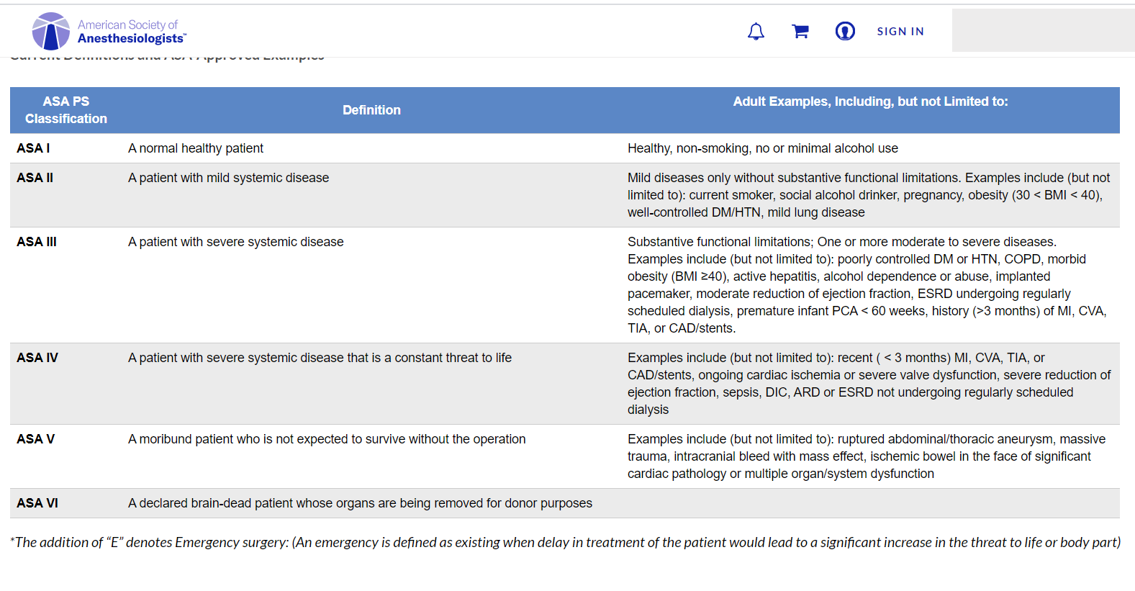
ASA Physical Status Classification
https://www.asahq.org/standards-and-guidelines/asa-physical-status-classification-system

Slide 6
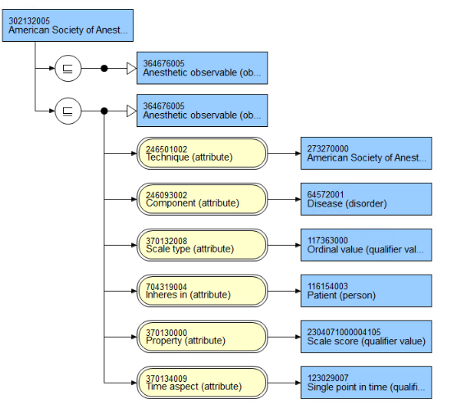
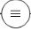
ASA Score
302132005
American Society of Anesthesiologists Physical Status Class
273270000
American Society of Anesthesiologists
physical status classification (assessment scale)

Slide 7
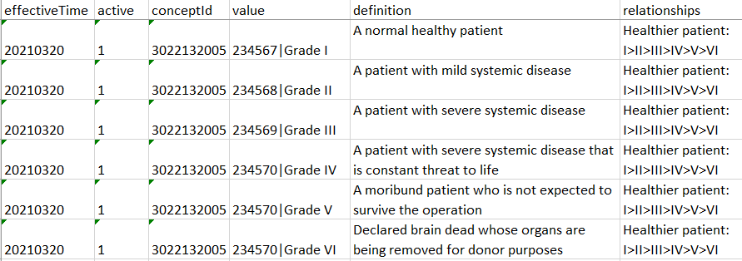
ASA Refset Scale Values

Slide 8
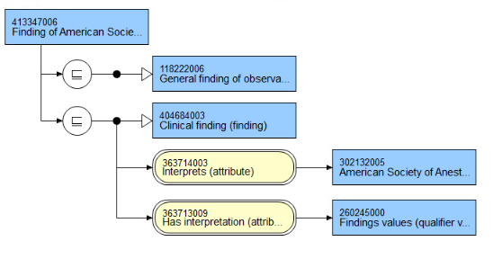
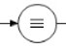
413347006|Finding of American Society of Anesthesiologists physical status classification (finding)
302132005|American Society of Anesthesiologists physical status class
Findings values /
Ordinal scale values (qualifier)

Slide 9
Anatomical Assessment Classification:
Quality Observable model
Mallampati Airway Assessment Scale
Mallampati SR et al . A clinical sign to predict difficult intubation: a prospective study Canadian Anaesthetists Society Journal 1985; 32(4): 429-434.
Iohom G, Ronayne M, Cunningham AJ. Prediction of difficult tracheal intubation
European Journal of Anaesthesiology 2003; 20(1) :31-36. - A useful study on sensitivity and specificity of the Mallampati scale as a predictor of difficult intubation and when combined with an anatomical distance measure such as thyromental distance - which is a common practice in preoperative airway assessment

Slide 10
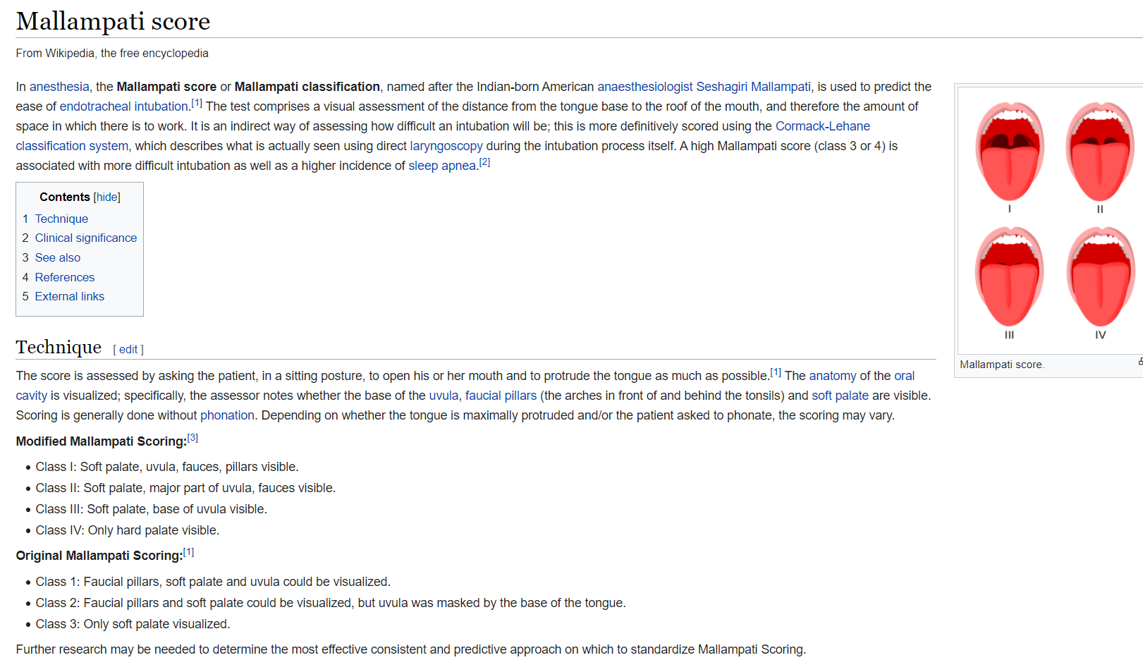
Mallampati Airway Assessment Scale

Slide 11
277388005|Mallampati Grade (observable entity)
INHERES_IN = Entire oropharyngeal cavity (body structure)
PROPERTY = Length property
TECHNIQUE = Mallampati score (assessment scale)
TECHNIQUE = Inspection technique (visual assessment)
SCALE_TYPE = Ordinal
PRECONDITION=Mouth wide open

Slide 12
Mallampati Findings Values
Findings values (qualifier)
Ordinal findings value (qualifier)
Anesthesia ordinal findings value (qualifier)
Mallampati scale value (qualifier)
Grade 1 (qualifier)
Grade 2 (qualifier)
Grade 3 (qualifier)
Grade 4 (qualifier)

Slide 13
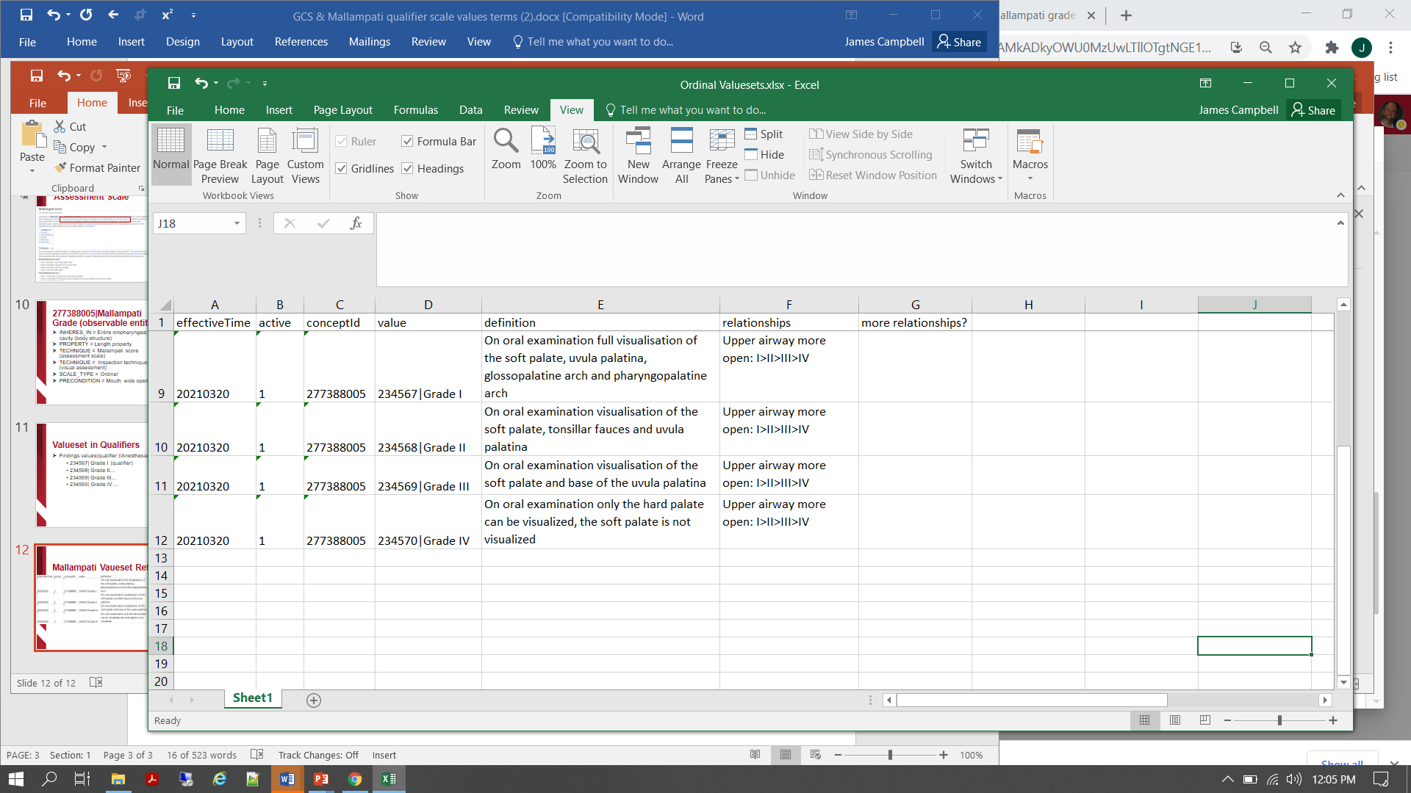
Mallampati Vaueset Refset

Slide 14
424397003|Mallampati class IV (finding)
Fully defined
IS_A = Finding of assessment scale
INTERPRETS = 277388005|Mallampati grade
HAS_INTERPRETATION = Grade 4

Slide 15
Physiologic Function Classification
Functional Observables Model
Glasgow Coma Scale
The Scale was described in 1974 by Graham Teasdale and Bryan Jennett as a way to communicate about the level of consciousness of patients with an acute brain injury.
Assessment of coma and impaired consciousness. A practical scale. Lancet 1974; 2:81-4.
Teasdale G, Maas A, Lecky F et al. The Glasgow Coma Scale at 40 Years: standing the test of time. Lancet Neurology 2014 ;13(8) : 844-854

Slide 16

Glasgow Coma Scale

Slide 17
FUNCTION Observable:
24824002|Glasgow coma score (observable entity)
INHERES_IN = Structure of cerebrum (body structure)
CHARACTERIZES = Neuropsychological process \ Sensorium: awareness and interaction (process)
PROPERTY = Process realization rate
TECHNIQUE = 386554004|Glasgow coma scale (assessment scale)
SCALE_TYPE = Ordinal or quantitative

Slide 18
Assessment Scores and Components Defined
  248241002|Glasgow coma total score (observable entity)
  ::=
  IS_A = |Component of Glasgow coma scale (observable entity)
  INHERES_IN = 83678007|Cerebral structure(body structure)
  HAS_REALIZATION = |Sensorium: awareness and interaction (process)
  TECHNIQUE = 386554004|Glasgow coma scale(assessment scale)
  PROPERTY = |Process achievement rate
  SCALE_TYPE = |Ordinal or quantitative
  248241002|Glasgow coma scale: Eye opening (observable entity)
  ::=
  IS_A = |Component of Glasgow coma scale (observable entity)
  INHERES_IN = 83678007|Cerebral structure(body structure)
  HAS_REALIZATION = |Sensorium: eye opening (process)
  TECHNIQUE = 386554004|Glasgow coma scale(assessment scale)
  PROPERTY = |Process achievement rate
  SCALE_TYPE = |Ordinal or quantitative
  248241002|Glasgow coma scale: Verbal response (observable entity)
  ::=
  IS_A = |Component of Glasgow coma scale (observable entity)
  INHERES_IN = 83678007|Cerebral structure(body structure)
  HAS_REALIZATION = |Sensorium: Verbal response (process)
  TECHNIQUE = 386554004|Glasgow coma scale(assessment scale)
  PROPERTY = |Process achievement rate
  SCALE_TYPE = |Ordinal or quantitative
  248241002|Glasgow coma scale: Best motor response (observable entity)
  ::=
  IS_A = |Component of Glasgow coma scale (observable entity)
  INHERES_IN = 83678007|Cerebral structure(body structure)
  HAS_REALIZATION = |Sensorium: Best motor response(process)
  TECHNIQUE = 386554004|Glasgow coma scale(assessment scale)
  PROPERTY = |Process achievement rate
  SCALE_TYPE = |Ordinal or quantitative

Slide 19
Glasgow Coma Scale Values Refset…

Slide 20
Sequential Organ Failure (SOFA) Score
Scale employing multiple physiologic measurements to assess major organ system function with calculated score shown to correlate well with ICU mortality
Ferreira FL, Bota DP, Bross A et al. Serial evaluation of the SOFA score to predict outcome in critically ill patients. Journal of the American Medical Association 2001; 286(14) :1754-1758.

Slide 21
Sequential Organ Failure (SOFA) Score
Scale score items:
Respiratory: pAO2/Fraction inhaled oxygen content(%)
Hematologic: Platelet count (10³/µL)
CNS: Glasgow Coma Scale (estimate if on sedatives)
Hepatic: Bilirubin (umol/L)
Cardiac: Mean arterial pressure(mmHg) or dose of pressors in use
Renal: Creatinine(umol/L) or Urine output

Slide 22
Sequential Organ Failure Total Score (observable entity)
Fully defined
IS_A = Finding of assessment scale
INHERES_IN = 91689009|Body system structure (body structure)
HAS_REALIZATION = 2140201000004100|Metabolic physiological process
TECHNIQUE = 459231000124102 |Sequential Organ Failure Assessment Scale
PROPERTY = 2304071000004105|Scale score
SCALE_TYPE = Ordinal or quantitative

Slide 23
Sequential Organ Failure (SOFA) Score
  |Oxygen [partial pressure] in Arterial blood (LOINC:2703-7) [PAO2]
  ::=
  IS_A = |Clinical chemistry observable
  INHERES_IN = Blood (substance)
  DIRECT_SITE = |Arterial blood specimen
  COMPONENT = Oxygen (substance)
  PROPERTY = |Partial pressure
  SCALE_TYPE = |Quantitative
  UNITS = ‘mmHg’
  250774007|Inspired Fraction Oxygen Concentration (observable entity) [FIO2]
  ::=
  IS_A = Clinical lab observable
  INHERES_IN = 74974009|Gaseous substance (substance)
  DIRECT_SITE = 119337004|Inspired gas specimen (specimen)
  COMPONENT = 24099007|Oxygen (substance)
  PROPERTY = 118563004|Substance ratio
  SCALE_TYPE = |Quantitative
  UNITS = ‘%’
Scale score items:
pAO2/Fraction inhaled oxygen content(%)
Platelet count (10³/µL)
Glasgow Coma Scale (estimate if on sedatives)
Bilirubin (umol/L)
Mean arterial pressure(mmHg) or dose of pressors in use
Creatinine(umol/L) or Urine output

Slide 24
Sequential Organ Failure (SOFA) Score
Scale score items:
Fraction inhaled oxygen content(%)
Platelet count (10³/µL)
Glasgow Coma Scale (estimate if on sedatives)
Bilirubin (umol/L)
Mean arterial pressure(mmHg) or dose of pressors in use
Creatinine(umol/L) or Urine output
  Platelets [#/volume] in Blood (observable entity) [PLATELETS]
  ::=
  IS_A = |Hematology observable
  INHERES_IN = 87612001|Blood (substance)
  DIRECT_SITE = 119297000|Blood specimen
  COMPONENT = |Population of all platelets in a sample of fluid
  PROPERTY = |Number concentration property
  SCALE_TYPE = |Quantitative
  UNITS = ‘10^3uL’

Slide 25
Sequential Organ Failure (SOFA) Score
Scale score items:
Fraction inhaled oxygen content(%)
Platelet count (10³/µL)
Glasgow Coma Scale (estimate if on sedatives)
Bilirubin (umol/L)
Mean arterial pressure(mmHg) or dose of pressors in use
Creatinine(umol/L) or Urine output
  SOFA Score
  ::=
  CASE WHEN [PAO2]/[FIO2] < 400 THEN 1
  WHEN [PAO2]/[FIO2] < 300 THEN 2
  WHEN [PAO2]/[FIO2] < 220 THEN 3
  WHEN [PAO2]/[FIO2] < 100 THEN 4
  +
  CASE WHEN [PLATELETS] >= 150 THEN 0
  WHEN [PLATELETS] >= 100 THEN 1
  WHEN [PLATELETS] >= 50 THEN 2
  WHEN [PLATELETS] >= 20 THEN 3
  WHEN [PLATELETS] >= 0 THEN 4 ELSE NULL
  + …

Slide 26
Sequential Organ Failure (SOFA) Score
Scale score items:
Fraction inhaled oxygen content(%)
Platelet count (10³/µL)
Glasgow Coma Scale (estimate if on sedatives)
Bilirubin (umol/L)
Mean arterial pressure(mmHg) or dose of pressors in use
Creatinine(umol/L) or Urine output
  Question: Should we develop a logical extension of SNOMED expression language which supports Boolean logic and a standard method for calculating scores such as SOFA from EHR data extracts using SNOMED Observables and Clinical findings as the defining features?

