Slide 1






Clinical Engagement Strategy
2021 - 2025
Shelley Lipon,
Global Customer Relations Executive

Slide 2
Why clinical engagement ?
“Clinicians are frequently the first to hear, see and identify patient conditions and findings that need documentation. Further, clinicians are in a unique position to see correlations between the items that need documentation. Being able to contribute to terms, definitions, and the valuable relationships available within SNOMED CT improves usability. Working with the entire design team for an EHR allows for better presentation, and proper representation that may significantly contribute to timeliness, efficiency, and most important, improved care outcomes”.
Mark Jurkovitch,
Chair, SNOMED International Dentistry Clinical Reference Group

Slide 3
Benefits of clinical engagement
Promote collaboration between international healthcare professional groups that improve SNOMED International products and services by improving knowledge and demonstrating value
Identification of clinical relevance to clinicians of using SNOMED CT to ensure benefits realization
Ensuring clinical input into SNOMED CT implementation developments and development of clinical analytics functionality using SNOMED CT
Clinical engagement of EHR vendors and NLP vendors will ensure SNOMED CT meets current and future requirements
SNOMED CT is used as the basis for delivering clinical care and improving care quality
Informing direction of SNOMED International products and services to meet current and emerging global clinical requirements
Improving the quality, and thus clinical usability and acceptability, of SNOMED International products and services, based on clinical knowledge and expertise

Slide 4


SNOMED CT with clinical engagement
SNOMED CT, enhanced by clinicians to support current and future clinical practice
Timely responses to clinical advances
Clinically assured SNOMED CT content
Development of clinically supportive derivatives
CLINICAL
ENGAGEMENT
Clinical input into future developments
Development of clinically responsive educational materials
Corporate culture driving clinically assured product development
Clinically driven implementation support
EHR/NLP vendor engagement

Slide 5
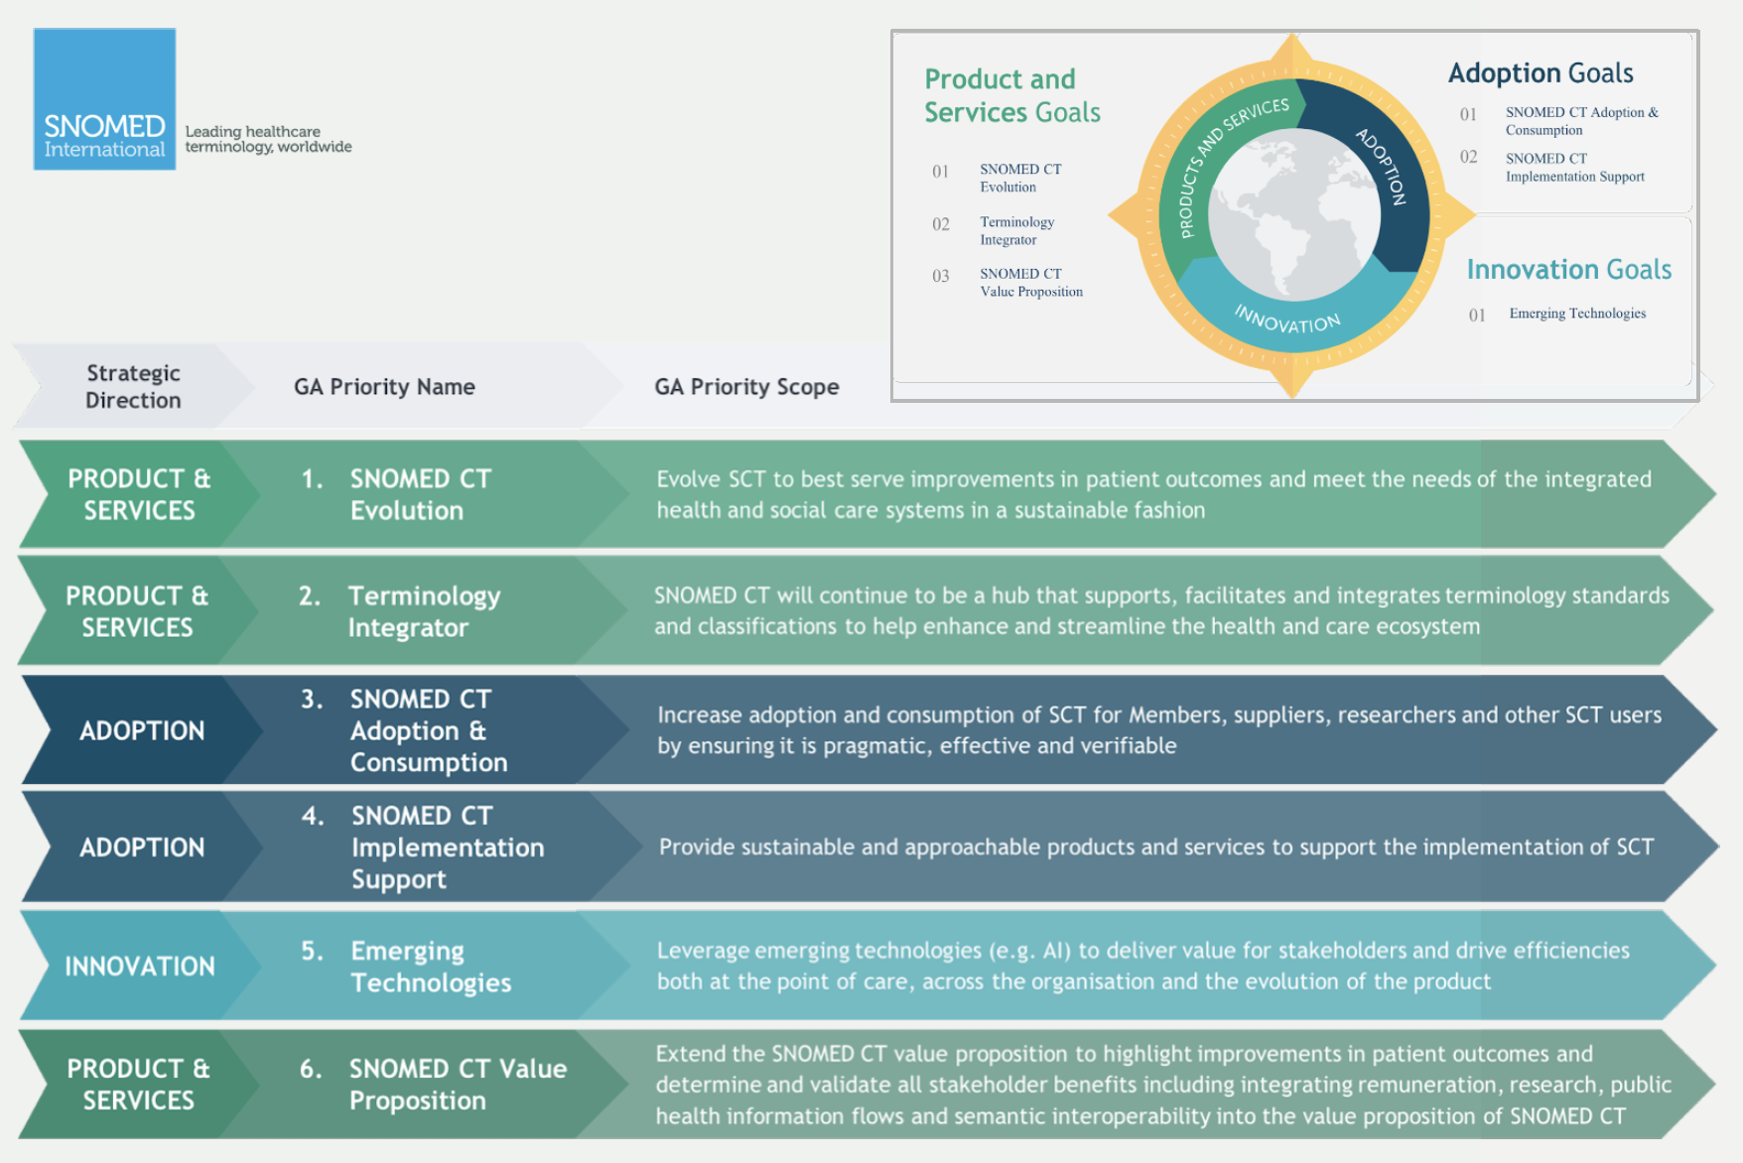
SNOMED International Strategy 2020 - 25

Slide 6


Vision of Clinical Engagement
SNOMED is well positioned to provide a set of tools (concepts, methodologies, and programs) that allow clinicians to readily work with EHRs, thereby increasing adoption, accuracy of information, and improvement in care outcomes
SNOMED International’s culture has a progressive and sustainable approach to engaging clinicians and clinically focused vendors

Slide 7
Principles – stakeholder engagement
Individual clinicians
National clinical groups & bodies
International clinical groups & bodies
Clinically focused standards bodies
Vendors (EHR & NLP)
SNOMED CT
Doctors
Clinical
educators
Allied health
professionals
Nurses
Clinical managers

Slide 8
Principles
Clinical engagement is central to the culture of SNOMED International
Clinical engagement activities apply across all global regions
Clinical engagement encompasses all healthcare professions globally
Clinical engagement will apply across all stakeholder groups
Clinical engagement approach will foster and encourage a culture of open engagement and discussion between clinicians
Clinical engagement approach will leverage experience and shared learning globally across all specialties
Clinical engagement approach will assure the quality and clinical relevance of SNOMED International products and services
Clinical engagement will include EHR vendors and NLP vendors to ensure current and future clinical use case requirements are met
Clinical engagement will identify the relevance to individual clinical, clinical organizations and vendors of using SNOMED CT in clinical practice to optimize safe delivery of quality care

Slide 9
Strategic approach
Aim to improve care documentation systems and methods with SNOMED concepts and tools that support artificial intelligence and development of decision support tools
Improve SNOMED CT ease of use for clinicians. CRG’s taking a lead on developing concepts and methodologies to work effectively with new technologies (NLP, voice recognition, artificial intelligence products) that are developing to serve the health care market. These tools need to incorporate SNOMED CT to differentiate between patient reported symptoms, clinician observations and other patient related information
Identify engaged clinicians to assist in identifying individuals in target markets, to engage with by developing clinically focused relationships that can evolve to the benefit of the target organization and SNOMED CT
Develop and support a community of clinicians focused on ensuring SNOMED CT is fit for purpose to support clinical practice in current and future healthcare systems
Develop and maintain a robust source of clinical information from the global SNOMED clinical user community

Slide 10
Clinical engagement goals/objectives to support SNOMED International strategic direction
  Raise the profile of SNOMED CT for clinicians locally/nationally/globally
Identify and support local/regional/national/global health care professional ambassadors/SMEs for SNOMED CT
Clinical engagement of EHR vendors and NLP vendors to ensure SNOMED CT meets current and future requirements
Identify and gather use case examples from clinical and research perspectives to demonstrate benefits of using SNOMED CT
Provision of information/guidance regarding SNOMED CT and it’s interface with other standards, e.g., ICD-11
Identify opportunities to enhance SNOMED CT through collaboration with other clinical standards
Identify and respond to key external drivers that impact clinical perspectives alongside patient care, e.g., billing and quality improvement
Identify key clinical requirements/priorities/trends to inform SNOMED International products and services
Increase the access and promotion of relevant SNOMED CT educational materials by all healthcare professionals
  Development of clinical analytics documentation and educational materials to showcase SNOMED CT functionality within clinical practice

Slide 11
Clinical Engagement work plan approach
The annual work plan will include global clinical engagement activities
The clinical engagement plan will deliver on the strategic direction for the SNOMED International
The annual work plan will be developed in collaboration with the leads of the clinical groups (reference and project groups) and clearly identify deliverables, with an implementation plan and measure of success
All clinical engagement activities will coordinate with the relevant SNOMED International lines of business in order to ensure appropriate and timely delivery
All clinical engagement activities within Member countries will be undertaken only following consultation with the relevant national authority
Outreach to clinical registries to support interoperability and data exchange
Focus on content – logical definitions to support future analytics and measurement specification (QA measures)
Developing tools to support content review by CRGs
Outreach to clinical training schools
Identification of clinical champions who support and endorse the implementation of SNOMED CT and related products and services
Development of clinical value statement

Slide 12
Clinical Engagement Work plan
2021-25

Slide 13
Work plan 2021-25
Strategic Objective | Raise the profile of SNOMED CT for clinicians locally/nationally/ globally
Deliverable | Clinical engagement web interface and forum, to provide information, documentation and educational materials Annual calendar identifying key opportunities for clinical engagement leads to promote SNOMED CT globally
Mechanisms/Action Plans | Member countries will be consulted to agree engagement activities within their borders Gather requirements from clinicians/clinical groups globally on what information, documentation and educational materials are required to increase the implementation of SNOMED CT (Design, develop and implement a web interface based on requirements). Identify key areas of focus for opportunities for clinical engagement e.g. Genomics and “Big data” Support the prescience of SNOMED International at international/national clinical conferences to raise awareness of SNOMED CT - the product and functionality
Measures of Success | Number of clinicians accessing Clinical portal and partaking in clinical groups

Slide 14
Work plan 2021-25
Strategic Objective | Identify and support local/regional/national/ global health care professional ambassadors/subject matter experts for SNOMED CT
Deliverable | To develop an identified group of global clinician ambassadors/SMEs Develop a sustainable clinically focused community within SNOMED International Provide access to clinical validation resources for SNOMED CT content
Mechanisms/Action Plans | Identification of global ambassadors /SMEs - through the delivery of clinical sessions by the clinical leads, and by supporting clinician interest in advanced functionality within SNOMED CT Develop and maintain a group of SMEs to advise on the development of SNOMED Ct and derivatives and support outreach to EHR/NLP vendors Develop a description of the role of professional ambassadors/SMEs Develop a quality assurance process for clinicians/clinical groups, including standardization of feedback methodology, and leveraging of existing SNOMED International tooling (or identification of new requirements) Identify International clinical Groups e.g. CMSS (Council of Medical Specialty Societies)
Measures of Success | List of clinician ambassadors/SMEs providing global coverage Number of clinicians involved with SNOMED International (baseline)

Slide 15
Work plan 2021-25
Strategic Objective | Identify and gather use case examples from clinical and research perspectives to demonstrate benefits of using SNOMED CT
Deliverable | Central list of documented use cases
Mechanisms/Action Plans | Work with clinicians and clinical groups to document clinical use case requirements Publish clinical use cases via the clinical portal
Measures of Success | Number of use cases documented and published

Slide 16
Work plan 2021-25
Strategic Objective | Increase the access to relevant SNOMED CT educational materials for healthcare professionals
Deliverable | Provision of a central source of educational materials Development and documentation of clinician focused education requirements
Mechanisms/Action Plans | Develop new/revised clinically focused education materials/module based on stated requirements
Measures of Success | Inventory of clinical educational materials available, and under development Publication of clinical educational materials available through a central point

Slide 17
Work plan 2021-25
Strategic Objective | Identify key clinical requirements/priorities/trends to inform SNOMED International products and services
Deliverable | Structured methodology for identifying clinical requirements/priorities/trends to inform SNOMED International products and services Roadmap for Genomics
Mechanisms/Action Plans | Develop and agree methodology/template for gathering requirements/ priorities/ trends and developing subsets Develop strategy and roadmap for supporting genomics
Measures of Success | Methodology developed and implemented Genomics strategy published Genomics roadmap developed

Slide 18
Work plan 2021-25
Strategic Objective | Demonstrate high value clinical decision support capabilities of SNOMED CT
Deliverable | Provision of a tool that demonstrates high value decision support and analytic capability for clinicians Plan for ongoing engagement with key high value users
Mechanisms/Action Plans | Build/enhance tooling to demonstrate decision support and analytic capability Identify users of SNOMED CT that are interested, and capable of moving to a high value implementation Develop plan for long term engagement with high value users
Measures of Success | Tool that is operational and accessible to demonstrate advanced decision support and analytic capabilities

Slide 19
Work plan 2021-25
Strategic Objective | Identify clinically focused interoperability opportunities to enhance SNOMED CT through collaboration
Deliverable | Provide recommendations to Collaboration Lead on global collaboration opportunities Recommend potential future derivatives based on clinical feedback, in conjunction with discussion with vendors
Mechanisms/Action Plans | Identification of interoperability/collaboration requirements through clinical contacts Document future potential derivatives for discussion with Collaboration lead, and Release team
Measures of Success | Number of additional collaboration activities List of future potential derivative products, with documented justification

Slide 20
Work plan 2021-25
Strategic Objective | Identify and work with EHR and NLP vendors to gather use case requirements to inform SNOMED CT developments
Deliverable | Documented EHR and NLP vendor use case requirements Professional relationships with EHR and NLP vendors
Mechanisms/Action Plans | Develop professional relationships with EHR and NLP vendors Provision of standardized use case requirements template Publication of use case requirements via clinical portal
Measures of Success | Number of published use case requirements documentation Number of vendor contacts in active discussions

