Slide 1
Semantic Interoperation of Laboratory Results with SNOMED CT -
EAG proceedings
James R. Campbell
Daniel Karlsson
University of Nebraska Medical Center
Omaha, NE, USA
Swedish Board of Health
Stockholm, SW

Slide 2
EAG Minutes
Discussion:
Consensus was support for the integration of the Evaluation procedures and Observable entity hierarchies for the single property observations.
Questions arose about the value of the "Performable" type of concept
A small group of participants was organized to begin a pilot to determine the feasibility and level of effort required to transform single property evaluation procedures (laboratory evaluations?) into observable entities and whether an automated process would be possible.

Slide 3
E2O Meeting 1 Agenda
Information management from clinical lab in 21st century EHR
State of the art in lab interoperation and findings
Barriers created to semantic interoperation by SNOMED concept model
Toward a unified model supporting semantic interoperation of laboratory results employing SNOMED CT
Step one proposal for SNOMED remediation

Slide 4
Lab-EHR Information Management
The information management cycle within the EHR starts with an order for a lab test (ORDERABLE) which is directed to a laboratory department where a specific technology is employed (PERFORMABLE) to produce a result which is then reported (RESULTABLE) back to the Learning Health System. The concept model for Observable entities allows us to specify templates for each of these types of information which require different subsets of defining attributes. Such a unified model also has slightly different information processing requirements for QUALITY observables – the vast majority use case, PROCESS and PANEL ORDERABLES and they will be discussed separately.

Slide 5
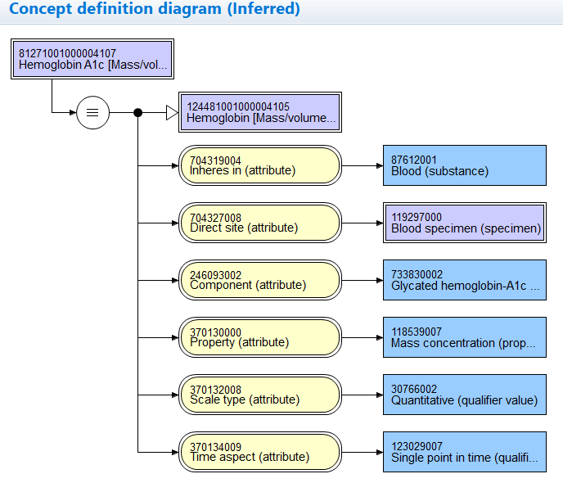
Ordering the Lab:
ORDERABLE
(test portion of Order record)
Dr Jim Campbell orders a hemoglobin A1C to assess diabetic control of his patient
Defining attributes
commonly required
for QUALITY orderables:
Inheres in
Inherent location
Direct site
Relative to
Component
Property
Scale type
Time aspect
Precondition
Technique

Slide 6
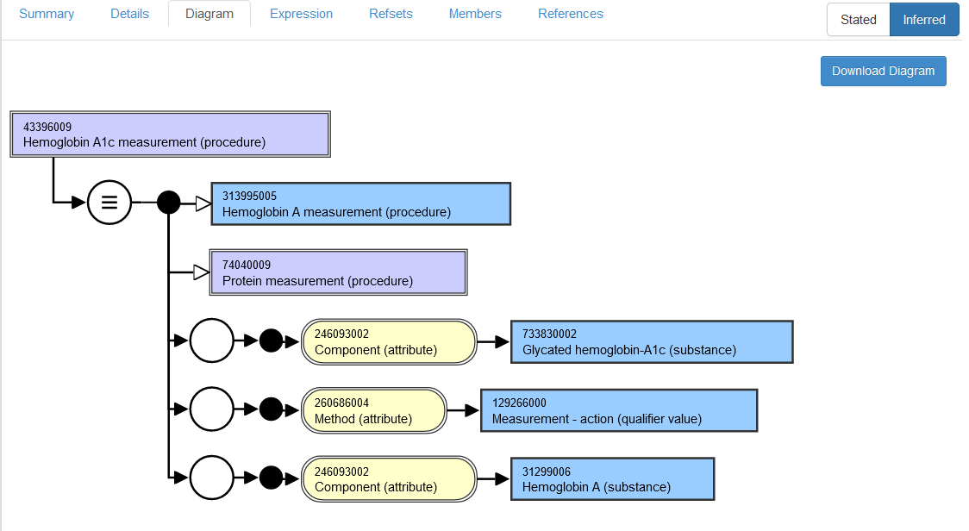
Processing the Lab:
PERFORMABLES
Dr Scott Campbell receives the order, directs the specimen to the testing device which can deliver the result requested by the physician
The pathology lab
Director has carefully
Coded his lab master
For tests as
SNOMED CT
Lab test (Procedure)
Which contains detail
Regarding TECHNIQUE
And DIRECT SITE, but
Little other detail for
The RESULTABLE

Slide 7
Processing the Lab:
PERFORMABLES
Dr Scott Campbell receives the order, directs the specimen to the testing device which can deliver the result requested by the physician
Lack of applicable standards or direction from ONC has created confusion
Among US users and re-users of laboratory results data – such as research
Networks and public health databanks – and when obliged to encode
The laboratory results issuing from their laboratories they often use the
Billing codes for the procedures they employed to develop the results.
In the US, CPT-4/HCPCS is probably the most widely used coding scheme.
The SNOMED CT procedure code used in this example would be uncommon
In the US realm, but IHTSDO members, faced with inconsistent guidance
On relevant data standards, may well be employing the Lab procedures
From SNOMED CT.
The pathology lab
Director has carefully
Coded his lab master
For tests as
SNOMED CT
Lab test (Procedure)
Which contains detail
Regarding TECHNIQUE
And DIRECT SITE, but
Little other detail for
The RESULTABLE

Slide 8
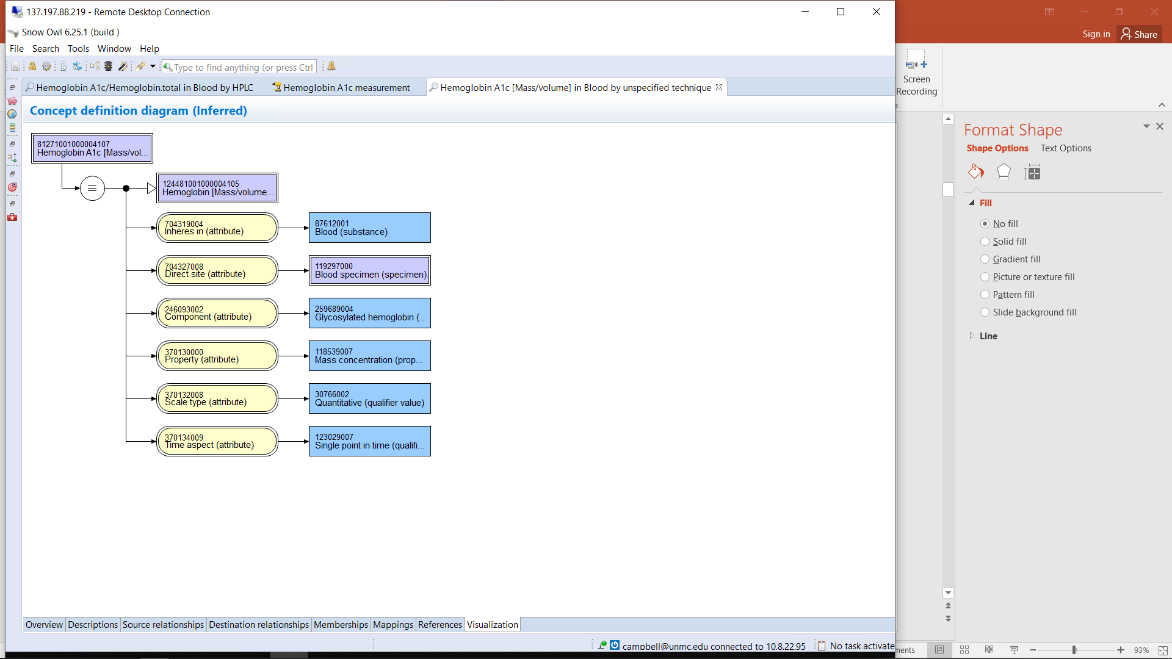
Reporting the Lab:
RESULTABLES
(=ORDERABLE with possible technical detail from lab)
Dr Scott Campbell’s lab issues an HL7 OBX segment back to the EHR with the results of the test which are defined by the ORDERABLE specifications occasionally modified by to include PERFORMABLE or PANEL specifications
Defining attributes
commonly required
for QUALITY results:
Inheres in
Inherent location
Direct site
Relative to
Component
Property
Scale type
Time aspect
Precondition
Technique

Slide 9
Nebraska Medicine
Hemoglobin A1C tests
18 Orderables specifying performing laboratory or specific diagnostic procedure to be employed
  Order Routing metadata; context of care
2 Performables employing different testing equipment in different enterprise labs
  Equipment = testing technique
2 Resultables chosen by data manager specifying testing procedure employed
  Techniques yield results which have different normal ranges

Slide 10
Nebraska Medicine
Hemoglobin tests
162 Orderables: 2 POC, 16 Hemoglobin and hematocrit panels, 144 CBC panels
  Hemoglobin rarely performed as single test; order routing metadata and lab; specimen
2 Performables employing different testing equipment in different enterprise labs
  1 testing device performs virtually all tests except POC testing
4 Resultables chosen by data manager specifying testing procedure or specimen
  Different techniques and specimen types yield results which have different normal ranges

Slide 11
Lab Results Codification in US Research Networks
Variability in reference standards used to identify results:
  CPT-4 procedure coding for billable lab test
  LOINC lab coding
  SNOMED CT Lab procedure codes

Slide 12
Lab-EHR Information Management
The point of this discussion is that one testing procedure or machine (PERFORMABLE) might be used by the lab to develop observation results for MANY different observable ORDERABLEs (HL7:OBR-3) depending upon the patient preparation, the specimen,sampling protocol employed or organization of the enterprise labs. Details of the specimen processed, the specimen preparation and patient preparation must be married from the ORDERABLE to the PERFORMABLE in generating an accurately defined RESULTABLE (HL7:OBX-3) from the LIMS to the EHR so that the final lab result database supports semantic interoperation and the datamart serves all downstream users – clinicians, researchers or public health.
FDA Shield project is currently promoting a reference database called LIVD of PERFORMABLES in what they believe will promote uniform coding of the RESULTABLES but this can only be a partial solution for the coding needs of the enterprise.

Slide 13
State of the art in lab interoperation and findings
Managing a modern clinical lab is complex and reporting the breadth of results as interoperable data is daunting and fraught with error
Each IHTSDO member may or may not have deployed national lab results coding schemes
No basis for semantic interoperation other than equivalence mapping on national code level between those shared schemes
No commitment among IHTSDO members for shared concept model for equivalence

Slide 14
Analytics Employing Semantic Interoperation supported by SNOMED CT
*HEMOGLOBIN A1C FRACTION
'Observable entity (observable entity)'
and ('Role group (attribute)' some ('Component (attribute)' some
'Glycated hemoglobin (substance)'))
and ('Role group (attribute)' some ('Relative to (attribute)' some
'Hemoglobin (substance)'))
and ('Role group (attribute)' some ('Inheres in (attribute)' some 'Blood (substance)'))
*BLOOD OR URINE OPIATE SCREEN
'Observable entity (observable entity)'
and ('Role group (attribute)' some ('Component (attribute)' some
'Substance with opioid receptor agonist mechanism of action (substance)'))
and (('Role group (attribute)' some
('Direct site (attribute)' some 'Acellular blood (serum or plasma) specimen (specimen)'))
or
('Role group (attribute)' some ('Direct site (attribute)' some 'Urine specimen (specimen)')))

Slide 15
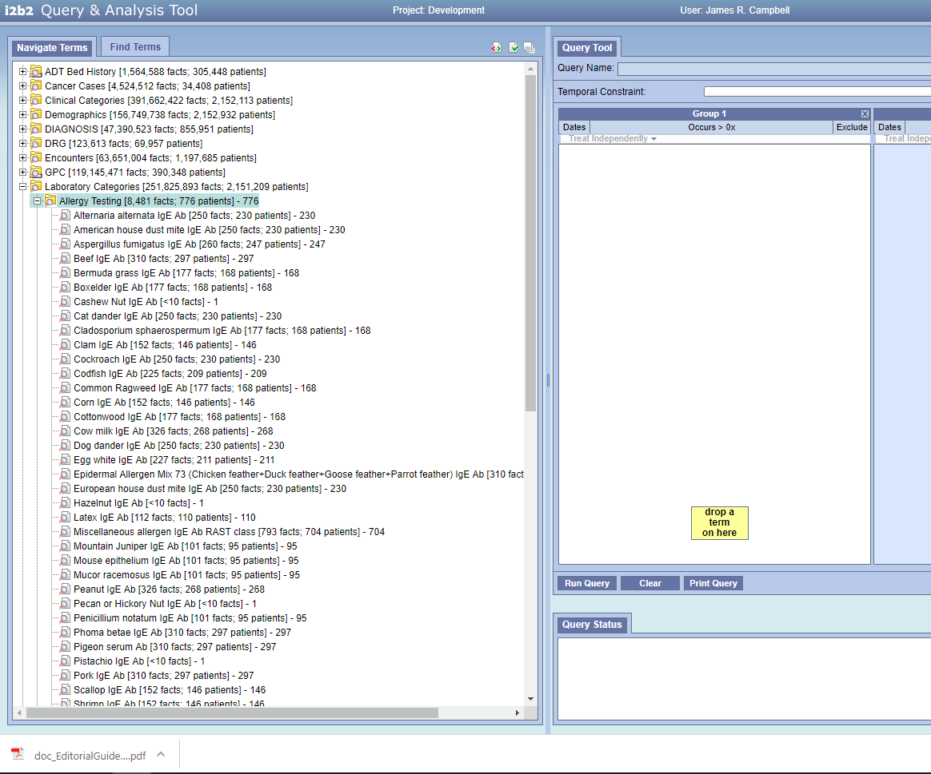
I2b2 metadata Tooling

Slide 16
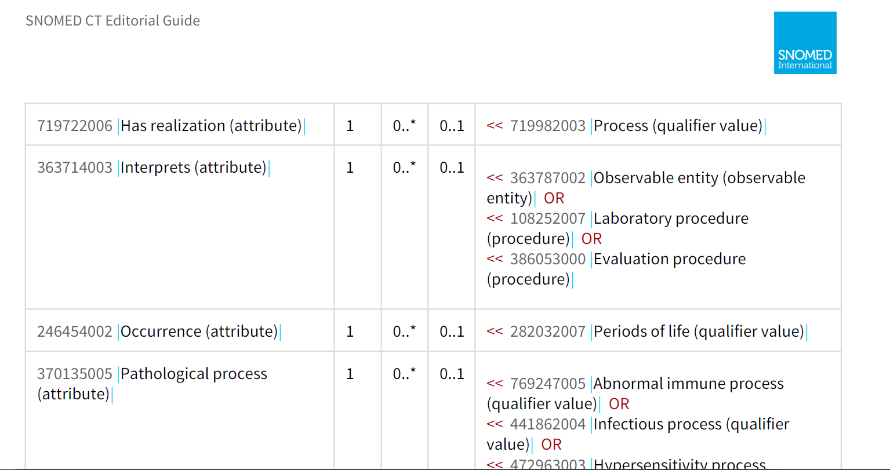
Barriers created to semantic interoperation by SNOMED CT
Newness of the concept model for Observables
Ambiguity created by inclusion of BOTH <<386053000|Evaluation procedures| AND <<108252007|Laboratoy procedure| AND <<363787002|Observable entity| to populate 363714003|Interprets (attribute)| and therefore to code a RESULTABLE finding
Procedure testing concept model lacks the specificity of the Observables model for fully defining a REDSULTABLE
Non-alignment of defining attributes for these two hierarchies, specifically METHOD-TECHNIQUE

Slide 17
Barriers created to semantic interoperation by SNOMED CT
Newness of the concept model for Observables
Ambiguity created by inclusion of BOTH <<386053000|Evaluation procedures| AND <<108252007|Laboratoy procedure| AND <<363787002|Observable entity| to populate 363714003|Interprets (attribute)| and therefore to code a RESULTABLE finding
Procedure testing concept model lacks the specificity of the Observables model for fully defining a RESULTABLE
Non-alignment of defining attributes for the Observable and Procedure hierarchies, eg METHOD-TECHNIQUE

Slide 18
SNOMED CT Lab Procedures
Concept Inventories
<<108252007|Laboratory procedure| = 5165 concepts
<<386053000|Evaluation procedure| + Method=Measurement – action 7125 concepts

Slide 19
Proposal
Apply Observables concept model to fully define <<some Evaluation Procedures for lab and <<Lab Procedures and move them to Observable entities while maintaining SCTID to support interoperability of lab RESULTABLES that have employed the codes – specifically analytics for decision making, research and public health
Evaluate effects on:
  Observables classification of lab RESULTABLES for analytics and decision support
  Clinical findings classification of findings employing Interprets=Lab Observables
Further content revisions to Procedures can be informed by the results of this work and could then proceed in steps:
  Laboratory testing procedures
  ?Vitals signs
  ?Imaging

Slide 20
Step 1 Protocol Proposal
Purpose:
  1) Develop non-ambiguous, unique and fully defined set of RESULTABLE Observable entities in use within IHTSDO members starting with Nebraska Lexicon (~2500 in active use)
  2) Move relevant SNOMED Procedures to Observables hierarchy
  3) Analyze applicable Clinical finding and Observables use cases for analytics
Scope: ?<<Evaluation procedure + Method=Measurement action + Lab context OR ?<<Lab procedure
~12290 concepts

Slide 21
Step 1 Protocol
Scope: <<Evaluation procedure + Method=Measurement action + Lab context OR <<Lab procedure (~12290 concepts)
?Identify ambiguous or duplicate concepts for retirement (for discussion)
Redefine supertype ➔ISA Observable entity
Retire invalid attribute-values from the Procedure concept model and convert definition to Observable concept model (Some procedure attributes provide similar semantics with different value sets; eg Method ➔Technique)
?Structured FSN: [Component] [Property] [Inheres In] [Direct_Site_Substance][Precondition]
Equivalent to an existing Observable entity? Then retire observable as duplicate and retain SCTID of Evaluation procedure for the concept due to the presumption of standing bodies of work
Later: Revise Clinical findings concept model to exclude Evaluation Procedures from Includes attribute Value

Slide 22
Exemplar 1:
43396009|Hemoglobin A1c Measurement (procedure)|

Slide 23
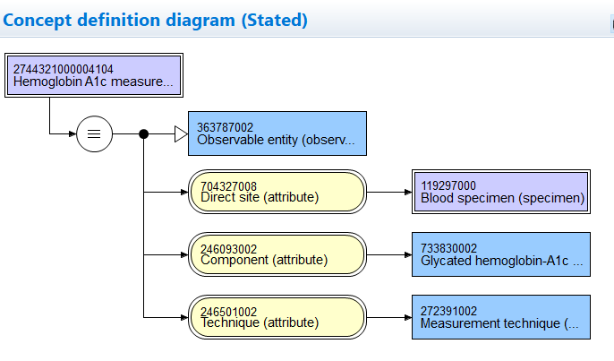
43396009|Hemoglobin A1c [Measurement] in Blood (Observable entity)|

Slide 24
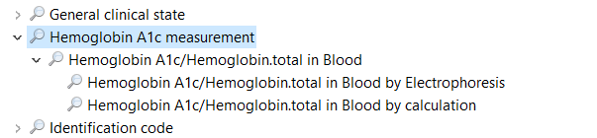
DL Classification of Change
*HEMOGLOBIN A1C MEASUREMENT
'Observable entity (observable entity)'
and ('Role group (attribute)' some
('Component (attribute)' some 'Glycated hemoglobin – A1c (substance)'))
and ('Role group (attribute)' some ('Direct site (attribute)' some 'Blood (substance)'))

Slide 25
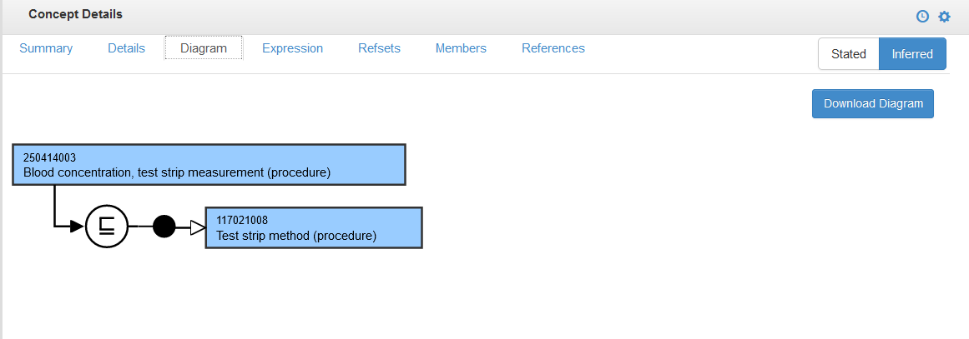
250414003|Blood concentration, test strip method (procedure)

Slide 26
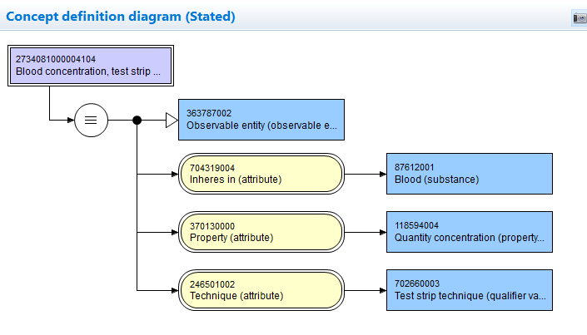
250414003|Blood concentration, test strip method (observable entity)

Slide 27
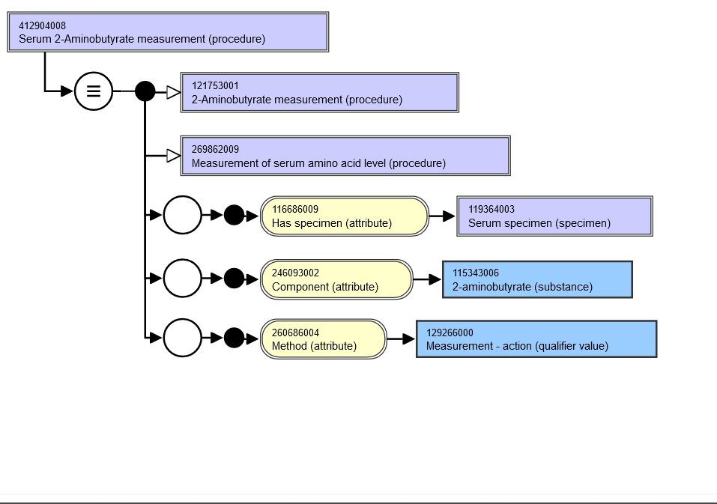
412904008 Serum 2-Aminobutyrate measurement (procedure)

Slide 28
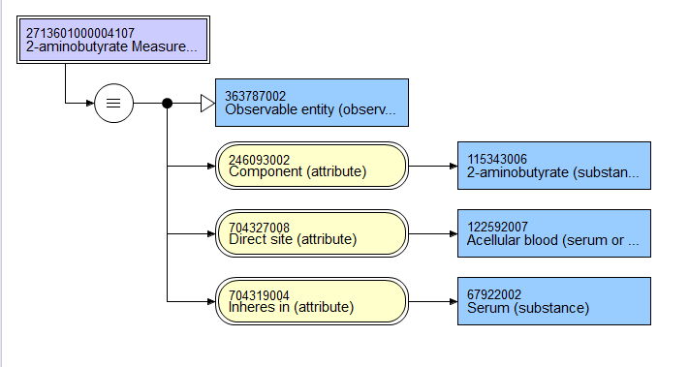
412904008| 2-aminobutyrate measurement in serum specimen (observable entity)|
Stated

Slide 29
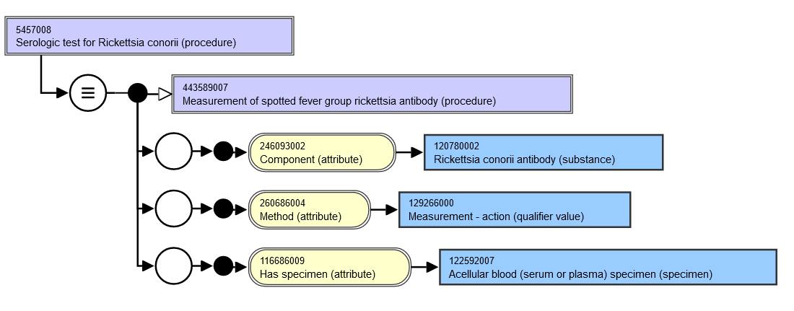
5457008|Serologic test for Rickettsia conorii (procedure)|

Slide 30
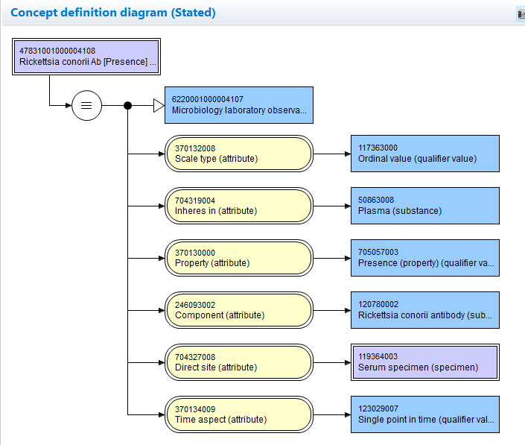
47831001000004108|Rickettsia conorii antibody [Presence] in serum (Observable entity)|

Slide 31
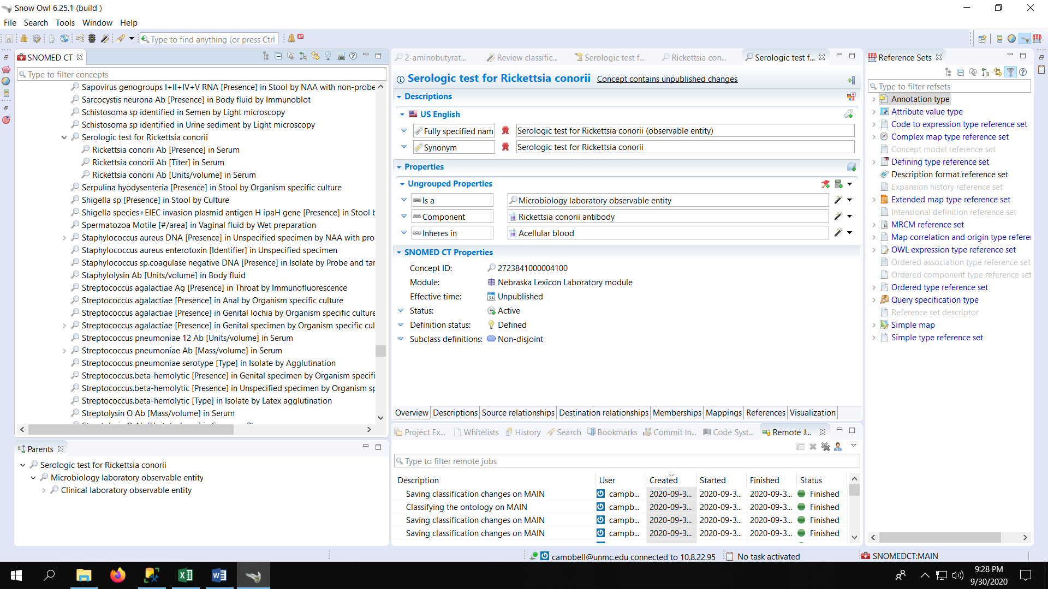
Classification of 5457008

Slide 32
Laboratory Unified Model Relationships(#)
TYPEID | TERM | FREQUENCY
116680003 | Is a (attribute) | 42424
370130000 | Property (attribute) | 22762
370132008 | Scale type (attribute) | 22655
704327008 | Direct site (attribute) | 22615
370134009 | Time aspect (attribute) | 22028
704319004 | Inheres in (attribute) | 21627
246093002 | Component (attribute) | 21129
246501002 | Technique (attribute) | 5634
704325000 | Relative to (attribute) | 2135
704321009 | Characterizes (attribute) | 656
704324001 | Process output (attribute) | 621
704322002 | Process agent (attribute) | 617
704323007 | Process duration (attribute) | 607
718497002 | Inherent location (attribute) | 443
704326004 | Precondition (attribute) | 360
246514001 | Units (attribute) | 288
704320005 | Towards (attribute) | 48
363701004 | Direct substance (attribute) | 9
719722006 | Has realization (attribute) | 1

Slide 33
Step 1 Plan
Scope: <<Evaluation procedure + Method=Measurement action + Lab context OR <<Lab procedure (~12290 concepts)
Proceed with assembling priority set for study and migration from systems in use: Nebraska, UK NHS, VA
?Identify ambiguous or duplicate concepts for retirement (for discussion)
Redefine supertype ➔ISA Observable entity
Retire invalid attribute-values from the Procedure concept model and convert definition to Observable concept model (Some procedure attributes provide similar semantics with different value sets; eg Method ➔Technique)
?Structured FSN: [Component] [Property] [Inheres In] [Direct_Site_Substance][Precondition]
Equivalent to an existing Observable entity? Then retire observable as duplicate and retain SCTID of Evaluation procedure for the concept due to the presumption of standing bodies of work
Later: Revise Clinical findings concept model to exclude Evaluation Procedures from Includes attribute Value

Slide 34
E2O Meeting 2 Agenda
Review of meeting 1 plan; proceed with prioritization of migration set
Discussion of Evaluation Procedures in use at Nebraska Medicine -Jim Campbell
Discussion of EP usage in NHS as READ code mapping – Karim Nashar
Discussion of implications for modelling and template creation – Group
Next meeting datetime -Group

Slide 35
Frequency of use analysis for Procedures in scope
Occurrence of evaluation procedure codes in Problem list:
  Arguably miscodes of problem list entries for abnormal tests – “Elevated troponin level” (105000003 Troponin measurement (procedure) )
  ~500 instances; ~30 codes
Occurrence of findings in EHR which employ Interprets = Evaluation procedure:
  13534 Clinical findings in 20200730 SNOMED CT with Interprets = Evaluation_procedure
  5269 codes in use in Nebraska EHR; ~ 1M entries in problem list, family history and allergy list

Slide 36
Procedure codes in use; Nebraska Medicine
CODE | CODE_NAME | DATA_FREQUENCY
30058000 | Therapeutic drug monitoring assay (regime/therapy) | 191
171126009 | Tuberculosis screening (procedure) | 113
105000003 | Troponin measurement (procedure) | 65
171128005 | Venereal disease screening (procedure) | 44
417429003 | Human leukocyte antigen B27 antigen phenotyping (procedure) | 37
165771000 | Coombs test - anti-human globulin (procedure) | 32
307571006 | Anticoagulant drug monitoring (regime/therapy) | 30
35904009 | Human papillomavirus deoxyribonucleic acid detection (procedure) | 29
65946008 | Anticardiolipin antibody measurement (procedure) | 27
275972003 | Cholesterol screening (procedure) | 21
405824009 | Genetic test (procedure) | 17
3352000 | Parathyroid hormone measurement (procedure) | 11

Slide 37
Frequency of use analysis for Procedures in scope
Occurrence of evaluation procedure codes in Problem list:
  Arguably miscodes of problem list entries for abnormal tests – “Elevated troponin level” (105000003 Troponin measurement (procedure) )
  ~500 instances; ~30 codes
Occurrence of findings in EHR (problem list, family history, ED chief complaint) which employ Interprets = Evaluation procedure:
  13534 Clinical findings in 20200730 SNOMED CT with Interprets = Evaluation_procedure
  5269 codes in use in Nebraska EHR; ~ 1M entries in problem list, family history and allergy list

Slide 38
Findings in use;
Nebraska Medicine
SCTID | TERM | PROCID | PROC_TERM | DATA_FREQUENCY
55822004 | Hyperlipidemia (disorder) | 104780002 | Lipids measurement (procedure) | 625264
55822004 | Hyperlipidemia (disorder) | 104780002 | Lipids measurement (procedure) | 55682
55822004 | Hyperlipidemia (disorder) | 104780002 | Lipids measurement (procedure) | 47438
42399005 | Renal failure syndrome (disorder) | 441915005 | Measurement of renal function (procedure) | 40525
127040003 | Sickle cell-hemoglobin SS disease (disorder) | 14089001 | Red blood cell count (procedure) | 34315
127040003 | Sickle cell-hemoglobin SS disease (disorder) | 441689006 | Measurement of total hemoglobin concentration (procedure) | 34315
271737000 | Anemia (disorder) | 14089001 | Red blood cell count (procedure) | 27885
271737000 | Anemia (disorder) | 441689006 | Measurement of total hemoglobin concentration (procedure) | 27885
13644009 | Hypercholesterolemia (disorder) | 412808005 | Serum total cholesterol measurement (procedure) | 25755

Slide 39
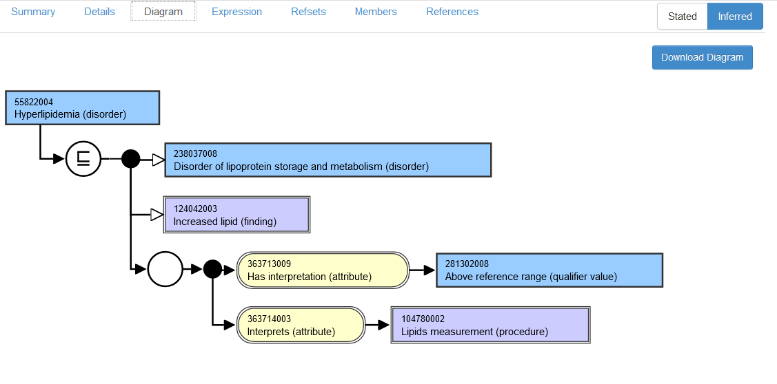
55822004|Hyperlipidemia (disorder)

Slide 40
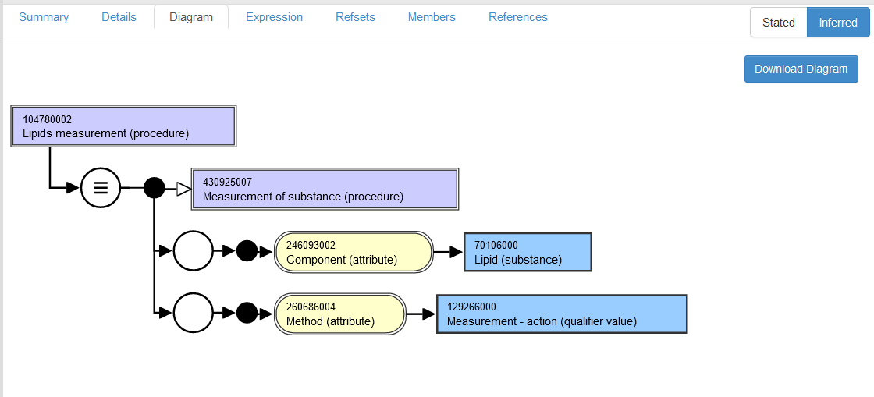
104780002 Lipids measurement (procedure)

Slide 41
Defining the Semantics
Dictionary: “Hyperlipidemia is an abnormally high concentration of fats or lipids in the blood”
I would agree that the finding is primitive since the finding site should presumably be a body fluid or preferably blood and the measurement should be a concentration determination
Hence, the procedure definition can be created in Observables as assessing some property of lipids in some substance but is too vague to fully define Hyperlipidemia
Alternatively the procedure may be promoted to Observables but a second grouper defined consistent with the semantics of the clinical finding which could then be fully defined as concentration of lipids in some blood (component)

Slide 42
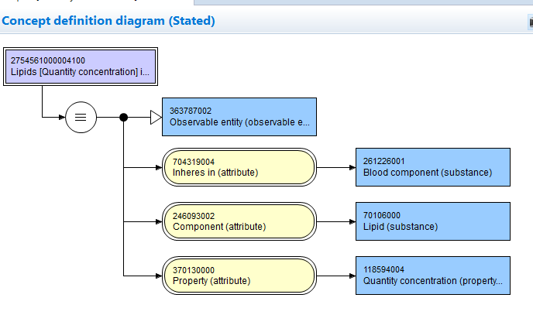
Lipids[Quantity concentration] in Blood (observable entity)

Slide 43
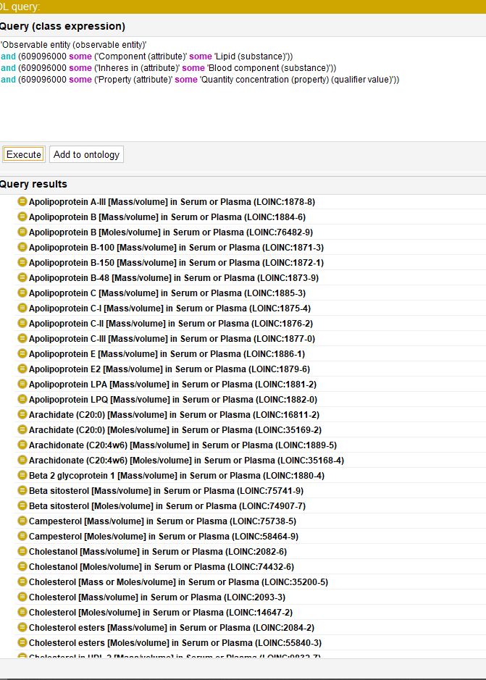
Did the patient have a lipid measurement?

Slide 44
Review of Material from VA
(Penny and John)
Attachment TOP500labs_VAH.csv
Discussion of content by

Slide 45
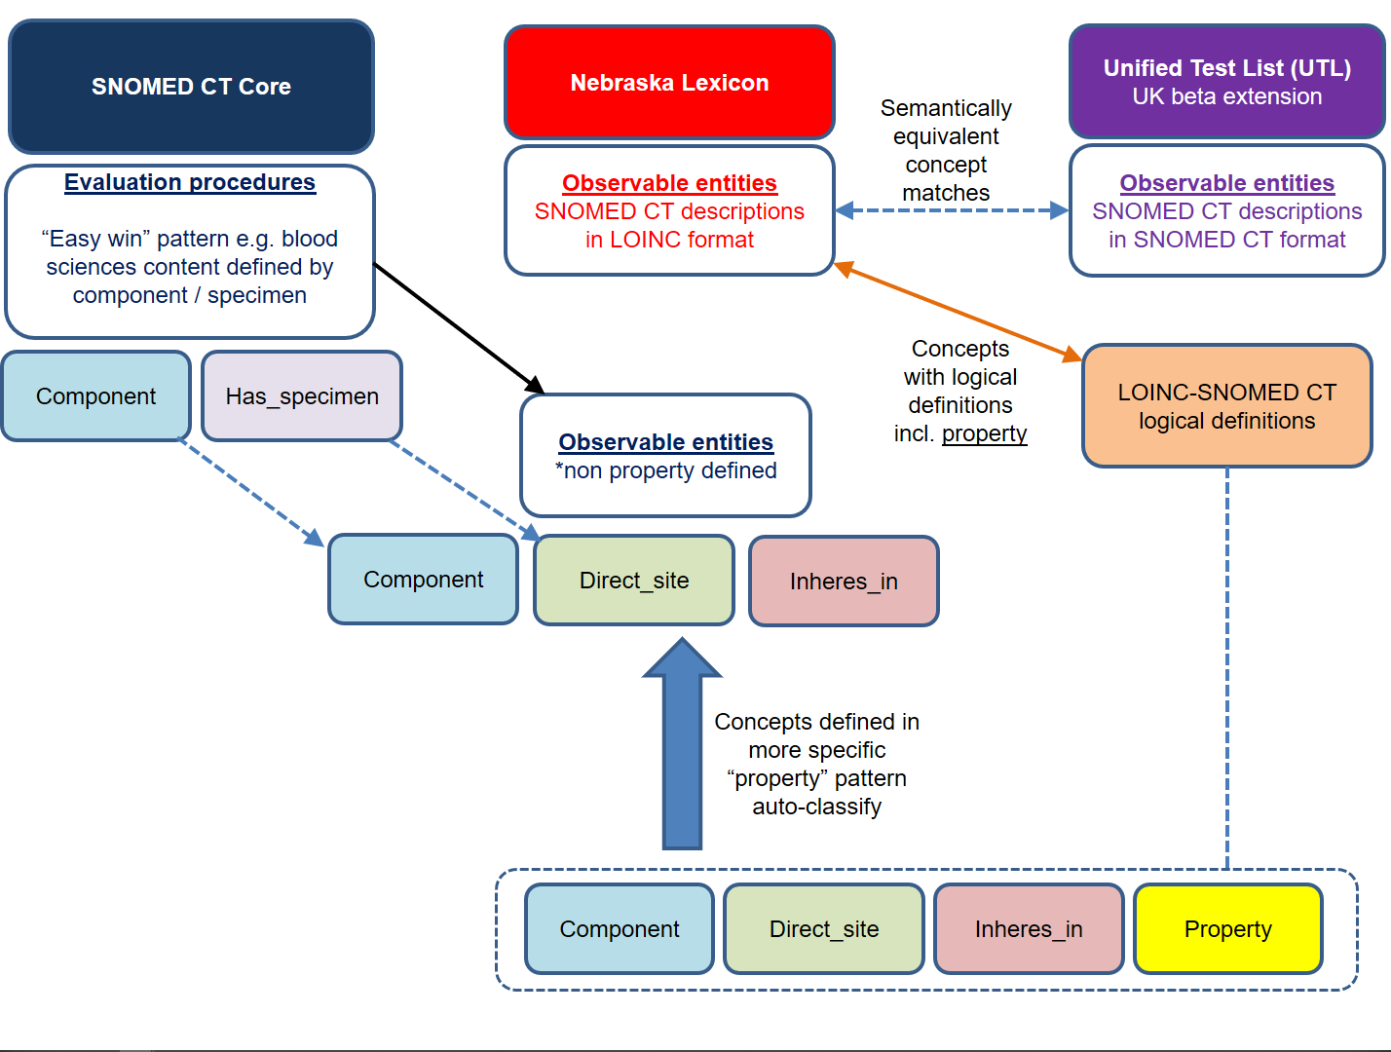

Slide 46
Issues
Evaluation procedures used in “Interprets” to define Clinical findings are generally too imprecise to fully define the finding
Do we consider the defining role of these EP in Clinical findings and demand that the semantics are logical and accurate, or revise the CF definition to assure validity? …or add Observables of appropriate semantics and redefine?

Slide 47
NHS Evaluation Procedure Usage (READ code maps)
EvaluationProcedureID | EvaluationProcedureTERM | 2011-2019 Usage
113075003 | Creatinine measurement, serum | 278893220
104934005 | Sodium measurement, serum | 263533050
271236005 | Serum potassium measurement | 263083990
271026005 | Haemoglobin level estimation | 250937900
442673006 | Measurement of total haemoglobin concentration using dipstick | 250937900
391558003 | Total white blood count | 249562990
767002 | White blood cell count | 249562990

Slide 48
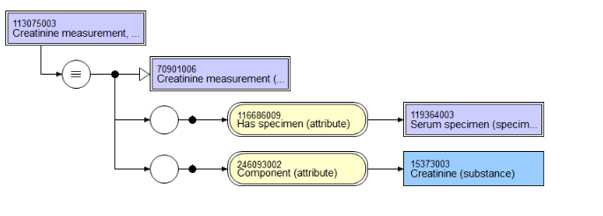
113075003|Creatinine measurement, serum (procedure)|

Slide 49
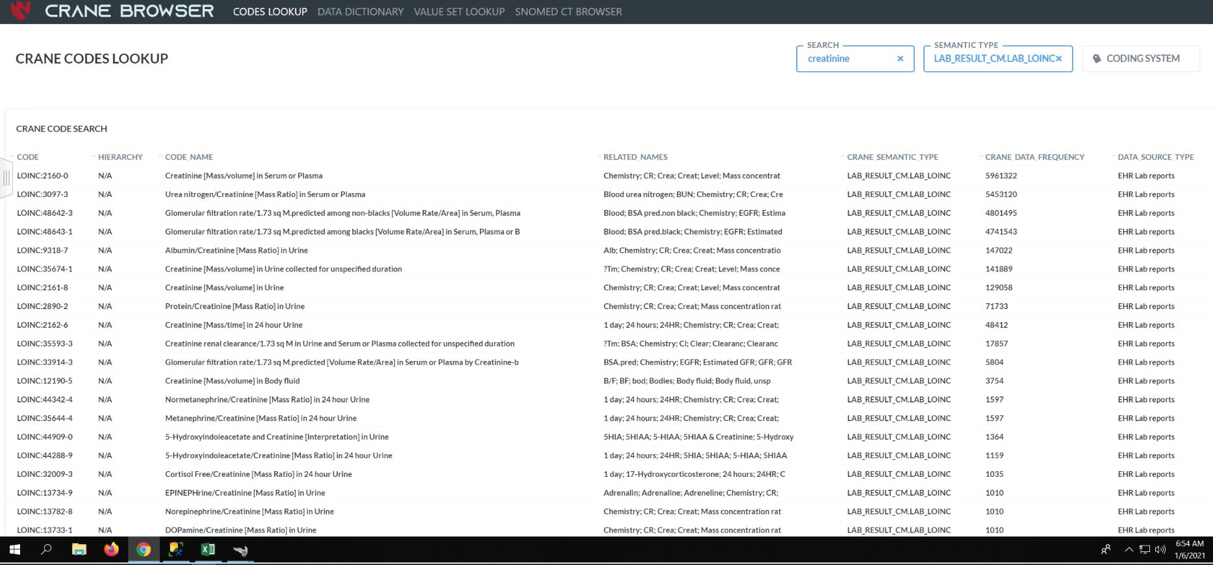
Creatinine Frequency: US Realm

Slide 50
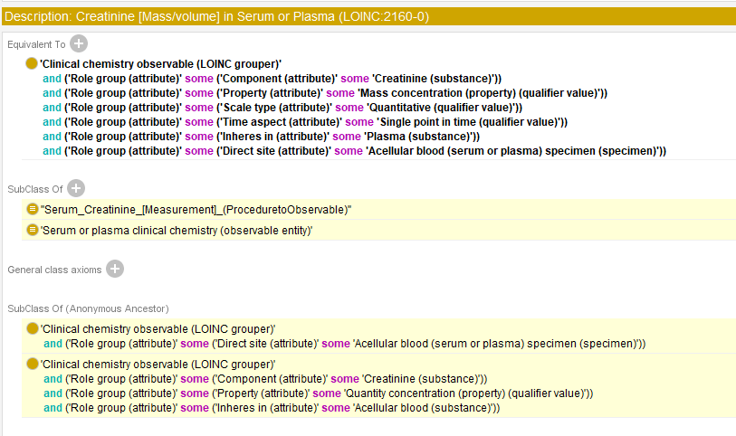
2160-0|Creatinine [Mass/volume] in serum or plasma (observable entity)

Slide 51
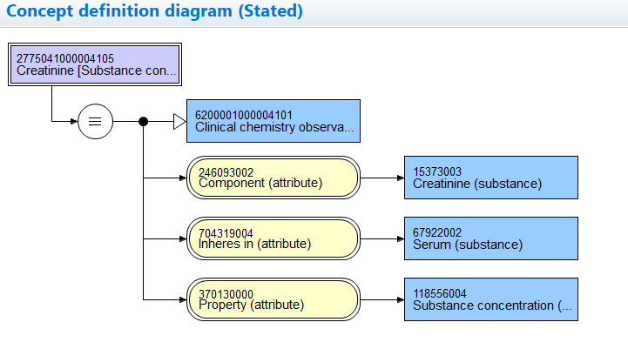
Creatinine [Quantity concentration] in serum (observable entity)

Slide 52
Phase 1 Extraction Template
E2O_Phase_1_scope.xlsx
<<Evaluation Procedure
Component is not null
Method = Measurement – action
7176 concepts
‘Serum methionine measurement (procedure)’ (no direct site)
‘Urine sugar chromatography (procedure)’ (direct site specified)

Slide 53
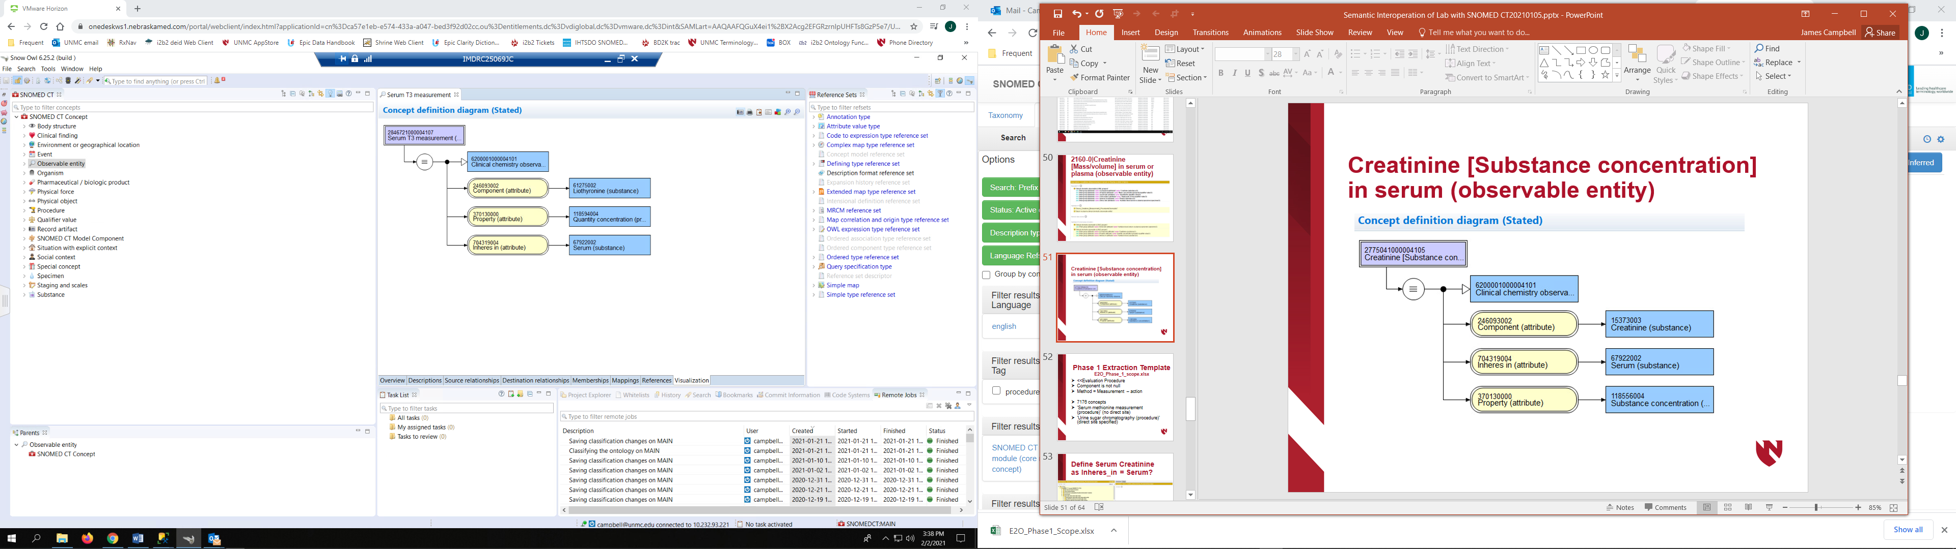
166324000|Serum T3 measurement (procedure) ➔
Observable entity

Slide 54
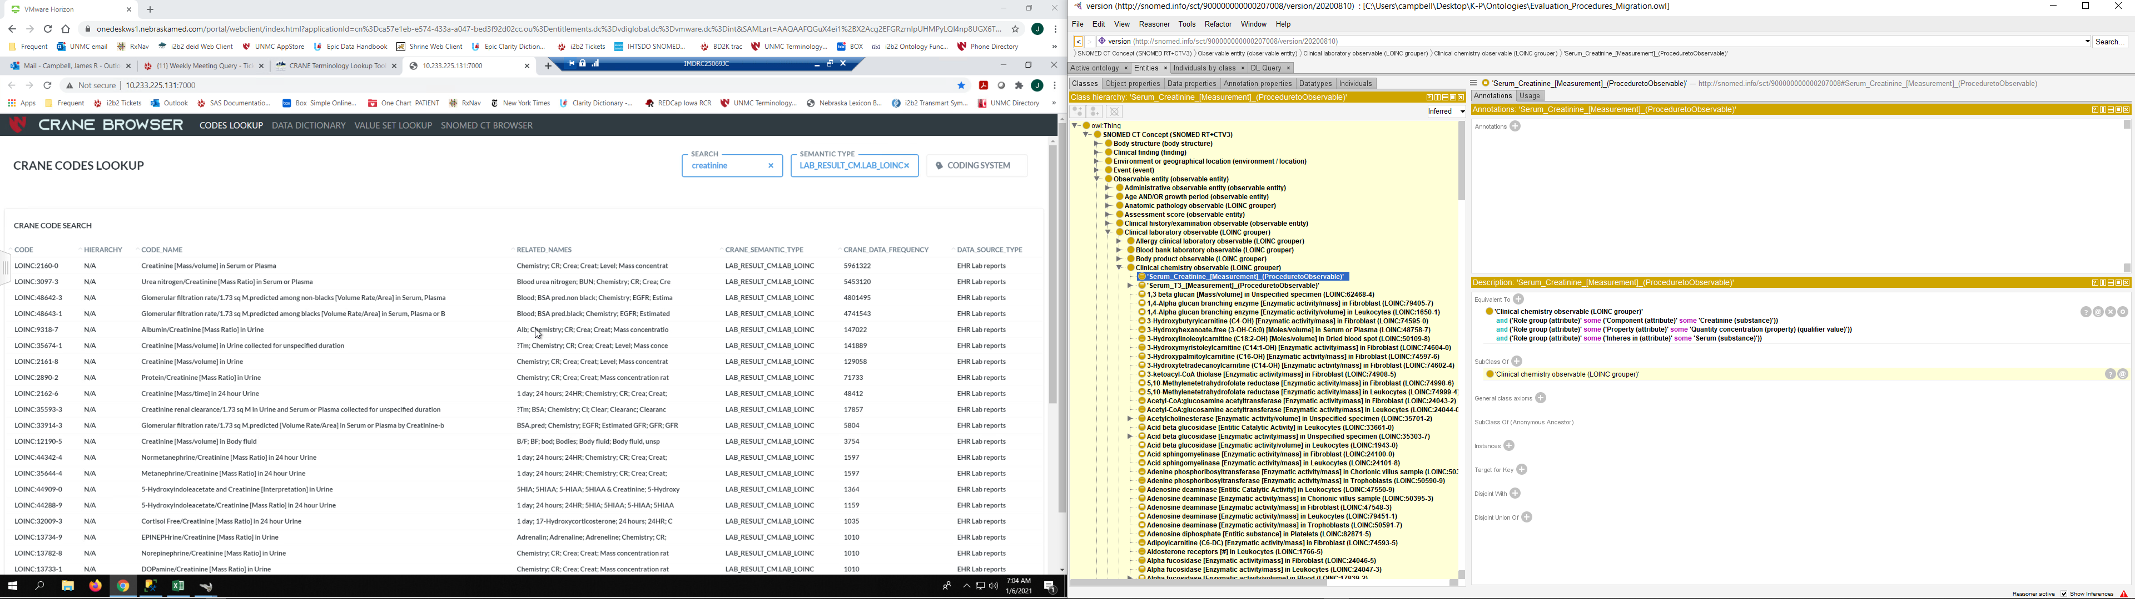
Define Serum Creatinine as Inheres_in = Serum?

Slide 55
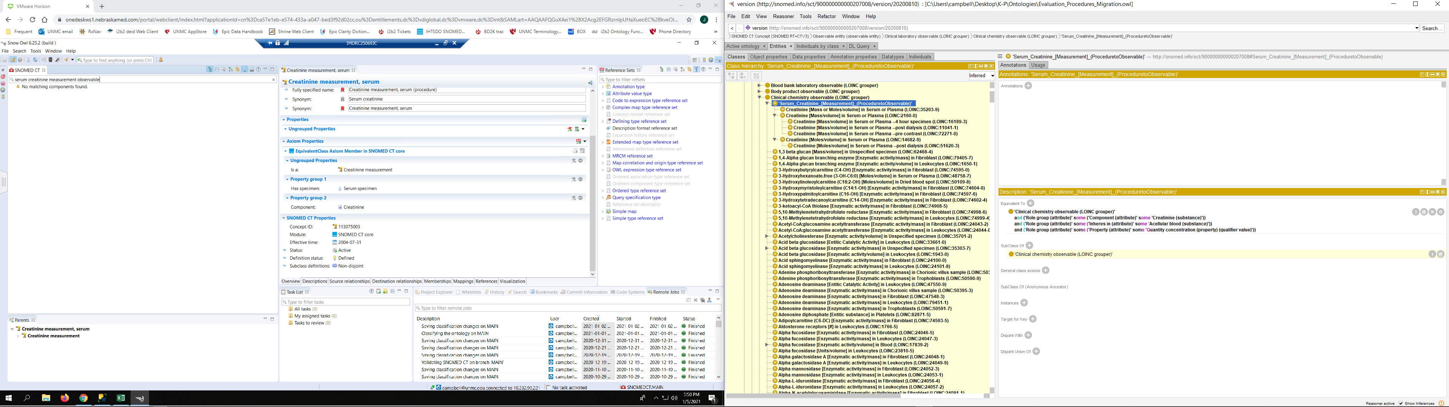
Proposed:
113075003|Creatinine [Measurement] in Serum (observable entity)|

Slide 56
Classifies as Grouper for Common lab test results

Slide 57
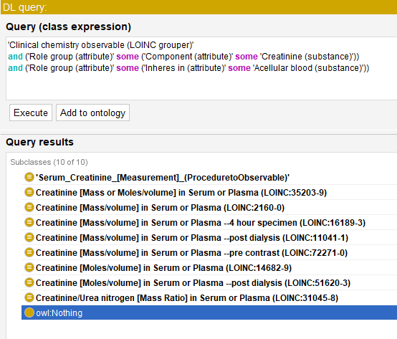
Use Case for Interoperation:
Did the patient have a creatinine measurement?

Slide 58
Lab Templates:
Assumptions & Pragmatics
The most specific Substance will be chosen based upon FSN and/or COMPONENT value will be chosen to specify the Observables COMPONENT
If specimen is specified in SCT definition, INHERES_IN will be populated with that substance; for serum and plasma tests, ‘acellular blood’ will be chosen OR Tech Preview model must change from INHERES_IN = Plasma
If “measurement” is specified in FSN, then PROPERTY will be populated with the most general MEASUREMENT_PROPERTY that is consistent with laboratory test deployment eg: 118594004|Quantity concentration(qualifier)|

Slide 59
Findings employing Serum creatinine measurement
SOURCEID | FULLY SPECIFIED NAME
166714005 | Serum creatinine abnormal (finding)
166715006 | Serum creatinine low (finding)
166716007 | Serum creatinine normal (finding)
166717003 | Serum creatinine raised (finding)
365757006 | Finding of serum creatinine level (finding)

Slide 60
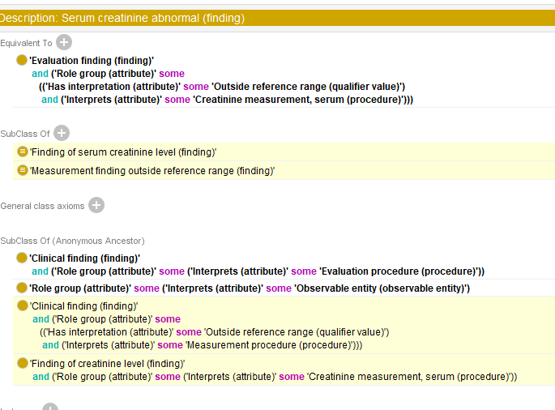
166714005
Serum creatinine abnormal (finding)
Serum_Creatinine_[Measurement] (ProceduretoObservable)

Slide 61
Issues for ‘Has Interpretation’
How to define qualifiers such as “Outside reference range” into an interoperable expression for a Quantitative test result?
How will we deploy Quantitative findings? (Concrete domains)
How about Ordinal? (Expand 26024500|Findings values to include Ordinal findings)
Nominal? (SNOMED CT valuesets will work with current model)

Slide 62
?Serum measurement procedure
SCTID | FSN
166324000 | Serum T3 measurement (procedure)
166329005 | Serum T4 measurement (procedure)
273967009 | Serum urea measurement (procedure)
273975003 | Serum zinc measurement (procedure)
250216004 | Serum iron measurement (procedure)
273966000 | Serum urate measurement (procedure)
313744004 | Serum valine measurement (procedure)
313744003 | Serum serine measurement (procedure)
… | 381 concepts from query

Slide 63
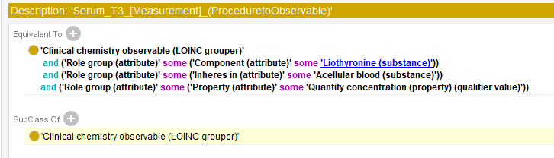
166324000
Serum T3 measurement (procedure)

Slide 64
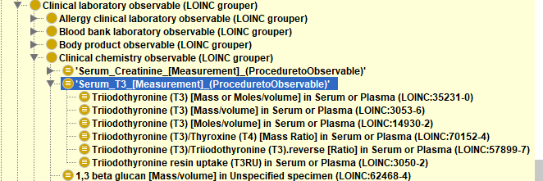
Interoperation Use Case

