Slide 1
Disorder associations
Additional considerations

Slide 2
Note about co-occurrent and due to pattern:
A decision was reached during October 2018 to discontinue the use of the co-occurrent and due to pattern because of:
  Difficulty in maintaining consistency of use
  The presence of co-occurrence may depend on the time a patient is evaluated
  Requires detailed knowledge of the natural history and treatment of the individual diseases
  Similar combined disorders such as hernia with complications if interpreted variously as co-occurrent and due to vs. due to will result in some of these as subtypes of the cause and complication and others as subtypes of the complication only.
  Applying the co-occurrent and due to pattern may result in incorrect subsumption

Slide 3
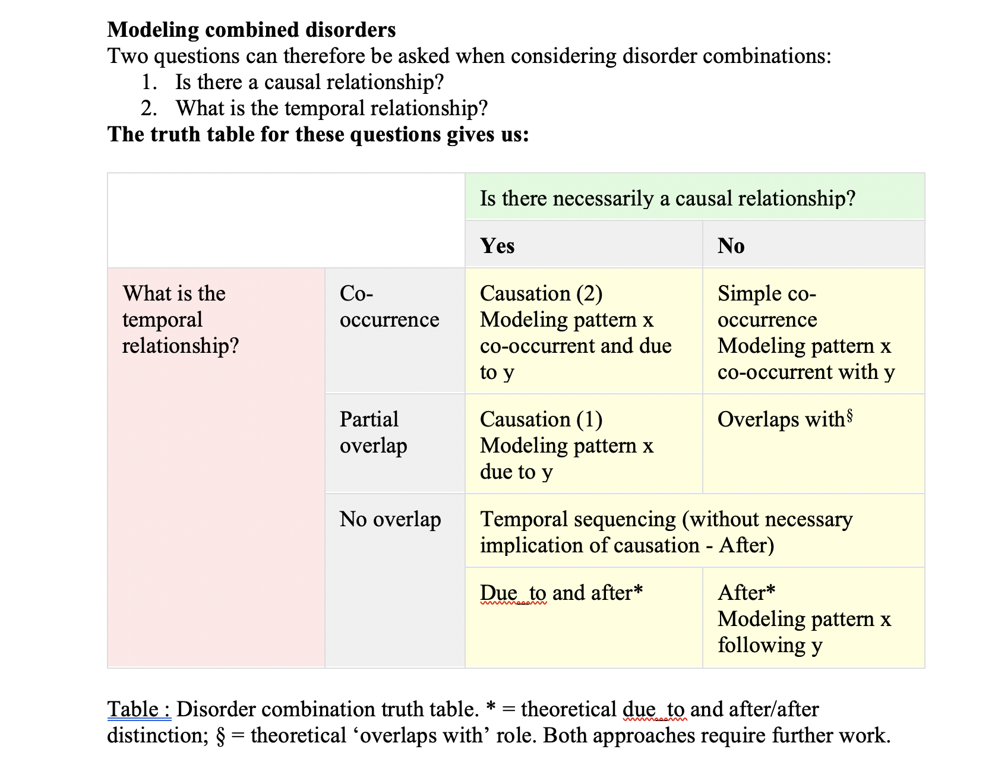
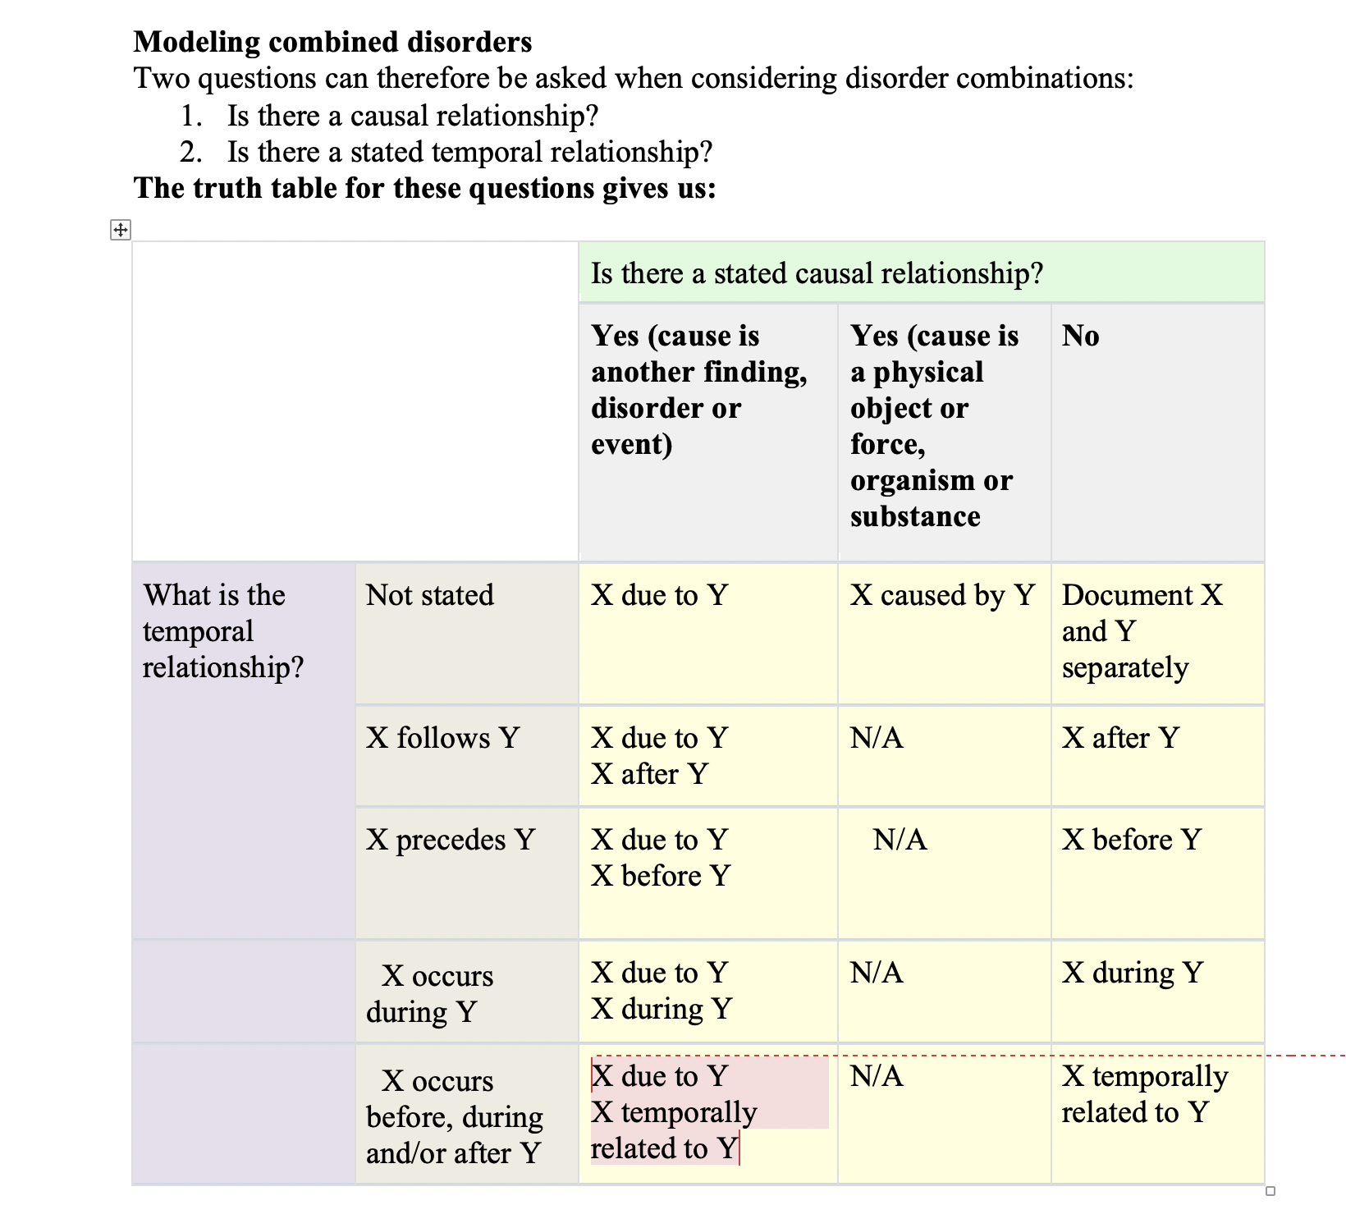
Approach to modeling combined disorders (2017-2018) decision trees represented as truth tables
Prior to 2018
October 2018

Slide 4
Statement of problem
Concern expressed that using the Due to relationship may result in loss of other important relationships that could be stated in an axiom.
Identifying these instances may prove challenging and may be best implemented at the time of template creation for complex associations.
Goal is to work through several examples to determine if a decision tree can be developed in order to assign appropriate defining relationships for combined disorders

Slide 5
Associated disorders – Phil Brown
The relationship between ‘disorder states’ is clinically complex and changes during the development and resolution of the condition as illustrated below. The temporality and co-occurrence of the associated concepts evolve during the progression of this scenario and many others.

Slide 6
Simple Solution – Phil Brown
The association between two disorders should always be the principal expression in axiom form e.g. 266439004 |Acute appendicitis with appendix abscess (disorder)|; or rarely primitive is-a, if definition is not possible e.g. 735527002 |Human immunodeficiency virus World Health Organization 2007 stage 4 co-occurrent with tuberculosis (disorder)|.
Where there is a definite causal relationship between two disorders this is also expressed using a ‘Due to’ attribute formulation e.g. Diabetic retinopathy.
In the exceptional scenario where there is no co-occurrence at any stage of the evolution of the disease, this association is expressed using the attribute ‘After’ e.g. 31097004 |Post poliomyelitis syndrome (disorder)|

Slide 7
Additional considerations
Optional use of “due to” based on what one considers to be a definite causal relationship between two disorders will lead to inconsistency in modeling.
  We had previously agreed to consider any point in a causal chain to represent a causal relationship
Should precoordinated combined disorders only be created for concepts for which a causal relationship exists and for for multi-component syndromes and should separate statements be used for all other cases (e.g. diarrhea and vomiting)?

Slide 8
Summary
 |  |  | Phil | Bruce
 |  | Causal relationship
Temporal relationship | X precedes Y/X meets Y | Present Absent | Due to and after After | Due to and after Need examples. Feeling is most would have a causal relationship to a preceding disorder and thus Due to and after
 | Not stated | Present Absent or unknown | Co-occurrent and due to Co-occurrent | Co-occurrent and due to Represent as separate statements
Proposal: For most combined disorders without a specified temporal relationship but where both disorders exist concurrently at least for part of the time, model both disorders (+ due to the causative disorder).
For combined disorders with a specified temporal relationship, model as X after (+ due to?) Y

Slide 9
Spontaneous rupture of tympanic membrane (of X ear) co-occurrent and due to recurrent acute suppurative otitis X
  Modeling this concept with both conditions is problematic because the causative disorder (recurrent acute suppurative otitis) has a clinical course of recurrent acute but the primary disorder (spontaneous rupture of tympanic membrane) is not recurrent.
  Possible solution: Model with both spontaneous rupture of tympanic membrane and acute suppurative otitis media" with a clinical course of acute and represent the recurrent condition (recurrent acute suppurative otitis) as a separate statement.

Slide 10
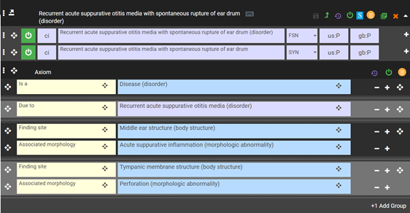
Current model for 1088181000119100 |Spontaneous rupture of tympanic membrane of left ear co-occurrent and due to recurrent acute suppurative otitis media (disorder)|
This model does not capture the recurrent acute suppurative otitis media as a separate axiom

Slide 11
Combined disorders inheriting 2 clinical course relationships
<<64572001 |Disease|: [2..*] 263502005 |Clinical course|=*
 | id | fsn
1 | 16024431000119108 | Acute polyarticular juvenile idiopathic arthritis (disorder)
2 | 368881000119109 | Rapidly progressive nephritic syndrome co-occurrent and due to membranoproliferative glomerulonephritis type III (disorder)
3 | 106001000119101 | Chronic obstructive lung disease co-occurrent with acute bronchitis (disorder)
4 | 838358000 | Acute and subacute endocarditis of left side of heart due to infection (disorder)
5 | 829976001 | Thunderstorm asthma (disorder)
6 | 762455001 | Anaphylaxis caused by low temperature (disorder)
7 | 715564000 | Paroxysmal dystonic choreoathetosis with episodic ataxia and spasticity (disorder)
8 | 714817004 | Recurrent hematuria co-occurrent and due to diffuse endocapillary proliferative glomerulonephritis (disorder)
9 | 714815007 | Recurrent hematuria co-occurrent and due to diffuse crescentic glomerulonephritis (disorder)
10 | 266237004 | Acute and subacute bacterial endocarditis (disorder)
11 | 238850005 | Mouth and genital ulcers with inflamed cartilage syndrome (disorder)
12 | 197268000 | Acute and subacute liver necrosis (disorder)
13 | 196001008 | Chronic obstructive pulmonary disease with acute lower respiratory infection (disorder)
14 | 194926000 | Acute and subacute infective endocarditis associated with another disorder (disorder)
15 | 194921005 | Acute and subacute endocarditis (disorder)
16 | 75822003 | Acute polyarticular juvenile rheumatoid arthritis (disorder)
17 | 44433009 | Recurrent transient tic disorder (disorder)

Slide 12
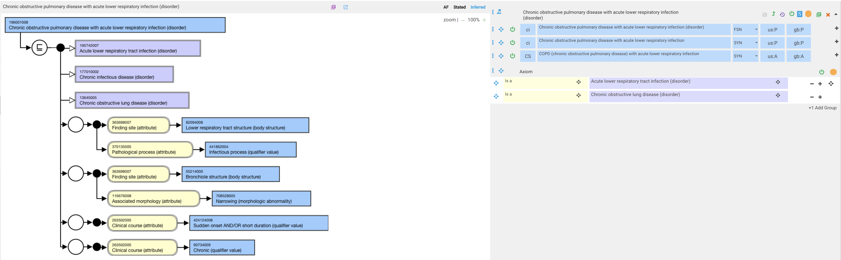
196001008 |Chronic obstructive pulmonary disease with acute lower respiratory infection (disorder)|
  Inherits 2 clinical course relationships of chronic and acute.
  This likely refers to an acute exacerbation of COPD due to an acute lower respiratory infection.
    195951007 |Acute exacerbation of chronic obstructive airways disease (disorder)| is SD with a clinical course of acute on chronic
    13645005 |Chronic obstructive lung disease (disorder)|is SD with a clinical course of chronic

Slide 13
195951007 |Acute exacerbation of chronic obstructive airways disease (disorder)|

Slide 14
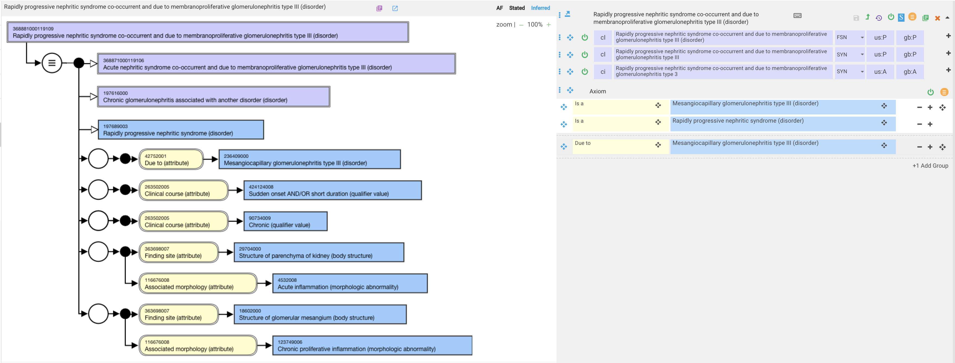
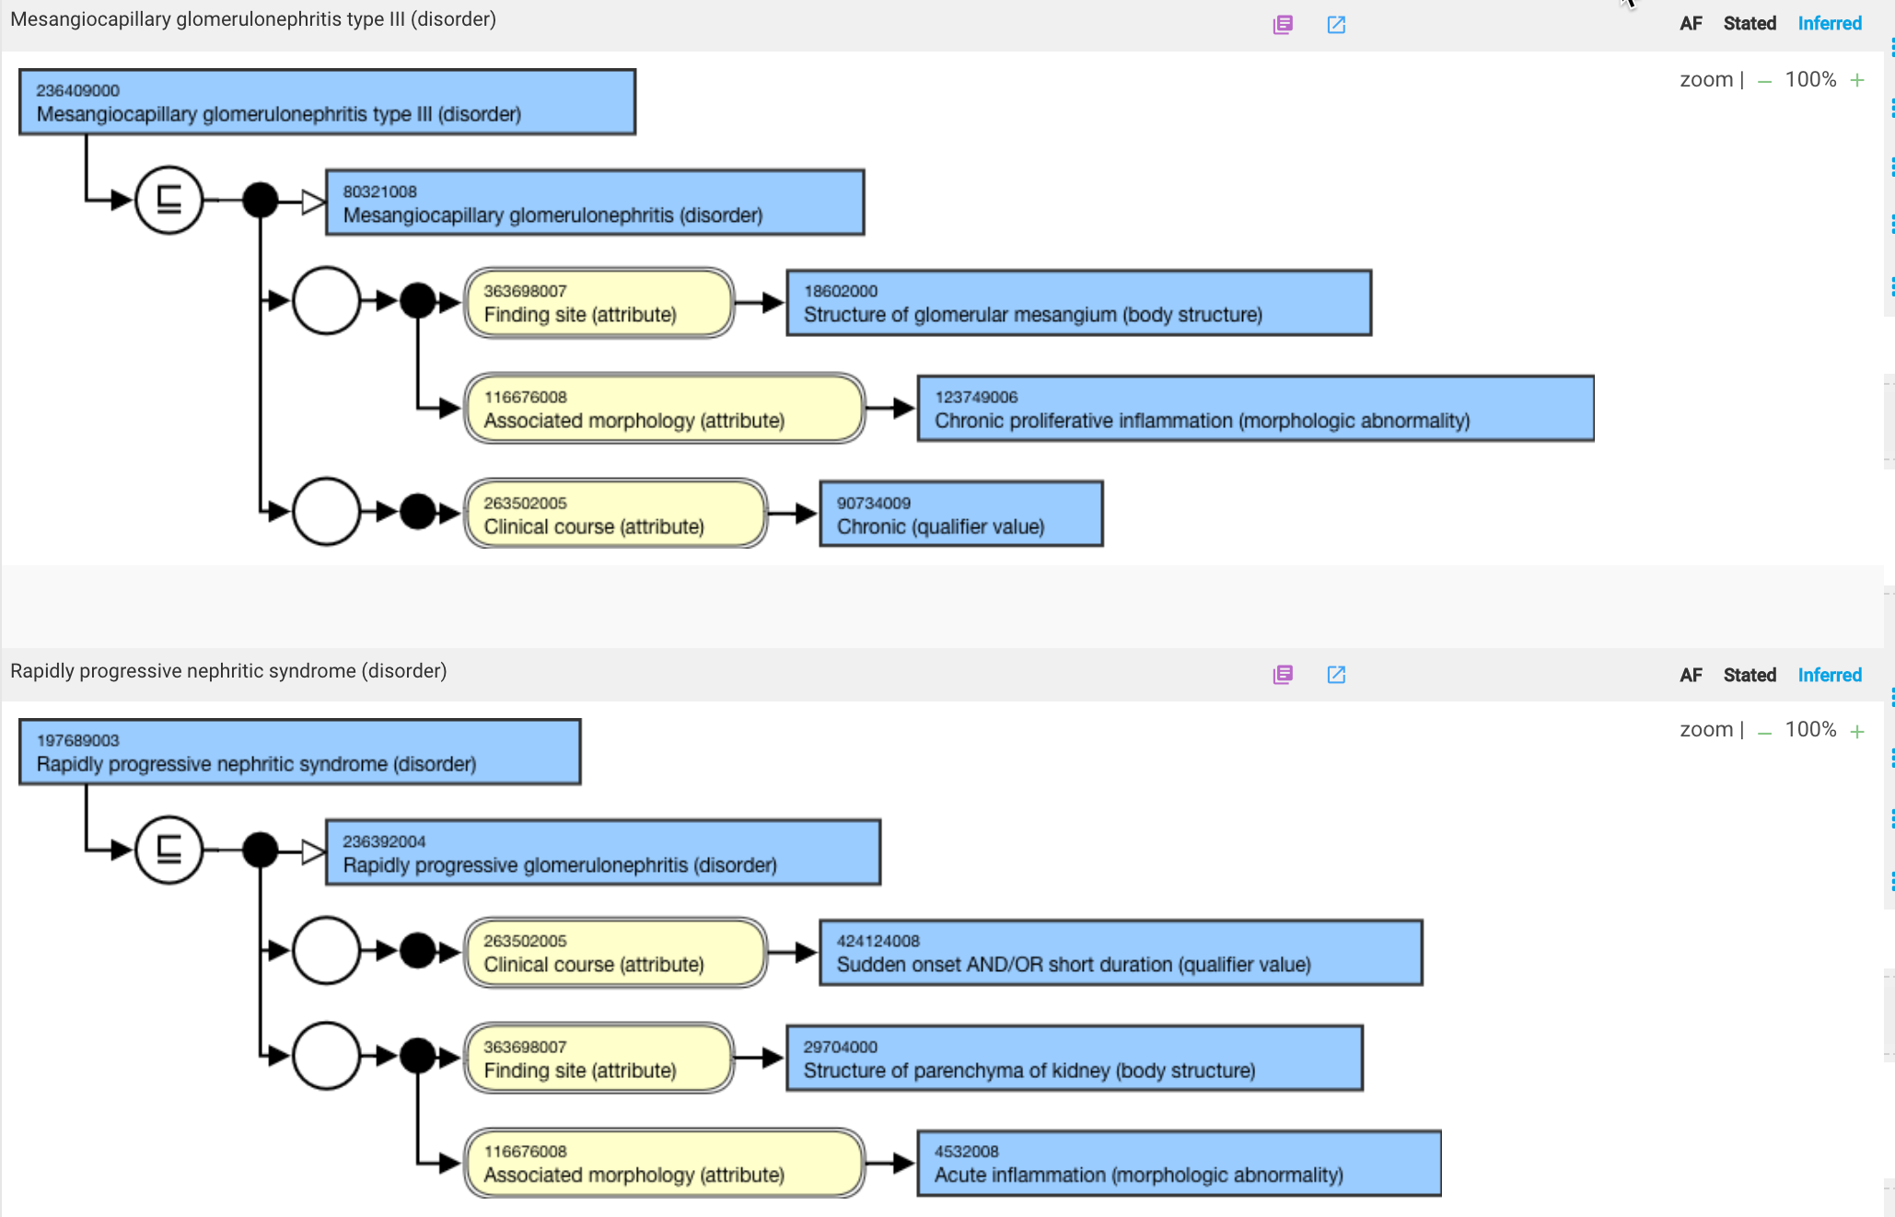
368881000119109 |Rapidly progressive nephritic syndrome co-occurrent and due to membranoproliferative glomerulonephritis type III (disorder)|

Slide 15
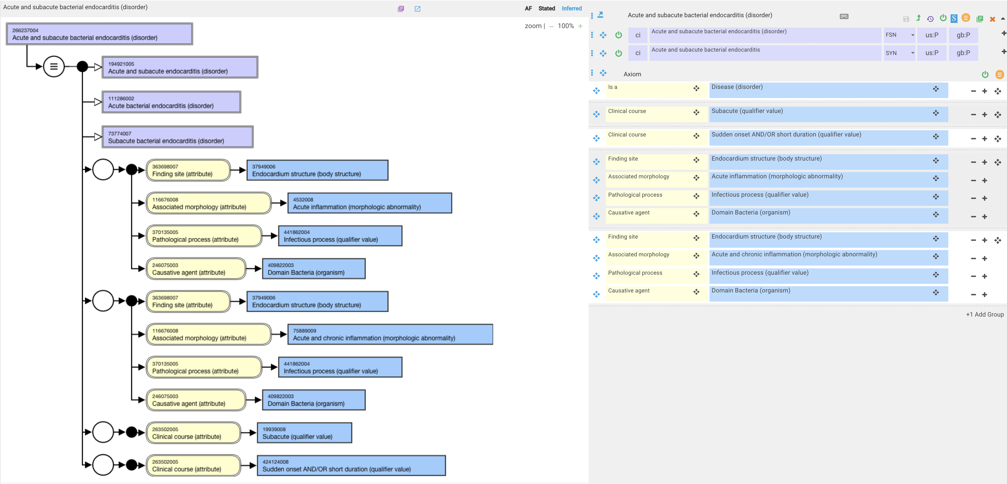
266237004 |Acute and subacute bacterial endocarditis (disorder)|
2 stated clinical course relationships
This concept could be replaced with separate statements

Slide 16
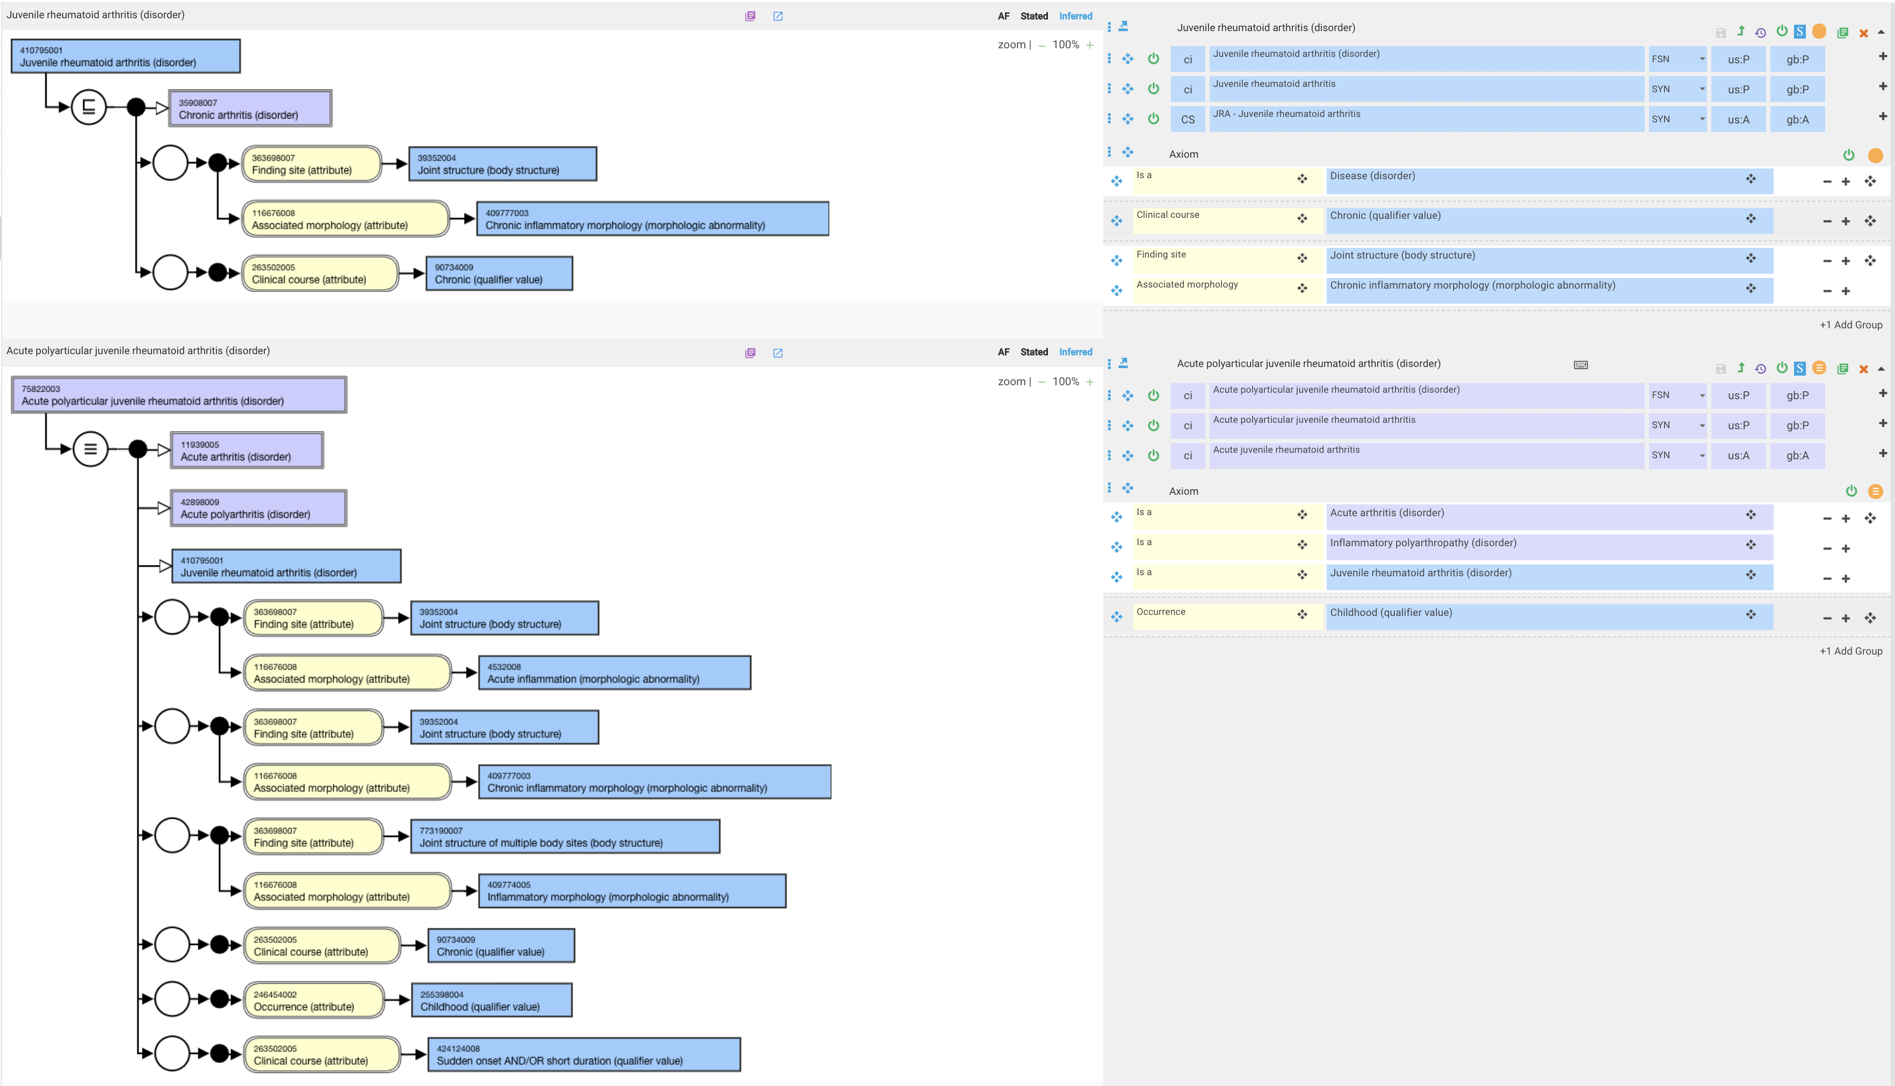
If there is an acute form of JRA then JRA should not have a clinical course of chronic

Slide 17
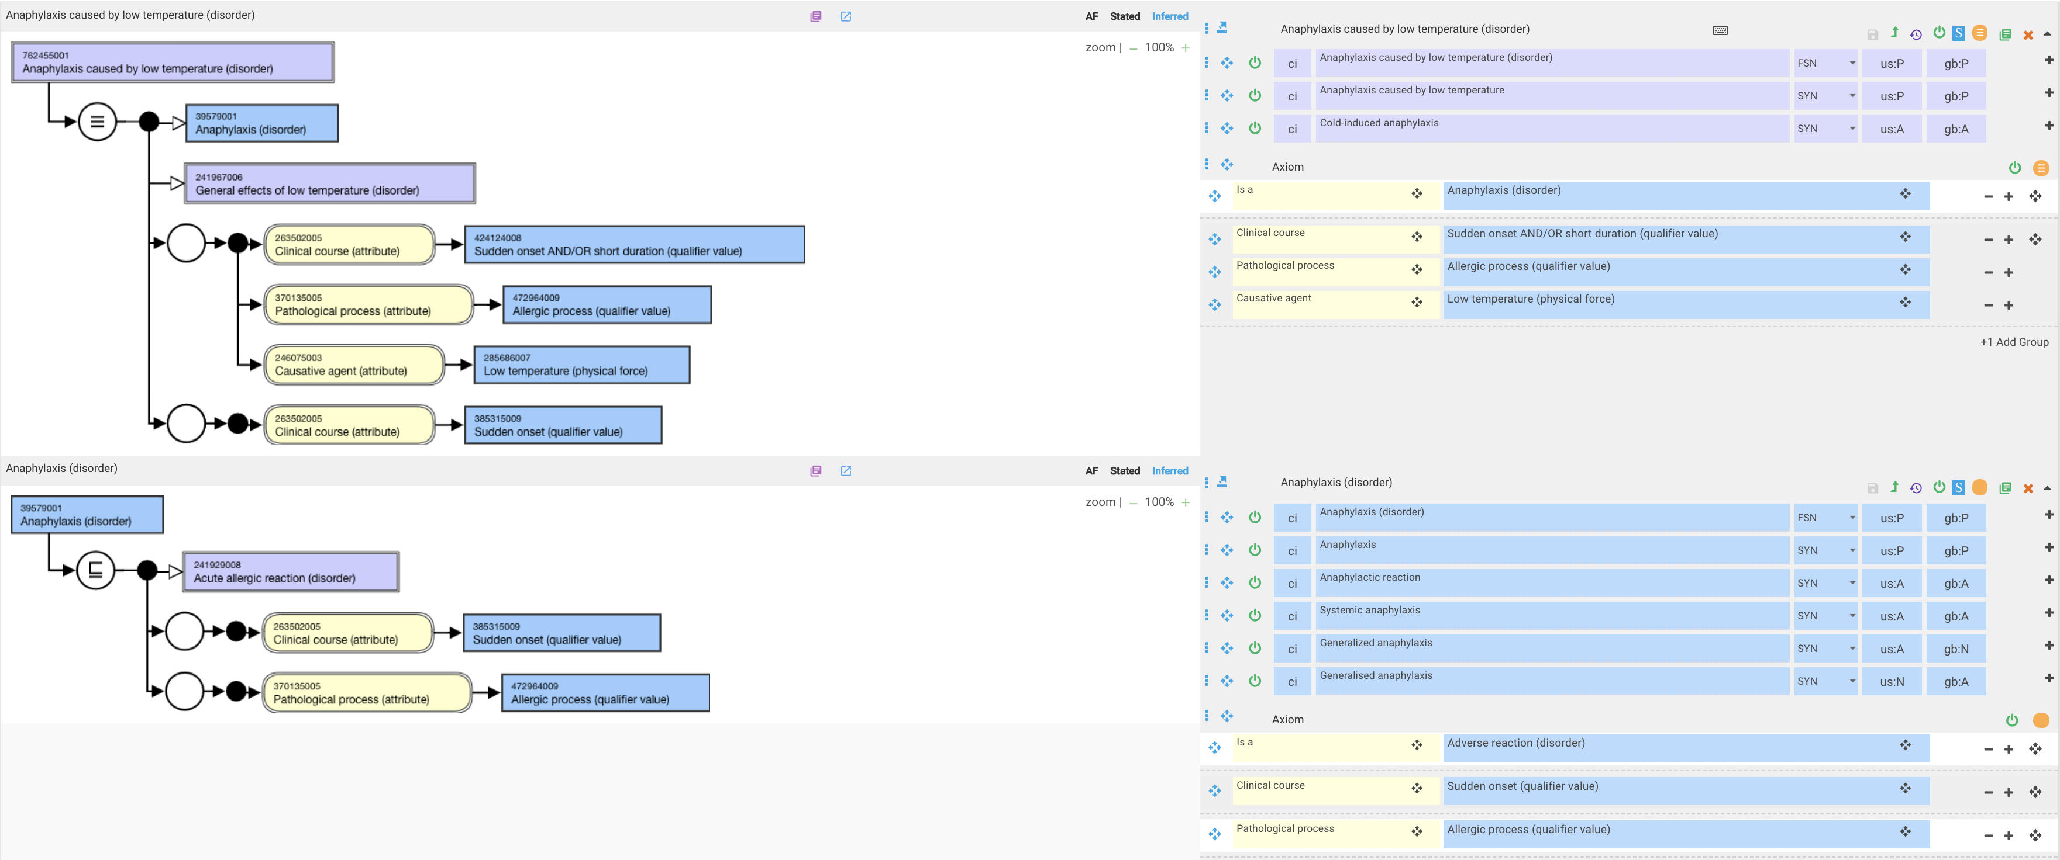
762455001 |Anaphylaxis caused by low temperature (disorder)|
This is incorrect

Slide 18
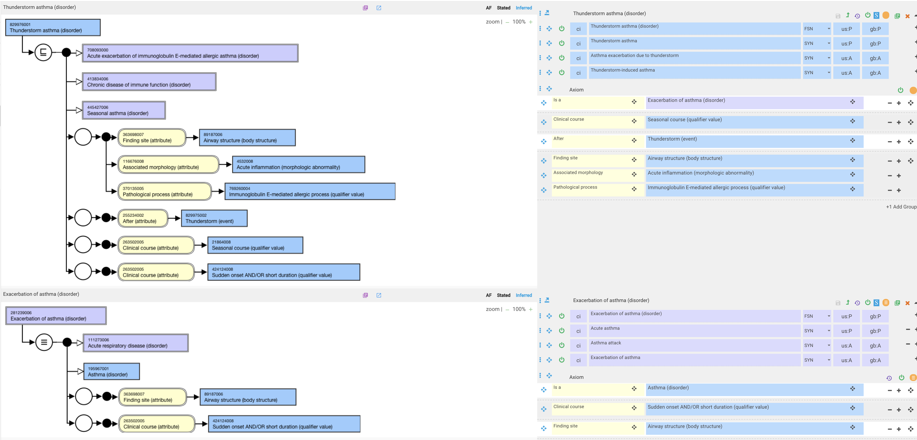
829976001 |Thunderstorm asthma (disorder)|

