Slide 1
Clinical Indexes and Scale Scores

Slide 2
EAG Test Case:
Anesthesia Observables Scales
Jim,
I've picked out a few examples of very widely used scales in Anesthesia and Critical care.
As there are so many assessment scales names included in SNOMED, we should take a value approach to this and only concentrate on ones that have a demonstrable wide use across multiple member countries. I would imagine that there are a number of obsolete examples in the current SNOMED CT content.
ASA (American Society of Anesthesiologists) Physical Status Classification
Mallampati scale (Airway assessment, prediction of difficult airway management)
Cormack Lehane scale (Airway assessment at direct laryngoscopy)
SOFA (Sequential Organ Failure Assessment) scale - (prediction of Intensive Care mortality)
Canadian Study of Health and Aging (Rockwood) clinical frailty scale - (widely used in COVID-19 as a determinant of suitability for intensive care admission)
APACHE (Acute Physiology and Chronic Health Evaluation) - (severity of illness in first 24 hours of Intensive Care admission). There are a number of versions, most widely used being APACHE II. Apache IV is not included in SNOMED CT
p-POSSUM. Portsmouth modification of the Physiological and Operative Severity Score for the enUmeration of Mortality - widely used as a risk predictor for surgical interventions.
The other clinical leads of the Anesthesia CRG may have some other suggestions of scales worth looking at.
Best wishes
Dr Andrew C Norton

Slide 3
Observables Project: Assessment Scales
Glasgow Coma Scale
ASA (American Society of Anesthesiologists) Physical Status Classification
Mallampati scale (Airway assessment, prediction of difficult airway management)
Cormack Lehane scale (Airway assessment at direct laryngoscopy)
SOFA (Sequential Organ Failure Assessment) scale - (prediction of Intensive Care mortality)
Canadian Study of Health and Aging (Rockwood) clinical frailty scale - (widely used in COVID-19 as a determinant of suitability for intensive care admission)
APACHE II (Acute Physiology and Chronic Health Evaluation) - (severity of illness in first 24 hours of Intensive Care admission).
p-POSSUM. Portsmouth modification of the Physiological and Operative Severity Score for the enUmeration of Mortality - widely used as a risk predictor for surgical interventions.
Folstein Mini-mental Status Exam (dementia screening)
Montreal Cognitive Assessment (dementia screening)
PHQ-9 Depression screening scale
HEART score (acute coronary syndrome)
SCHMID (fall risk) scale
ALS Functional Rating Scale
Critical Care Pain Rating Scale
Braden Scale (pressure ulcer risk)
Charlson Co-morbidity Index (Mortality risk for admissions)

Slide 4
Deployed and In-use as Observables at Nebraska Medicine
Folstein mini-mental status (cognitive screening)
Patient Health Questionnaire – 9 (depression screening)
HEART score (acute coronary syndrome)
Glasgow coma scale (sensorium\coma)
SCHMID fall risk scale
ALS Functional Rating Scale
Critical Care Pain Observation Tool
Braden Scale (pressure ulcer risk)
Charlson Co-morbidity Index (inpatient outcomes)

Slide 5
Agenda: Observables definitions for Scale scores and associated Clinical findings
Quality Observables
Charlson Comorbidity Index
American Society of Anesthesiologists Physical Classification
Mallampati Airway Assessment Scale
Function Observables
Glasgow Coma Scale
Calculations of Assessment Scale scores
SOFA scale

Slide 6
Morbidity Index Use Cases:
Assessing Disease Burden for Prognosis
Observables Quality Template Model
Charlson Comorbidity Index (UNMC)
ASA Physical Assessment Classification
Mallampati Airway Assessment Scale

Slide 7
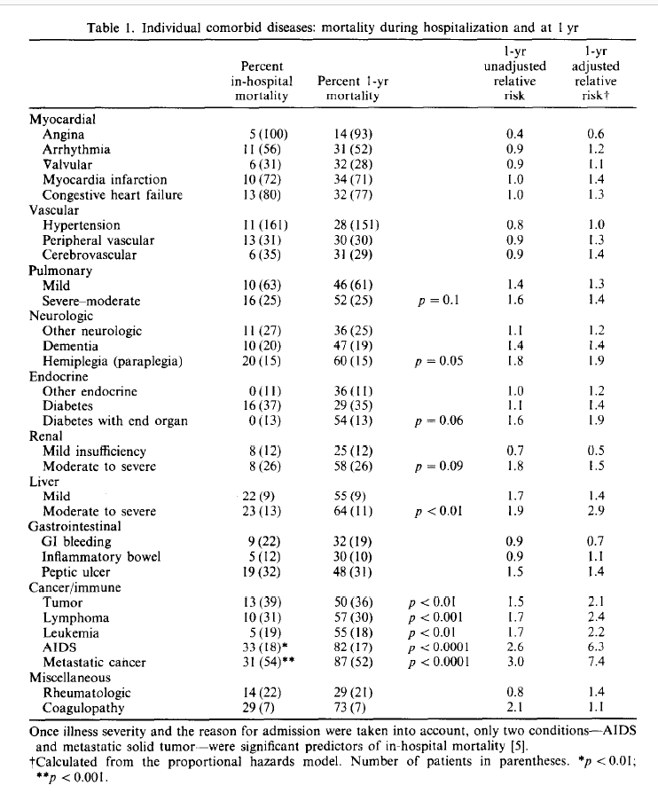
Charlson Comorbidity Index
Retrieves and enumerates EHR diagnoses in 14 clinical categories. Assigns scale scores to the importance of each relative to 10 year mortality risk in patients admitted to medicine wards of NYU hospital. Hence the observable is a weighted count of diagnostic conditions borne by the patient found from EHR review
Charlson ME, Pompei P, Ales KL, MacKenzie CR: A new method of classifying prognostic co-morbidity in longitudinal studies: Development and validation. J Chron Dis; 1987, 40(5), 373-383.

Slide 8
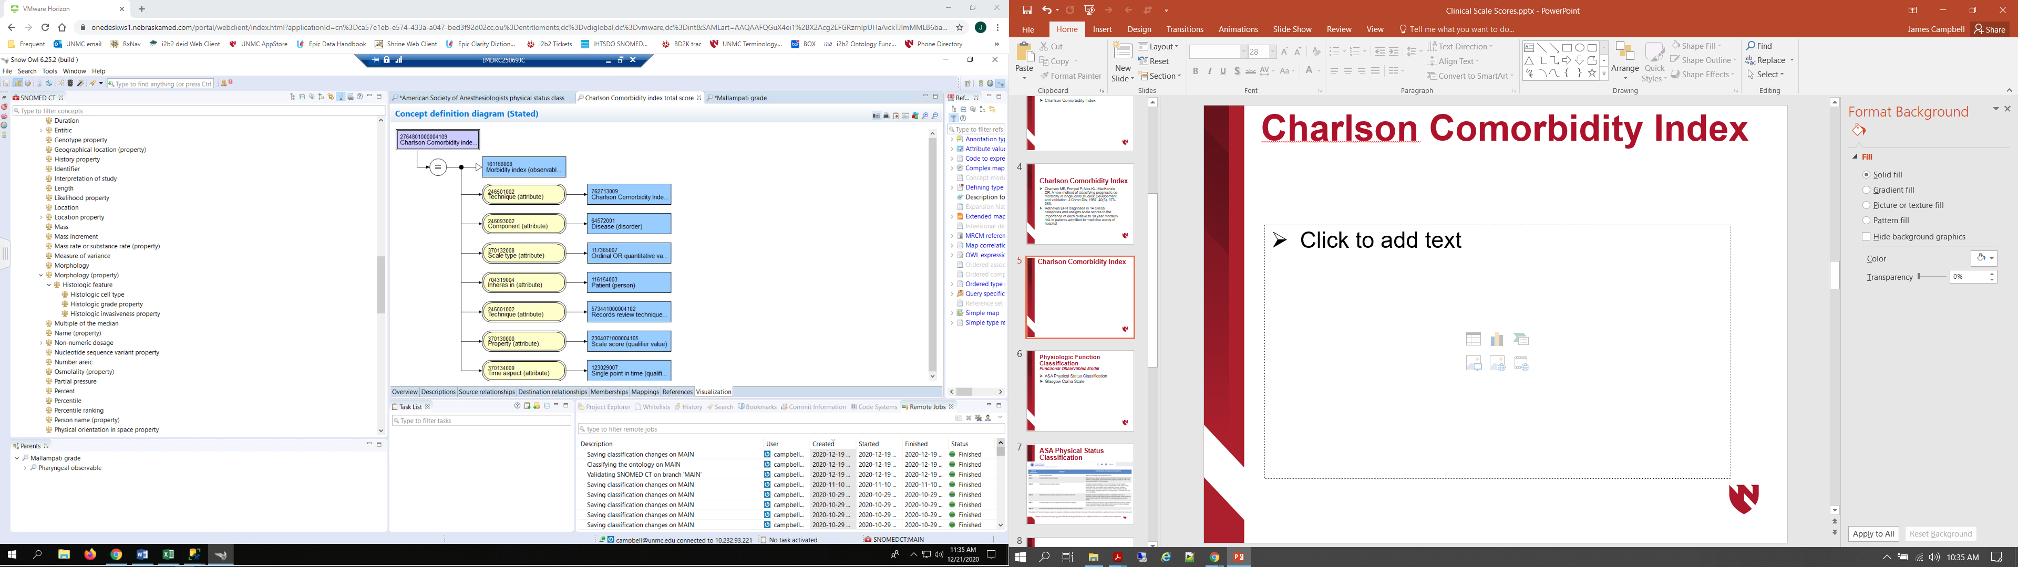
Charlson Comorbidity Index

Slide 9
Charlson Comorbidity Index
  Proposal: For comparable scales which assess disease burden borne by the patient, modify the concept model for Observables to allow Clinical Findings to the valueset for Component.
  Question for discussion: Should we consider ‘Has Focus’ attribute or simply consider it implicit in the design of the scale since many scales are named by their goal/objective rather than the actual item they assess or measure? Alternative is to maintain Observables groupers to identify scale purpoe. Use of a HAS FOCUS attribute could allow for Clinical findings for diagnostic scales such as Disease Activity Score for severity of Rheumatoid arthritis as well as Observables for prognostic values such as Mortality risk:
  HAS_FOCUS = 161168008|Morbidity index(observable entity)?

Slide 10
ASA Physical Status Classification (ASA Class)
American Society of Anesthesiologists Physical Status Classification assesses disease burden borne by the patient as a prognostic indicator of postoperative outcomes
Wolters U, Wolf T, Stützer H, Schröder T. ASA classification and perioperative variables as predictors of postoperative outcome. Br J Anaesth. 1996 Aug;77(2):217-22. DOI: 10.1093/bja/77.2.217 PMID: 8881629.
Hackett NJ, De Olivera GS, Jain UK et al. ASA class is an reliable independent predictor of medical complications and mortality following surgery. International Journal of Surgery 2015; 18: 184-90

Slide 11

ASA Physical Status Classification
https://www.asahq.org/standards-and-guidelines/asa-physical-status-classification-system

Slide 12
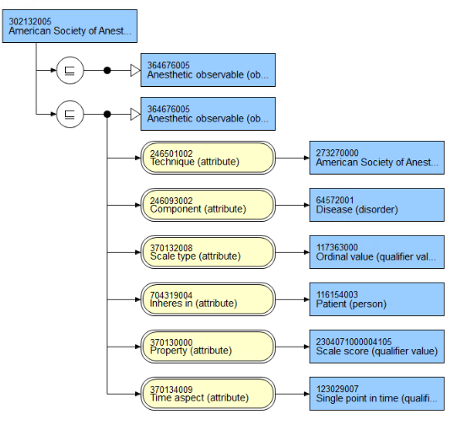
ASA Score
302132005
American Society of Anesthesiologists Physical Status Class
273270000
American Society of Anesthesiologists
physical status classification (assessment scale)

Slide 13
ASA Score
302132005
American Society of Anesthesiologists Physical Status Class
  Proposal: Although Regenstrief proposes ‘Ordinal or quantitative’ scales for scale score observables SCALE_TYPE, suggest that we use Ordinal\INTEGER when they are meant to summed or used in calculation. “Has interpretation(attribute)” should be expanded in editorial advice to support concrete domains and Ordinal valuesets for Assessment Scales supported by SNOMED CT; these should be added:
  Qualifier value\Findings values\Ordinal Values\ASA scale\I – Healthy patient
  \II – Mild systemic disease
  \III – Severe system disease
  \IV – Severe, threat to life
  \V – Not expected to survive
  \VI – Declared brain dead
  Question: Does this mean we have to get permission from ASA?
273270000
American Society of Anesthesiologists
physical status classification (assessment scale)

Slide 14
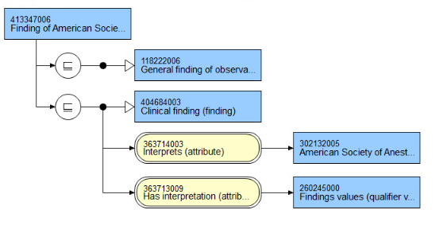
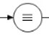
413347006|Finding of American Society of Anesthesiologists physical status classification (finding)
302132005|American Society of Anesthesiologists physical status class
Findings values /
Ordinal scale values (qualifier)

Slide 15
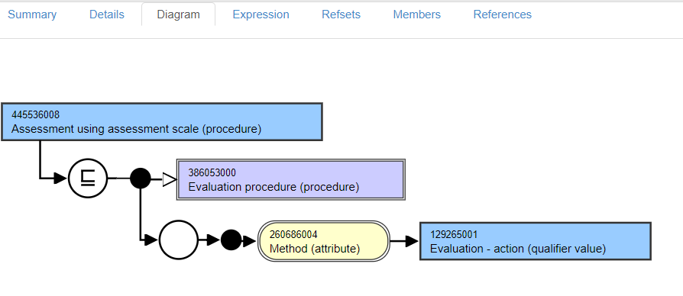
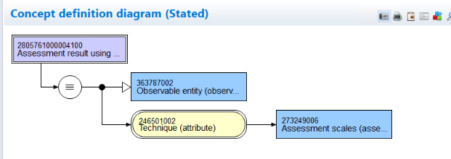
445536008|Assessment using assessment scale (procedure)|
Subtype of 386053000|Evaluation procedure (procedure)|
Falls within scope of the E2O project…

Slide 16
445536008|Assessment using assessment scale (procedure)|
  As pointed out in Andrew’s position paper, current editorial guidance is to use this concept as the primitive parent in modeling new assessment scale observation findings.
  Since this concept is a subtype of Evaluation procedure (procedure) and falls within the scope of the E2O project:
  Proposal: Migrate this concept and subtypes to Observable entities as fully defined groupers. The classifier would identify all observables with TECHNIQUE << ASSESSMENT_SCALE as logical subtypes.
Subtype of 386053000|Evaluation procedure (procedure)|
Falls within scope of the E2O project…

Slide 17
Anatomical Assessment Classification:
Quality Observable model
Mallampati Airway Assessment Scale
Mallampati SR et al . A clinical sign to predict difficult intubation: a prospective study Canadian Anaesthetists Society Journal 1985; 32(4): 429-434.
Iohom G, Ronayne M, Cunningham AJ. Prediction of difficult tracheal intubation
European Journal of Anaesthesiology 2003; 20(1) :31-36. - A useful study on sensitivity and specificity of the Mallampati scale as a predictor of difficult intubation and when combined with an anatomical distance measure such as thyromental distance - which is a common practice in preoperative airway assessment

Slide 18
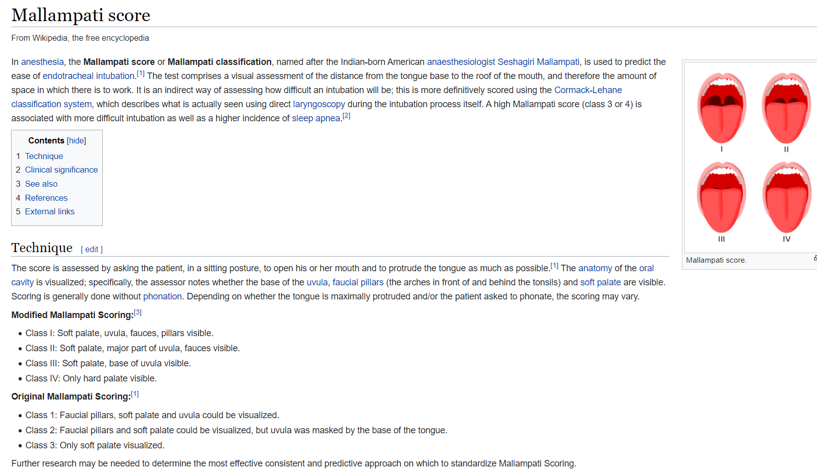
Mallampati Airway Assessment Scale

Slide 19
277388005|Mallampati Grade (observable entity)
INHERES_IN = Entire oropharyngeal cavity (body structure)
PROPERTY = Length property
TECHNIQUE = Mallampati score (assessment scale)
TECHNIQUE = Inspection technique (visual assessment)
SCALE_TYPE = Ordinal or quantitative

Slide 20
424397003|Mallampati class IV (finding)
Fully defined
IS_A = Finding of assessment scale
INTERPRETS = 277388005|Mallampati grade
HAS_INTERPRETATION = Findings values \ Ordinal findings values \ Grade 4

Slide 21
Physiologic Function Classification
Functional Observables Model
Glasgow Coma Scale
The Scale was described in 1974 by Graham Teasdale and Bryan Jennett as a way to communicate about the level of consciousness of patients with an acute brain injury.
Assessment of coma and impaired consciousness. A practical scale. Lancet 1974; 2:81-4.
Teasdale G, Maas A, Lecky F et al. The Glasgow Coma Scale at 40 Years: standing the test of time. Lancet Neurology 2014 ;13(8) : 844-854

Slide 22

Glasgow Coma Scale

Slide 23
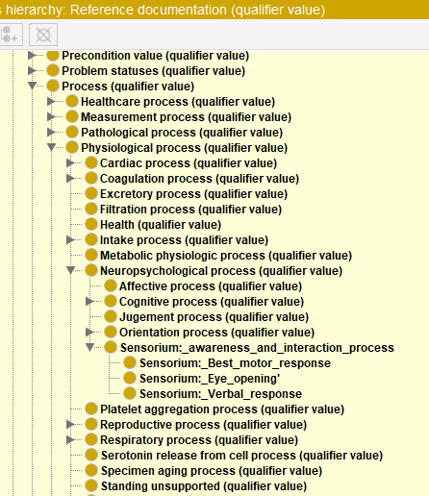
FUNCTION Observable:
24824002|Glasgow coma score (observable entity)
INHERES_IN = Structure of cerebrum (body structure)
CHARACTERIZES = Neuropsychological process \ Sensorium: awareness and interaction (process)
PROPERTY = Process realization rate
TECHNIQUE = 386554004|Glasgow coma scale (assessment scale)
SCALE_TYPE = Ordinal or quantitative

Slide 24
Assessment Scores and Components Defined
  248241002|Glasgow coma total score (observable entity)
  ::=
  IS_A = |Component of Glasgow coma scale (observable entity)
  INHERES_IN = 83678007|Cerebral structure(body structure)
  HAS_REALIZATION = |Sensorium: awareness and interaction (process)
  TECHNIQUE = 386554004|Glasgow coma scale(assessment scale)
  PROPERTY = |Process achievement rate
  SCALE_TYPE = |Ordinal\Integer

Slide 25
Assessment Scores and Components Defined
  248241002|Glasgow coma total score (observable entity)
  ::=
  IS_A = |Component of Glasgow coma scale (observable entity)
  INHERES_IN = 83678007|Cerebral structure(body structure)
  HAS_REALIZATION = |Sensorium: awareness and interaction (process)
  TECHNIQUE = 386554004|Glasgow coma scale(assessment scale)
  PROPERTY = |Process achievement rate
  SCALE_TYPE = |Ordinal\Integer
  248241002|Glasgow coma scale: Eye opening (observable entity)
  ::=
  IS_A = |Component of Glasgow coma scale (observable entity)
  INHERES_IN = 83678007|Cerebral structure(body structure)
  HAS_REALIZATION = |Sensorium: eye opening (process)
  TECHNIQUE = 386554004|Glasgow coma scale(assessment scale)
  PROPERTY = |Process achievement rate
  SCALE_TYPE = |Ordinal or quantitative
  Finding values\Ordinal\Glasgow Coma Scale\Eye opening\4- Spontaneous
  \3 – To sound
  \2 – To pressure
  \1 - None
  \Untestable

Slide 26
Assessment Scores and Components Defined
  248241002|Glasgow coma scale: Verbal response (observable entity)
  ::=
  IS_A = |Component of Glasgow coma scale (observable entity)
  INHERES_IN = 83678007|Cerebral structure(body structure)
  HAS_REALIZATION = |Sensorium: Verbal response (process)
  TECHNIQUE = 386554004|Glasgow coma scale(assessment scale)
  PROPERTY = |Process achievement rate
  SCALE_TYPE = |Ordinal\Integer
  248241002|Glasgow coma scale: Best motor response (observable entity)
  ::=
  IS_A = |Component of Glasgow coma scale (observable entity)
  INHERES_IN = 83678007|Cerebral structure(body structure)
  HAS_REALIZATION = |Sensorium: Best motor response(process)
  TECHNIQUE = 386554004|Glasgow coma scale(assessment scale)
  PROPERTY = |Process achievement rate
  SCALE_TYPE = |Ordinal\Integer

Slide 27

Nebraska Data Frequency:
Glasgow Coma Scale
  Proposal: Promote structured Observables code sets to support Assessment scale data within EHRs and gradually demote pre-coordinated Scale findings such as ‘386557006|Glasgow coma scale total score 3 (finding)’ from Clinical findings as clinical data management matures in EHR systems.

Slide 28
112110007|Glasgow coma scale, 4 (finding)
Fully defined
IS_A = Finding of assessment scale
INTERPRETS = 24824002|Glasgow coma score
HAS_INTERPRETATION = 4

Slide 29
Sequential Organ Failure (SOFA) Score
Scale employing multiple physiologic measurements to assess major organ system function with calculated score shown to correlate well with ICU mortality
Ferreira FL, Bota DP, Bross A et al. Serial evaluation of the SOFA score to predict outcome in critically ill patients. Journal of the American Medical Association 2001; 286(14) :1754-1758.

Slide 30
Sequential Organ Failure (SOFA) Score
Scale score items:
Respiratory: pAO2/Fraction inhaled oxygen content(%)
Hematologic: Platelet count (10³/µL)
CNS: Glasgow Coma Scale (estimate if on sedatives)
Hepatic: Bilirubin (umol/L)
Cardiac: Mean arterial pressure(mmHg) or dose of pressors in use
Renal: Creatinine(umol/L) or Urine output

Slide 31
Sequential Organ Failure Total Score (observable entity)
Fully defined
IS_A = Finding of assessment scale
INHERES_IN = 91689009|Body system structure (body structure)
HAS_REALIZATION = 2140201000004100|Metabolic physiological process
TECHNIQUE = 459231000124102 |Sequential Organ Failure Assessment Scale
PROPERTY = 2304071000004105|Scale score
SCALE_TYPE = Ordinal or quantitative

Slide 32
Sequential Organ Failure (SOFA) Score
  |Oxygen [partial pressure] in Arterial blood (LOINC:2703-7) [PAO2]
  ::=
  IS_A = |Clinical chemistry observable
  INHERES_IN = Blood (substance)
  DIRECT_SITE = |Arterial blood specimen
  COMPONENT = Oxygen (substance)
  PROPERTY = |Partial pressure
  SCALE_TYPE = |Quantitative
  UNITS = ‘mmHg’
  250774007|Inspired Fraction Oxygen Concentration (observable entity) [FIO2]
  ::=
  IS_A = Clinical lab observable
  INHERES_IN = 74974009|Gaseous substance (substance)
  DIRECT_SITE = 119337004|Inspired gas specimen (specimen)
  COMPONENT = 24099007|Oxygen (substance)
  PROPERTY = 118563004|Substance ratio
  SCALE_TYPE = |Quantitative
  UNITS = ‘%’
Scale score items:
pAO2/Fraction inhaled oxygen content(%)
Platelet count (10³/µL)
Glasgow Coma Scale (estimate if on sedatives)
Bilirubin (umol/L)
Mean arterial pressure(mmHg) or dose of pressors in use
Creatinine(umol/L) or Urine output

Slide 33
Sequential Organ Failure (SOFA) Score
Scale score items:
Fraction inhaled oxygen content(%)
Platelet count (10³/µL)
Glasgow Coma Scale (estimate if on sedatives)
Bilirubin (umol/L)
Mean arterial pressure(mmHg) or dose of pressors in use
Creatinine(umol/L) or Urine output
  Platelets [#/volume] in Blood (observable entity) [PLATELETS]
  ::=
  IS_A = |Hematology observable
  INHERES_IN = 87612001|Blood (substance)
  DIRECT_SITE = 119297000|Blood specimen
  COMPONENT = |Population of all platelets in a sample of fluid
  PROPERTY = |Number concentration property
  SCALE_TYPE = |Quantitative
  UNITS = ‘10^3uL’

Slide 34
Sequential Organ Failure (SOFA) Score
Scale score items:
Fraction inhaled oxygen content(%)
Platelet count (10³/µL)
Glasgow Coma Scale (estimate if on sedatives)
Bilirubin (umol/L)
Mean arterial pressure(mmHg) or dose of pressors in use
Creatinine(umol/L) or Urine output
  SOFA Score
  ::=
  CASE WHEN [PAO2]/[FIO2] < 400 THEN 1
  WHEN [PAO2]/[FIO2] < 300 THEN 2
  WHEN [PAO2]/[FIO2] < 220 THEN 3
  WHEN [PAO2]/[FIO2] < 100 THEN 4
  +
  CASE WHEN [PLATELETS] >= 150 THEN 0
  WHEN [PLATELETS] >= 100 THEN 1
  WHEN [PLATELETS] >= 50 THEN 2
  WHEN [PLATELETS] >= 20 THEN 3
  WHEN [PLATELETS] >= 0 THEN 4 ELSE NULL
  + …

Slide 35
Sequential Organ Failure (SOFA) Score
Scale score items:
Fraction inhaled oxygen content(%)
Platelet count (10³/µL)
Glasgow Coma Scale (estimate if on sedatives)
Bilirubin (umol/L)
Mean arterial pressure(mmHg) or dose of pressors in use
Creatinine(umol/L) or Urine output
  Proposal: Developing a logical extension of SNOMED expression language which supports Boolean logic, a standard method for calculating scores such as SOFA from EHR data extracts using SNOMED Observables and Clinical findings could standardize the definition of the Observable AND promote the interoperable use of scale score data

