Slide 1


SNOMED CT Drug Extension
User Support Group
Linda Bird, SNOMED International
Julie James, Blue Wave Informatics
Thursday 10th December 2020

Slide 2

http://snomed.org/deusg
Welcome
National drug use cases
Issues raised so far
  Status and questions
  Prioritisation
Implementation resources
  Guidance
  Maps
  Other?
Next steps
AGENDA
Notes:
Presentation – “This is what we’re doing, and these are the challenges and questions we have.

Slide 3


Please introduce yourself … (new attendees only)
Name, organization and role
Are you implementing (or planning to implement) the SNOMED drug model?
Why are you interested in participating in this group?
Introductions
Notes:
3. Reason for participating

Slide 4
SNOMED National Drug Extension Model
Pharmaceutical / biologic product
Medicinal product
[[ Medicinal product
category ]]
Medicinal Product
(MP)
Medicinal Product Only (MP-O)
Medicinal Product Precise Only (MP-OP)
Real Medicinal Product
(RMP-OP)
Medicinal Product Form
(MPF)
Medicinal Product Form Only (MPF-O)
Clinical Drug
(CD-OP)
Real Clinical Drug
(RCD-OP)
Packaged Clinical Drug
(PCD-OP)
Real Packaged Clinical Drug
(RPCD-OP)
Notes:
Medicinal product categorized by disposition
Medicinal product categorized by structure
Medicinal product categorized by therapeutic role

Slide 5

Discussion
National drug use cases
Issues raised so far
Implementation Resources

Slide 6

Medicinal Product Directory Use Cases
The different use cases for a MPD system require a different granularity and identifying characteristics. The interrelations between the layers and concepts support all users to ‘understand’ each other
Prescribing
Dispensing
Administration
Medication history
Patient medication lists
Ordering and supply chain
Analytics / statistics (eg pharmacoepidemiology)
Electronic data exchange
Reimbursement (to support dispensing)
Clinical research
Tracking and tracing for patient/public safety
Pharmacovigilance
Linking to clinical decision support
Based on ISO TS19256

Slide 7
“This is what we’re doing and these are the challenges and questions we have” presentations
Jerry O’Sullivan – Irish Pharmacy Union
Achyut Patil – NRCes India
Martha Hynne – Norwegian Directorate of E-Health
Notes:
3. Reason for participating

Slide 8

DEUSG Issues Register
Access to documentation
Drugs not found in international release
  Hydration or no hydration
  Rate and frequency of additions
  Duplication (extension + core)
Dose form mismatches
BOSS / precise ingredient mismatch
  Confirm against actual products
  Different BOSS or PAI used
Consistency of strength rounding
Presentation strengths for clinical use
Strength UoM conventions
Stability of model
Relationship to IDMP

Slide 9
Access to Documentation
Challenge: Documentation is not easy to find or access without a password
Response: The drug models and editorial guidance are currently undergoing some work to relocate them alongside the SCT editorial guide, so that they will be openly accessible (without a password). This work is expected to be complete before the January 31st international release. In the meantime, the documents are available via the DEUSG website at http://snomed.org/deusg.
Notes:
3. Reason for participating

Slide 10
Drugs not found in International Release
General
Challenge: Some required clinical drug concepts do not exist in the SCT international edition
Response: To help us to better understand the scale of this issue, can you please send us any clinical drugs in your national drug dictionary, which you believe should be in scope of the International Edition (each with a local id, name, and reference to a real drug product specification).
This will help us understand the scale of the issue and plan next steps.
Notes:
India (Achyut) – 598 clinical drugs
IPU – indicated 2,500 clinical drugs

Slide 11
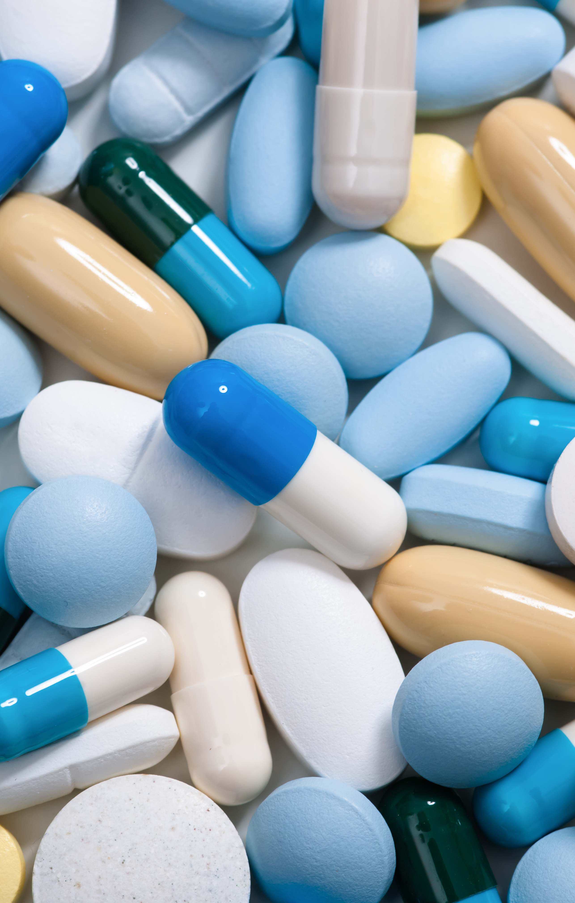
Current Scope of International Medicinal Product Hierarchy
Please refer to
Section 3 ‘Scope of Content’ in
‘2a. Medicinal Product Hierarchy – Editorial Guidelines for Modeling and Terming v3.0.pdf’ attached at bottom of
http://snomed.org/deusg
Note: We will be doing further work on a “scoping statement” to ensure that there is a shared understanding of the scope of the international release
http://snomed.org/deusg
Notes:
Concepts that refer to ….

Slide 12
Drugs not found in International Release
Use of Hydration
Challenge: Use of hydration in international clinical drugs is inconsistent
783147000 |Alendronic acid (as alendronate sodium) 70 mg/oral tablet|
783072003 |Cefalexin 500 mg oral tablet |
783075001 |Cefalexin (as cefalexin monohydrate) 500 mg oral capsule|
783280002 |Amoxicillin (as amoxicillin trihydrate) 500 mg oral capsule|
Response: This issue will be going to the drug modelling working group to establish the guidelines for the international release, and based on this, a determination will be made as to what guidance will be given to national extensions
Notes:
3. Reason for participating
In July 2020 international there are 158 CDs with ‘hydrates’

Slide 13
Drugs not found in International Release
Clinical drug not interchangeable (liposomal forms)
Challenge: Some products with same ingredients, strength and dose form are not interchangeable – for example:
Doxorubicin Accord vs Caelyx pegylated liposomal
Response: For products in which the ingredient has been changed to have a different dosing regime, a separate substance should be used eg
MP: 773365000 |Doxorubicin liposome only product|
If the required CD is not available, please submit a CRS request via your NRC.
Notes:
3. Reason for participating
In July 2020 international there are 158 CDs with ‘hydrates’

Slide 14
Drugs not found in International Release
Rate and Frequency of International Releases
Challenge: Implementers need to wait several months for new drugs to be added. In the meantime, national/local codes must be added to support implementations → proliferation of local codes
Response: There are plans to start producing monthly international SCT releases from July 2021. Please submit your CRS tickets via your NRC, with evidence/literature of a real manufactured product. Also, as COVID-19 vaccines are approved in your local jurisdictions, please ask NRC to submit CRS tickets.
Notes:
3. Reason for participating

Slide 15
Drugs not found in International Release
Duplication of extension concepts in international release
Challenge: National extensions must add new clinical drugs to fill in the gap for products missing from the international release. As new products are added to the international release, this can cause duplication of clinical drug concepts, causing additional work to migrate to a new international version
Response: Implementation guidance is needed to advise on best way to manage this process
Notes:
3. Reason for participating

Slide 16
Dose Form Mismatches
General
Challenge: An equivalent mapping from local dose forms to SNOMED CT dose forms is not always available to support clinical drugs.
Azithromycin 500 mg film-coated tablet
Response: New dose forms or clinical drugs may be requested by NRCs if needed. Further guidance may also be required.
Notes:
3. Reason for participating

Slide 17
Dose Form Mismatches
Pharmaceutical dose form
Challenge: Some SCT clinical drugs include the manufactured dose form and some use only the administrable dose form. Both may be needed for national use cases.
Cefaclor (cefaclor monohydrate) 25 mg/mL granules for oral suspension
Cefaclor (cefaclor monohydrate) 25 mg/mL oral suspension
Response: New dose forms or clinical drugs may be requested by NRCs if needed. Further guidance may is also required.
Notes:
3. Reason for participating

Slide 18
Dose Form Mismatches
Dose Form Groupers
Challenge: For some use cases a single concept is required for dose forms with multiple routes of administration. It was noted that when the unit of presentation is different, a separate CD is needed
Ceftazidime (as ceftazidime pentahydrate) 1 g/vial powder for solution for infusion or injection
Response: Further investigation and analysis is required (action for SI)
Notes:
3. Reason for participating

Slide 19
BOSS / PAI Mismatches
Same PAI+Strength Value / Different BOSS (confirm actual products)
Challenge: The BOSS and precise active ingredients in some SCT clinical drugs do not match actual/real products. They may have the same PAI and strength, but a different BOSS.
Metoclopramide (metoclopramide hydrochloride) 10 mg tablet vs
322091008 |Metoclopramide hydrochloride 10 mg oral tablet|
Response: If you find any inconsistencies, please submit these via CRS with supporting evidence (e.g. a link to the regulatory documentation for the drug) and we will investigate these as soon as possible
Notes:
3. Reason for participating

Slide 20
BOSS / PAI Mismatches
Same PAI/ Different BOSS + Strength Value (but clinically equivalent)
Challenge: National drug dictionaries may use a different BOSS to what is used in the international core. In some cases the international release uses different BOSSs for the same ingredient in different clinical drugs
Almotriptan (as malate) 4.5 mg oral tablet vs
363570002 |Almotriptan malate 6.25 mg oral tablet|
Response: Implementation guidance to be developed to provide advice on mapping to the international edition. If you find any inconsistencies, please submit via CRS with supporting evidence
Notes:
Molecular weight of “Almotriptan” is 335.465 g/mol
Molecular weight of “Almotriptan malate” is 469.6 g/mol.
So 4.5 mg of Almotriptan is approximately 6.25 mg of Almotriptan malate.

Slide 21
BOSS / PAI Mismatches
Same BOSS + Strength / Different Precise Active Ingredient
Challenge: In some cases the local clinical drug uses an identical BOSS but a different precise active ingredient to the international concept – e.g. Almotriptan (as di-hydrogenmalate) vs Almotriptan (as malate)
Rasagiline (as rasagiline mesylate) 1 mg tablet vs
418125001 |Rasagiline 1 mg oral tablet |
Response: Implementation guidance to be developed. Please check your substances – e.g. di-hydrogenmalate and malate are synonyms.
Notes:
3. Reason for participating

Slide 22
Consistency of Strength Rounding
Challenge: Normalisation of strengths do not use a consistent number of significant digits when rounding – e.g.
784845004 |Anakinra 149 mg/mL solution for injection|
769506006 |Estradiol 3.125 microgram/hour prolonged-release transdermal patch|
Response: As part of the move to concrete domains (planned for July 2021 release), the Modelling Advisory Group will be providing guidance on the number of decimal places that strengths will use in the international release and the method of expressing equivalent strengths using different units of measure
Notes:
3. Reason for participating

Slide 23
Presentation Strengths
Challenge: Different strength denominators are required for clinical use
For example:
Enoxaparin sodium 40 mg/0.4 mL solution for injection
Cefadroxil 125 mg/5 mL oral suspension
Estradiol (estradiol hemihydrate) 75 mcg/24 hour transdermal patch
Response: The drug modelling working group will be clarifying the guidance on this
Notes:
3. Reason for participating

Slide 24
Strength UoM Conventions
Challenge: (a) Conventions used for units of measure are not clear
(b) International modeling guidance says product strengths should be normalised and % not used. Can “Barclude 0.5 mg oral tablet” or “Progesterone 8% vaginal gel” be a preferred term?
(c) Should “international units” or “units” be used in CDs?
Response: (a) Further Implementation Guidance will be developed
(b) Extensions can create their own Preferred Terms for CDs
(c) Pending guidance from drug modelling working group.
Notes:
3. Reason for participating

Slide 25
Stability of Model
Challenge: The product hierarchy is continuously evolving and covering different use cases. It has been a challenge to keep up with the changes to the international model
Response: This is part of the evolutionary process of SNOMED CT in response to customer requests for improvement. We try to give advanced notification when changes are going to be made
Notes:
3. Reason for participating

Slide 26
Relationship to IDMP
Challenge: It’s difficult to communicate the differences and similarities between PHPIDs in IDMP and Medicinal product levels in SNOMED CT (especially since a global PHPID does not exist yet)
Response: Yes – this is currently difficult. We will monitor the evolution of PHPIDs. SNOMED International is active in the UNICOM project.
Notes:
3. Reason for participating

Slide 27
DEUSG Issues Register
Prioritisation
Drugs not found in international release
Dose form mismatches
BOSS precise ingred mismatches (matching against actual products)
Hydration
Duplication
Consistency of strength rounding
Consistency of strength rounding
Strength UoM conventions
Access to documentation
Drugs not found in international release
  Hydration or no hydration
  Rate and frequency of additions
  Duplication (extension + core)
Dose form mismatches
BOSS / precise ingredient mismatch
  Confirm against actual products
  Different BOSS or PAI used
Consistency of strength rounding
Presentation strengths for clinical use
Strength UoM conventions
Stability of model
Relationship to IDMP

Slide 28
Implementation Resources
Questions
What types of implementation resources do you currently use & which could be shared?
What types of additional implementation resources would be helpful?
Which of these could DEUSG work on?
Which of these would it be helpful for SNOMED International to develop?
Examples
Implementation guidance
  How to create a national SCT drug extension
  How to map to the SCT international edition
  How to use SCT drugs in a clinical system
Maps (e.g. map to ATC)
Value sets
Tool (e.g. mapping local CDs to int CDs)
Other
http://snomed.org/deusg

Slide 29
ACTIONS – SNOMED International
Relocate documentation for accessibility
Work on international scoping statement
Drug modelling working group
  Guidelines for hydration
  Different strength denominators
  “international unit” vs “unit”
Implementation guidance for
  Hydration
  Different strength denominators
  Strength unit of measure conventions
  Migrating to new international version
  Mapping to international concepts
From July 2020 international release
  Monthly releases planned
  Strengths to use concrete values with consistent rounding (MAG to advise)
Investigation into dose form groupers
Monitor evolution of IDMPs PHPIDs
ACTIONS – DEUSG MEMBERS
Send SI any clinical drugs in your national drug dictionary, which you believe should be in scope of the international edition (with local id, name and reference to real drug product specification)
Submit CRS tickets via your NRC for
  New or missing clinical drugs
  New or missing dose forms
  New or missing substances (check substances first for synonymity)
  COVID-19 vaccines approved locally
  Any inconsistencies you identify in international CDs (please include supporting evidence)
Add local Preferred Terms to extension
Share implementation resources

Slide 30

Members to send us examples
SI to further analyse each issue
Next meeting
David Mitchell, NZ
Thursday 21st January 2021
at 11:00 UTC
NEXT STEPS
30

Slide 31


THANK YOU
SNOMED International: Delivering SNOMED CT

