Slide 1






Clinical Engagement Strategy
2021 - 2025
Shelley Lipon,
Global Customer Relations Executive

Slide 2
Why clinical engagement ?
“Clinicians are frequently the first to hear, see and identify patient conditions and findings that need documentation. Further, clinicians are in a unique position to see correlations between the items that need documentation. Being able to contribute to terms, definitions, and the valuable relationships available within SNOMED CT improves usability. Working with the entire design team for an EHR allows for better presentation, and proper representation that may significantly contribute to timeliness, efficiency, and most important, improved care outcomes”.
Mark Jurkovitch,
Chair, SNOMED International Dentistry Clinical Reference Group

Slide 3
Benefits of clinical engagement
Informing direction of SNOMED International products and services
Improving quality, and thus clinical usability and acceptability, of SNOMED International products and services, based on clinical knowledge and expertise
Identification of clinical champions who support and endorse the implementation of SNOMED CT and related products and services
Ensuring clinical input into SNOMED CT implementation developments and development of clinical analytics using SNOMED CT
Development of clinical value statement
Improving clinical granularity of SCT to support NLP

Slide 4
Benefits realization of clinical engagement
Promote collaboration between international healthcare professional groups that improve SNOMED International products and services by improving knowledge and demonstrating value
Outreach to clinical training schools
Developing a “clinical business case” for clinician usage
Using SNOMED CT as the basis for delivering care and improving quality
Identification of relevance and need to clinicians
Outreach to clinical registries to support interoperability and data exchange
Develop a “What SNOMED CT can do for you ?”
Links to vendors, smaller groups, clinician informaticists, NLP developers, CDSS, (value of semantics)
Focus on content – logical definitions to support future analytics and measurement specification (QA measures)
Developing tools to support content review by CRGs

Slide 5


SNOMED CT with clinical engagement
SNOMED CT, enhanced by clinicians to support current and future clinical practice
Timely responses to clinical advances
Clinically assured SNOMED CT content
Development of clinically supportive derivatives
CLINICAL
ENGAGEMENT
Clinical input into future developments
Development of clinically responsive educational materials
Corporate culture driving clinically assured product development
Clinically driven implementation support

Slide 6
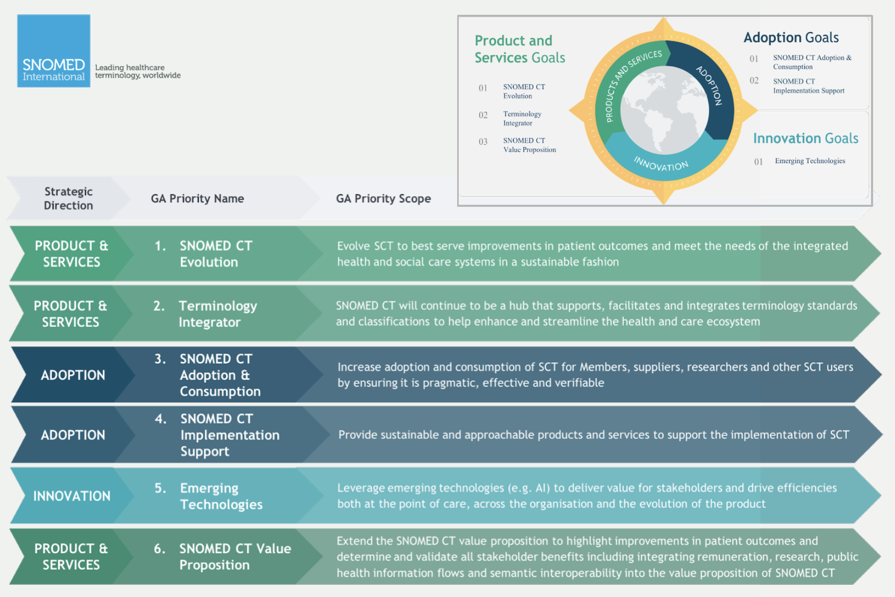
SNOMED International Strategy 2020 - 25

Slide 7
Who are our clinical stakeholders?
Doctors
Allied health professionals
Clinical
educators
Clinical care providers
Nurses
Professional bodies
Clinical colleges

Slide 8


Vision of Clinical Engagement (Previous)
To ensure that all activities of SNOMED International are influenced by global clinical communities
SNOMED International’s culture has a progressive and sustainable approach to engaging clinicians

Slide 9
Vision of Clinical Engagement (New)
Engaging and professionally recognizing clinicians . . . .
<ADD>

Slide 10
Principles
Clinical engagement is central to the culture of SNOMED International
Clinical engagement activities apply across all global regions
Clinical engagement encompasses all healthcare professions globally
Clinical engagement will apply across all stakeholder groups
Clinical engagement approach will foster and encourage a culture of open engagement and discussion between clinicians
Clinical engagement approach will leverage experience and shared learning globally across all specialties
Clinical engagement approach will assure the quality and clinical relevance of SNOMED International products and services

Slide 11
Clinical engagement goals/objectives to support SNOMED International strategic direction
  Raise the profile of SNOMED CT for clinicians locally/nationally/globally
Identify and support local/regional/national/global health care professional ambassadors/SMEs for SNOMED CT
Provision of information/guidance regarding SNOMED CT and it’s interface with other standards, e.g., ICD-11
Identify and respond to key external drivers that impact clinical perspectives alongside patient care, e.g., billing and quality improvement
Identify and gather use case examples from clinical and research perspectives to demonstrate benefits of using SNOMED CT
Increase the access and promotion of relevant SNOMED CT educational materials by all healthcare professionals
Identify key clinical requirements/priorities/trends to inform SNOMED International products and services
  Develop clinical analytics documentation and educational materials to showcase SNOMED CT functionality within clinical practice
  Identify opportunities to enhance SNOMED CT through collaboration with other clinical standards

Slide 12
Clinical Engagement work plan approach
The annual work plan will include global clinical engagement activities
The clinical engagement plan will deliver on the strategic direction for the SNOMED International
The annual work plan will be developed in collaboration with the leads of the clinical groups (reference and project groups)
All clinical engagement activities will coordinate with the relevant SNOMED International lines of business in order to ensure appropriate and timely delivery
All clinical engagement activities within Member countries will be undertaken only following consultation with the relevant national authority
The annual workplan will clearly identify deliverables, with an implementation plan and measure of success

Slide 13
Clinical Engagement Work plan
2021-22

Slide 14
Work plan 2016-17 - Example
Strategic Objective | Deliverable | Mechanisms/Action Plans | Measures of Success
Raise the profile of SNOMED CT for clinicians locally/nationally/ globally | Clinical engagement web interface and forum, to provide information, documentation and educational materials Annual calendar identifying key opportunities for clinical engagement leads to promote SNOMED CT globally Provide documentation on subset development and maintenance Create and publish a document on “SNOMED CT and Precision Medicine” | Member countries will be consulted to agree engagement activities within their borders Gather requirements from clinicians/clinical groups globally on what information, documentation and educational materials are required to increase the implementation of SNOMED CT (Design, develop and implement a web interface based on requirements). Identify key areas of focus for the coming year and resulting opportunities for clinical engagement e.g. Genomics and “Big data” Publish subset development and maintenance guidance documentation Create initial list of available subsets by specialty Develop a document to support the genomics strategy, that targets clinicians and clinical groups on how SNOMED CT can support the developments in precision medicine | Number of clinicians accessing portal “SNOMED CT and Precision Medicine” published

Slide 15
Work plan 2016-17 - Example
Strategic Objective | Deliverable | Mechanisms/Action Plans | Measures of Success
Identify and support local/regional/national/ global health care professional ambassadors/subject matter experts for SNOMED CT | To develop an identified group of global clinician ambassadors/SMEs Develop a sustainable clinically focused community within SNOMED International Provide access to clinical validation resources for SNOMED CT content | Identification of global ambassadors /SMEs - through the delivery of clinical sessions by the clinical leads, and by supporting clinician interest in advanced functionality within SNOMED CT Develop a description of the role of professional ambassadors/SMEs Analyze and provide recommendations on future role and management of SIGs Develop a quality assurance process for clinicians/clinical groups, including standardization of feedback methodology, and leveraging of existing SNOMED International tooling (or identification of new requirements) Identify International clinical Groups e.g. CMSS (Council of Medical Specialty Societies) | List of clinician ambassadors/SMEs providing global coverage Number of clinicians involved with SNOMED International (baseline) Agreed documented approach for the future of SIG’s in the context of clinical engagement, following consultation with existing clinical groups and organization leads

Slide 16
Work plan 2016-17 - Example
Strategic Objective | Deliverable | Mechanisms/Action Plans | Measures of Success
Identify and gather use case examples from clinical and research perspectives to demonstrate benefits of using SNOMED CT | Standard template for clinical use cases Central list of documented use cases | Develop and agree standard template for recording clinical use cases Add requirement to web interface design to enable publication of use cases | Number of use cases documented and published
Increase the access to relevant SNOMED CT educational materials for healthcare professionals | Provision of a central source of educational materials Development and documentation of clinician focused education requirements | Education baseline assessment for clinicians – what we have in place, and what we are missing Delivery of documented clinical education requirements Develop new/revised clinically focused education materials/module based on stated requirements | Inventory of clinical educational materials available, and under development Publication of clinical educational materials available through a central point
Identify key clinical requirements/priorities/trends to inform SNOMED International products and services | Structured methodology for identifying clinical requirements/priorities/trends to inform SNOMED International products and services Roadmap for Genomics | Develop and agree methodology/template for gathering requirements/ priorities/ trends and developing subsets Develop strategy and roadmap for supporting genomics | Methodology developed and implemented Genomics strategy published Genomics roadmap developed

Slide 17
Work plan 2016-17 - Example
Strategic Objective | Deliverable | Mechanisms/Action Plans | Measures of Success
Demonstrate high value clinical decision support capabilities of SNOMED CT | Provision of a tool that demonstrates high value decision support and analytic capability for clinicians Plan for ongoing engagement with key high value users | Build/enhance tooling to demonstrate decision support and analytic capability Identify users of SNOMED CT that are interested, and capable of moving to a high value implementation Develop plan for long term engagement with high value users | Tool that is operational and accessible to demonstrate advanced decision support and analytic capabilities
Identify clinically focused interoperability opportunities to enhance SNOMED CT | Provide recommendations to Collaboration Lead on global collaboration opportunities Recommend potential future derivatives based on clinical feedback, in conjunction with discussion with vendors | Identification of interoperability/collaboration requirements through clinical contacts Document future potential derivatives for discussion with Collaboration lead, and Release team | Number of additional collaboration activities List of future potential derivatives, with justifications

