Slide 1
Clinical Reference Groups (CRGs)

Slide 2
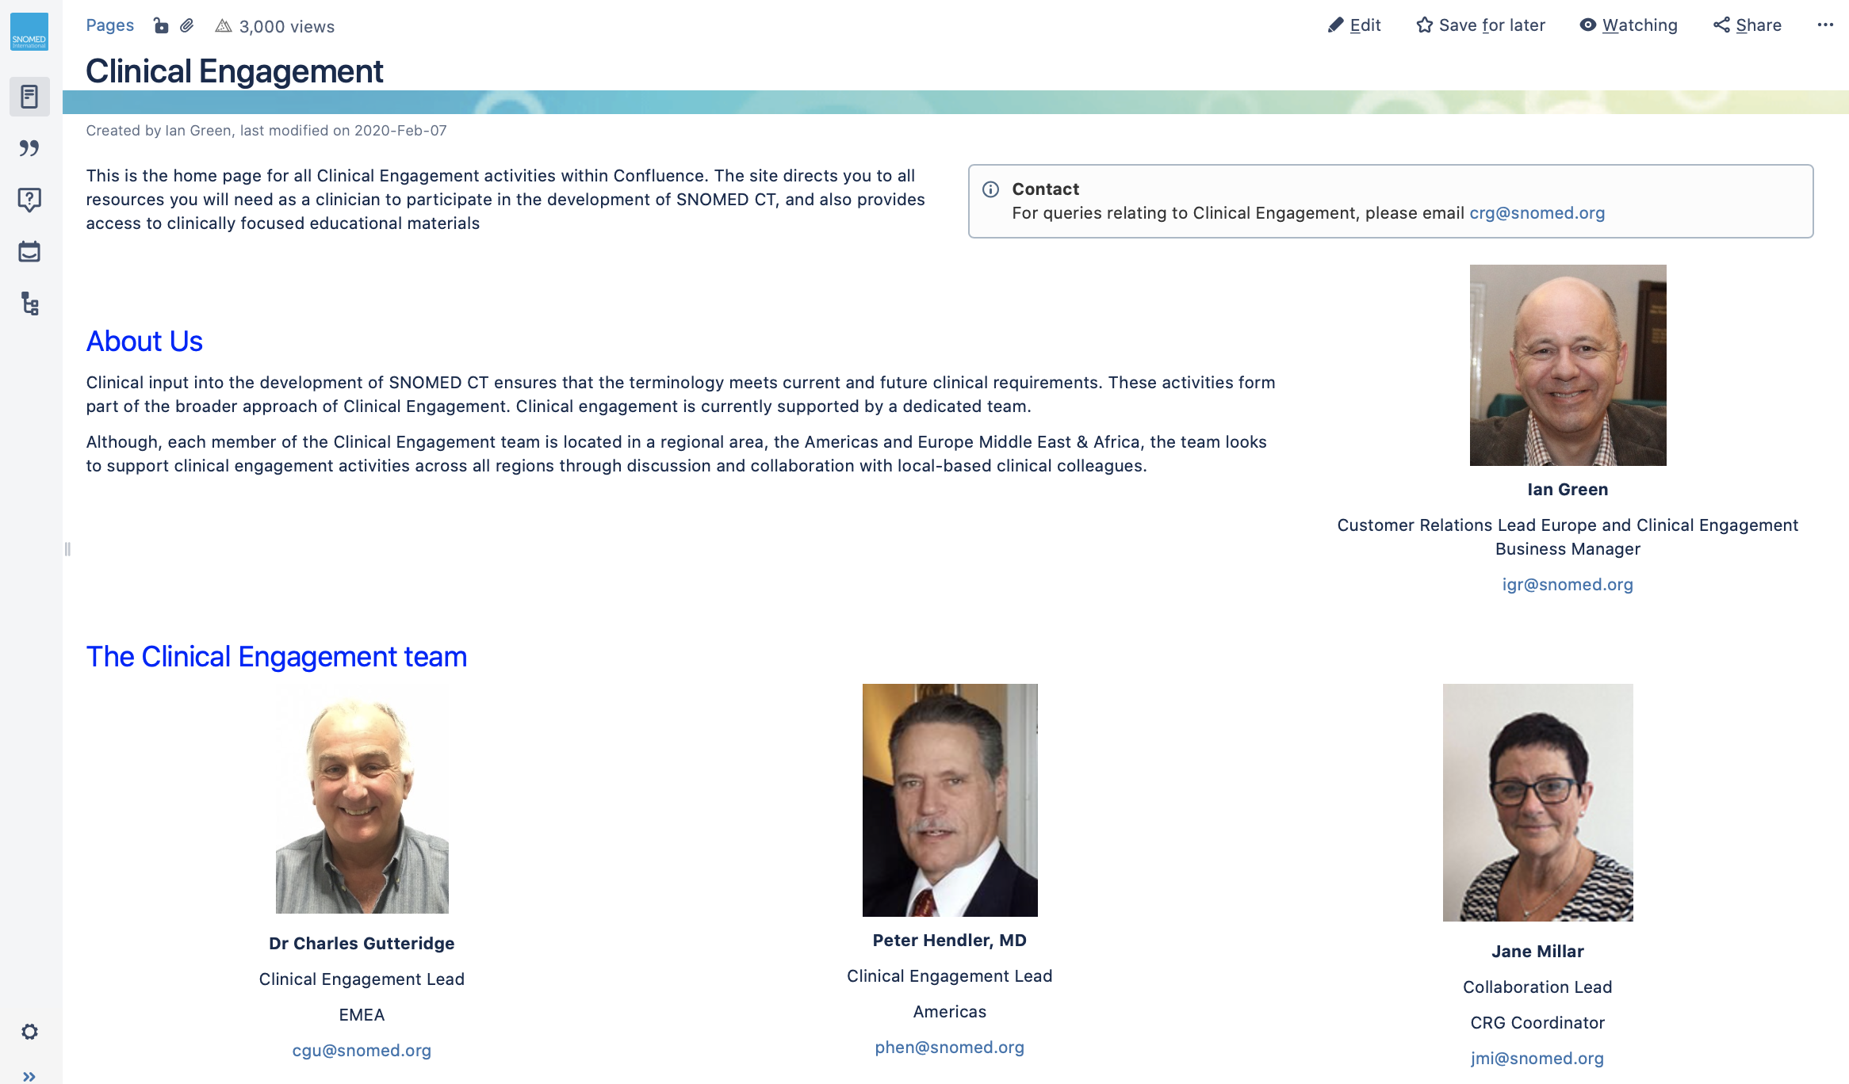
Clinical Portal
https://confluence.ihtsdotools.org/display/CP/Clinical+Engagement

Slide 3
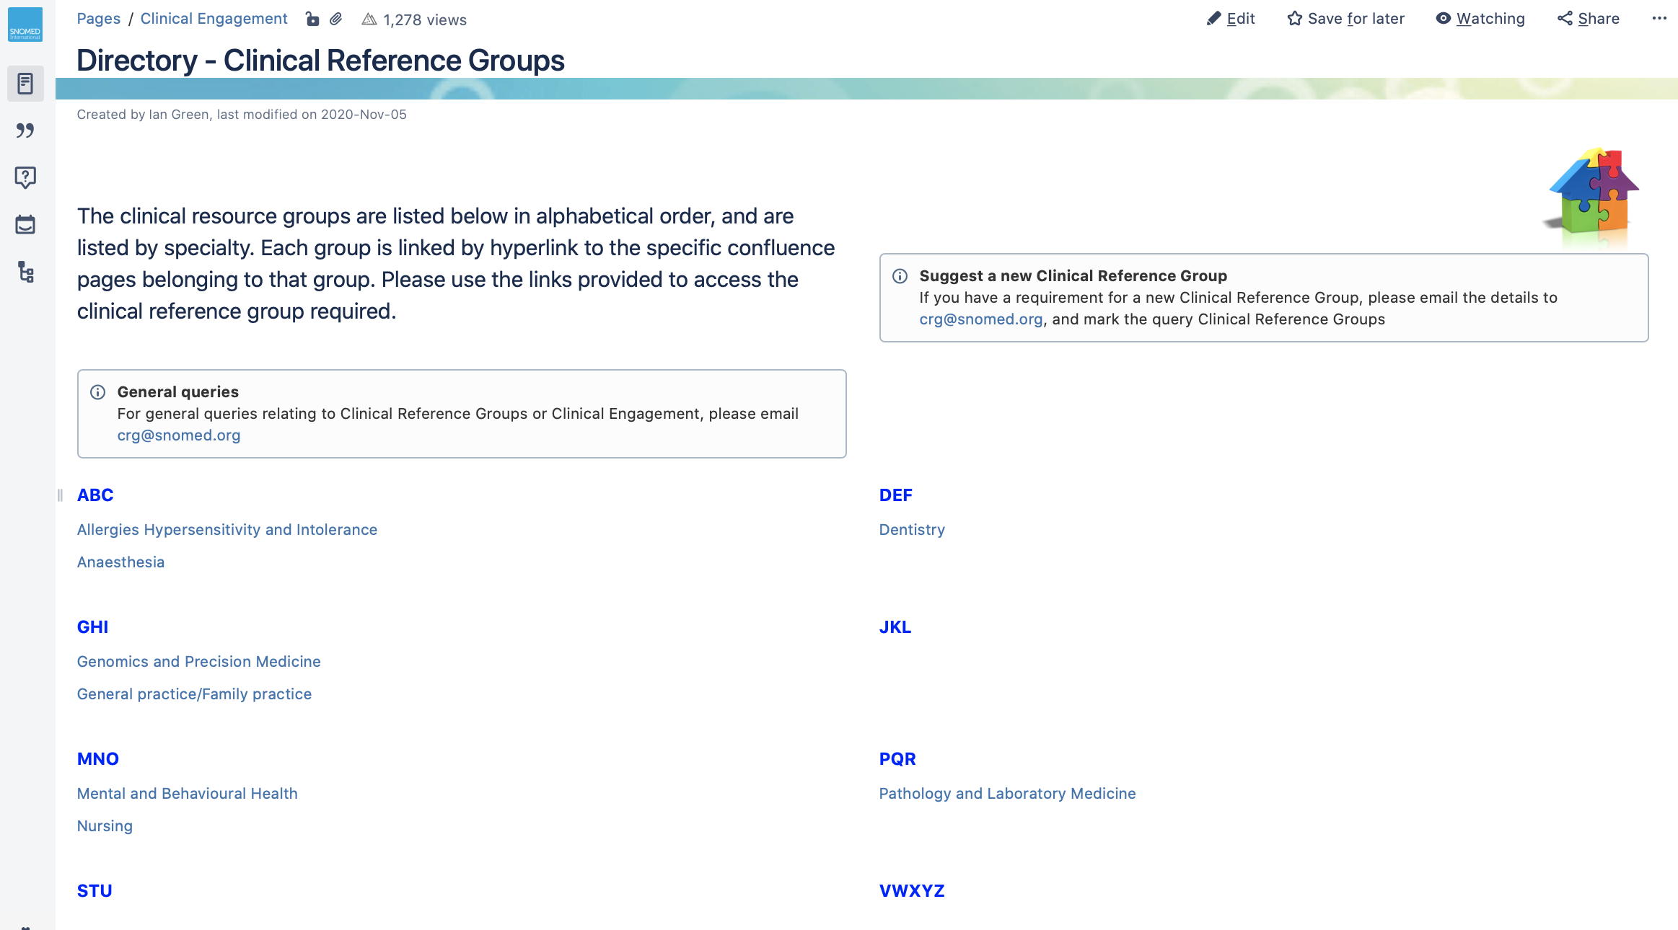
CRG Directory
https://confluence.ihtsdotools.org/display/CP/Directory+-+Clinical+Reference+Groups

Slide 4
Clinical Reference Groups (CRG) - principles
Virtual
  Face to face - for specific agreed deliverables
  Face to face - if there is a clinical engagement event
Specialty based
Advisory groups
Clinical leadership, supported by SNOMED International
Clear scope statement to manage clinician expectations
Open membership, but need to be group registered to take an active part in discussions
Route for identifying work items that have clinical global relevance
Topics raised by clinicians and SNOMED International
Dedicated Confluence site

Slide 5
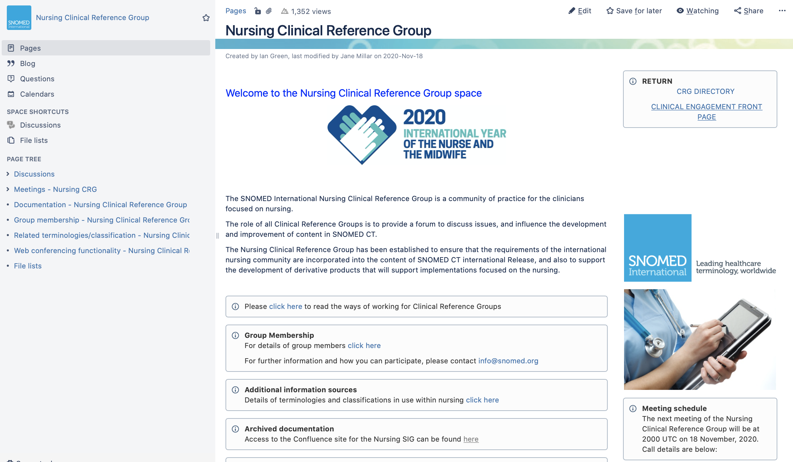
Nursing CRG
https://confluence.ihtsdotools.org/display/Nursing/Nursing+Clinical+Reference+Group

