Slide 1


High-level structure for TCM
Traditional Medicine
Expert Working Group meeting
25/11/2020
Yongsheng Gao

Slide 2
Requirements
Disorder and patterns – ICD11
WHO-Standard Terminologies
Malaysia requests
Others
500
4,000
200
>100,000
Alignment with the WHO classification
Support clinical practice, research, healthcare policies
SI Member requests
Procedures, Herbs, and Substances
Notes:
WHO ICD-11 TM chapters
Terminologies on Traditional Medicine in Western Pacific Region
Requirement from member countries
Standard requirements e.g. ISO standards

Slide 3

Impact of the Policy Documents
Relevant Document
Malaysia’s context
Malaysia’s Requirements
The Acts do not define the Practice & product by the fundamental philosophy of the respective practices.
Unique features of T&CM in Malaysia :
  Highly diverse practices
  Deep-rooted ethno-cultural influence
Knowledge structure of the respective practices is not clearly defined and unable to establish the boundary line of the respective practice.
In order to avoid inter-practice confusion, Malaysia need a precise and unique definition of term use by the respective practices.
The implicit meaning of the terms and concepts use in the respective practices is embedded in the culture as expressed in the form of language
a) To define the respective practices base on its fundamental principle or philosophy. Hence, the category structure of respective practice can be clearly defined.
b)To adopt a standardized TCM term in English with priority to translate the pronunciation from Chinese language (Han Yu Ping Yin)
c) The relationships between the core module and TCM module can be in parallel and may not as an extension module
T&CM Acts 2016 (Act 775)
Poison Act 1952 (Act 336)
T&CM Blueprint 2018-2027 (Health care)
Dangerous drug Act 1952 (Act 234)

Slide 4
Core module
Community content
Extension module
Genomics
module
Traditional Medicine
module
Extension module
Extension module
Extension module
Extension module
Notes:
Single TM module vs. multiple TM modules. For example, Traditional Chinese Medicine,

Slide 5
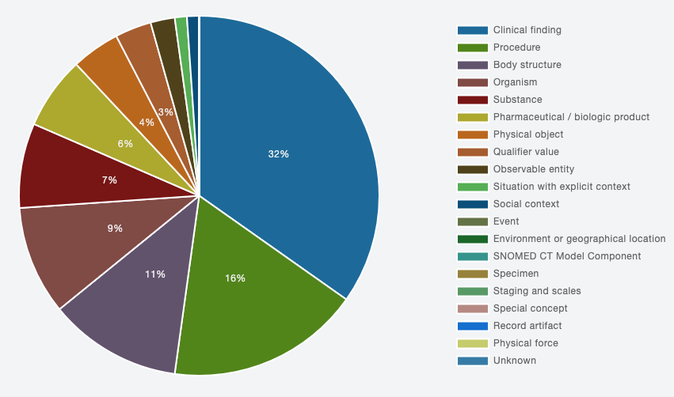

Slide 6
Top-level concepts in SNOMED CT
Clinical Finding
Procedure & Regime
Body structure
Medicinal Product
1119477002 |Pattern (pattern)|
(证)
Finding of pulse
Finding of tongue
277132007 |Therapeutic procedure|
773412008 |Traditional medicine (regime/therapy)|
272743000 |Acupuncture point (body structure)|
Meridian
349365008 |Herbal medicine (product)|
Notes:
Principle-based
Environmental factor
Body constituents
Organ system
Meridian & collateral
Six stage
Triple energizer
Four phases
Four constitution
450718002|Temple region structure (body structure)|
temple 太陽; 太陽穴
(1) the area on each side of the forehead above
the cheek bones, lateral to and slightly superior to
the outer canthus of the eye; (2) an non-meridian
acupuncture point on the temporal part of the head

Slide 7
Top-level concepts in SNOMED CT
Observable entity
Qualifier Value
Theoretical entity
Physical object
60161006 |Acupuncture needle, device (physical object)|
Pulse (脉象):
Tongue:
shape
colour
coating
224891009 |Healthcare services (qualifier value)|
Yin-yang
Five phase
Qi, Blood, Essence
Fluid
Viscera and bowels
Triple energizers
Cold, dampness, wind, phlegm
Notes:
8499008|Pulse, function (observable entity)|

Slide 8
Poly-hierarchies in SNOMED CT
Deficiency pattern
Yin pattern
Lung yin deficiency pattern

Slide 9

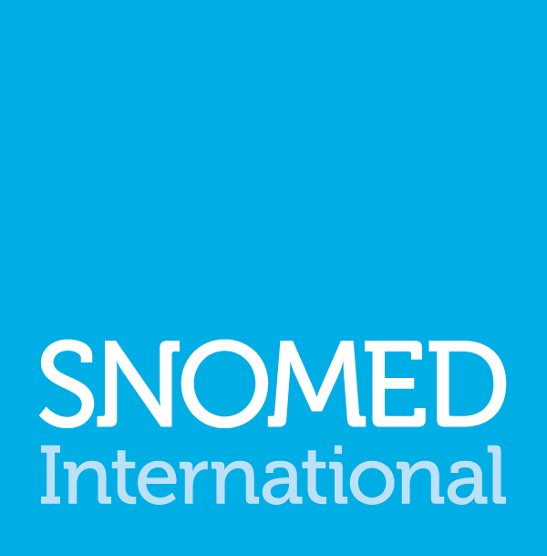
THANK YOU
SNOMED International: Delivering SNOMED CT

