Slide 1
Dentistry CRG
December 2, 2020
14:30 UTC
Link:https://snomed.zoom.us/my/dentistrycrg

Slide 2
Agenda
Attendance and Regrets
SNOMED report
Editor’s report, Nicola Ingram, Sarah Warren
Brief review of alteration of “unilateral” concept
Periodontal classification system status
  Update on use agreement, possible alteration from use to collaboration agreement
    Hold on adding to January release
  European Federation of Periodontology to provide input
    Will review both periodontal and gingival disease concepts
    May result in some requested alterations to the spreadsheets previously reviewed by the CRG
  Consensus on any alterations
  Next steps of project
    Implant and implant related conditions
    Other periodontal concepts not previously covered
2021 Work Plan discussion
  Review and need to alter some
  Use case for substances review (possibly related to procedures review)
Meeting updates
New Business

Slide 3

Editors Report
SNOMED International updates
Brief discussion of unilateral concept alteration example

Slide 4
Periodontal Classification System Project
European Federation of Periodontology(EFP) requested input into project
Broader global input is always encouraged by SNOMED
EFP asking members to identify possible participants in CRG
EFP will review Periodontal Disease and Gingial disease concepts previously reviewed by CRG and may request alterations to those identified in spreadsheets previously.
CRG would then review and develop consensus
EFP and AAP discussing possible collaboration agreement with SNOMED rather than use agreement for Classification system. Common process within SNOMED.

Slide 5
Periodontal Classification System Project
EFP review and consensus development within CRG for Periodontal disease concepts and gingival disease concepts.
Review of Implant related concepts within Classification System
Review of any remaining concepts not previously evaluated within Classification System
Ongoing process of developing an agreement between SNOMED and AAP/EFP. All will bekept updated on status of project.

Slide 6
2021 Work Plan Development
Purpose: Guide our work for the next year
SNOMED International needs this to estimate and prioritize editor time commitments.
Goal today is simple and twofold:
  Prioritize what we wish to work on. This does not limit us from other areas but may limit amount of editorial support we can expect.
  Propose any ideas (including problems with what is currently in SNOMED) you may have on how to approach a specific issue in our list.

Slide 7
2021 Work Plan Development
Prioritized 2021 Work Plan per October Meeting:
  Completion of necessary concepts for Periodontal Classification System
  Review and development of Dental Procedures
    Additional granularity
    Regimes/therapies versus procedures
    Potential issues related to current dental anatomy and substances. (SNOMED requesting a use case and/or examples on the need to evaluate dental substances in order to assign editor time and include in any work plan)
  Supernumerary tooth disorders model development and remodeling of existing concepts
  Dental anatomy review of issues brought forther by Jorn Andre Jorgensen:
    Examples: relationship of dental arch to tooth; “soft” tissues of tooth (pulp, etc.) and model deficiencies currently
  Observables as discussed at our August meeting with Daniel Karlsen. Likely longer term rather than 2021.

Slide 8
2021 Work Plan Development
Provide examples for SNOMED International so they can better estimate and prioritize editor time commitments.
Potential anatomy issues
  Example: Tooth relationship to jaw
  Example: pulpal tissues relationship to tooth and dentin
Potential substance/material confusion
  Concepts with brand specific materials
  Classifying dental substances

Slide 9
Procedures
Work Plan
Development
(Malaysia, UK, Norway have all had varying requests)
May involve several areas:
1) Additional procedures desired
2) Additional refinement of current procedures
3) Interim steps of procedures (i.e. crown preparation, impression, crown placement)
Other factors to complete request?
Borneo Post 11-1-2019

Slide 10
Procedures Work Plan Development
Primary use case: Review procedures and identify the processes (steps) necessary to perform or complete the specific dental procedure. Create SNOMED concepts for any process not currently represented and create an appropriate hierarchy for the processes to be properly linked to a specific procedure.
Secondary use case would be additional concepts for greater granularity of current dental procedures that may not have interim steps

Slide 11
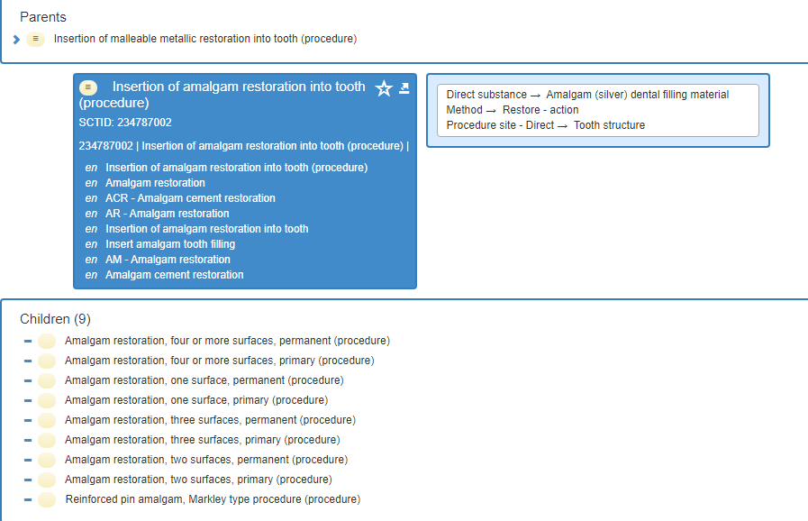

Slide 12
The procedure (amalgam restoration)
What are the processes?
  Anesthetize
  Preparation by removing tooth structure and/or current restorative material
  OR by preparing a fractured portion of tooth structure to retain an amalgam
  Place any base materials
  Place/insert amalgam
  Carve/polish

Slide 13
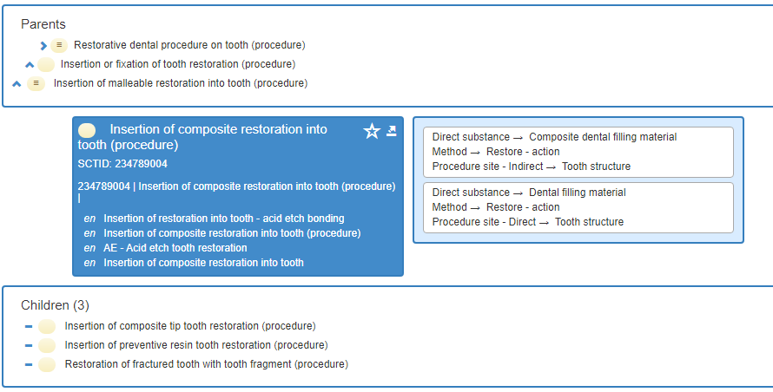

Slide 14
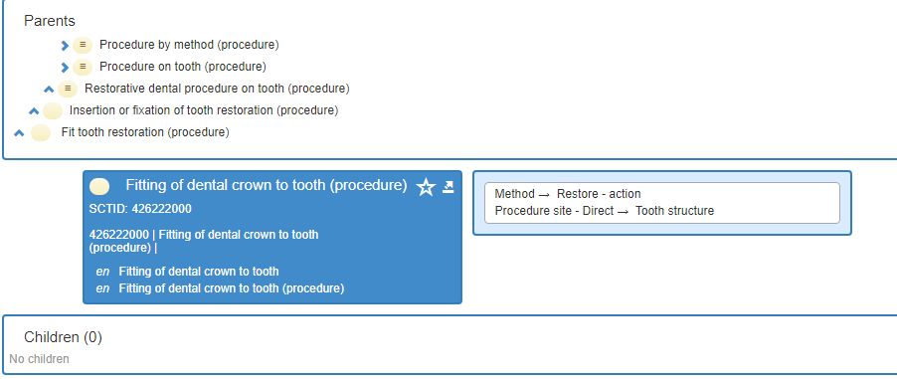

Slide 15
Process or Procedure (or both?)
Do we need to review hierarchies of current dental procedures to create a common format for interim steps?
Is this a critical piece for our work plan development?

Slide 16
Substances and Procedures
Should substances be a consideration in developing the procedures work plan?
90 different dental specific substances previously identified (likely an incomplete list now) and sent with August materials.
How might substances intersect with procedures or influence the development of new concepts for procedures?
  i.e. Interim step of impression could use various substances or be a scan. Is the substance itself important to the procedure concept?

Slide 17
2021 Work Plan Development
Suggested areas to date:
  Completion of Periodontal classification system (in progress)
  Work with observables discussed at last meeting- this would be new
  Procedure development and design- requested by a few members
  Substance review and how it fits into Procedures review
  Review of obsolete Periodontal concepts
  Anatomy review and analysis
  Refset updating and possible new ref set requests
  Other?

Slide 18
Other Business and Meeting Updates
Any additional business?
Meeting updates:
  Next meeting is scheduled for Wednesday, February 3, 2021 at 1430UTC
  We currently meet every other month for 60-90 minutes. Do we need to change meeting frequency or time/day?

