Slide 1


SNOMED CT and ICNP – what next in supporting nursing practice globally
Nick Hardiker
ICNP Director, International Council of Nurses
Jane Millar
Collaboration Lead, SNOMED International

Slide 2

Overview
Challenges that drive the enhanced need for nursing data
  WHO’s State of the World’s Nursing report 2020
  COVID-19 ICN Call to Action
Responding to the demand for nursing data
  Partnership between ICN and SNOMED International

Slide 3

WHO’s State of the World’s Nursing report 2020
Provides current evidence about, and policy options for,
the global nursing workforce, covering:
  Good clinical practice and patient care
  Investment decisions
  Supporting leadership and governance
  Facilitating collaboration

Slide 4
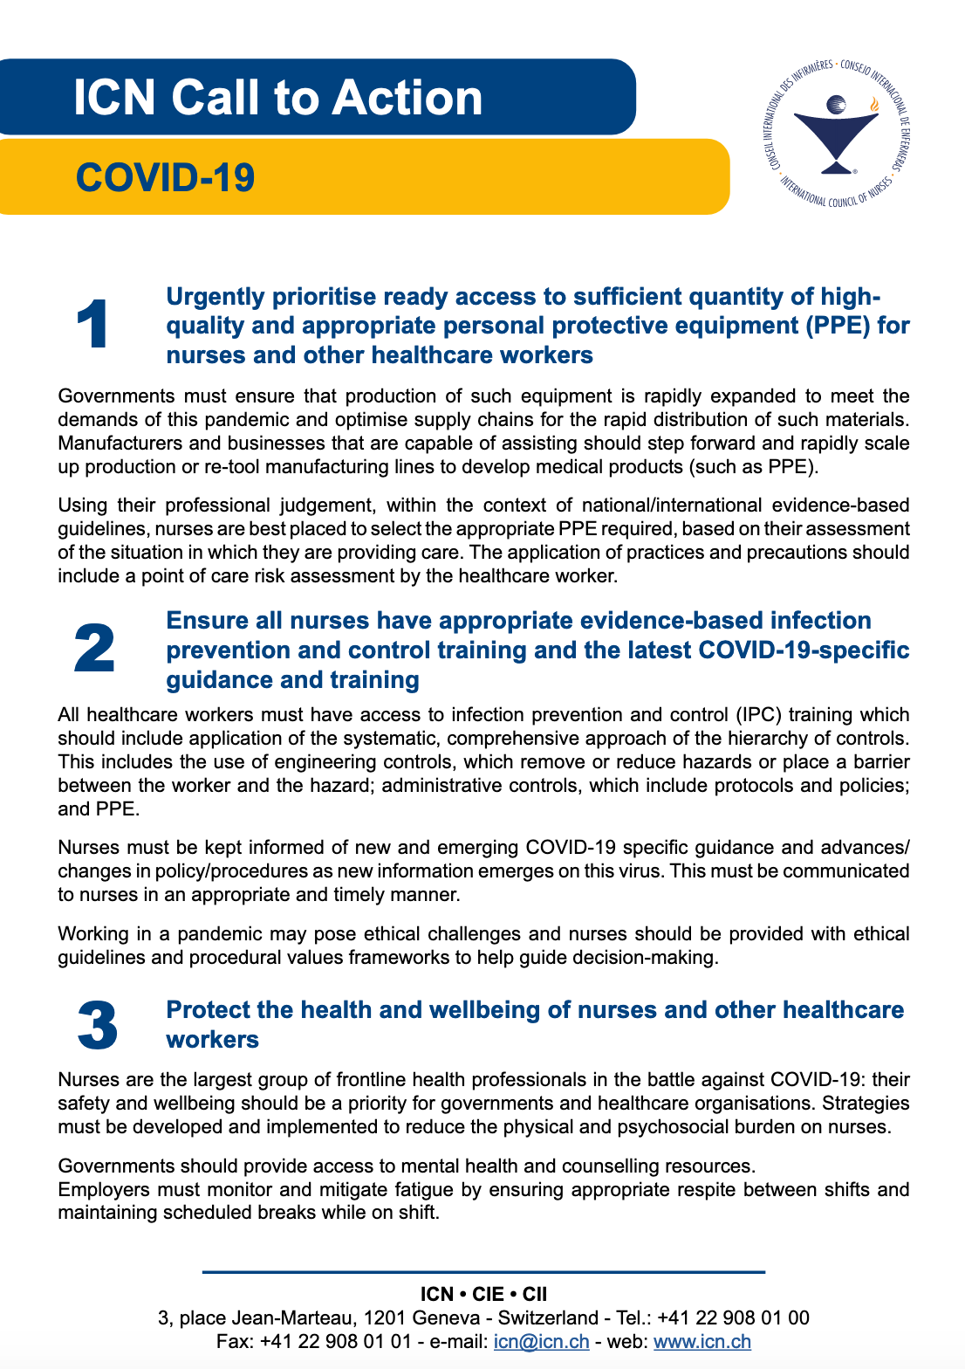
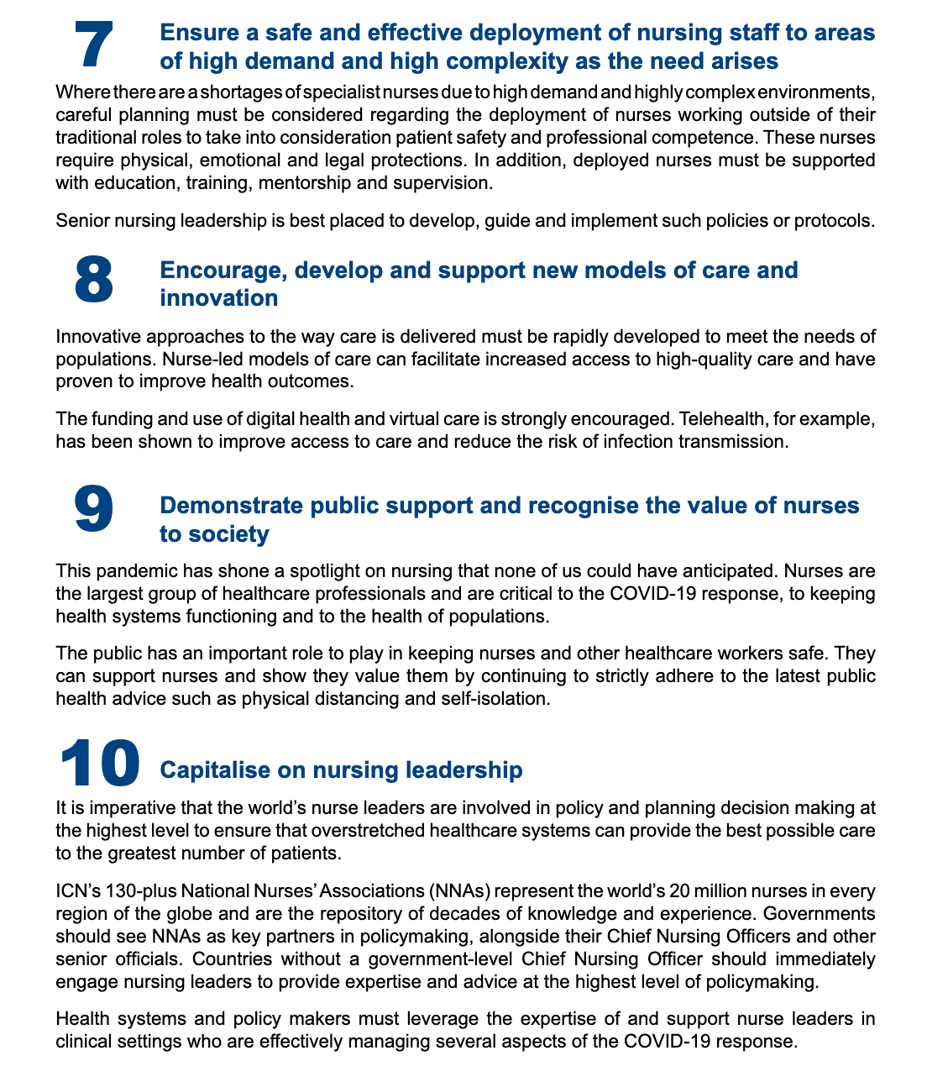
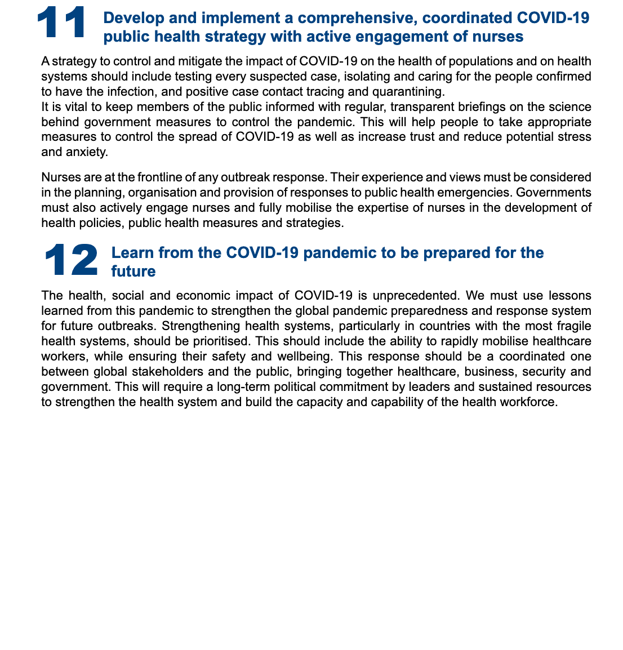
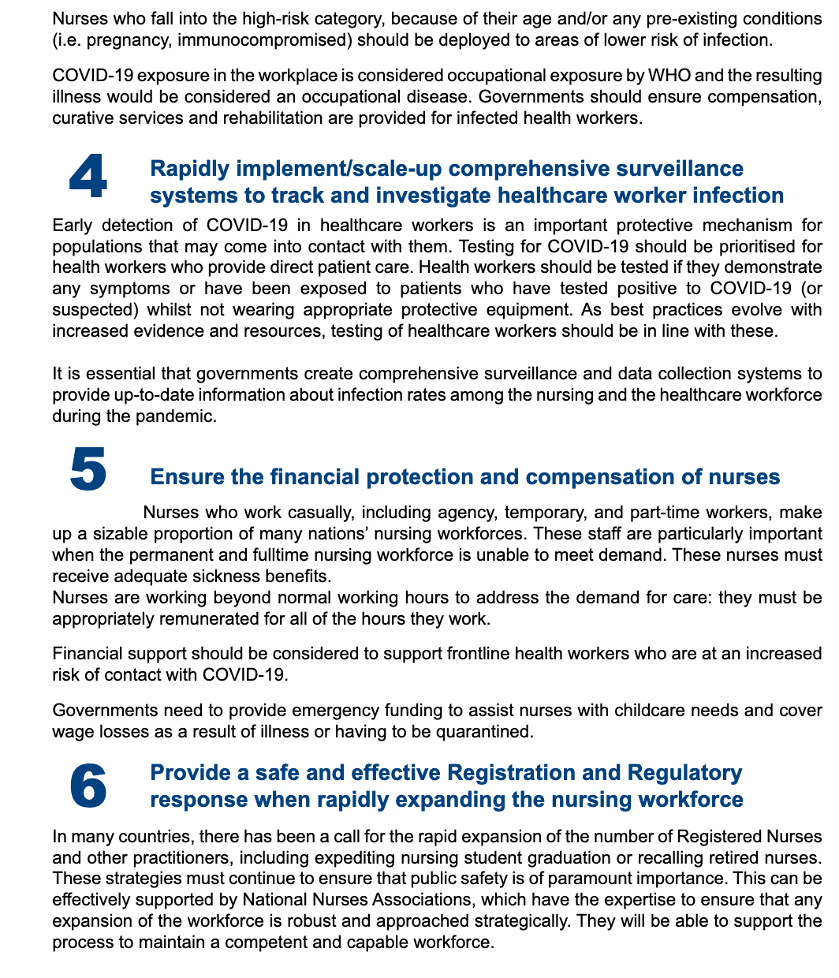
COVID-19 ICN Call to Action
Data, essential for success!

Slide 5
Responding to the demand for nursing data
  Strengthened partnership between ICN and SNOMED International
  ICNP incorporated into SNOMED CT
  Principles
    ICN to retain ownership of ICNP – SNOMED International to retain ownership of SNOMED CT
    Content relevant to nurses not confined to ICNP
    ICN to continue to lead on ICNP development over time and its quality assurance through ICN governance processes
    SNOMED International to maintain and distribute
    Non-commercial agreement

Slide 6
Operationalising the agreement
  Reviewing and including new content in line with ICNP 2019
  Released as the ICNP reference set
  Free for use in SNOMED International member countries and licensed by ICN in non-member countries
  Sense checking by the international Nursing Clinical Reference Group at SNOMED International, working with ICN
  Timelines
    First release September 2021
    Annual release thereafter

Slide 7
Benefits of partnership
Increased nursing usage of agreed terminologies
  Enhanced reach of ICNP as an integrated part of a global healthcare terminology
  Reinforcing SNOMED CT support for nursing content
Enhanced quality for both ICNP and SNOMED CT
Avoiding duplication and delivering an integrated resource that supports implementation
More responsive to changes in practice
Making visible the nursing contribution to collaborative patient care

Slide 8
QUESTIONS & DISCUSSION

