Slide 1

SNOMED CT in
Genomics and Precision Medicine
Clinical Reference Group Seminar
13/01/2021
Year 2COVID19

Slide 2
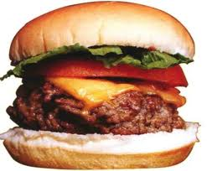



How do humans think and act?
31414400
16064300
230063004

Slide 3
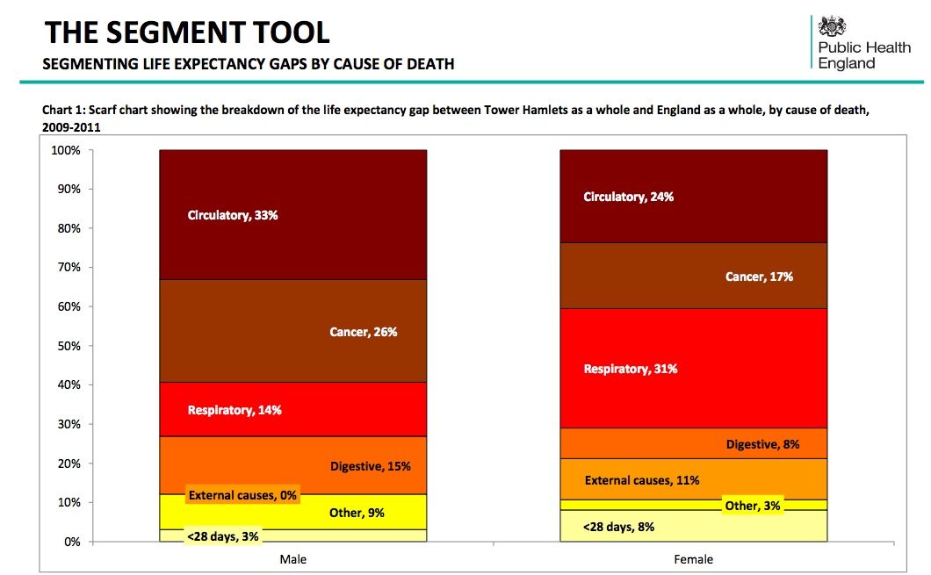

Slide 4
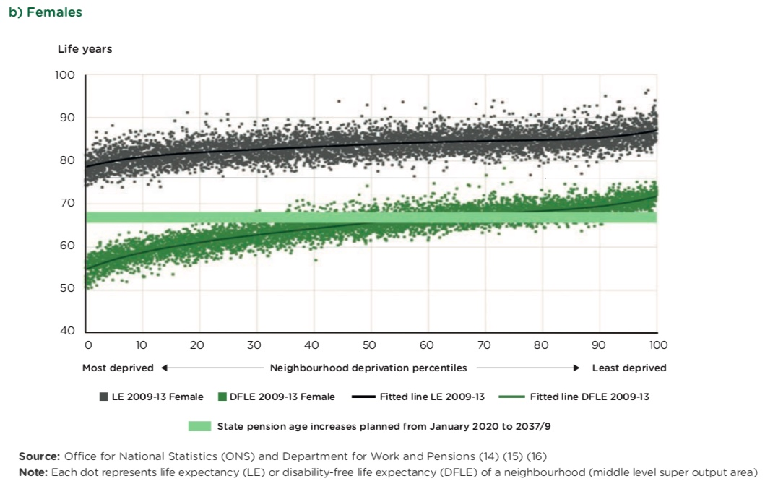

Slide 5
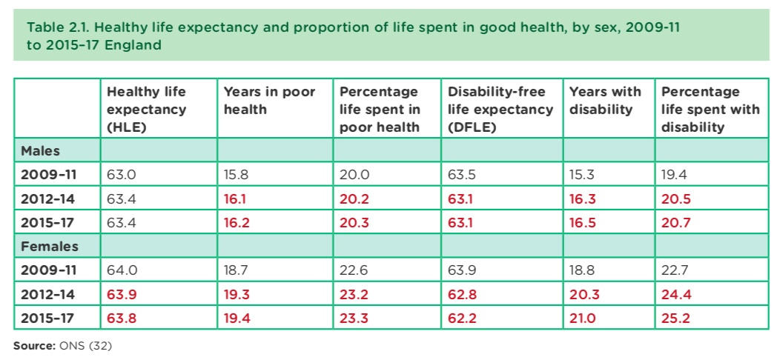

Slide 6


Slide 7
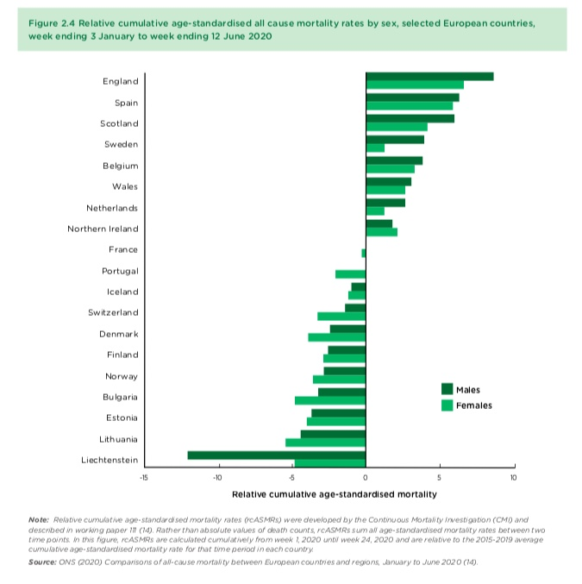

Slide 8
Wave 1 – Wave 2 inpatient demographics
Confirmed cases only, all hospital sites
Wave 1: Positive SARS-CoV-2 test before 01-09-2020
Wave 2: Positive SARS-CoV-2 test after 01-11-2020 (up to 11-01-2021)
 | Wave 1 | Wave 2
All inpatients, n patients | 2063 | 3384
All attending ICU*, n patients | 544 | 658
All deceased **, n patients | 560 | 467
* underestimate
** within 28days of positive SARS-CoV-2 test

Slide 9
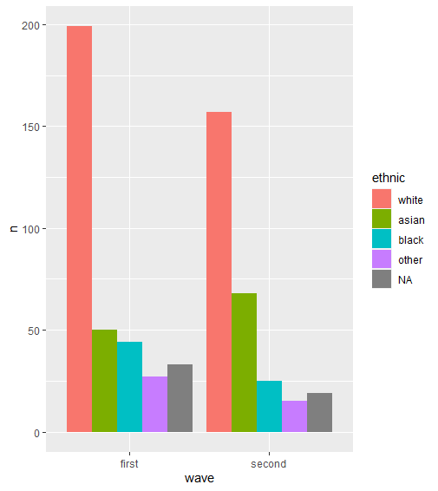
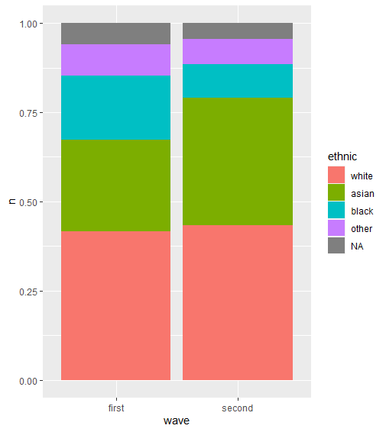
Mortality

Slide 10
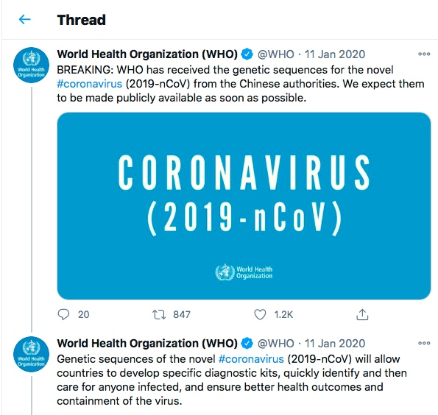

Slide 11
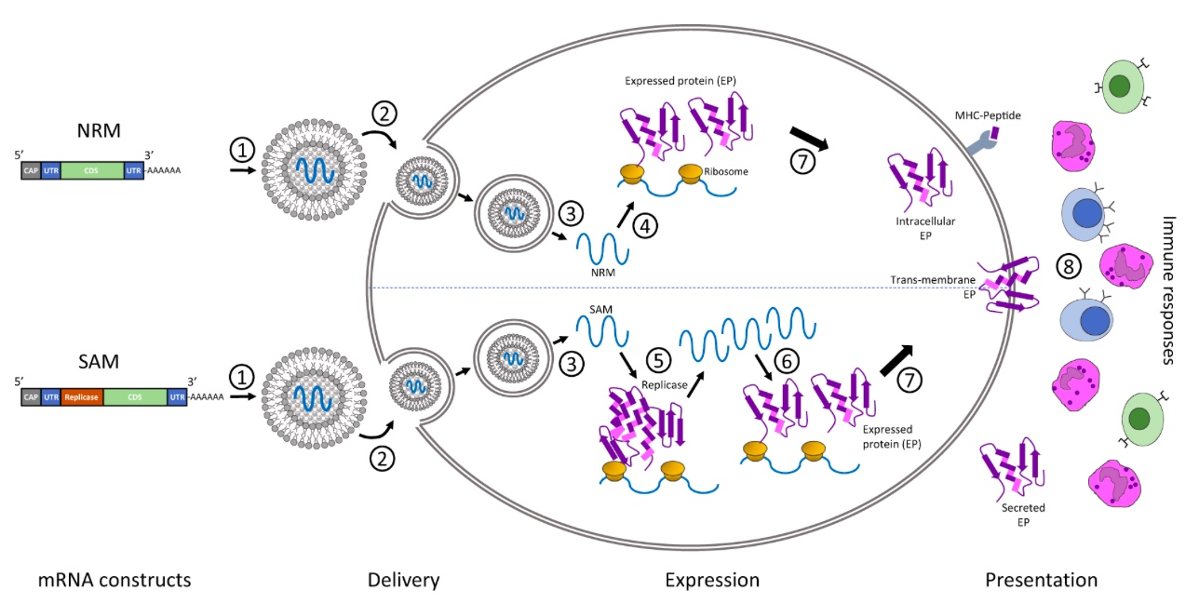

Slide 12
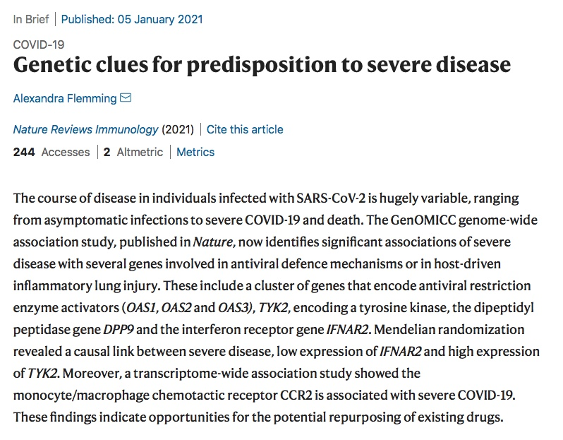
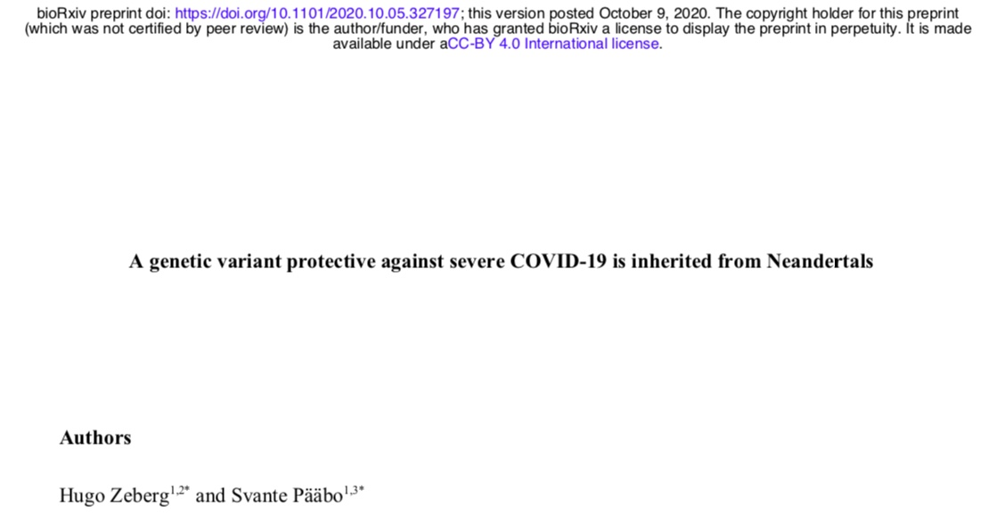
Loss of function genes and gene targets in severe COVID19 infections - GenomiCC

Slide 13
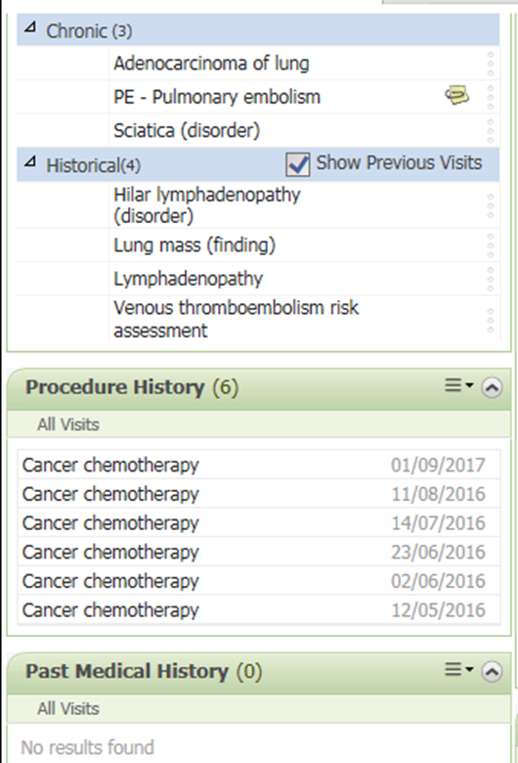
Point of care data for computation
Immediate access for care
Always on
Activity data recorded
Reports real time
Report flexibility
Clinically driven

Slide 14
Patient and Clinical utility
@gutteridgec
Precision Medicine
Drug
Disease
Gene
Protein Complex
Gene Product
Show me all the GENES with somatic mutations in BIOBANK samples with the SNOMED Clinical Term for LUNG CANCER and reference with PHARMA database to show me all COMPOUNDS known to modulate those GENES

Slide 15
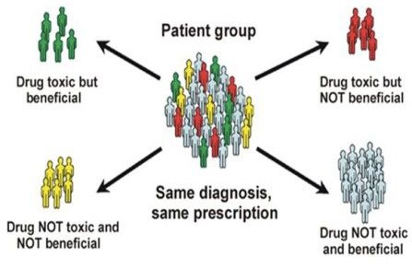
Drug effects and variation

Slide 16
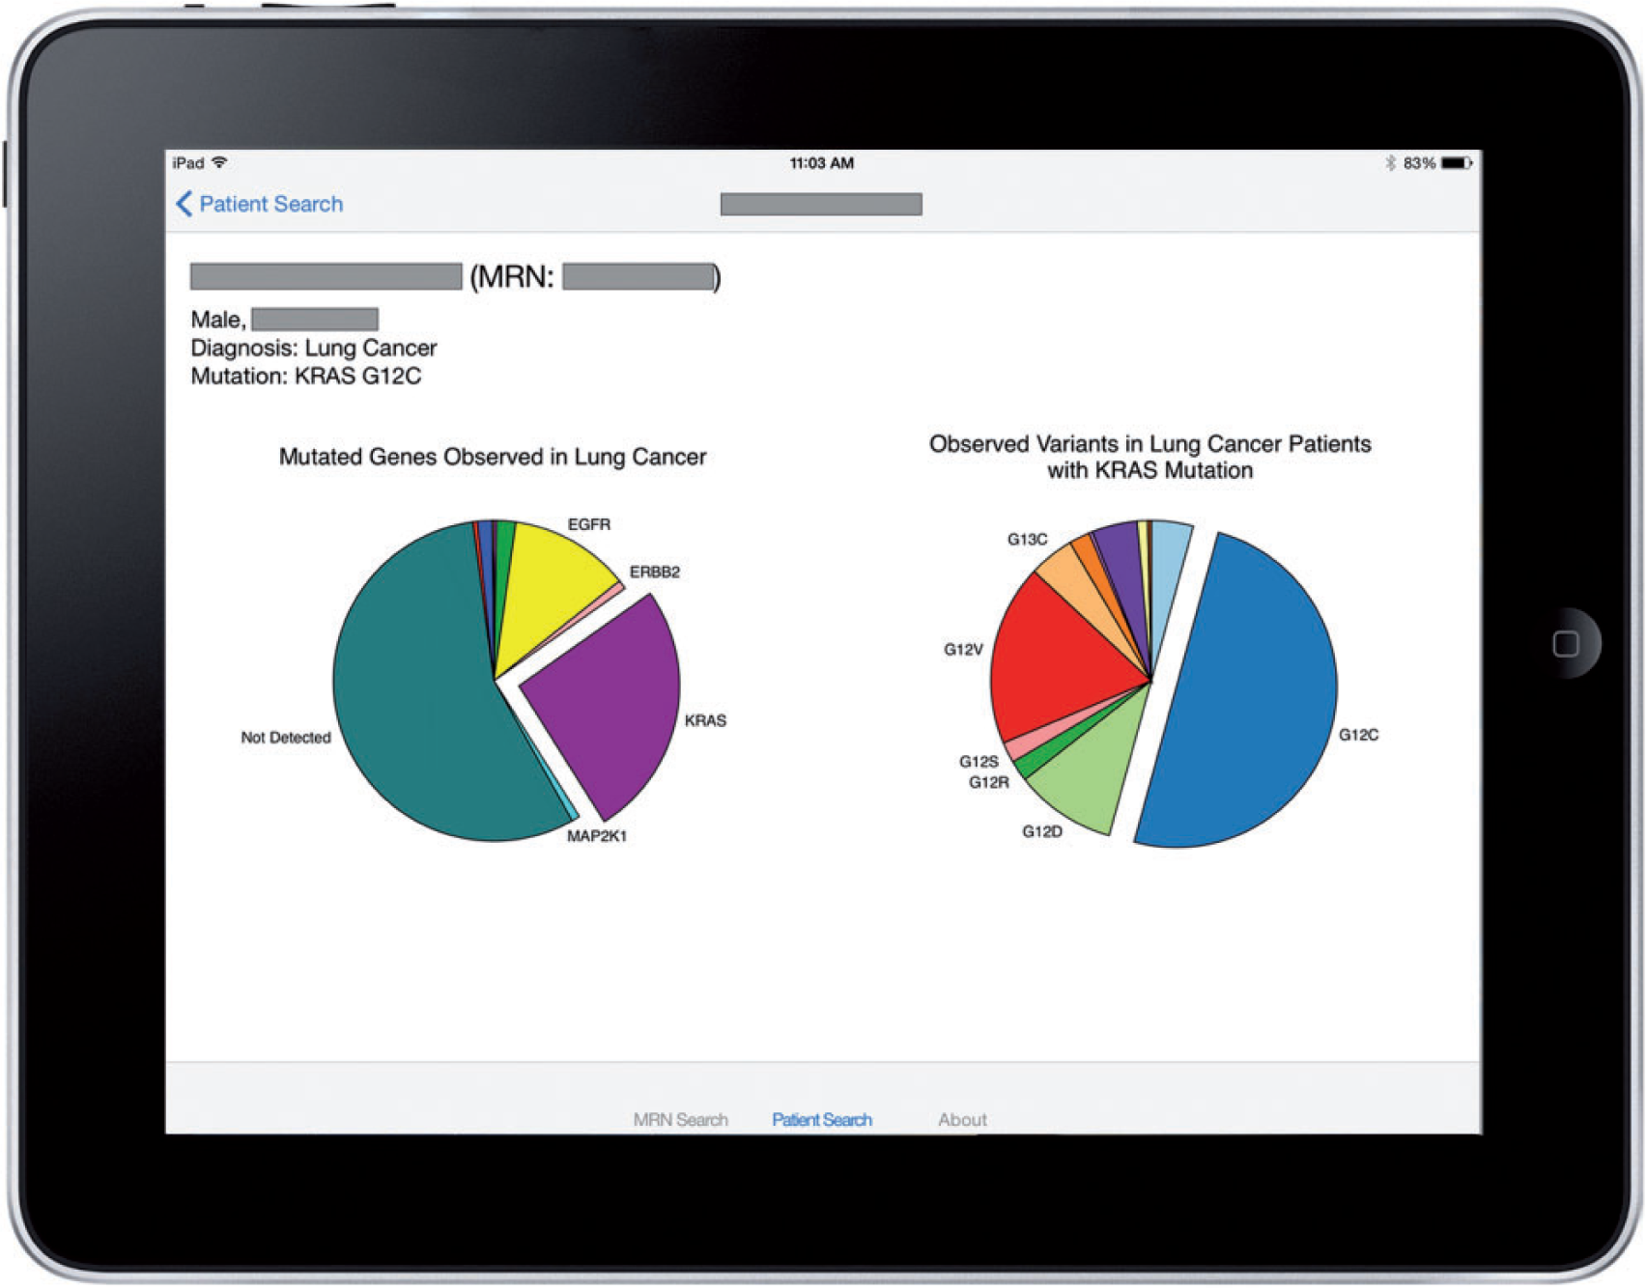

Figure 2: Example output of the SMART PCM app, showing a lung cancer patient with KRAS p.G12C mutation in the context ...
Notes:
Figure 2: Example output of the SMART PCM app, showing a lung cancer patient with KRAS p.G12C mutation in the context of other lung cancer patients tested at VUMC. Further information is available to the user through interaction with the pie charts, all pieces of which are activated by touch. On the left, a pie chart shows the population distribution of gene mutations. In this example, it is evident that slightly more than half the patients have no mutation detected, whereas KRAS is the most commonly mutated gene. On the right, the distribution of variants of the mutated gene is shown, where it is evident that p.G12C is the most common KRAS mutation. In a case where a patient has no mutation detected, the variant pie chart is suppressed. Patient details (name, age, gender) are redacted to preserve PHI.
Unless provided in the caption above, the following copyright applies to the content of this slide: © The Author 2016. Published by Oxford University Press on behalf of the American Medical Informatics Association. All rights reserved. For Permissions, please email: journals.permissions@oup.com

Slide 17

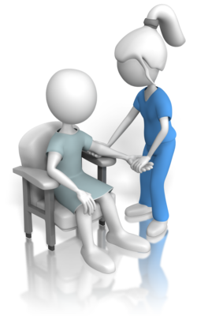
Precision medicine and clinical Phenotyping
Big Data Analytics
Epidemiology
Population Health Needs Assessment
Clinical Audit
Clinical Research
Large Clinical Trials
Gathering Evidence for Best Practice
Small Data Analytics
Patient Record Summary
Point of Care Reporting
Knowledge Linkage
Applying Best Practice
Guidelines
Adverse Reaction Reduction
Decision Support

Slide 18

Use of SNOMED for Interventional Radiology
Neurointerventions

Slide 19
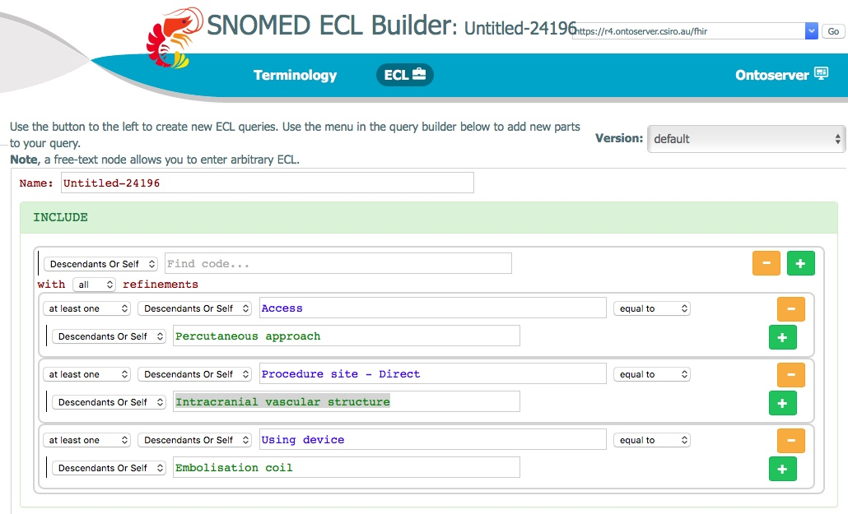

Slide 20
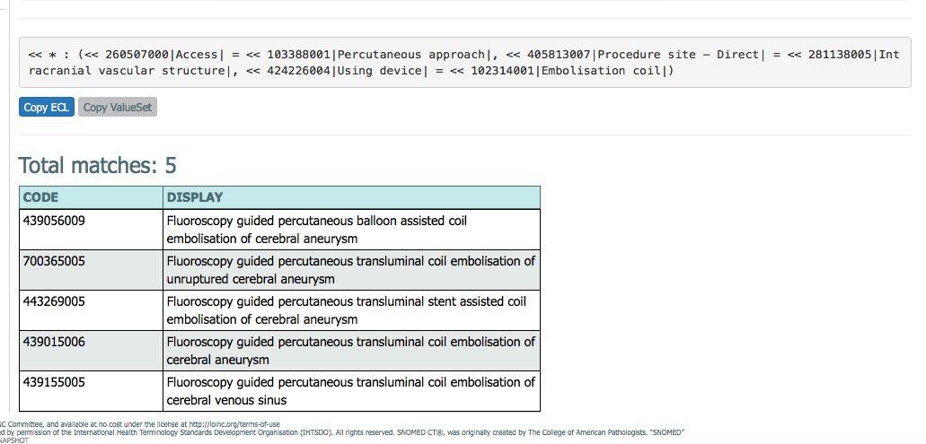
The ECL query finds the following SNOMED codes
The query starts with <<*
The matches are displayed

Slide 21
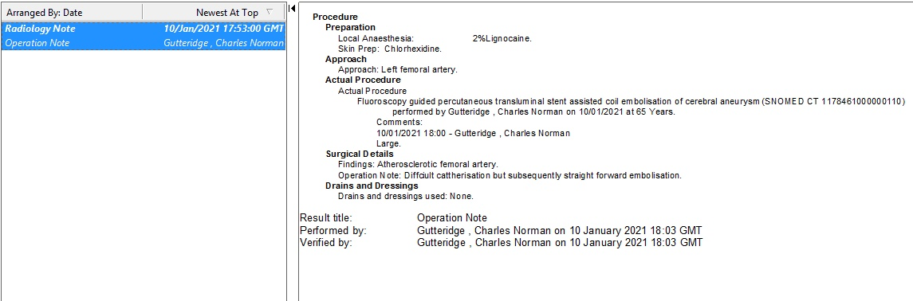
Operation note using structured data recorded and free text

Slide 22

Building the platform for Precision medicine
EHRs need to improve data recording interfaces
Health data is for patients, carers and families
Information connects people to their carers and providers
Single systems must be planned to connect
Interoperability matters
Connectedness needs security
Connectedness should be a health outcome measure

