Slide 1


SNOMED CT Drug Extension
User Support Group
Linda Bird, SNOMED International
Julie James, Blue Wave Informatics
Thursday 29th October 2020

Slide 2


During meetings please . . .
Mute your microphone when others are presenting
Be polite and respectful to all
Keep the conversation relevant
Be honest and open with your challenges and constructive with possible solutions
Don’t be afraid to ask questions – there are no stupid ones!
Meeting Rules

Slide 3

Welcome
Background
Introductions
Presentation
Discussion
Next steps
AGENDA
Notes:
Presentation – “This is what we’re doing, and these are the challenges and questions we have.

Slide 4

Drug Extension
User Support Group
Objectives
To provide implementers of the SNOMED CT drug extension model with a forum through which they can share their real world experiences, challenges and questions, with other stakeholders and SNOMED International
http://snomed.org/deusg
Notes:
And to provide SNOMED International with a forum through which we can better understand how to assist implementers of the SNOMED CT drug extension model.

Slide 5
Drug Extension
User Support Group
What does implementation look like?
Creating a SNOMED CT drug extension
Mapping an existing drug dictionary to the SNOMED CT drug model for interoperability
Integrating a SNOMED CT drug extension with other drug standards, such as ISO’s IDMP
Utilising the SNOMED CT drug model to implement clinical decision support (CDS)
http://snomed.org/deusg

Slide 6
Drug Extension
User Support Group
Goals
To enable the successful implementation of national SNOMED CT drug extensions, that meet the requirements of both national use and cross-border data sharing
To enable the successful interoperability between national SNOMED CT drug extensions and other medicinal product standards required for national or cross-border data sharing
http://snomed.org/deusg

Slide 7
Drug Extension
User Support Group
Membership
Open to any stakeholder who is actively using, planning to use, or interested in using the SNOMED CT drug extension model
Meetings
Initially held every two weeks
May be adjusted to meet the needs of the group
http://snomed.org/deusg

Slide 8
Please introduce yourself …
Name, organization and role
Are you implementing (or planning to implement) the SNOMED drug model?
Why are you interested in participating in this group?
Introductions
Notes:
3. Reason for participating

Slide 9
Relevant Documentation
SNOMED CT Model Specifications
SNOMED CT drug model for supporting national extensions
SNOMED CT medicinal product model specification
SNOMED CT Editorial Guidelines
Medicinal product hierarchy
Pharmaceutical dose form hierarchy
Roles
Other Relevant Sites
Drugs project confluence space
ISO TC215 WG6 IDMP
UNICOM project
http://snomed.org/deusg
Notes:
National drug extension model
International drug model

Slide 10
SNOMED International Drug Model
Pharmaceutical / biologic product
Medicinal product
[[ Medicinal product
category ]]
Medicinal Product
(MP)
Medicinal Product Only (MP-O)
Medicinal Product Precise Only (MP-OP)
Medicinal Product Form
(MPF)
Medicinal Product Form Only (MPF-O)
Clinical Drug
(CD-OP)
Notes:
Medicinal product categorized by disposition
Medicinal product categorized by structure
Medicinal product categorized by therapeutic role

Slide 11
SNOMED International Drug Example
Pharmaceutical / biologic product
Medicinal product
[[ Medicinal product
category ]]
MP
Amoxicillin-containing product
MP-O
Amoxicillin only product
MPF
Amoxicillin-containing product in oral dose form
MPF-O
Amoxicillin only product in
oral dose form
CD-OP
Amoxicillin (as amoxicillin trihydrate) 250 mg oral capsule
Notes:
Aminopenicillin-containing product
Broad spectrum penicillin-containing product
Penicillin antibiotic product
Beta-lactam antibiotic
Product containing beta-latam Product containing anti-infective Medicinal product categorized by disposition
Product containing nitrogen and nitrogen compound
Medicinal product categorized by structure

Slide 12
SNOMED International Drug Attributes
MP
Has active ingredient
Plays role
(non-defining)
MP-O
Count of base of active ingredient
MP-OP
Has precise active ingredient
Count of active ingredient
Count of base and modification pair
MPF
Has manufactured dose form
MPF-O
Has manufactured dose form
CD-OP
Has unit of presentation
Has basis of strength substance
Has presentation strength numerator value / unit
Has presentation strength denominator value / unit
Has concentration strength
numerator value / unit
Has concentration strength
denominator value / unit

Slide 13
SNOMED National Drug Extension Model
Pharmaceutical / biologic product
Medicinal product
[[ Medicinal product
category ]]
Medicinal Product
(MP)
Medicinal Product Only (MP-O)
Medicinal Product Precise Only (MP-OP)
Real Medicinal Product
(RMP-OP)
Medicinal Product Form
(MPF)
Medicinal Product Form Only (MPF-O)
Clinical Drug
(CD-OP)
Real Clinical Drug
(RCD-OP)
Packaged Clinical Drug
(PCD-OP)
Real Packaged Clinical Drug
(RPCD-OP)
Notes:
Medicinal product categorized by disposition
Medicinal product categorized by structure
Medicinal product categorized by therapeutic role

Slide 14
SNOMED National Drug Extension Model
Pharmaceutical / biologic product
Medicinal product
[[ Medicinal product
category ]]
MP
Amoxicillin-containing product
MP-O
Amoxicillin only product
MP-OP
Amoxicillin trihydrate only product
RMP-OP
AMOXIL GSK [Amoxicillin trihydrate]
MPF Amoxicillin-containing product in oral dose form
MPF-O
Amoxicillin only product in oral dose form
CD-OP
Amoxicillin (as amoxicillin trihydrate) 250 mg oral capsule
RMP-OP
AMOXIL GSK [Amoxicillin (as trihydrate) 250 mg oral capsule]
PCD-OP Amoxicillin (as trihydrate) 250 mg oral capsule, 28 capsules
RPCD-OP
AMOXIL GSK [Amoxicillin (as trihydrate) 250 mg oral capsule], 28 capsules

Slide 15
SNOMED National Drug Extension Attributes
RMP-OP
Has product name
Has supplier
RCD-OP
Has unit of presentation
PCD-OP
Contains clinical drug
Count of clinical drug type
Has pack size
Has pack size unit
RPCD-OP

Slide 16

The “this is what we’re doing and these are the challenges and questions we have”
presentation
Jerry O’Sullivan
Irish Pharmacy Union

Slide 17


SNOMED Drug Extension User Support Group
Irish Pharmacy Union Presentation
Speaker, on behalf of the IPU: Jerry O’Sullivan
29-Oct-2020

Slide 18

Overview
Product File, VMPs and SNOMED Project
  Background – the IPU and its Product File
  The “VMP Project”
    Rationale, process, results
  The “SNOMED Mapping Project”
    Rationale
    Process
    Results

Slide 19
Background
The Irish Pharmacy Union (IPU)
  Representative organisation for community pharmacists in Ireland
  Has 2,200 members working in over 1,800 pharmacies
  Maintains a medicinal product database as a service to their members
    Originally as a paper price list
    Then as a GS1 (formerly EAN) standards based set of product identifiers and descriptions
      Used in dispensing systems and
      For product ordering (supply chain)
      Also contains some supporting professional information (e.g. labelling warning and counselling information)

Slide 20
Background
The Irish Pharmacy Union Vision
  “to be the authoritative voice of community pharmacy and a driving force in the evolution of accessible, equitable and patient-focused primary healthcare”

Slide 21
Background
National Health Product Catalogue
  The National Health Products Catalogue (NHPC) was launched by the IPU this month.
  This is one of the key priorities in the National eHealth Strategy for Ireland (Department of Health, 2013)
  The NHPC meet the requirements of the Data model for a national electronic medicinal product reference catalogue published by HIQA on 5 January 2015

Slide 22
Background
National Health Product Catalogue
  The NHPC is maintained by a dedicated team of specialists including pharmacists and has ISO 9001 and ISO 27001 accreditation
  Medicinal Product database (the “IPU Product File” (IPU PF)) is distributed under licence to
        Pharmacists
        Hospitals
        Various Government Services
        System Vendors
  For more information see www.nhpc.ie

Slide 23
Enhancing the NHPC: Why?
  In 2009 the Irish Government announced plans to introduce Generic Substitution and Reference Pricing to help reduce the state’s spend on medicines
  This meant substantial changes for everyone involved in using medicines healthcare
  Initial analysis showed a requirement for a concept similar to the UK NHS dm+d’s “VMP” so….

Slide 24
IPU PF VMP Project : What
  The IPU embarked on a “VMP Project” to ensure that the IPU PF could support
    The legislation for Generic Substitution and Reference Pricing
    Generic prescribing of medicines (interface use)
  The IPU liaised closely with all system vendors and developers that implement the NHPC to keep them up to date on the proposed changes and improvements

Slide 25
IPU PF VMP Project : How
  Developed the data model and editorial guidelines
  Undertook a HUGE data cleaning exercise on the existing IPU PF content to get it ready for creation of VMPs
  Iterative development
    IT personnel developed database scripts and queries
    Editorial staff reviewed these
    Scripts and data were updated

Slide 26
IPU PF VMP Project : Result
Success!
  Large number of actual medicinal products in the Product File being linked to a generated VMP
  Not linked (and not required to be linked to a VMP)
    Multi-ingredient products with more than 3 active ingredient substances
    Medical devices
    Sundries etc.

Slide 27
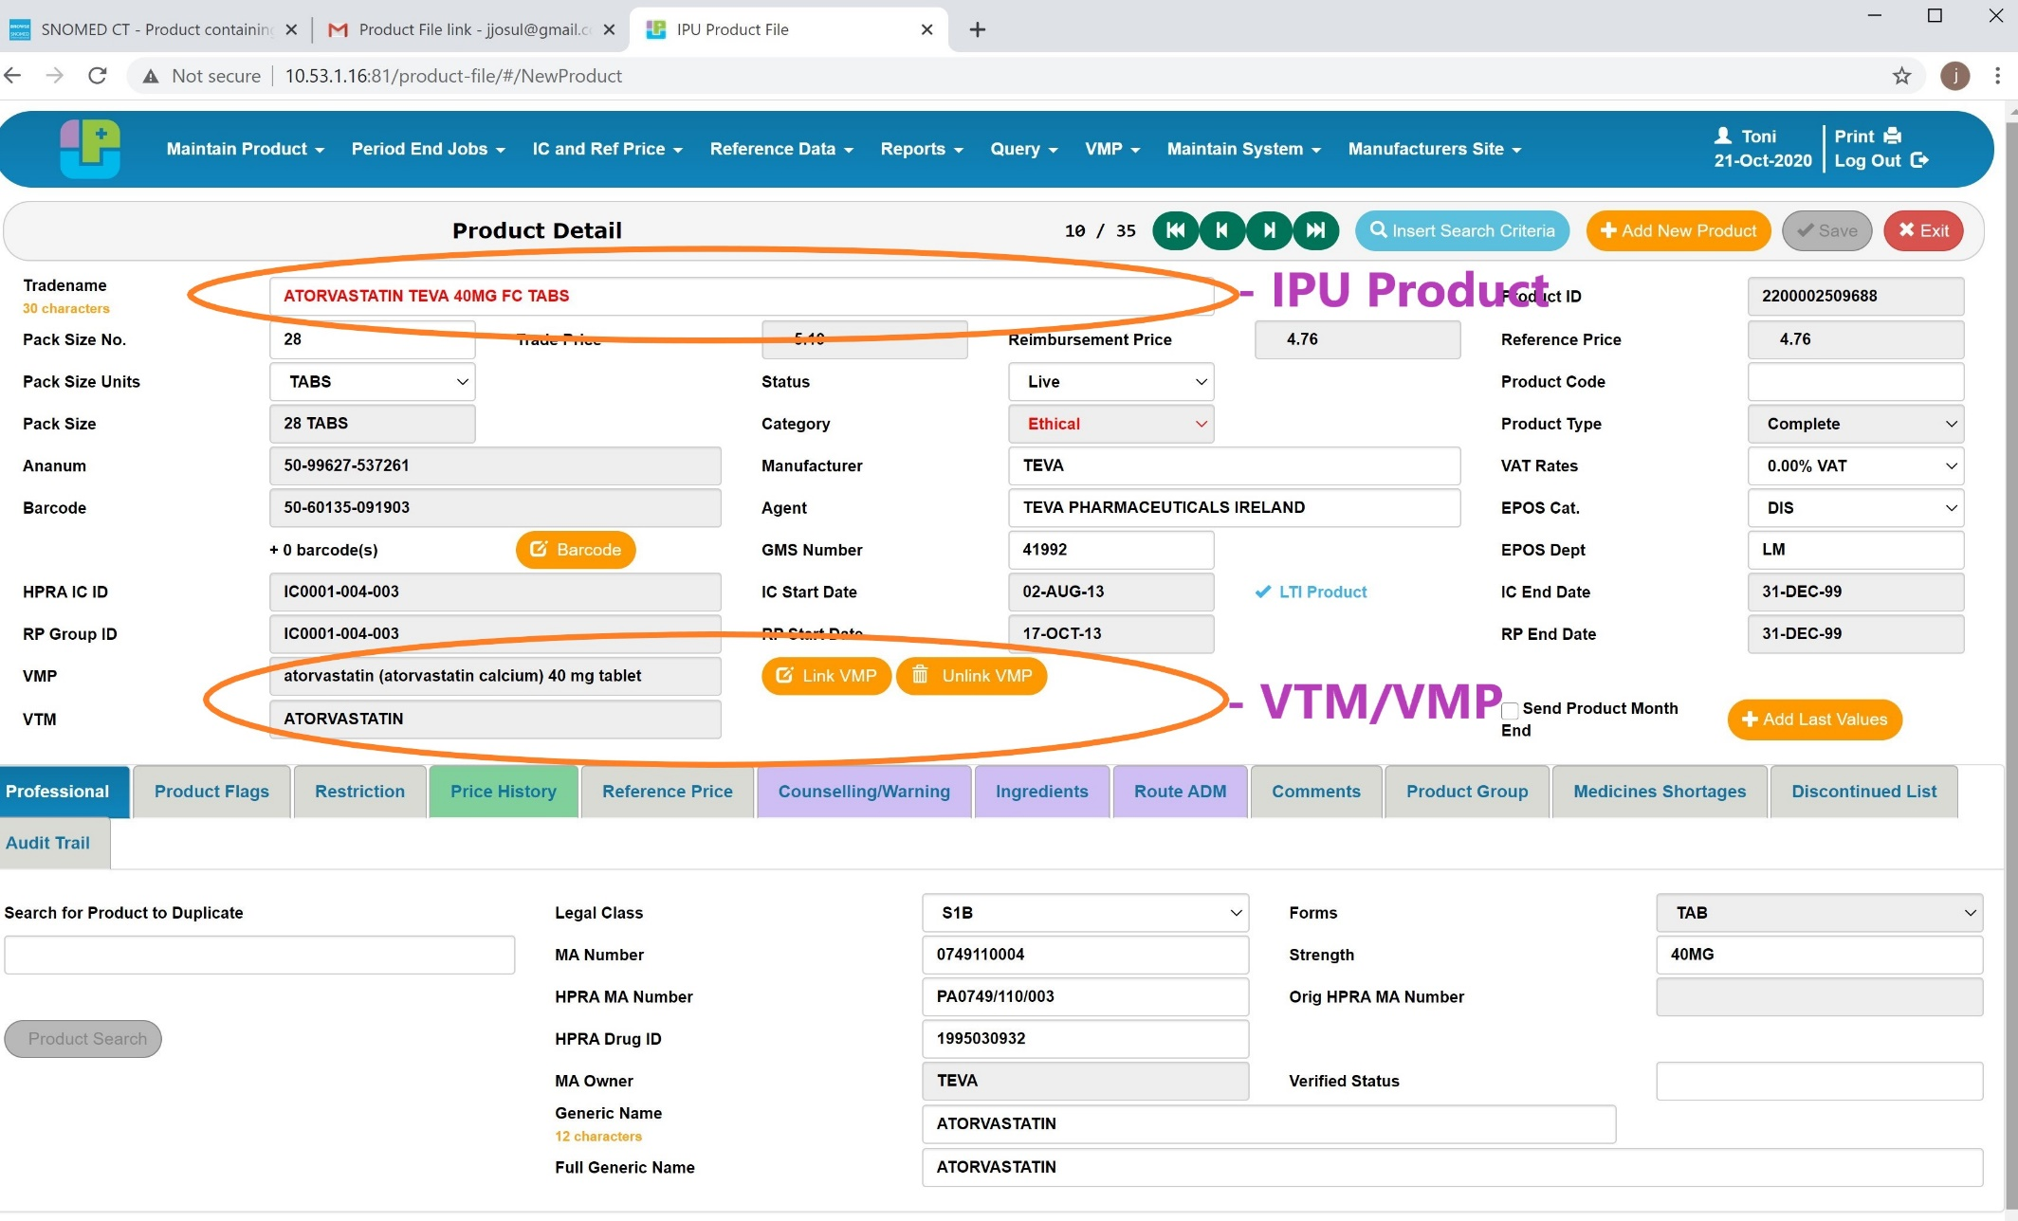
IPU Product File Screen : VTM/VMP

Slide 28
SNOMED CT Mapping Project : Why?
  News that the Irish Government was about to purchase a SNOMED CT licence triggered the setup of the IPU’s SNOMED CT Mapping Project (2016)
  Preparation phase of this project involved extensive research of SNOMED Preparation for SNOMED
    What it is
    What it is it for
    Who uses it
    How it handles pharmaceutical products
    SNOMED’s extensive guidelines for the implementation of SNOMED CT

Slide 29
SNOMED CT Mapping Project : IPU Involvement
  IPU has established a close working relationship with the Irish SNOMED National Release Centre (NRC)
  and in particular with
  Theresa Barry, Irish NRC manager within the HSE in the Office of the Chief Information Officer
  IPU subsequently applied for and received an affiliate licence for SNOMED CT
  With the support of the Irish NRC Manager, the IPU is trying to map its data to SNOMED

Slide 30
SNOMED CT Mapping Project : What?
  Quickly became clear that the IPU’s VMP equates broadly speaking to SNOMED’s Clinical Drug concept
  Therefore, the project was able to piggy-back on all the work done on VMPs (particularly the data cleaning). VMPs are described using
    Precise active ingredient substance(s)
    Basis of strength substance(s) with their strength as a ratio of value + unit of measure
    Standard dose form concepts (EDQM-based)
    Usual route of administration

Slide 31
SNOMED CT Mapping Project : How?
  IT team loaded the SNOMED data into the IPU’s Oracle database
    Updating each international release, including the most recent SNOMED data set from July-2020
  A set of scripts was developed to try to map the IPU VMPs to a SNOMED Concept Id using
    An IPU-EDQM dose form to SNOMED dose form map
    An IPU-substance to SNOMED substance map (text match)
  This was an iterative process and all results were scrutinised extensively by the NHPC team

Slide 32

SNOMED CT Mapping Project : Result?
  Despite our best efforts our matching success rate is only about 36%
    And less for multi-ingredient products
  BUT:
  For Ingredient Substances the match rate is over 95%.
The remainder of this presentation will deal mainly with issues the IPU encounters when trying to map its data to SNOMED

Slide 33
SNOMED Mapping Issue Categories
  I VMP not in SNOMED
  II VMP – Not in July-2020 Release
  III Dose Form Mismatch
  IV BOSS/Precise Active Ingredient Substance Mismatch
  V Different Strength Description Conventions
  VI Inconsistent Strength Descriptions
  Finishing with some interesting statistics

Slide 34
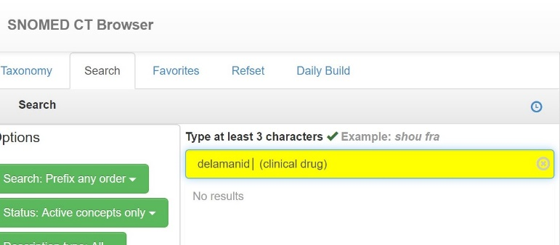
IPU VMP not present as SNOMED Clinical Drug (I)
  VMP: alendronic acid (alendronate sodium trihydrate) 70 mg tablet
  NO Exact SNOMED match BUT
  Is this a SNOMED ‘hydrate’ issue?
  VMP: delamanid 50 mg tablet
  Not in SNOMED:

Slide 35
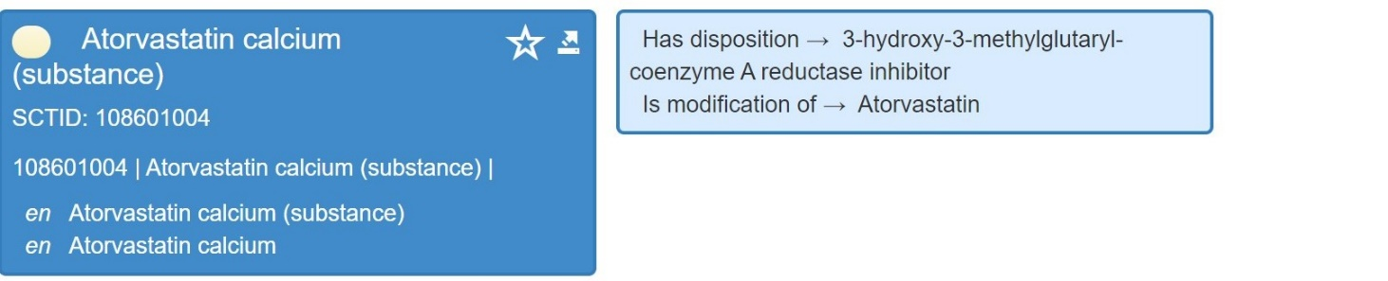
IPU VMP not present as SNOMED Clinical Drug (I continued)
  ATORVAS 10MG FC TABS ATORVASTATIN
  IPU PF VMPs = atorvastatin (atorvastatin calcium) 10 mg tablet
  We DON’T have an exact SNOMED match BUT
  exists in SNOMED as a Substance

Slide 36
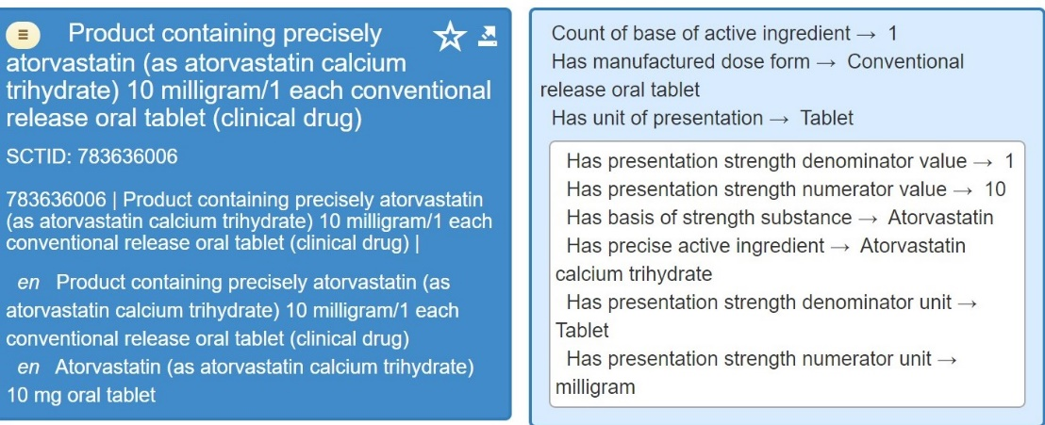
IPU VMP not present as SNOMED Clinical Drug (I continued.)
  ATORVAS 10MG FC TABS ATORVASTATIN
  IPU PF VMPs = atorvastatin (atorvastatin calcium) 10 mg tablet
  This SNOMED record exists:
  So we can see that there are ‘hydrate’ type Clinical Drug records in SNOMED

Slide 37
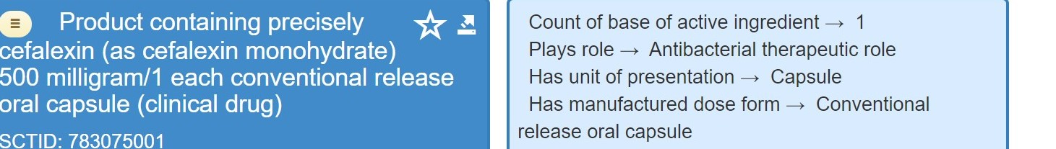
IPU VMP not present as SNOMED Clinical Drug (I continued.)
  The Last Hydrate example:
  VMP: cefalexin (cefalexin monohydrate) 500 mg tablet
  Only exists in SNOMED as:
  783072003 | Product containing precisely cefalexin 500 milligram/1 each conventional release oral tablet (clinical drug) |
  These are NOT the same BUT the ‘capsule’ exists
  VMP: cefalexin (cefalexin monohydrate) 500 mg capsule

Slide 38
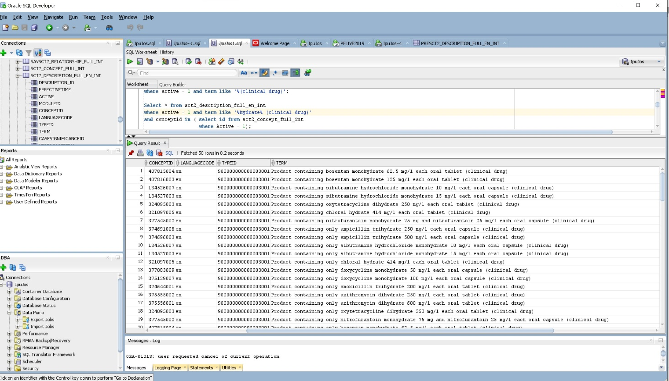
IPU VMP not present as SNOMED Clinical Drug (I continued.)
  The SNOMED July-2020 release contains 158 ‘hydrate’ type records – here’s some example:
  So what’s the issue with mapping Hydrates?

Slide 39
Exists in SNOMED but NOT in July-2020 release (II)
  VMP: agomelatine 25 mg tablet
  SNOMED: 895385006 | Product containing precisely agomelatine 25 milligram/1 each conventional release oral tablet (clinical drug)
  Most seem to be New Concepts in SNOMED so we expect to see these in the Jan-2021 release
  But it’s a long time to wait…
  If a Covid-19 Tablet became available today:
  IPU: Details available via Web Services tonight – would also be included in this Month-End circulation.
  SNOMED: Would have to wait until July-2021 for its Concept Id in SNOMED
  Clearly this is NOT good…

Slide 40
Exists in SNOMED but NOT in July-2020 release (II)
  VMP: agomelatine 25 mg tablet
  SNOMED: 895385006 | Product containing precisely agomelatine 25 milligram/1 each conventional release oral tablet (clinical drug)
  Most seem to be New Concepts in SNOMED so we expect to see these in the Jan-2021 release
  But it’s a long time to wait…
  If a Covid-19 Tablet became available today:
  IPU: Details available via Web Services tonight – would also be included in this Month-End circulation.
  SNOMED: Would have to wait until July-2021 for its Concept Id in SNOMED
  Clearly this is NOT good…

Slide 41
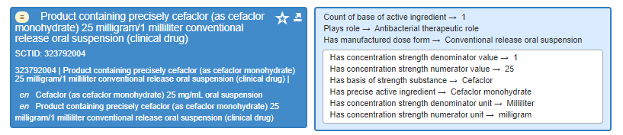
Dose Form Mismatch (III)
  IPU PF VMP = Cefaclor (cefaclor monohydrate) 125 mg / 5 mL granules for oral suspension
  Granules versus oral suspension
  IPU’s Dose Form IS mapped to correct concept: 385029002 Granules for conventional release oral suspension (dose form)
  In July-2020 Release there are 23 SNOMED records of type
  “granules for conventional release oral suspension (clinical drug)”

Slide 42
IPU VMP SNOMED Ingredient/BOSS Issues (IV)
  Ingredient/Basis of Strength Substance differences:
  VMP: rilpivirine (rilpivirine hydrochloride) 25 mg tablet
  Nearest SNOMED:
  VMP: metoclopramide (metoclopramide hydrochloride) 10 mg tablet
  Nearest SNOMED:
  These are NOT the same so what’s the fix?
Notes:
This is the issue that really annoys me. As you can see from the examples, there are differences between the representation of the VMP record compared to SNOMED. And the question has to be asked – Are these the same?
What’s the fix?

Slide 43
IPU VMP/SNOMED Ingredient/BOSS Issues (IV continued)
  IPU Routine Product Checks:
  Drug Manufacturer’s SPC
  Health Products Regulatory Authority (HPRA)
  Medicines Complete and other reputable sources
  In the previous examples the IPU is satisfied their data is correct
  The issues are either:
      The IPU data is correct
      The SNOMED data is correct
      Both sets of data are correct

Slide 44
IPU VMP/SNOMED Ingredient/BOSS Issues (IV continued)
  The IPU data is correct:
  SNOMED needs to change its data
  The SNOMED data is correct:
  IPU needs to change its data
  Both sets of data are correct
  SNOMED needs to contain two different concepts
  There is no other way to fix these issues. And I don’t see any efficient mechanism to address this problem.

Slide 45
Strength Conversion Issues (V)
  Where a Denominator Unit <> 1 SNOMED will convert to express the strength per unit
  <numer value> <numer unit> / 1 <denom unit>
  But the conversions are NOT consistent
  Sometimes values are rounded to and integer
  Other times values are rounded to a number of decimal places

Slide 46
Strength Conversion Issues (V continued)
  Round to Integer:
  VMP: anakinra 100 mg/0.67 ml solution for injection
  (100 / 0.67 = 149.2537)
  SNOMED:
  Round to Decimal:
  VMP: estradiol (estradiol hemihydrate) 75 mcg/24 hour transdermal patch
  (75 / 24 = 3.125)
  SNOMED:

Slide 47
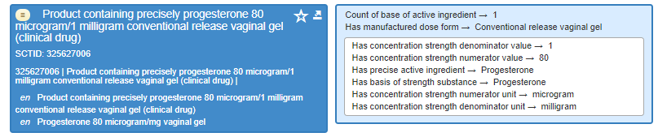
Different Strength Description Conventions (VI)
  IPU PF VMP = progesterone 8 % vaginal gel
  SNOMED CT has 80 mcg per 1 mg as per Editorial Guidelines

Slide 48
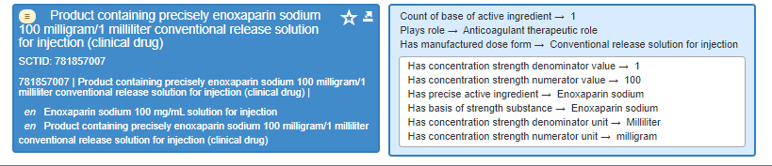
Different Strength Description Conventions (VIII)
  IPU PF VMP = enoxaparin sodium 20 mg/0.2 ml solution for injection
  SNOMED CT has a unitary strength (100 mg per 1 mL) as per Editorial Guidelines

Slide 49
5 VMPs – 1 Clinical Drug in the international release:
  Examples:
  IPU VMP: enoxaparin sodium 20 mg/0.2 ml solution for injection
  IPU VMP: enoxaparin sodium 40 mg/0.4 ml solution for injection
  IPU VMP: enoxaparin sodium 60 mg/0.6 ml solution for injection
  IPU VMP: enoxaparin sodium 80 mg/0.8 ml solution for injection
  IPU VMP: enoxaparin sodium 100 mg/1 ml solution for injection
  SNOMED: 781857007 – Strength defined as 100 milligram/1 milliliter

Slide 50
SNOMED Clinical Drug records
  Question: How many ACTIVE Clinical Drug records are there in SNOMED?
  Answer:
  July-2019 7052
  July-2020 7155
  Difference 103
  Irish NRC Submissions account for over 26% of these
  Another Question: How long will it take to match IPU VMPs not in SNOMED?
  Answer: 38 Years (based on current input trends)
  Clearly there’s a problem that needs a Solution!

Slide 51
SNOMED Clinical Drug records
  Question: How many ACTIVE Clinical Drug records are there in SNOMED?
  Answer:
  July-2019 7052
  July-2020 7155
  Difference 103
  Irish NRC Submissions account for over 26% of these
  Another Question: How long will it take to match IPU VMPs not in SNOMED?
  Answer: 25 Years (based on current input trends)
  Clearly there’s a problem that needs a Solution!

Slide 52
SNOMED Medication User Group
Irish Pharmacy Union Presentation
That concludes this presentation.
I hope it has illustrated some of the issues us data integrators are having and that we can start a conversation NOW on how to fix these issues
Thank you
  Questions?

Slide 53
Discussion and
Questions

Slide 54

Volunteers to present
Next meeting:
Thursday 12th November 2020 at 11:00 UTC
NEXT STEPS
54

Slide 55


THANK YOU
SNOMED International: Delivering SNOMED CT

