Slide 1


Traditional Medicine Expert Working Group
14/10/2020
Yongsheng Gao

Slide 2

Scope
Background
Approach
Way of working
Overview

Slide 3
Project Scope
Step 2
Address requests from member countries, e.g. Malaysia
Start Project
End Project
Step 1
Final Step
Design top-level categorical structures
Identify and plan for future TM content development
Notes:
The proposed project supports the following strategic directions from the 2020-2025 strategy:
Identify and address gaps in SNOMED CT based on the value proposition and stakeholder requirements
Develop a terminology integration framework to evaluate existing collaborations and identify new ones
ICD-11 - working with Member stakeholders, to develop a strategy to address the SNOMED CT/ICD-11 journey
An increase in the adoption and consumption of SNOMED CT

Slide 4
Limited TM content coverage in SNOMED CT
Acupuncture
points
Herbs & Substance
Regime procedure
Physical objects
500
85
10
10
39,458
22,502/26,853
58,290
15,725
https://browser.ihtsdotools.org/qa/#/descriptive-statistics

Slide 5
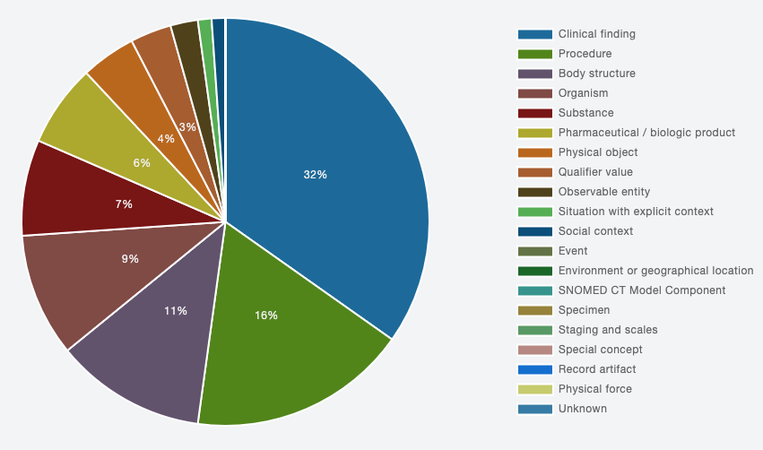

Slide 6
Requirements for TM
Disorder and patterns – ICD11
WHO-Standard Terminologies
Malaysia requests
Others
500
4,000
200
>100,000
Alignment with the WHO classification
Support clinical practice, research, healthcare policies
SI Member requests
Procedures, Herbs, and Substances

Slide 7
Core module
Community content
Extension module
Genomics
module
Traditional Medicine
module
Extension module
Extension module
Extension module
Extension module

Slide 8
Zoom meetings:
Frequency of meetings
Date/time of meetings
Confluence page:
Documentations
References
JIRA tickets
Tracking progress of tasks
TM Expert Working Group
https://confluence.ihtsdotools.org/display/IAP/Tradition+Medicine+Pilot+Project

Slide 9


Questions?
SNOMED International: Delivering SNOMED CT

Slide 10

THANK YOU
SNOMED International: Delivering SNOMED CT

