Slide 1
Clinical session
Wednesday, 7th, October 2020
Ian Green
Clinical Engagement Business Manager & Customer Relations Lead, Europe

Slide 2
Mark Jurkovitch,
Chair, SNOMED International Dentistry Clinical Reference Group
“
“Clinicians are frequently the first to hear, see and identify patient conditions and findings that need documentation. Further, clinicians are in a unique position to see correlations between the items that need documentation. Being able to contribute to terms, definitions, and the valuable relationships available within SNOMED CT improves usability. Working with the entire design team for an EHR allows for better presentation, and proper representation that may significantly contribute to timeliness, efficiency, and, most important, improved care outcomes”.
Mark Jurkovitch, Chair, SNOMED International Dentistry Clinical Reference Group
”

Slide 3
Agenda
(first session)
“
13:00 – 13:05 | Welcome/introductions | Ian Green
13:05 – 13:10 | Agenda (structure of the day) | Ian Green
13:10 – 13:50 | Keynote - “Starting from scratch with SNOMED in EHR implementation. Experience in a Global Digital Exemplar” | Dermot O’Riordan
13:50 – 14:05 | Clinical engagement strategy (high-level overview) Review of current SNOMED International clinical engagement strategy | Ian Green
14:05 – 14:15 | Clinical reference groups (CRGs) and project groups Overview, approach and current status | Jane Millar
14:15 – 14:25 | Clinical community Clinical portal Clinical webinars | Ian Green
14:25 – 14:35 | Clinical analytics Why is clinical analytics important? Clinical analytics demonstrator | Charles Gutteridge/Peter Hendler
14:35 – 14:45 | SNOMED CT authoring and clinical input Overview of clinical input into authoring and quality assurance processes | SNOMED team
14:45 – 14:50 | Education materials Clinical course (presentations and recordings) Clinical resources available on clinical portal | Ian Green
14:50 – 15:00 | Questions and reminder for next sessions | Ian Green/All
”

Slide 4
Agenda
(Clinical Reference Group meetings
&
Closing Plenary)
“
15:30 – 17:00 | Individual CRG meetings
17:00 – 17:02 | Introduction/welcome | Jane Millar
17:02 – 17:07 | SNOMED International update Available clinical resources Community update | Ian Green
17:07 – 17:15 (2mins each) | Feedback from CRG sessions Dentistry Genomics and precision medicine Cancer synoptic reporting Anesthesia | Summary slide from each CRG (2 mins per group)
17:15 – 17:25 | Overview of key activities in other CRGs Mental and behavioural health CRG Nutrition care process clinical project group Nursing CRG/ICNP 2019 alignment project group Allergies, hypersensitivities and intolerances CRG Diabetes clinical project group Epilepsy clinical project group | Summary slide from each CRG
17:25 – 17:30 | Forthcoming clinical sessions CRG meetings Clinical webinars Research webinars | Ian Green/Jane Millar
”

Slide 5
Starting from scratch with SNOMED in EHR implementation. Experience in a Global Digital Exemplar
Dermot O’Rioridan
Consultant Surgeon &
Chief Clinical Information
Officer
West Suffolk NHS FT

Slide 6
SNOMED International – Clinical Engagement Strategy
Clinical Engagement Strategy
Ian Green
Clinical Engagement
Business Manager &
Customer Relations Lead
Europe

Slide 7
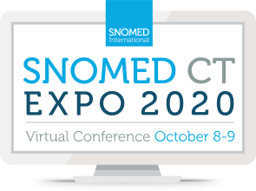
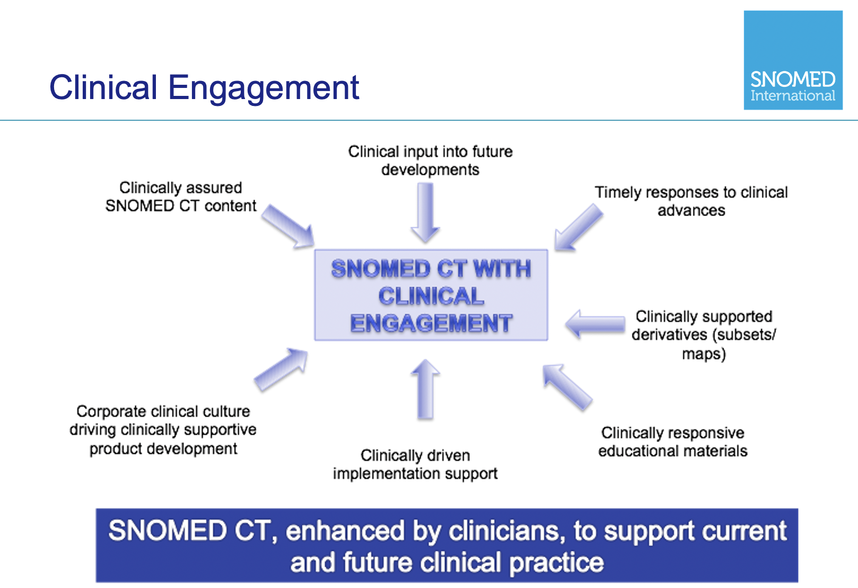
Clinical Engagement Approach

Slide 8
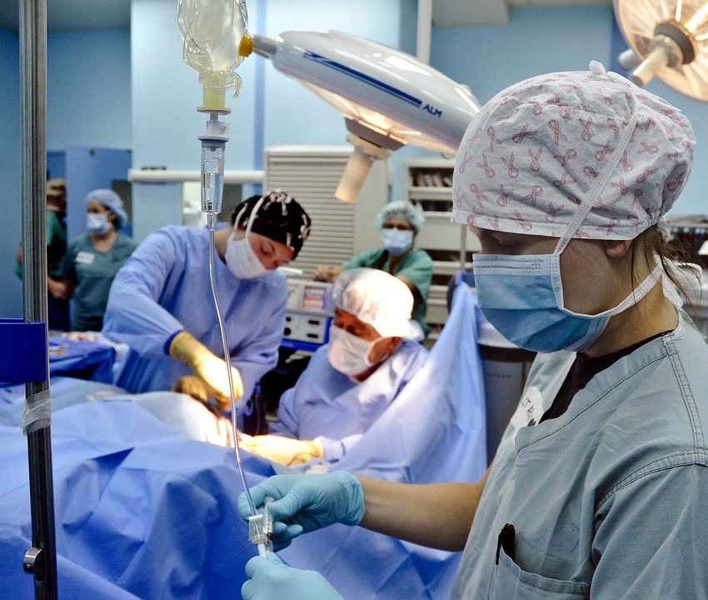

Clinical Engagement Vision
To ensure that all activities of the SNOMED International are influenced by global clinical communities
SNOMED International’s culture has a progressive and sustainable approach to engaging clinicians
8

Slide 9

Clinical Engagement Strategic Directions
Demonstrate successful large-scale implementations of SNOMED CT
Remove barriers to adoption for our customers and stakeholders
Enable continuous development of our product to meet customer requirements
Provide scalable products and services that drive SNOMED CT adoption
Set new trends and shape new technologies that increase the overall use of SNOMED CT
“We want to hear your views . . . “
9

Slide 10
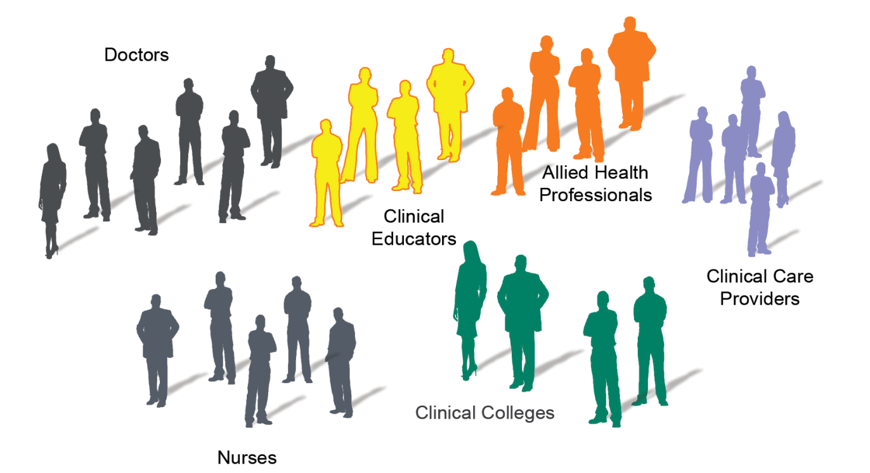
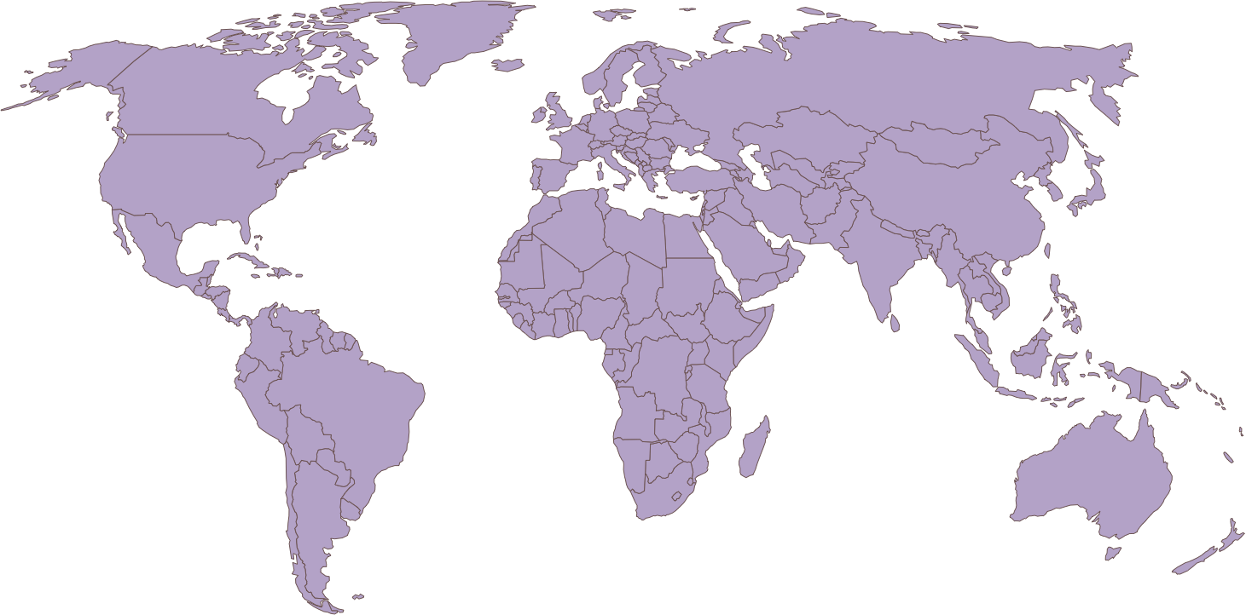
Who are our stakeholders ?

Slide 11
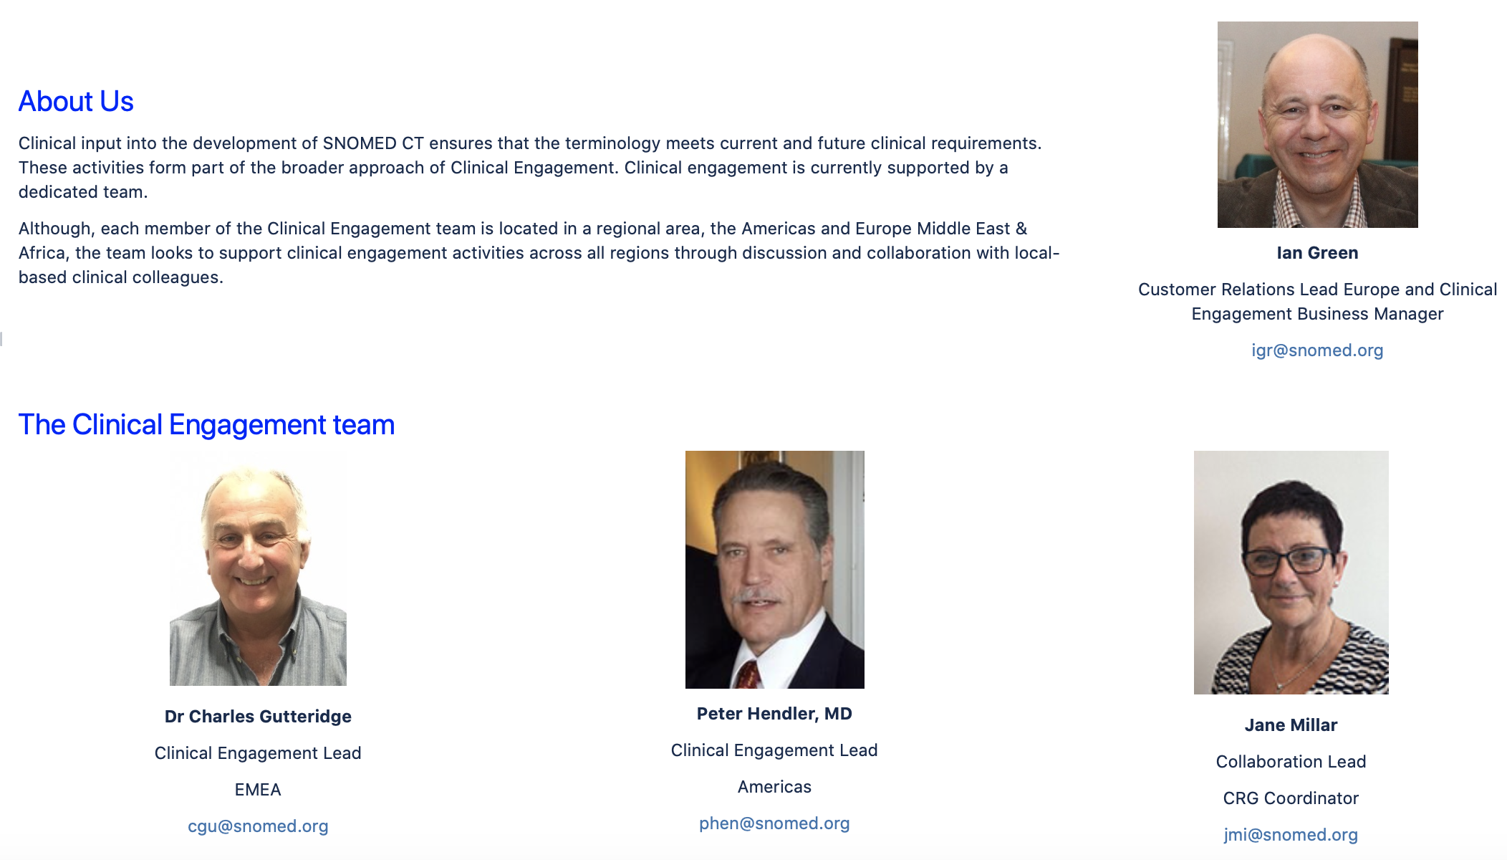
Our team

Slide 12
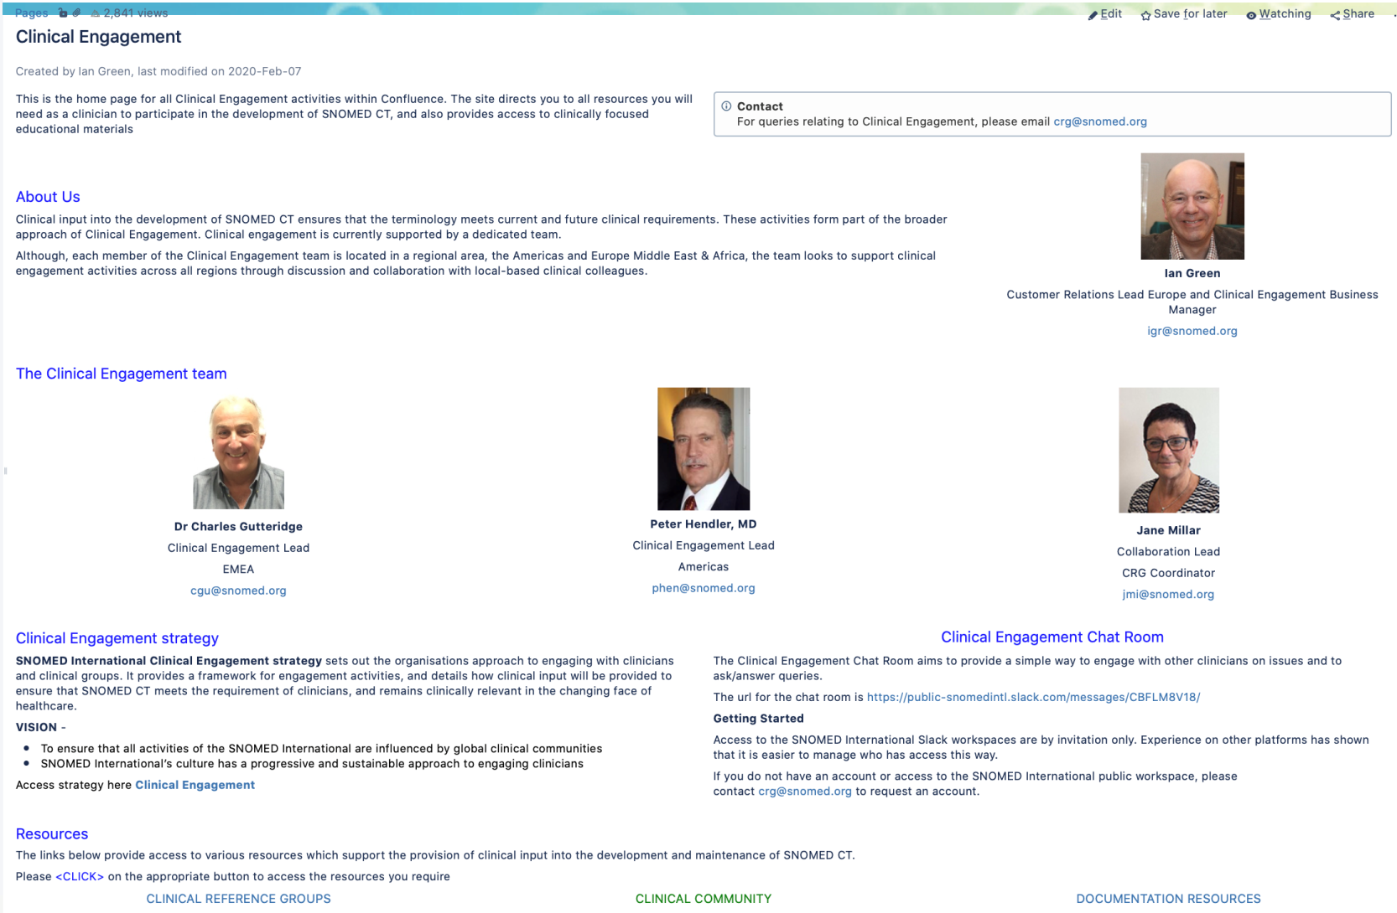


Clinical portal
https://confluence.ihtsdotools.org/display/CP/Clinical+Engagement

Slide 13
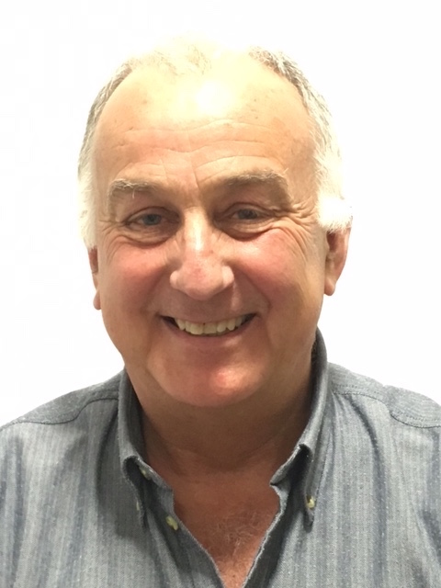
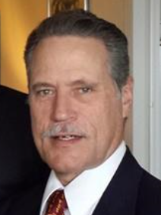
Meet our clinical leads
Provide a lead role in discussions related to clinical aspects of SNOMED CT and its implementation
Provide clinical expertise both internally and externally
Engage with all healthcare professionals, providing a network to support input into the work of SNOMED community
Help develop clinical tools and education materials for use by the SNOMED community
Provide advice on new areas of developments, to ensure that these meet the requirements of todays, and future, clinicians

Slide 14
Clinical Engagement and Customer Relations
Clinical engagement sits within the Customer Relations team
Provide clinical input into the wider customer relations agenda, This includes working with:
Member countries
Clinical bodies
Vendor Engagement
Education and implementation support
Clinical engagement is accepted as a crucial part of supporting Members, all healthcare professionals, vendors and SNOMED licensees
With member countries we work to provide clinical insight and support both centrally and within their own clinical communities
Ensure a clinical viewpoint is provided into all discussions and developments

Slide 15
Working with the content team
Developing and maintaining a clinical terminology requires access to clinical expertise, to ensure that the content reflects current global clinical practice. This manifests itself in a number of different ways:
Individual requests for clinical expertise relating to single content enhancements
Working with larger groups of concepts, where a clinical group would be established to review existing content, and provide advice on changes or new additions based on global clinical requirements
Creation of a clinical contacts database which can be used to identify clinical experts quickly to provide expert advice

Slide 16

Questions and discussion

Slide 17
Clinical Reference Groups (CRGs)
Clinical Reference Groups
Jane Millar
Collaborations Lead

Slide 18
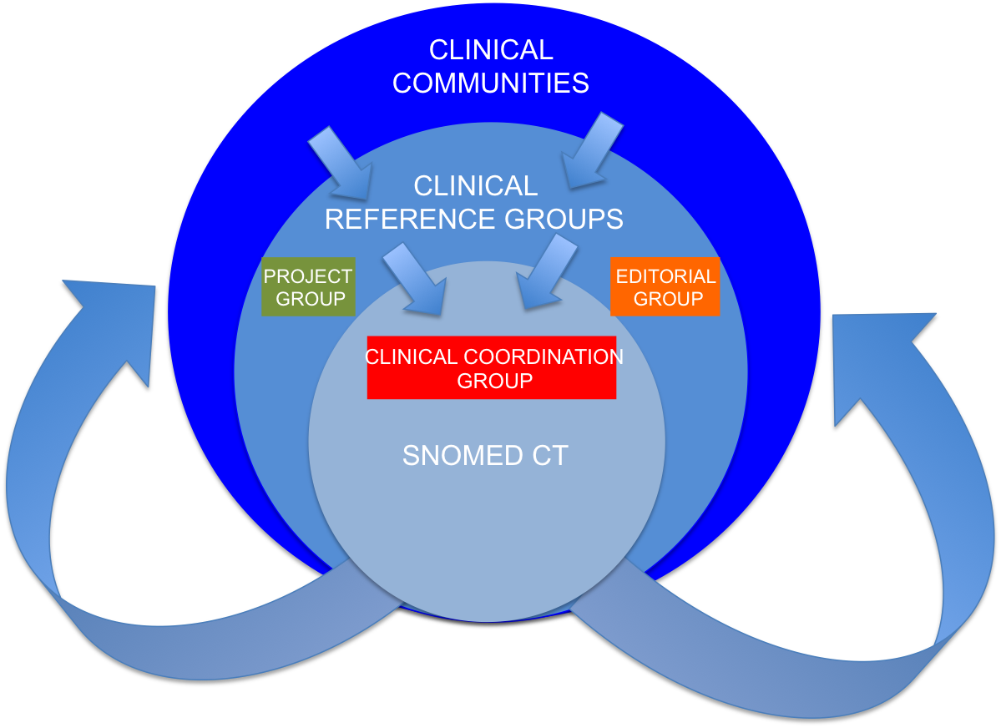
Clinical Engagement model

Slide 19

Clinical reference Groups (CRGs)
Facilitate discussion between clinicians focused on specific clinical specialties or topic areas
Provide a platform for clinicians to discuss with colleagues any questions, issues and experience relating to SNOMED CT and its implementation
Dedicated Confluence area and zoom accounts
Clinical community leadership
Open to all, input not limited to just clinicians from the clinical specialty
Input from SNOMED CT author and access to SNOMED CT change request mechanism where appropriate

Slide 20
What is the reality of CRG’s?
CRG’s provide the following:
A framework for multi-disciplinary topic discussion and working across professions
Global perspective, especially required for SNOMED CT international edition
Access to expertise from all clinical domains
A mechanism for different levels of engagement
Access to discussions on clinical developments by other groups (e.g. implementers), to ensure that products are developed meet clinical requirements.
Early identification of global changes to healthcare delivery

Slide 21

Clinical Project Groups and Editorial Groups
Clinical project groups
Task and finish groups to address specific areas of clinical content agreed as part of work plan
Review of existing content and identification of changes/additions to the international release
International requirements, led by external SME
Input from a SNOMED CT author
Editorial groups (where relevant)
To provide editorial review of derivative products e.g. reference sets and maps

Slide 22
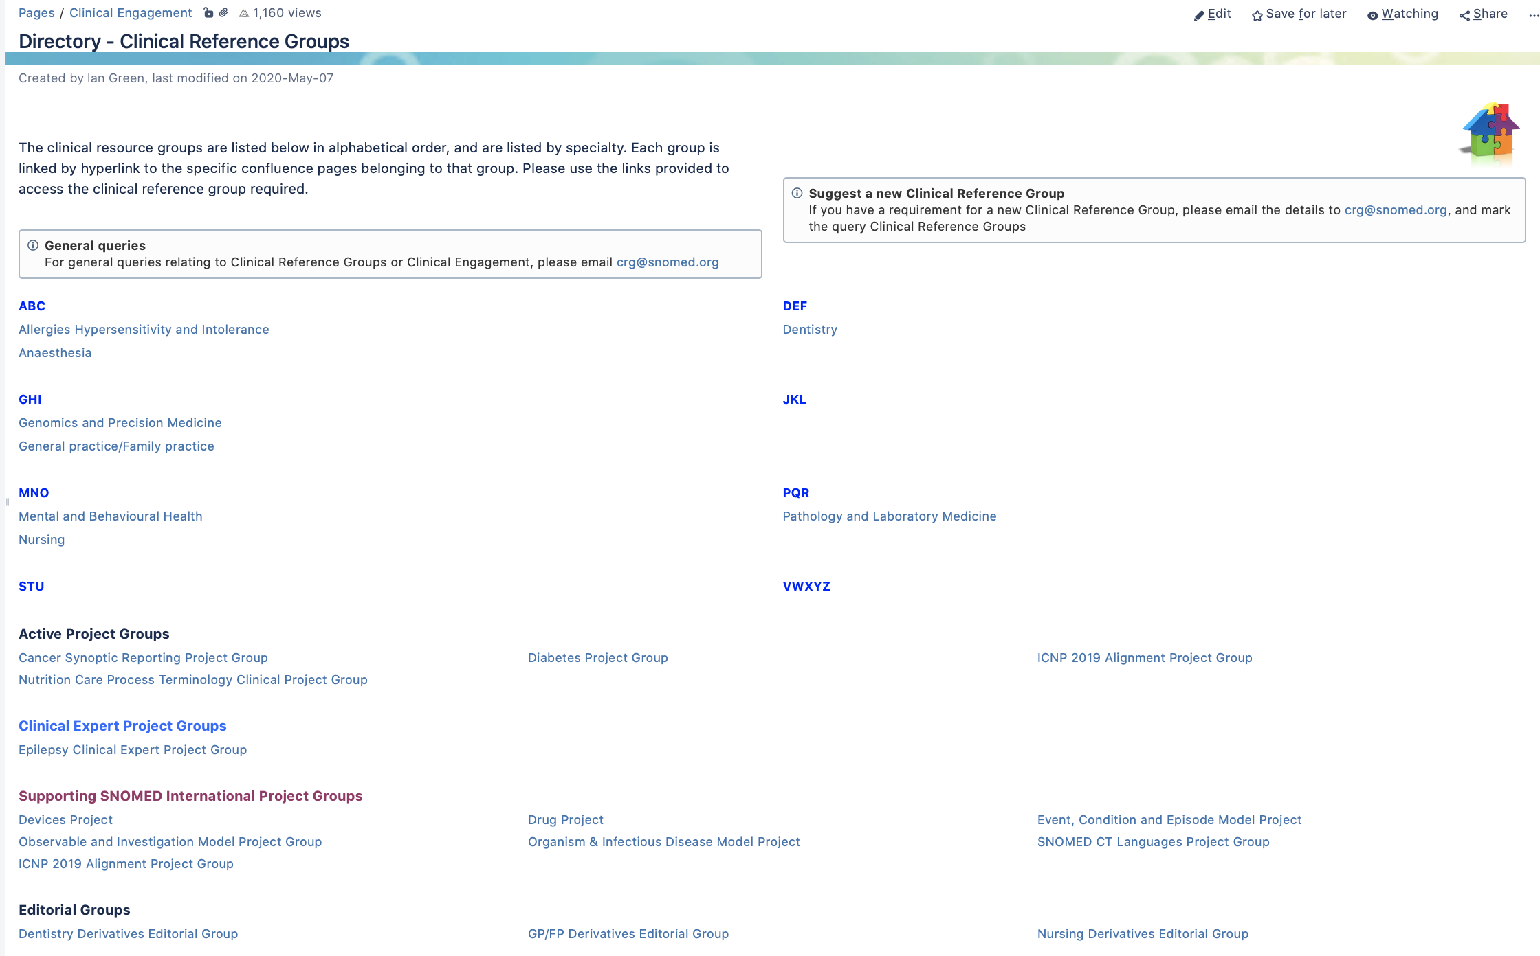
https://confluence.ihtsdotools.org/display/CP/Directory+-+Clinical+Reference+Groups

Slide 23
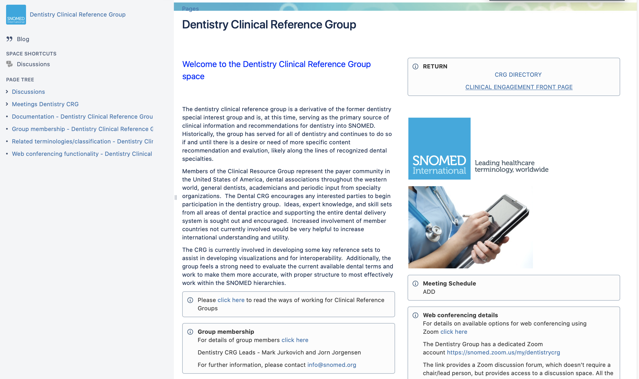

Slide 24
Clinical Community
Clinical Community
Ian Green
Clinical Engagement
Business Manager &
Customer Relations Lead
Europe

Slide 25
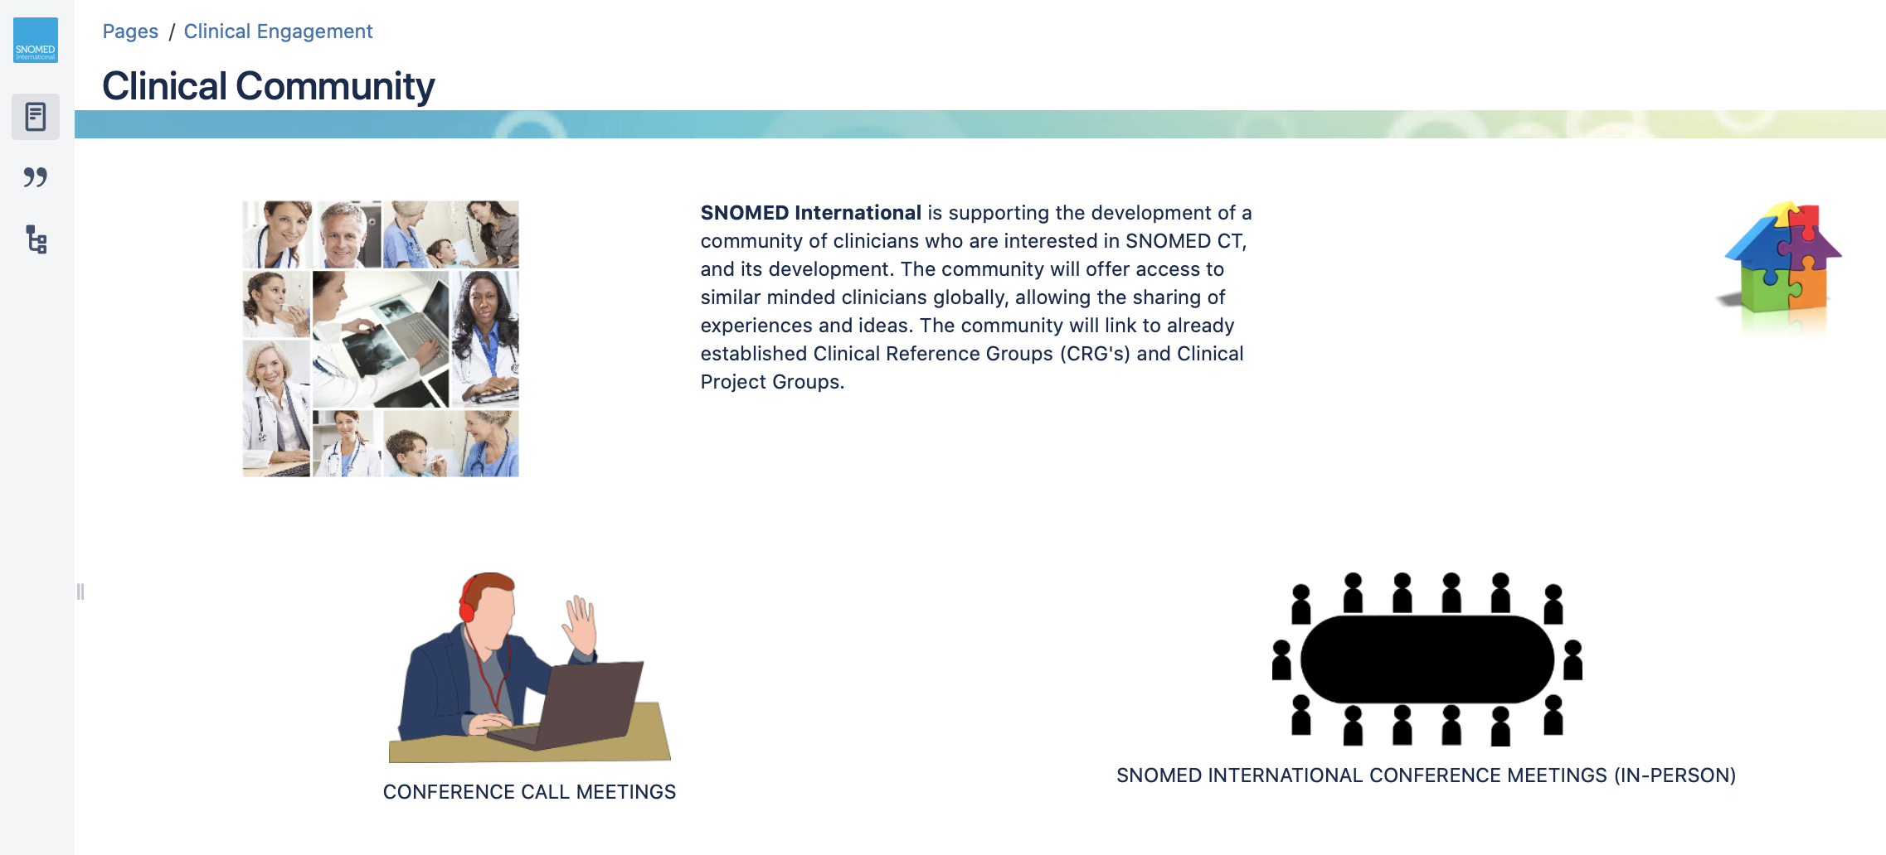
https://confluence.ihtsdotools.org/display/CP/Clinical+Community

Slide 26
Clinical community
Aim:
To build a community of interest, which will support clinician use of SNOMED CT globally
Community offers access to like-minded clinicians globally, allowing the sharing of experiences and ideas.
Community links to already established Clinical Reference Groups (CRG's) and Clinical Project Groups.
How:
Providing clinicians access to education (clinical webinars and clinical sessions)
Providing interaction through discussion forums or through existing SNOMED clinical groups
Opportunities for input into content development and shaping implementation advice

Slide 27
Clinical webinars
Held monthly, on the first Wednesday of the month at 19:00 UTC for 90 mins
Two presenters
Topic is always clinically related. Try to keep the focus on real life implementations
Each session has a dedicated Confluence page, providing agenda, presentation and a link to a recording of the sessions. To access past and future sessions, please use the following link:
https://confluence.ihtsdotools.org/display/CP/Clinical+Webinars
(You will find each webinar is a sub-page)

Slide 28
Clinical contact database
Purpose:
To provide a mechanism for accessing experienced, up-to-date clinical specialists
To provide internationally relevant knowledge
Database
Individuals contact information, specialty, availability and experience with terminology
Database information is solely for the use of the clinical engagement team, and is not shared elsewhere
Participation is voluntary

Slide 29
Clinical Analytics
Clinical Analytics
Charles Gutteridge
Clinical Engagement
Lead EMEA
&
Peter Hendler
Clinical Engagement
Lead Americas

Slide 30
SNOMED CT authoring and clinical input
SNOMED CT authoring and clinical input
Monica Harry
Director of Content

Slide 31
Education materials
Education materials
Ian Green
Clinical Engagement
Business Manager &
Customer Relations Lead
Europe

Slide 32
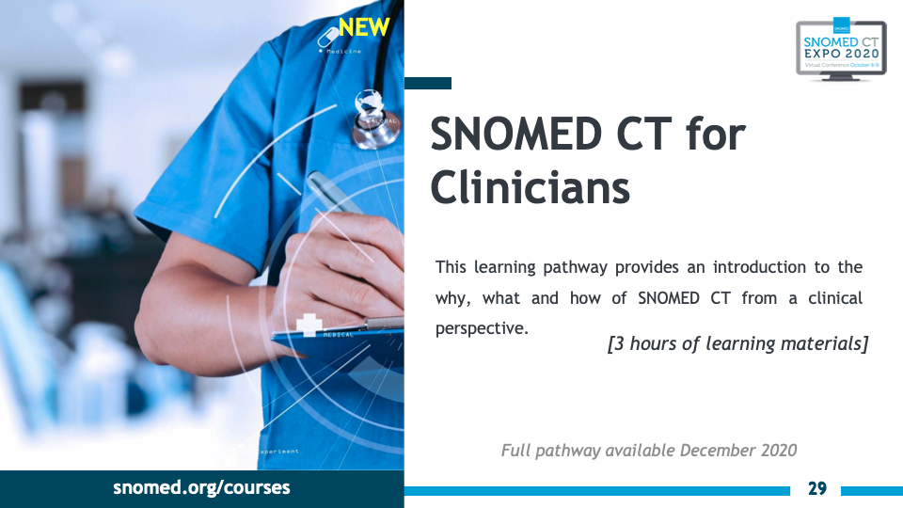

Slide 33
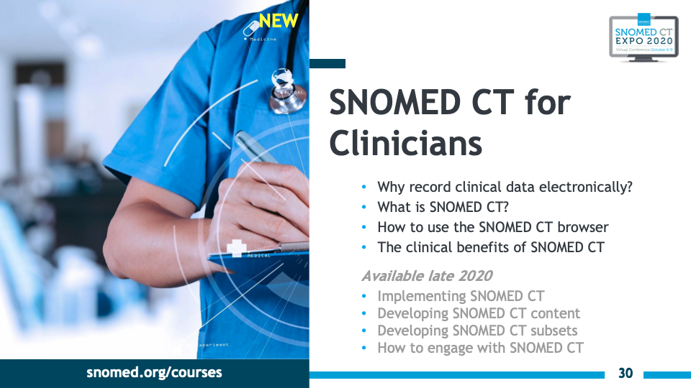

Slide 34
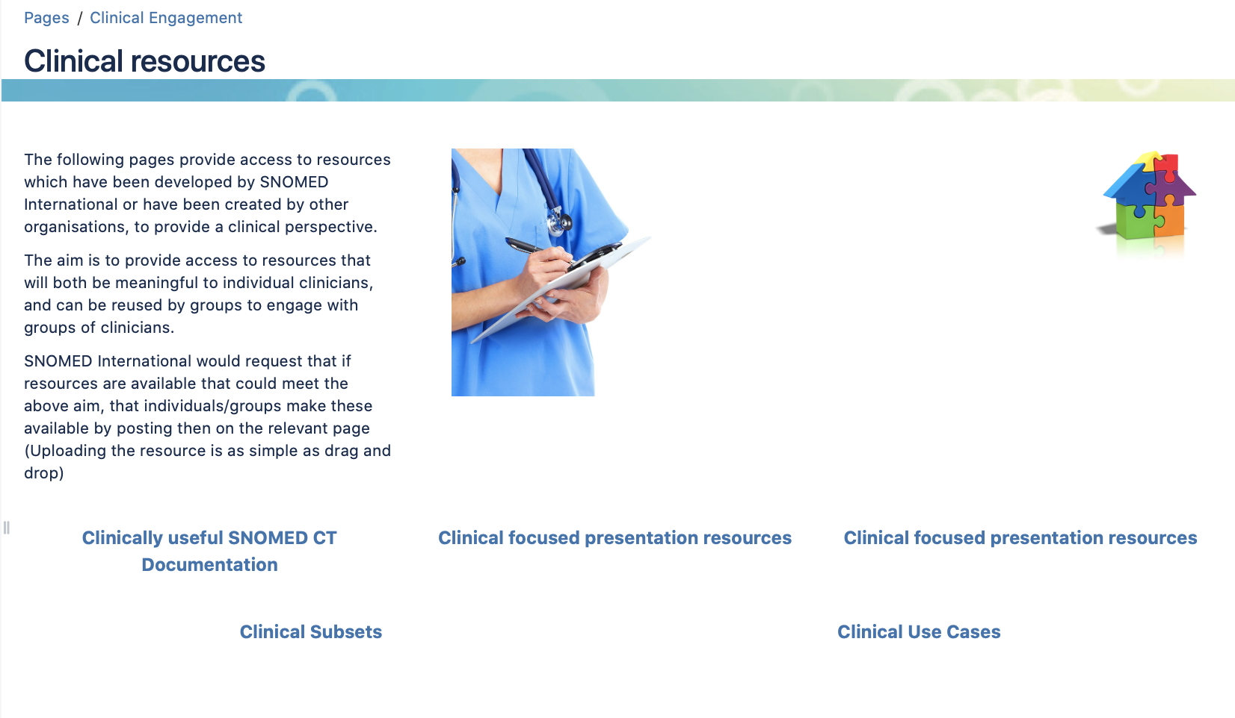
Clinical resources and presentations
https://confluence.ihtsdotools.org/display/CP/Clinical+resources

Slide 35
Questions . . .

Slide 36
Following sessions . . .
Anesthesia CRG
https://snomed.zoom.us/j/99693144583?pwd=bXR5Qk1lNWE5cTZoOGhucVc1ZXhwZz09
Dental CRG
https://snomed.zoom.us/my/dentistrycrg
Cancer Synoptic Reporting Project Group
https://snomed.zoom.us/my/cancersynoptic
Genomics and Precision Medicine CRG
https://snomed.zoom.us/webinar/register/WN_-IBoobDIQ3GnB5ojbpV2LA
Closing plenary session
https://snomed.zoom.us/webinar/register/WN_-IBoobDIQ3GnB5ojbpV2LA

