Slide 1
Sequelae
Investigate outcome of removing 362977000 |Sequela (disorder)|parent from all Disorders due to and/or following disorders and procedures

Slide 2
Current status of < 362977000 |Sequela (disorder)|hierarchy

Slide 3
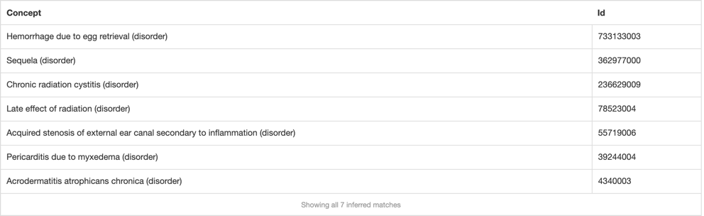
Pre-analysis
1546 concepts that contain an after relationship do not have a parent of Sequela (disorder)
  106 concepts represent traumatic injuries
    (<<64572001 |Disease| minus <<362977000 |Sequela|): 255234002 |After| = (<<773760007 |Traumatic event (event)|)
  611 concepts represent postoperative complications
    (<<64572001 |Disease| minus <<362977000 |Sequela|): 255234002 |After| = (<<387713003 |Surgical procedure (procedure)|)
  836 concepts represent other than above
    (<<64572001 |Disease| minus <<362977000 |Sequela|): 255234002 |After| != (<<387713003 |Surgical procedure (procedure)| OR <<773760007 |Traumatic event (event)|)
678 concepts have a parent of Sequela (disorder)
  6 concepts modeled with a parent of Sequela (disorder) do not have an after relationship
    (<<362977000 |Sequela|): 255234002 |After| != *)

Slide 4
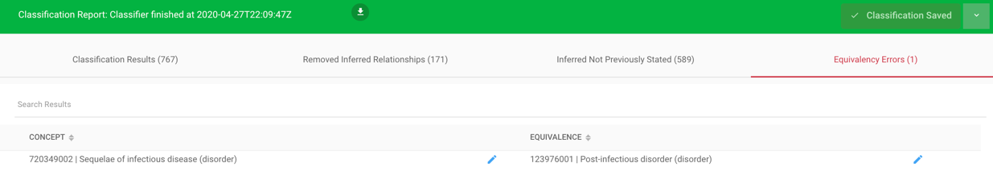
362977000 |Sequela (disorder)|inactivated and Replaced by 64572001 |Disease (disorder) |
Classification Results (767)
Removed Inferred Relationships (171)
Inferred Not Previously Stated (589)
Equivalency Errors (1)

Slide 5
Resultant status of < 362977000 |Sequela (disorder)|hierarchy
Current status | < 362977000 |Sequela (disorder)| | < 302049001 |Sequelae of disorders (disorder)| | < 312087002 |Disorder following clinical procedure (disorder)|
 | 678 | 382 | 265
After inactivation of 362977000 |Sequela (disorder)| | < 362977000 |Sequela (disorder)| | < 302049001 |Sequelae of disorders (disorder)| | < 312087002 |Disorder following clinical procedure (disorder)|
 | N/A | 748 | 1322

Slide 6
Disorders following events
 | Current status # descendants | After inactivation of Sequela (disorder) # descendants
<<64572001 |Disease (disorder)|: 255234002 |After|=<272379006 |Event| | 129 | 130
<<362977000 |Sequela (disorder)|: 255234002 |After|=<272379006 |Event| | 20 | N/A

Slide 7
Disorders after inactivation Sequela (disorder)
130 disorders modeled using after Event (event)
  All but 10 of above are modeled as Traumatic injuries (after Traumatic event (event)
Thunderstorm asthma (disorder)
Late effect due to homicide attempt (disorder)
Late effect of child abuse (disorder)
Late effect of domestic violence (disorder)
Reactive airways dysfunction syndrome (disorder)
Allergic reaction caused by bee sting (disorder)
Late effects of assault (disorder)
Benign asbestos pleural effusion (disorder)
Late effect of accidental fall (disorder)
Late effect of motor vehicle accident (disorder)

Slide 8
Examples of lost isA relationships

Slide 9
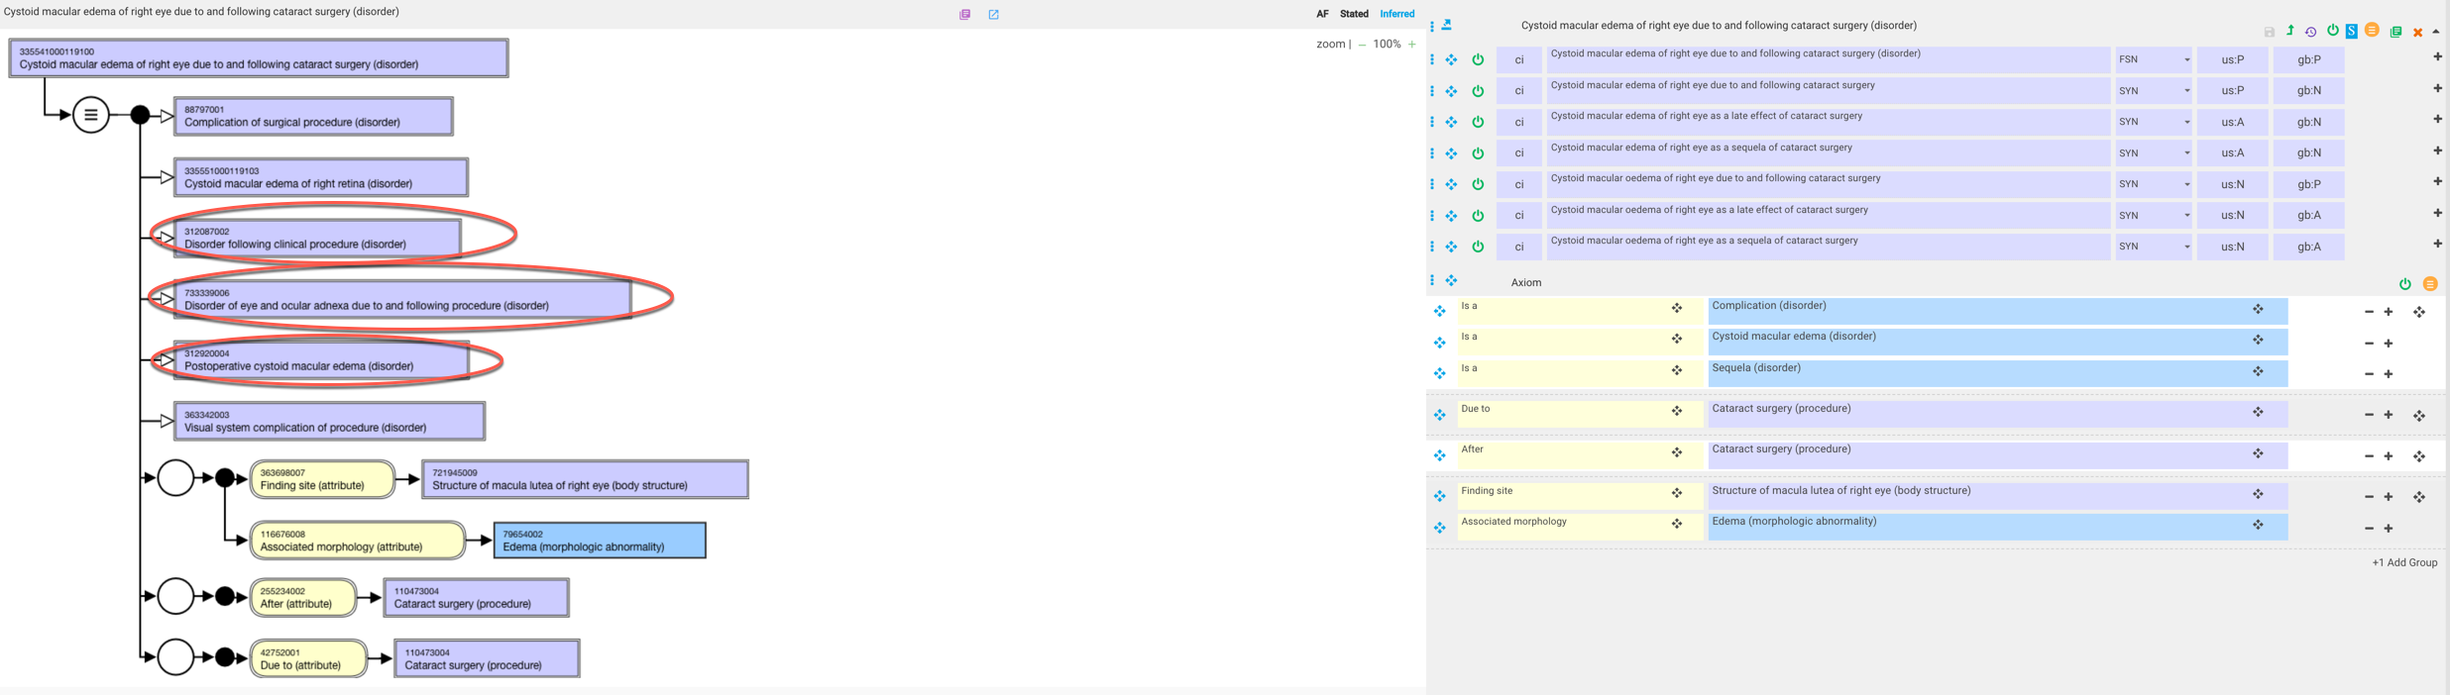
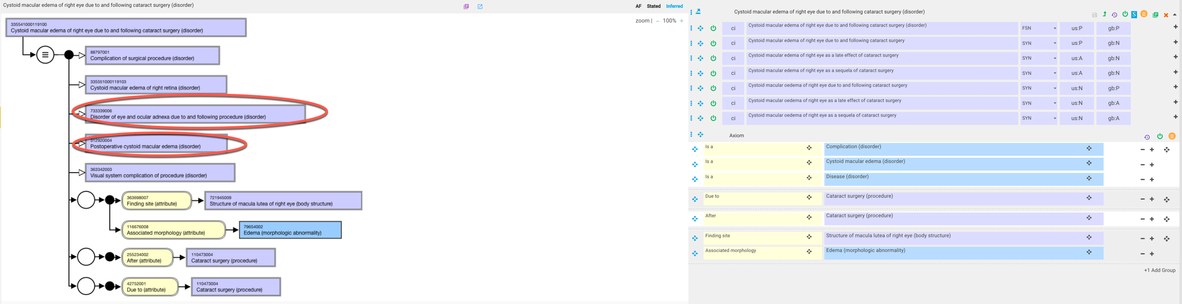
335541000119100 |Cystoid macular edema of right eye due to and following cataract surgery (disorder)|
With sequela parent
Without sequela parent

Slide 10
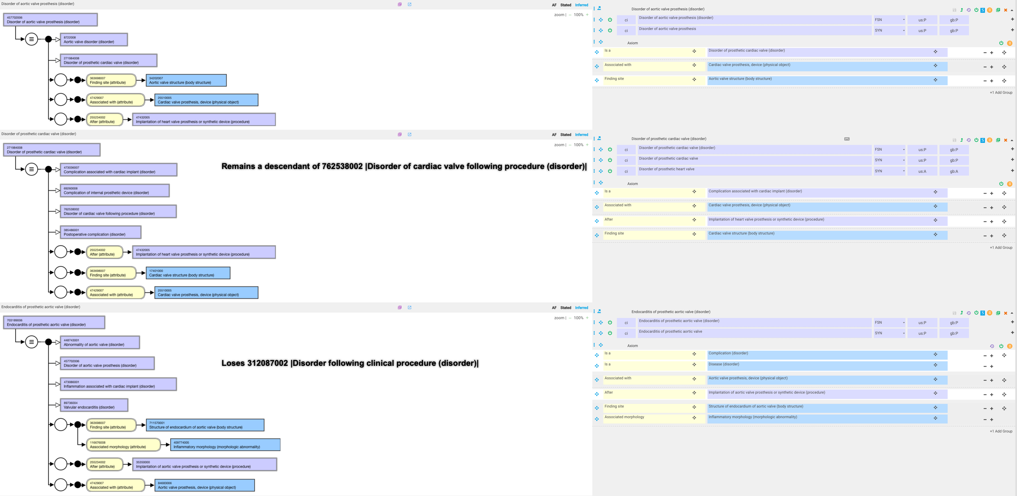
703189006 |Endocarditis of prosthetic aortic valve (disorder)|

Slide 11
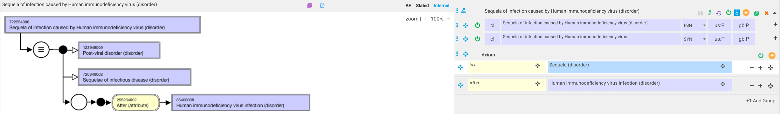
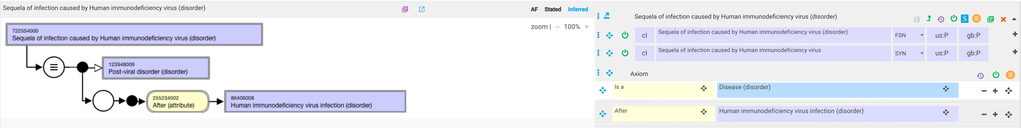
722554000 |Sequela of infection caused by Human immunodeficiency virus (disorder)|

Slide 12
Examples of gained isA relationships

Slide 13
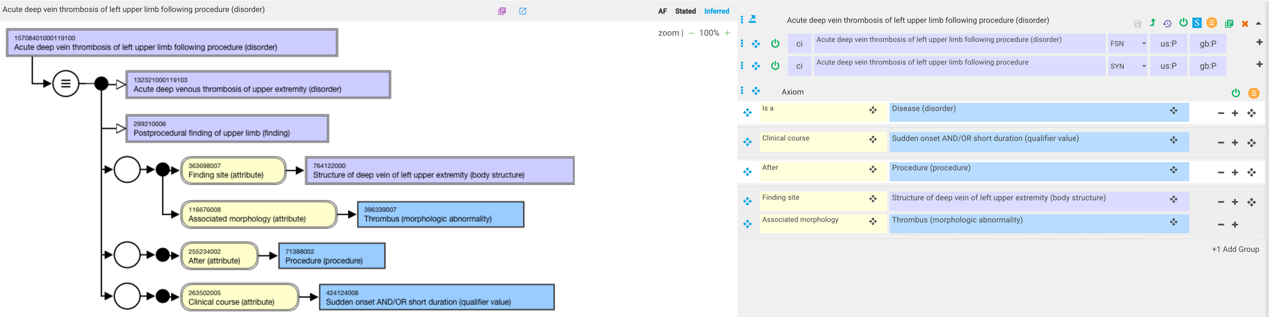
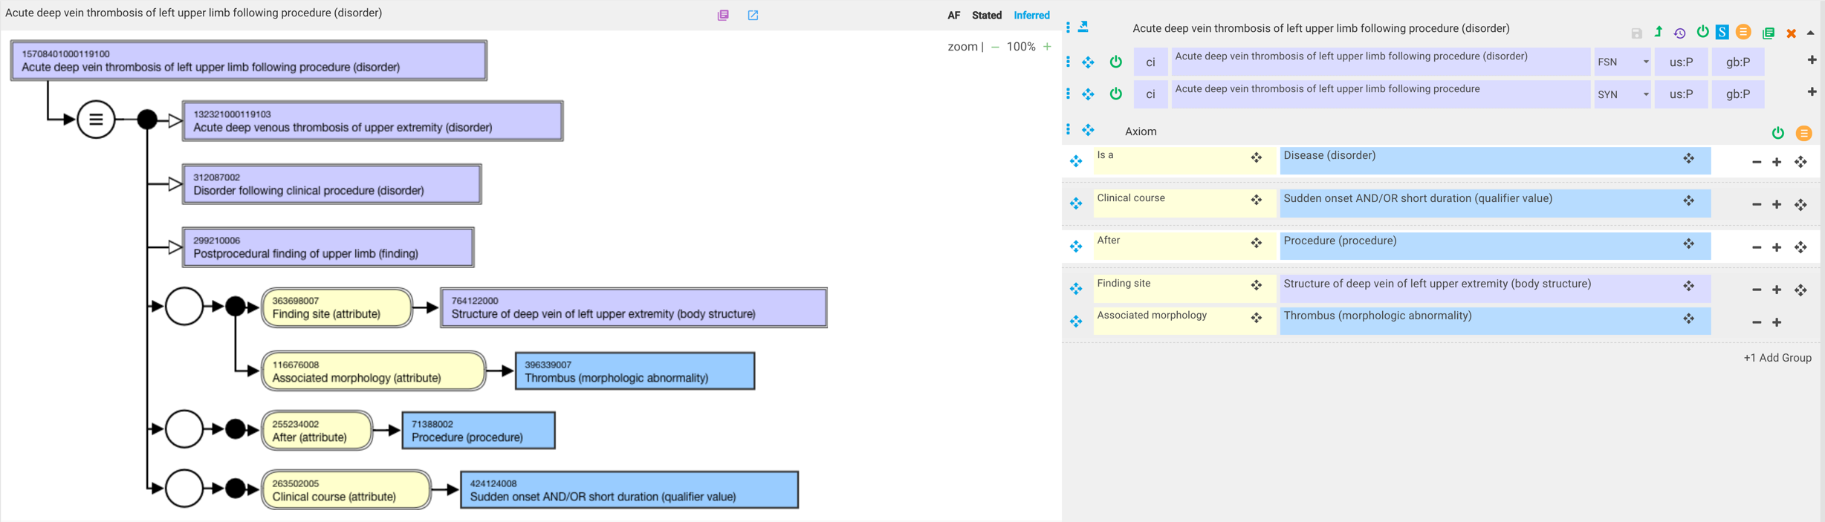
15708401000119100 |Acute deep vein thrombosis of left upper limb following procedure (disorder)|
Current state
Gains this parent
After inactivation of Sequela (disorder

Slide 14
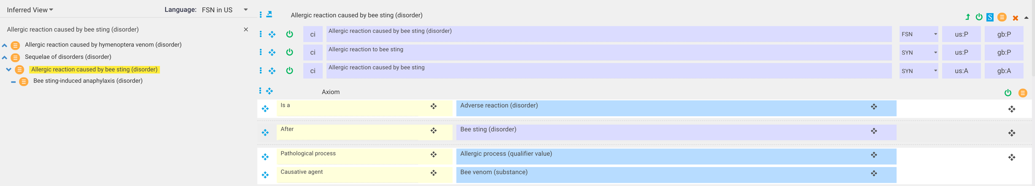
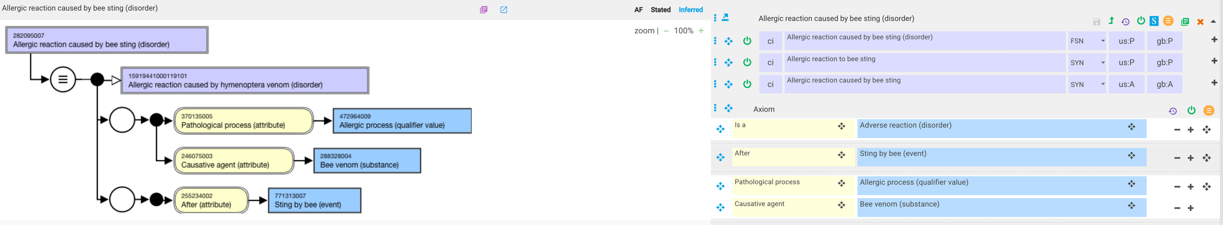
282095007 |Allergic reaction caused by bee sting (disorder)|
Gains this parent but model is incorrect
Revised model

