Slide 1
Semantic Interoperation of Laboratory Results with SNOMED CT
James R. Campbell MD
University of Nebraska Medical Center
Omaha, NE, USA

Slide 2
Agenda
Information management from clinical lab in 21st century EHR
State of the art in lab interoperation and findings
Barriers created to semantic interoperation by SNOMED concept model
Toward a unified model supporting semantic interoperation of laboratory results employing SNOMED CT
Step one proposal for SNOMED remediation

Slide 3
Lab-EHR Information Management
The information management cycle within the EHR starts with an order for a lab test (ORDERABLE) which is directed to a laboratory department where a specific technology is employed (PERFORMABLE) to produce a result which is then reported (RESULTABLE) back to the Learning Health System. The concept model for Observable entities allows us to specify templates for each of these types of information which require different sets of defining attributes. Such a unified model also has slightly different information processing requirements for QUALITY observables – the majority use case, PROCESS and PANEL ORDERABLES and they will be discussed separately.

Slide 4
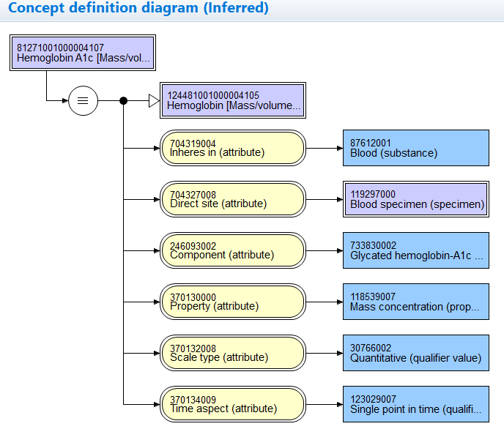
Ordering the Lab:
ORDERABLE
(test portion of Order record)
Dr Jim Campbell orders a hemoglobin A1C to assess diabetic control of his patient
Defining attributes
commonly required
for QUALITY orderables:
Inheres in
Inherent location
Direct site
Relative to
Component
Property
Scale type
Time aspect
Precondition
Technique

Slide 5
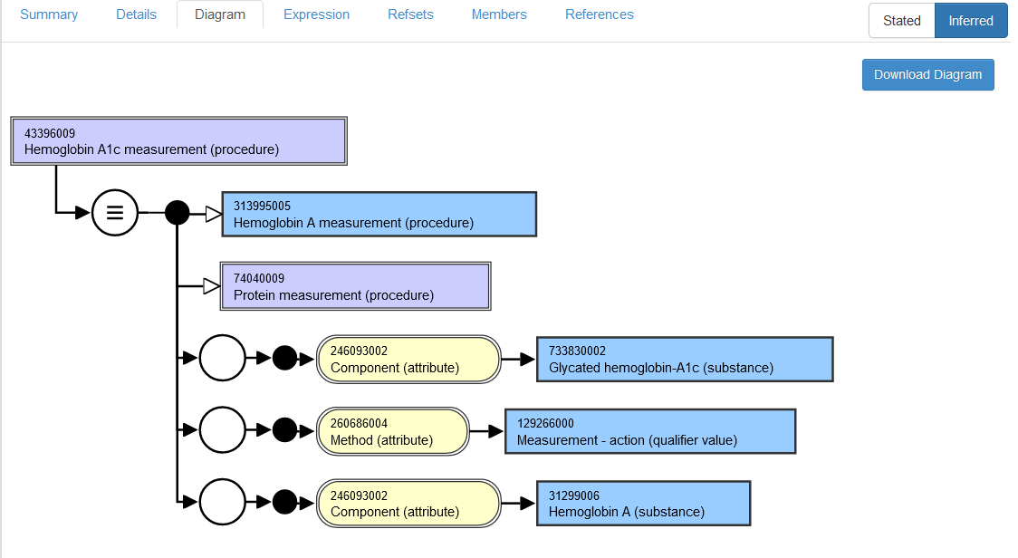
Processing the Lab:
PERFORMABLES
Dr Scott Campbell receives the order, directs the specimen to the testing device which can deliver the result requested by the physician
The pathology lab
Director has carefully
Coded his lab master
For tests as
SNOMED CT
Lab test (Procedure)

Slide 6
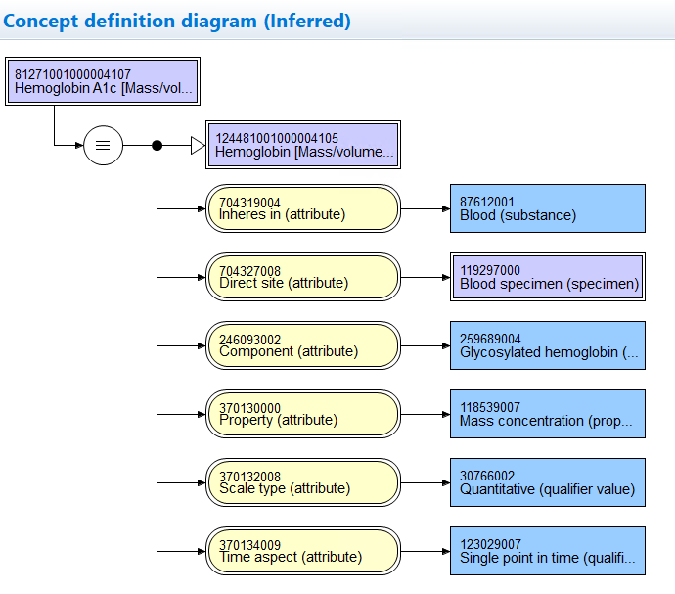
Reporting the Lab:
RESULTABLES
Dr Scott Campbell’s lab issues an HL7 OBX segment back to the EHR with the results of the test which are indexed by the ORDERABLE and PERFORMABLE specifications
Defining attributes
commonly required
for QUALITY results:
Inheres in
Inherent location
Direct site
Relative to
Component
Property
Scale type
Time aspect
Precondition
Technique

Slide 7
Lab-EHR Information Management
The point of this discussion is that one testing procedure or machine (PERFORMABLE) might be used by the lab to develop observation results for MANY different observable ORDERABLEs depending upon the patient preparation, the specimen and the sampling protocol employed. Details of the specimen processed, the specimen preparation and patient preparation must be married from the ORDERABLE to the PERFORMABLE in generating an accurately defined RESULTABLE from the LIMS to the EHR so that the final lab result database supports semantic interoperation. FDA Shield project is currently promoting a reference database called LIVD of PERFORMABLES in what they believe will promote uniform coding of the RESULTABLES.

Slide 8
State of the art in lab interoperation and findings
Managing a modern clinical lab is complex and reporting the breadth of results as interoperable data is daunting and fraught with error
Each IHTSDO member may or may not have deployed national lab results coding schemes
No basis for semantic interoperation other than equivalence mapping on national code level between those shared schemes
No commitment among IHTSDO members for shared concept model for equivalence

Slide 9
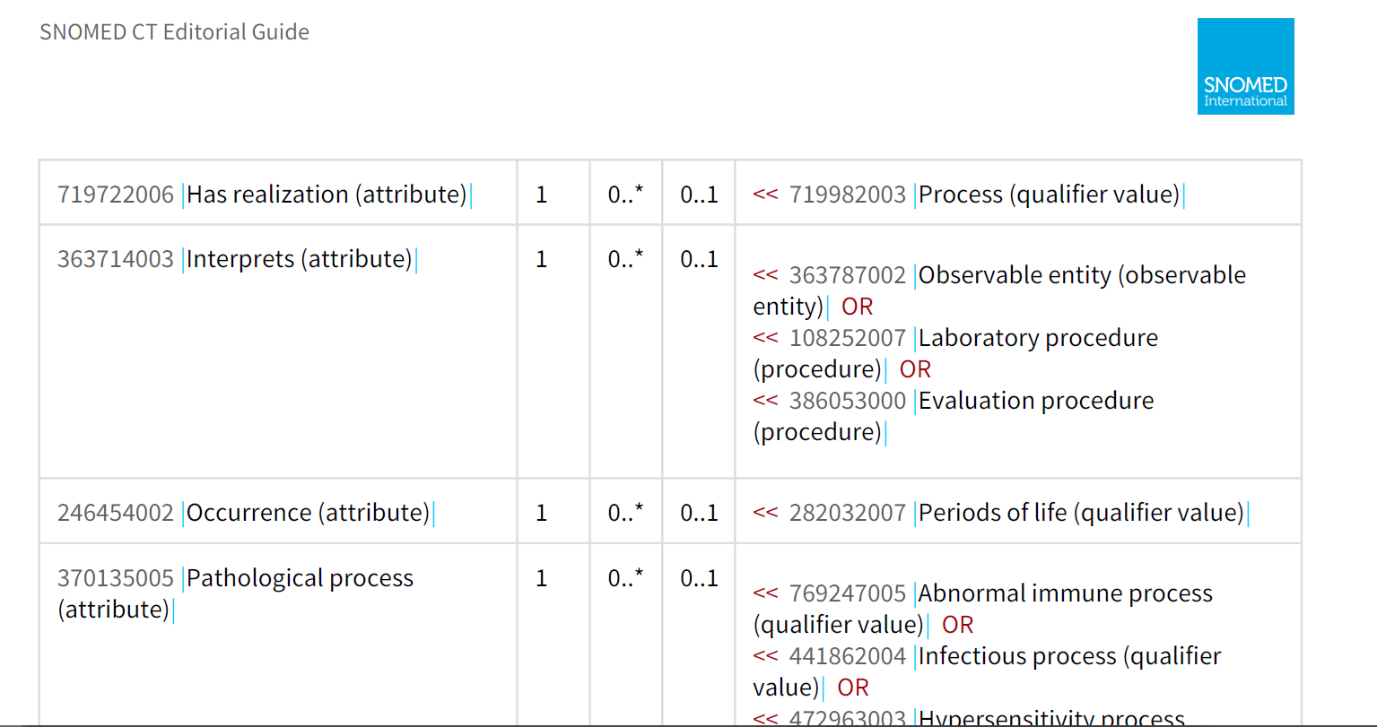
Barriers created to semantic interoperation by SNOMED CT
Newness of the concept model for Observables
Ambiguity created by inclusion of BOTH <<386053000|Evaluation procedures| AND <<108252007|Laboratoy procdure| AND <<363787002|Observable entity| to populate 363714003|Interprets (attribute)| and therefore to code a RESULTABLE
Procedure testing concept model lacks the specificity of the Observables model for fully defining a REDSULTABLE
Non-alignment of defining attributes for these two hierarchies, specifically METHOD-TECHNIQUE

Slide 10
Concept Inventories
<<108252007|Laboratory procedure| = 5165 concepts
<<386053000|Evaluation procedure| + Method=Measurement – action 7125 concepts
Today in Nebraska Lexicon: Anatomic pathology 599; Clinical laboratory 22716; Molecular pathology 288; Tumor observables 397

Slide 11
Proposal
Apply Observables concept model to fully define <<some Evaluation Procedures and <<Lab Procedures and move them to Observable entities while maintaining SCTID
Further content revisions can be informed by the results of this work and could then proceed in steps:
  Laboratory testing procedures
  ?Vitals signs
  ?Imaging

Slide 12
Step 1 Protocol Proposal
Scope: ?<<Evaluation procedure + Method=Measurement action + Lab context OR ?<<Lab procedure
~12290 concepts
Redefine supertype ➔ISA Observable entity
Retire invalid attribute-values from the Procedure concept model and convert definition to Observable concept model (Some procedure attributes provide similar semantics with different value sets; eg Method ➔Technique)
?Structured FSN: [Inheres_In] [Component] [Property] [Direct_Site_Substance] [Property][Precondition]
Equivalent to an existing Observable entity? Then retire observable as duplicate and retain SCTID of Evaluation procedure for the concept due to the presumption of standing bodies of work
Revise Clinical findings concept model to exclude Procedures from Includes attribute Value
Standardize valuesets for Has interpretation by Observable property for interoperation of evaluation clinical findings requiring Interprets

Slide 13
Exemplar 1:
43396009|Hemoglobin A1c Measurement (procedure)|

Slide 14
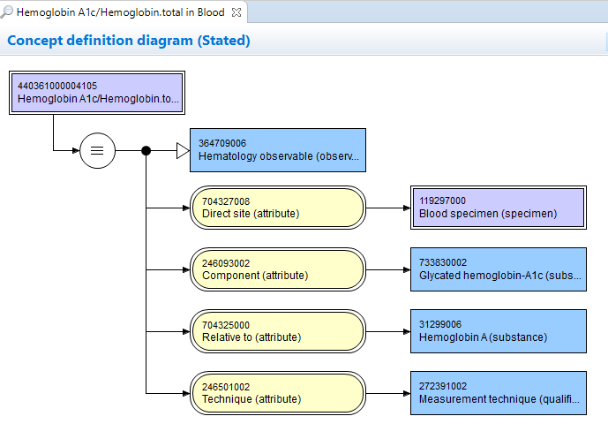
43396009|Hemoglobin A1c Measurement (Observable entity)|

Slide 15
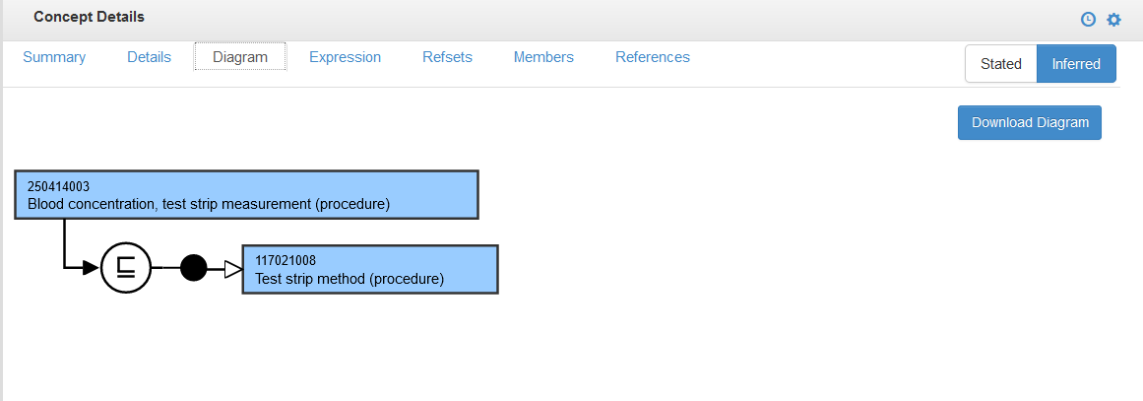
250414003|Blood concentration, test strip method (procedure)

Slide 16
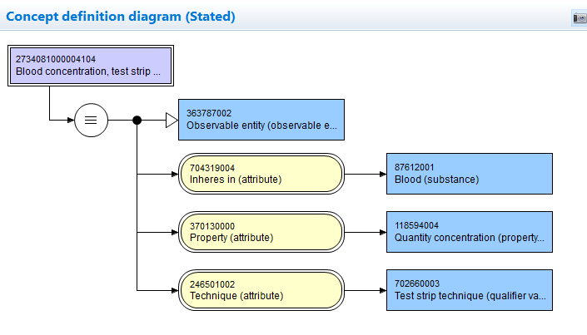
250414003|Blood concentration, test strip method (observable entity)

Slide 17
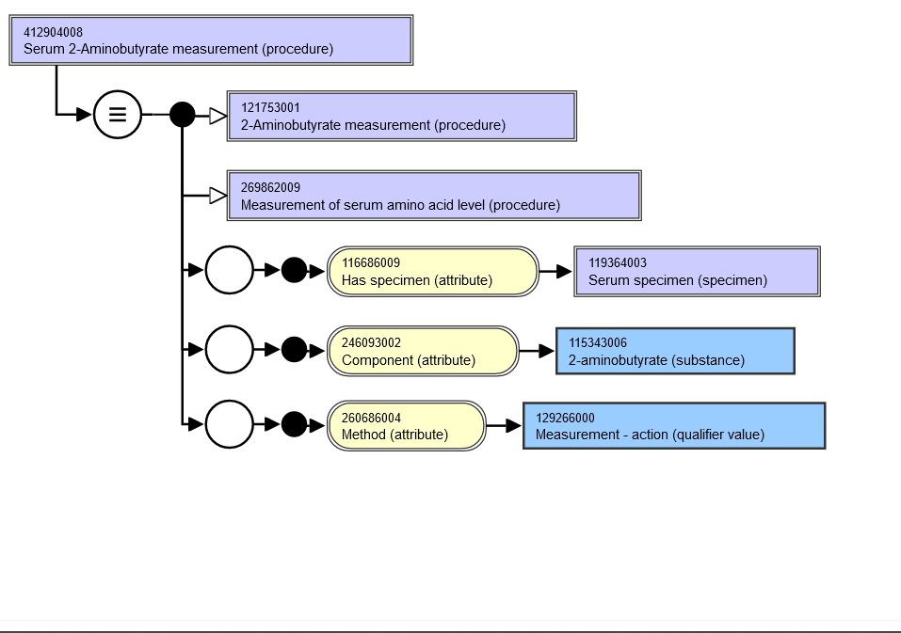
412904008 Serum 2-Aminobutyrate measurement (procedure)

Slide 18
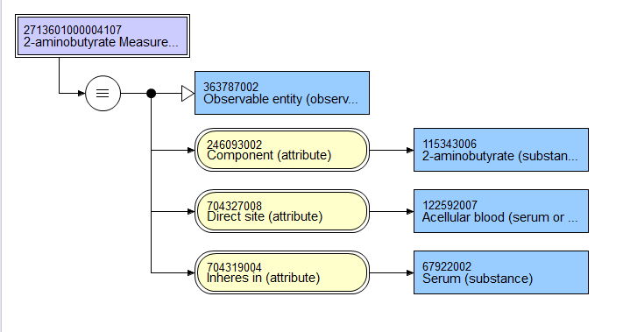
412904008| 2-aminobutyrate measurement in serum specimen (observable entity)|
Stated

Slide 19
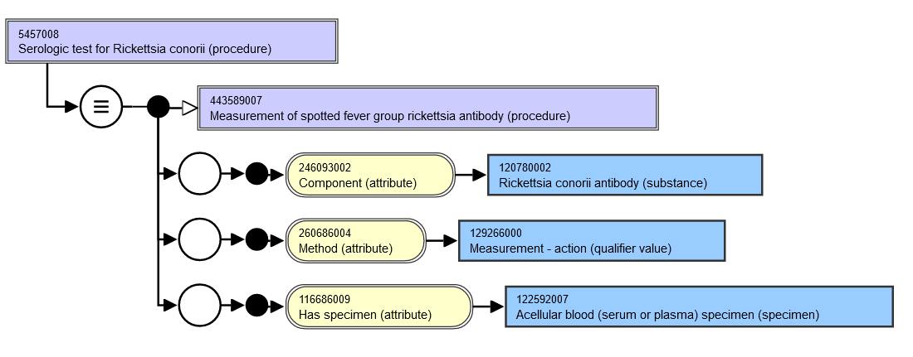
5457008|Serologic test for Rickettsia conorii (procedure)|

Slide 20
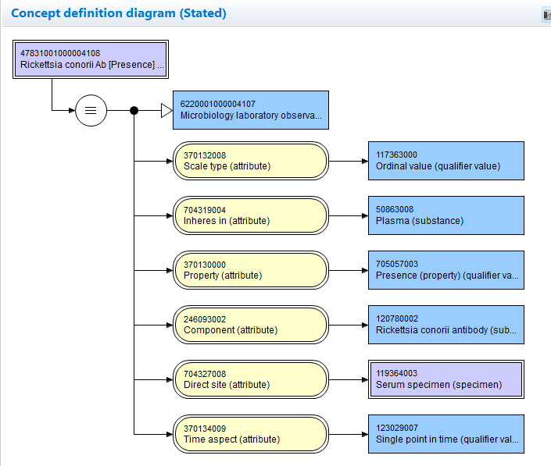
47831001000004108|Rickettsia conorii antibody [Presence] in serum (Observable entity)|

Slide 21
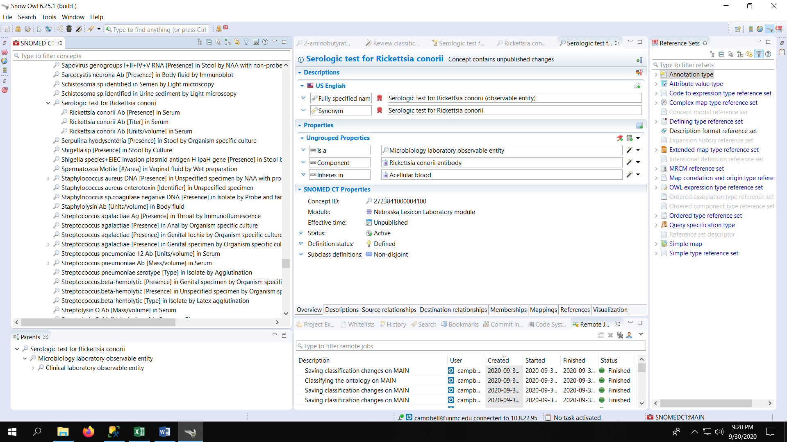
Classification of 5457008

Slide 22
Nebraska Progress to Laboratory Interoperation
Technology preview expressions for 23K lab LOINC concepts deployed into NebLex extension namespace as fully defined concepts
Additional lab concepts in shared use within US PCORnet research network modeled, published and added to core lab in use
Concepts modeled for cancer synoptic reporting bring total to 24175 Lab/Pathology concepts defined with Observables collaborative model
Collaborating with NLM to deploy Medicinal Products/Substance model for US medications, prioritizing those in use in lab test definition (eg Amoxicillin [Susceptibility] of bacteria by MIC)

Slide 23
Laboratory Unified Model Relationships(#)
TYPEID | TERM | FREQUENCY
116680003 | Is a (attribute) | 42424
370130000 | Property (attribute) | 22762
370132008 | Scale type (attribute) | 22655
704327008 | Direct site (attribute) | 22615
370134009 | Time aspect (attribute) | 22028
704319004 | Inheres in (attribute) | 21627
246093002 | Component (attribute) | 21129
246501002 | Technique (attribute) | 5634
704325000 | Relative to (attribute) | 2135
704321009 | Characterizes (attribute) | 656
704324001 | Process output (attribute) | 621
704322002 | Process agent (attribute) | 617
704323007 | Process duration (attribute) | 607
718497002 | Inherent location (attribute) | 443
704326004 | Precondition (attribute) | 360
246514001 | Units (attribute) | 288
704320005 | Towards (attribute) | 48
363701004 | Direct substance (attribute) | 9
719722006 | Has realization (attribute) | 1

Slide 24
Analytics Employing Semantic Interoperation supported by SNOMED CT
*HEMOGLOBIN A1C FRACTION
'Observable entity (observable entity)'
and ('Role group (attribute)' some ('Component (attribute)' some
'Glycated hemoglobin (substance)'))
and ('Role group (attribute)' some ('Relative to (attribute)' some
'Hemoglobin (substance)'))
and ('Role group (attribute)' some ('Inheres in (attribute)' some 'Blood (substance)'))
*BLOOD OR URINE OPIATE SCREEN
'Observable entity (observable entity)'
and ('Role group (attribute)' some ('Component (attribute)' some
'Substance with opioid receptor agonist mechanism of action (substance)'))
and (('Role group (attribute)' some
('Direct site (attribute)' some 'Acellular blood (serum or plasma) specimen (specimen)'))
or
('Role group (attribute)' some ('Direct site (attribute)' some 'Urine specimen (specimen)')))

Slide 25
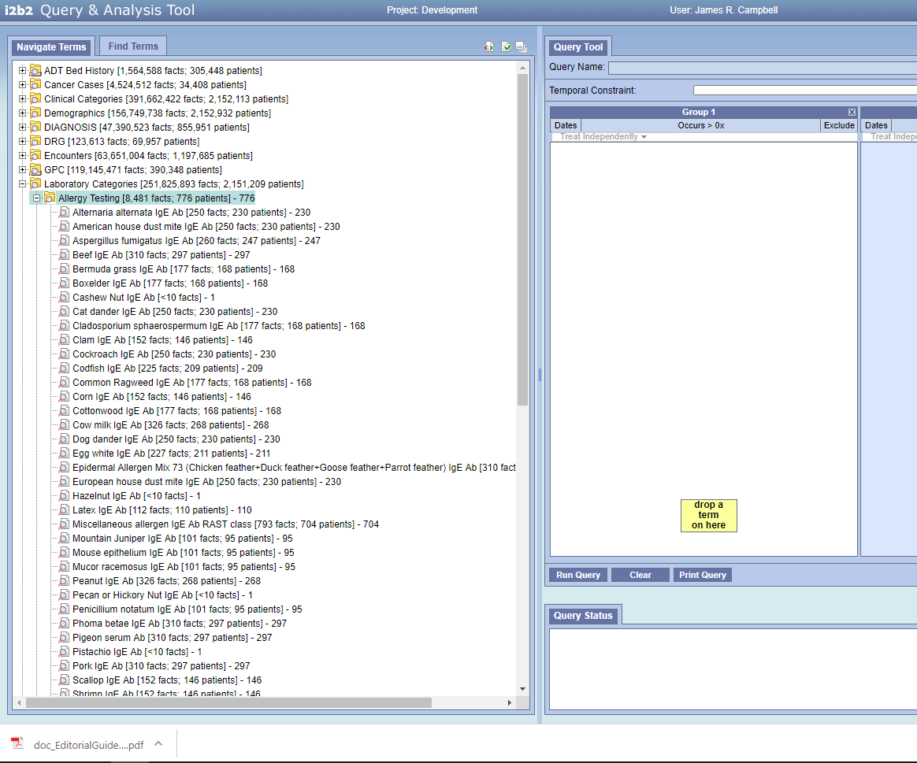
I2b2 metadata Tooling

Slide 26
Questions?
James R. Campbell
campbell@unmc.edu

