Slide 1


Why you should adopt nested concepts and expression templates as the new way to translate SNOMED CT
SNOMED international Translation User Group
22th of September 2020
Marie-Alexandra Lambot, MD
Adjunct to the Medical Direction, CHU St Pierre, Brussels, Belgium
Coordinator of the Consortium for Support on Clinical Terminologies (CSCT)

Slide 2

The classical "recommanded" way of translating SNOMED CT
Translation guidelines
Selection of the subset to translate
Meaning based translation by reviewer 1
Meaning based translation by reviewer 2 either in parallel or sequencial
Reconciliation by a "judge" of the differences if there is a discordance between the two reviewers
Linguistic quality controls
Technical controls
NRC
Domain experts
NRC

Slide 3
The classical "recommanded" way of translating SNOMED CT
Translation guidelines
Selection of the subset to translate
Meaning based translation by reviewer 1
Meaning based translation by reviewer 2 either in parallel or sequencial
Reconciliation by a "judge" of the differences if there is a discordance between the two reviewers
Linguistic quality controls
Technical controls
NRC
EMPTY
Domain experts
NRC

Slide 4
The empty gap in the classical translation method
No guideline about structured preparation of the translator's work using for example automatical lexical based translations
Each concept is translated by itself
  no guidelines about translating concepts by "family" (branch of subhierarchy)
  no recommandation to refer to a "canonical" translation of its attributes - value pairs
  no recommandation to refer to the translation of the "nested concepts that might be contained in the FSN of the concept to be translated
The systematic standardisation of the reviewer's work happens (if any) "at the tail", after the domain experts' work and is mainly of linguistic nature
Why try to chase the tail of the beast when you could steer it much better by starting standardization at the head?

Slide 5
Lexical based pretranslation
Method invented by Dr Michel Walravens
Parse the FSNs into single "lexical units" = words, digits or punctuation marks
Translate each of these units in a lexicon in two steps:
  Google pretranslation
  Validation of the translation(s) by experts with regard to the context of the FSNs these concepts will be used into
  Eventually group words that appear systematically together in the lexicon as "multiwords"/"word group" lexical entries
Produce a lexicon-based automated pretranslation using programmed grammatical rules

Slide 6
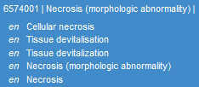





The notion of "nested concepts"
A lexical-based translation is good method to speed up the translation process and offer some basic level of standardization to the translators
But we can do much better because some words or word groups ("multiwords") in the lexicon are in fact SNOMED CT concepts themselves
Example: 429224003 | Acute renal failure due to acute cortical necrosis (disorder) |

Slide 7
Nested-based translation
Consists in first running the FSNs of the subset to be translated against the international Edition to identify the nested concepts then to
Translate the "root" nested concepts as a pre-required sub-project, following the usual translation best practice for SNOMED CT concepts
Translate the words that are not SNOMED CT nested concepts/word groups as in the classical lexical approach
Proceed with either manual "recomposition" or the more precoordinated concepts to be translated by the translators or offer them advanced lexical- nested-based pretranslations to judge
Note that while this process is described here on FSN since those are the "source of truth" it could be applied to the English international acceptable synonyms too to offer more suggestions to the translators.

Slide 8
Nested-based translation
Offers a higher quality of pretranslations to start with for the domain experts
Higher standardization inside concept family groups at pretranslation level but the authors can still refuse to take these suggestions into account
Does not guarantee standardization of the structure of the term "sentence"
Quality can be severly affected by the (lack of) quality of the programmation of the grammatical reconstruction algorythm

Slide 9
Translation templates
Inspired by SNOMED international editorial templates for concepts but taking into account the specific problems related to translation
Aims to offer a standard "sentence" construction and similar terms for families of concepts, taking into account the previous translation of root-words, root-nested concepts and less precoodinated concepts of the same family
Gives rules on the default choice of the PT (may be changed on a case by cas basis if the clinical usage prefers another term) and the default synonymes to be added (may be omitted on a case by case basis if they turn out to be linguistically correct but artificial for clinicians)
Can either be built "as you go" from the suggestions of the reviewers 1 as they stumble on recurrent patterns in concepts they translate or be the subject of a specific preparation work on subhierarchies or on concepts using specific attributes or a mix of both.

Slide 10
Top down translation template example (1)
Root concept translation:
39607008 |Lung structure (body structure)| => poumon, structure pulmonaire
7771000 |Left (qualifier value)| => droit
24028007 |Right (qualifier value)| => gauche
=> 44029006 |Left lung structure (body structure)|
3341006 |Right lung structure (body structure)|
Template BS-0001: " structure of [localization] lobe of [laterality] lung "
[localization] values= (empty), upper, middle, lower
264217000 |Superior (qualifier value)| => supérieur
260528009 |Median (qualifier value) | => moyen
261089000 |Inferior (qualifier value)| => inférieur
PT: " lobe [position] du poumon [latéralité] "
Ps-FSN: " structure du lobe [position] du poumon [latéralité] "
Syn 2: " lobe pulmonaire [position] [latéralité] "
[laterality]
[latéralité]
[position]

Slide 11
Top down translation template example (2)
Template BS-0004: " structure of [localization2] segment of [localization] lobe of [laterality] lung "
[laterality] values = (empty), right, left
[localization] values= (empty), lower, middel, upper
[localization2] values= (empty), apical, subapical, lateral, ….
PT: " segment [localisation Nouvelle Nomenlclature] du lobe [position] du poumon [latéralité] " (Med acad)
Ps-FSN: " structure du segment [localisation Nouvelle Nomenlclature] du lobe [position] du poumon [latéralité] "
Syn 2: " segment [localisation ancienne nomenclature] du lobe [position] du poumon [latéralité] " (Med acad)
Syn 3: " segment [numéro en chiffre romains] du poumon [latéralité] "
Syn 4: " terme latin venant de la Terminologia Anatomica " + en remarque: "latin TA [nr de TA] "
Syn 5: " segment [localisation] du lobe (pulmonaire) [position] [latéralité] "
BS-0001

Slide 12
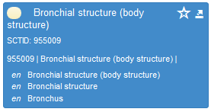
Top down translation template example (3)
20218002 | Structure of middle lobe lateral segmental bronchus of right lung (body structure) |
Template BS-0008: " structure of [localization] lobe [localization2] segmental bronchus of [laterality] lung "
Root concept translation: 955009 |Bronchial structure (body structure)|
PT: " bronche segmentaire [localisation Nouvelle Nomenlclature] de la bronche lobaire [position][latéralité] " (académie de médecine)
Ps-FSN: " structure de la bronche segmentaire [localisation Nouvelle Nomenlclature] de la bronche lobaire [localisation Nouvelle Nomenlclature] "
Syn 2: " bronche segmentaire [localisation ancienne nomenclature] de la bronche lobaire [position][latéralité] " (académie de médecine)
Syn 3: " bronche segmentaire [localisation] du lobe [position][latéralité] "
Syn 4: " bronche du segment [numéro en chiffre romains] du poumon [latéralité] "
Syn 5: " terme latin venant de la Terminologia Anatomica" + en remarque "latin TA [nr de TA] "
Syn 6: optionnel, pour un autre synonyme ancien sur le modèle du Syn 2 ou s'il existe une dénomination utilisant un éponyme (ex: bronche de Nelson du lobe inférieur gauche)
BS-0004

Slide 13
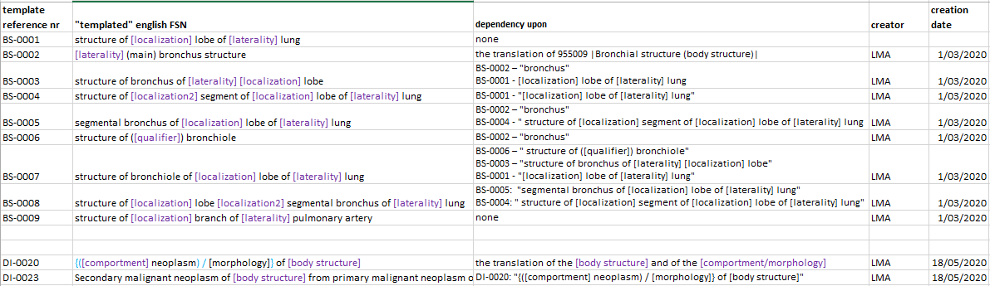
Organizing templates
Quickly the need to keep track of template dependencies arise to
  Know what you have, what you can/must base you upon
  Know what you need to update if you add or modify a given template

Slide 14
Organizing templates: Two aspects to consider
Keeping track of templates in Excel or Jira is quickly inefficient then useless. There a just too may of them with too many dependences.
But what is a template exactly?
Templates are a simplified representation of the SNOMED CT terminology.
If the FSN are unambiguous and well crafted, dependencies between templates mirror of relationships between concepts
Templates differ from concepts only by the fact they use "wild cards" representing simple value sets of concepts for the variable parts of the term
=> What is needed is a hierarchy of templates + their allowed value sets
You would want to keep also a link between the template and every concept it is used for so you can quickly pinpoint which concept translations need updating should you find a flaw with a template

Slide 15

Link between the descriptions and their translation templates
descritptions FR* (CTS)
language refset FR* (CTS)
Translation template association refset (CTS)
Plural to singular link refset FR**(CTS)
1..1
Preferred Fully Specified Name (EN)
1..1
Preferred acceptable synonyme FR
0..n
Translation template row id
Preferred acceptable synonyme FR-plural
0..n
Translation template row id
Concept SCTID
0..1
0..n
Acceptable synonyme FR
0..n
Translation template row id
Acceptable synonyme FR -plural
0..n
Translation template row id
0..1
0..n
Acceptable interface term FR
0..n
Translation template row id
Acceptable interface term FR-plural
0..n
Translation template row id
0..1
A translation template is linked to the concept it is applied to while a translation template row is linked directly to the description that arise from it.

Slide 16
Description translation template association refset structure
Links the description in a given language to the translation template used to create this descritpion in this language.
Note that this method is applicable also to the SNOMED international english templates currently lying scattered in the authoring guide, on various confluence pages and in Jira.
iD | Effective time | Active | Module ID | refsetID | referencedComponentID | targetComponentID
UUID | date | integrer | SCTID | SCTID | SCTID | SCTID
 |  |  |  | Translation template association refset | description ID | Translation template row id
In order to do this, we need to create template concepts and template row concepts and make an association between the translation concept and its rows.

Slide 17
Translation template description file
Template rows are probably best viewed as "descriptions of a translation concept not as concepts themselves.
So it's not so much an association refset but more technically a template description file that should be used to represent template rows and associat them with thamplate concepts.
Template BS-0003
Template X Concept
structure of bronchus of [laterality] [localization] lobe
Template X row1
bronche lobaire [localisation Nouvelle Nomenlclature]
Template X row2
Template X row3
structure de la bronche lobaire [localisation Nouvelle Nomenlclature]
Template X row4
bronche lobaire [localisation ancienne Nomenlclature]
bronche du lobe [position] du poumon [latéralité]

Slide 18
Template relationship file
Dependencies between templates can be represented by "is a" relationships between template concepts.
BS-0001 | structure of [localization] lobe of [laterality] lung |
is a
is a
BS-0004| structure of [localization] segment of [localization2] lobe of [laterality] lung
is a
BS-0003 | structure of bronchus of [laterality] [localization] lobe |
BS-0005| segmental bronchus of [localization] lobe of [laterality] lung
is a
BS-0008 | structure of [localization2] lobe [localization] segmental bronchus of [laterality] lung |
This creates a "backbone" hierarchy of templates concepts mirroring the "true" precise medical SNOMED CT hierarchy.

Slide 19
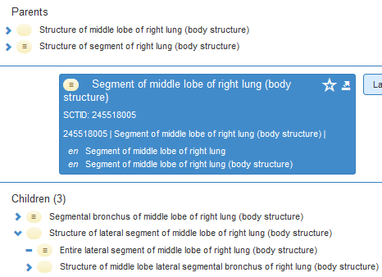
Template relationship file
It is like having a "simplified" version of the terminology with [ wild cards ] that can be represented as simple refsets.
BS-0001 | structure of [localization] lobe of [laterality] lung |
middle
right
is a
[localization]= empty
BS-0004| structure of [localization2] segment of [localization] lobe of [laterality] lung
[localization2]= lateral
is a
middle
[localization]= empty
BS-0008 | structure of [localization2] lobe [localization] segmental bronchus of [laterality] lung |
lateral
right
value set laterality = empty, right, left.
value set localization = empty, superior, middle, inferior.
value set localization2: empty, lateral, medial, anterior, apical, posterior, subapical, apicoposterior, superior.

Slide 20
Translation template rows association refset structure
Links the clincial concept descriptions to their translation templates.
iD | Effective time | Active | Module ID | refset ID | referenced ComponentID | target Component ID | Template language
UUID | date | integrer | SCTID | SCTID | SCTID | SCTID | text
 |  |  |  | Tr. Templ. Row Ass. Refset | translation template concept SCTID | Translation template row SCTID | code de langue au format iso
Translation template acceptability | Obligation status of the description translation Y/N | Singular/plural status | Singular parent ID
SCTID | integrer | SCTID | SCTID
translation template default acceptability | 0/1 | plural form | Description ID of the singular term it is the plural of
Translation template
Template language/dialect
structure of bronchiole of [localization] lobe of [laterality] lung
FR
bronchiole du lobe [localisation] du poumon [latéralité]
Preferred term
1
Terme singulier
structure d'une bronchiole du lobe [localisation] du poumon [latéralité]
Pseudo-FSN
1
Terme singulier
bronchioles du lobe [localisation] du poumon [latéralité]
Acceptable synonym
1
Terme pluriel
SCTID
Template rows
Row acceptability
Descriptionrow obligation
Plural status
Singluar parent

Slide 21
Translation template row values association refset structure
Linking the chosen value from the value set for each of the wild card(s) might be interesting too.
Representation of the values might be done with a refset looking like this
iD | Effective time | Active | Module ID | refset ID | referenced ComponentID | target value set
UUID | date | integrer | SCTID | SCTID | SCTID | SCTID
 |  |  |  | Tr. Templ. Values Ass. Refset | Translation template row SCTID | SCTID of the refset used in the template
value type | Value | Value language
SCTID / text | text/SCTID | text
SCT concept or non-SCT word | Term if it is a non SCT concept. SCTID of the descrition in the translation language | code de langue au format iso
Template row
bronche segmentaire [localisation2] de la bronche lobaire [localisation][latéralité]
Important for the non-SCTID who are not linked to a language refset like the SCTdescriptions
[Localisation2 refset]
Text
"apicale"
FR
[Localisation refset]
SCTID
SCTID description FR "inférieure"
FR
[Laterality refset ]
SCTID
SCTID description FR "gauche"
FR
Target value set
Value type
Value
Value language

Slide 22
Translation templates creation process
Start by the root / nested concept(s) of the subfamily
Let a first author work on a few concepts of the subfamily and propose the template(s)
Submit the template(s) to another author and have him apply the template(s) to other concepts of the subfamily to see if it (they) fit(s)
Put the authors together to modify the template(s) according to the remarks if any
Have the authors apply the template(s) to all the subfamily
If any additional remarks arise, modify the template(s) and re-apply the modified template(s) to all the subfamily
Storage of the templates/values used in each term should be linked immediately to the term while authoring it, thanks to an adequate tooling interface

Slide 23
Conclusion
The creation of translation templates:
Help standardize SNOMED CT description terms in non-Core languages
Takes more preparation time but speeds up the translation process itself once the templates are in place
Imposes a real thorough comprehension of the concept, its relation AND exploration of its family => less risk the author will do a lexical translation without fully understanding the concept
Help pinpoint the current errors in the structure of FSNs and synonyms so the work on non-Core templates should always refer to current SCT authoring templates when available and ideally should be linked to a reporting system/correction system of the English descriptions
Proposes a way to store the Core authoring templates currently scattered in the authoring guide, confluence and Jira as a SCT file format that can be distributed with the International Edition and used in authoring tools

Slide 24
Conclusion
Further work is needed to evaluate if creating a "SNOMED CT Edition of templates" containing template concepts, descriptions and relationships, however over-ambitous this may sound at first, wouldn't be the most logical and best approach to template storage if we want to move toward a higher standardization of the SNOMED CT terms, in whatever language they come.

Slide 25


Thanks for your attention
@ Belgian Consortium for Support on Clinical Terminologies
https://csct.be
contact: info@csct.be

