Slide 1

Clinical Engagement in Sweden
Daniel Karlsson and Keng-Ling Wallin
The National Board of Health and Welfare (Socialstyrelsen)
Sweden
Notes:
DK

Slide 2
Contents
Healthcare and knowledge management in Sweden
NRC and clinical engagement
Examples of clinical engagement
Challenges
Notes:
DK

Slide 3
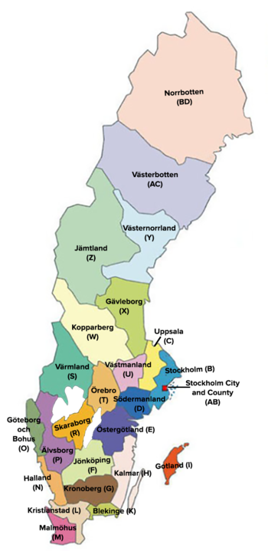
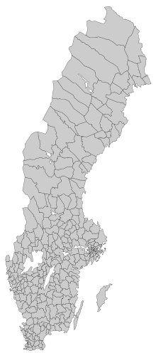
Healthcare in Sweden
Sweden is divided into 290 municipalities and 21 regional councils. Swedish healthcare is (largely) government-funded and decentralized. Responsibility lies with the regional councils and in some cases, with the local councils or municipal governments.
The role of the central government is to set the political agenda for health and medical care, through the establishment of principles and guidelines.
Notes:
10.35 M citizens (june 2020)
Region, largest Stockholm 2.3 M, smallest Gotland 60 k
Municipality, largest Stockholm 1 M, smallest Bjurholm 2.4 k
DK

Slide 4
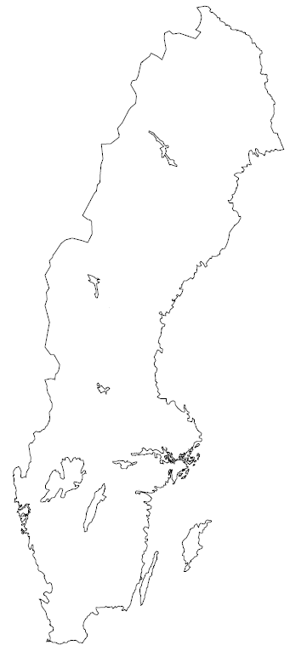
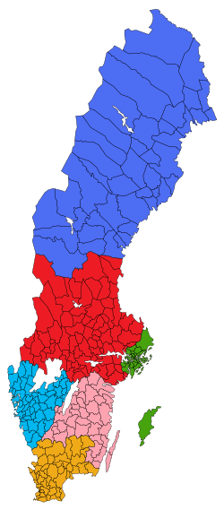
Healthcare knowledge management in Sweden
International level
National level
  Government agencies (Board of Health and Welfare, Public Health Agency, Medical Products Agency, eHealth Agency, …)
  Professional societies
(Multi-)Regional level
  National program areas
  National collaboration groups
  Interregion collaboration
  Domain-specific interregional collaboration, e.g. cancer
Notes:
DK

Slide 5
The National Board of Health and Welfare – the Swedish NRC (national release center) for SNOMED CT
NRC’s role
Maintainence of SNOMED CT terminology (Swedish SNOMED CT extension)
  Including translation into Swedish
Provide educational, advisory and terminology-based support services to SNOMED CT users; primarily for implementation purposes.
Notes:
KW

Slide 6
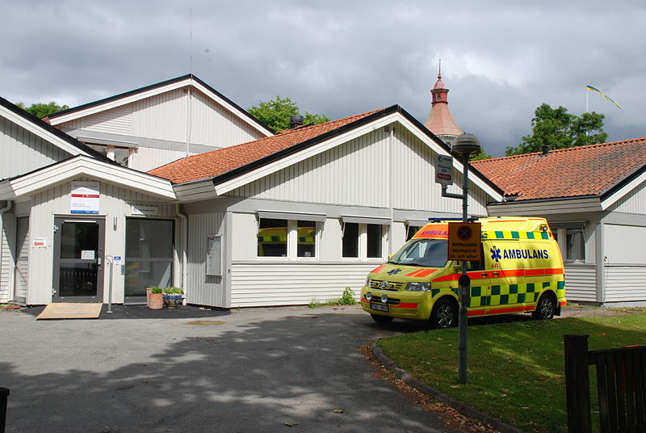
Clinical engagement
At the NRC
  We are a mix of staff with clinical and non-clinical background
In collaborative project and maintenance tasks
  Clinical reference groups available
With professional societies
  Translation
  Development projects
With healthcare regions
  New healthcare information systems
Notes:
DK

Slide 7
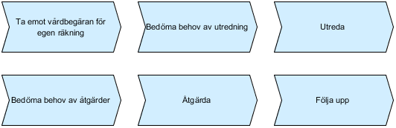
Clinical engagement – typical process
SNOMED CT is a means to and end...
Identification of stakeholders (or opposite)
Requirements
Resources – project and maintenance phase
Education
  Initial orientation provided by NRC + SNOMED International courses
Supporting SNOMED CT work
Transition to maintenance
Notes:
DK

Slide 8
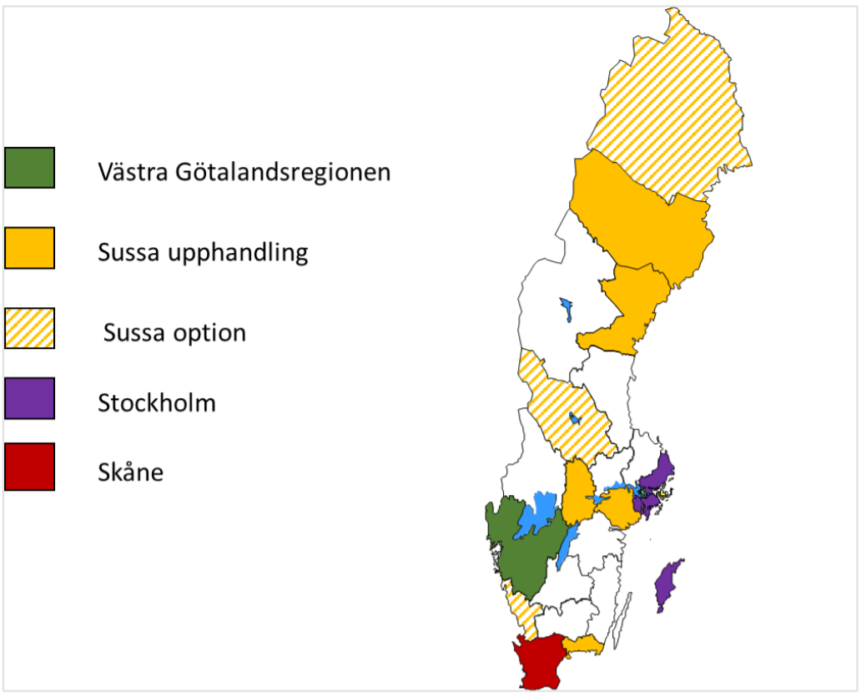
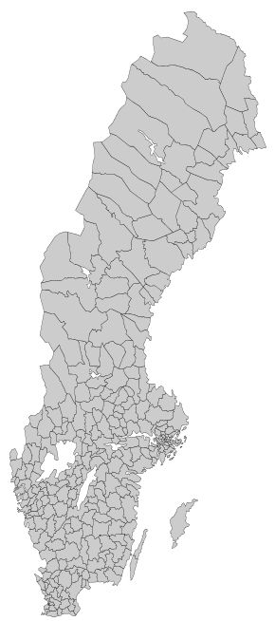
Procurement of new EHR systems
Social welfare
Healthcare
VGR and Skåne – Millenium (CERNER)
SUSSA -COSMIC
Cerner Millenium 2018
Cambio Cosmic 2018
For each region, there are several work streams, staffed with clinicians, that require user support in SNOMED CT
Cambio Cosmic 2019
Yet undecided
Cerner Millenium 2018
Cambio Cosmic < 2018
Notes:
DK

Slide 9
Areas of clinical engagement: National projects
NKOO – National Knowledge Base for Reasons for Prescription
UMI – Alert information
Intyg – Medical certificates
Infektionsverktyget – Program for Anti-infection control or alert
Nationell läkemedelslista – National Medication List
Kontaktorsak – National index of chief complains
National Recommendations and Guidelines for diseases, national screening programs for cancer, and in dentistry
Laboratory medicine reports
Anatomical pathology
Quality registers
Orders
…
Notes:
DK (NLL) + KW (patologi + lite om resten)

Slide 10
Clinical Specialty Organization Engagement: Ongoing Work
Punktlista Arial fet 26 pkt
Swedish Society of Pathology – synoptic reports
Swedish Nursing association – translation (implementation)
Swedish Society for Dieticians – translation (implementation)
Punktlista
Punktlista
Punktlista
Punktlista
Notes:
KW ICNP

Slide 11
Clinical Specialty Area Engagement: Initiation Phase
Punktlista Arial fet 26 pkt
Radiology
Action against obesity in children
Cancer
Care protocols for schizophrenia, stroke, heart failure, sepsis
Genomic Medicine
Punktlis
Notes:
KW

Slide 12
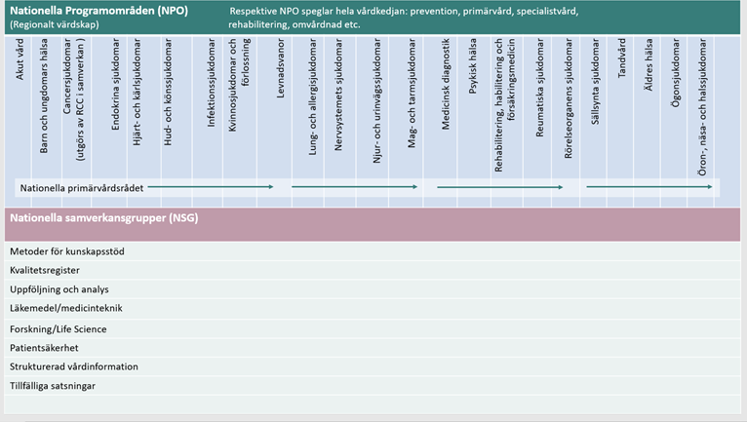
Swedish Association of Local Authorities and Regions - Professional advisory groups (Sv. NPO)
Professional advisory groups for implementation of the new healthcare systems.
Punktlista Arial fet 26 pkt
Punktlista
Punktlista
Punktlista
Punktlista
Nationella Samverkansgrupper (NSG)
NSG for Structured dokumentation of health information
Notes:
DK

Slide 13
Challenges
Decentralised mandate – responsibility for healthcare lies with the regional councils and in some cases, with the local councils or municipal governments
In a paradigm shift – procurement of new healthcare systems
Knowledge about SNOMED CT
Legacy issues from older healthcare systems
Notes:
KW

