Slide 1
Disease exacerbations
Bruce Goldberg MD, PhD
Notes:
I would like to review the model for combined disorders by going over the background principles that lead to the development of this model as well as discuss the individual modeling patterns with the hope of answering some of the questions that have arisen in terms of applying the model

Slide 2
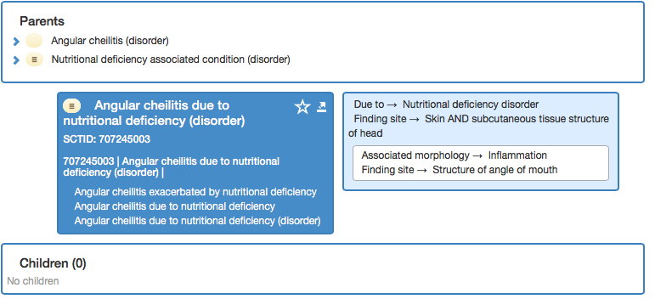
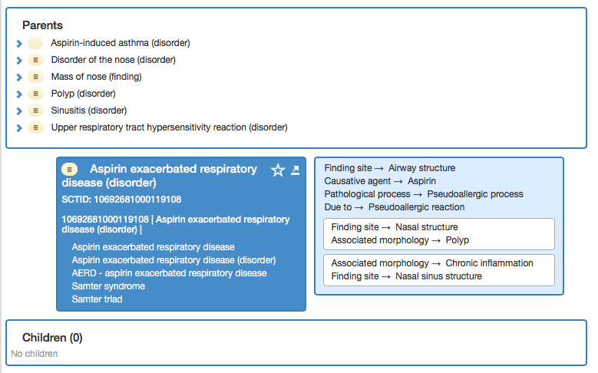
Exacerbated by
Another type of association is the exacerbation (worsening) of a disorder by another disorder, procedure or material agent
These associations are often masked by using FSNs and models that incorrectly imply causality

Slide 3
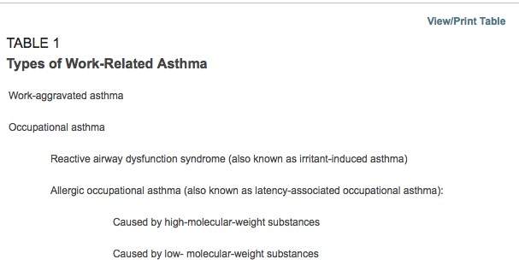
Work-related asthma
Work-related asthma includes work aggravation of preexisting asthma and new-onset asthma induced by occupational exposure (i.e. occupational asthma).
Youakim S. Work-related asthma. Am Fam Physician. 2001 Dec 1;64(11):1839-48.PubMed PMID: 11764862.

Slide 4
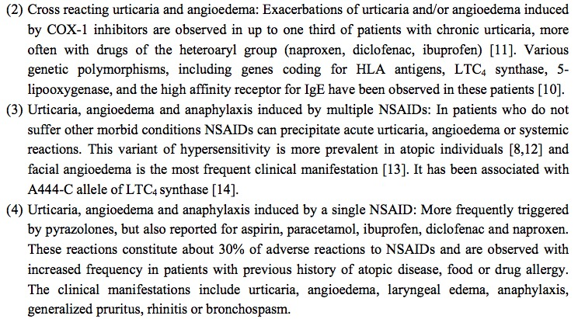
Issues identified - 2
241959003 |Non-steroid anti-inflammatory drug-induced angioedema-urticaria (disorder)|

Slide 5
Patterns
Pattern | #
Exacerbation of | 69
Aggravated by / X aggravated Y | 6
Worsening X | 3
Exacerbated by / X exacerbated Y | 5
Worse by | 1

Slide 6
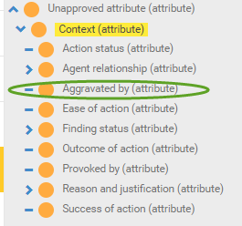
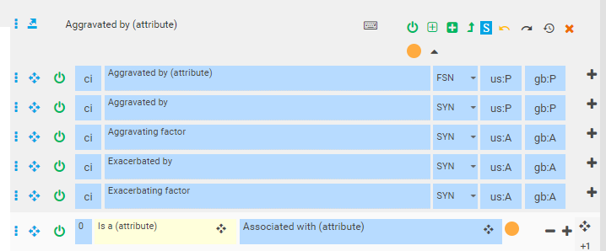
410660005 |Aggravated by (attribute)|
Current location
Proposed location
Proposed domain: clinical findings and disorders
Proposed range: clinical findings and disorders, substances, physical forces, physical objects

Slide 7
Models
Goal is to have X exacerbated Y classify under Exacerbation of Y and not X caused by

Slide 8
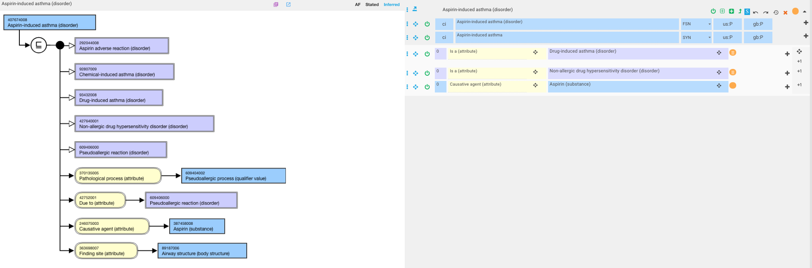
407674008 |Aspirin-induced asthma (disorder)|

Slide 9
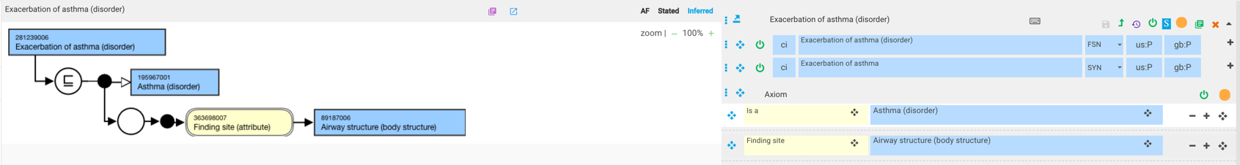
281239006 |Exacerbation of asthma (disorder)| - current model

Slide 10
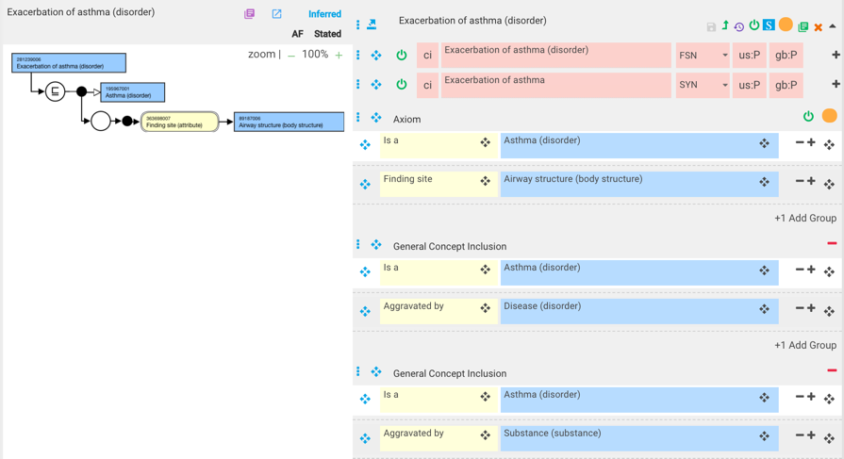
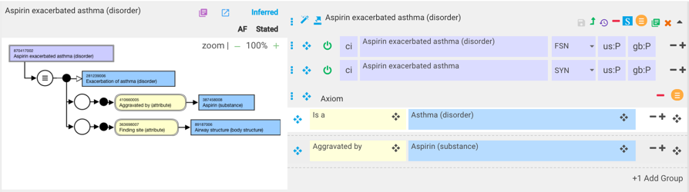
Aspirin exacerbated asthma

Slide 11
371627004 |Angiotensin converting enzyme inhibitor-aggravated angioedema (disorder)|
current model
revised model

