Slide 1
Dentistry CRG
June 3, 2020
13:30 UTC
Link:https://snomed.zoom.us/my/dentistrycrg

Slide 2
Agenda
Attendance and Regrets
Meet our new editor, Nicola Ingram
Editor’s report, outstanding projects and issues
Update on odontogram ref set
Primary/Permanent tooth status updates
Periodontal classification system status
Proposed work project from Malaysia
Patient directed care concepts
Oral Health Status concepts need revision
Meeting updates
Old Business
New Business

Slide 3
Odontogram refset
Will be revised to add the concepts submitted for primary and permanent teeth that hopefully also reduce confusion caused by synonyms.
Revised version will be released later this year.
Initial use case is for information exchange
  Intent is to use FHIR

Slide 4
Primary/Permanent Revisions
Penni submitted a list of changes but left the multiple groupers alone at this time
Grouper review and evaluation will be part of a new work plan
This key initial step is designed to allow for better representation of the odontogram and will be added to that ref set.
Spreadsheet forwarded with this slide deck
*Any volunteers willing to lead/work on the groupers?*

Slide 5
Periodontal Disease submissions
SNOMED has received (verbal) permission to use the 2017 periodontal classification system to develop new concepts
For periodontal disease, a set of pre-coordinated concepts representing each of the stages and grades has been submitted. Copy of spreadsheet accompanies this slide deck
Significant work remains as we move into the many areas of gingival disease and relationships to other health factors
*Small group is working with the periodontal community on this process. Anyone is welcome to join in. Send me your contact info, if interested.*

Slide 6
Malaysian Work Plan Request
Borneo Post 11-1-2019

Slide 7
Malaysian Work Plan Request
Primary use case: Review procedures and identify the processes (steps) necessary to perform or complete the specific dental procedure. Create SNOMED concepts for any process not currently represented and create an appropriate hierarchy for the processes to be properly linked to a specific procedure. There may then be a rationale for developing a reference set of processes used in dental procedures.
Secondary use case: Provide a necessary terminology and reference tool that can be effectively used in MyHarmony.

Slide 8
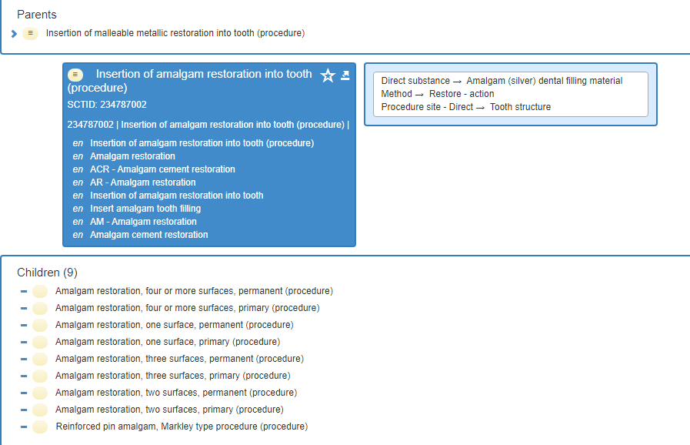

Slide 9
The procedure (amalgam restoration)
What are the processes?
  Anesthetize
  Preparation by removing tooth structure and/or current restorative material
  OR by preparing a fractured portion of tooth structure to retain an amalgam
  Place any base materials
  Place/insert amalgam
  Carve/polish

Slide 10
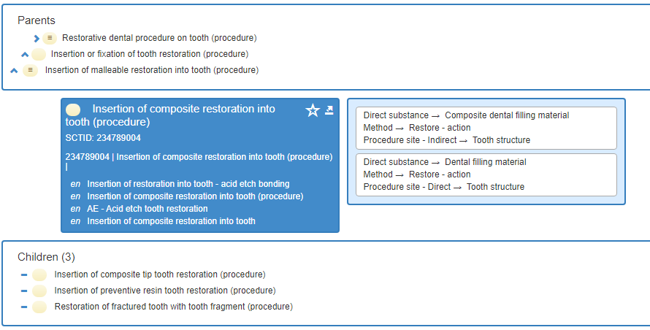

Slide 11
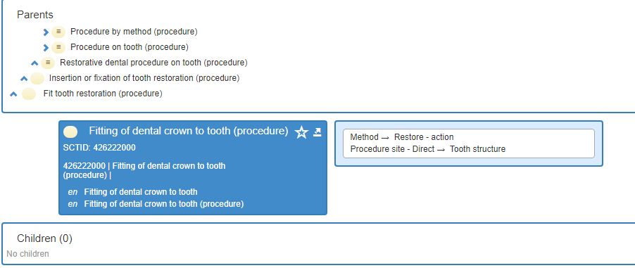

Slide 12
Process or Procedure (or both?)
Do we need a grouper and hierarchy similar to amalgam restoration?
Similar issue for glass ionomer, nothing for compomer
Similar for crown (fitting of crown to tooth)
Procedure hierarchy likely needs some detailed work also
* Shall this be added to our work plan? *

Slide 13
Patient Directed Care Concepts
Have briefly discussed for the past 2 years
A couple of new questions/requests recently
Several useable concepts already in SNOMED CT
* Shall we submit those on the following spreadsheet that are not currently in SNOMED CT? *

Slide 14
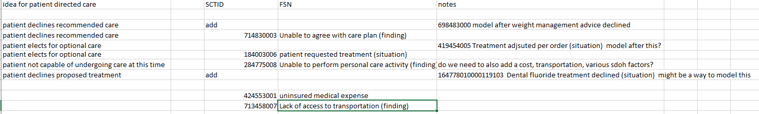

Slide 15
Oral Health Status Concept Issues
Concepts were rejected, note issues below
Several issues identified
  Use of CPITN
    Need permission
    Combination with a scale
  Use of specific ranges for carious teeth
  Extraction “due to” issues
* Need to review again prior to resubmission. My apologies. *

Slide 16
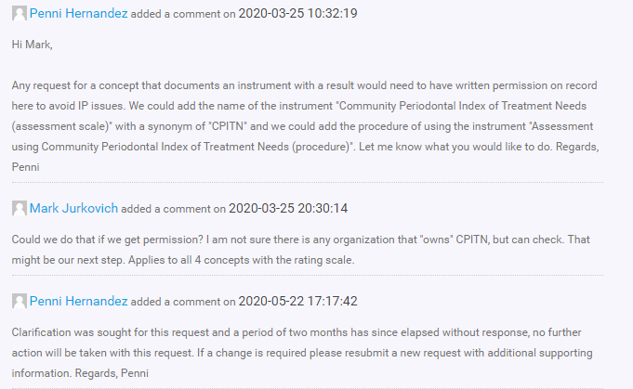

Slide 17
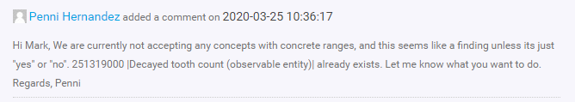

Slide 18
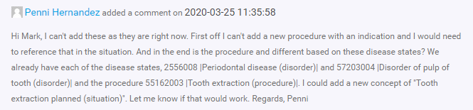

Slide 19
Other Business, Next meetings
In Person meeting in Lisbon has been moved to “Virtual” . Submissions are still open.
Upcoming Zoom meetings: August 5, December 2 (subject to delay for 1 week)
* Shall we add a meeting associated with the “Virtual” Business meeting in October? If so, meeting length? *
New Business?

