Slide 1


SNOMED CT Clinical Web Series
Karen Horridge (Disability Paediatrician - Sunderland & TChair, Informatics for Quality committee, Royal College of Paediatrics and Child Heath, UK
Using SNOMED-CT to articulate and make visible the multifaceted needs of disabled children: an opportunity to improve outcomes?
Srdan Prodanovic (Owner of ezDerm)
SNOMED in EZDERM - supporting dermatology requirements
Wednesday, June 3, 2020
15:00 UTC

Slide 2
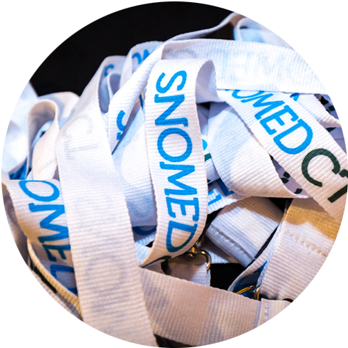
Upcoming Webinars:
RESEARCH WEB SERIES
Wednesday, July 17, 2020
CLINICAL WEB SERIES
Wednesday, July 1, 2020

Slide 3


