Slide 1
Using SNOMED-CT to articulate and make visible the multifaceted needs of disabled children:
an opportunity to improve outcomes?
Dr Karen Horridge, Paediatrician (Disability),
South Tyneside and Sunderland NHS Foundation Trust,
Chair, Informatics for Quality committee,
Royal College of Paediatrics and Child Heath, UK
Notes:
One of the first jobs the SAG is tasked with – defining aims and objectives – those areas of care we want to explore in more details
Organisational
Access to services – including pathways of care
Delivery of healthcare services – including MDT care
The views of the patient and parent carers

Slide 2

Data capture and coding by clinicians at the point of healthcare: Why bother?
Makes each and every need of children and young people visible
Accurate data inform intelligent service commissioning and design, based on patient needs rather than custom/practice
Data evidence activity and outcomes achieved
    Protection of effective services
    Business cases for more resources based on needs
    Revalidation portfolios

Slide 3

Coding = Communication about needs
GP Read coding
Hospital episode statistics
Bespoke databases
Missing ingredient:
  Data capture and coding in community and outpatient settings

Slide 4
Harmonisation of terminologies: SNOMED-CT
Internationally recognised
Independent of hardware/software
Captures multifaceted conditions, situations, technology dependencies, interventions etc.
Regular cycle of review and refresh of terms
Synonyms permitted
Outdated terms ‘retired’

Slide 5

Risks of non-engagement from clinicians
SNOMED CT terms and codes likely to be decided by non-specialists /non-clinicians and imposed
Poor data input = poor data outputs = goals not achieved
Missed opportunity to really improve evidence base for service commissioning, design and delivery
Missed opportunity to improve patient care

Slide 6
Paediatric terminologies set
Paediatric neurodisability terminologies set (296 terms)
Work in progress to expand – currently 3000+ terms and counting!
  Led by RCPCH Informatics for Quality Committee
  Supported by RCPCH subspecialty groups
  Links to terminologies in Emergency Care Data Set
  Collaboration with New Zealand paediatric SNOMED-CT development group
Needs4Pathways webApp in development, to support data capture by clinicians and identify SNOMED-CT terms: a ‘bridge’ until all electronic medical records enable easy data capture

Slide 7
Data capture and coding set-up exemplar:
Collaborative engagement
Clinical champion for data capture and coding
Systems coordinator for electronic medical record
Data analyst
Management support
Drivers:
  Mandate to report diagnostic data to NHS Digital’s
  Community Services Data Set (England)
  Need to achieve accurate population data - all nations

Slide 8
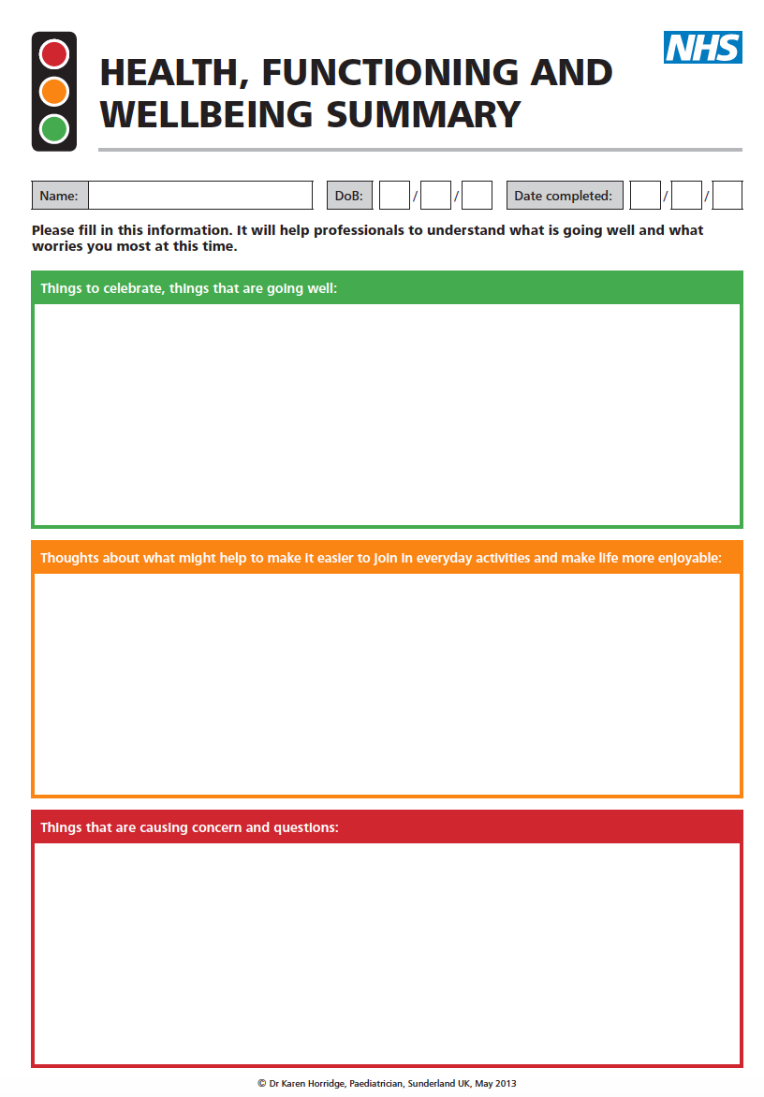
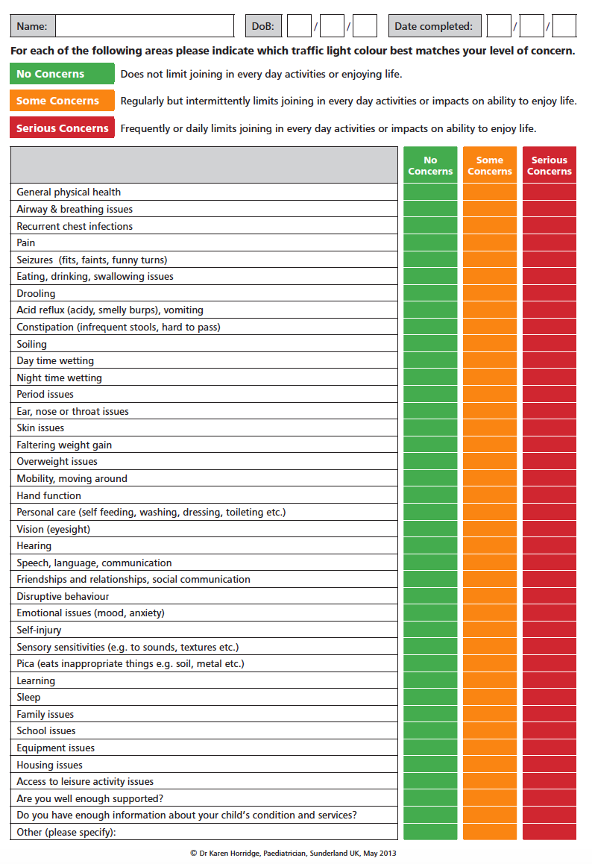

Slide 9
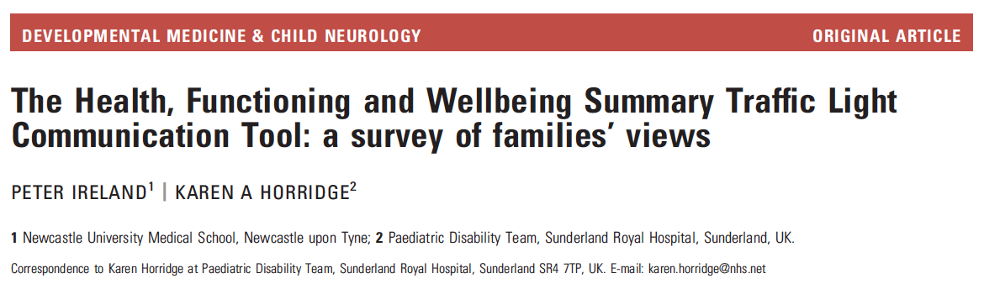

Slide 10
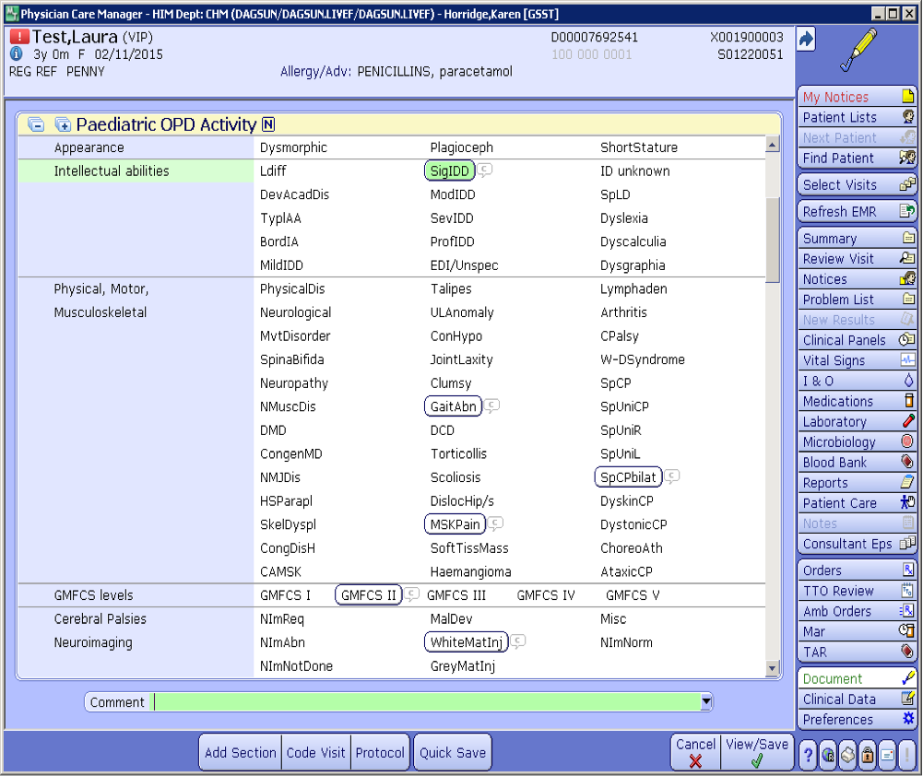

Slide 11
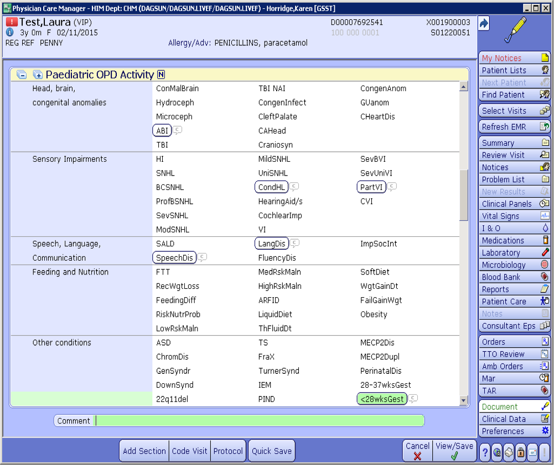

Slide 12
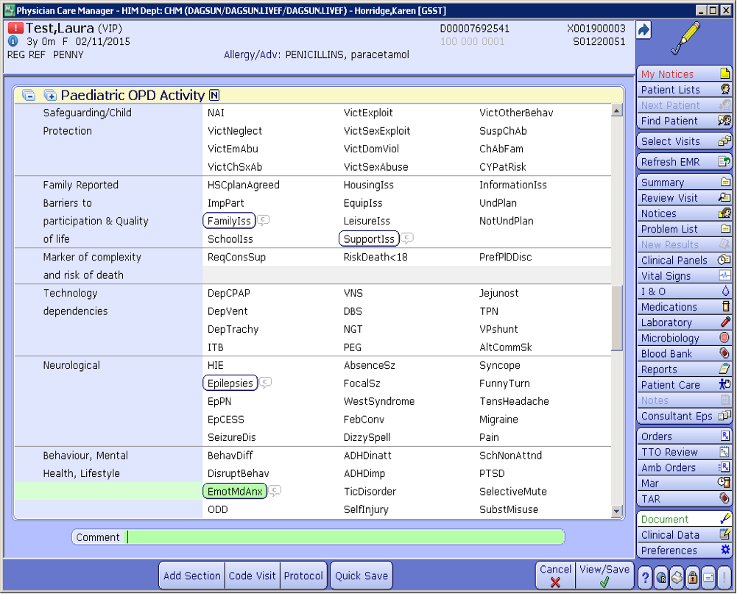

Slide 13
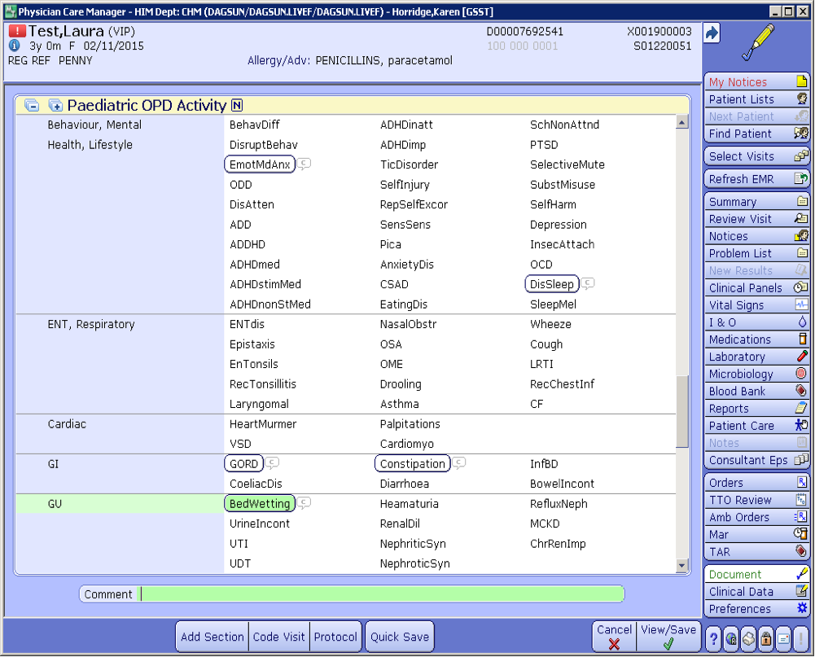

Slide 14
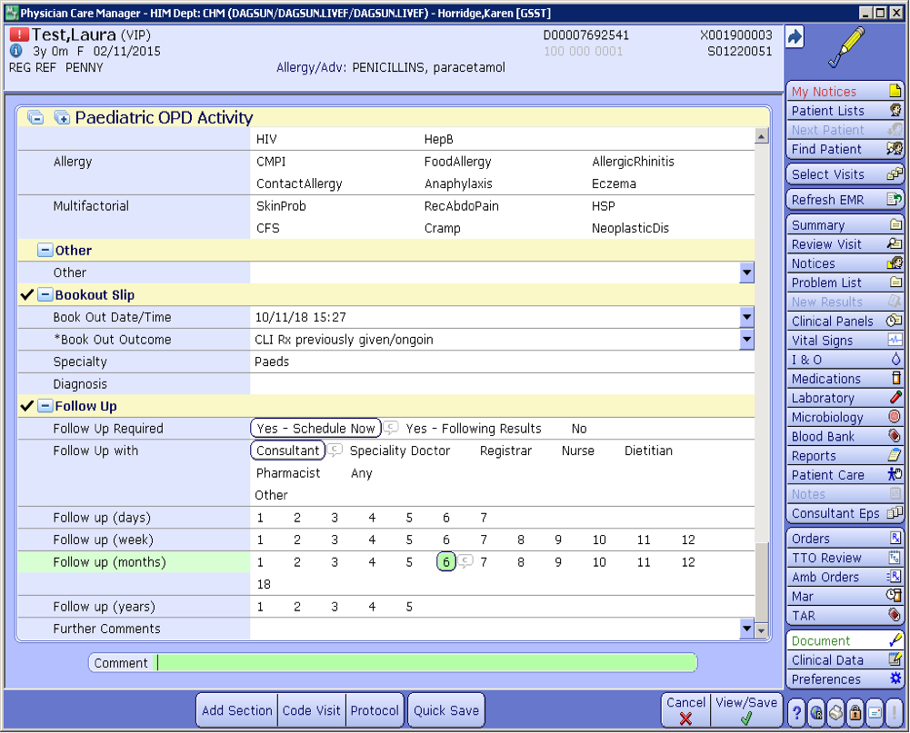

Slide 15
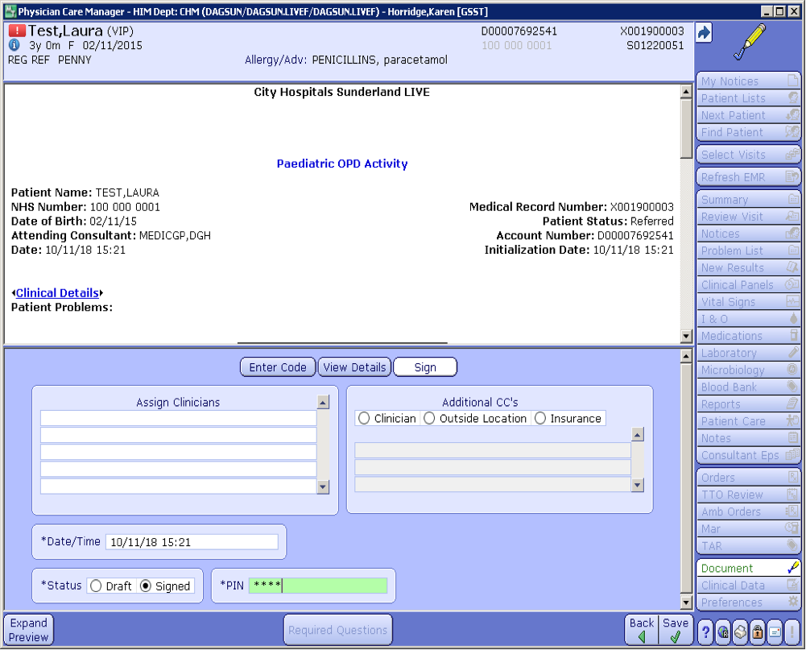

Slide 16
Outcomes of data capture at point of care: local
Improved understanding of patients’ multifaceted needs ✅
  Redesign of clinics and care pathways informed by evidence of population needs
  Rolled out to all Sunderland paediatric clinics
Successful business cases based on evidence of needs ✅
  Additional paediatric disability consultant
  Additional autism specialist speech and language therapy time
Fulfil duty in NHS long term plan to flag records of all with learning disabilities and autism, including notifying GPs to do the same ✅
Joint Strategic Needs Assessment informed by real data ✅
Data flow to NHS Digital’s Community Services Data Set ✅
Robust platform of data for audit and research ✅

Slide 17
Flagging records of all children with learning disabilities and autism
Early identification of learning disabilities and autism allows for early interventions and proactive health, education and social care with reasonable adjustments as needed
Flagging all children with autism and learning disabilities means young people transition to adult services with proactive plans and support in place
Facilitates targeted healthcare and engagement in research to improve outcomes for all

Slide 18
Outcomes of data capture at point of care: national
Development, publication and validation of Disability Complexity Scale ✅
Development of British Academy of Childhood Disability’s Quality Principles for paediatric disability services ✅
Underpins NHS England currency model for services for disabled children & young people, linked to complexity of needs, in time to link to tariffs ✅

Slide 19
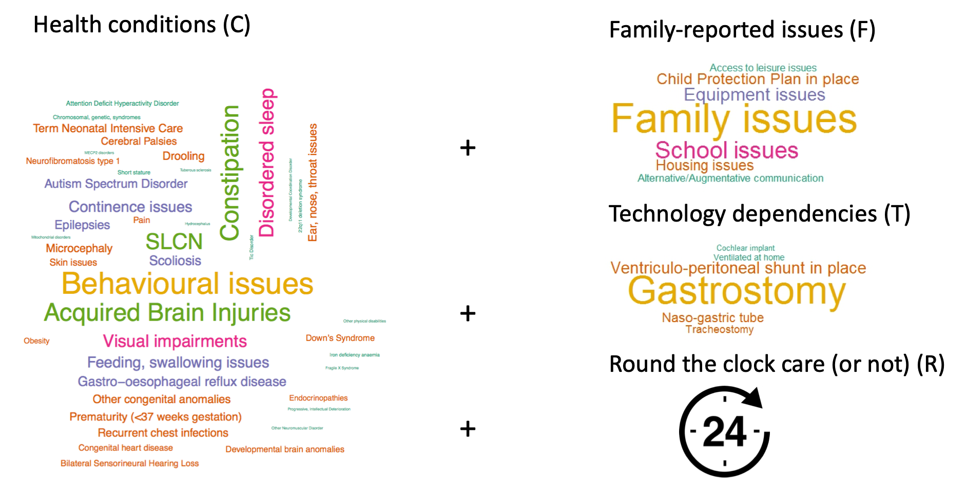
Disability complexity scale

Slide 20
Exemplar data outputs: 1 April 2017 to 31 March 2019
Documented needs of ~7000 children and young people, seen in >14000 consultations
41% girls, 59% boys
~50% new patients

Slide 24
Numbers of new patients by age with
Behavioural, emotional and mental health needs

Slide 28
Profile of most frequently documented needs of children and young people with requirement for round-the-clock care

Slide 31
Percentage of children with and without learning disabilities with each number of needs

Slide 32
Prevalence rates of children with autism spectrum conditions over time as percentage of live births for each birth year

Slide 33

Outputs of data captured at point of care
Will transform the way we:
  Think about our patients’ needs
  Design services to meet identified needs
  Measure outcomes

Slide 34

Notes:
If LD present, 58 times more likely to die before 50 than if no LD present

Slide 35
Data makes each and every need visible
Needs that are visible to providers, commissioners and policy-makers are more likely to be met
Capturing and recording data accurately is the responsibility of us all
Notes:
One of the first jobs the SAG is tasked with – defining aims and objectives – those areas of care we want to explore in more details
Organisational
Access to services – including pathways of care
Delivery of healthcare services – including MDT care
The views of the patient and parent carers

Slide 36
More resources:
RCPCH guide to SNOMED CT coding and best practice videos:
  https://www.rcpch.ac.uk/resources/how-guide-clinicians-interested-developing-snomed-ct-concepts
  https://www.rcpch.ac.uk/resources/snomed-ct-best-practice-videos
NHS Digital SNOMED-CT case study:
  https://hscic.kahootz.com/connect.ti/t_c_home/viewcontent?contentid=301171&done=CONCreated

