Slide 1

Immunoglobulin and Antibody
EAG meeting 03/06/2020

Slide 2
Scope
In Scope:
  Establishing definitions for terms representing Antibody and Immunoglobulin
    Out of Scope:
  Content change
      Should be evaluated and prioritized for a future release
  Additional areas for improvement, e.g.:
      Specific sub-hierarchies: Autoantibodies, Antivenoms, Antitoxins
      Source/Origin: Human vs. Non-human
      Immune globulin vs. Immunoglobulin
      Inconsistency in terming similar concepts:
        76128005 |Antibody to hepatitis B core antigen, immunoglobulin G type|
        710450004 |Immunoglobulin G antibody to Hepatitis B virus surface|

Slide 3
Background
There are two sets of concepts in SNOMED CT:
  << 112133008 | Immunoglobulin (substance) | (Descendants Count: 1252 concepts)
  << 68498002 | Antibody (substance) |(Descendants Count: 3063 concepts)
There is no association between these two supertypes
There are concepts with both supertypes as parent (stated or inferred):
  710439002 |Immunoglobulin G antibody to Filaria (substance)|
  404245002 |Platelet associated immunoglobulin M (substance)|
Some concepts have both terms as description:
  78263004 |Immunoglobulin, constant region (substance)|,
      Syn: Antibody constant region
  722794000 |Antibody to Hepatitis C virus c22p (substance)|,
      Syn: Hepatitis C virus c22p IgG and Antibody to Hepatitis C virus c22p

Slide 4
Antibody vs. Immunoglobulin – Feedback to Date
“Antibody-ness" is a function of the substance immunoglobulin. According to this view, the two concepts 112133008 | Immunoglobulin (substance) | and 68498002 | Antibody (substance)| are duplicates:
  MeSH scope note: https://meshb.nlm.nih.gov/record/ui?ui=D000906
  Dictionaries list them as synonyms or hyponym-hypernyms: https://www.merriam-webster.com/dictionary/immunoglobulin#medicalDictionary
  UpToDate: The terms "immunoglobulin" and "antibody" are generally used interchangeably
All antibodies are immunoglobulins. Not all immunoglobulins have antibody activity:
  Immunoglobulin may refer to a protein structure consisting of chains, fragments and regions. The term "antibody" implies a degree of functionality. Paraproteins of the IgG, IgM, IgD and IgE classes are considered to be immunoglobulins, but frequently are non-functional as antibodies.

Slide 5
Issue Description
The lack of clear definition for Antibody and Immunoglobulin has resulted in:
  Possible duplication in the substance hierarchy and other areas, e.g.:
      418747006 |Hepatitis B surface antigen immunoglobulin (substance)|
        82645009 |Antibody to hepatitis B surface antigen (substance)|
      3527003 |Antibody measurement (procedure)|
        42441008 |Immunoglobulin measurement (procedure)|
  Potential inconsistency in defining concepts in other hierarchies → inconsistent or incorrect classification
      871531005 |Medicinal product acting as passive immunity stimulant (product)|
        9778000 |Product containing Cytomegalovirus antibody (medicinal product)|
        9542007 |Product containing Hepatitis B surface antigen immunoglobulin (medicinal product)|
  Ambiguous terms e.g. 399812006 |Antibody class (substance)|

Slide 6
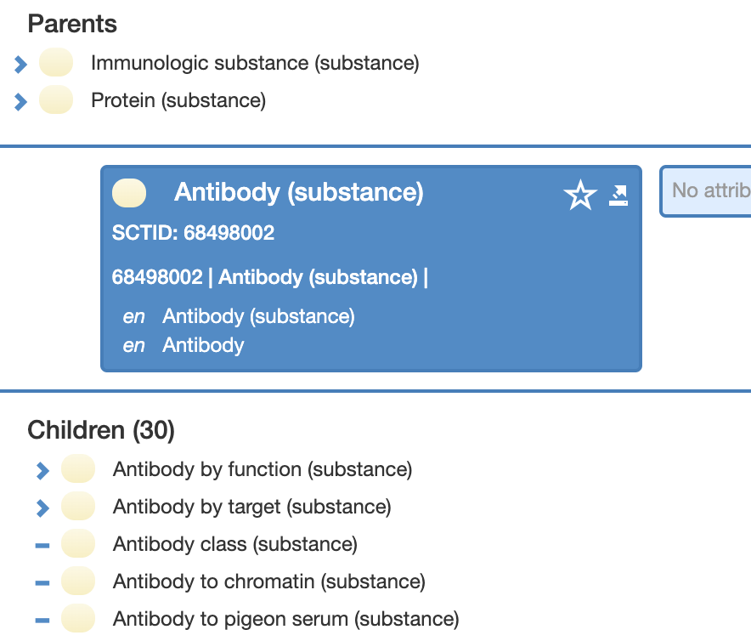
Antibody

Slide 7
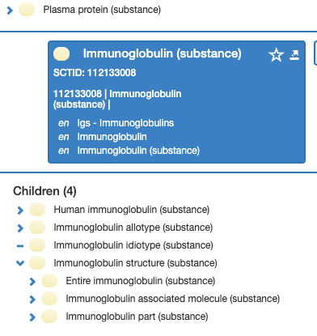
Immunoglobulin

Slide 8
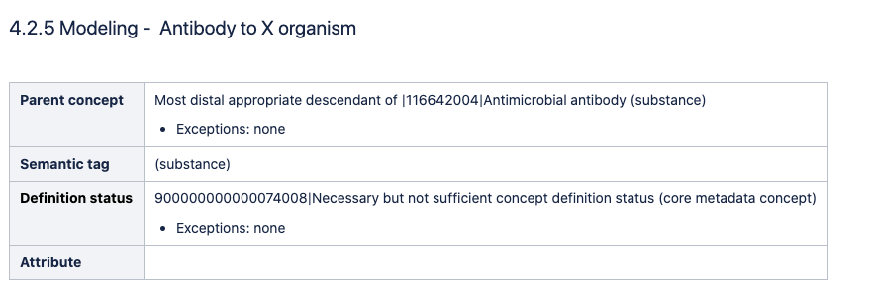
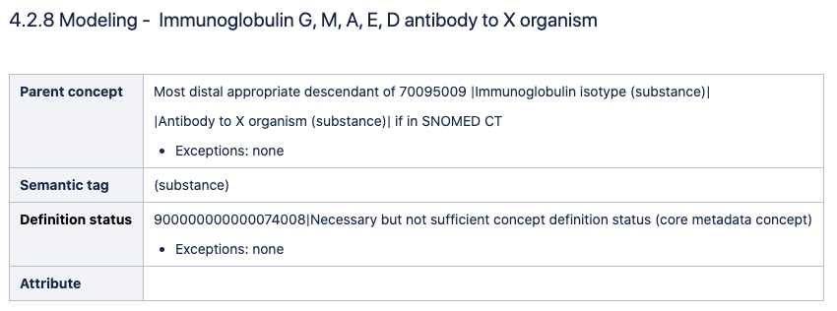
Current Editorial Guidelines

Slide 9
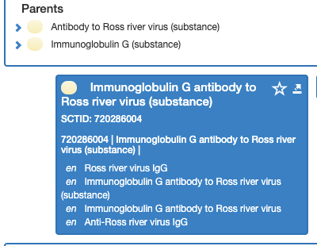
Antibody to Organism X

Slide 10
Options
The terms can be used interchangeably
  How to represent structure vs. functionality? “There is one concept, but that the words are used differently in different situations, "antibody" when there is a specific antigen and "immunoglobulin" if there isn't and both if there is a specific antigen and a specific immunoglobulin class.”
Keep the two concepts and maintain an association between them where applicable:
  Parent-Child: e.g. similar to current editorial guidelines for Microbial antibody
  Attribute-Value Pair: e.g. disposition – requires a tremendous change in content in multiple hierarchies

Slide 11

Thank
you!
Please contact Farzaneh Ashrafi| fas@snomed.org for further information.
11

