Slide 1




Information models: from sharing to analytics
Charles Gutteridge
Clinical Engagement Lead Europe

Slide 2
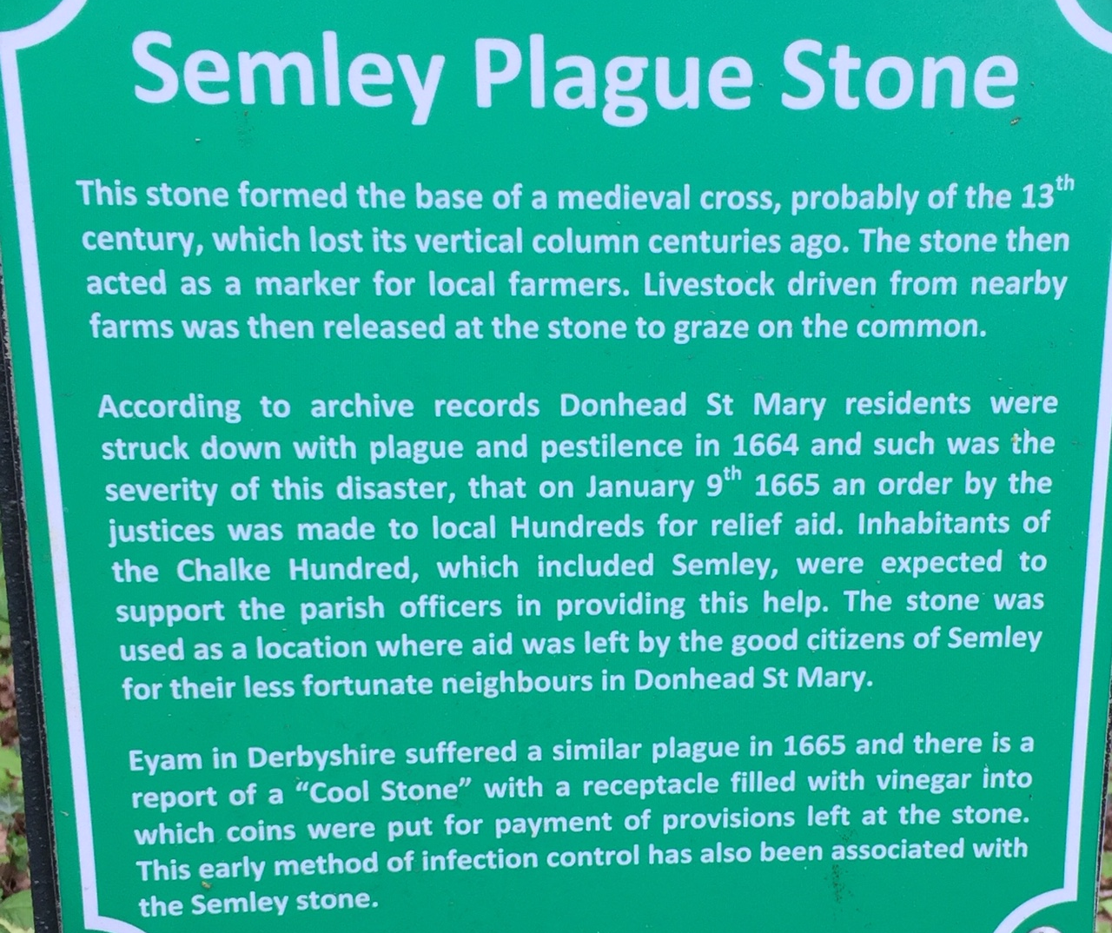
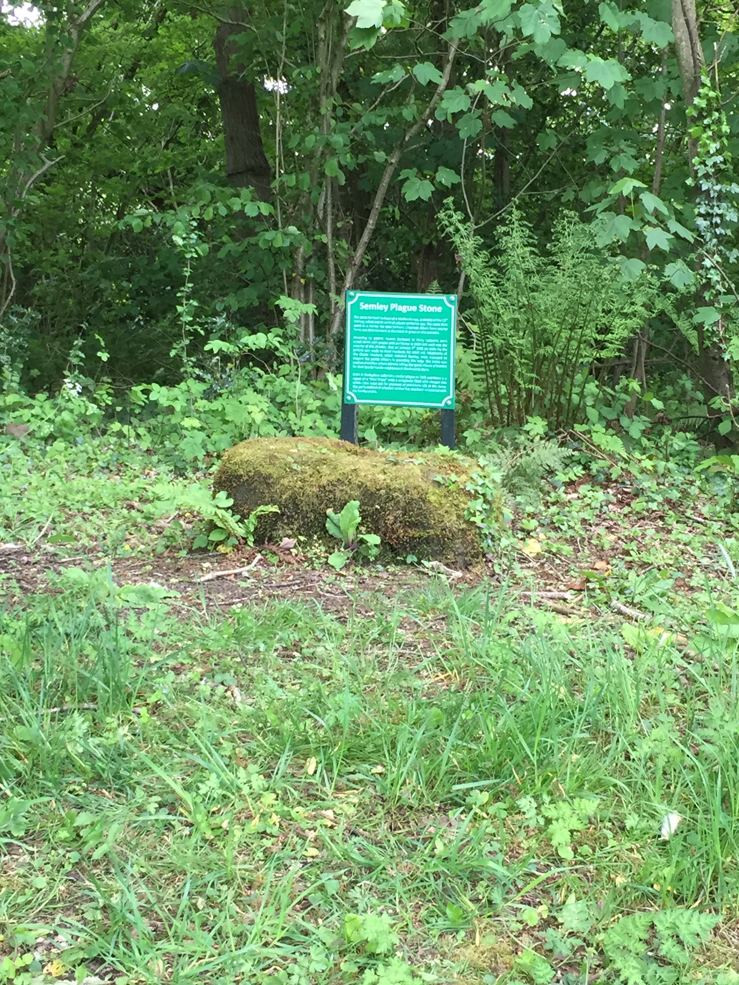
Information point

Slide 3


Slide 4


Recording signals from the real world
The computable semantic record

Slide 5
How do people think about their health?
How am I?
What do my family know about me?
What do others know about me?
What is in my records?

Slide 6
A possible high level conceptual model
Patient, providers, locations and organisations
Health profile – includes social determinants of health
Health interventions – products and services offered by provider
Health care plan – work plans, goals and objectives for patients within the health and healthcare domain

Slide 7
Developing a clinical vocabulary
Multidisciplinary
Easy navigation
Comprehensive
Computable

Slide 8
Considerations for using EHR data for benefit
Societal context
People focus
Regulation
Confidentiality
Data security
Consent
Data
Are the real world data of sufficient quality?
Minimal missing data
Reliable and valid
Established data quality procedures
Methods
Are the methods sufficiently rigorous?
Interventional or observational
Prospective or retrospective
Analytics appropriate
Credible
Reproducible
Clinical context – is there a question to be addressed using real world data?
Disease prevalence
Treatment effect
Ethical review

Slide 9
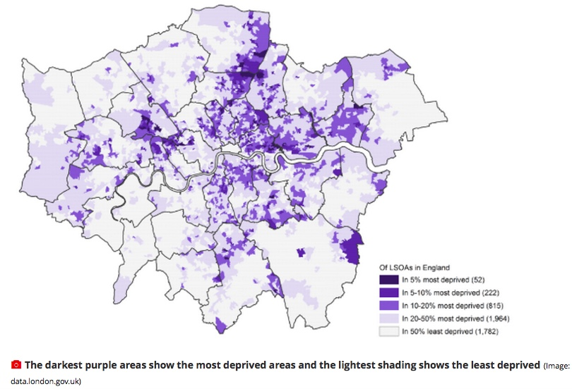

Slide 10
Moving to the new world: the LHR
east London Patient Record (eLPR)
  IHE standards
  SNOMED encoded lists
  Free text
  Multi-user platform
Discovery Data Service
  Data service for health and social care
  SNOMED on FHIR
  Publisher- subscriber model
  Research access and consent model

Slide 11
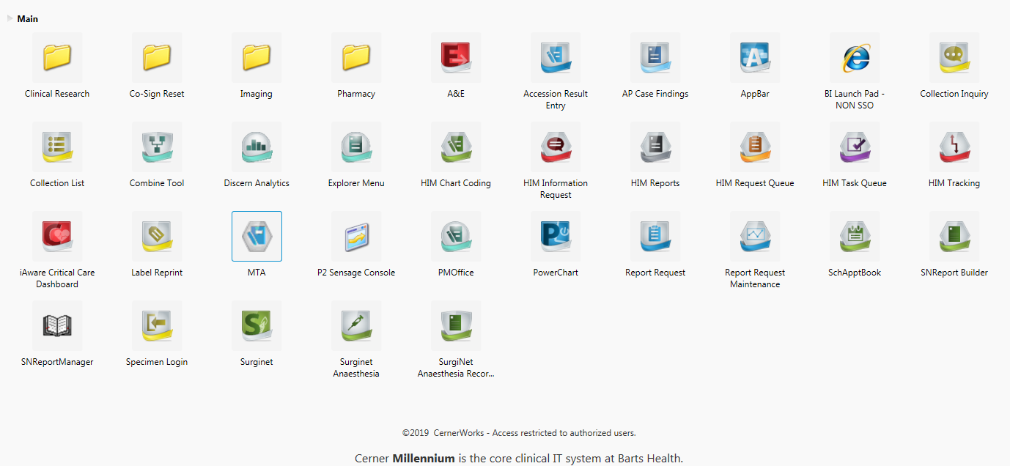
Conceptualising a health record

Slide 12
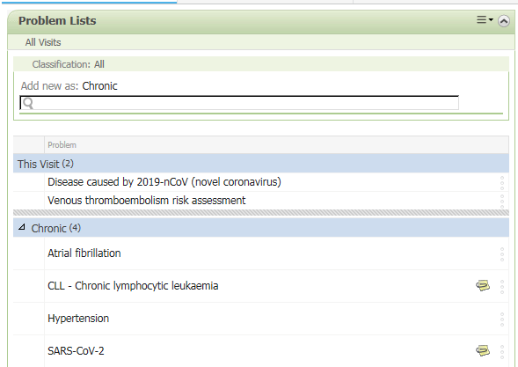
Hospital
problem list

Slide 13
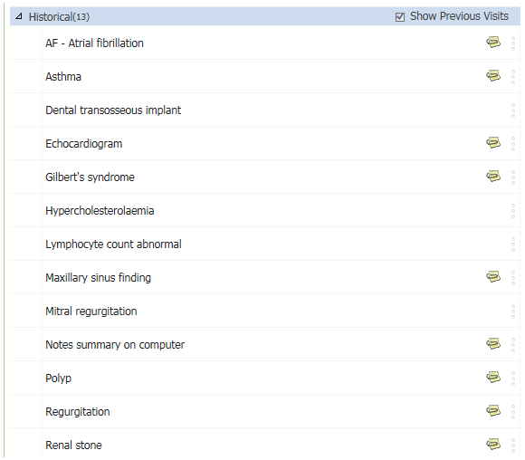
Curation
challenges

Slide 14
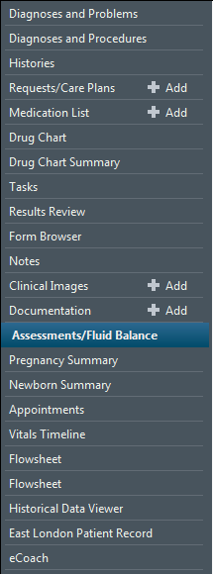
EHR – Table of contents

Slide 15
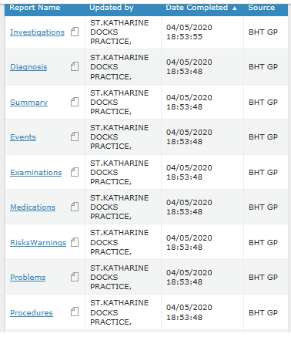
Structured data by
GP heading

Slide 16
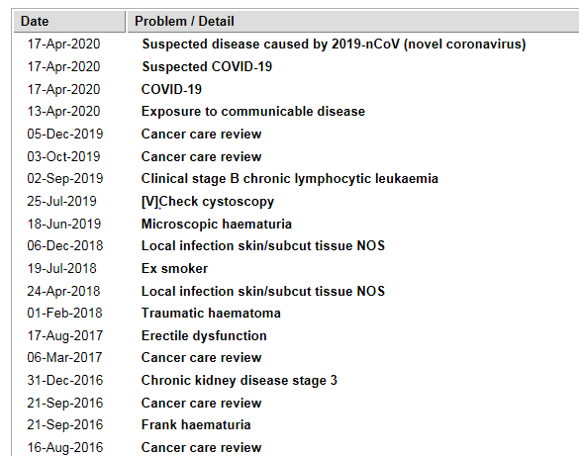
The GP problem
list in the ELPR

Slide 17
Where are we going and where have we got to?
Ubiquitous data sharing and viewing
Normalised data service for population health and research
Health data use and ownership by patients and citizens

Slide 18
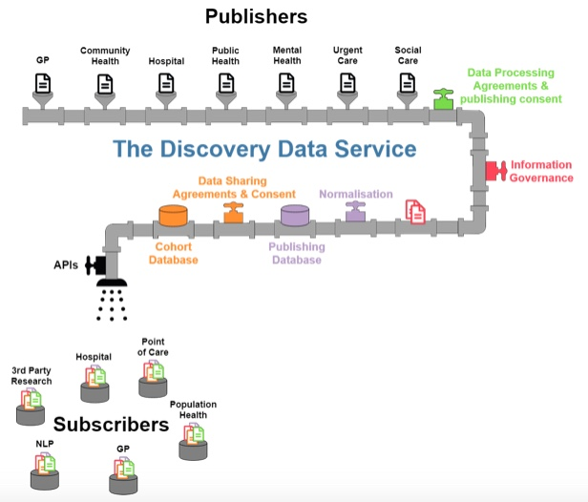

Slide 19
How big?
3.2m and it’s
SNOMED

Slide 20
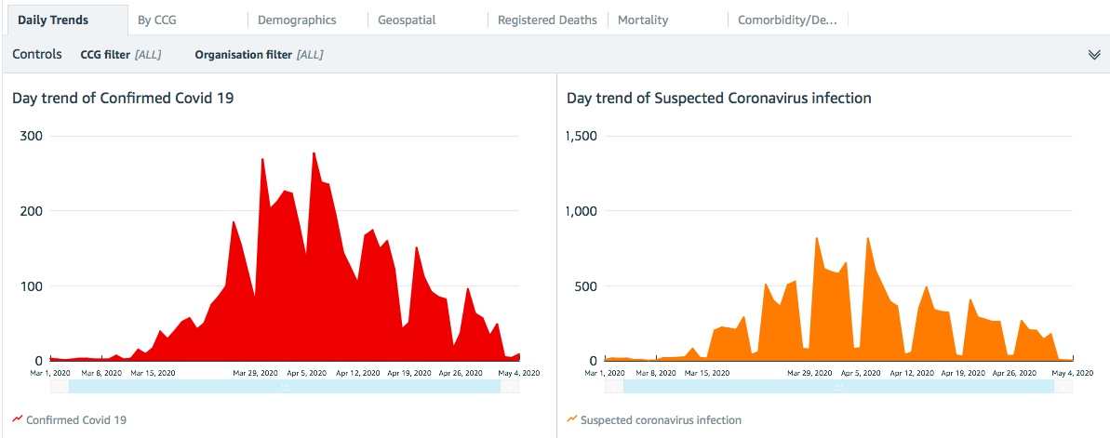

Slide 21
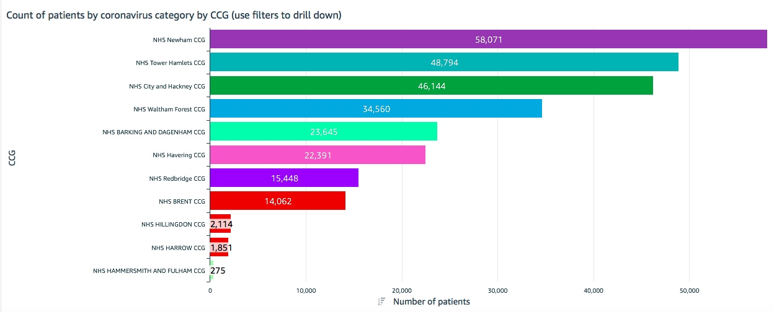

Slide 22
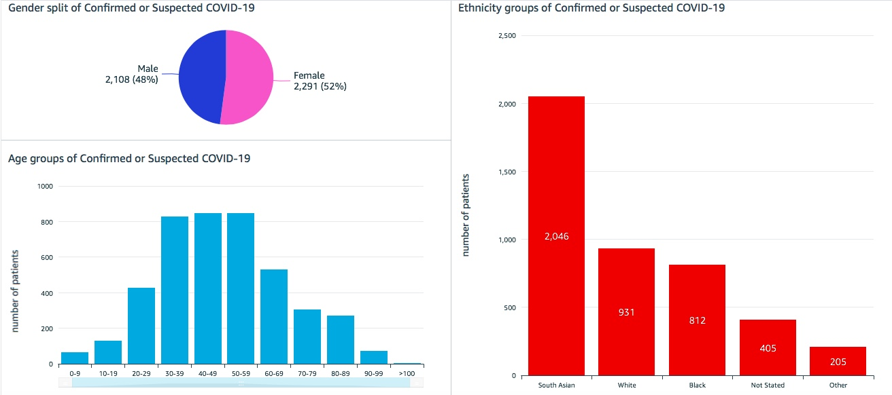

Slide 23
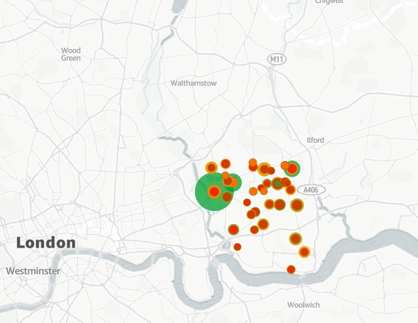

Slide 24
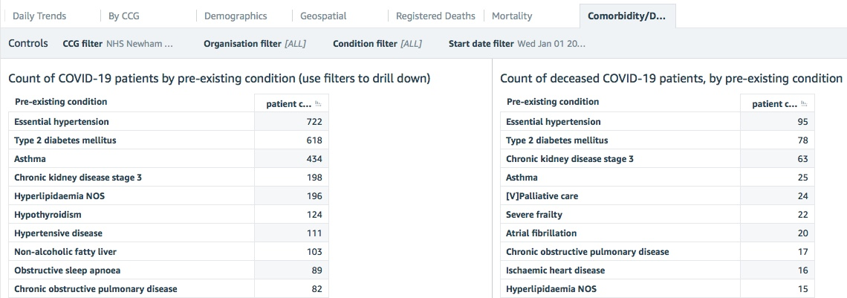

Slide 25
London Health Record and Data Service
Real world data entered at the point of care
Multi-layered
Near real time analytics
Based on enterprise level single systems
Structured data – SNOMED and FHIR
Widening platform – based on Cloud technologies

