Slide 1
A COVID-19 clinical trial and research database derived from electronic patient records
Practical use of SNOMED CT for clinical data analytics
Sophie Williams
Research Data Scientist
sophielouise.williams@nhs.net
SNOMED London - 06 May 2020

Slide 2
Presentation outline:
COVID-19
  Research at Barts Health
  Master dataset
Use of SNOMED expression constraint language (ECL) for clinical analytics
  Defining and categorising
  Statistics
Text analytics

Slide 3

Data requests at Barts
There are many requests for our COVID-19 patient data, but it is not feasible to allow broad access to the entire Data Warehouse
We prepared a standard dataset for all uses, including:
Clinical trials: To enrol (and co-enrol) patients and reduce manual data entry for 6 NIHR-prioritised clinical trials:
ReCOVery, ReMAP-CAP, ISARIC, GenomiCC, Accord2 and PRIEST
Internal audit: To understand the population of COVID-19 patients at Barts, and how outcomes are related to demographics, comorbidities, virus symptoms and treatments.
Research: Finally, there is a need to produce this dataset to share with external researchers and for contributing to large data collection studies. There is lots of interest in data on COVID- patients, with increased attention from NHS Nightingale London.

Slide 4
Use of SNOMED within Barts Health hospitals
Bart's Health NHS Trust
2.5 million patients/ year
One of the largest NHS Trusts
5 Hospitals (+ 1 field hospital)
Diverse east London population
Bart's DWH
Patient ID: 2.2 million
Encounters: 21 million
Clinical events: 705 million
Procedures: 8.1 million
Last year
1.1 million
8.1 million
158 million
868,684
The DWH contains both administrative CDS (Commissioning Data Sets) and clinician-completed data from Cerner Millennium.
Data quality varies between patients and across departments. There are different uses of SNOMED and also use of ICD-10 coding:
  - ECDS (Emergency Care Data Sets) subset of SNOMED conceptIDs
  - SNOMED descriptionIDs are stored in the DWH, whereas conceptID used in analysis
  - Historical entries contain codes now deprecated and not supported for analysis
Notes:
Dependiang if patient has been in before much

Slide 5







COVID-19 Master datasets
Full dataset for internal analytics, with subsets sent to clinical trials. A deidentified version for researchers and external requests. This covers:
7500 suspected-COVID patients, with 2800 COVID-positive patients. 225 enrolled into interventional clinical trials + many more in observational trials.
Both raw and processed data (e.g. categoried) for trials
Linked with open datasets (including. deprivation), and primary care data (via Discovery)
Demographics
Hospital encounters
Co-morbidities
Symptoms + complications
Lab results
Vital signs
Free text

Slide 6
COVID dataset: Example extracts
Raw data: problems list
nhsn | MRN | Encntr_id | Problem | Problem_code | Onset_date | confirmation
xxxx | xxxx | xxxx | Chronic ulcer of lower leg | 3043676017 | 2018-12-26 00:00:00.000 | Confirmed
xxxx | xxxx | xxxx | BMI 30+ - obesity | 2164216018 | 2900-01-01 00:00:00.000 | Confirmed
xxxx | xxxx | xxxx | SARS-CoV | 2537007017 | 2020-04-13 00:00:00.000 | Confirmed
Processed data: Previous medical history
nhsn | pmh_cvd | pmh_htn | pmh_ast | pmh_rd | pmh_srd | pmh_dm | pmh_...x
xxxx | 1 | 1 | 0 | 0 | 0 | 0 | ..
xxxx | 1 | 0 | 1 | 0 | 0 | 1 | ..
xxxx | 1 | 1 | 0 | 1 | 1 | 1 | ..
Processed data: presenting illness and complications
nhsn | COMP_vpn | COMP_bpn | COMP_ards | COMP_pnt | COMP_plef | COMP_bron | COMP_me | COMP_...x
xxxx | 2020-03-30 | NULL | 2020-03-24 | NULL | NULL | NULL | NULL | ….
xxxx | NULL | NULL | 2020-03-31 | NULL | NULL | NULL | NULL | ….
xxxx | 2020-04-18 | NULL | 2020-04-22 | NULL | NULL | NULL | NULL | ….

Slide 7
Text analytics to enhance clinical content
There is lots of clinical information in free text documents which is otherwise inaccessible:
Bag of Words used to identify relevant clinical information from dictionary's:
medication names from BNF (British National Formulary)
doses
medical terms from WHO list (trimmed down) / SNOMED TRUD files
Free text: Drug History Furosemide 40mg BD Atorvastatin 20mg ON Warfarin 1,3,5mg as per INR Amiodarone 200mg OD Dependent Habits No Results Found Allergies Penicillin -class of antibiotic- penicillins Lab Results Diagnostic Results Diagnostic Interpretation VBG: pH 7.409, pCO2 6.62, Hb 121, Na 142, K 2.9, Glu 6.6, Lac 3.0, Cr 67, HCO3 30.8 ECG: sinus rhythm, prolonged QT CXR: normal
Free text: XR Chest Comparison with previous chest x-ray 08/04/2020. Rotated projection. Right intercostal drain again noted. There remains a small right apical pneumothorax with associated extensive subcutaneous emphysema throughout the right hemithorax. The left lung remains clear. No new changes. Reporting Radiographer HCPC No.
Medical Terms (WHO): with, chest, projection, intercostal, drain, small, right, apical, pneumothorax, associated, extensive, subcutaneous, emphysema, hemithorax, left, lung, clear, changes, Dean
Medication Names: Atorvastatin, 20mg, tetanus, furosemide, swabs
Notes:
Benefit of SNOMED trud files vs WHO dictionary
DM+D vs BNF

Slide 8
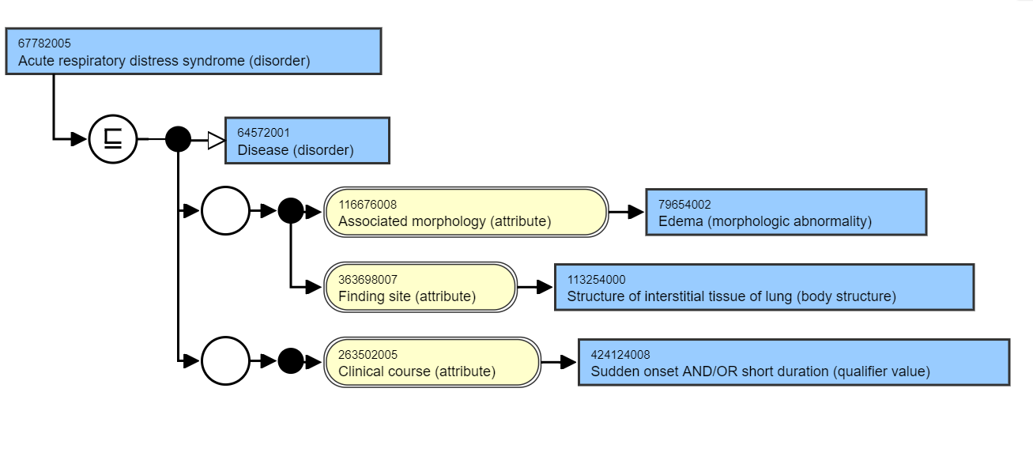
Processing SNOMED CT data with Expression Constraint Language
76746
64572001 | Disease (disorder) |
42752001 | Clinical course (attribute) |
363698007 |
Finding site (attribute) |
424124008|Sudden onset AND/OR short duration|
113254000 | Structure of interstitial tissue of lung (body structure) |
1530
59
9
Notes:
32 concept

Slide 9
Clinical analytics with SNOMED CT
Expression constraint language (ECL) is used to query SNOMED coded data:
  Structured, polyhierarchical form is great for answering analytical questions
  Query SNOMED using ECL via a terminology server API
  Python scripts to make table (dataframe) including SNOMED codes
  Find matches in our data, to add label for analytics or feature modelling
  e.g. find codes of diseases with a sudden onset and of short duration, affecting the interstitial tissue of lung:
< 64572001|Disease|:
263502005|Clinical course| = 424124008|Sudden onset AND/OR short duration|,
363698007|Finding site| = 113254000|Structure of interstitial tissue of lung|
How should clinical data be categorised?
Art/ trial-and-error of writing ECL queries to contain all possible ways of describing condition
ECL query builder: https://ontoserver.csiro.au/shrimp/ecl/

Slide 10
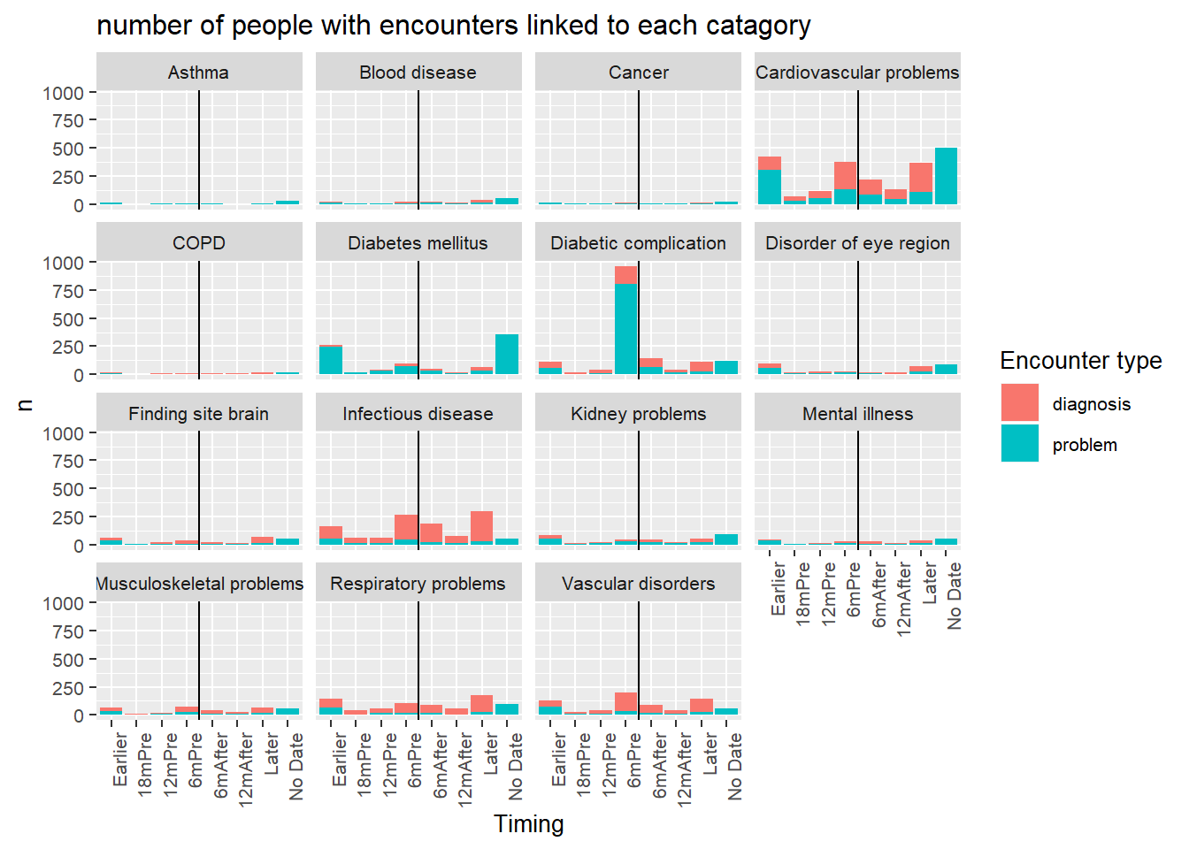
Clinical analytics with SNOMED CT
Project to identify at features predicting diabetic foot disease:
Pseudonymised dataset of Barts Health diabetes patients (35k) including basic demographics, diagnoses, procedures, encounters
25k unique SNOMED codes associated with patients
Average 12 hospital encounters per person
Compared to onset of DF
Notes:
We don’t mind/are happy with a diversity of SNOMED codes being used

Slide 11
Analytics with SNOMED International’s Health Data Analytics tool
statistical-test API to generate hazard ratio
Define patient cohorts (ECL) and compare incidence of an outcome (ECL) with different exposures (ECL)
In patients with diabetes, we compare the outcomes in those with neuropathy and vascular disease
Generate hazard ratios for outcome of lower limb amputation
 | Neuropathy | Vascular disease
N cohort affected (%) | 1214 (5.6) | 1086 (5)
N (%) affected, LL amputation | 21 (1.7) | 64 (5.9)
N (%) not affected LL amputation | 161 (0.8) | 118 (0.6)
Hazard Ratio | 2.22 | 10.36
This fits with the literature
https://github.com/IHTSDO/health-data-analytics

Slide 12
Conclusion
EHR data is rich enough to share for data collection clinical trials.
Deidentified version is a valuable resource for research
Also need to develop data access rules, prioritisation and hosting platform for external access
SNOMED CT coded data can easily be categoried using ECL
ECL used by Snowstorm for descriptive statistics.
Dave Brown (Genomics England): Text processing
Kai Kewley (SNOMED Int): Health Data Analytics tool
Elisa Rauseo (Barts Health): SNOMED CT + ICD10 phenotyping
Thank you

