Slide 1


Allergies and the Belgian CSCT:
Why you should never think you're too small to contribute to the SNOMED international community
SNOMED international Clinical engagement group - 9th of April 2020
Marie-Alexandra Lambot, MD
Adjunct to the Medical Direction, CHU St Pierre
Coordinator Consortium for Support on Clinical Terminologies (CSCT)

Slide 2

SNOMED CT in Belgium
In 2013, Belgium decides to start its SNOMED CT journey as part of an ambitious national eHealth plan, with one aim being mandatory registration of emergency patient data in SNOMED CT in 2017.
But...

Slide 3
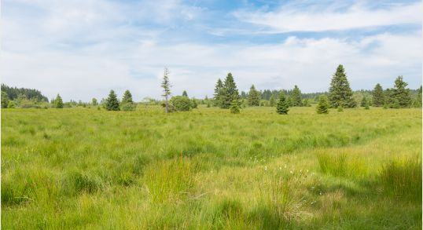
On the EHR side
Belgian EHRs use very little coding if at all, a lot of them are still (scanned) papers.
The only SNOMED use is anecdotic and outdated (SNOMED RT in Pathology labs).

Slide 4
The early chaotic years: 2014-2016
The politic will but not the means: NRC = 1-1,5 FTE; calls for volunteers to translate SNOMED CT in Belgian French and Dutch.
There is interest in hospitals for the benefits of SNOMED CT and because of the coming mandatory registration but no-one really knows how to begin with it.
The EHR providers standpoint is to wait and see: wait for the official instructions of use and the official translation of SNOMED CT, wait to see if any of it will ever come to pass before engaging money in it.
As the deadline for mandatory use of SNOMED CT "codes" draws near, and is not cancelled no matter the lack of progress all around, the hospitals begin to panic.

Slide 5
The early years: 2014-2016
In this context of rising concern, 8 hospitals decide to create in July 2016 a common workgroup to share their (little) knowledge and (big) concerns about SNOMED CT
Quickly knowledge that this "SNOMED CT support group" exists spreads
So on the 26 October 2016, the now 12 hospitals plus their EHR provider and the two emerging Belgian NPL companies vote unanimously upon the creation of the "Consortium SNOMED CT (CSCT)", defined as a sharing community and think-tank,
  Open to all institutions who want to collaborate to set up common interoperable SNOMED CT implementations/standards in their EHRs Belgium and their software providers.
  Aiming to put in relation the actors: to connect those with needs with those with solutions or to devise common solutions if none is available currently anywhere.

Slide 6
The CSCT is born
  The CSCT is built as a "Spanish inn", without any legal framework and with only one rule:
  "Everybody does something and everyone gets everything"
  (and anyone cheating gets kicked out)
  Doing "something" = "anything that helps"
  => Allows people with no SNOMED CT knowledge but other useful qualities, like clinical or organizational knowledge, to fit in the community.
  There is a deliberate choice not to deal with money between ourselves, but to barter time and knowledge.
  Very profitable system even with a limited number of participants.

Slide 7
Setting up the common work
  Internal and external communication: own website/email, CSCT logo to forge the sense of community, and set us free of the usual belgian cleavages.
  "This is common good and the property of all.
  All are equals in the community, we'll grow together."
  SNOMED CT education of the members: the first priorities are:
  to form a sufficient number of experts so we can make plans
  to inform our deciders on the basic features of SNOMED CT so no hospital would be sold a cat in a bag by a dishonest provider surfing on the panic.
  40 people get a general formation, between Foundation and Implementation course level
  22 an implementation course level education; in French, some 280 slides worth, based on the ELAG courses.

Slide 8
Setting up the common work
  Choosing common use-cases: they must be easy and of high value
      Allergies :
      Simple to agree on clinically
      Of high value medically even in simple implementations
      Yet offering links to the more complicated implementations like linkage to knowledge banks and care pathways
      The best test-case in every sense, as much for testing our ability to work on SNOMED CT as to test our ability to work together as a community.
    Emergency :
    "Urgently needed" to comply to the "UREG" emergency minimal data mandatory registration foreseen for 2017.
    Existing local ICD10CM-based dictionary that could be mapped to SNOMED CT

Slide 9
Allergy use-case: Why, what and how?
  First we determined the scope of the data:
  The allergies, hypersensitivities and intolerances of the patient.
  Not the adverse effects.
  Second we determined to what purpose we wanted those data?
  To record the hypersensitivities at the point of care
  To consult the hypersensitivities at the point of care
  To share the hypersensitivities between care providers inside the hospital, between the hospitals and with first line care givers.
  To link allergy data with EHR alerts: on prescription (ex: penicillin), kitchen warnings (food allergies) and procedure warnings (ex: latex, contrast media)
  To link allergy data with care pathways (ex: that a "penicillin allergy in childhood" would trigger a care pathway to confirm this allergy)

Slide 10
Allergy use-case: What, why and how?
  Third we determined what that means in terms of data?
  The type of reaction + causative agent + the general patient/provider/encounter administrative metadata
  What else?
  What is the minimum a busy clinician would agree to register versus what level of detail would an allergologist want to capture? How can we please "everyone"?
  What would we want if we could technically do anything we like versus what is currently possible in our various (stone age) EHRs? How can we bridge that gap?
  What must we do to allow for convergent evolution of every participating institution / EHR /care provider line toward our "dream" model of capture and reuse of data? How can we fit that nationally?

Slide 11
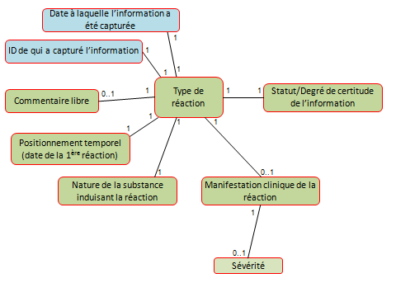
Temporary CSCT model

Slide 12
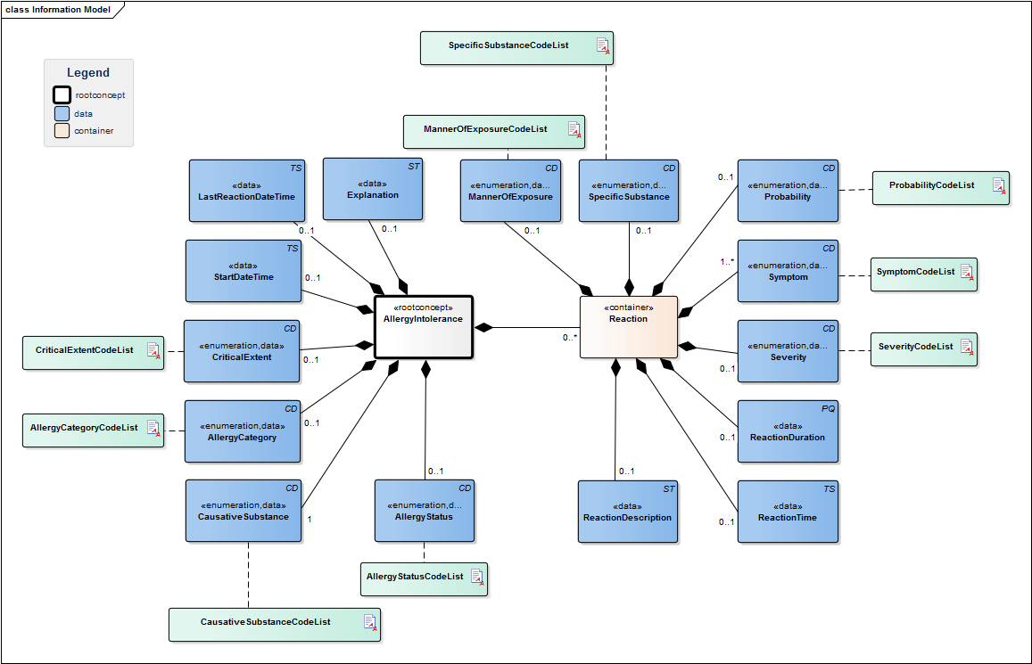
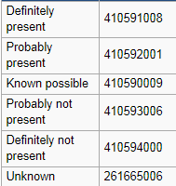


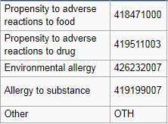

The Clinical Building Blocks model (NICTIZ)
all SNOMED CT
< Route of administration value
Text
small list SCTID
Text
dd/mm/jjjj hh:mm
all SNOMED CT

Slide 13
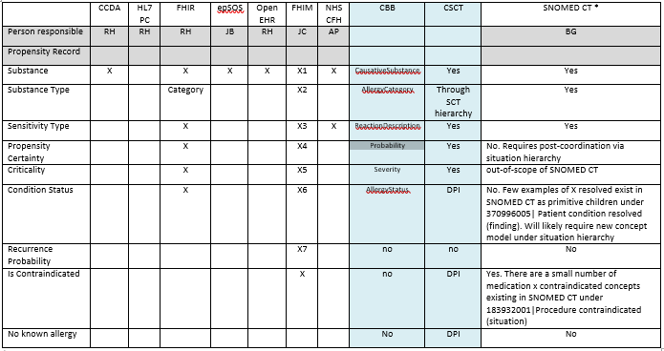
Allergy models documented by SNOMED Int.

Slide 14
Allergies et intolerences use-case
Model meaning bindings
418038007 │Propensity to adverse reactions to substance (disorder)│
Type of reaction
value list: allergy, non-allergic hypersensitivity, intolerance
246075003 | Causative agent (attribute) |
Causative agent
<<105590001 │Substance (substance)│
<410607006 │Organism (organism)│
<<373873005 | Pharmaceutical / biologic product (product) |
404684003 │Clinical finding (finding)│
Clinical manifestation
<404684003 │Clinical finding (finding)│
Severity
246112005 | Severity (attribute) |
value list: <272141005 | Severities (qualifier value) |

Slide 15
Origin of the CSCT allergen/allergy to subset
10/2016
Local sources of flat list dictionaries
10/2016 - 05/2017
Erasme university hospital EHR allergy dictionary
Fusion of the sources => 1 allergen list
SNOMED CT mapping of the French substances
Expansion of the food allergens to the useful SNOMED CT siblings.
Limitation of the Drugs included to the main clinically needed substance (awaiting progress from the SAMv2= national drug database).
1-to-1 Mapping to the corresponding precoordinated hypersensitivity concepts
CHU St Pierre EHR allergy dictionary
CHU Brugmann EHR allergy dictionary
CH Jolimont EHR allergy dictionary
Patch test list Clinique St Jean
IgE laboratory blood test Clinique St Jean
IgE laboratory blood test LBS (general private lab)
494 concepts pairs CSCT 2017 hypersensitivities dictionary (beta 20170616, production release 20171020)
"Allergy to" dictionary implemented effectively in a number of institutions over 2017-2018*.
No active use-case yet for the registration of allergic dispositions through the capture of the substance alone (active use-cases expected in 2019-2020).
*Number of implementations not formally accounted for. At least 4 separate member institution in 2018.

Slide 16

What happens when you do what you should not
494 concepts pairs CSCT 2017 hypersensitivities dictionnary
Made in Excel sheets
Update to v20170731 international edition missed
Update INT20180131started and missed
You can't properly maintain refsets solely in Excel sheet at least not for long and not easily or cost-effectively
BUT it's a very valuable lesson starting from nothing
it can give you your first practical use-case to build adoption
=> Ok as stepping stone, as long as you're careful of the scope and risks

Slide 17
What happens when you do what you should not
494 concepts pairs CSCT 2017 hypersensitivities dictionary
Errors and questions found within the Core
Forwarded to SNOMED International Allergy and hypersensitivity SIG
Not "stupid" questions/remarks
Invited to participate to SNOMED International Allergy and hypersensitivity SIG
Contribution to the definition of the Allergy to concept model and clean up of the allergy hierarchy
For the CSCT: Invaluable lessons learned from experienced terminologists
Prevented useless work on soon to be retired concepts
For the SIG: "Naïve" opinions are not always "stupid"; they shed new lights and challenge beliefs, leading to improvements

Slide 18
It's all about sizing opportunities
HL7 FIHR - SNOMED on FIHR
Request for a SNOMED CT minimal value set for code field (allergen) of their AllergyIntolerance HL7 FIHR resource
SNOMED international SIG
HL7 110 million records veteran study on the most frequent allergens
15 environmental
130 foods
622 medications (RXnorm)
Non English-speaking countries need a "starter" minimal allergen refset awaiting their full translation of SNOMED CT (Belgium, NICTIZ)
SIG decision to create and maintain a minimal allergen list for the HL7 FIHR model
494 concepts pairs CSCT 2017 hypersensitivities dictionary,
in need of update
CSCT volunteers to merge their dictionary to the HL7 study list both for national and international use

Slide 19
The job done
SNOMED CT mapping of the HL7 study substances
Mapping to the corresponding precoordinated hypersensitivity concepts
Allergen list proposed for the Belgian allergy care set (HL7 FIHR profile)
Creating the missing precoordinated hypersensitivity concepts (on paper)
Allergens from the Belgian first line thesaurus
Reviewing the (to become international) refset with Dr Goldberg
Impact on the International edition presented to the SIG by Dr Lambot
Of the 1186 substances considered from all sources
996 concepts pairs beta version CSCT 2019 hypersensitivities dictionaries
To be tested in Belgium
954 substances SIG dictionary
(awaiting SIG final processing)
Formal SNOMED CT modelling and promotion by the SIG to the core if used
CSCT formal linguistic validation of translations
International HL7 FIHR hypersensitivity model substance value list
INT20200731?
CSCT hospitals EHRs
Belgian national allergy care set

Slide 20
With this approach, there are only winners
  CSCT
  SNOMED international
Learned by doing
Avoided useless work on soon-to-be outdated concepts
Demonstrated at national level both what can and can't be achieved without tooling
Belgian allergen refset based both on international data and local clinical demand and aligned to the SNOMED international refset
=> Solution the our need that can go live
=> Same creation work but less future maintenance
=> a methodology that can and will be replicated with other domains (vaccines)
New active CRG contributor(s)
Local testing of candidate precoordinated concepts before spending time on extensive modeling and publishing
Minimal allergen refset for FIHR based both on international data and local clinical demand
=> Answers the FIHR and Member requests with less work
=> A good demonstration what clinicians can achieve in SNOMED CT, even starting from scratch if motivated

Slide 21
Take home messages
  You can "cheat" with the recommendations of good practice and do some SNOMED CT on paper and in Excel but you can't get away with it
  By all means do it to learn and as step stone to prove your point, to get adoption
  But Never plan to use this approach for big refsets or for long; You can't maintain a refset properly, effectively, without tooling
  Being a "beginner" with SNOMED CT doesn't mean you're useless. You can and should contribute to any level of work you can
  Theoretical study can only take you so far, you can only truly learn SNOMED CT by doing it
  People who discover SNOMED CT don't know its history so they can unearth what experienced users don't notice anymore and ask challenging questions

Slide 22
Take home messages
  It's not lots of money that makes a success story it's motivated people
  Build your local community
  Decide what your final aim will be even it takes 15y to get there and then start walking one step at a time toward that aim
  Teach, teach, teach; always support each other; share, share, share
  It's a hard road but at every step SNOMED international supported us
  Don't hesitate to reach out to the staff, they're a great team and we'd have given up on the terminology many times without them
  As soon as you can, engage in the SNOMED international work and give back to the next generation what you have been given
  SNOMED CT isn't just a terminology it's a mindset of sharing and building together what we need. Made by clinicians for clinicians!

Slide 23
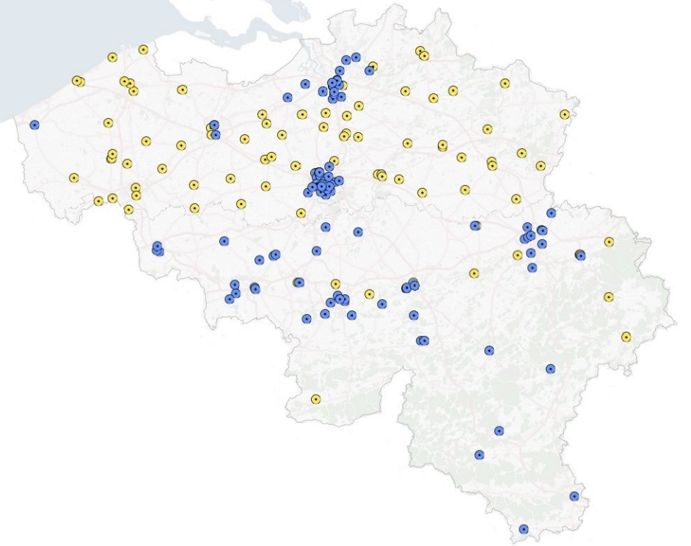

Consortium for Support on Clinical Terminologies today
In 3,5y from 8 to 38 institutions
= 53% of Belgian hospitals in term of beds
100% Brussels
75% Wallonia
28% Flanders
From two people wanting to share to more then a hundred participants ranging from student level to the almost daily committed staff.

Slide 24


Thanks for your attention
@ SNOMED International Allergy Clinical Related Group
@ Belgian Consortium for Support on Clinical Terminologies
https://csct.be
contact: info@csct.be

